Slide 1

Synergistic Use of Lidar and In Situ aerosol measurements over a high altitude site (1800-2300 m): Highlights from the CALISHTO Campaign at the Helmos Mountain
(Autumn 2021)
A. Papayannis^{1,2},C.A. Papanikolaou¹, D. Anagnou¹, R. Foskinis^{1,3}, A. Moutafidou⁴, A. Aktypis⁴, K. Eleftheriadis³, A. Nenes^{2,4}, M. Gini³, P. Fetfatzis^{3,5}, M. Gidarakou¹, K. Granakis³, O. Zografou³, C. Spitieri³, E. Diapouli³, M. Mylonaki¹, P. Kokkalis⁶,
O. Soupiona¹, S. Solomos⁷, M. Kommpula⁸, V. Vakkari^{8,9}, T. Podvin¹⁰, P. Goloub¹⁰
Laser Remote Sensing Unit, Department of Physics, National and Technical University of Athens, 15780 Zografou, Greece
Laboratory of Atmospheric Processes and their Impacts, École Polytechnique Fédérale de Lausanne, Lausanne, CH-1015, Switzerland
Environmental Radioactivity Laboratory, Institute of Nuclear & Radiological Sciences & Technology,Energy and Safety, National Centre of Scientific Research “Demokritos”, 15310 Attiki, Greece
Center for Studies of Air Quality and Climate Change, Institute of Chemical Engineering Sciences, Foundation for Research and Technology Hellas, Patras 26504, Greece
Department of Industrial Design and Production Engineering, University of West Attica, 12243 Egaleo-Athens, Greece
Physics Department, Kuwait University, 5969, Safat 13060, Kuwait
Research Centre for Atmospheric Physics and Climatology, Academy of Athens, 10680 Athens, Greece, Email: ssolomos@academyofathens.gr
Finnish Meteorological Institute, Helsinki, FI-00101, Finland
Atmospheric Chemistry Research Group, Chemical Resource Beneficiation, North-West University, Potchefstroom, South Africa
Laboratoire d'Optique Atmosphérique, University of Lille, CNRS, UMR8518, 59000 Lille, France
The 30th International Laser Radar Conference (ILRC) virtual conference, June 26-July 1, 2022

Slide 2
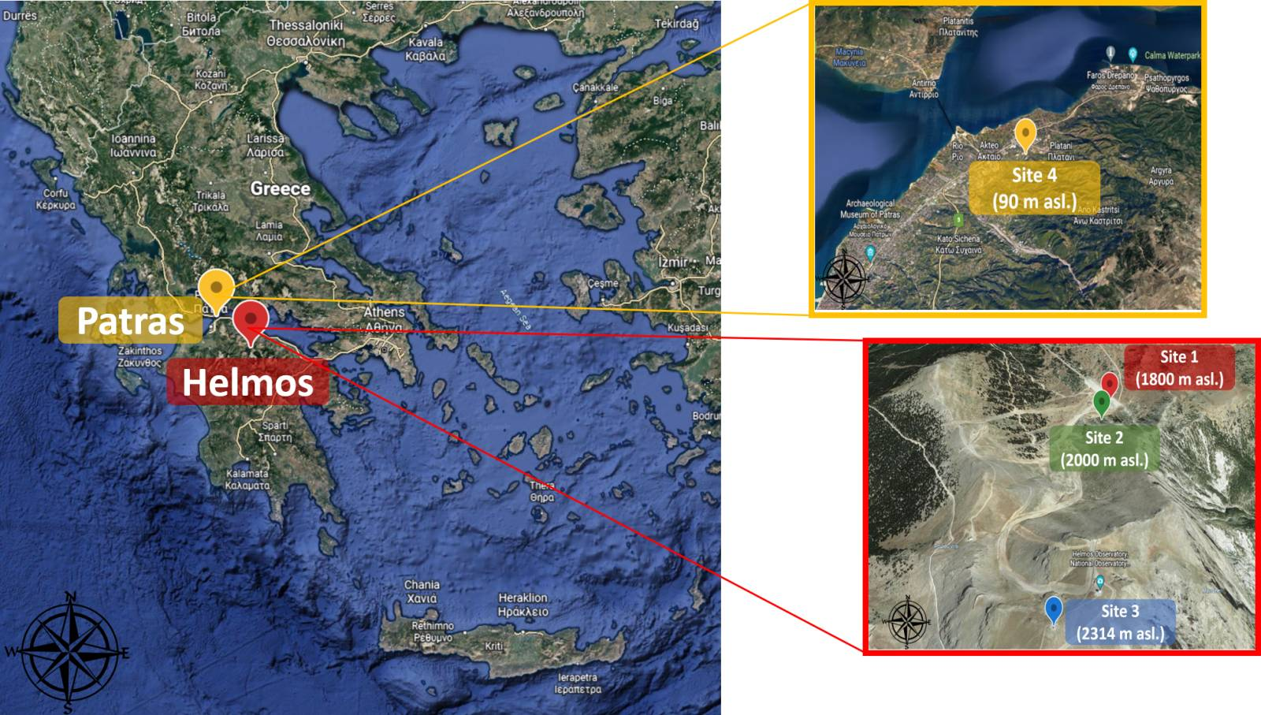
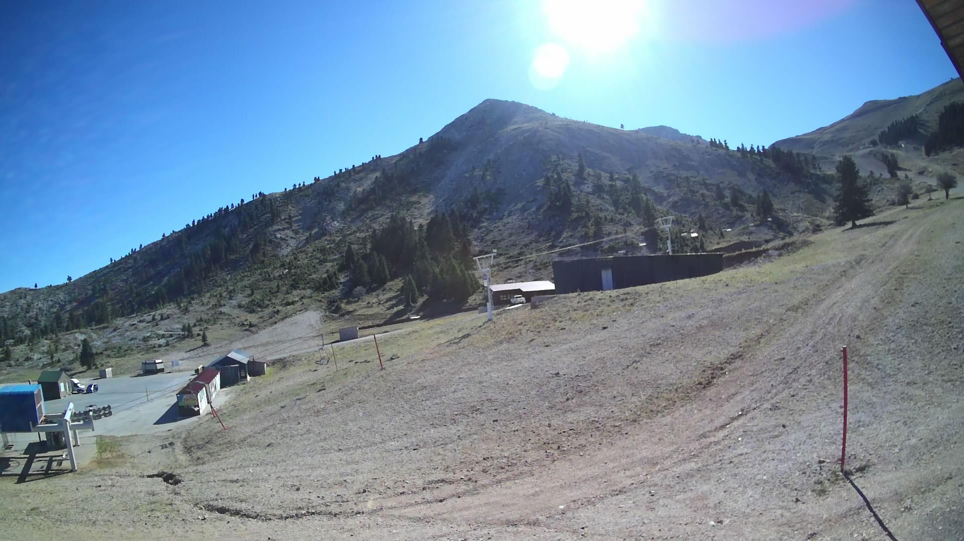
Synergistic Use of Lidar and In Situ aerosol measurements over a high altitude site (1800-2300 m): Highlights from the CALISHTO Campaign at the Helmos Mountain (Autumn 2021)
Cloud-AerosoL InteractionS in the Helmos background TropOsphere (CALISHTO-HELMOS Campaign)
Site: Helmos mountain
Synergetic action: Two main actors:
The PANhellenic infrastructure for Atmospheric Composition and climatEchAnge (PANACEA) and
the European Research Council Pyrogenic TRansformations Affecting Climate and Health (PyroTRACH) Projects
Main goal : to gain a better understanding of the processes involved in the formation and evolution of mixed-phase clouds under pristine environmental conditions, with an additional goal to study the properties of long-range transported Saharan dust particles, as well as their role in cloud formation, over the remote high-altitude site
(38.006◦N, 22.198◦E, 1800-2314 m a.s.l.)
The 30th International Laser Radar Conference (ILRC) virtual conference, June 26-July 1, 2022
Notes:
The 2021 Greece wildfires during the first half of August 2021 after a historic heatwave for the country with the highest temperatures, reaching 47.1 °C (116.8 °F).
The World Meteorological Organization highlighted the Greek wildfires noting the wildfires as an example of the extreme weather being caused by climate change.
The last published IPCC report warned about the planet’s warming resulting in more heatwaves, droughts, and other extreme weather events, unless drastic and immediate action is taken to reduce carbon emissions.
Reliable estimates aerosol pollutants and related impacts on Earth’s radiation budget are key to better inform policy-makers. Such information is essential to implementing, monitoring and evaluating policies that help to tackle air pollution while also protecting health.
Addressing this issue, we focus on the radiative effects of this extreme and long-lasting wildfire episode, following a dust intrusion using CALIOP’s lidar extinction profiles and libRadtran simulations. We examine 3 time periods referring to dust, smoke and mixed aerosols.

Slide 3
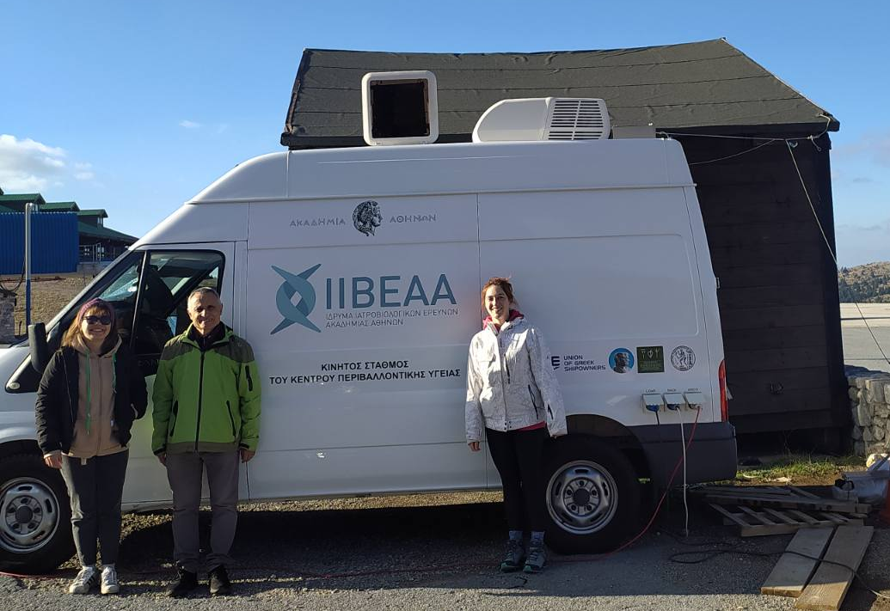
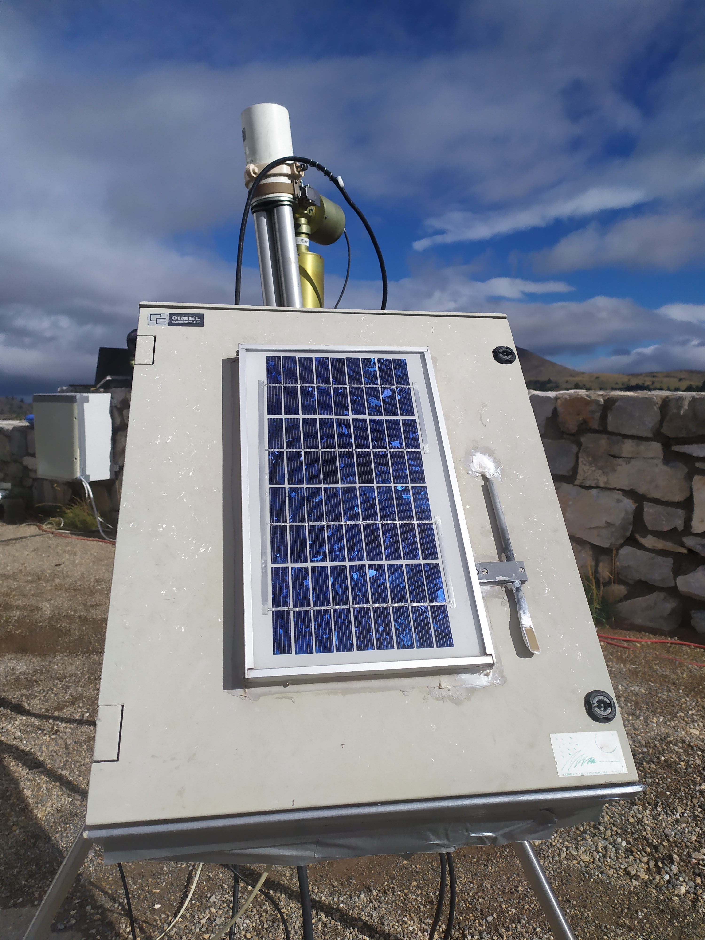
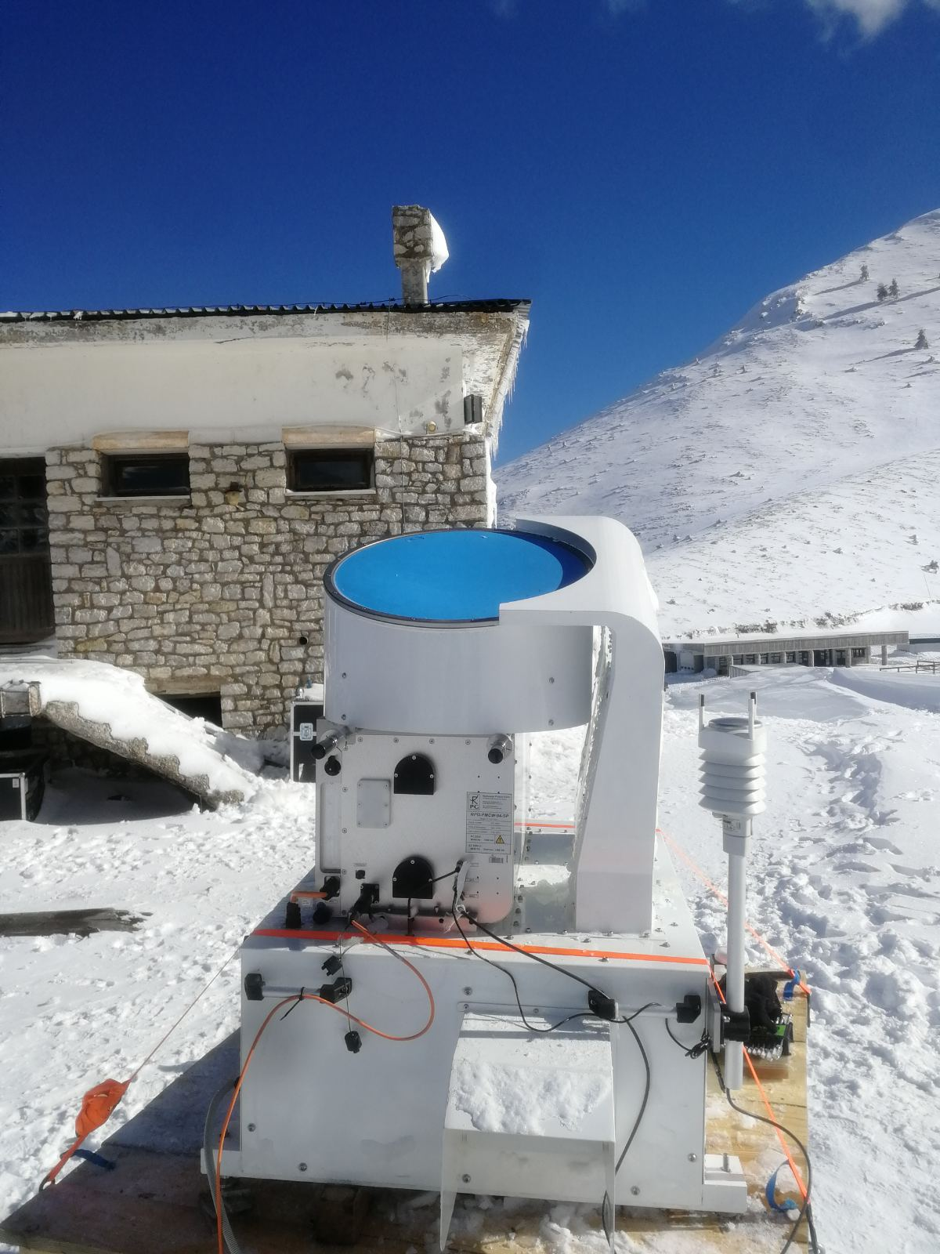
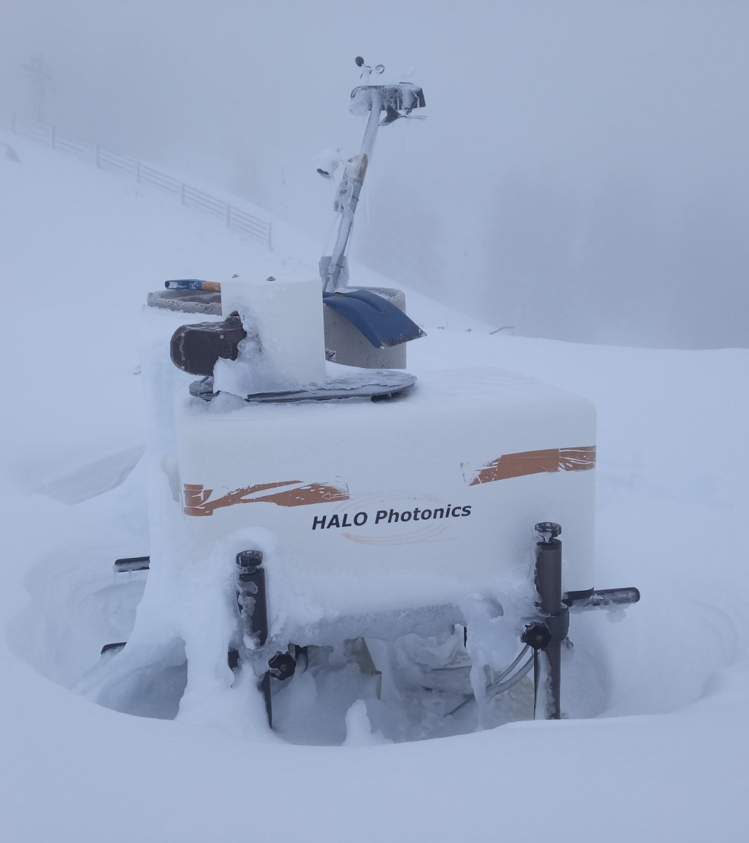
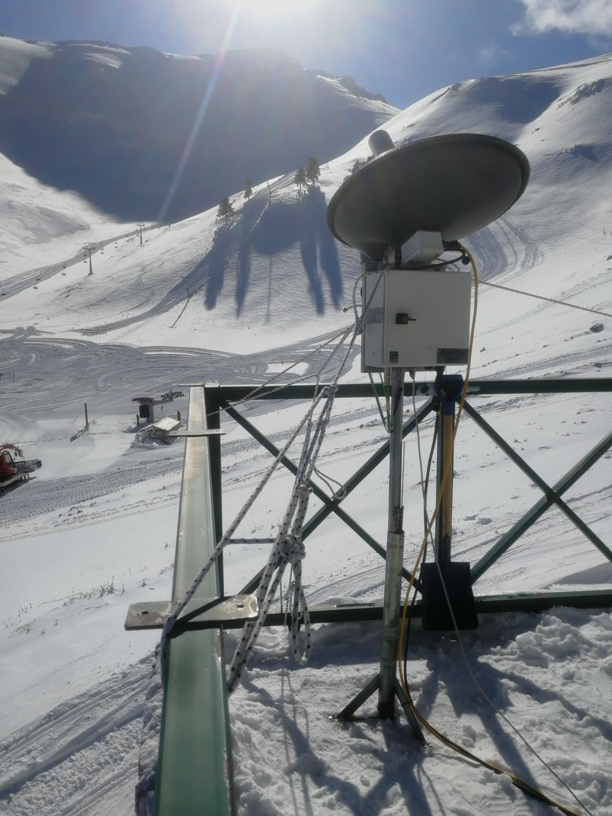
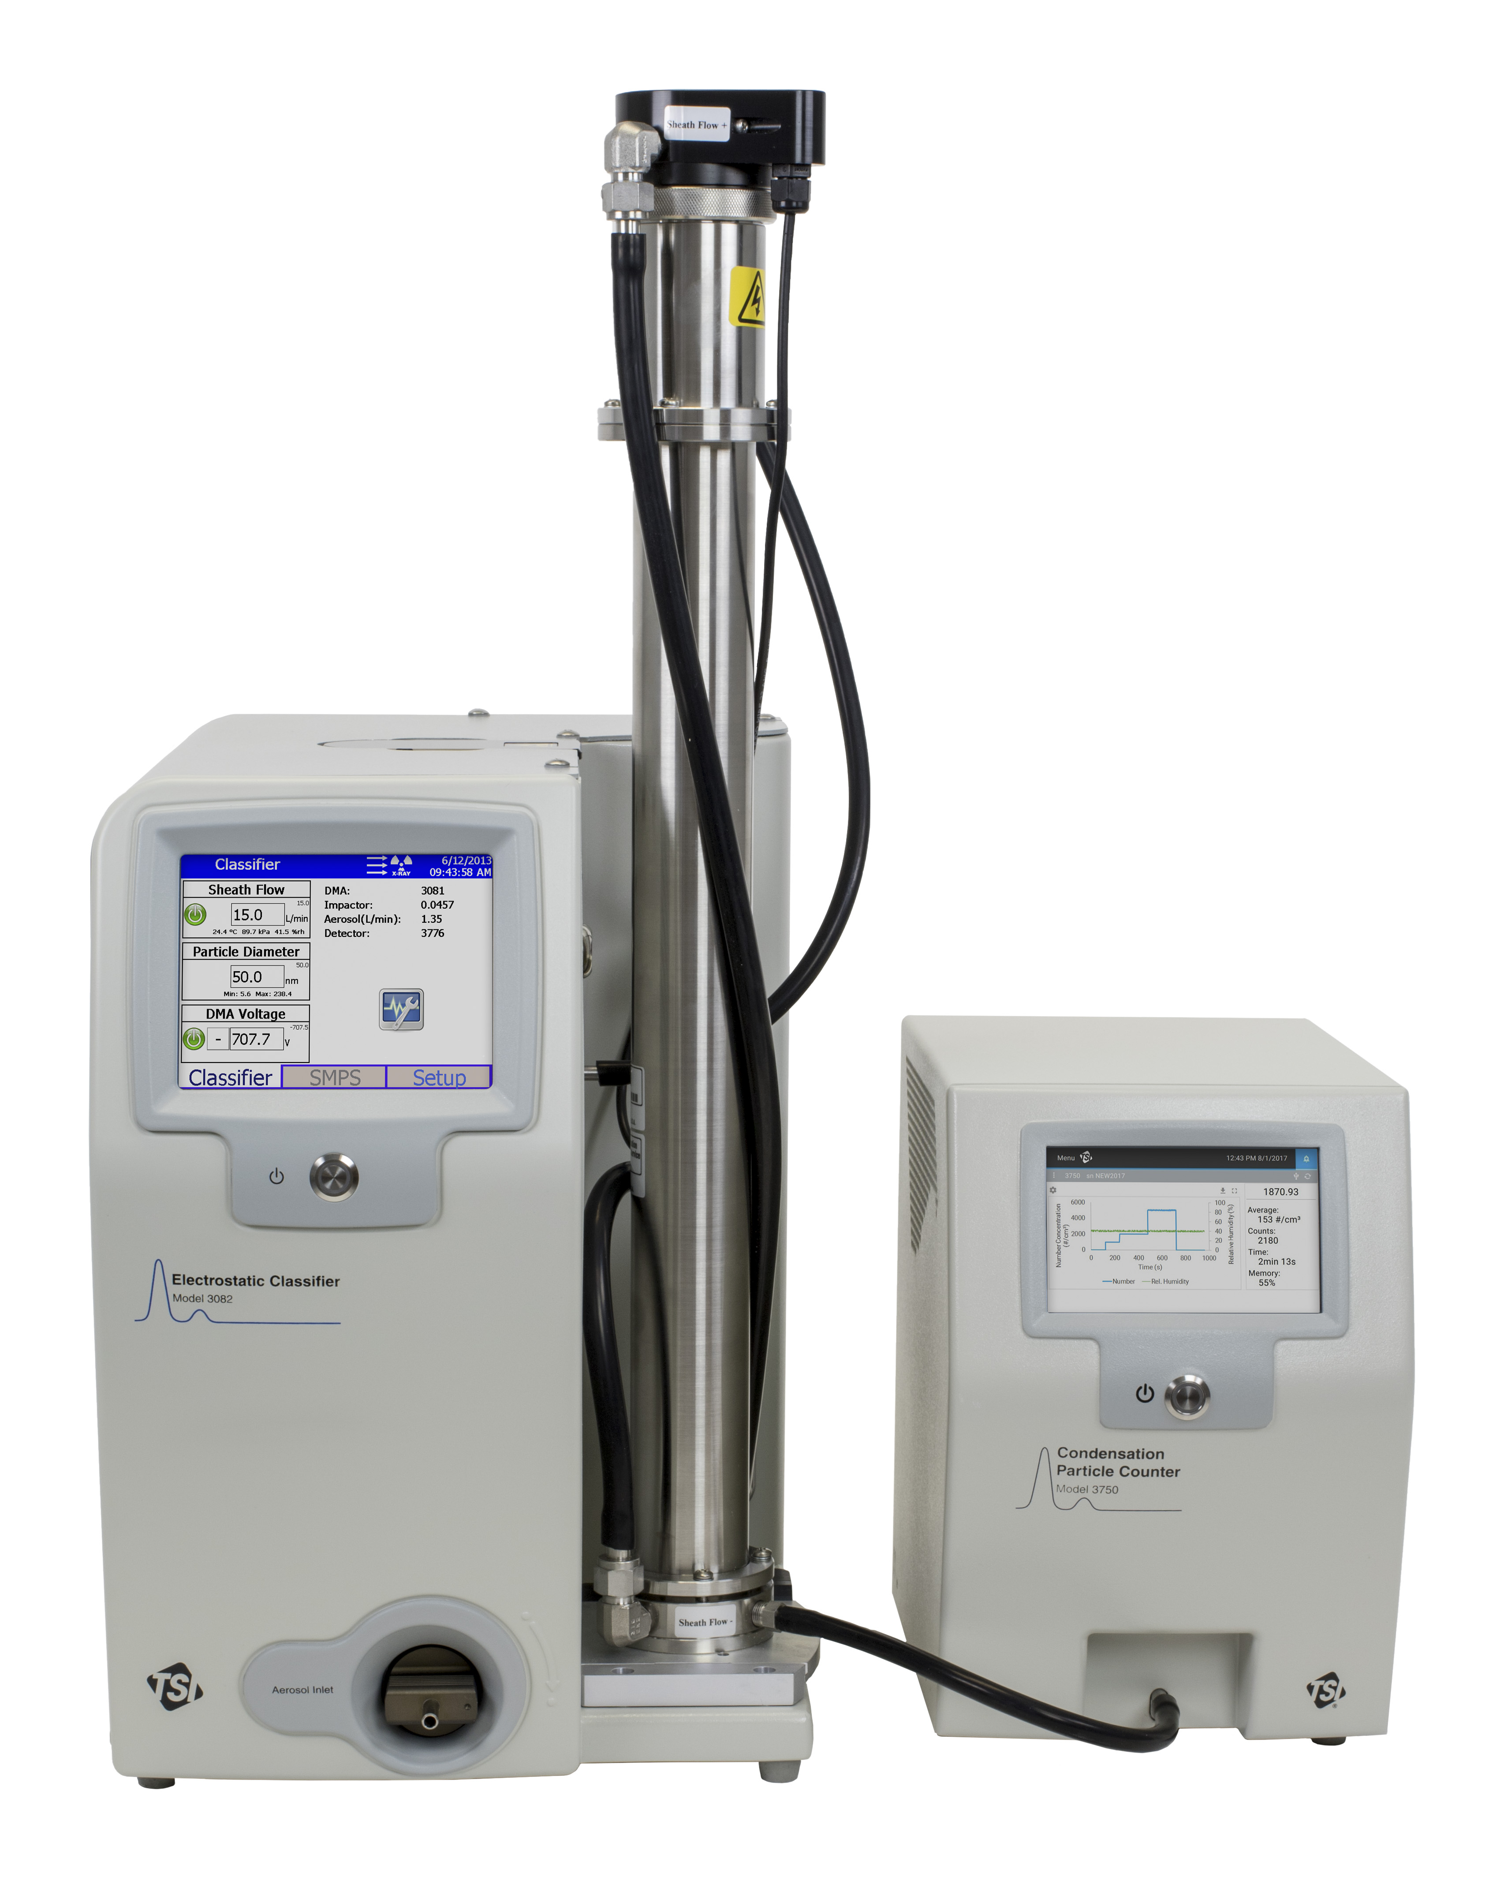
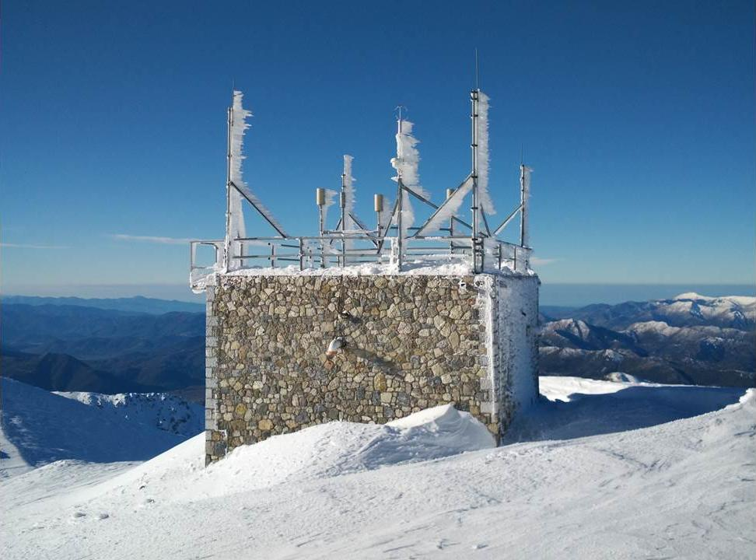
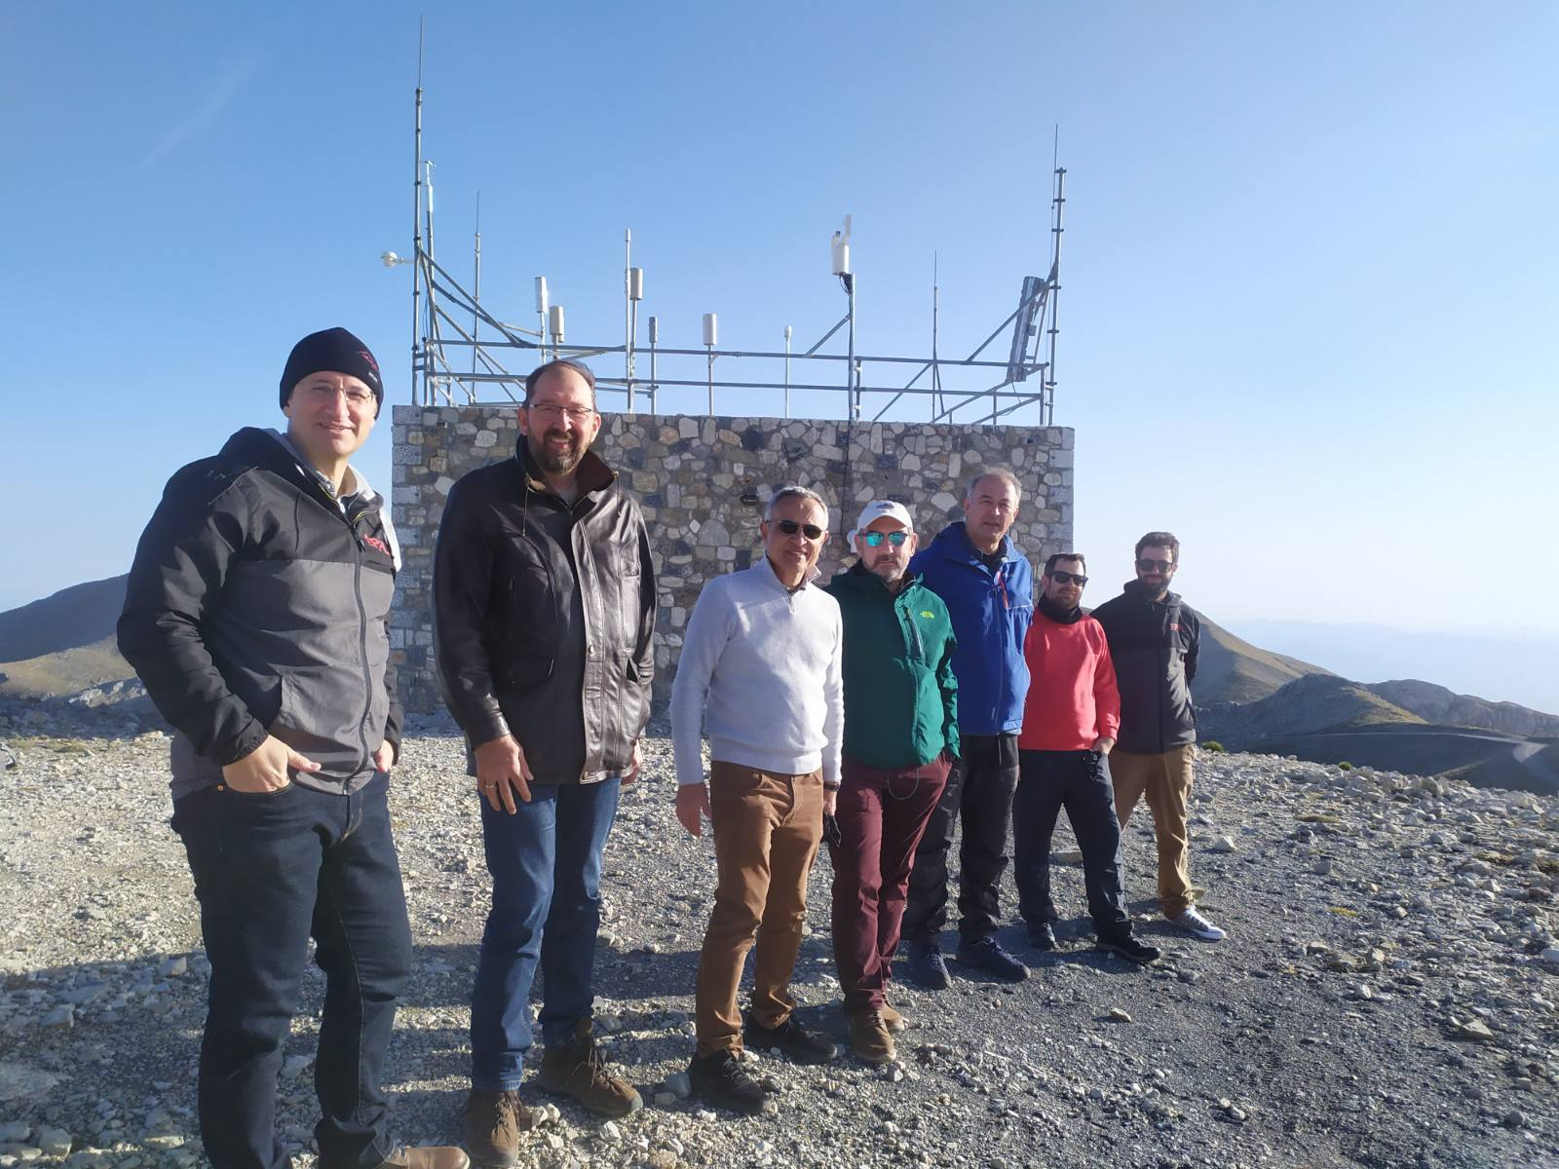
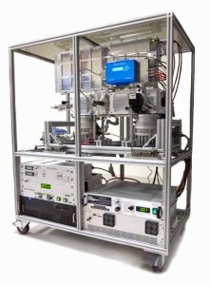
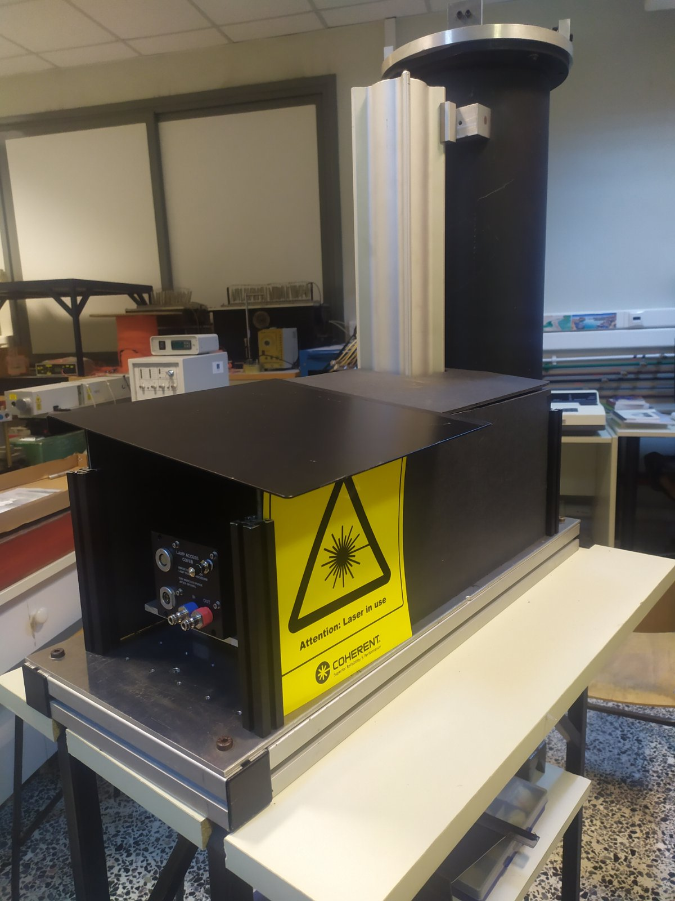
AIAS 532-1064 nm Aerosol backscatter-depolarisation lidar
CIMEL sun photometer
Meteo station
Wind Doppler radar
HALO wind lidar
SMPS
Micro-rain radar
4 instrumented sites:
Helmos ski resort area (1800 m asl.)
Site 1:
Site 2:
Site 3: NCSR-Demokritos permanent station (2314 m asl.)
Site 4: FORTH-ITE station (50 m asl.) ARIS 532 aerosol backscatter lidar
Aerosol Mass Spectrometer
Vathia Lakka (2000 m asl.)
A typical free tropospheric background site with very low influence from the surface polluted layers - in a cross-road of different air masses
SMPS, AMS, Aethalometer, Nephelometer, Bioaerosol detector, CCN counter, Light Absorption Photometer, APS, ACSM, Portable Ice Nucleation Experiment, High volume filter samplers
The 30th International Laser Radar Conference (ILRC) virtual conference, June 26-July 1, 2022
Notes:
The 2021 Greece wildfires during the first half of August 2021 after a historic heatwave for the country with the highest temperatures, reaching 47.1 °C (116.8 °F).
The World Meteorological Organization highlighted the Greek wildfires noting the wildfires as an example of the extreme weather being caused by climate change.
The last published IPCC report warned about the planet’s warming resulting in more heatwaves, droughts, and other extreme weather events, unless drastic and immediate action is taken to reduce carbon emissions.
Reliable estimates aerosol pollutants and related impacts on Earth’s radiation budget are key to better inform policy-makers. Such information is essential to implementing, monitoring and evaluating policies that help to tackle air pollution while also protecting health.
Addressing this issue, we focus on the radiative effects of this extreme and long-lasting wildfire episode, following a dust intrusion using CALIOP’s lidar extinction profiles and libRadtran simulations. We examine 3 time periods referring to dust, smoke and mixed aerosols.

Slide 4
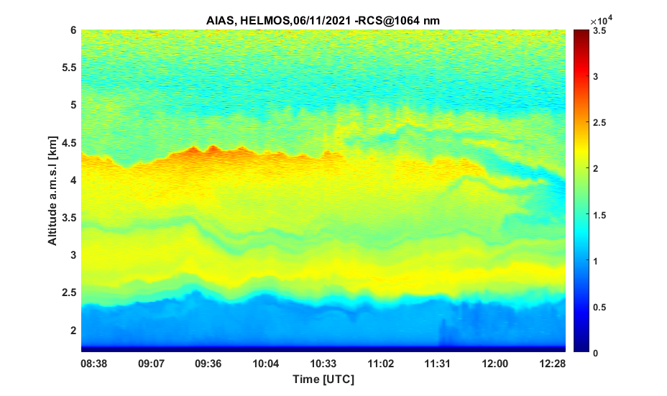
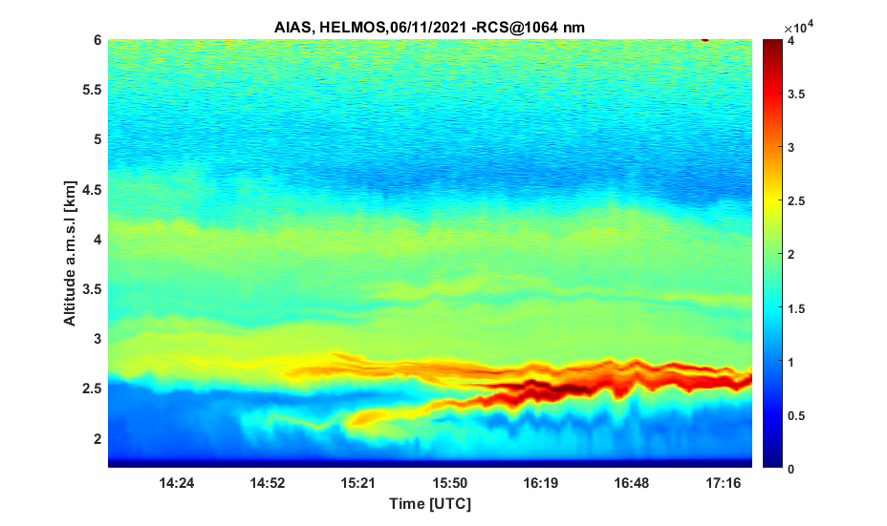
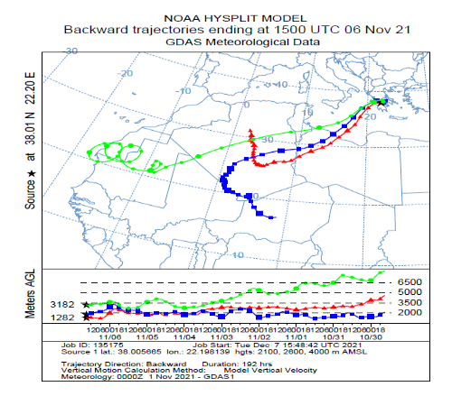
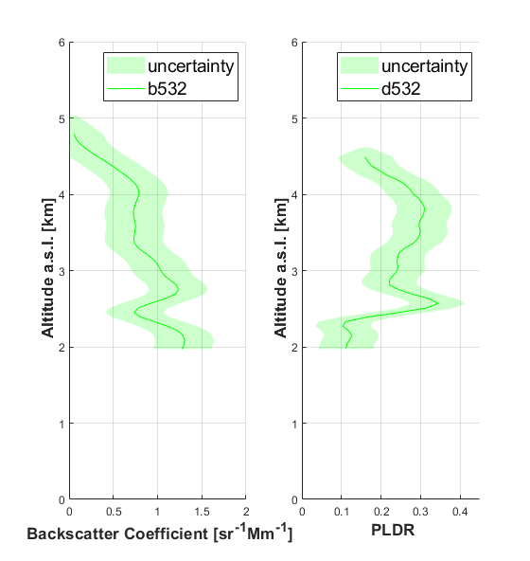
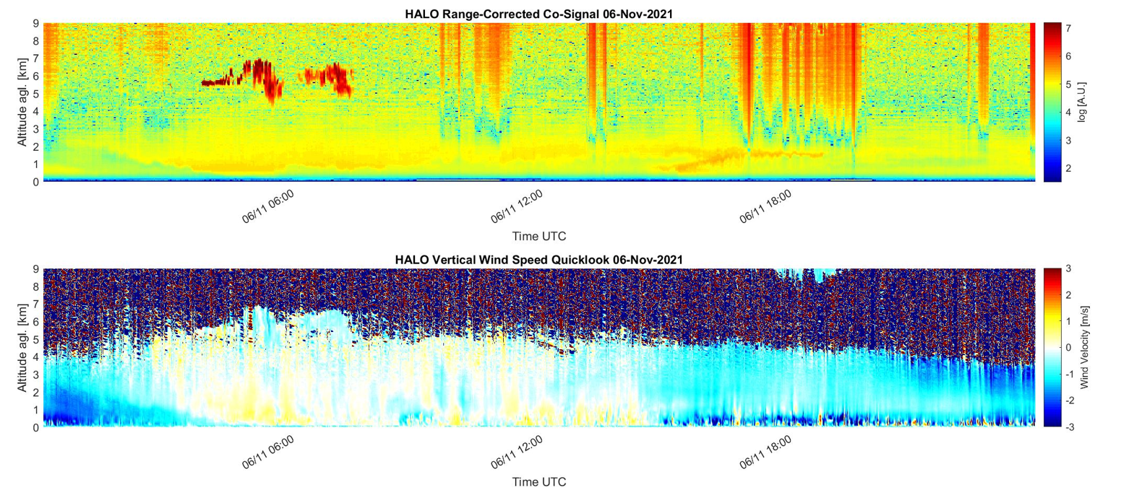
Experimental results (Case of 06 November 2021)
Several dust layers (2.5-5.0 km asl.)
PBL height (~2-2.3 km asl.)
Around 14:45 UTC arrival of
continental aerosols ~2.2-2.3 km asl.)
~16:20 UTC continental aerosols are mixed with dust ones ~2.5 km asl.
Dust
(PLDR~0.2-0.3)
continental
15:00 UTC
The 30th International Laser Radar Conference (ILRC) virtual conference, June 26-July 1, 2022
Notes:
The 2021 Greece wildfires during the first half of August 2021 after a historic heatwave for the country with the highest temperatures, reaching 47.1 °C (116.8 °F).
The World Meteorological Organization highlighted the Greek wildfires noting the wildfires as an example of the extreme weather being caused by climate change.
The last published IPCC report warned about the planet’s warming resulting in more heatwaves, droughts, and other extreme weather events, unless drastic and immediate action is taken to reduce carbon emissions.
Reliable estimates aerosol pollutants and related impacts on Earth’s radiation budget are key to better inform policy-makers. Such information is essential to implementing, monitoring and evaluating policies that help to tackle air pollution while also protecting health.
Addressing this issue, we focus on the radiative effects of this extreme and long-lasting wildfire episode, following a dust intrusion using CALIOP’s lidar extinction profiles and libRadtran simulations. We examine 3 time periods referring to dust, smoke and mixed aerosols.

Slide 5
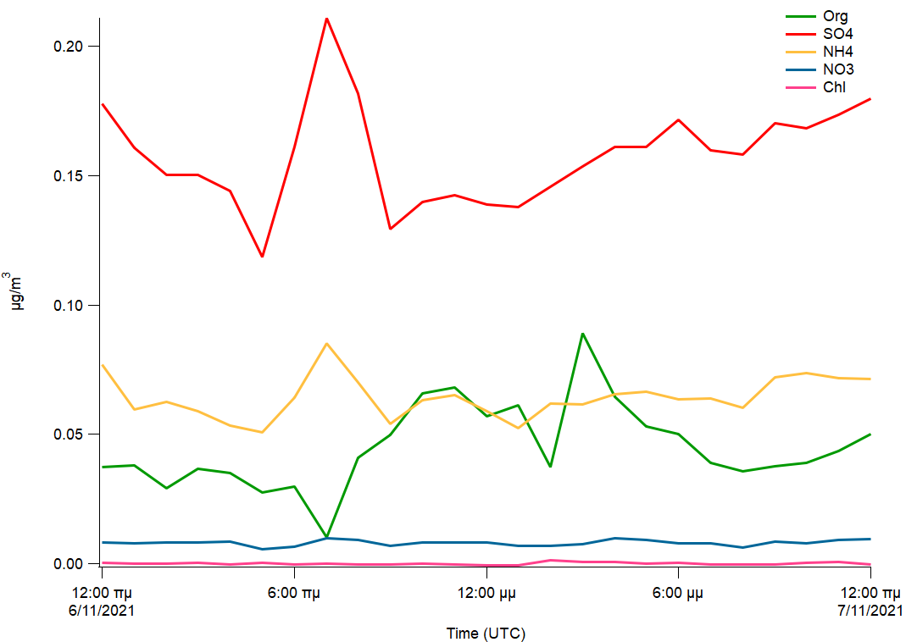
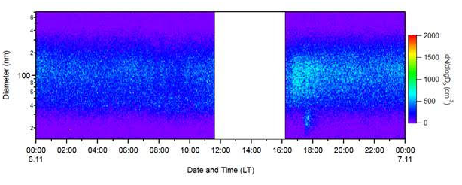
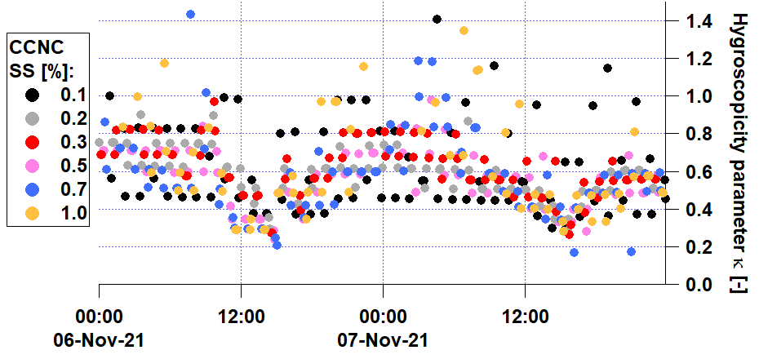
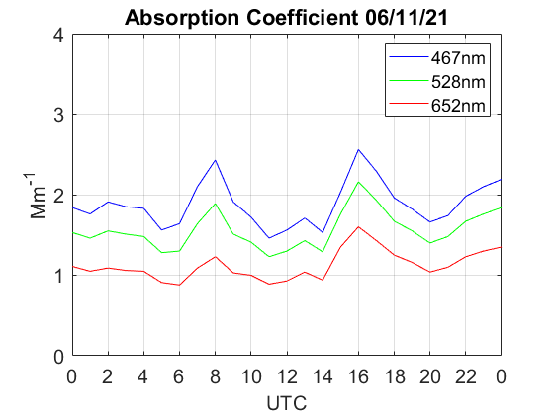
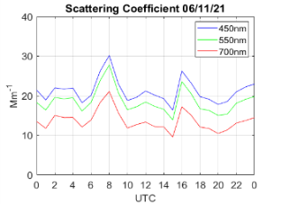
Experimental results (Case of 06 November 2021)
15:00-17:00 UTC
Rising plume containing polluted aerosols (as seen in the aerosol optical properties, diameter, and the observed hygroscopicity factor κ) detected by the synergy of the AIAS lidar and in situ measurements
ACSM ToF Chemical components
In situ measurements (2.314 m asl.)
In situ data
Doubling of the organic aerosols concentrations up to ~0.09 μg/m³
Hygroscopicity factor κ drops down to 0.4-0.6 for different hypersaturations s
Increased (+25-50%) values of aerosol absorption and backcscatter coefficients
Increased aerosol diameter 40-200 nm (> 16:00 UTC)
Arrival of less hygroscopic air masses
Helmos in-situ
The 30th International Laser Radar Conference (ILRC) virtual conference, June 26-July 1, 2022
Notes:
The 2021 Greece wildfires during the first half of August 2021 after a historic heatwave for the country with the highest temperatures, reaching 47.1 °C (116.8 °F).
The World Meteorological Organization highlighted the Greek wildfires noting the wildfires as an example of the extreme weather being caused by climate change.
The last published IPCC report warned about the planet’s warming resulting in more heatwaves, droughts, and other extreme weather events, unless drastic and immediate action is taken to reduce carbon emissions.
Reliable estimates aerosol pollutants and related impacts on Earth’s radiation budget are key to better inform policy-makers. Such information is essential to implementing, monitoring and evaluating policies that help to tackle air pollution while also protecting health.
Addressing this issue, we focus on the radiative effects of this extreme and long-lasting wildfire episode, following a dust intrusion using CALIOP’s lidar extinction profiles and libRadtran simulations. We examine 3 time periods referring to dust, smoke and mixed aerosols.

Slide 6
Data processing in progress
Retrieval of aerosol properties [Organic carbon/Elemental carbon content, exact aerosol chemical composition, ice nucleation events, aerosol-cloud interactions (formation, lifetime, etc.)]
Estimation of aerosol radiative properties (Single Scattering Albedo, Direct Radiative Effect at surface (SRF) and top of the atmosphere-TOA)
Take-home message
Multi-instrumented campaigns at high altitude remote areas are required to obtain a better understanding of the aerosol-clouds interactions, due to embedded complex mechanisms.
Acknowledgments :
We acknowledge funding from the PANACEA infrastructure and the European Research Council, CoG-2016 project PyroTRACH (726165) H2020-EU.1.1. - Excellent Science. We also acknowledge support by the “PANhellenic infrastructure for Atmospheric Composition and climatE change” (MIS 5021516), which is implemented under the Action “Reinforcement of the Research and Innovation Infrastructure”, funded by the Operational Programme “Competitiveness, Entrepreneurship and Innovation” (NSRF 2014-2020) and co-financed by Greece and the European Union (European Regional Development Fund). The Service National d’Observation PHOTONS/AERONET is also acknowldeged for providing a sun/sky photometer in the frame of the ACTRIS framework.
The 30th International Laser Radar Conference (ILRC) virtual conference, June 26-July 1, 2022
Notes:
The 2021 Greece wildfires during the first half of August 2021 after a historic heatwave for the country with the highest temperatures, reaching 47.1 °C (116.8 °F).
The World Meteorological Organization highlighted the Greek wildfires noting the wildfires as an example of the extreme weather being caused by climate change.
The last published IPCC report warned about the planet’s warming resulting in more heatwaves, droughts, and other extreme weather events, unless drastic and immediate action is taken to reduce carbon emissions.
Reliable estimates aerosol pollutants and related impacts on Earth’s radiation budget are key to better inform policy-makers. Such information is essential to implementing, monitoring and evaluating policies that help to tackle air pollution while also protecting health.
Addressing this issue, we focus on the radiative effects of this extreme and long-lasting wildfire episode, following a dust intrusion using CALIOP’s lidar extinction profiles and libRadtran simulations. We examine 3 time periods referring to dust, smoke and mixed aerosols.

