Slide 1

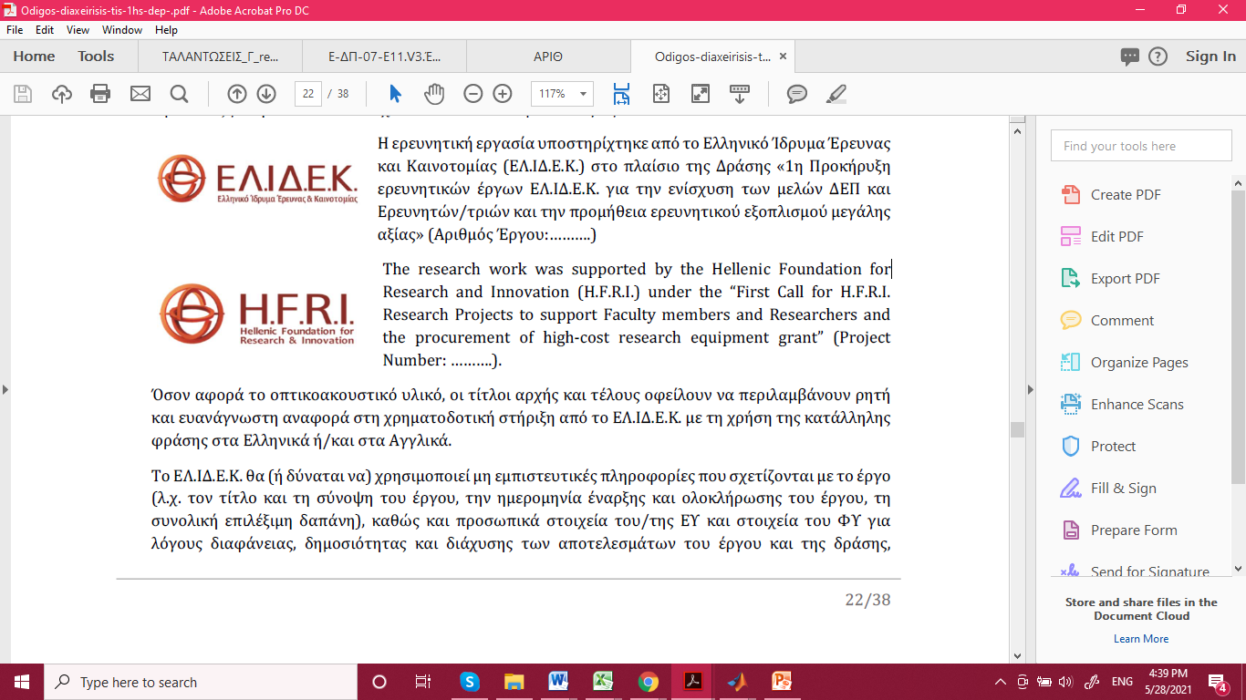
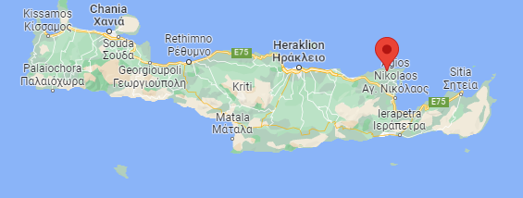
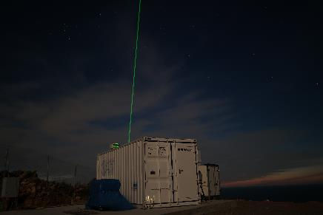
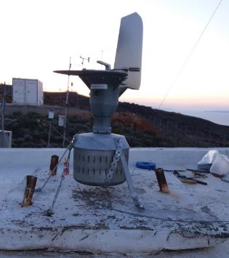
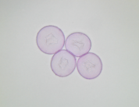
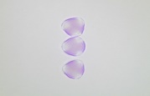
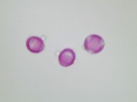
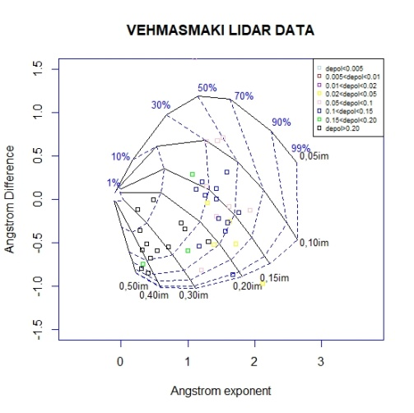
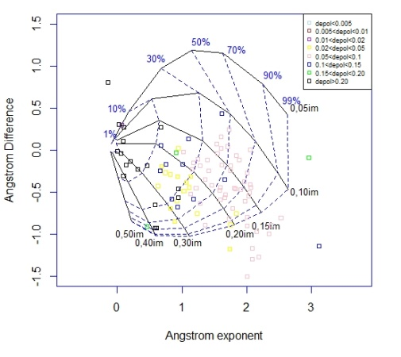
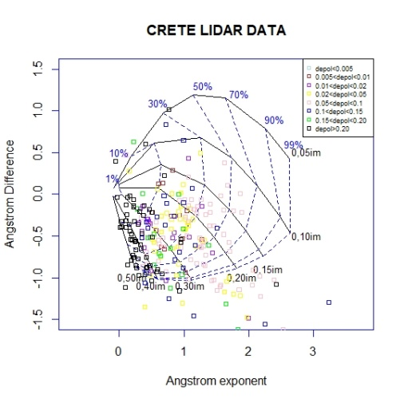
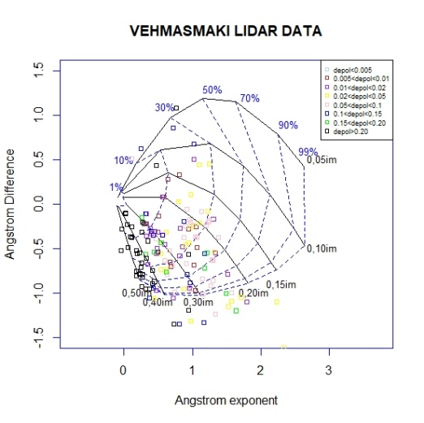
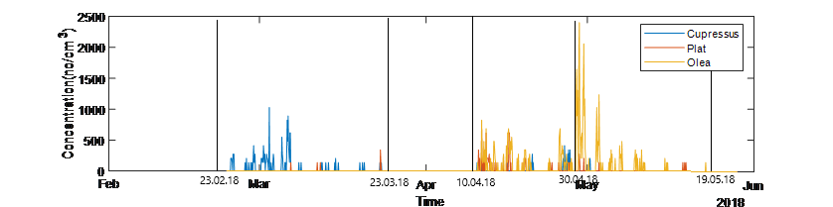
Pollen characterization using AERONET, lidar
and Burkard data
M. C. Gatou¹, E. Giannakaki^{1,2}, X. Shang², S. Bohlmann ², M. Komppula²
margat@phys.uoa.gr
Department of Environmental Physics and Meteorology, University of Athens, 15784 Athens, Greece,
(2) Finnish Meteorological Institute, Atmospheric Research Centre of Eastern Finland ,70211, Kuopio, Finland
Motivation and methodology
Period | Stations | Instruments
February-May 2018 | Finokalia, Crete, Greece (35° 19′ 52″ N, 25° 40′ 4″ E) | Buckard type volumetric air sampler | Multi-wavelength Raman polarization lidar PollyXT(Fig.1(c))
Τhe pollination periods of the three different dominant pollen types are distinct, as can be seen from the Burkard-observed number concentration of pollen types shown in Fig. 2. The dominant pollen types are shown in Table 1, along with each intense pollen period (IPP).
 | IPP1 | IPP2 | IPP3
Period | 23/2-23/3/2018 | 10/4-30/4/2018 | 1/5-19/5/2018
Pollen Type | Cupressus | Olea and Platanus | Olea
Pollen photo
Rain shield
Wind Vane
Inlet
Vacuum Pump
Fig.1 (a)Location of Finokalia station (b) Burkard type pollen air sampler, (c) Multi-wavelength Raman polarization lidar PollyXT
Table 1. The 3 intense pollen types and the respective pollination periods(IPP’s).
Results
The first layer of the observed profile was identified by using the Wavelet Covariance Method and then mean Ångström exponent values were computed. Ångström differences, Δå(z), were found negative for the 92% of the 356 aerosol layers, indicating the dominant presence of coarse particles within the first aerosol layer for the period under study. During IPP1 we observed larger depolarization ratio (0.23+-0.02) and smaller Ångström exponent(1.26+-0.3), while within IPP2, smaller effective radius with larger contribution of fine particles was observed. During IPP3 the data covers mainly two distinguish areas in the Gobbi diagram: one with large depolarization ratio (>0.1)with Ångström exponent lower than 1 and fine mode contribution (FMC) between 10-30% and a second one with moderate depolarization ratio(0.02-0.05) with Ångström exponent between 1 and 2 and FMC between 30 and 50%.
Fig.2 Timeseries of pollen concentration measured by the Burkard sampler, throughout the 3 intense pollination periods (IPPs).
The black vertical lines represent the start and the finish time for every IPP.
Fig.3 Gobbi diagram of the depolarization ratio from our whole data set , Gobbi diagram of the depolarization ratio for IPP1, Gobbi diagram of the depolarization ratio for IPP2, Gobbi diagram of the depolarization ratio for IPP3.
Conclusion
We aim to link lidar optical aerosol properties with different pollen types.
Depolarization ratio in Gobbi diagrams can show great diversity, depending on the shape of the dominant pollen type for every intense pollination period.
Ångström differences, Δå(z), were found negative for the 92% of the 356 aerosol layers, indicating the dominant presence of coarse particles
ACKNOWLEDGEMENTS
The research work was supported by the Hellenic Foundation for Research and Innovation (H.F.R.I.) under the “First Call for H.F.R.I. Research Projects to support Faculty members and Researchers and the procurement of high-cost research equipment grant” (Project Number:16645).
REFERENCES
[1] Després, et.al.(2012). Chemical and Physical Meteorology 64.1 (2012): 15598.
[2]Giesecke, et.al.(2010). Vegetation History19(4),247-258.
[3]Engelmann, R., et.al. (2016). Atmospheric Measurement Techniques, 9(4), 1767-1784.
[4] Ansmann, et.al. (1992).. Applied optics, 31(33), 7113-7131.
[5]Bohlmann, et.al. (2019), Vol. 19, No. 23 p. 14559-14569.
[6]Shang, X.,et..al. (2020). Atmospheric Chemistry and Physics, 20(23), 15323-15339.

