Slide 1

ILRC30, Virtual Conference 2022,
26, June – 1 July, 2022
29th June, 2022
Interaction between sea wave and surface atmosphere
by shallow angle LED lidar
Tatsuo Shiina, Kosuke Okubo, Nofel Lagrosas, Alifu Xiafkaiti
Chiba University, Japan
椎名 達雄 千葉大学 大学院工学研究院
Tatsuo Shiina Associate Professor
Graduate school of Engineering,
Chiba University, Japan
shiina@faculty.chiba-u.jp

Slide 2
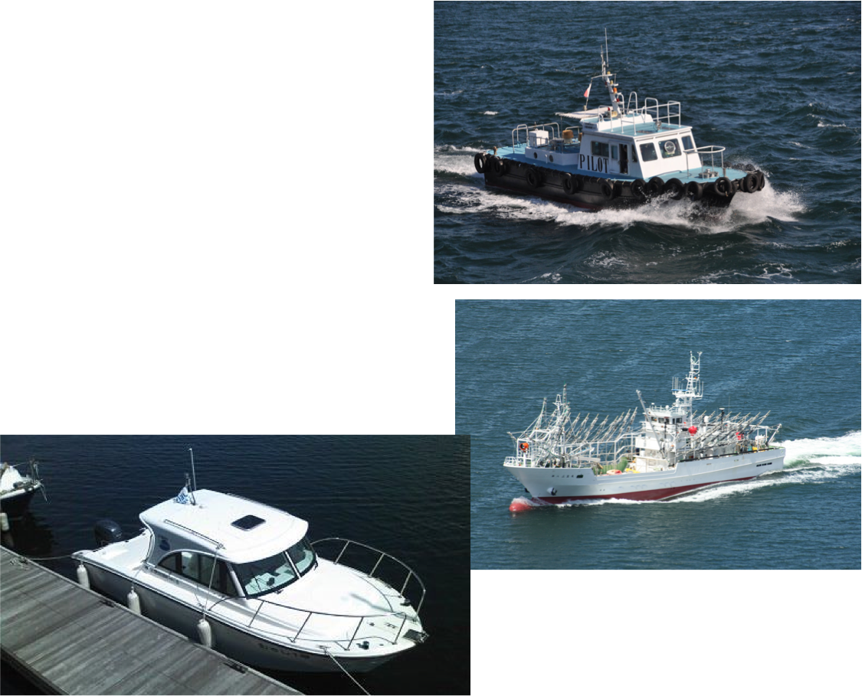
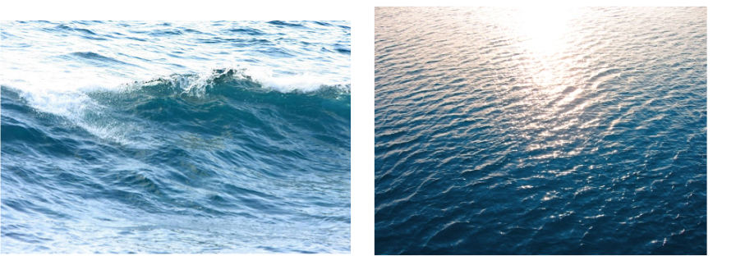
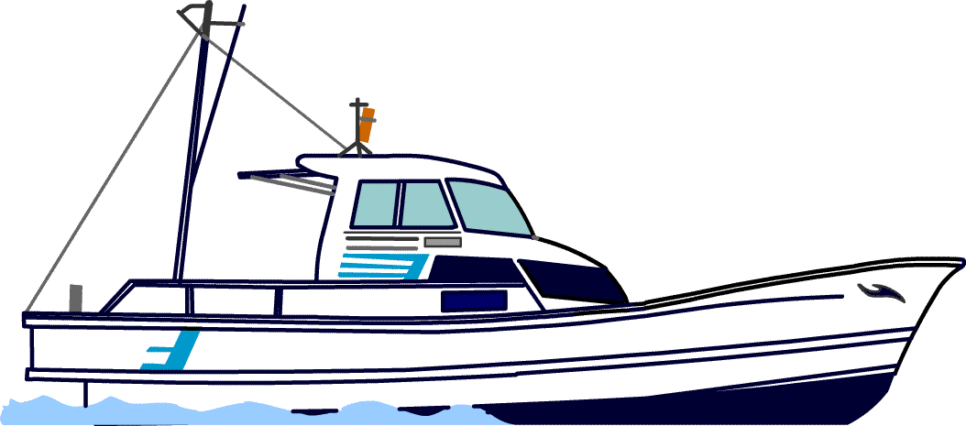

Backgrounds and Purpose
Safety for fish-boats and pleasure-boats
Efficiency improvement
Auto-driving control
Prediction of sea wave dynamics
Purpose
Visualization of Interaction between the sea surface and the lower atmosphere by LED mini-lidar with shallow angle observation
Shallow angle Observation
Sea wave : 0.1〜1Hz

Slide 3
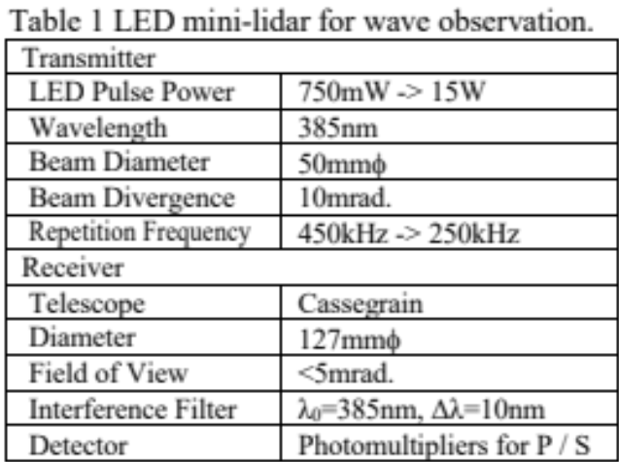
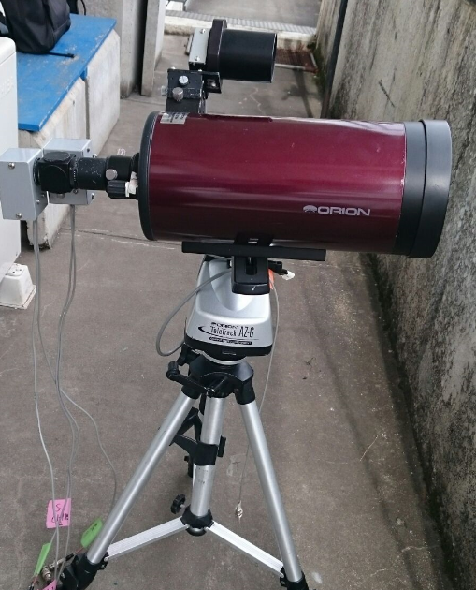
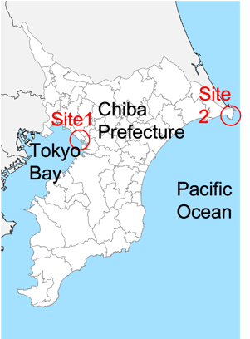
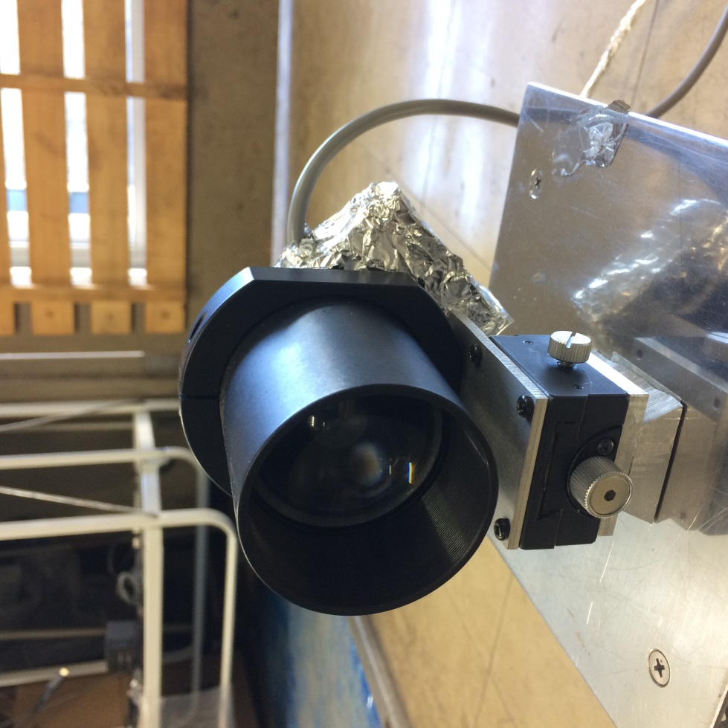
Led mini-lidar and Observation Sites
LED mini-lidar Specification
Observation Sites
Photon Counter
Trimatiz co.Ltd.(japan)
2 - 4 channels
Minimum BIN width 1ns
( Spatial Resolution 0.15m)
Responsibility 65535 (16bits)
Repetition Frequency >500kHz

Slide 4
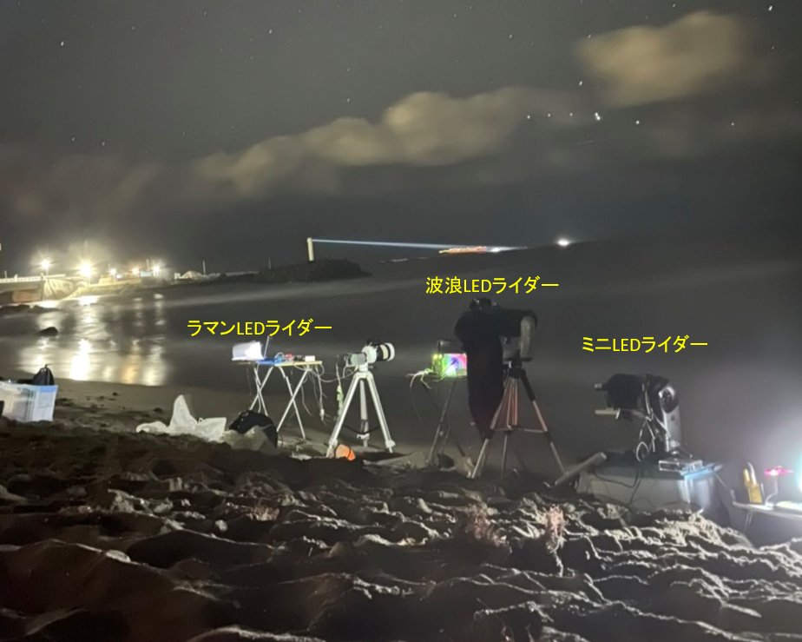
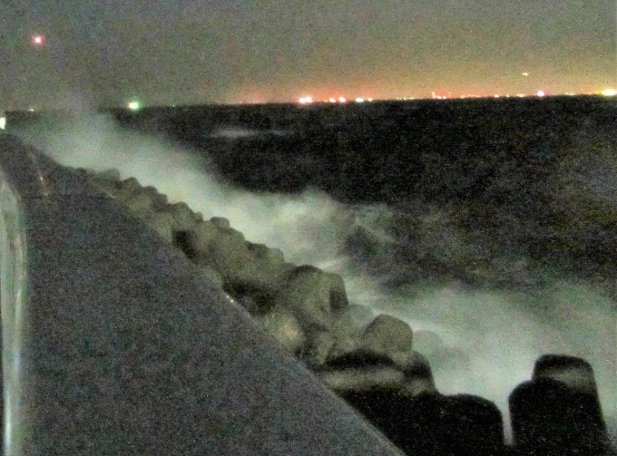
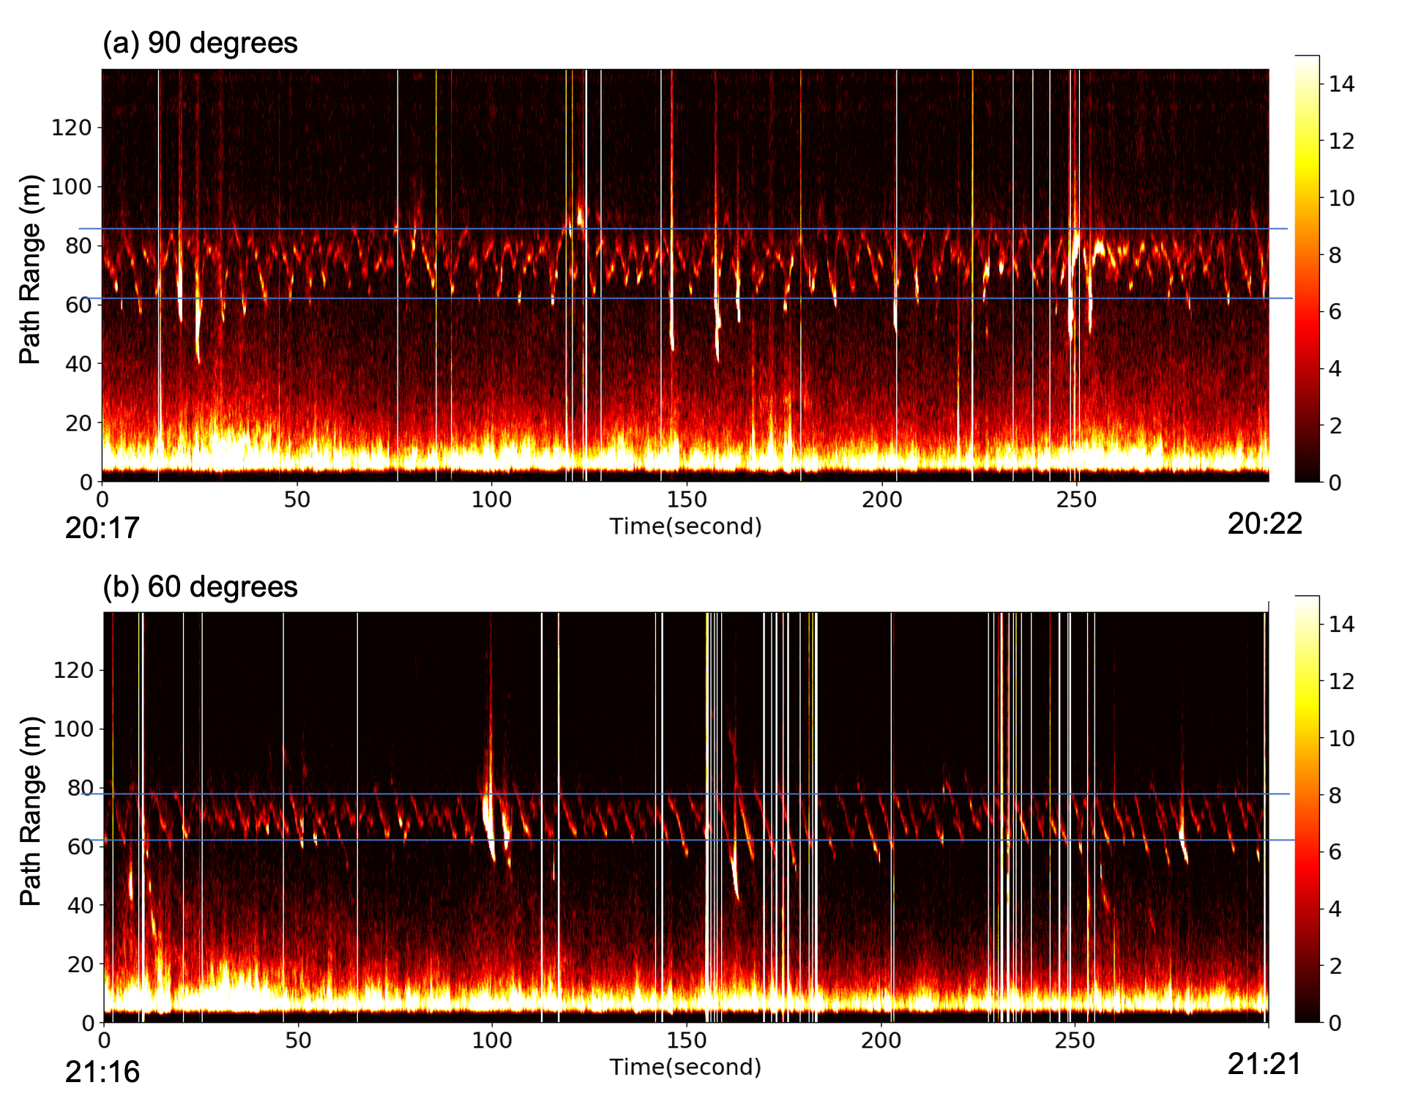
Sea Wave Observations
Sea wave echoes on orthogonal polarizations
Sea wave dynamics under strong wind flow
Sea wave observation results at Site 2: Sotokawa at 20:34 – 20:36 (JST) on 27th Dec. 2021. Dep. Angle 10 degrees. Orthogonal polarizations of (a) P polarization and b) S polarization. White bars; Wind speed
Sea wave observation results at Site 1: Kemigawa at 20:17 – 20:22 and 21:16 – 21:21 (JST) on 27th Dec. 2021. Dep. Angle 3 degrees. Lidar sight directions of (a) Perpendicular and b) 60 degrees against the wind direction.

Slide 5
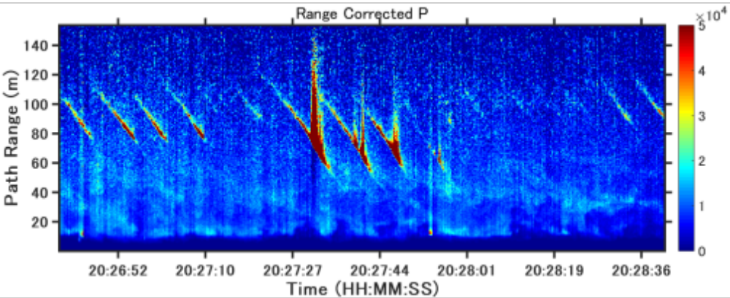
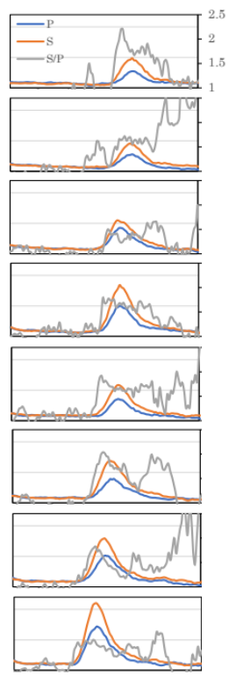
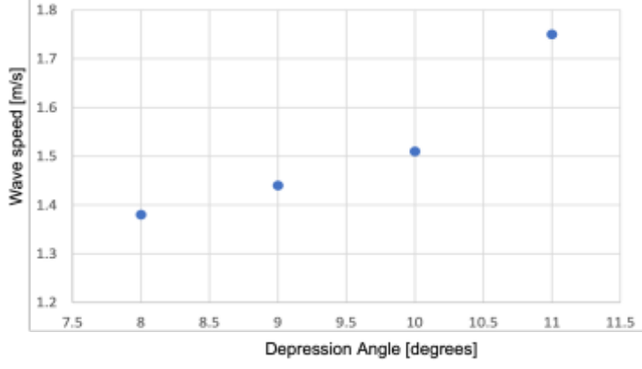
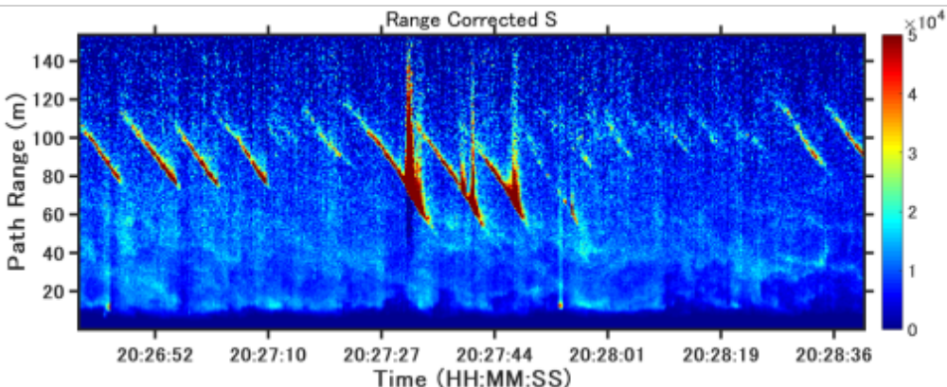
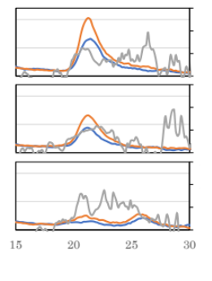
Sea Wave Observations
Interaction between sea wave and atmosphere
Wave flow
Wave height variations
in depression angle
Dep. Angle (°) | Wave Speed (m/s) | Wave Hight (m) | Period (s)
8 | 1.38 | 0.40 | 5.97
9 | 1.44 | 0.50 | 4.93
10 | 1.51 | 0.63 | 4.93
11 | 1.75 | 0.63 | 5.19
Sea wave observation results at Site 2: Sotokawa at 20:26 – 20:28 (JST) on 15th Jan. 2020. Dep. Angle 2 degrees. Orthogonal polarizations of (a) P polarization and b) S polarization.
Distance [m]

Slide 6
Summary
We have been developed a LED based mini-lidar to monitor sea wave fundamental profiles, and to deduce additional information of wave dynamics interacted with winds. This time, wave motions are compared at the observation sites in an inland side and ocean side. Both can capture periodic wave motion reflected on the local wind profile.
References
1. Belmont M. R., Horwood J. M. K., Thurley R. W. F., and Baker J., “Shallow Angle Wave Profilig Lidar”, J.
Atmospheric and Oceanic Technology, 24, 1150-1156 (2007).
2. Mikhalevich V. and Solntsev M., “Laser Methods for Measuring the Ocean Surface-Wave Spectrum”,
EARSeL Advances in remote sensing, l.1, 33-35 (1992).
3. Reineman B. D., Lenain L., Castel D., and Melville W. K., “A Portable Airborne Scanning Lidar System
for Ocean and Coastal Applications”, American Meteorological Society, 26, 2626-2641 (2009).
4. Shiina T., “LED mini-lidar”, 26th ILRC proceeding S1P-17, (2012).
5. Mori Y., Shimada S., Shiina T., Baji H., and Takemoto S., “Dynamic analysis of sea wave data measured
by LED lidar”, SPIE proceeding 10006, 100060G (2016).
6. Shiina T. and Mori Y., “Shallow angle measurement of sea wave dynamics by LED mini-lidar”, 28th ILRC
proceedings 011_193, (2017)

