Slide 1

Observation of Low-level Wind Field over Ocean with Floating Coherent Doppler Lidar during the passage of Typhoon “Rai”
Qichao Wang ^{1,4}, Songhua Wu ^{1,2,3, *}, Pei Chen ¹, Kailin Zhang ^{1,3}, Bingyi Liu ^{1,3}, Junwu Tang ³,
Xiaoye Wang ¹, Rongzhong Li ^{1,4}
¹ College of Marine Technology, Faculty of Information Science and Engineering, Ocean University of China, No.238, Songling Road, Qingdao, 266100, China, E-mail: wangqichao@ouc.edu.cn (Q.W.); wush@ouc.edu.cn (S.W.);21200211101@stu.ouc.edu.cn (P.C.); zhangkl@ouc.edu.cn(K.Z.); liubingyi@ouc.edu.cn(B.L.); jwtang@vip.163.com (J.T.); wxy 941227@sina.com(X.W.); lirongzhong@leice-lidar.com (R.L.)
² Institute for Advanced Ocean Study, Ocean University of China, No.238, Songling Road, Qingdao, 266100, China
³ Laboratory for Regional Oceanography and Numerical Modeling, Pilot National Laboratory for Marine Science and Technology (Qingdao), No.1, Wenhai Road, Jimo, Qingdao, 266237, China
⁴ Qingdao Leice Transient Technology Co., Ltd., No.600, Jiushui East Road, Qingdao, 266100, China, E-mail: lirongzhong@leice-lidar.com (R.L.)
[08].[Atmospheric Boundary Layer Processes]
[30-Jun], [12:00]
[Thursday_ 08_P15]
The 30th International Laser Radar Conference (ILRC) virtual conference, June 26th – July 1st, 2022.

Slide 2
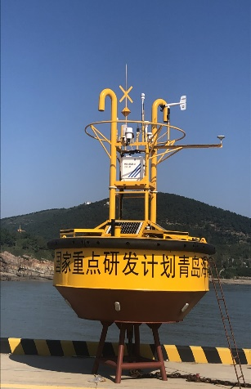
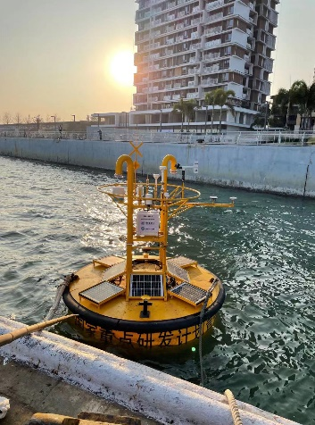
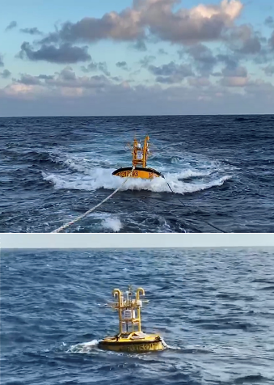
1 Introduction of motivation and instrumentation datasets
1
Research background and significance
The floating Doppler lidar system is of great potential for assessing marine wind resources, ocean dynamics prediction modeling, ocean-atmosphere interaction, and flux measurement.
Compact floating coherent Doppler lidar system of the type WindMast350-M
The system was jointly developed by Ocean University of China (OUC), Pilot National Laboratory for Marine Science and Technology (QNLM), and Leice Transient Technology Co. LTD (LEICE), which can achieve three-dimensional wind field information observation from 10 m to 300 m above sea level with high spatial and temporal resolution. The coherent Doppler lidar was installed in a small deep-sea buoy with the diameter of 3 meters (Fig. 1).
Fig. 1. The windMast350-M floating lidar system
During the observation campaign carried out in the South China Sea since December 2021, the floating lidar system performed well and achieved wind field characteristics observation of the 22nd typhoon named "Rai".

Slide 3
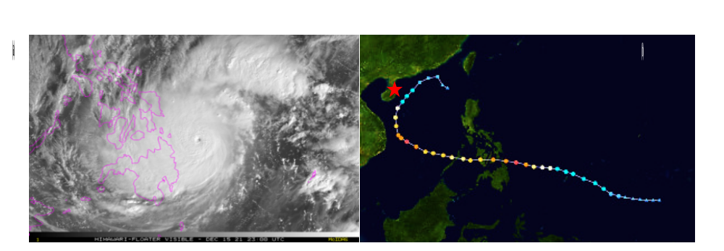
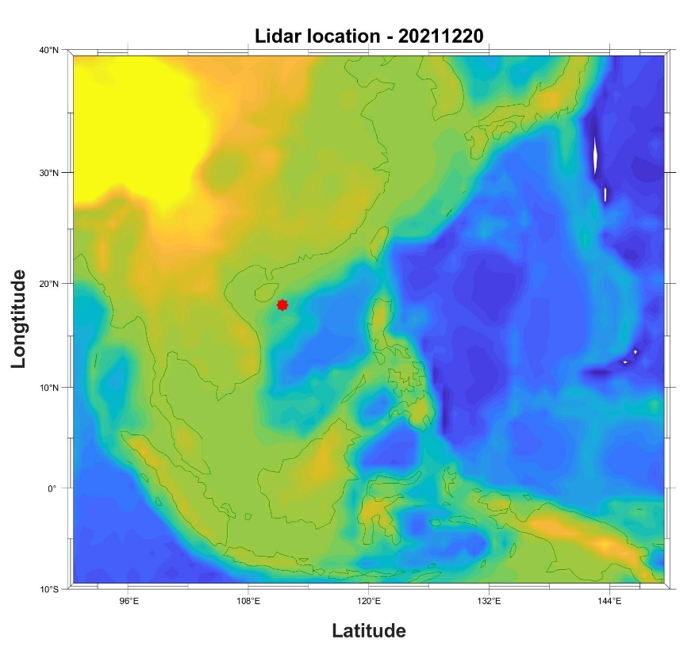
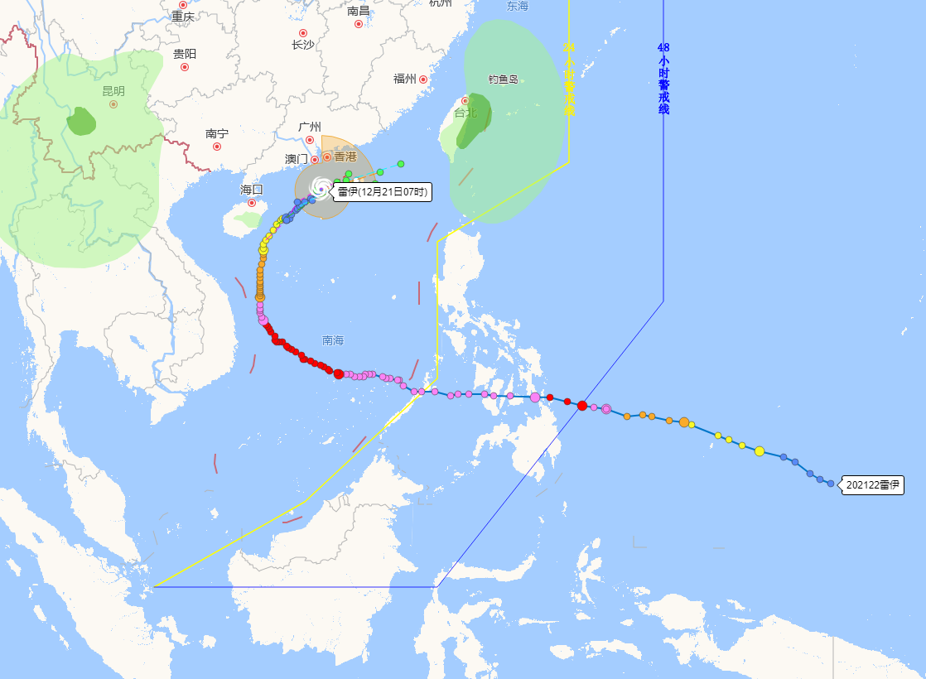
2 Characteristics of typhoon "Rai"
1
Transit event of typhoon "Rai"
According to the typhoon track information provided by the national meteorological center of China, the center of typhoon "Rai" went straight over the floating coherent Doppler lidar system placed in the South China Sea at 14:00 on December 20th. As shown in Fig. 3.
The red star presents the location of the floating lidar system (Latitude: 17.9538 °N, Longitude: 111.4061 °E), which is located to the left of the typhoon center. The distance between the typhoon center and the floating lidar system is less than 10 km.
Results from the field observation
The wind field data observed and inversed by the floating coherent Doppler lidar system are recorded during the typhoon transit. The floating lidar performed well during the passage of the 22nd typhoon named "Rai". The data acquisition rates of floating lidar at all heights are over 90%, and the typhoon eye's structure of wind speed at all heights has been observed completely during the typhoon transit.
Fig. 2. (a) The cloud map of typhoon Rai (b) The path of typhoon Rai and the location of the floating coherent Doppler lidar system (marked with the red star).
Fig. 3. The path of typhoon Rai and the location of the floating coherent Doppler lidar system (marked with the red star).

Slide 4
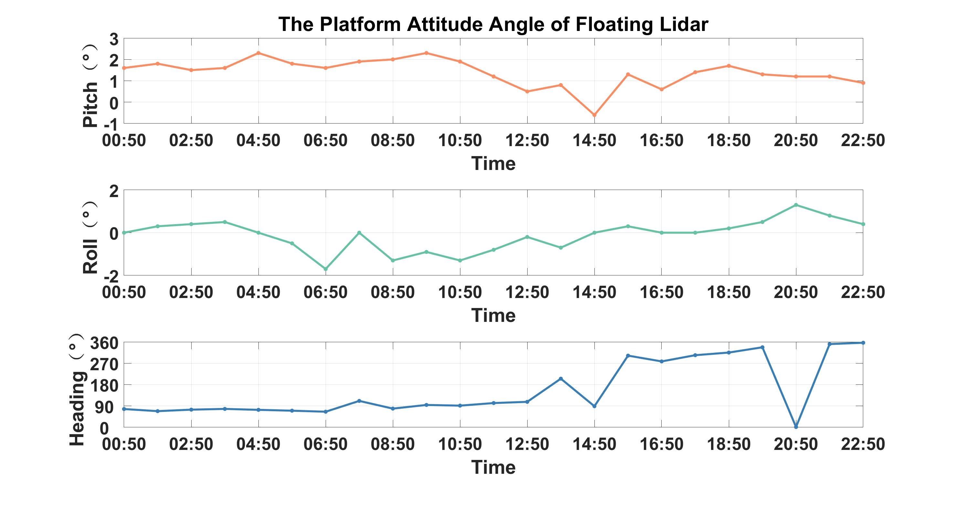
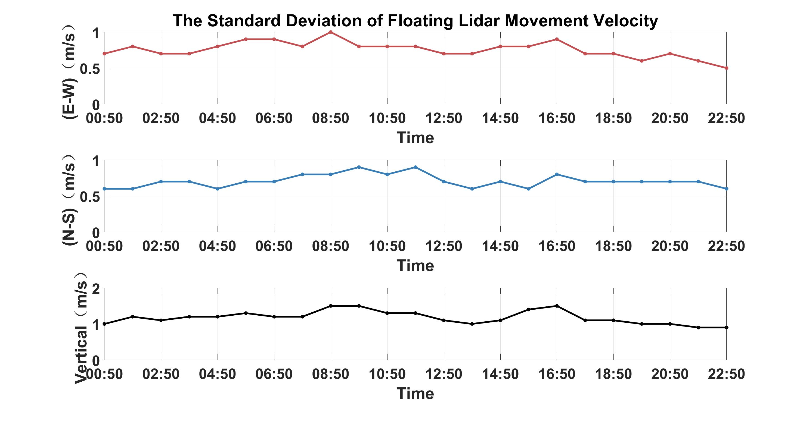
3 The analysis of wind field during Typhoon “Rai”
1
Instrumentation datasets
Due to the reason of satellite transmits data is limited by the transmission traffic, in this paper, we use the data with a time resolution of 60 minutes. The analysis of attitude characteristics of floating coherent Doppler lidar system is performed in this section, and the characteristics of wind field during typhoon “Rai” are also discussed.
attitude characteristics of floating coherent Doppler lidar system
The attitude information of the floating coherent Doppler lidar system in the geographic coordinate system is shown in Fig. 3.
When moving with the wave and current, the standard deviation of each direction-al component of floating lidar movement velocity in the three-axis of the floating coherent Doppler lidar system in the geographic coordinate system is shown in Fig. 4.
Fig. 3. Variation of attitude angle of the floating coherent Doppler lidar system
Fig. 4. Time-series diagram of the variation of three-axis velocity of the floating coherent Doppler lidar system

Slide 5
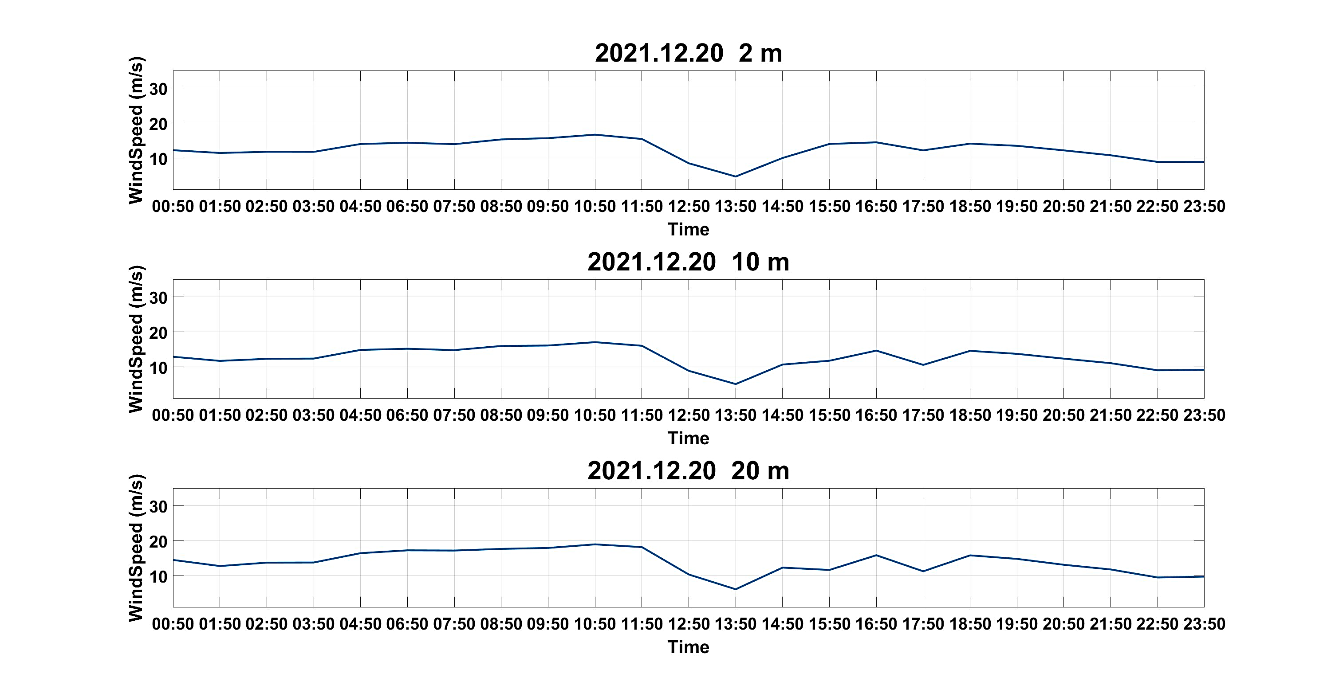
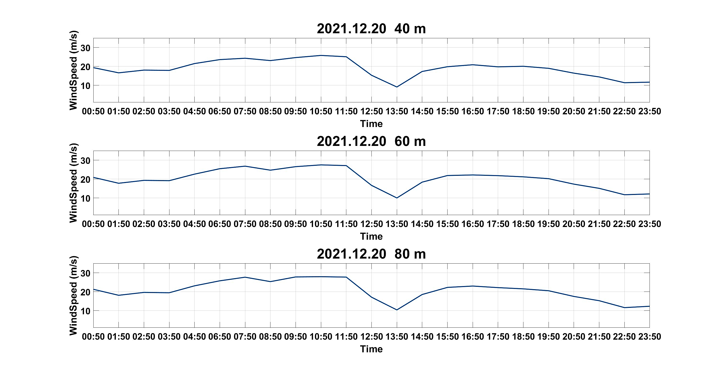
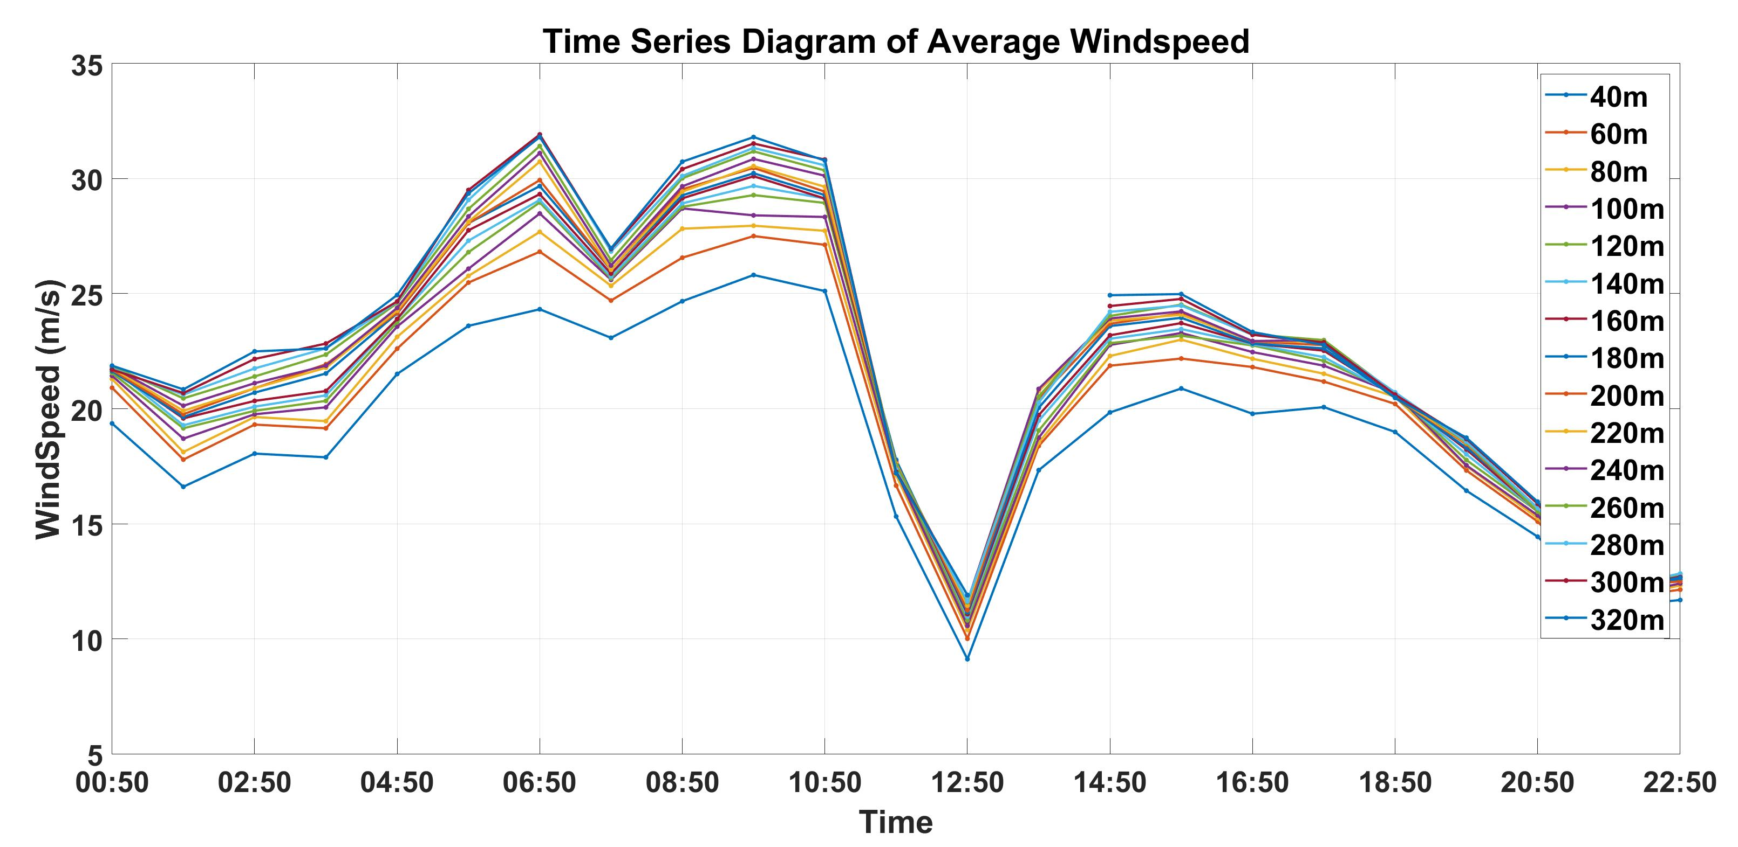
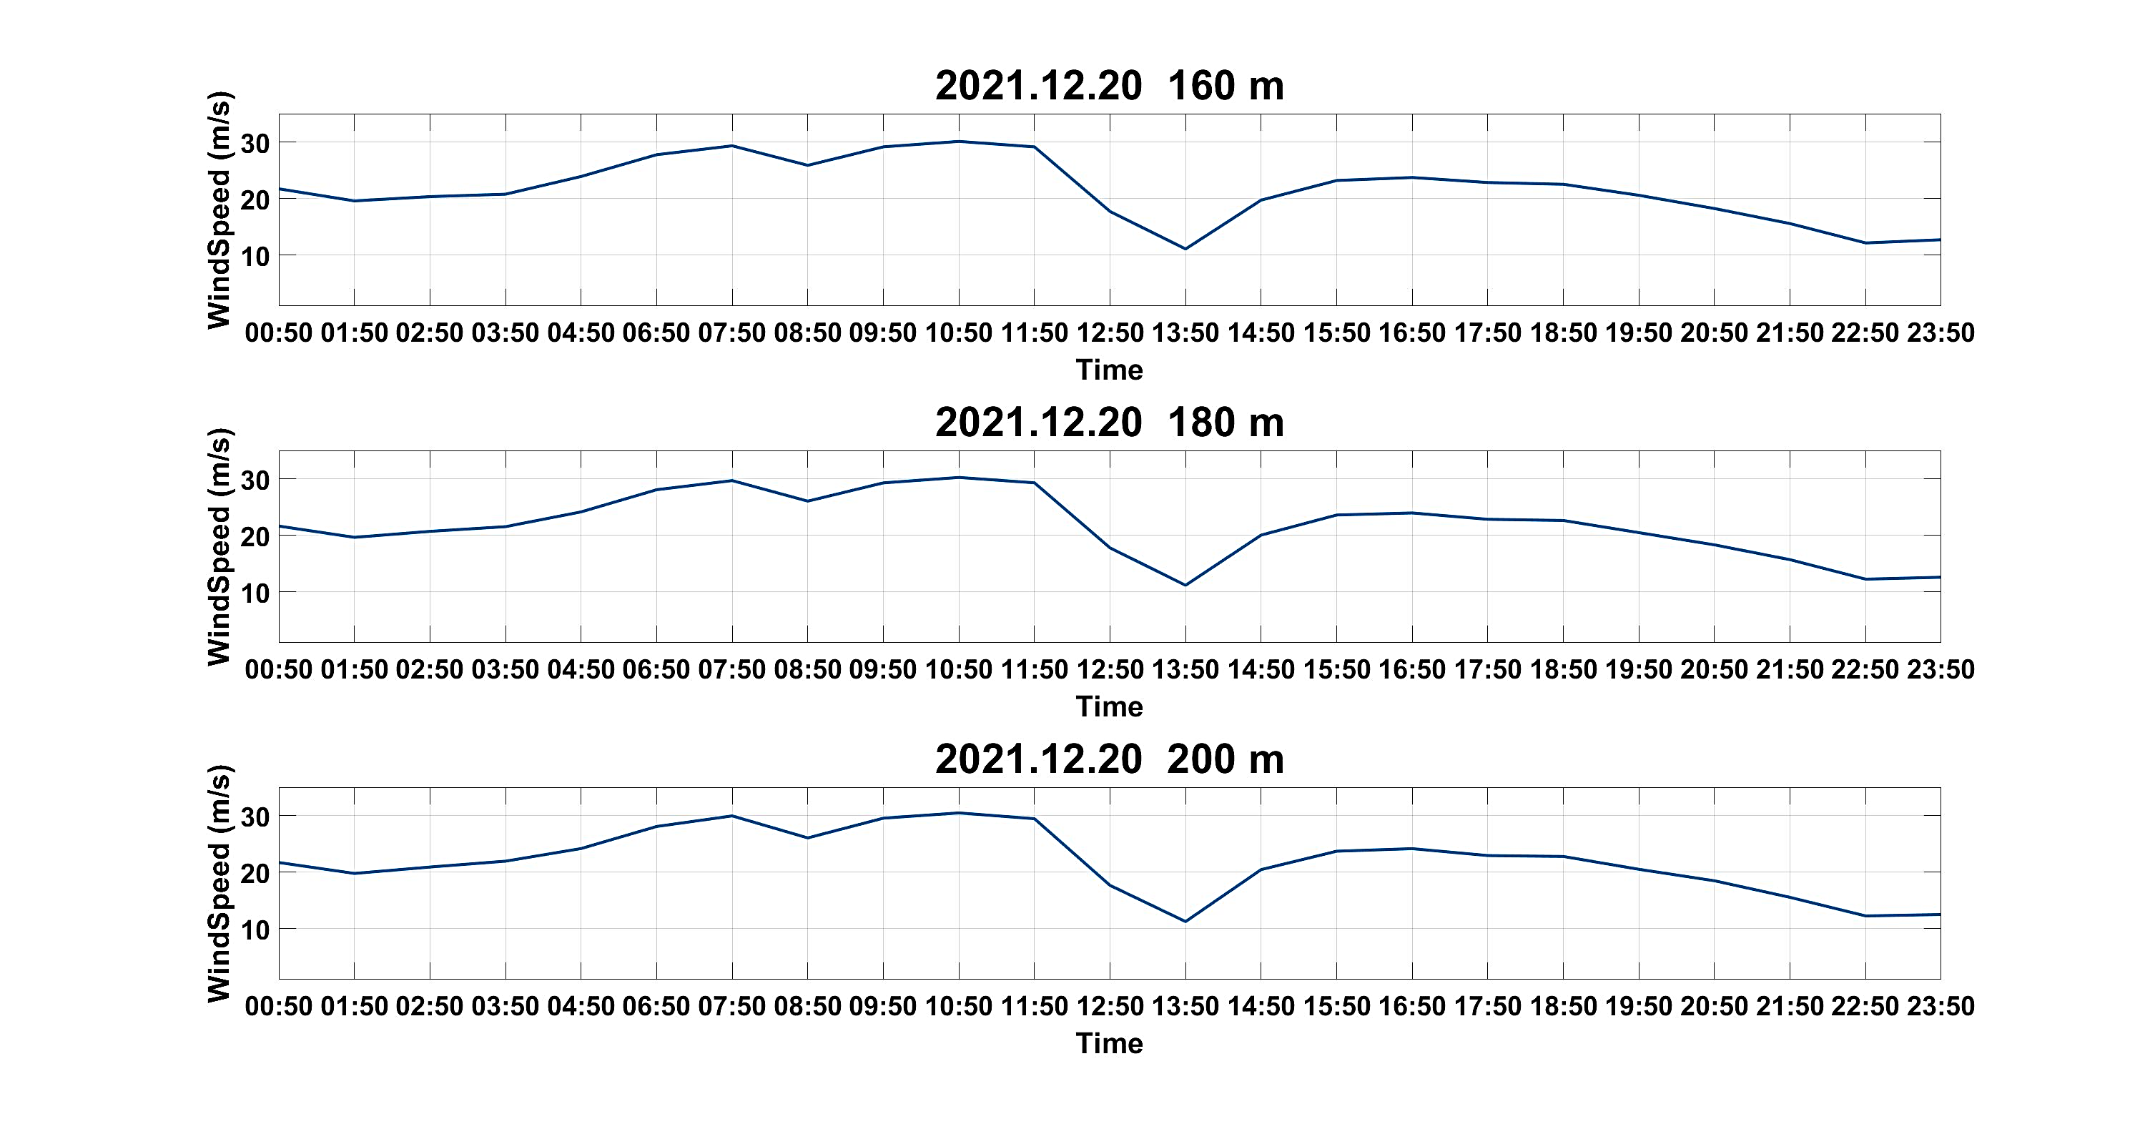
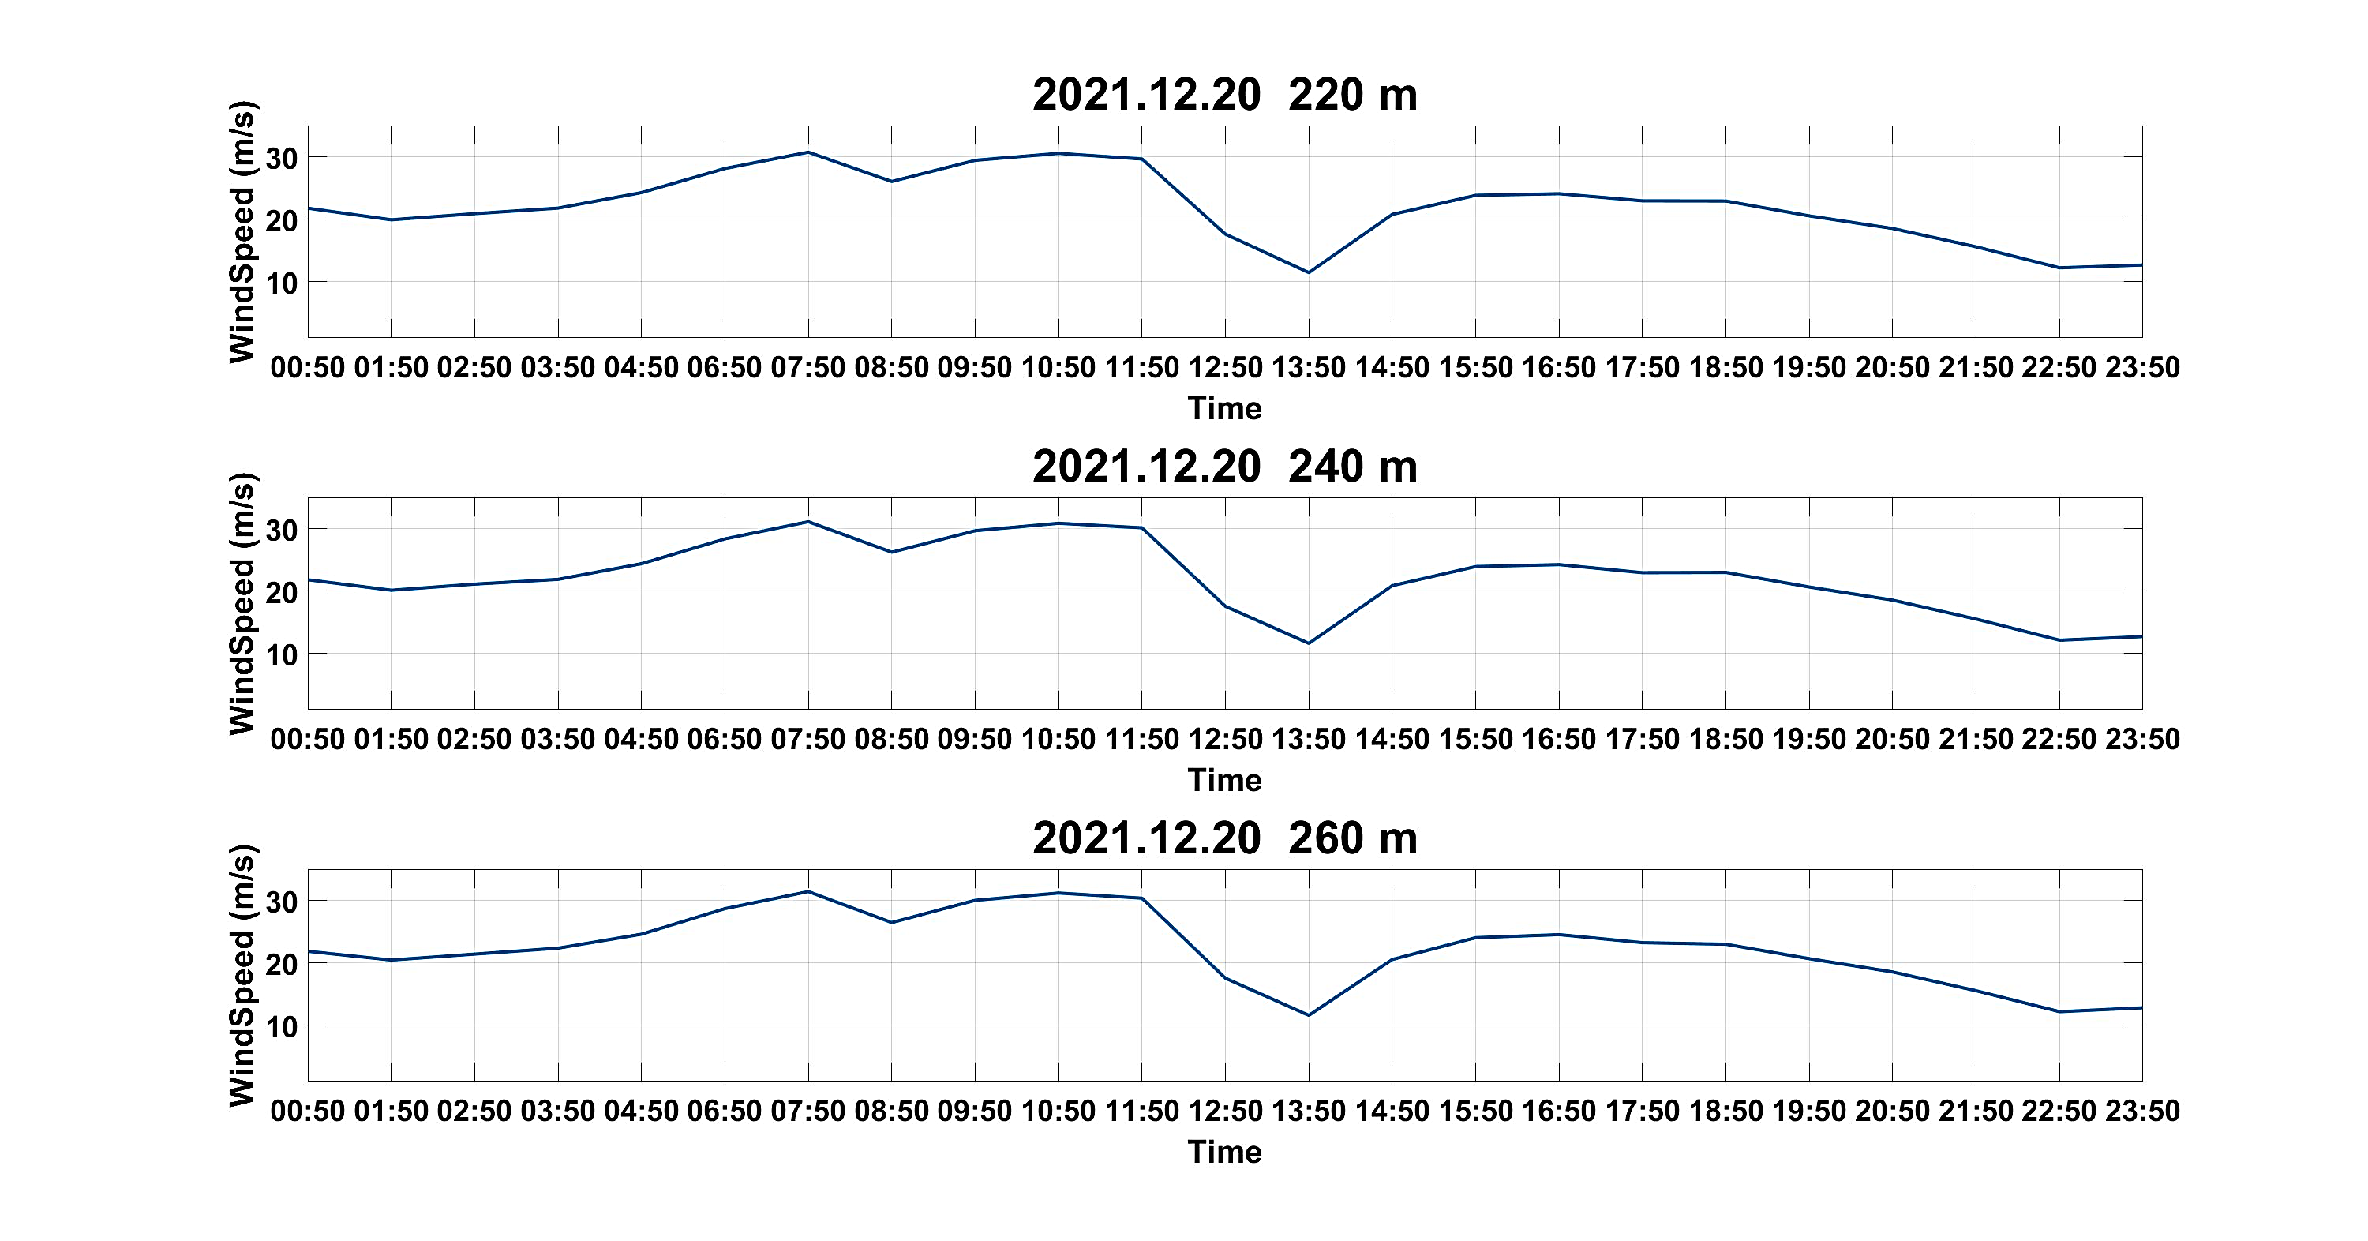
3 The analysis of wind field during Typhoon “Rai”
2
Results from the field observation
The wind speed and direction data measured by the floating coherent Doppler lidar system during the passage of Typhoon “Rai” (December 20-21, 2021) shows that the equipment operated stably during the typhoon's transit. The data acquisition rate was 100% at all altitudes levels, and the effective data rate was 99.54% (December 20, 2021) and 98.61% (December 21, 2021), respectively.
The characteristics of wind speed during typhoon transit
According to the structural characteristics of the typhoon and the resulting high wind speed phenomenon, combined with the time-series diagram of the wind speed variation (Fig. 5), the typhoon eyewall crossed the floating coherent Doppler lidar system from 10:50 to 16:50 on December 20. The wind speed showed the typical variation characteristics of the "M" type in the time series of each height.
Fig. 5. Time-series diagram of the variation of the 60-minute average wind speed at each height measured by the floating coherent Doppler lidar system

Slide 6
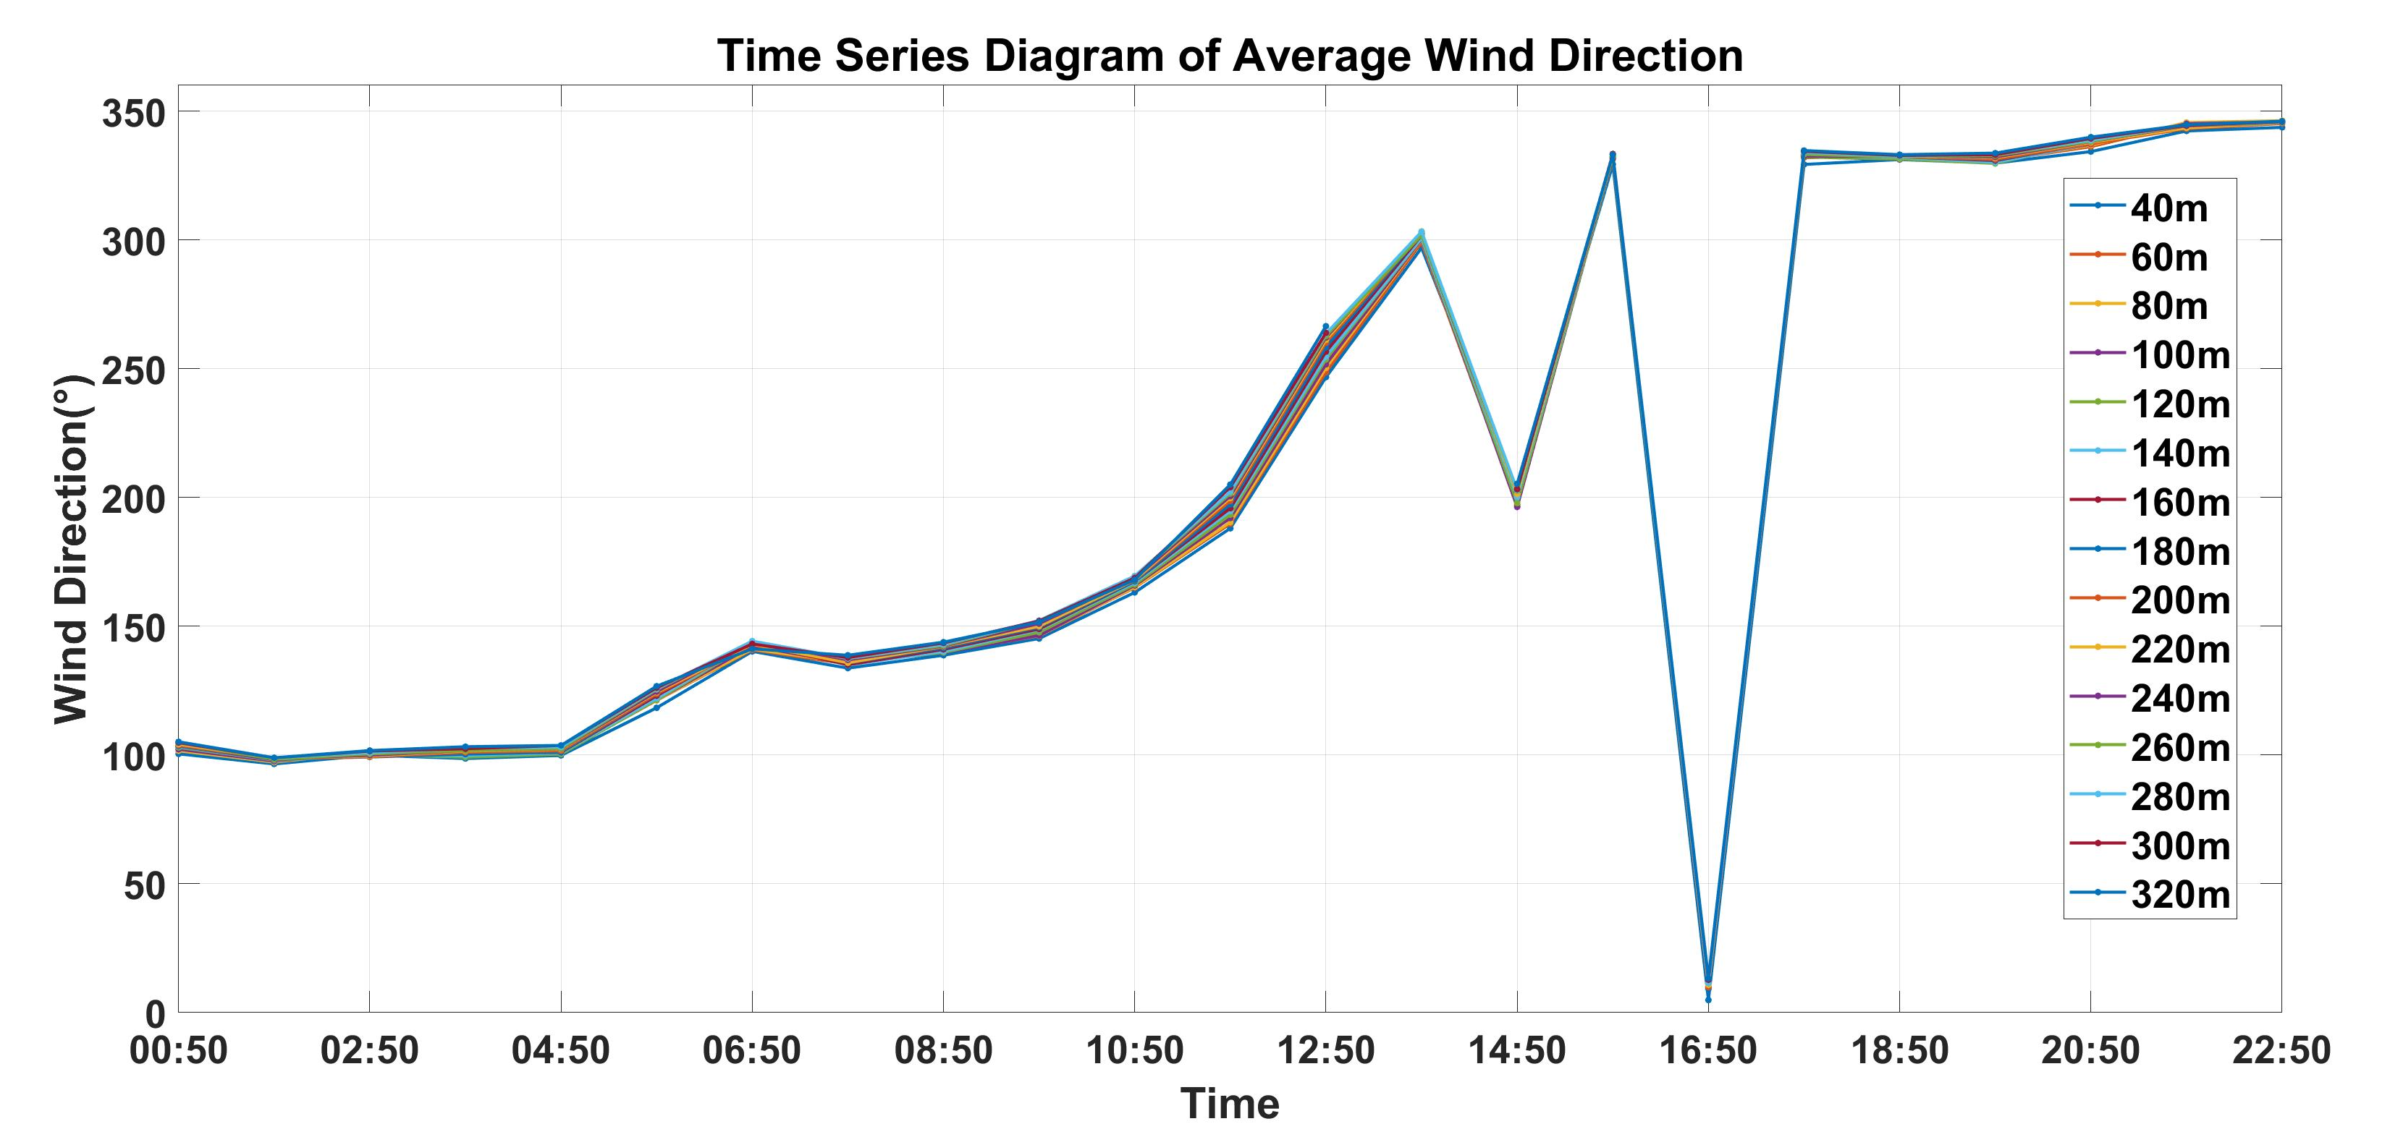
3 The analysis of wind field during Typhoon “Rai”
2
The characteristics of wind direction during typhoon transit
According to the structural characteristics of the typhoon and the resulting wind phenomenon, the time series diagram of wind direction was combined for analysis, as shown in Fig. 6.
From 10:50 to 13:50 on December 20th, due to the transit of the former wind circle, the wind direction showed a smooth change characteristic at all heights. At 13:50 on the 20th, when the typhoon eye area passed by, the wind direction showed a sudden change characteristic at all heights. After the passage of the typhoon eye, the time sequence of wind direction at all heights represented a smooth change characteristic from 15:50.
Fig. 6. Time-series diagram of the variation of the 60-minute average wind direction at each height measured by the floating coherent Doppler lidar system
Conclusion
This research shows the offshore wind field data measurement by the floating coherent Doppler lidar system developed by OUC, QULM, and LEICE, and the observation performance of the floating lidar system is verified.
In addition, the low-level wind field characteristics over the sea under complex weather conditions are analyzed, and the wind speed and wind direction data of several height layers over the sea level during the passage of typhoon “Rai” are compared and analyzed.
The bimodal characteristics of wind speed and the consistency of wind direction with the wind field change characteristics of the typhoon center are obtained under the influence of the typhoon.
The floating Doppler lidar system was verified to be an effective method for wind observation in areas with severe sea conditions.

