Slide 1



gPCE Uncertainty Quantification Modeling of Lidar for Bathymetric and Earth Science Applications
Alexandra K. Wise¹, Kevin W. Sacca¹, Jeff P. Thayer¹
¹University of Colorado, Boulder, CO 80303, USA,
Alexandra.Wise@Colorado.edu
01. Space-borne lidar missions, instruments and science
30-Jun, 12:00 UTC
Thursday 01-P11
The 30th International Laser Radar Conference (ILRC) virtual conference, June 26th – July 1st, 2022.
Notes:
Hi, my name is Alexandra Wise,
and this presentation is a
quick overview of
gPCE Uncertainty Quantification Modeling
OF Lidar
FOR Bathymetric and Earth Science Applications.
This is a session 01 poster,
number 11,
which will be presented June 30th at 12 UTC.

Slide 2
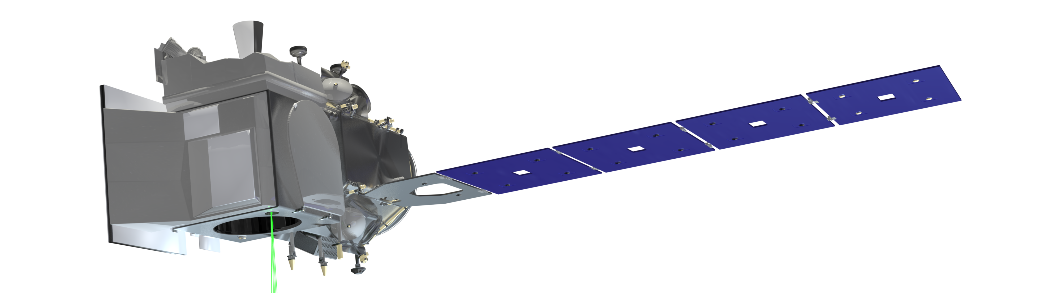
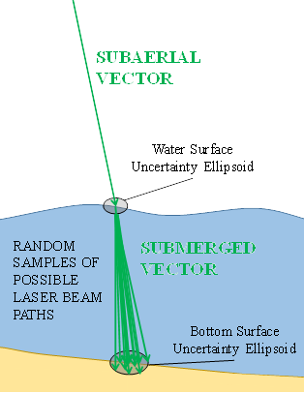
Motivation and Objectives
1
Motivation:
Most LiDARs are very sensitive to position, pointing errors, causing projection errors on target
Fidelity of location, pointing solutions can be high, but determination of uncertainty remains limited
NASA’s 2021 STV Incubation Study Report Identifies:
Vertical accuracy as an associated product parameter with all Science and Application Knowledge Gaps
Horizontal, Geolocation accuracy associated with most Knowledge Gaps
Research Objectives:
Develop gPCE method for topo-bathymetric LiDAR Uncertainty Quantification as an alternative to Total Propagated Uncertainty & Monte Carlo UQ methods
Quantify and compare performance of UQ methods, in terms of computational cost and model fidelity
Investigate subaerial simulations as validation to proceed with bathymetric simulation
Bounce
Point
Height
*(Modified from [2])
The 30th International Laser Radar Conference (ILRC) virtual conference, June 26th – July 1st, 2022.

Slide 3
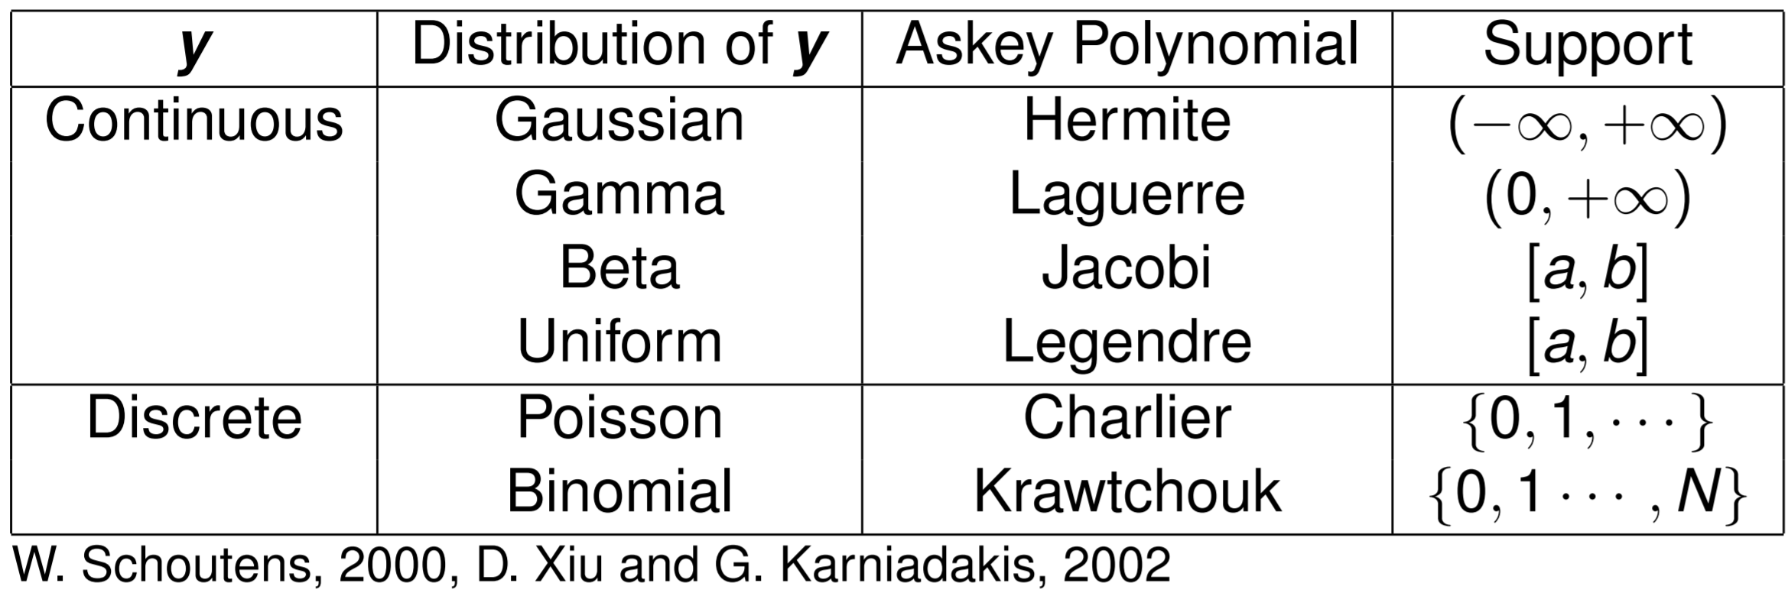
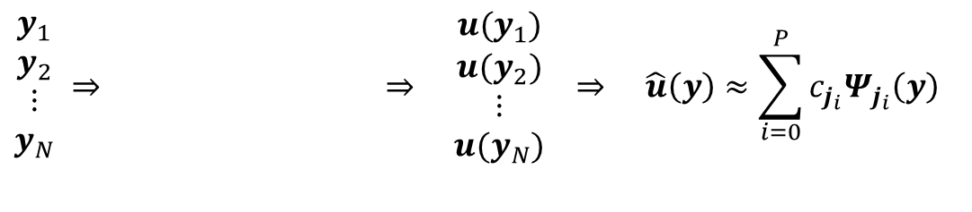
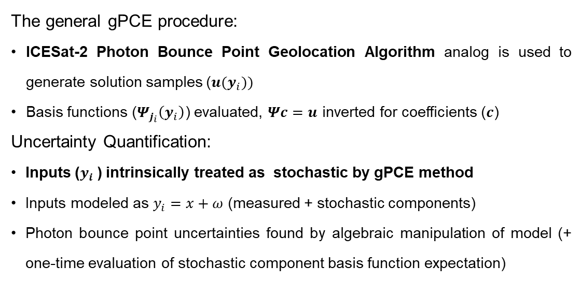
Approach
2
Approach:
gPCE (generalized Polynomial Chaos Expansion) analogous to a Fourier Series Expansion
Truncated infinite series of coefficients and orthogonal, multi-variate basis functions
  Properly represents co-variances and higher co-moments
gPCE utilizes Askey basis functions
  Properly represents Gaussian and (some) Non-Gaussian Input Variables
For smooth functions, with sufficient terms:
  Minimized mean squared error
  Guaranteed to converge
  Sparse Expansion
Complex
(Deterministic) System
$$\begin{matrix}y_{1} \\ y_{2} \\ \begin{aligned}⋮ \\ y_{N}\end{aligned}\end{matrix} ⇒ ⇒ \begin{matrix}u(y_{1}) \\ u(y_{2}) \\ \begin{aligned}⋮ \\ u(y_{N})\end{aligned}\end{matrix} ⇒ \hat{u}\left(y\right)≈\sum_{i=0}^{P}{c_{j_{i}}Ψ_{j_{i}}\left(y\right)}$$
Generate Input Samples
Generate Solution
Samples
gPCE Model
$Ψ_{j_{i}}\left(y\right)= ψ_{j_{\{i,1\}}}\left(y_{1}\right)∗ψ_{j_{\{i,2\}}}\left(y_{2}\right)∗⋯∗$ $ψ_{j_{\{i,d\}}}\left(y_{d}\right)$
The general gPCE procedure:
  ICESat-2 Photon Bounce Point Geolocation Algorithm analog is used to generate solution samples ($u(y_{i}))$
      Basis functions ($Ψ_{j_{i}}\left(y_{i}\right)$) evaluated, $Ψc=u$ inverted for coefficients ($c$)
Uncertainty Quantification:
      Inputs ($y_{i}$) intrinsically treated as stochastic by gPCE method
      Inputs modeled as $y_{i}=x+ω$ (measured + stochastic components)
      Photon bounce point uncertainties found by algebraic manipulation of model (+ one-time evaluation of stochastic component basis function expectation)
The 30th International Laser Radar Conference (ILRC) virtual conference, June 26th – July 1st, 2022.
Notes:
This research is motivated by the fact that
Most (if not all) lidars are very sensitive to position and pointing errors,
Leading to projection errors on target.
While the fidelity of location and pointing solutions can be very high,
Determination of uncertainty remains limited
The goal of this research is to develop gPCE for Lidar Uncertainty Quantification as an alternative
To Total Propagated Uncertainty and Monte Carlo Methods.
gPCE or generalized Polynomial Chaos Expansion is analogous to the well known Fourier Series Expansion.
It consists of an infinite series of coefficients and orthogonal, multi-variate basis functions
Allowing it to represent co-variances and higher order moments
gPCE also utilizes Askey basis functions, allowing both Gaussian and select Non-Gaussian Input Variables to be properly represented

Slide 4
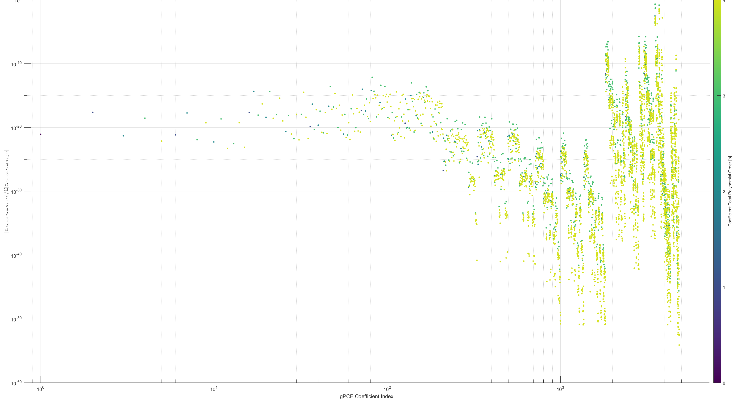
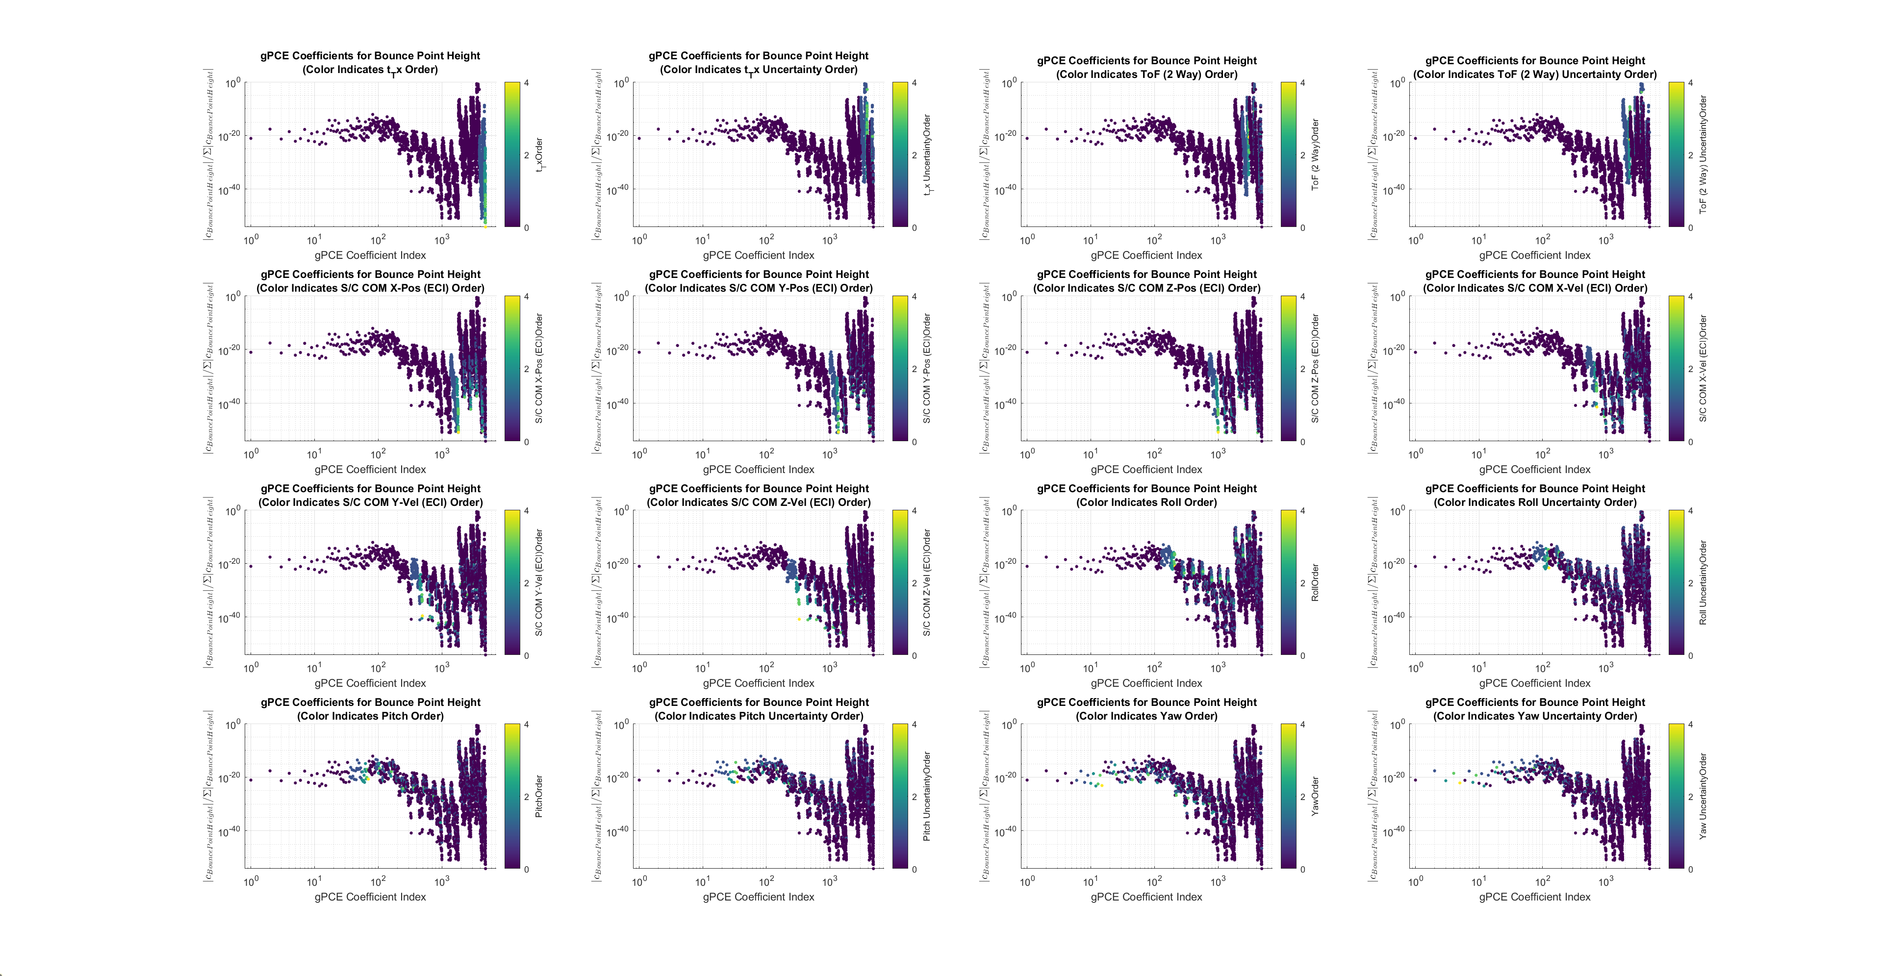

Bare Earth Results: ICESat-2 Geolocation Algorithm (Analog)
3
gPCE Model Constructed from an analog of the ICESat-2 (Bare Earth) Photon Bounce Point Geolocation Algorithm
Variables used correspond to real ICESat-2 ATL02, ATL03 data ranges spanning the Region 2 granule
NOTE: Same
Data Shown
(Color Significance Changed)
gPCE Coefficients for Bounce Point Height
Potential Coefficient Significance Cut-Off Point
Increasing Significance →
gPCE found a valid expansion, with a small number of significant coefficients
Only ~40 of 4850 terms have significance >1ppm
(Color indicates coefficient polynomial order)
gPCE enables high fidelity assessment of input-output variable relationships
Color indicates polynomial order of coefficients in a particular variable
Ordinate of figures represents the relative strength ${(\left|c_{i}\right|}/{\sum{|c_{i}|}})$ of each coefficient.
The 30th International Laser Radar Conference (ILRC) virtual conference, June 26th – July 1st, 2022.
Notes:
Some preliminary results are shown here:
First, we can see, by graphing the relative significance of coefficients
That gPCE found a valid expansion, there is a high dynamic range of coefficients,
With a small number of significant coefficients.
gPCE has also proven useful in assessing input-output variable relationships,
Shown here are the relative significance of coefficients involving ICESat-2 Spacecraft position and pointing angles, on the height of the photon bounce point.
Note the unexpectedly high significance of yaw angle terms for a near nadir pointing spacecraft.
Finally, gPCE captures nonlinear and covariate behaviors of input variables on output variables, which other methods, such as TPU often ignore

Slide 5
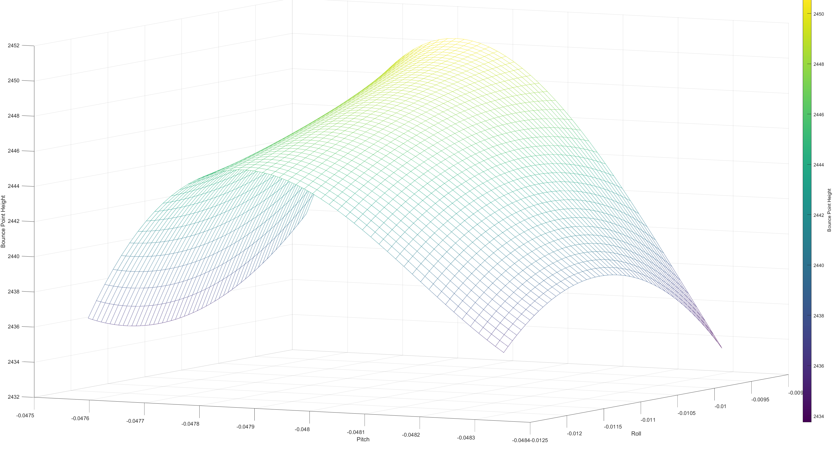
Bare Earth Results: ICESat-2 Geolocation Algorithm (Analog)
4
LiDAR Photon Bounce Point Height,
w.r.t. Pitch, Roll Pointing Angle
Graphical Decomposition
Pitch-Height
Non-linearity Effect
Photon Bounce Height
Uncertainty @ A
Potential Height Uncertainty
Under-/Over-estimation
Roll-Pitch Covariance Effect
Photon Bounce Height
Uncertainty @ B
B
Pitch Angle Changed,
Roll Stays Constant
2 Unit Pitch Uncertainty
Photon Bounce Height
Uncertainty @ A
A
5 Unit Roll Uncertainty
gPCE captures nonlinear behaviors, co-variances that TPU ignores
Graph corresponds to a specific ICESat-2 photon bounce point, west of Boulder, CO, at ~40.0N, 105.4W.
(Pitch, Roll ranges are kept broad for illustrative purposes)
The 30th International Laser Radar Conference (ILRC) virtual conference, June 26th – July 1st, 2022.
Notes:
Some preliminary results are shown here:
First, we can see, by graphing the relative significance of coefficients
That gPCE found a valid expansion, there is a high dynamic range of coefficients,
With a small number of significant coefficients.
gPCE has also proven useful in assessing input-output variable relationships,
Shown here are the relative significance of coefficients involving ICESat-2 Spacecraft position and pointing angles, on the height of the photon bounce point.
Note the unexpectedly high significance of yaw angle terms for a near nadir pointing spacecraft.
Finally, gPCE captures nonlinear and covariate behaviors of input variables on output variables, which other methods, such as TPU often ignore

Slide 6
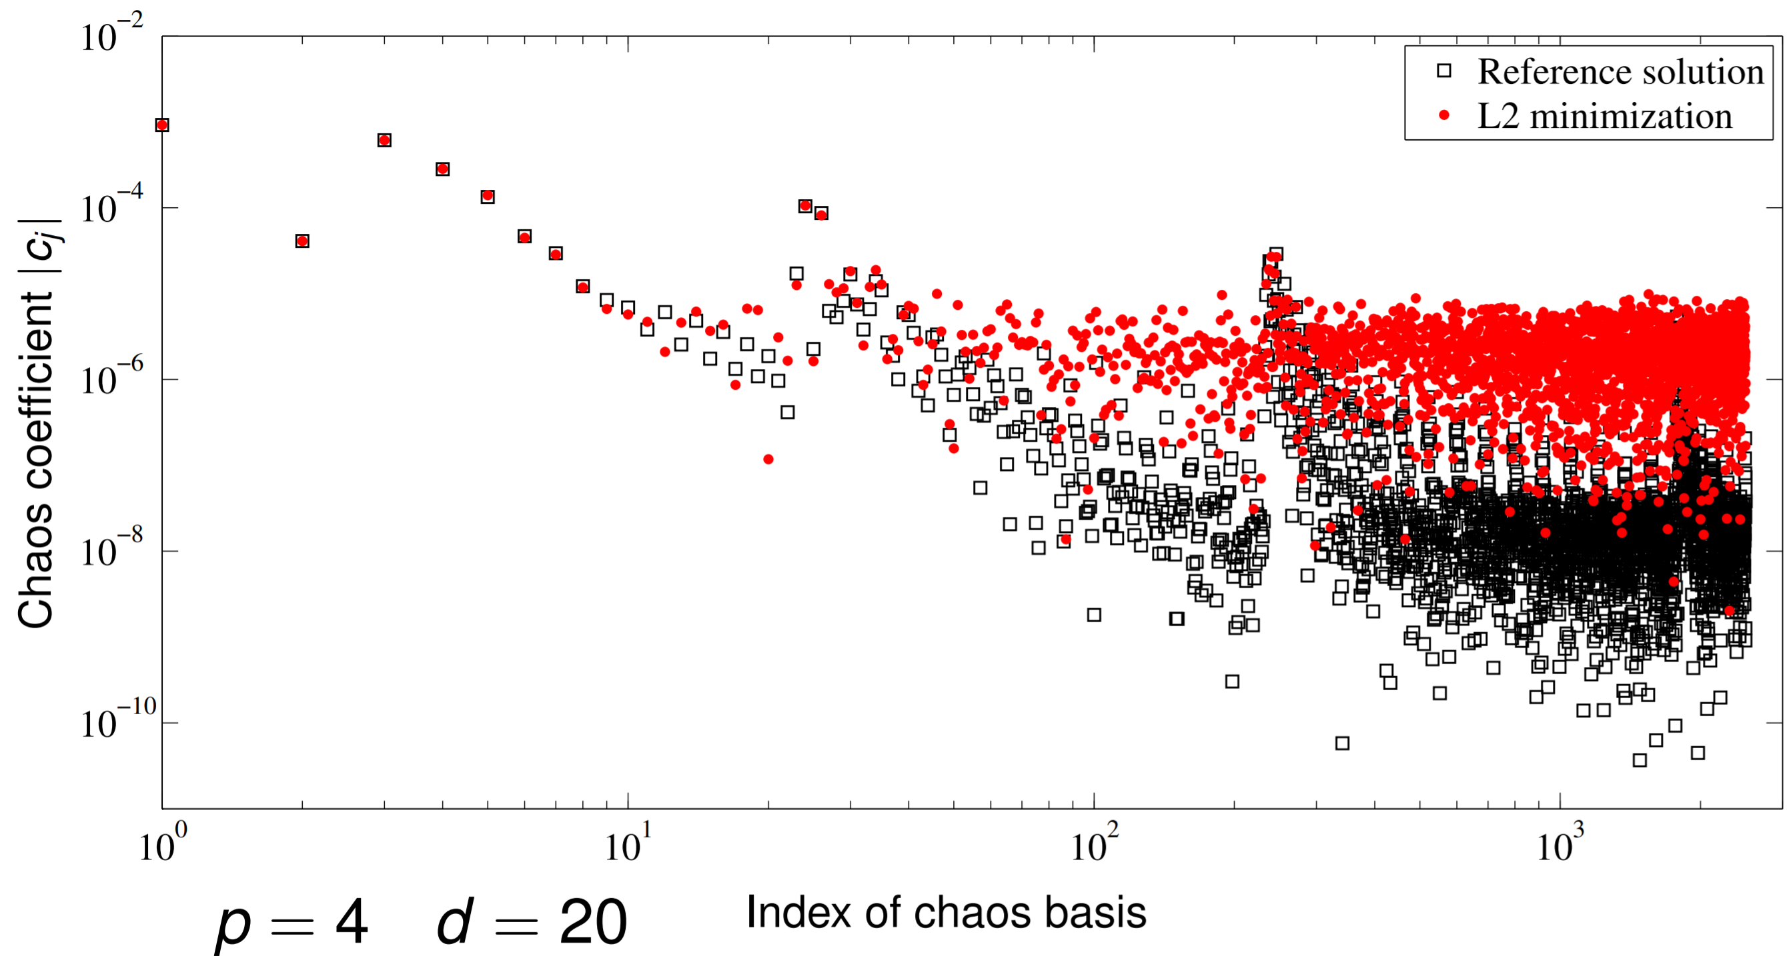
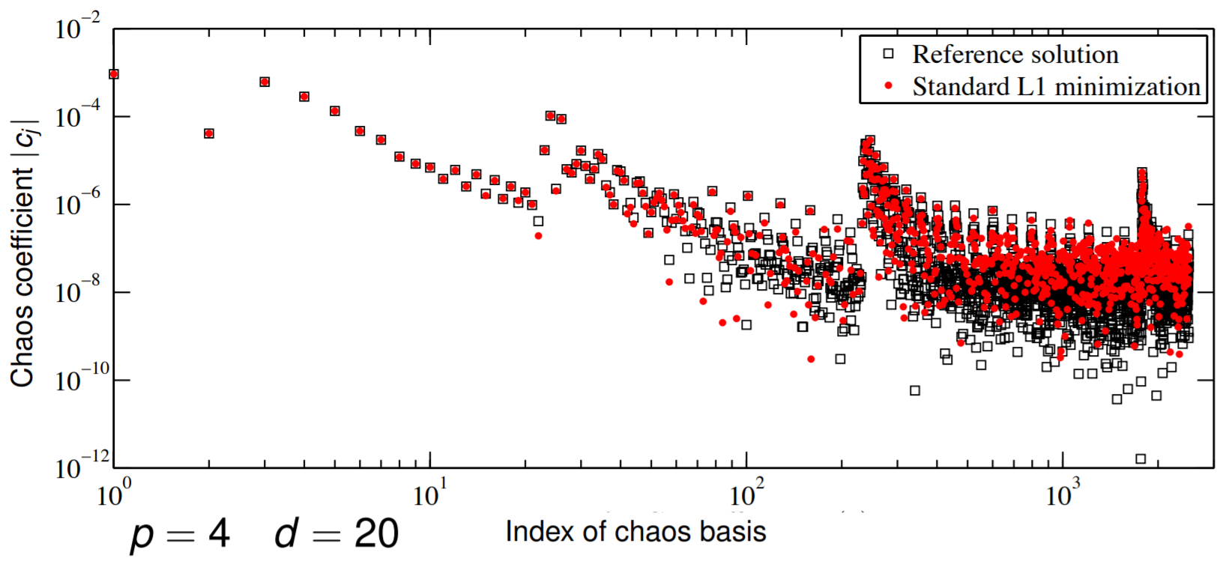
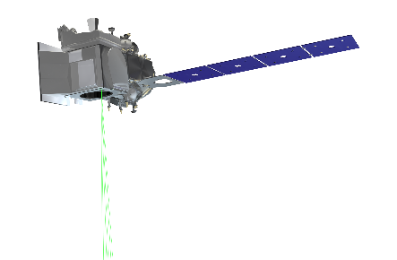
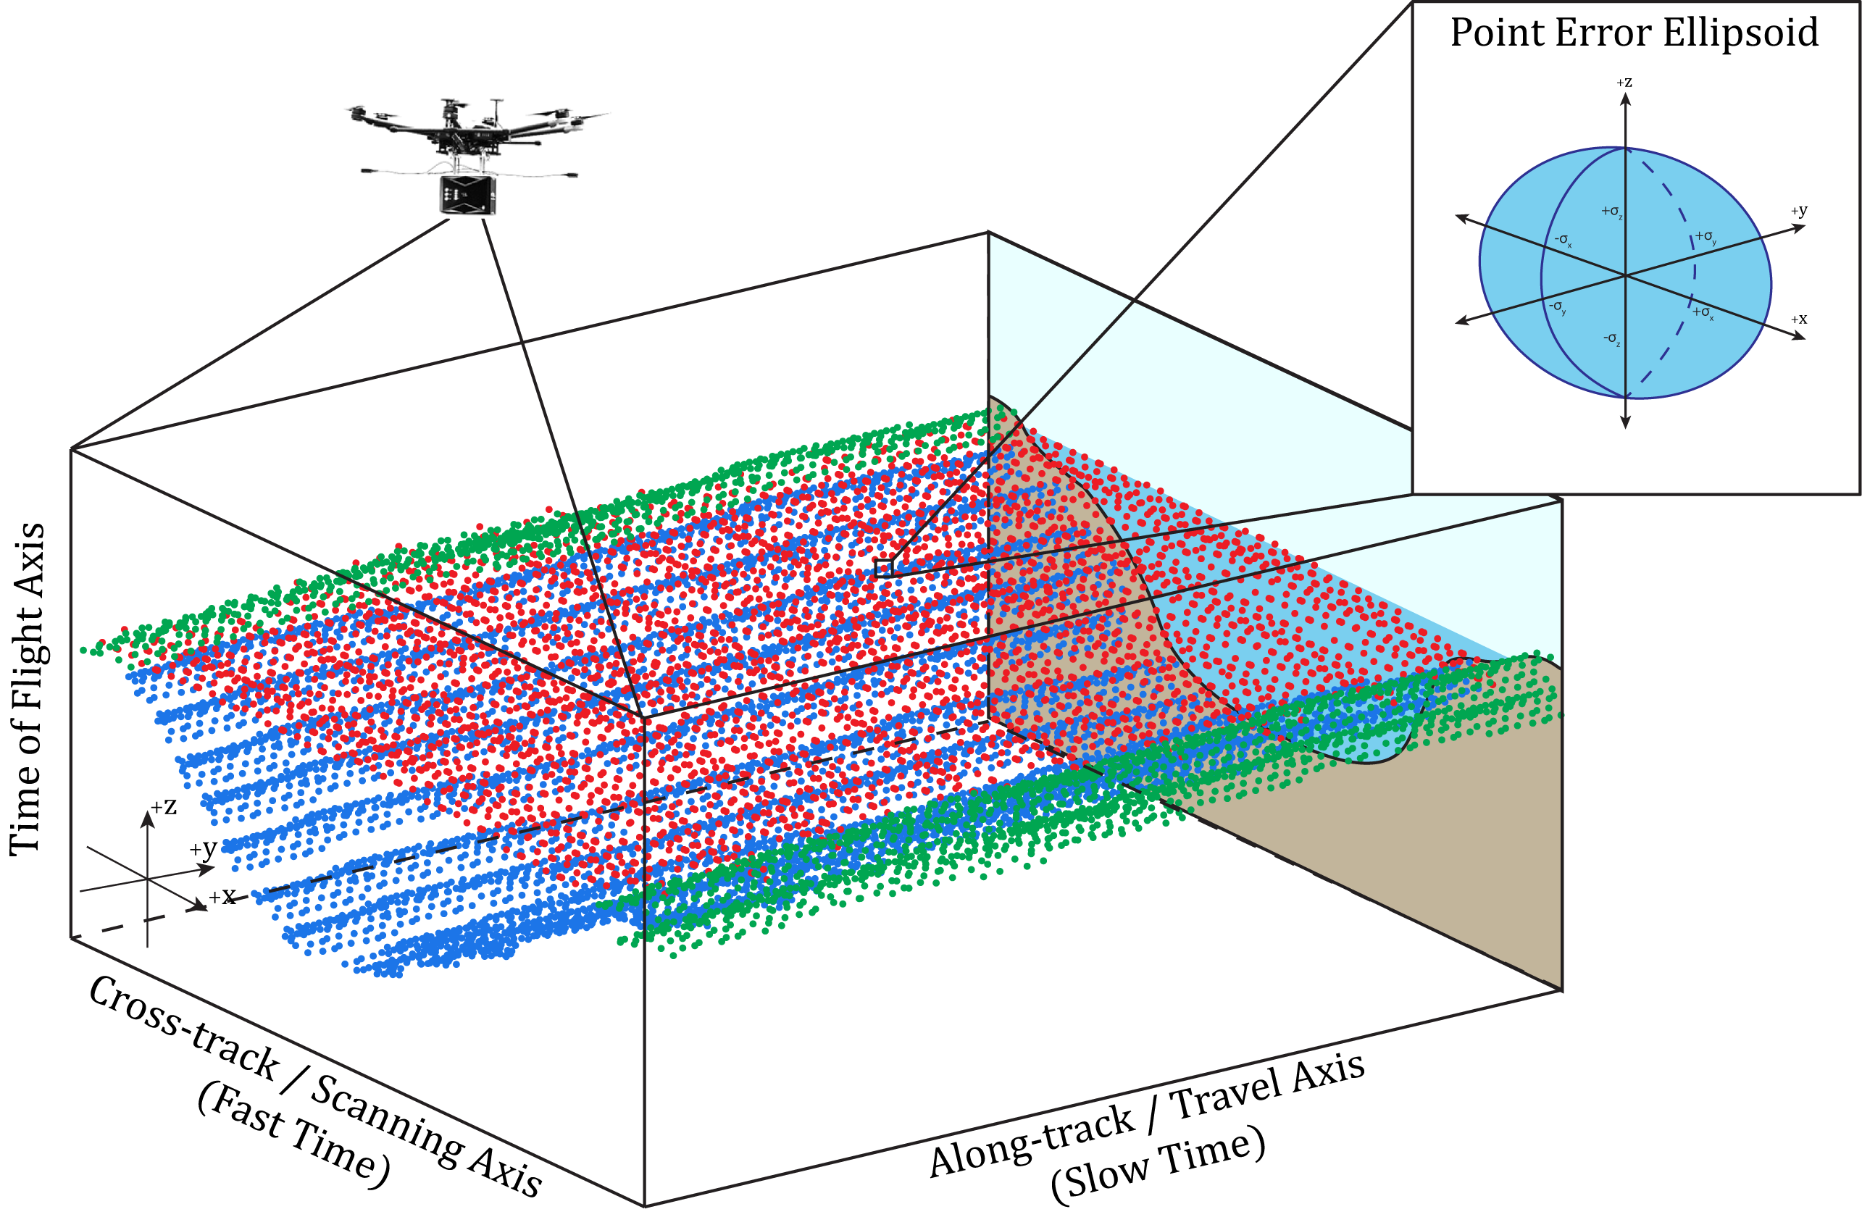
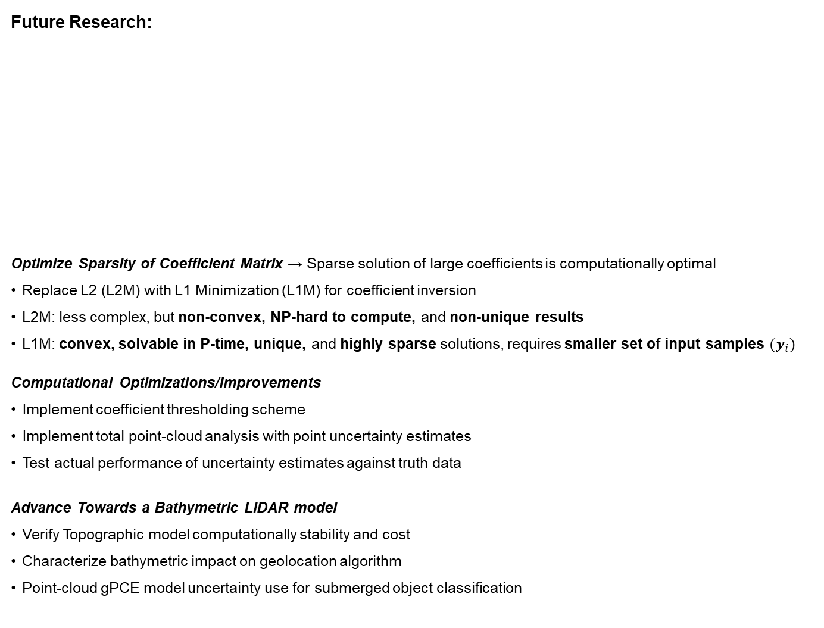
Future Research, Acknowledgements, References
5
Future Research:
Optimize Sparsity of Coefficient Matrix → Sparse solution of large coefficients is computationally optimal
Replace L2 (L2M) with L1 Minimization (L1M) for coefficient inversion
L2M: less complex, but non-convex, NP-hard to compute, and non-unique results
L1M: convex, solvable in P-time, unique, and highly sparse solutions, requires smaller set of input samples ${(y}_{i})$
Computational Optimizations/Improvements
  Implement coefficient thresholding scheme
  Implement total point-cloud analysis with point uncertainty estimates
  Test actual performance of uncertainty estimates against truth data
Advance Towards a Bathymetric LiDAR model
Verify Topographic model computationally stability and cost
Characterize bathymetric impact on geolocation algorithm
Point-cloud gPCE model uncertainty use for submerged object classification
L2 Minimization
L1 Minimization
Acknowledgements: The Authors would like to thank Professor Alireza Doostan, for his assistance in applying the gPCE Method to Air- and Spaceborne Topo-Bathymetric LiDAR Measurements, and the NASA FINESST Program for funding support.
Funding : NASA FINESST Awards #80NSSC19K1351 and #80NSSC21K1597.
References:
[1] S. B. Luthcke, T. C. Thomas, T. A. Pennington, T. W. Rebold, J. B. Nicholas, D. D. Rowlands, A. S. Gardner, and S. Bae, “ICESat-2 Pointing Calibration and Geolocation Performance,” Earth and Space Science, vol. 8, no. 3, pp. 1–11, 2021.
[2] F. Eren, J. Jung, C. E. Parrish, N. Sarkozi-Forfinski, and B. R. Calder, “Total vertical uncertainty (TVU) modeling for topo-bathymetric LIDAR systems,” Photogrammetric Engineering and Remote Sensing, vol. 85, no. 8, pp. 585–596, 2019.
[3] T. R. Scott B. Luthcke, Teresa Pennington and T. Thomas, “ICESat-2 ATL03g: ATBD for ATL03g ICESat-2 Receive Photon Geolocation,” tech. rep., 2019.
[4] S. Bae, L. Magruder, N. Smith, and B. Schutz, “ICESat-2 ATBD for Precision Pointing Determination,” tech. rep.
[5] A. J. Martino, M. R. Bock, T. A. Neumann, D. W. H. Iii, R. L. J. Iii, P. W. Dabney, and C. E. Webb, “ICESat-2 ATL02: Level 1B Data Product Processing,” tech. rep., 2020.
[6] T. Neumann, A. C. Brenner, D. W. Hancock, J. Robbins, J. Saba, K. Harbeck, and A. Gibbons, “ICESat-2 ATL03: ATBD for Global Geolocated Photons,” tech. rep., 2019.
[7] S. Bae, B. Helgeson, M. James, L. Magruder, J. Sipps, S. Luthcke, and T. Thomas, “Performance of ICESat-2 Precision Pointing Determination,” Earth and Space Science, vol. 8, no. 4, pp. 1–8, 2021.
[8] NATIONAL GEOSPATIAL-INTELLIGENCE AGENCY, “World Geodetic System 1984 (WGS84),” tech. rep., 2014.
[9] L. Petrov, “ICESat-2 ATL03a: ATBD for Atmospheric Delay Correction to Laser Altimetry Ranges,” tech. rep., 2014.
[10] V. Coppola, J. H. Seago, and D. A. Vallado, “The IAU 2000A and IAU 2006 precession-nutation theories and their implementation,” Advances in the Astronautical Sciences, vol. 134, no. January, pp. 919–938, 2009.
[11] S. B. Luthcke, N. P. Zelensky, D. D. Rowlands, F. G. Lemoine, and T. A. Williams, “The 1-centimeter orbit: Jason-1 precision orbit determination using GPS, SLR, DORIS, and altimeter data,” Marine Geodesy, vol. 26, no. 3-4, pp. 399–421, 2003.
[12] S. B. Luthcke, T. Pennington, B. D. Loomis, T. Rebold, T. C. Thomas, and E. N. Gsfc, “ICESat-2 ATBD for Precise Orbit Determination, Orbit Design, and Geolocation Parameter Calibration,” tech. rep., 2019.
[13] T. A. Neumann, A. Brenner, D. Hancock, J. Robbins, J. Saba, K. Harbeck, A. Gibbons, J. Lee, S. B. Luthcke, T. Rebold, and E. Al., “ICESat-2 ATL03 Known Issues,” Tech. Rep. January 2021, NASA, 2021.
L1M produced more sparse solution
Better match for reference solution
L1M solution used 1/3 input samples vs L2M
gPCE solved via L2M for reference problem
Many, approx. equal coefficients ↔ sub-optimal solution
The 30th International Laser Radar Conference (ILRC) virtual conference, June 26th – July 1st, 2022.

