Slide 1








COmpact RamaN lidar for Atmospheric CO2 and ThERmodyNamic ProfilING - CONCERNING
ESA AO/1-9544/20/I/NS
P. Di Girolamo¹, D. Dionisi², M. Cacciani³, A. Di Bernardino³, N. Franco¹, D. Summa⁴, M. Di Paolantonio^{1,2}, A. M. Iannarelli⁵, G. L. Liberti², T. Di Iorio⁶
¹ Scuola di Ingegneria, Università della Basilicata, Potenza, Italia,
² ISMAR-CNR, Roma, Italia
³ Dipartimento di Fisica, 'Università degli Studi di Roma “Sapienza, Roma, Italia
⁴ IMAA-CNR, Tito Scalo (Potenza), Italia
⁵ SERCO-ESA/ESRIN, Frascati, Italia
⁶ ENEA Centro Ricerche Casaccia, Italia
[5].[Greenhouse gases, tracers, and transport in the free troposphere and above]
[27-Jun], [14:15]
[Monday_ 05_P03]
The 30th International Laser Radar Conference (ILRC) virtual conference, June 26th – July 1st, 2022.

Slide 2
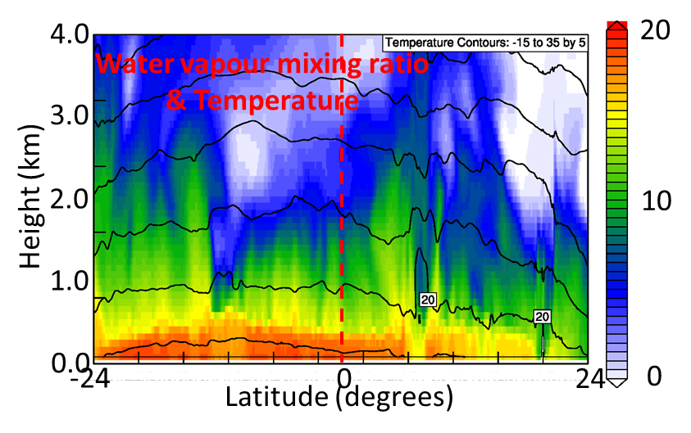
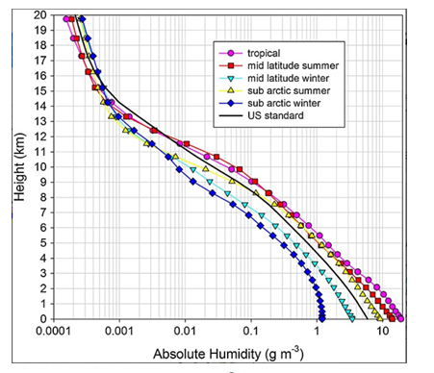
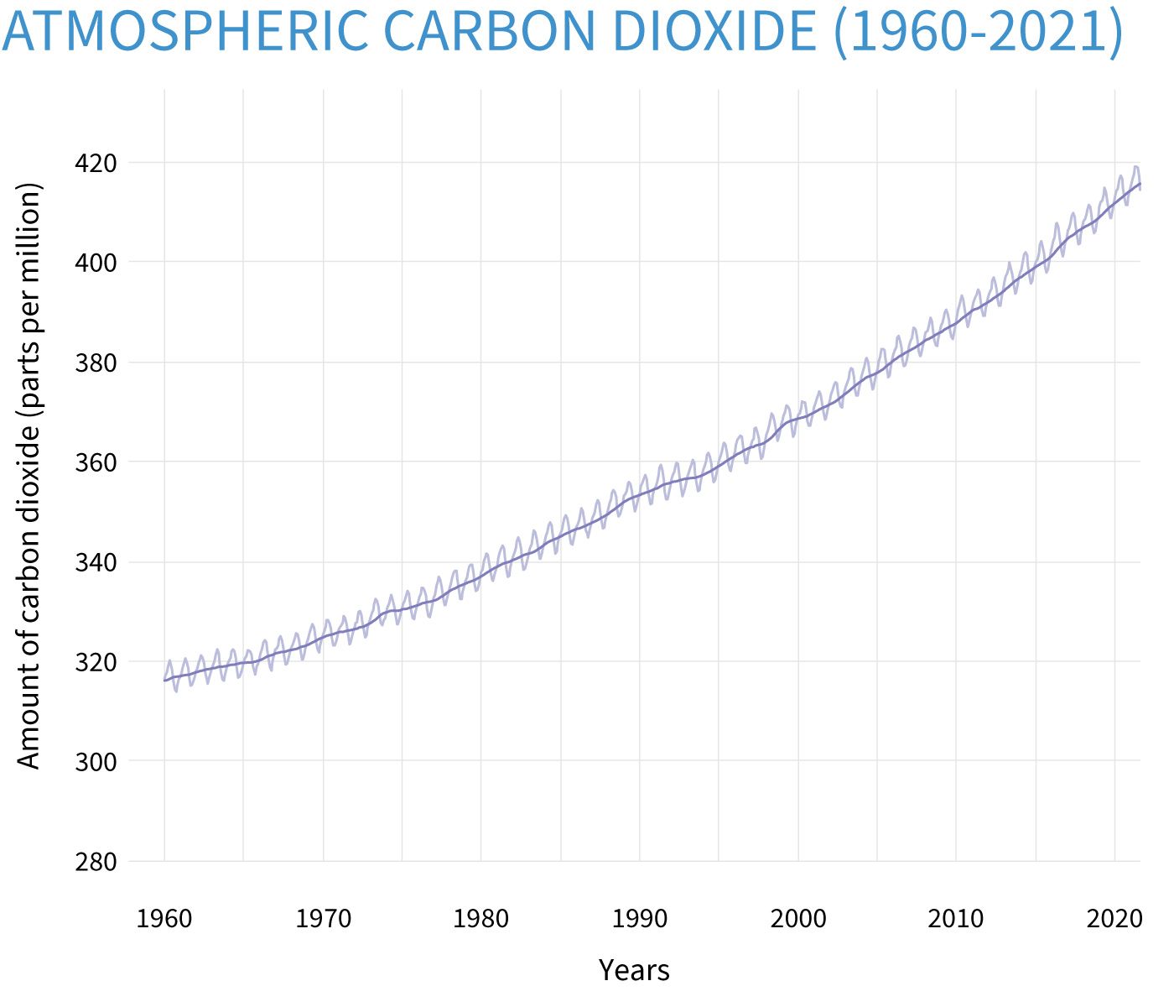
CONCERNING: context and objective
1
Motivation
Atmospheric CO₂ content has increased from values ​​close to 300 ppm in the 1950s to the current 415-420 ppm (i.e. annual increase rate of 2 ppm). Our understanding of the carbon cycles shows critical gaps on all temporal and spatial scales. Adequate quantitative assessment of the various components of the carbon cycle requires accurate measurements of the sink and source mechanisms and an accurate estimate of the Gross Primary Production.
Earth's hydrological and energy cycle shows important gaps on all spatial and temporal scales: unavailability of high vertical and temporal resolution of the atmospheric humidity and temperature profiles, especially in the lower troposphere.
Noaa.Climate.gov
The 30th International Laser Radar Conference (ILRC) virtual conference, June 26th – July 1st, 2022.

Slide 3
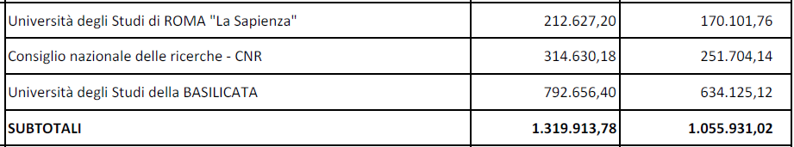
CONCERNING: context and objective
1
The CONCERNING (COmpact RamaN lidar for Atmospheric CO2 and ThERmodyNamic ProfilING) research project has been funded by the Ministry of University and Scientific Research under the "Fondo Integrativo
Context
Speciale per la Ricerca (FISR) 2019" call dedicated to "specific interventions of particular strategic importance, indicated in the National Research Program (NRP)."
Objective
Design and develop an innovative UV Raman lidar system for measuring the vertical profiles of:
atmospheric temperature
water vapour mixing ratio
CO₂ mixing ratio
particle backscatter coefficient at 354.7, 532 and 1064 nm
extinction coefficient at 354.7, 532 nm
depolarization ratio at 354.7, 532 and 1064 nm.
fluorescence from atmospheric particles
Consortium
The 30th International Laser Radar Conference (ILRC) virtual conference, June 26th – July 1st, 2022.

Slide 4
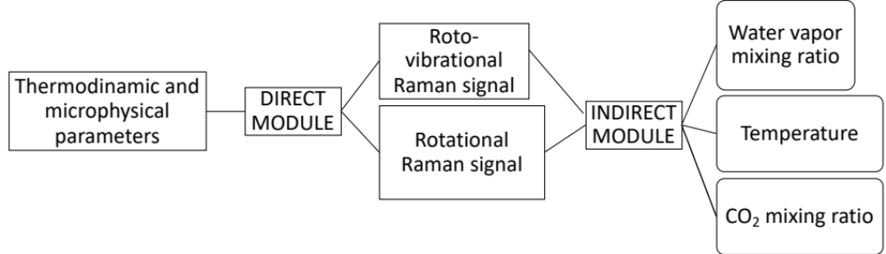
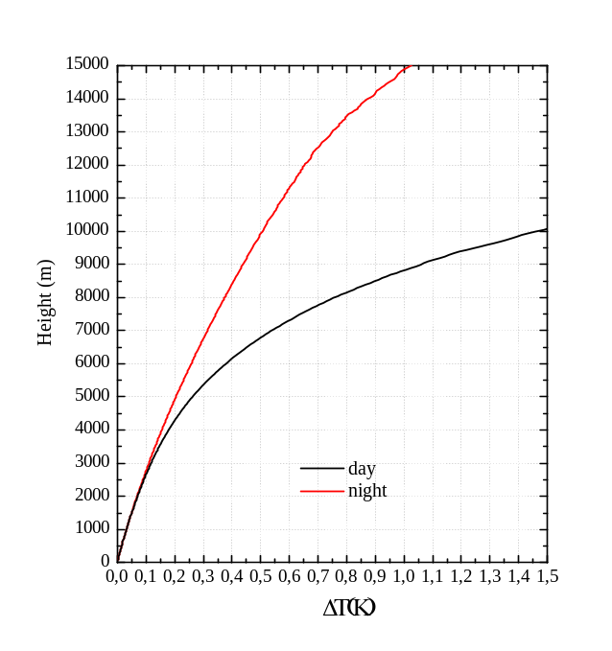
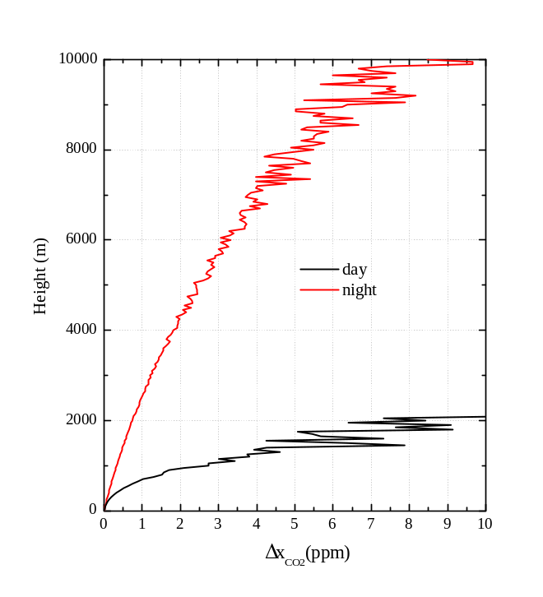
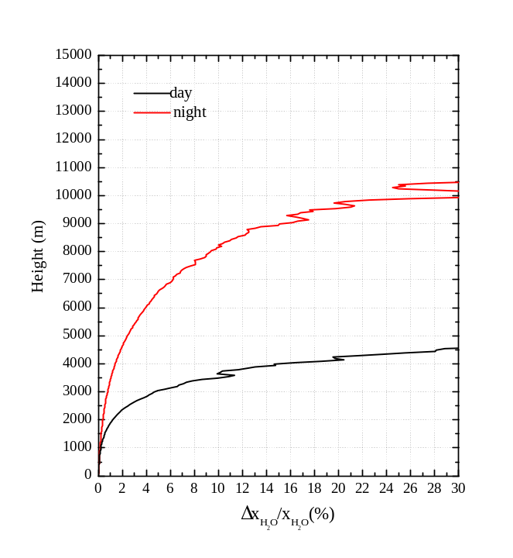
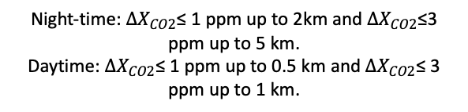
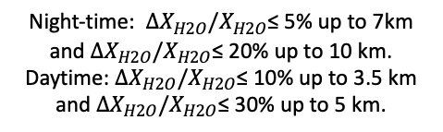
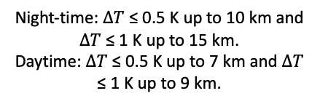
CONCERNING: preliminary results
2
Performance simulations
An end-to-end lidar simulator applied in the verification of the "instrumental concept" of the lidar system and in the definition of the technical specifications of the system components
Mid-latitude summer atmosphere model.
Temporal and vertical resolution of 1 min and 50 m
Temporal and vertical resolution of 3 hours and 50 m
Temporal and vertical resolution of 1 min and 50 m
Night-time: $∆T$ ≤ 0.5 K up to 10 km and $∆T$ ≤ 1 K up to 15 km.
Daytime: $∆T$ ≤ 0.5 K up to 7 km and $∆T$ ≤ 1 K up to 9 km.
Night-time: $∆X_{CO2}$≤ 1 ppm up to 2km and $∆X_{CO2}$≤3 ppm up to 5 km.
Daytime: $∆X_{CO2}$≤ 1 ppm up to 0.5 km and $∆X_{CO2}$≤ 3 ppm up to 1 km.
Night-time: $∆X_{H2O}/X_{H2O}$≤ 5% up to 7km and $∆X_{H2O}/X_{H2O}$≤ 20% up to 10 km.
Daytime: $∆X_{H2O}/X_{H2O}$≤ 10% up to 3.5 km and $∆X_{H2O}/X_{H2O}$≤ 30% up to 5 km.
The 30th International Laser Radar Conference (ILRC) virtual conference, June 26th – July 1st, 2022.

Slide 5
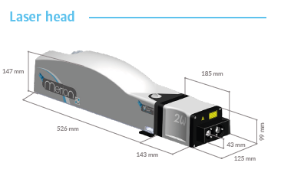
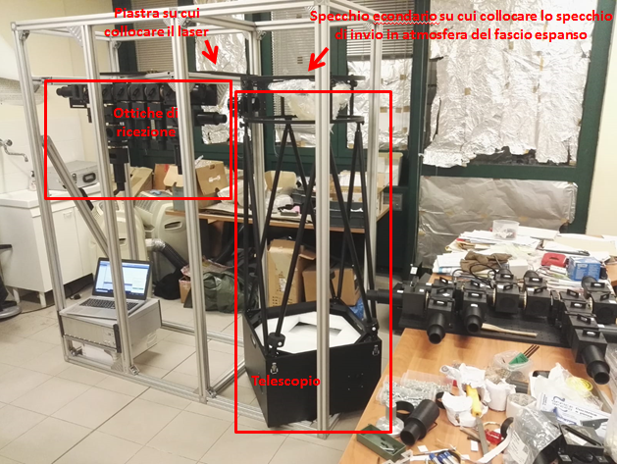
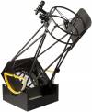
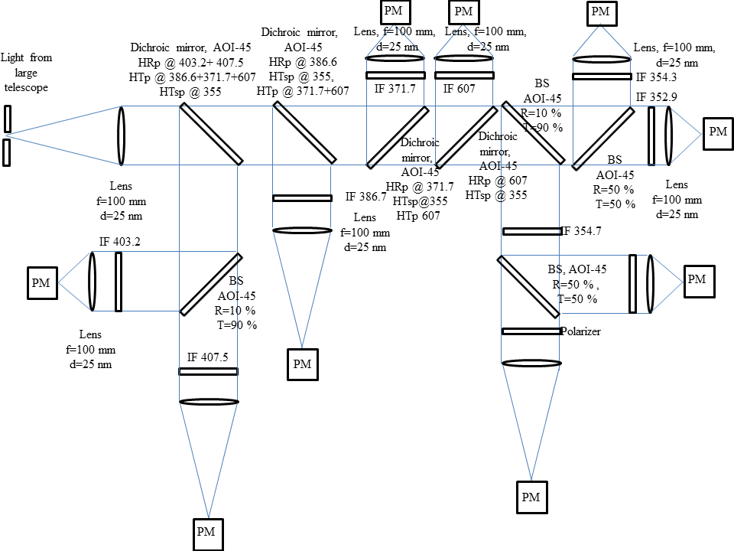
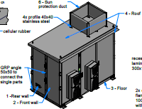
CONCERNING: preliminary results
2
Transmitter:
Energy at 355 nm: 110 mJ
Frequency: 100 Hz
Receiver:
Telescope: Dobsonian configuration (primary mirror with a diameter of 500 mm, focal length of 1800 mm).
System characteristics
The system is presently under development
Interferential filters:
H₂O vibrational Raman: CWL 407.5 nm, FWHM 0.3 nm, peak transmission 83%
N₂ vibrational Raman : CWL 386.7 nm, FWHM 0.3 nm, peak transmission 83%
CO₂ vibrational Raman : CWL 371.71 nm, FWHM 0.15 nm, peak transmission 60%
Rayleigh: CWL 354.7 nm, FWHM 0.5 nm, peak transmission 80%
N₂ and O₂ rotational Raman: FWHM 0.3 nm (LoJ) and 0.5 (HiJ), peak transmission: 80%.
A scanning receiving system is planned to be implemented
Optical layout of the CONCERNING receiver
The 30th International Laser Radar Conference (ILRC) virtual conference, June 26th – July 1st, 2022.

