Slide 1

Design and Validation of an Elastic Lidar Simulator for Testing Potential New Systems for Aerosol Typing
02 – Emerging lidar techniques, methodologies and discoveries
Thursday, 12:00, 02_P35
Rebecca Howe¹, Ioannis Binnietoglou², Anna Gialitaki^{1,3}, Joshua Vande Hey¹
¹ Department of Physics and Astronomy, University of Leicester
²INOE, Romania
³Laboratory of Atmospheric Physics, Aristotle University of Thessaloniki

Slide 2
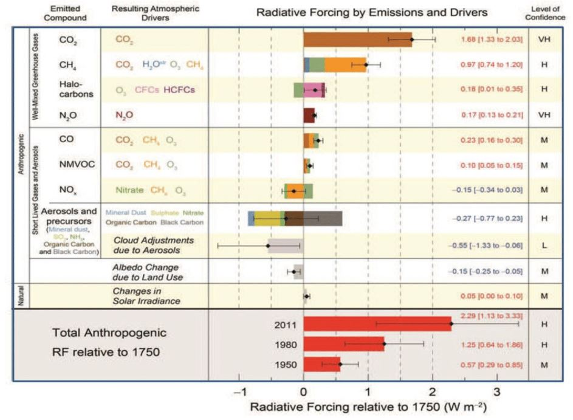






Introduction and Motivation
A lidar simulator based around the Single Scattering Lidar Equation and validated with the Klett Inversion for Backscatter
Simulations account for system components and atmospheric conditions to produce signals and Signal-to-Noise profiles from potential new systems
Effects of aerosols on health (1) and the global radiation budget (2) important but also highly uncertain
Motivation is to show how low-cost, portable lidars for city-wide aerosol measurements and typing would perform and what sort of parameters are viable to obtain useful measurements
(IPCC,2011)
Rebecca Howe, University of Leicester, rh394@le.ac.uk

Slide 3
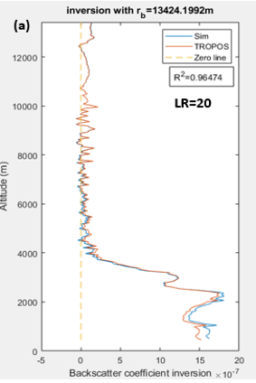
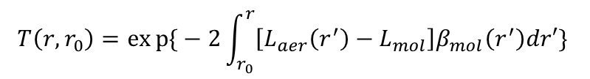
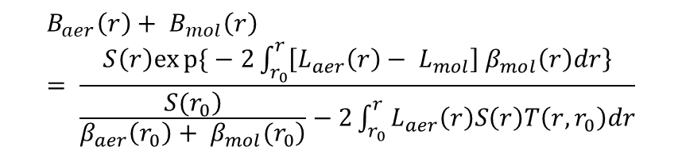
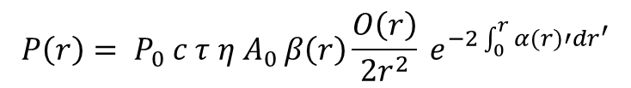
Theory and Methodology
Validation Simulator Framework
Input: Known backscatter profile
Input: Instrument parameters
Graphical Output
Input: Noise profiles
Validation
$$P\left(r\right)= P_{0} c τ η A_{0 }β\left(r\right)\frac{O\left(r\right)}{2r^{2}} e^{−2\int_{0}^{r}{α(r)′dr^{′}}}$$
Input: Lidar Ratio
Input: Molecular profiles
Input: Overlap function
Single Scattering Lidar Equation
Backscatter inversion profile
$$B_{aer}\left(r\right)+ B_{mol}\left(r\right)= \frac{S\left(r\right)exp{\{}−2\int_{r_{0}}^{r}{\left.\left[L_{aer}\left(r\right)− L_{mol}\right]{ β}_{mol}\left(r\right)dr\right\}}}{\frac{\left.S(r_{0}\right)}{\left.β_{aer}\left(r_{0}\right)+ β_{mol}(r_{0}\right)}−2\int_{r_{0}}^{r}{L_{aer}\left(r\right)S\left(r\right)T\left(r,r_{0}\right)dr}}$$
Output: Raw and Range corrected signals
Far boundary height solution
where
$$T\left(r,r_{0}\right)=exp{\{}−2\int_{r_{0}}^{r}{\left[L_{aer}\left(r^{′}\right)−L_{mol}\right]β_{mol}\left(r^{′}\right)dr′\} }$$
Output: Signal-to-Noise Ratio
Klett Inversion for Backscatter
Rebecca Howe, University of Leicester, rh394@le.ac.uk

Slide 4
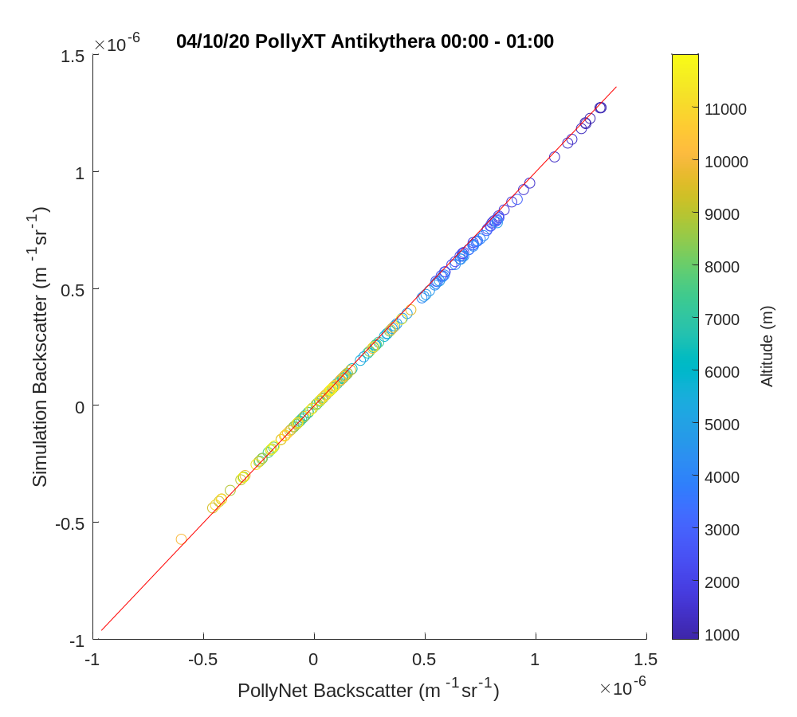
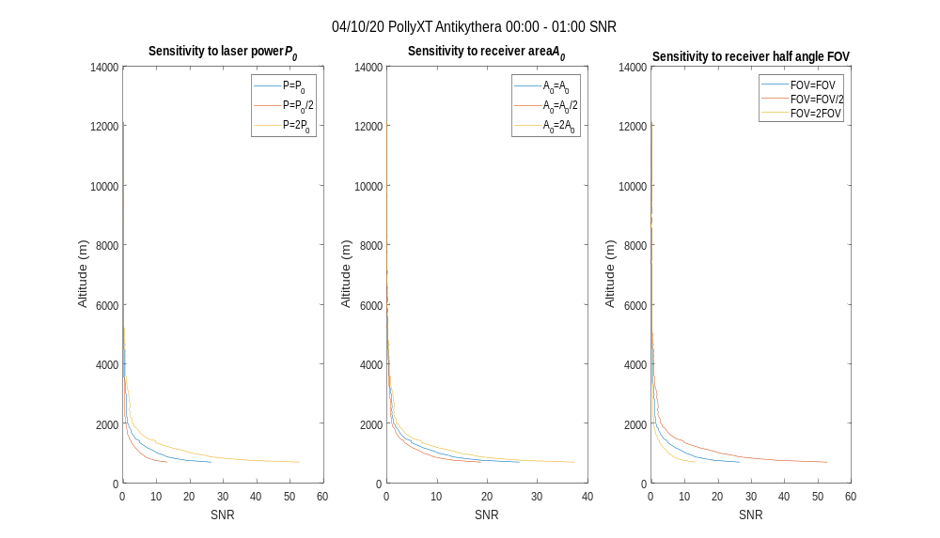
Results
Sensitivity studies of SNR dependencies on instrument parameter changes
Validation of simulator by recreating retrieved PollyNet backscatter using SSLE and Klett Inversion
Rebecca Howe, University of Leicester, rh394@le.ac.uk

Slide 5
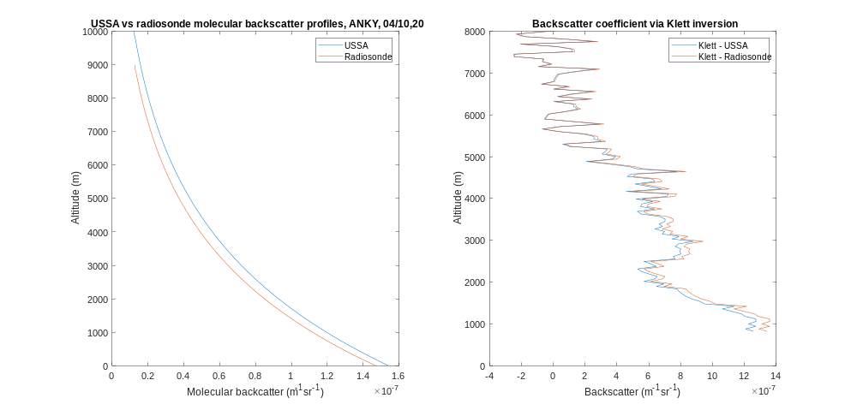
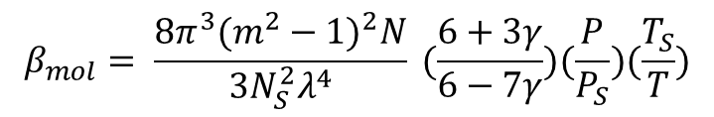
Results
Sensitivity study of how molecular backscatter profiles derived from the US Standard Atmosphere or local radiosonde measurements affect the simulator accuracy
$$β_{mol}= \frac{8π^{3}(m^{2}−1)^{2}N}{3N_{S}^{2}λ^{4}} (\frac{6+3γ}{6−7γ})(\frac{P}{P_{S}})(\frac{T_{S}}{T})$$
Rebecca Howe, University of Leicester, rh394@le.ac.uk

Slide 6
Further Work
Using volcanic eruptions with well characterised aerosol plumes to calibrate simulations
Producing SNR and signal outputs of different configurations using a range of instrument components
Complete sensitivity studies for all system parameters
Produce sets of components which would give correct outputs for a low cost lidar network
References
Bellouin et al., Bounding Global Aerosol Radiative Forcing of Climate Change. Reviews of Geophysics, 58(1)(2020).
Vos et al., Global burden of 369 diseases and injuries in 204 countries and territories, 1990–2019: a systematic analysis for the Global Burden of Disease Study 2019. The Lancet, 396(10258), pp.1204-1222(2019).
Rebecca Howe, University of Leicester, rh394@le.ac.uk

