Slide 1



30th International Laser Radar Conference
(Emerging lidar techniques, methodologies, and discoveries: 02-P22)
Multi-wavelength LED lidar for near ground atmospheric monitoring
Alifu Xiafukaiti*, Nofel Lagrosas, and Tatsuo Shiina
Graduate School of Engineering, Chiba University
(1-33 Yayoi-cho, Inage-ku, Chiba 263-8522, Japan)
*E-mail: xapkat_alip@chiba-u.jp

Slide 2
Objectives
In previous work, a single wavelength compact LED lidar system successfully observed atmosphere echoes. In this work, a multi-wavelength lidar system with LED light sources is designed and developed to continuously monitor near-surface atmosphere.
Advantages of LED lidars:
・Eye safety in urban areas
・Does not requires any heat dissipation system
・Keeps constant output in long periods of operation
・Low coast
・Compact
・Possibility of mobile measurements
The objectives of this study are twofold:
to design and develop a multiple-wavelength LED lidar.
to evaluate hard target signals and atmospheric echoes using this lidar.

Slide 3
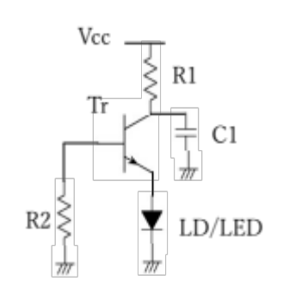
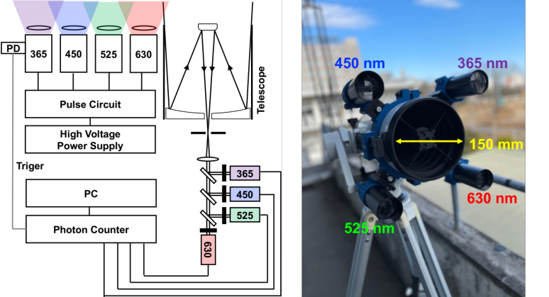
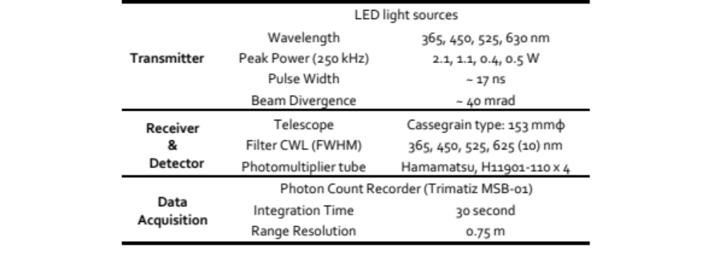
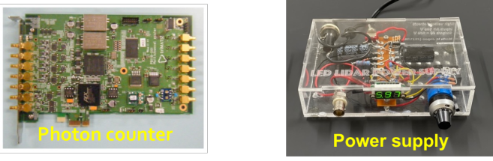
Instrument
LED Pulse Oscillation
The avalanche breakdown of the transistor is applied.
Multi-wavelength LED lidar system
LED with wavelengths of 365, 450, 525 and 630 nm are used as lidar transmitters.
Sensors are the photon-counting mode PMTs connected to a multi-channel signal recorder.
Photon Count Recorder
Pulse circuit diagram
Aluminum substrate

Slide 4
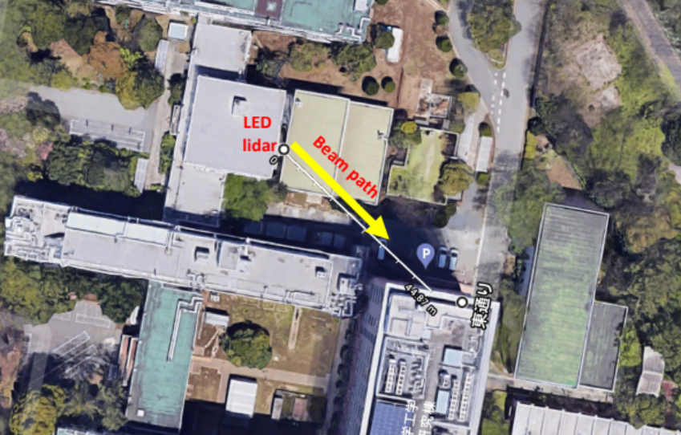
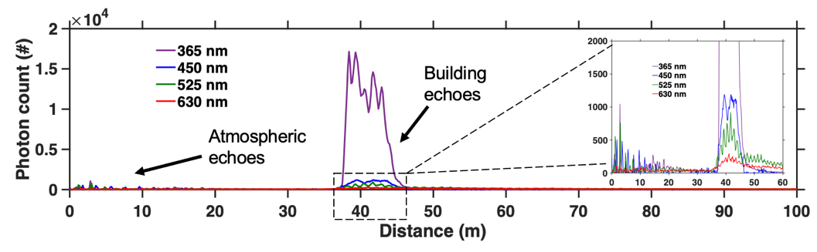
Hard target observation
A building, located 40 m from the LED lidar system, is used as a hard target in verifying the backscattered signal.
The LED light sources with wavelengths of 365, 450, 525 and 630 nm successfully detect hard target at the same range.
The order of the hard target intensities depends of the LEDs output powers.

Slide 5
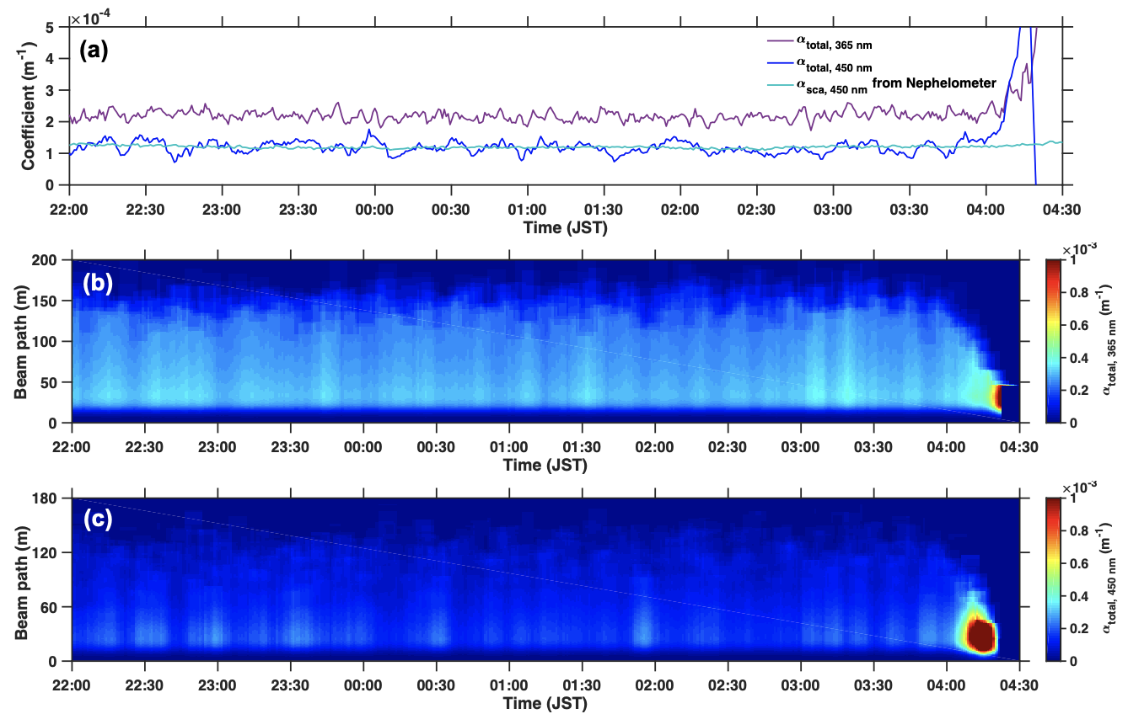
Atmospheric observation
Total (aerosols and molecules) extinction coefficients are derived from the slope and Klett methods.
The temporal variations of extinction coefficients show similar temporal trends at two wavelengths.
The extinction and scattering coefficients of the lidar and nephelometer have the same average values.
The space-time indication of extinction coefficient shows the stability of LED lidar measurement.
The measurement range gradually decreases from 04:00 due to strong backscattering signals from sun light.

Slide 6
Conclusion
The multi-wavelength LED lidar is designed and developed for near-ground atmospheric monitoring.
The LED light sources with wavelengths of 365, 450, 525 and 630 nm successfully detect hard target at the same range.
For the atmospheric measurements, extinction coefficient values from 365 and 450 nm are detected using Keltt method and are consistent with values from the nephelometer data.
In the next step of this project, we will explore the determination of the particle size distribution and Angstrom exponent of aerosols in the near-surface atmosphere with the multi-wavelength observation data.

