Slide 1

Extending the Useful Range of Florescence LIDAR Data by Applying the Layered Binning Technique
Gary W.S. Sutliff^{1,2}, Xinzhao Chu^{1,2}
¹Cooperative Institute for Research in Environmental Sciences
²Smead Aerospace Engineering Sciences, University of Colorado Boulder
12.Measurements in the stratosphere, mesosphere and thermosphere
29-June-2022, 12:00 UTC
Wednesday_ 12_P05
The 30th International Laser Radar Conference (ILRC) virtual conference, June 26th – July 1st, 2022.

Slide 2
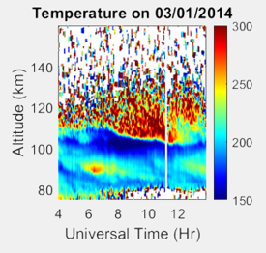
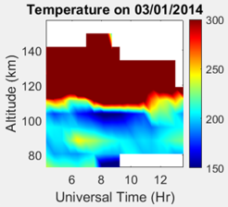
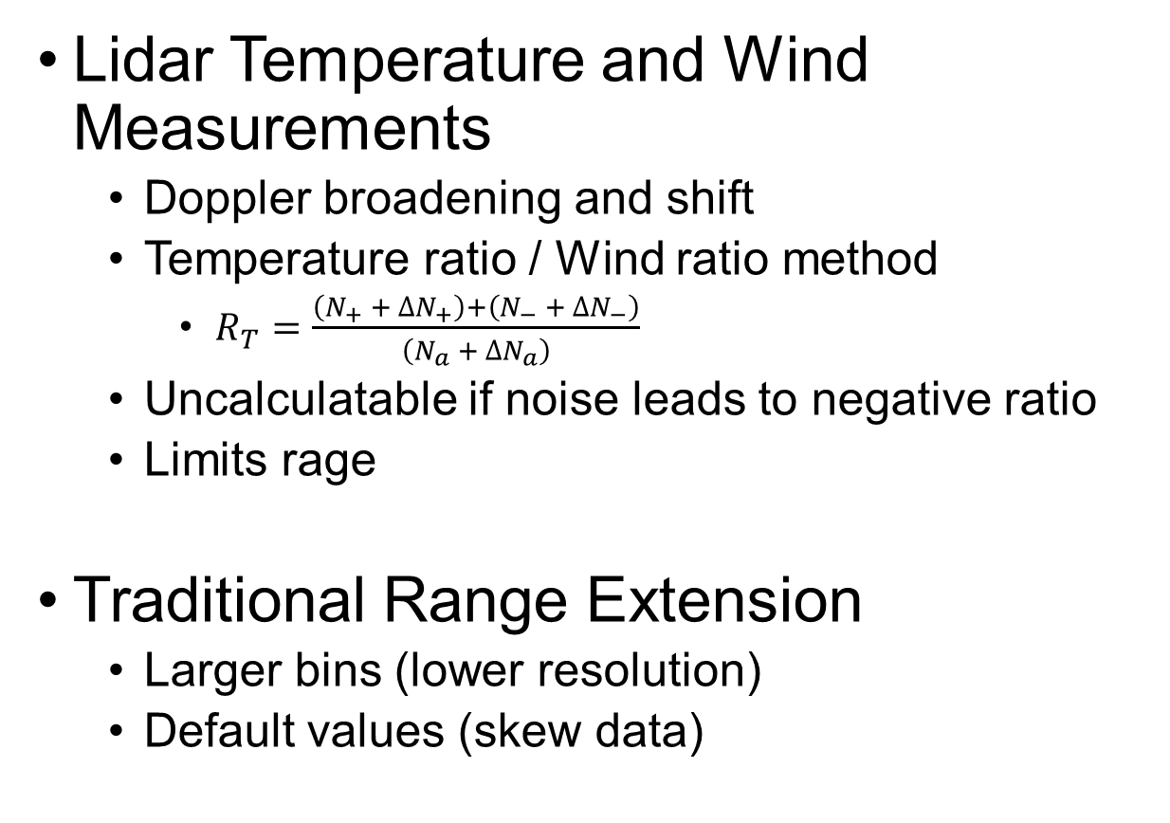
Background
Lidar Temperature and Wind Measurements
  Doppler broadening and shift
  Temperature ratio / Wind ratio method
    $R_{T}=\frac{\left(N_{+} + ∆N_{+}\right)+\left(N_{−} + ∆N_{−}\right)}{\left(N_{a} + ∆N_{a}\right)}$
  Uncalculatable if noise leads to negative ratio
  Limits rage
Traditional Range Extension
  Larger bins (lower resolution)
  Default values (skew data)

Slide 3
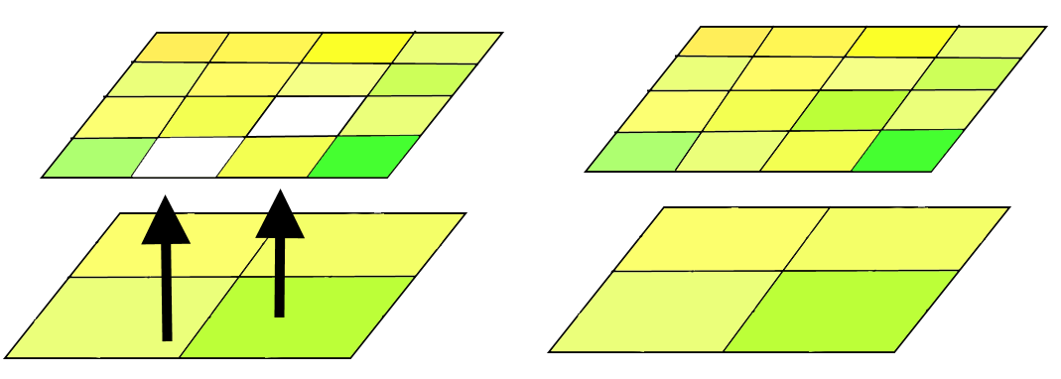
Methodology – Bin Layering
Multiple “layers” calculated
  Different resolution in both time and altitude axes
  Largest bins should lead to calculatable temperature and wind speed up to desired altitude
Bin substitution
  Largest bins (lowest resolution) calculated first
  Smaller bins (higher resolution) that can not be calculated substitute in lower resolution value at the same altitude and time step

Slide 4
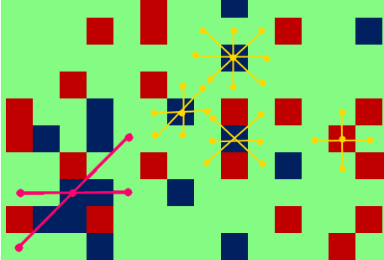
Methodology – Interpolation
Higher resolution could have some additional bins within uncalculatable bin of lower resolution
Interpolation fills small gaps
  At least one set of symmetrically opposed good data points needed
  Multiple data sets used if available

Slide 5
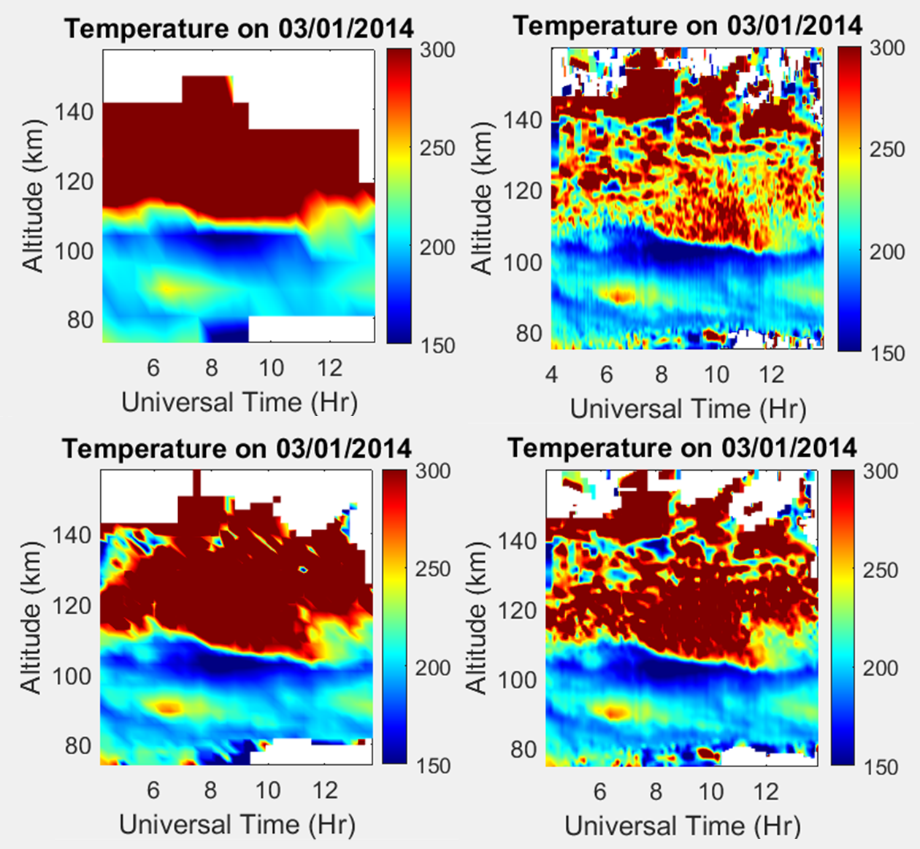
Methodology - Iteration
Multiple bin resolutions
  Adaptable to need vs processing time
Four resolutions used
  7.68 km x 32 min
  1.92 km x 16 min
  480 m x 8 min
  120 m x 4 min

Slide 6
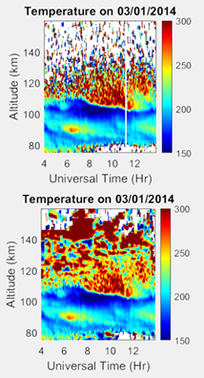
Results
Nearly 45% increase in total range
  75 km to 120 km range without layered binning
  75 km to 140+ km range using layered binning with the same maximum resolution
Resolution decreases at higher altitudes

