Slide 1

Development of low-cost high-spectral-resolution lidar using compact multimode laser for air quality measurement
Yoshitaka Jin¹, Makoto Aoki²
¹National Institute for Environmental Studies, Japan
²National Institute of Information and Communications Technology, Japan
[02].[Emerging lidar techniques, methodologies, and discoveries]
[27-Jun], [14:15]
[Presentation ID: Monday_02_P01]
The 30th International Laser Radar Conference (ILRC) virtual conference, June 26th – July 1st, 2022.
Notes:
Hello, my name is Yoshitaka Jin from NIES, Japan. I’ll make a presentation on development of low-cost high-spectral-resolution lidar using multimode laser. I talked on this topic in Romania 2017, but I’ll report some improvement.

Slide 2
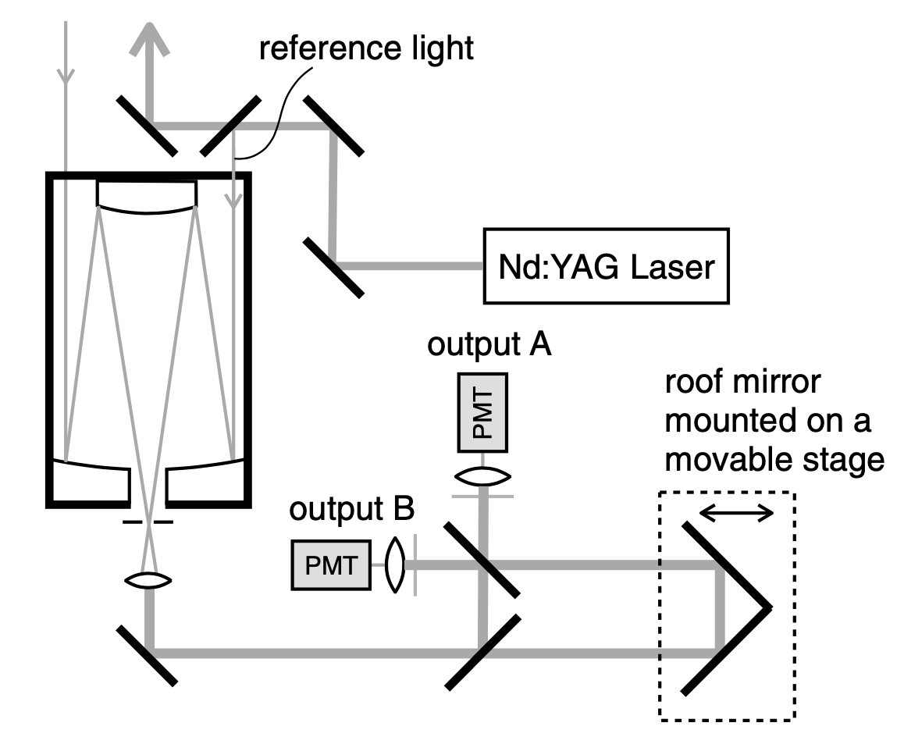
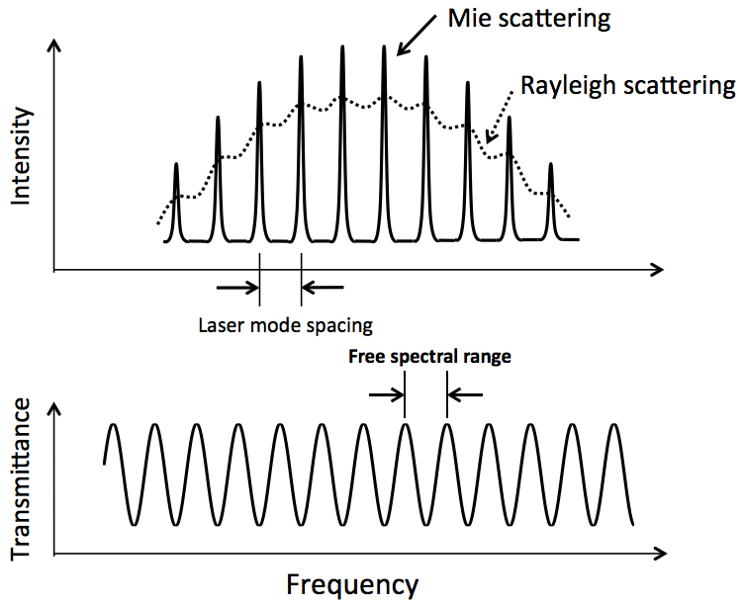
1. Introduction
1
Block diagram of multimode HSRL
Concept of HSRL using a multimode laser
An interferometer with the same mode spacing as the multimode laser is used for the HSR filter => low-cost system because single-mode laser is not used
By scanning the interferometer periodically for the range of one fringe, interference visibility is obtained at each height
The interference visibility and fringe position are calibrated with the reference signals taken from the laser => feedback controls are not required for the laser and interferometer
Jin et al. (2017)
Basic idea of measurement method
Problem of previous study (Jin et al. 2017)
Aerosol profiles were successfully measured by the multimode HSRL, but measurement efficiency and stability were poor because a long interferometer was used to have the mode spacing as the commercial laser, which had a long optical cavity length (~60 cm)
Due to the long interferometer, interference visibility for Mie scattering was very low (0.4) compared to the single-mode laser system (~0.9), resulting in poor measurement accuracy
Interferometer
spectrum
The 30th International Laser Radar Conference (ILRC) virtual conference, June 26th – July 1st, 2022.

Slide 3
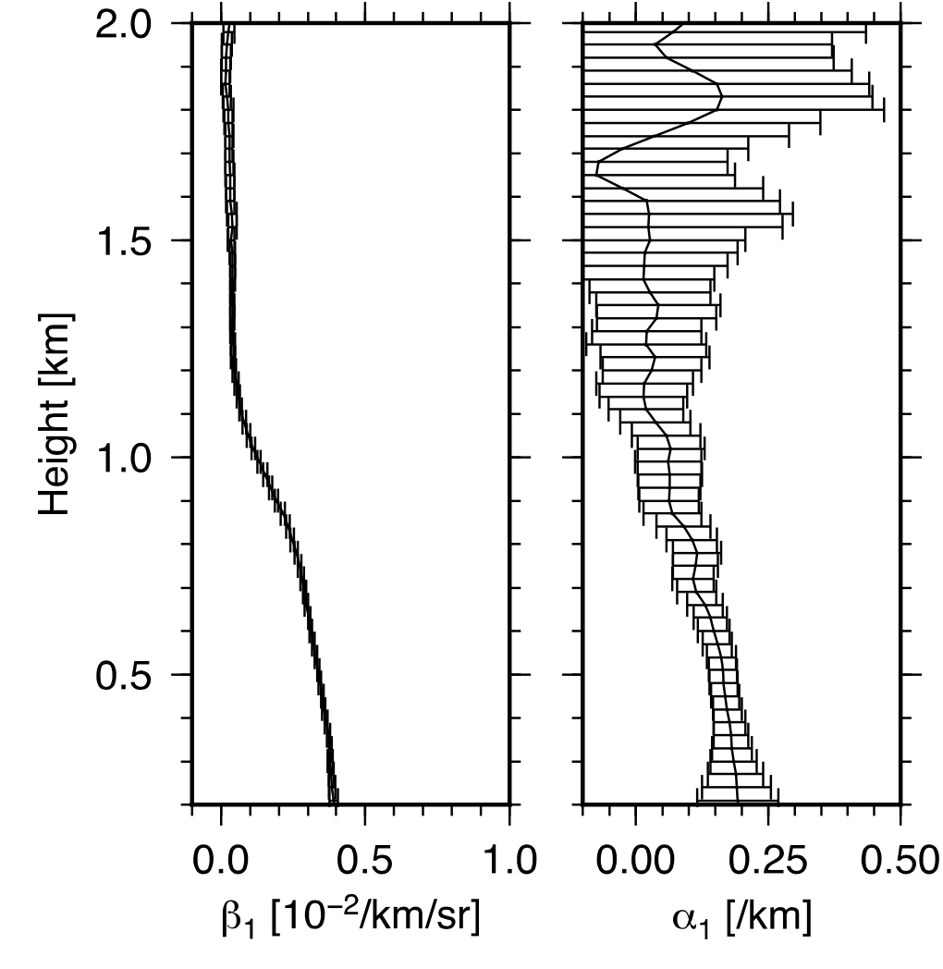
2. Purpose of this study and approach
2
Measurement of backscatter and extinction profiles with a multimode HSRL (continuous measurement was difficult due to the stability problem)
Purpose of this study
Develop a simple, durable, low-cost HSRL for long-term observation of aerosol backscatter and extinction profiles
Improve measurement efficiency and stability of the previously developed multimode HSRL system
15 min
average
Proposed method
Design multimode laser having the same mode spacing as the interferometer FSR optimized for HSRL
Laser cavity length is adjusted to the interferometer length, which is the opposite approach to the previous study
Have a shorter cavity length compared to commercial lasers, but keep narrow spectral width => to achieve the suitable laser spectrum, we employ master oscillator power amplifier (MOPA) system
Jin et al. (2017)
The 30th International Laser Radar Conference (ILRC) virtual conference, June 26th – July 1st, 2022.

Slide 4
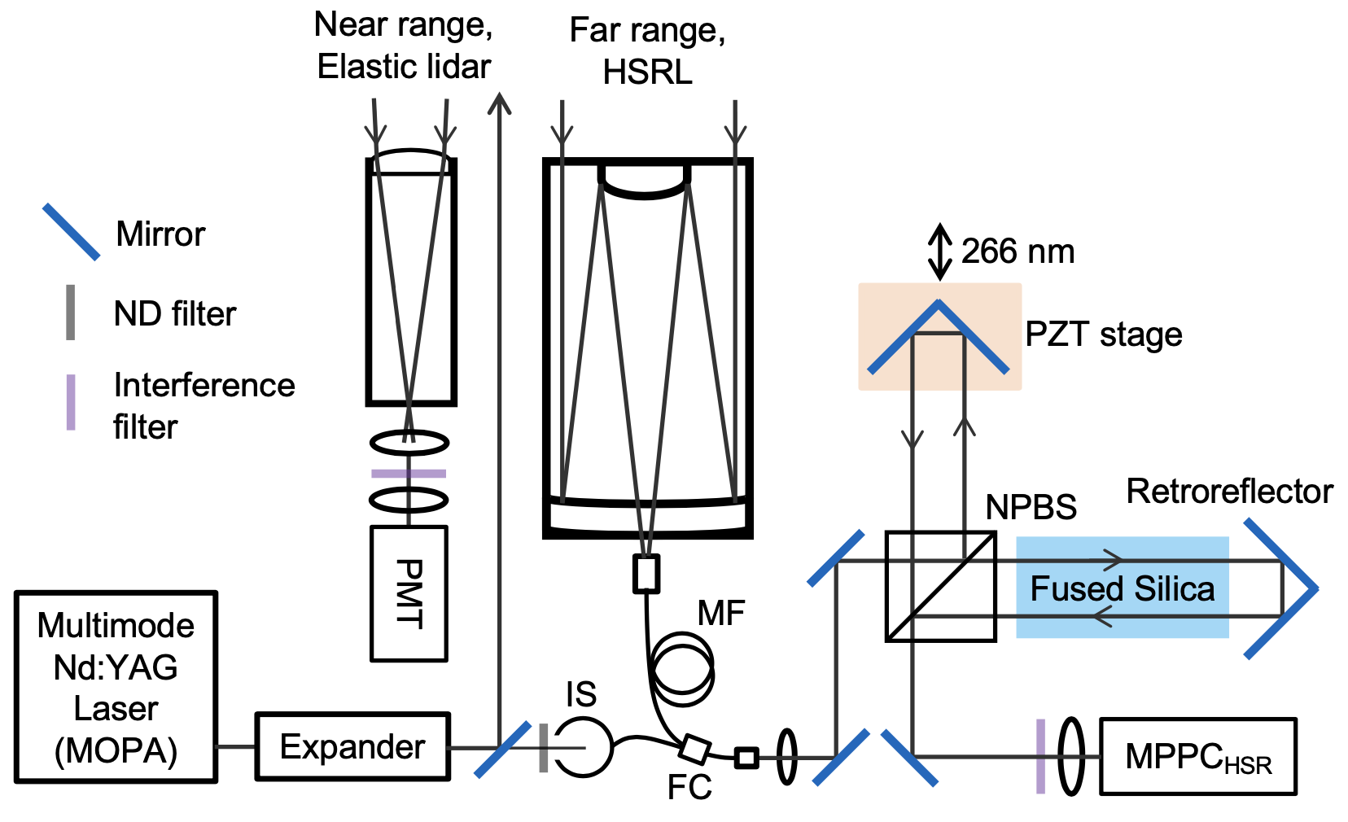
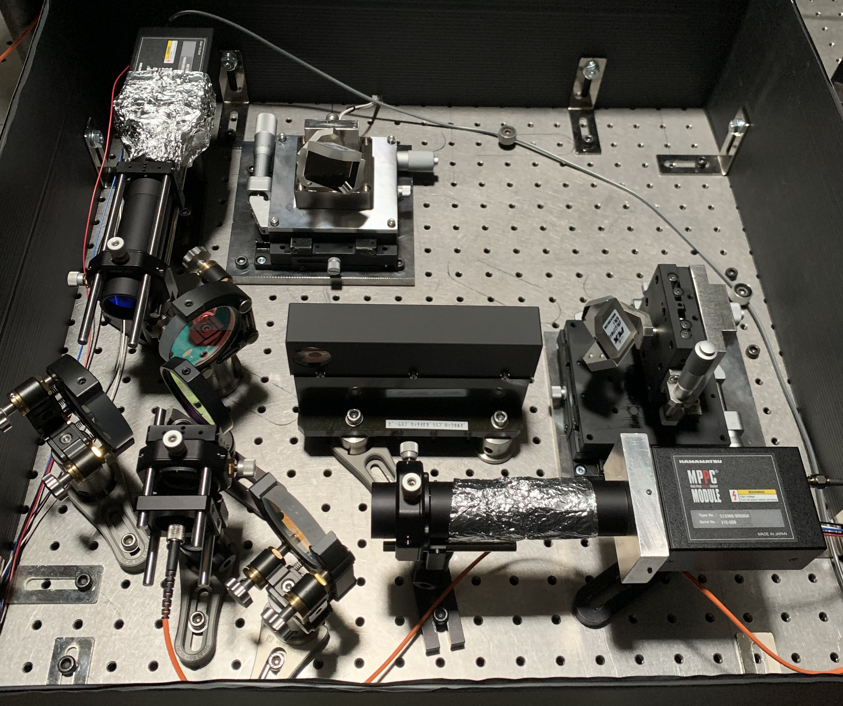
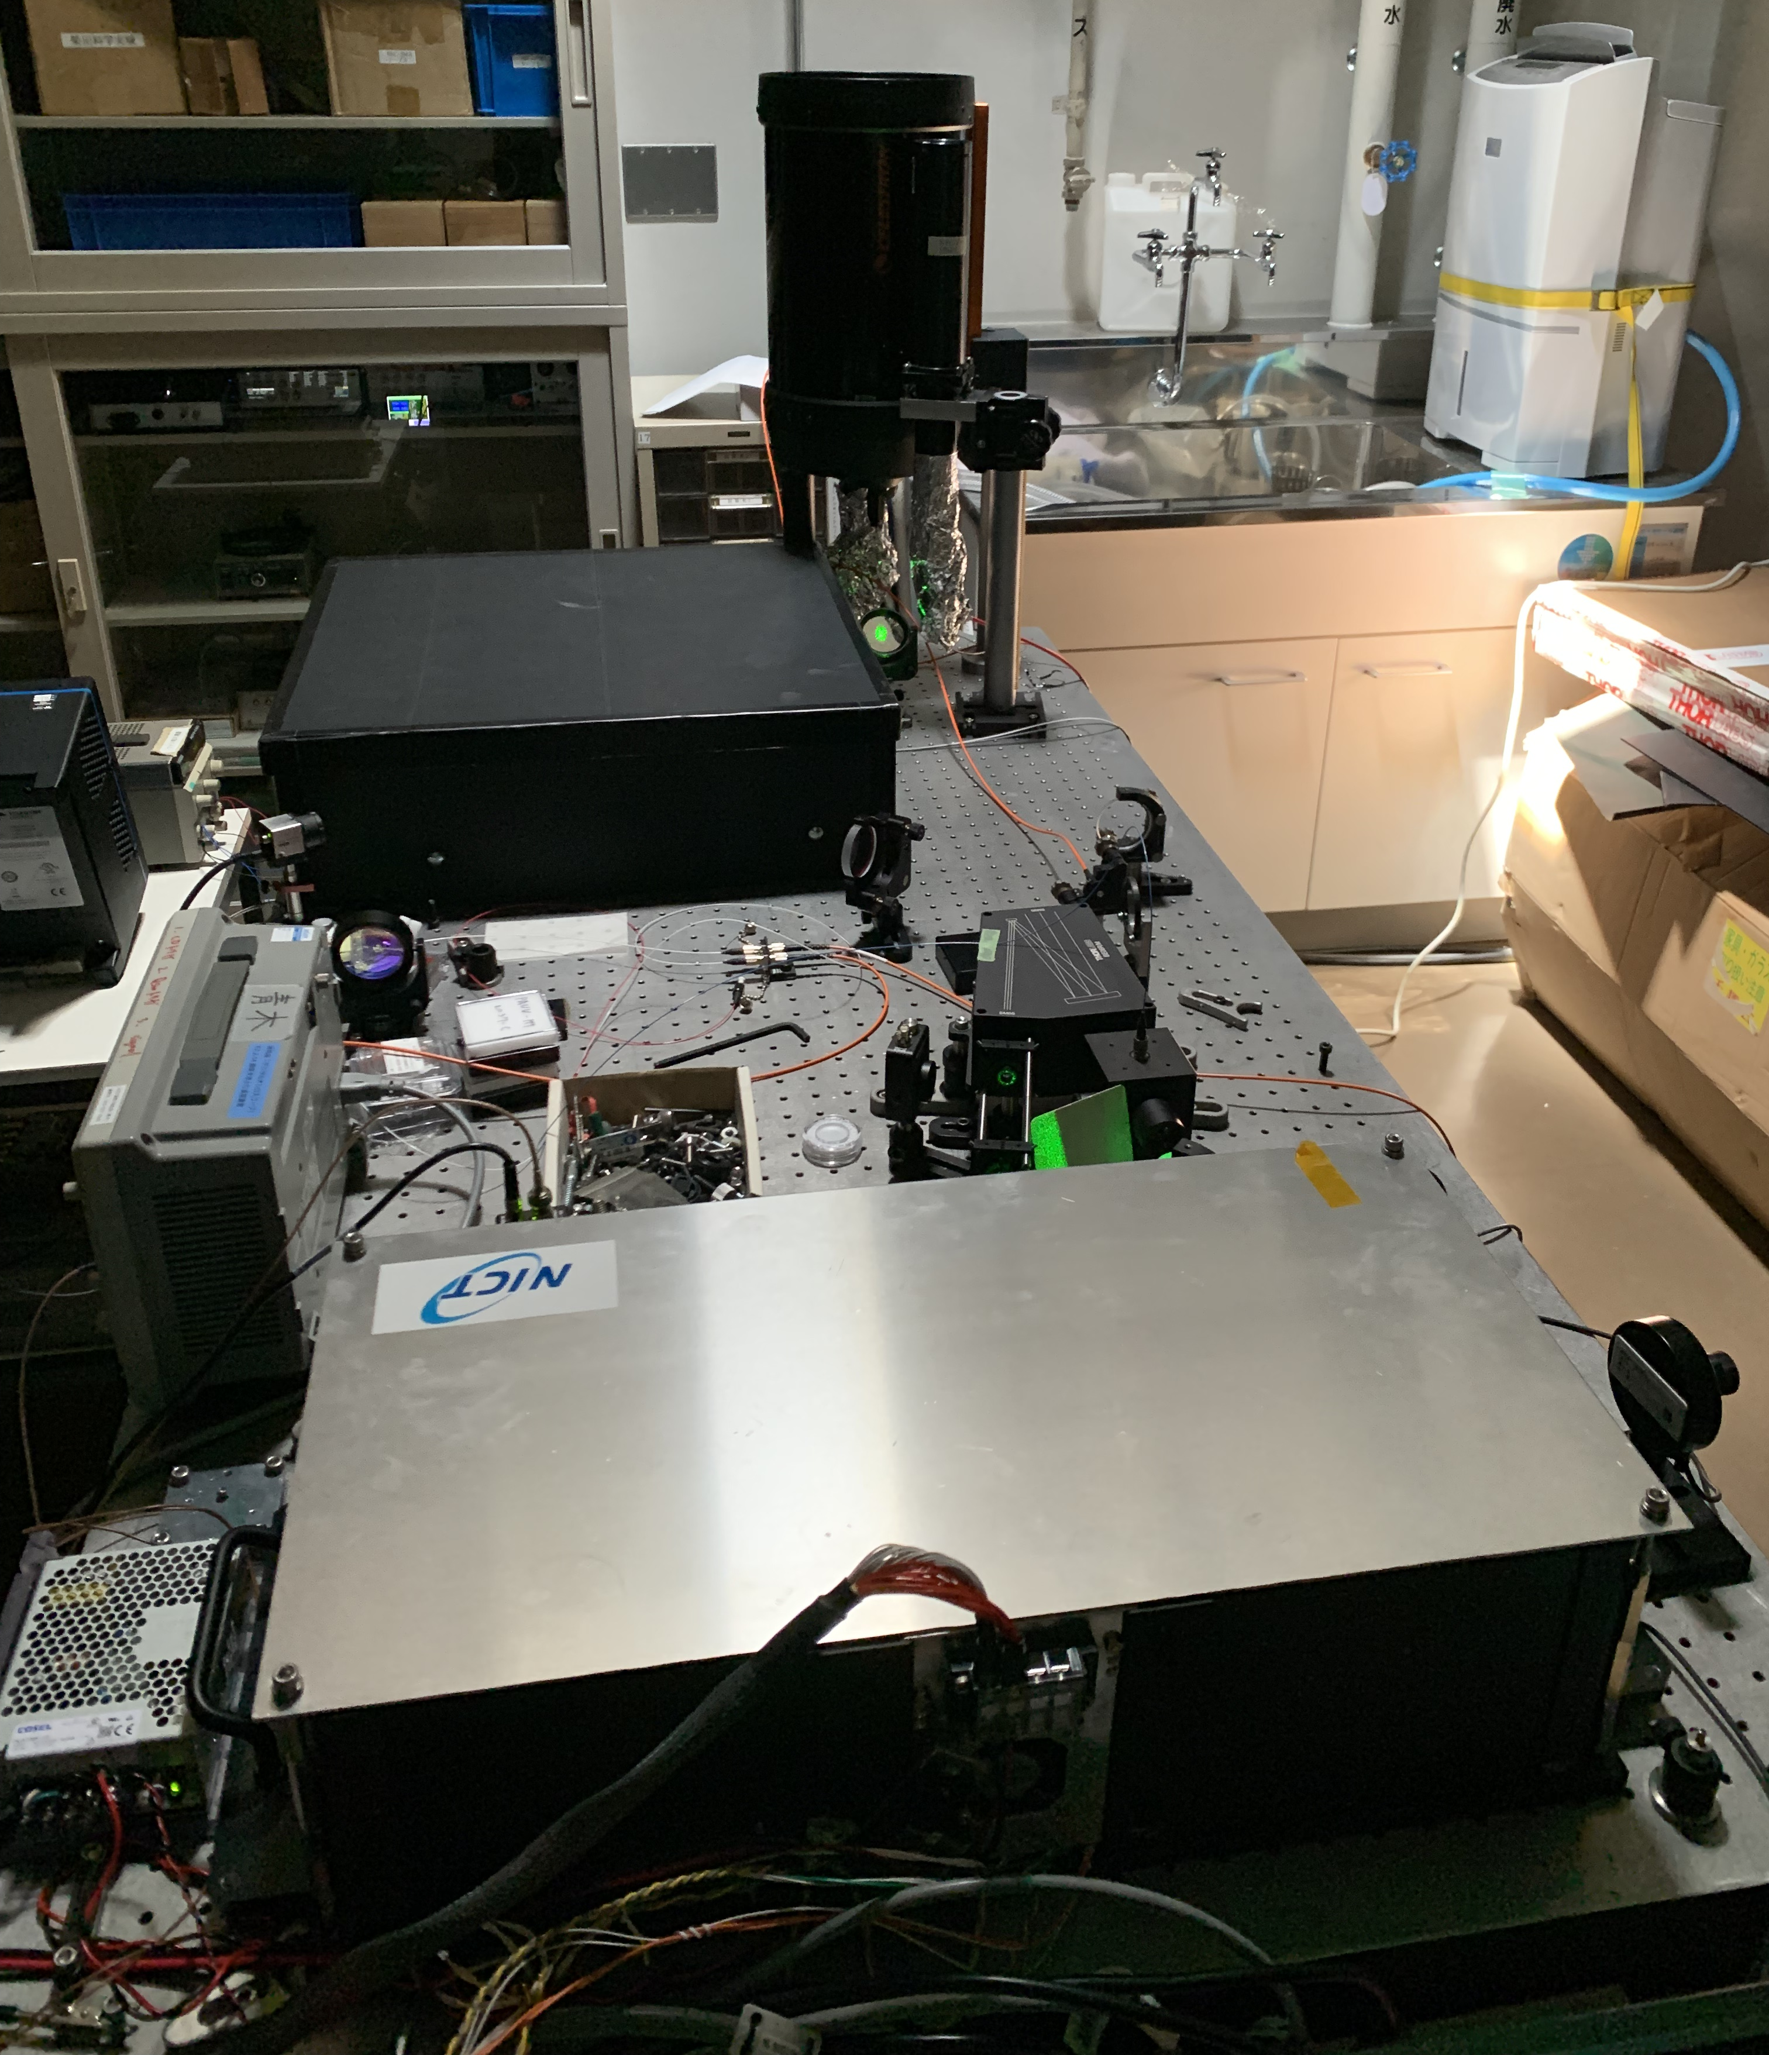
3. Block diagram and specification of multimode HSRL
3
Specification of HSRL using a multimode laser
Laser | Diode-pumped, Air-cooled, Q-switching Nd:YAG laser (MOPA system)
Wavelength | 532 nm
Pulse energy | 500 µJ
Beam divergence | 0.5 mrad (after x6 beam expander)
Repetition rate | 100 Hz
Receiver | Far range: Celestron C8 (Dia. = 20cm) Near range: refractive telescope (Dia. = 5cm)
Field-of-view | 0.5 mrad
Interferometer | Scanning Michelson interferometer Free spectral range = 1.5 GHz Scan speed: 8.3 Hz (12 data points / fringe)
Detector | Multi-pixel photon counter (MPPC) module (Hamamatsu C13366-3050GA)
Acquisition | 160MSPS ADC (AVALDATA ADO-1616-STD)
Receivers
607 Raman
Interferometer
Interferometer
Multimode laser
HSR
The 30th International Laser Radar Conference (ILRC) virtual conference, June 26th – July 1st, 2022.

Slide 5
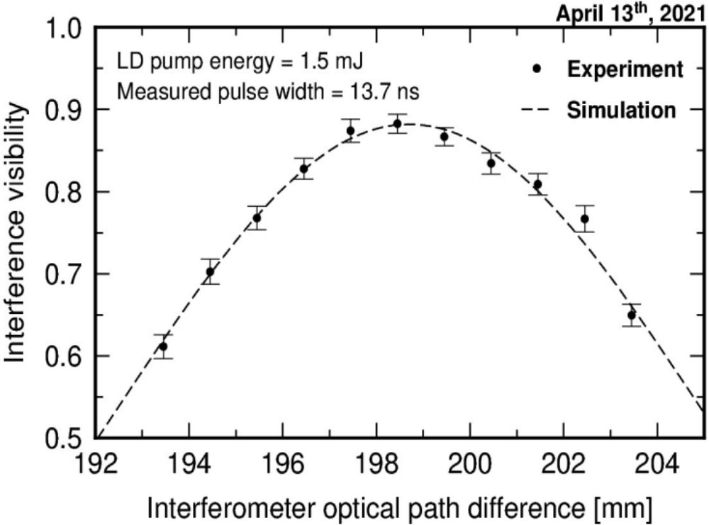
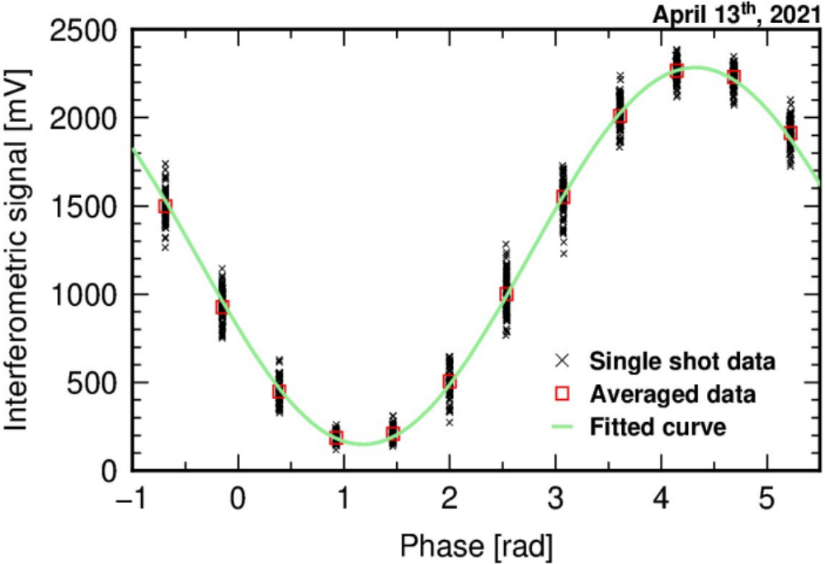
4. Optimization of laser cavity length for HSRL measurement
4
Interference visibility vs. OPD
Scan signal at peak visibility
Preliminary results
Laser spectral width
≈ 60 MHz
I_{max}
I_{max} – I_{min}
Visibility =
I_{max} + I_{min}
Laser mode interval
≈ 1.5 GHz
I_{min}
Laser cavity length was adjusted so that interference visibility peaks at the interferometer FSR (1.5 GHz)
Laser spectral width of modes was estimated at approximately 60 MHz from the peak visibility
Rejection rate of Mie scattering improved approximately 6 times compared to the previous study
The 30th International Laser Radar Conference (ILRC) virtual conference, June 26th – July 1st, 2022.

Slide 6
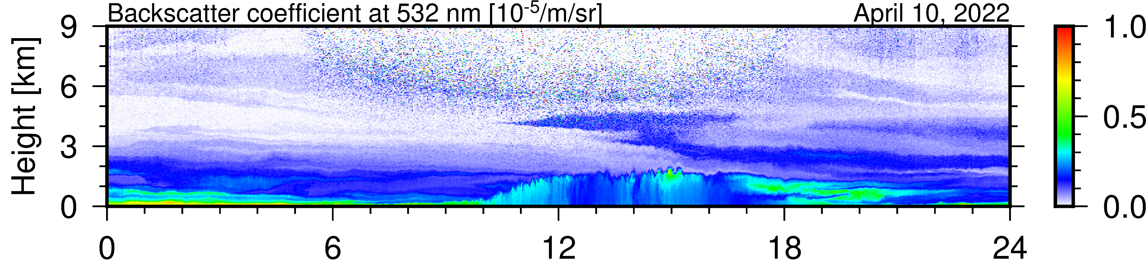
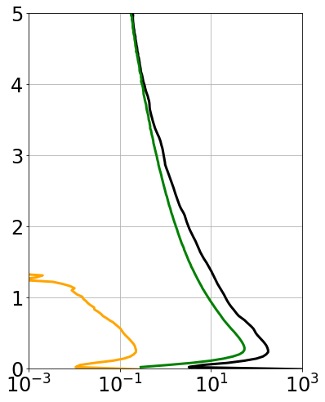
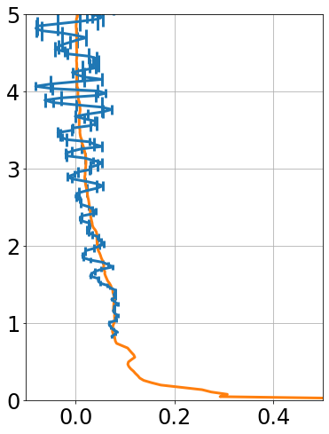
5. Observation of aerosol profiles with multimode HSRL
5
(Δt = 2 min, Δz = 30 m)
00:00
06:00
12:00
18:00
24:00
[Local Time]
Mie + Ray
2 h
average
Continuous observation of aerosol profiles was successfully carried out => stability improved!
Rayleigh scattering signals were more than two orders stronger than nitrogen Raman scattering signals
Compared to the previous study, lower laser energy (two order), but comparable measurement accuracy of aerosol extinction profiles => measurement efficiency significantly improved!
α₁
Height [km]
Ray
Raman
(607)
β₁ * 40
Lidar signal [mV]
Extinction [/km]
The 30th International Laser Radar Conference (ILRC) virtual conference, June 26th – July 1st, 2022.

Slide 7
6. Comparison tables for various HSRLs and ongoing studies
6
 | High-resolution spectral element | System Extensibility (Multi-wavelength) | Performance | Cost | Eye safety | Wavelength controls
Giant-pulse single mode laser based (e.g., Liu et al. 1999, Burton et al. 2015) | Molecular filter/ Interferometer | Yes | High | High | No | Yes
Micro-pulse single mode laser based (e.g., Piironen and Eloranta 1994) | Molecular filter/ Interferometer | No | Good | High | Yes | Yes
Diode-laser based (Hayman and Spuler 2017) | Molecular filter | No | Good | Low | Yes | Yes
Giant-pulse multimode commercial laser based (Jin et al. 2017) | Scanning Mach-Zehnder interferometer | Yes | Low | Low | No | No
Giant-pulse multimode compact laser based (This study) | Scanning Michelson interferometer | Yes | Good | Low | No | No
Ongoing studies
Long-term continuous observation of aerosol profiles with the multimode HSRL for monitoring air quality
Upgrade to dual-wavelength system using a single scanning interferometer (demonstrated for HSRL using a single-mode laser by Jin et al. 2022)
The 30th International Laser Radar Conference (ILRC) virtual conference, June 26th – July 1st, 2022.

