Slide 1
1
HSRL systems have been under development at the University of Wisconsin since the 1970’s
The University of Wisconsin High-Spectral-Resolution Lidars (HSRLs) are eye-safe instruments capable of continuous, autonomous, low-maintenance operation in remote areas.
In the last 20-years our lidar group has constructed five instruments. Table shows systems and years built.
Four of the constructed instruments
have undergone major upgrades.
List of channels implemented in the HSRLs and year.
*Expected date, in progress
Instrument | AHSRL (UW) | GV -HSRL (NCAR) | NSHSRL (DOE ARM) | MF2HSRL (DOE ARM) | BagoHSRL (UW)
Year Built | 2002 | 2008 | 2011 | 2011 | 2012
Year Upgraded | 2015, 2018 | - | 2020 | 2022 Undergoing | 2014,2018, 2019
Channel | AHSRL (U W) | GV-HSRL (NCAR) | BagoHSRL (U W) | NSHSRL (DOE) | MF2HSRL (DOE)
Molecular NFOV@532 | 2002/06 | 2008/06 | 2012/02 | 2011/03 | 2010/11
Combined High gain NFOV@532 | 2002/06 | 2008/06 | 2012/02 | 2011/03 | 2010/11
Combined Low gain NFOV@532 | 2005/06 | 2008/06 | 2012/02 | 2011/03 | 2010/11
Cross-pol NFOV@532 | 2002/06 | 2008/06 | 2012/02 | 2011/03 | 2010/11
Temperature NFOV@532 | - | - | 2012/11 | - | -
Molecular WFOV@532 | 2015/02 | - | 2014/04 | 2020/01 | 2022/07*
Combined WFOV@532 | 2018/10 | - | 2019/07 | 2020/01 | 2022/07*
Combined NFOV@1064 | 2015/02 | - | 2014/05 | 2020/01 | 2022/07*
Cross-pol NFOV@1064 | 2018/10 | - | 2018/02 | 2020/01 | 2022/07*
Molecular NFOV@1064 | - | - | - | - | In progress
02. Emerging lidar techniques,
methodologies, and discoveries
27 June, 14:15
228
The 30th International Laser Radar Conference (ILRC) virtual conference, June 26th – July 1st, 2022.

Slide 2

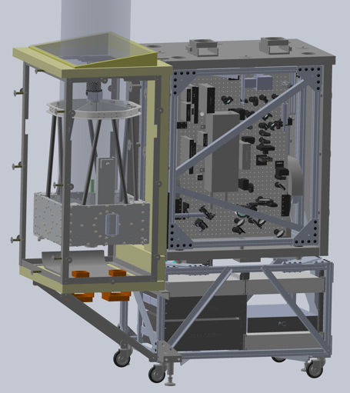
High Spectral Resolution Lidars at the University of Wisconsin
2
CAD models of the NSHSRL instrument upgraded in 2020
Upgrades of NSHSRL
The laser was modified to operate at 532 and 1064 nm wavelengths.
Added Combined and molecular wide-field-of-view channels operating at 532nm, with 1 mrad field-of-view (7.5 cm diameter refractive telescope).
The instrument received two elastic scattering channels (co-pol and cross-pol) at 1064nm.
The telescope was mounted on a servo motor and the instrument can scan near zenith angles to detect oriented ice crystals.
Fiber scrambler to reduce range dependence in lidar returns.
The 30th International Laser Radar Conference (ILRC) virtual conference, June 26th – July 1st, 2022.

Slide 3
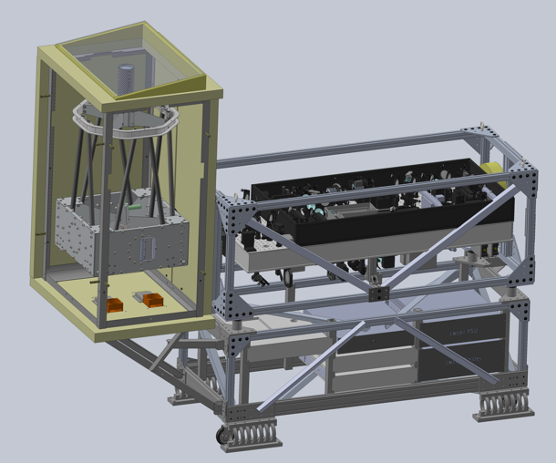
High Spectral Resolution Lidars at the University of Wisconsin
3
CAD model of the MF2HSRL instrument undergoing upgrade
MF2HSRL parameters
Upgrades of MF2HSRL
The MF2HSRL will receive all the upgrades the NSHSRL received with additional features.
Interferometer Cavity Length Controller for accurate frequency locking (+-15 MHz at 532 nm)
Molecular channel @ 1064 nm based on Field Widened Michelson Interferometer. The spectrometer will be tuned by pressure (air density). The proposed FSR is 1.5 GHz.
Transmitter
Laser Photonics Ind. Inc. | DS10-532/1064 SLM
Transmitted eye-safe power | 00.2 Watt@532nm 0.6 Watt@1064nm
Laser Spectral width | <50MHz
Spectral purity | <1:5000
Locking accuracy | 30 MHz
Pulse repetition rate | 4 kHz
Telescope Aperture | 40cm shared
Transmitter divergence | ~2 µrad
Receiver
Scanning telescope | 40cm Dall-Kirkham
Narrow field-of-view | 100 µrad
Wide field-of-view | 1 mrad
Spectral bandwidth 532 nm/Fe/T_{peak} | 7.5 GHz/49/76%
Spectral bandwidth 1064 nm/Fe/T_{peak} | 7 GHz/28/94%
Iodine filters (line #1109) | 1.8 GHz
Detectors | SPCM-AQRH-12
The 30th International Laser Radar Conference (ILRC) virtual conference, June 26th – July 1st, 2022.

Slide 4
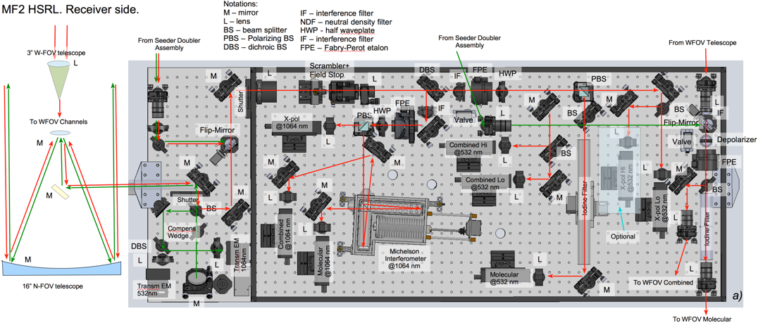
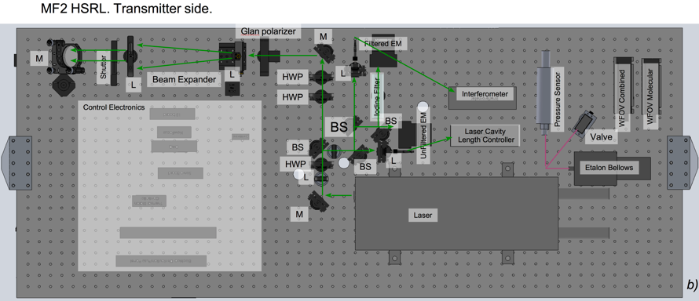
High Spectral Resolution Lidars at the University of Wisconsin
4
MF2 High Spectral Resolution Lidar Optical Design
Optical layout for MF2HSRL: a) Receiver, top view of the breadboard, b) Transmitter, bottom view of the breadboard.
The 30th International Laser Radar Conference (ILRC) virtual conference, June 26th – July 1st, 2022.

Slide 5
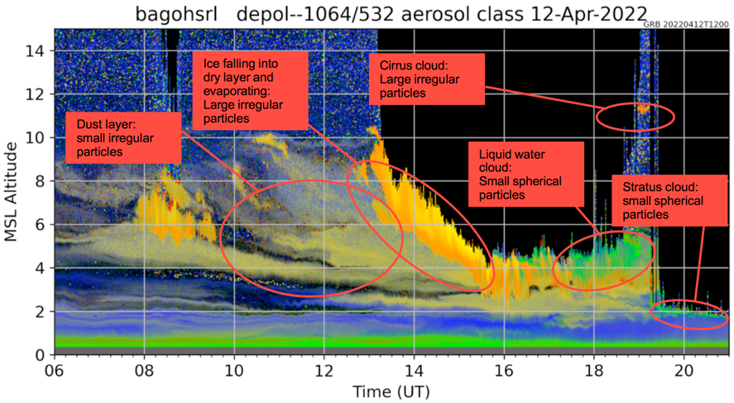
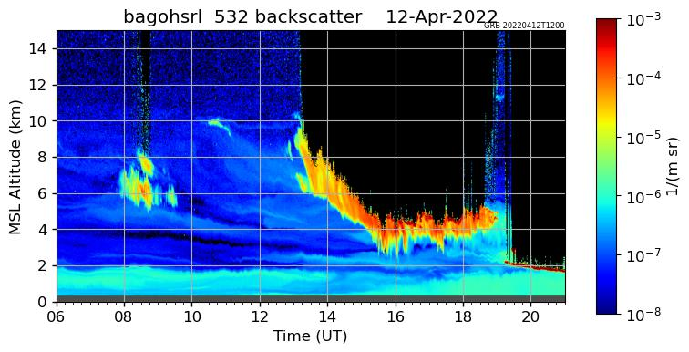
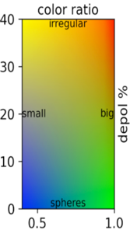
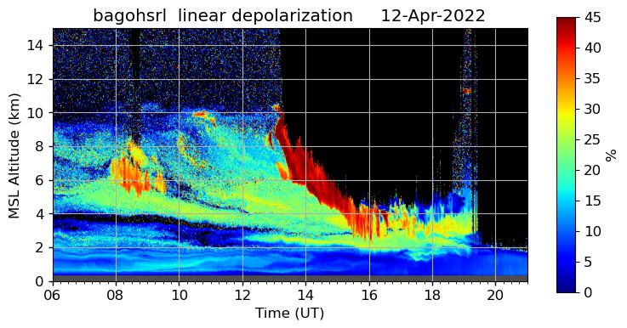
High Spectral Resolution Lidars at the University of Wisconsin
5
An example of HSRL data demonstrates a capability of the dual-wavelength instrument to discriminate between different types of aerosols
Aerosol classification measured with BagoHSRL on April 12th , 2022 from 6:00 to 21:00 UTC Madison, WI.
All of the data acquired by the Department of Energy HSRL systems are available from: https://www.arm.gov/data. Data from UW, NCAR and DOE systems can also be found at: http://hsrl.ssec.wisc.edu
The 30th International Laser Radar Conference (ILRC) virtual conference, June 26th – July 1st, 2022.

