Slide 1
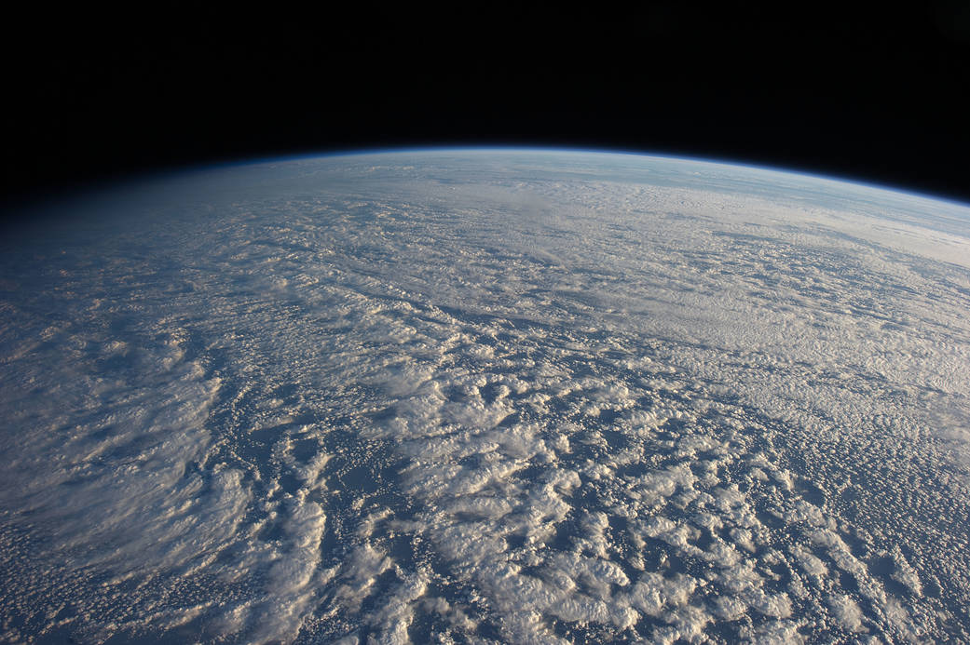
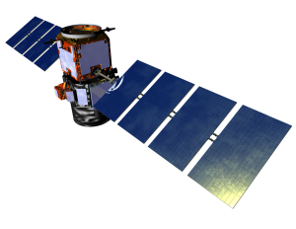
Correcting CALIOP Polarization
Gain Ratios for Diurnal Variations
Mark Vaughan^{1a}, Sharon Rodier^{1,2}, Zhaoyan Liu¹, Anne Garnier^{1,2},
Kam-Pui Lee^{1,2}, Brian Getzewich¹, Shan Zeng^{1,2}
¹ NASA Langley Research Center, Hampton VA USA
² Science Systems and Applications Inc. , Hampton VA USA
ª corresponding author: mark.a.vaughan@nasa.gov
image credit: NASA; see https://www.nasa.gov/mission_pages/station/multimedia/gallery/iss034e016601.html

Slide 2
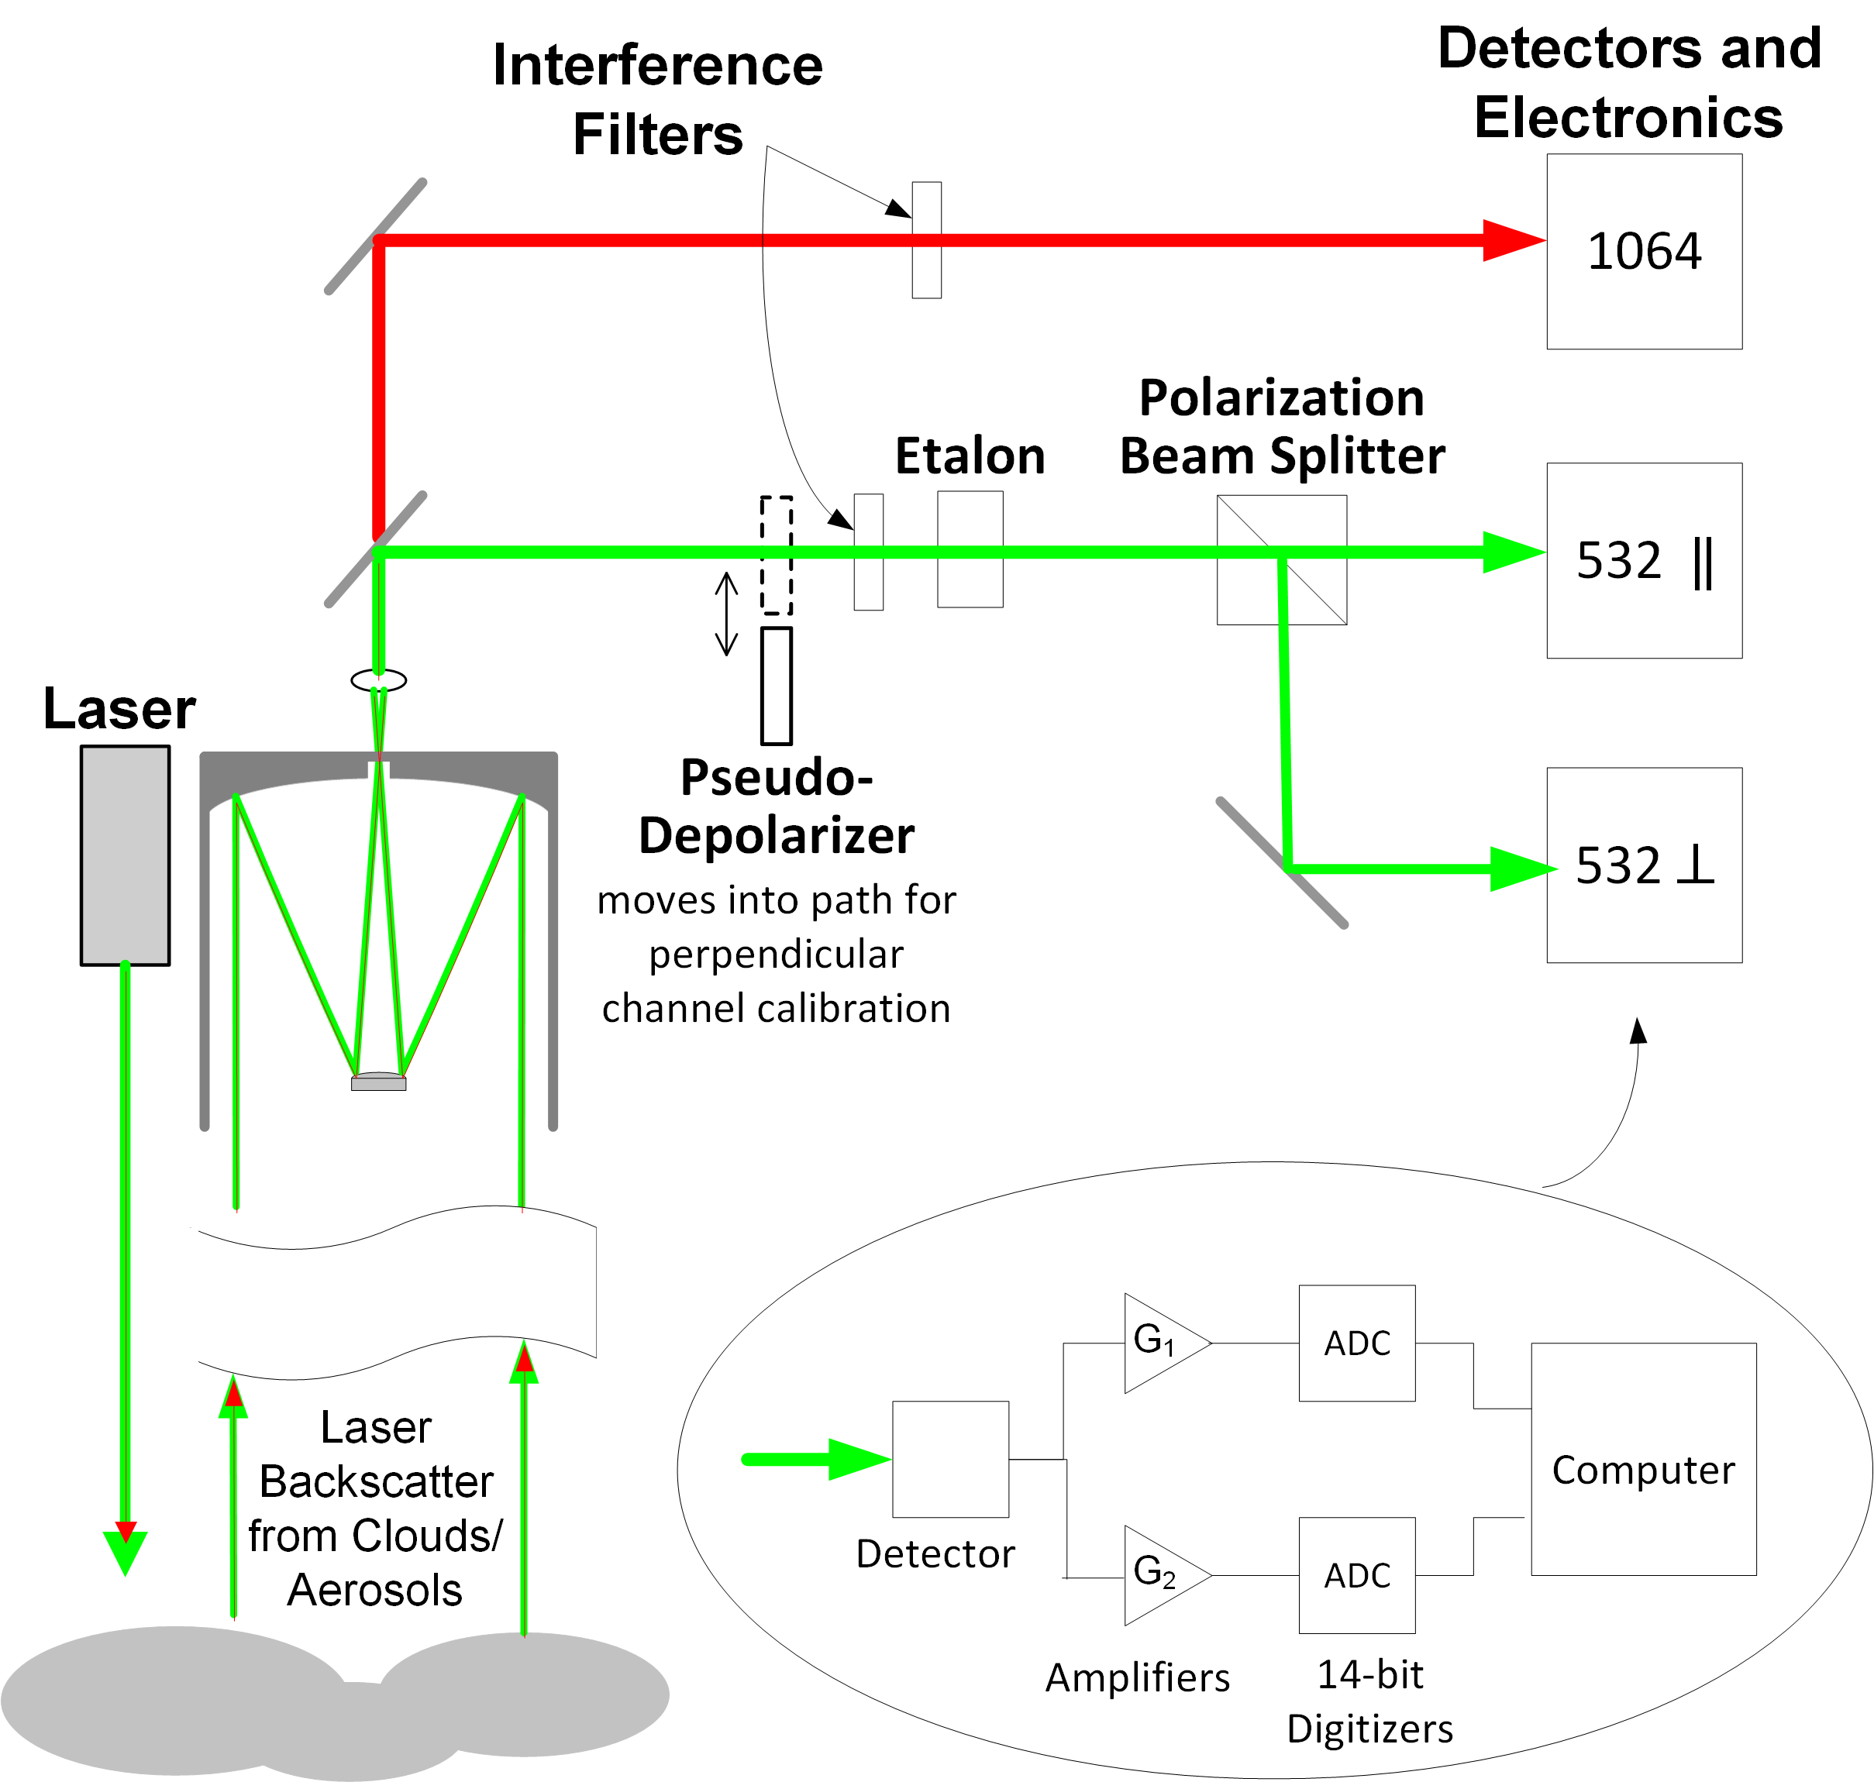

Polarization Gain Ratio (PGR)
Hostetler et al., 2005: CALIPSO Lidar Level 1 Algorithm Theoretical Basis Document
A spatial pseudo-depolarizer is inserted into the 532 nm optical path upstream of the polarization beam splitter (Figure 5.1). Insertion of this device results in a randomly polarized backscatter signal, and thus nominally equal optical power is directed into the detectors for the two orthogonal polarization orientations, regardless of the target being measured. Inserting the pseudo-depolarizer allows the relative sensitivity of the two 532 nm receiver channels to be determined. The ratio of the two detection channel signals is called the Polarization Gain Ratio (PGR)
Figure 2.2 Functional block diagram of CALIOP
https://www-calipso.larc.nasa.gov/resources/pdfs/PC-SCI-201v1.0.pdf

Slide 3
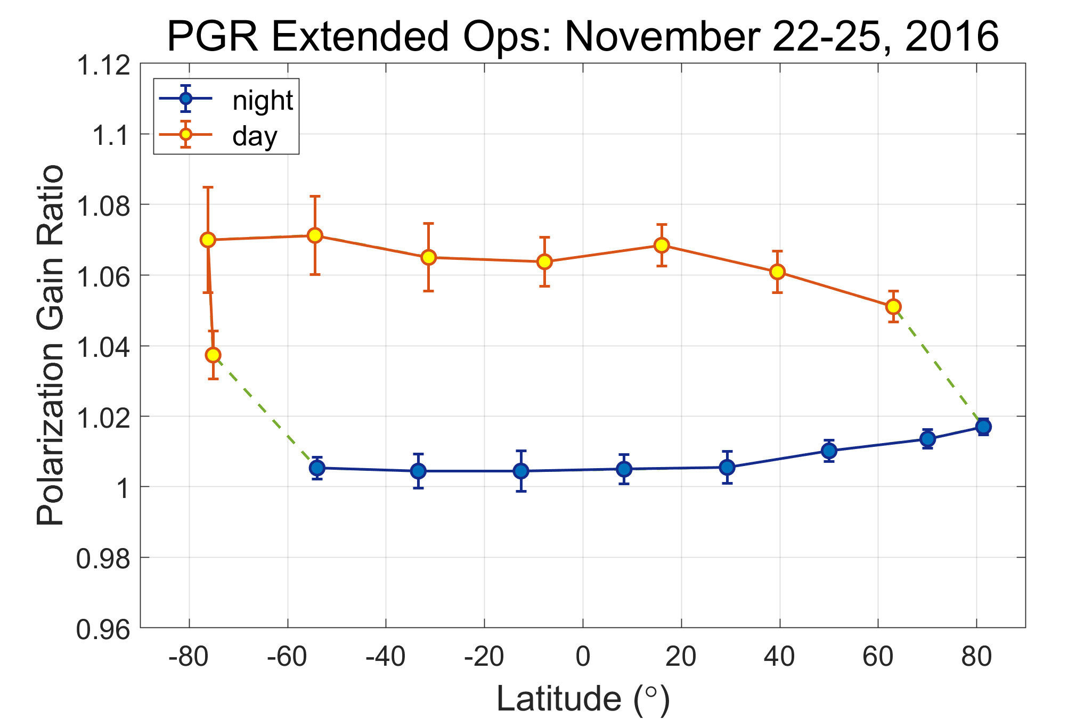
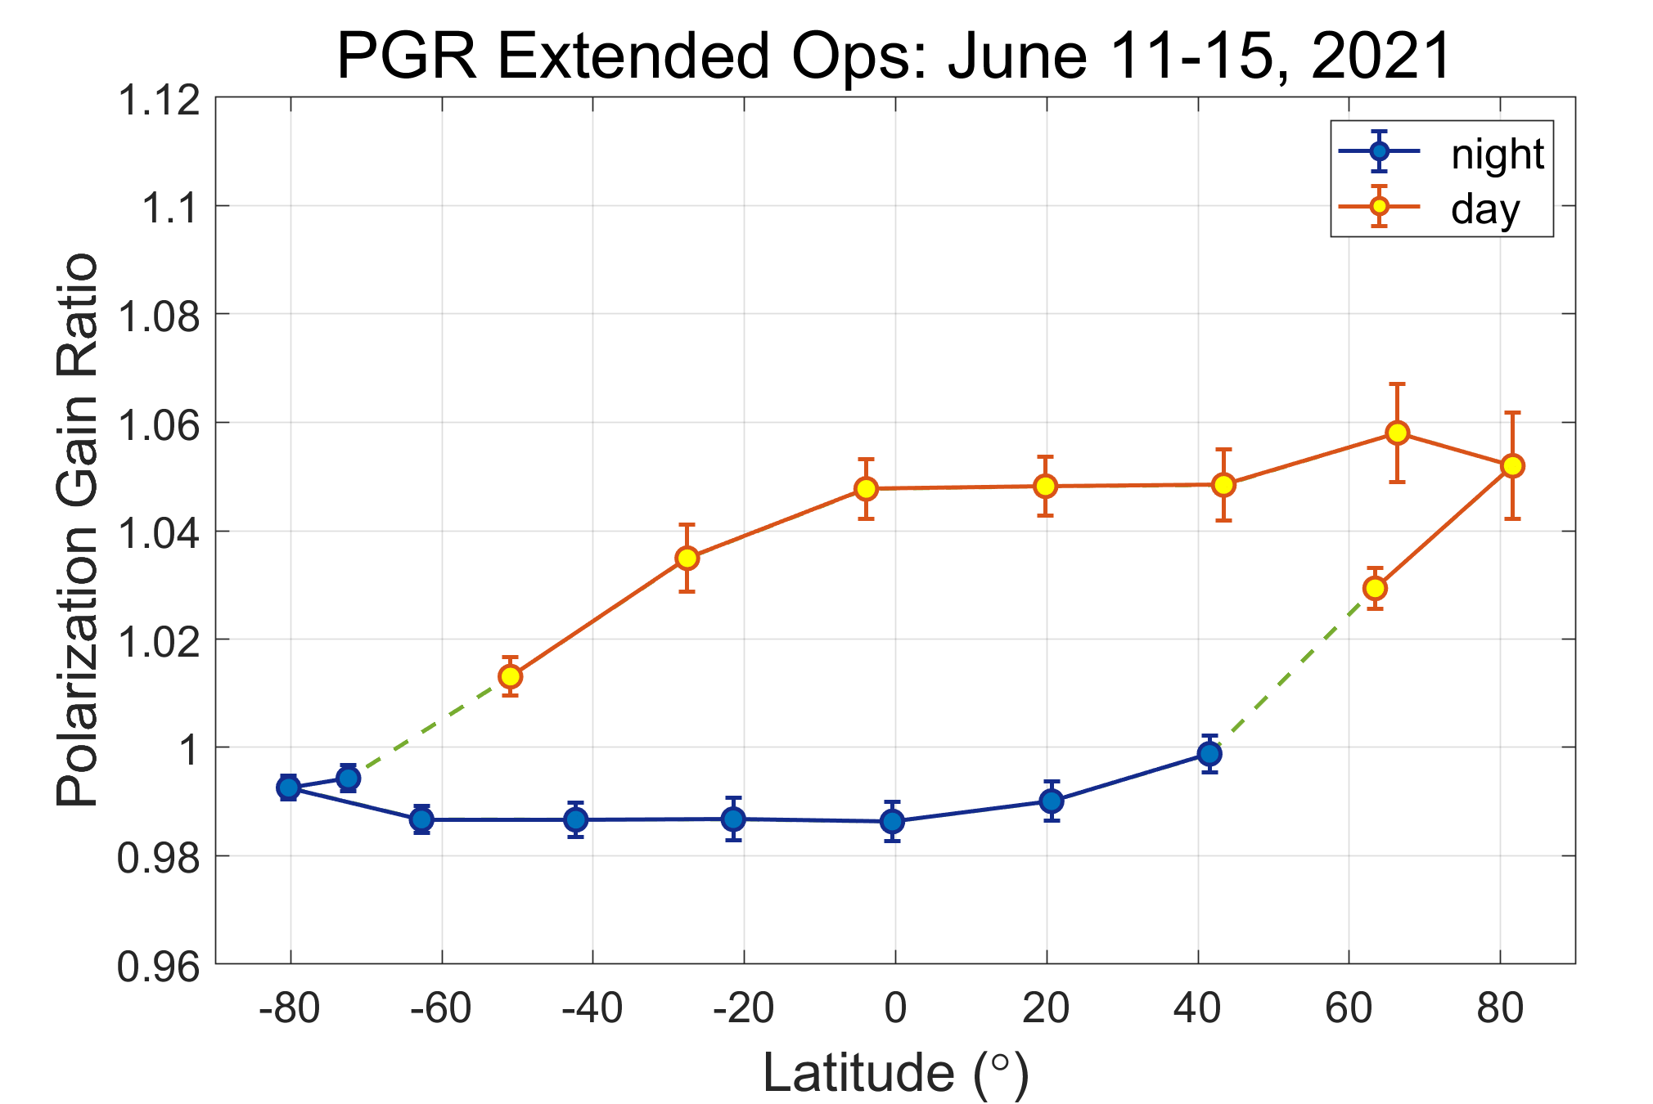
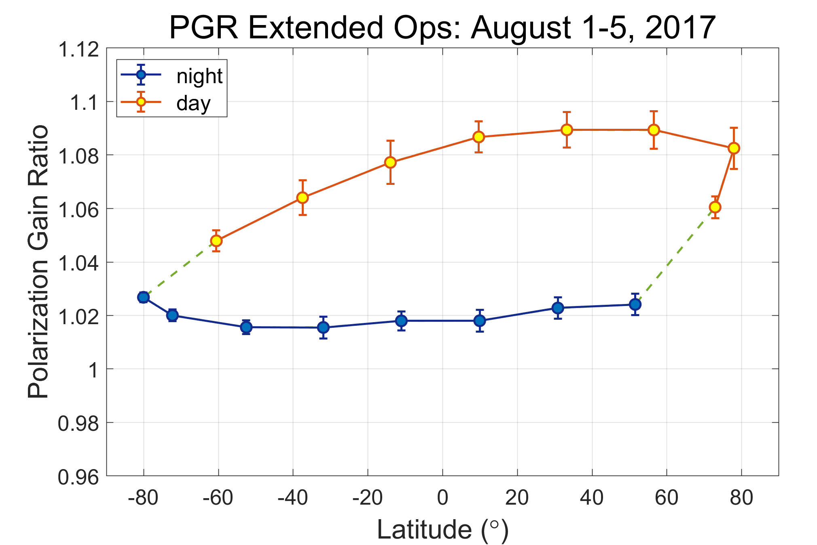
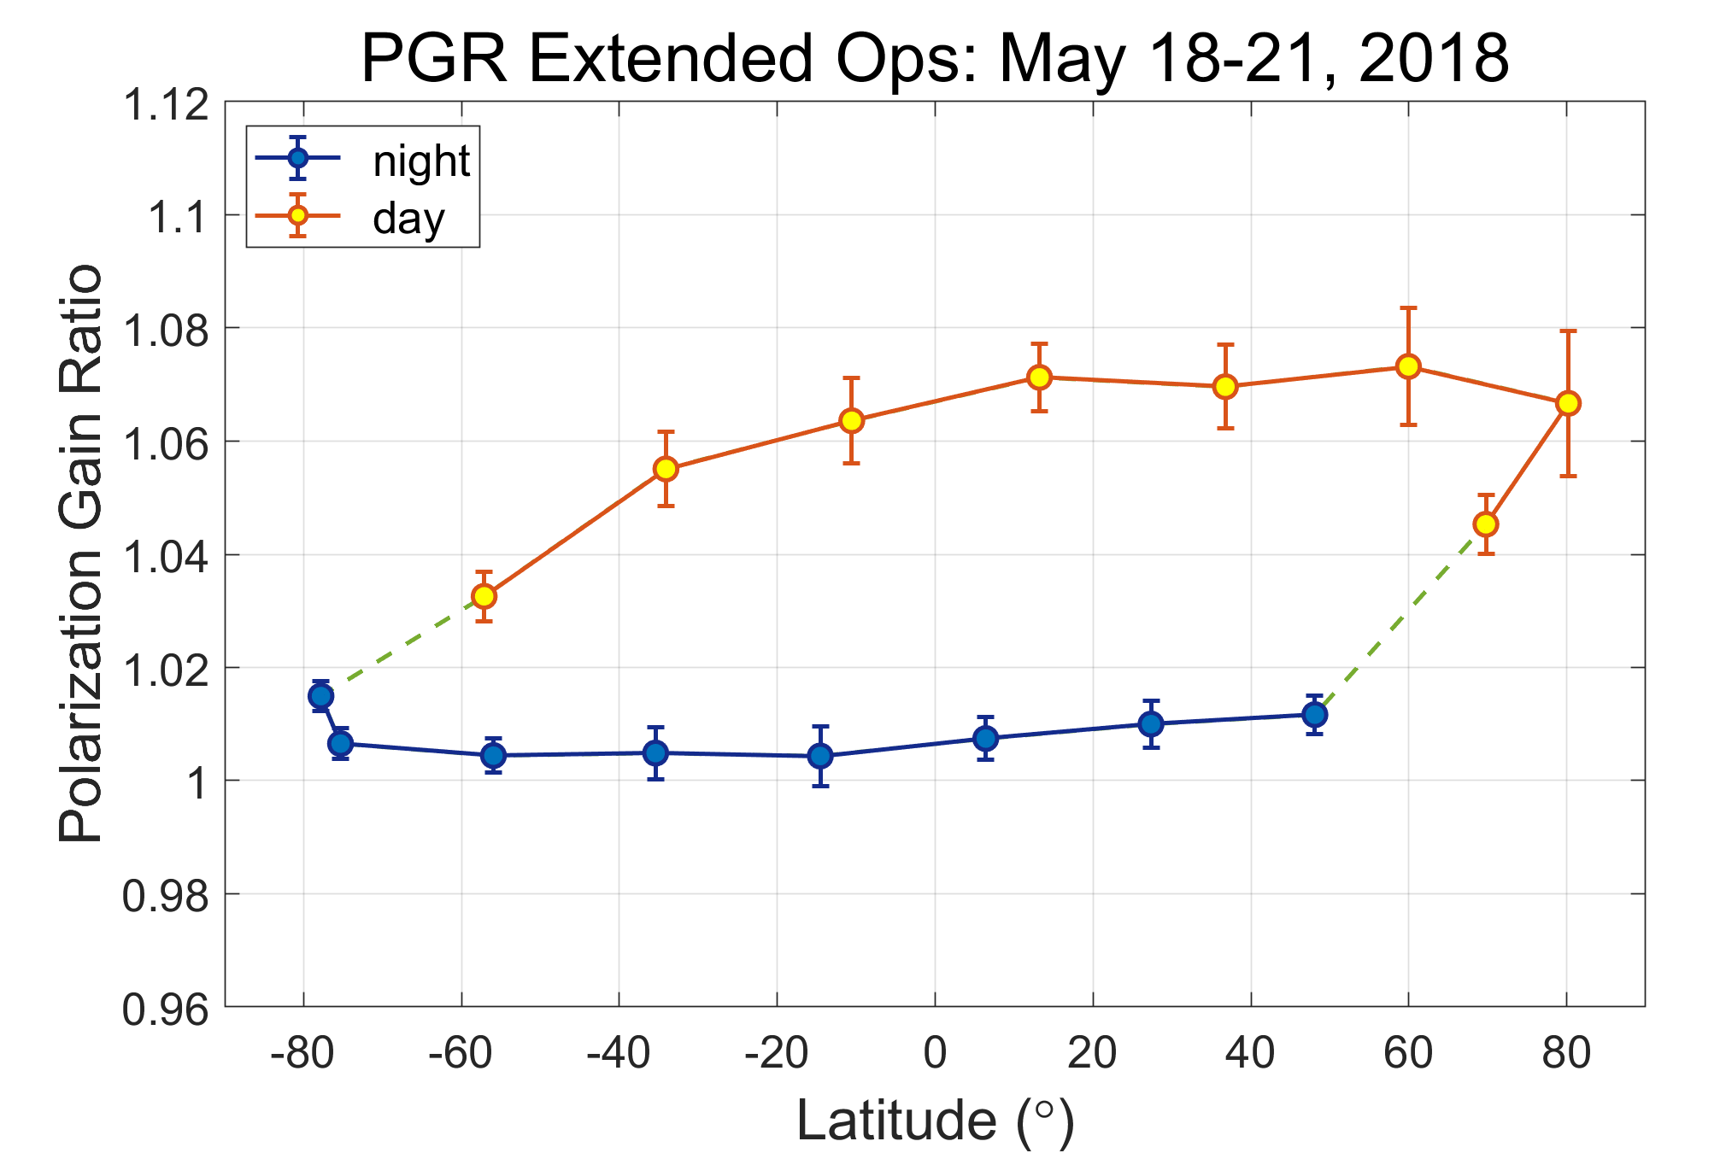
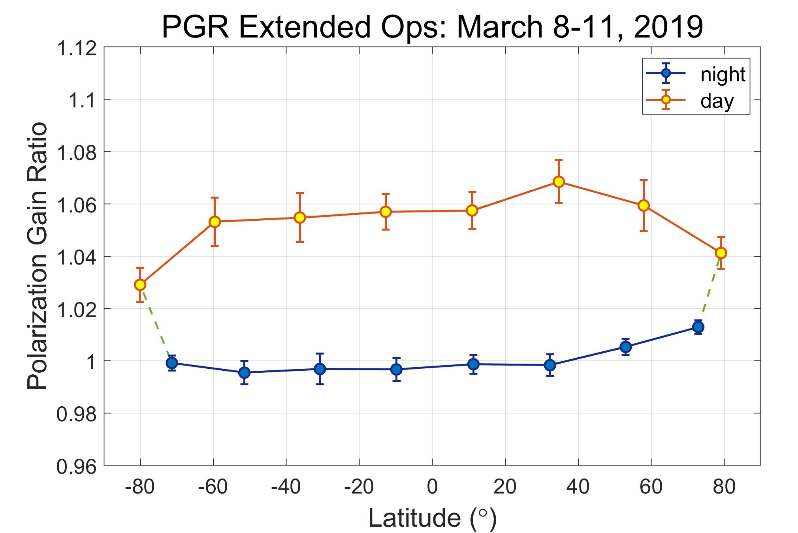
An Unexpected Discovery
CALIOP PGR Varies Diurnally And Seasonally
For the first 10+ years of the CALIPSO mission, PGR pseudo-depolarizer calibra-tions were conducted during night orbit segments only and the relative gain of the two receiver channels was assumed to be diurnally invariant.
Beginning in November 2016, periodic day-time pseudo-depolarizer calibrations are now made to track diurnal PGR changes. Day-night differences are typically on the order of ~3% to ~7% (day higher).
achieving daytime PGR uncertainties commensurate with prior nighttime values requires averaging over multiple days

Slide 4
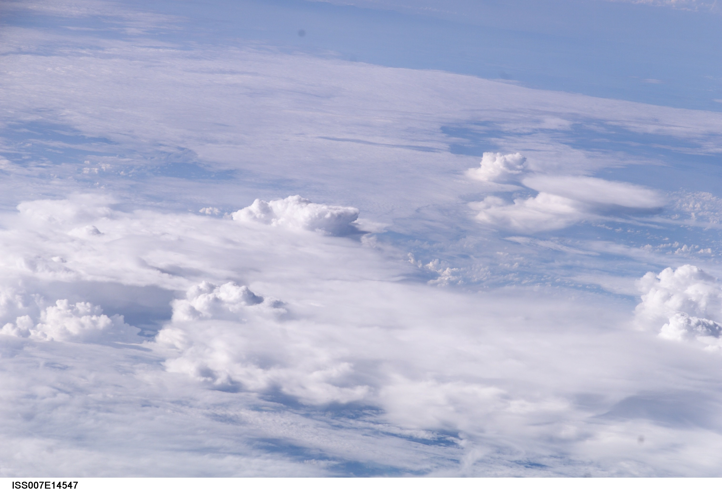
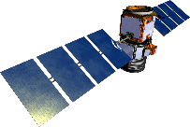
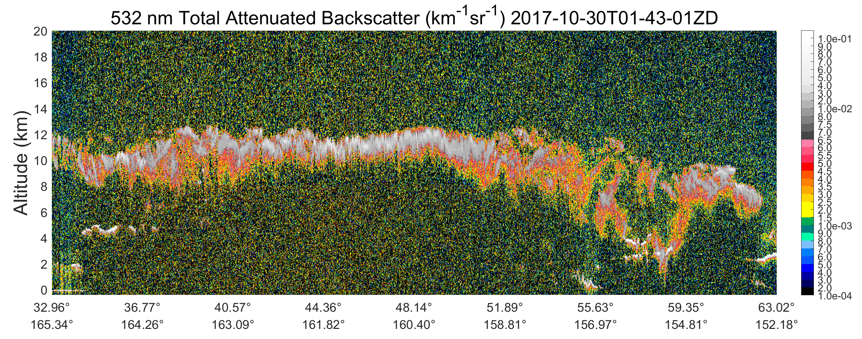
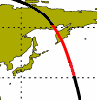
Deriving PGR from CALIOP Solar Background Measurements
Liu et al., 2004: Validating lidar depolarization calibration using solar radiation scattered by ice clouds,
IEEE Geosci. Remote Sens. Lett., 1, 157–161, https://doi.org/10.1109/LGRS.2004.829613.
The solar background radiation measured above dense ice clouds is essentially unpolarized, due to multiple internal reflections within the ice crystals and the multiple scattering that occurs among these particles. By using an approach pioneered by Liu et al. (2004), we can derive PGR estimates using the ratio of CALIOP’s polarization-sensitive background measurements acquired above strongly scattering ice clouds.
North
Zenith
Sun
Upwelling sunlight
VZA
SZA
Meridional plane
RAA
Liu’s method was developed using airborne measure-ments acquired at 1064 nm, where molecular scattering contributions to the above-cloud background signals are negligible. But because the polarizing characteristics of molecular scattering at 532 nm cannot be neglected, the CALIOP implementation of Liu’s method accounts for molecular contributions via a look-up table created using a polarization-sensitive radiative transfer model (Zhai et al., 2010; https://doi.org/10.1016/j.jqsrt.2009.12.005).
PGR measurement region
image credit : NASA's Johnson Space Center; see https://www.nasa.gov/topics/earth/features/icing-forecast.html
Notes:
Liu, Z., M. J. McGill, Y. Hu, C. A. Hostetler, M. Vaughan, and D. Winker, 2004: Validating lidar depolarization calibration using solar radiation scattered by ice clouds, IEEE Geosci. Remote Sens. Lett., 1, 157–161, https://doi.org/10.1109/LGRS.2004.829613.

Slide 5
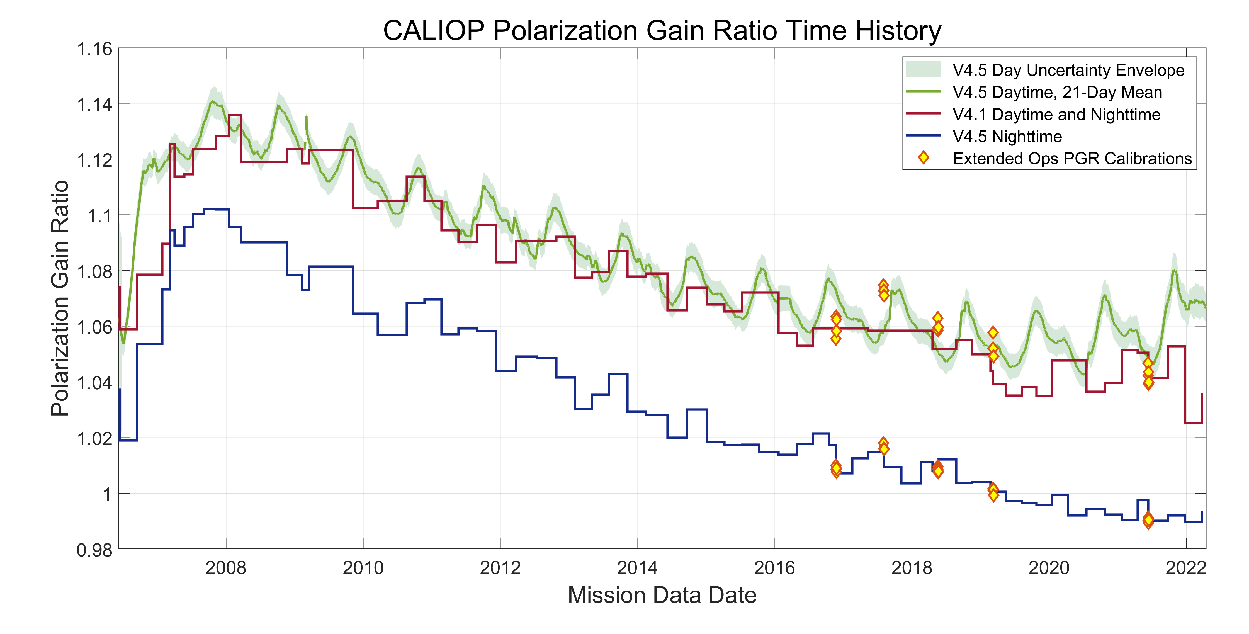
CALIOP Polarization Gain Ratio Time History
prior to version 4.5, a software error introduced high biases into nighttime PGR estimates derived from pseudo-depolarizer measurements
daytime pseudo-depolarizer measurements used to scale solar background estimates
new daytime PGR estimated using solar background signals measured above dense ice clouds (Liu et al., 2004)
mission mean ratio (red/blue) = 1.041
corrected nighttime PGR calculated using pseudo-depolarizer calibrations
Daytime PGR estimated from CALIOP parallel and perpendicular channel RMS baseline measurements acquired above opaque ice clouds with top heights higher than 6-km. Each data point represents the mean PGR for a single daytime orbit segment.

Slide 6
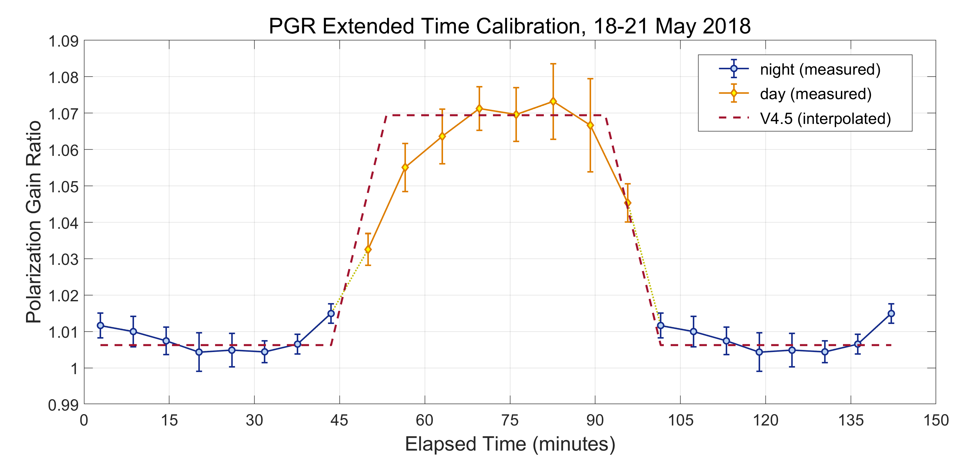
Creating a Continuous Record of PGR Change
The transition between the stable, near-constant nighttime PGR and the much more variable daytime PGRs does not occur instantaneously. Based on an assess-ment of the five extended time PGR calibrations accumulated to date, the transition period between stable states lasts approximately 585 seconds. To characterize the variability of the PGR throughout an orbit we use a piecewise linear approximation, as illustrated by the red dashed line in the figure below. As in all previous data releases, the PGR is held constant at night, using the most recent PGR estimate obtained from the standard nighttime only PGR calibration operations
Daytime values are assigned by partitioning the into three segments. The first extends 585 seconds forward in time from the night-to-day terminator, and the third extends 585 seconds backward in time from the day-to-night terminator. The PGR is held constant throughout the center segment (#2) at the Liu’s method value calculated for the data acquisition date. PGRs in daytime segments 1 and 3 are then linearly interpolated as a function of time between the segment end points and the segment 2 Liu’s method value.
night-to-day terminator
day-to-night terminator
1
2
3

Slide 7
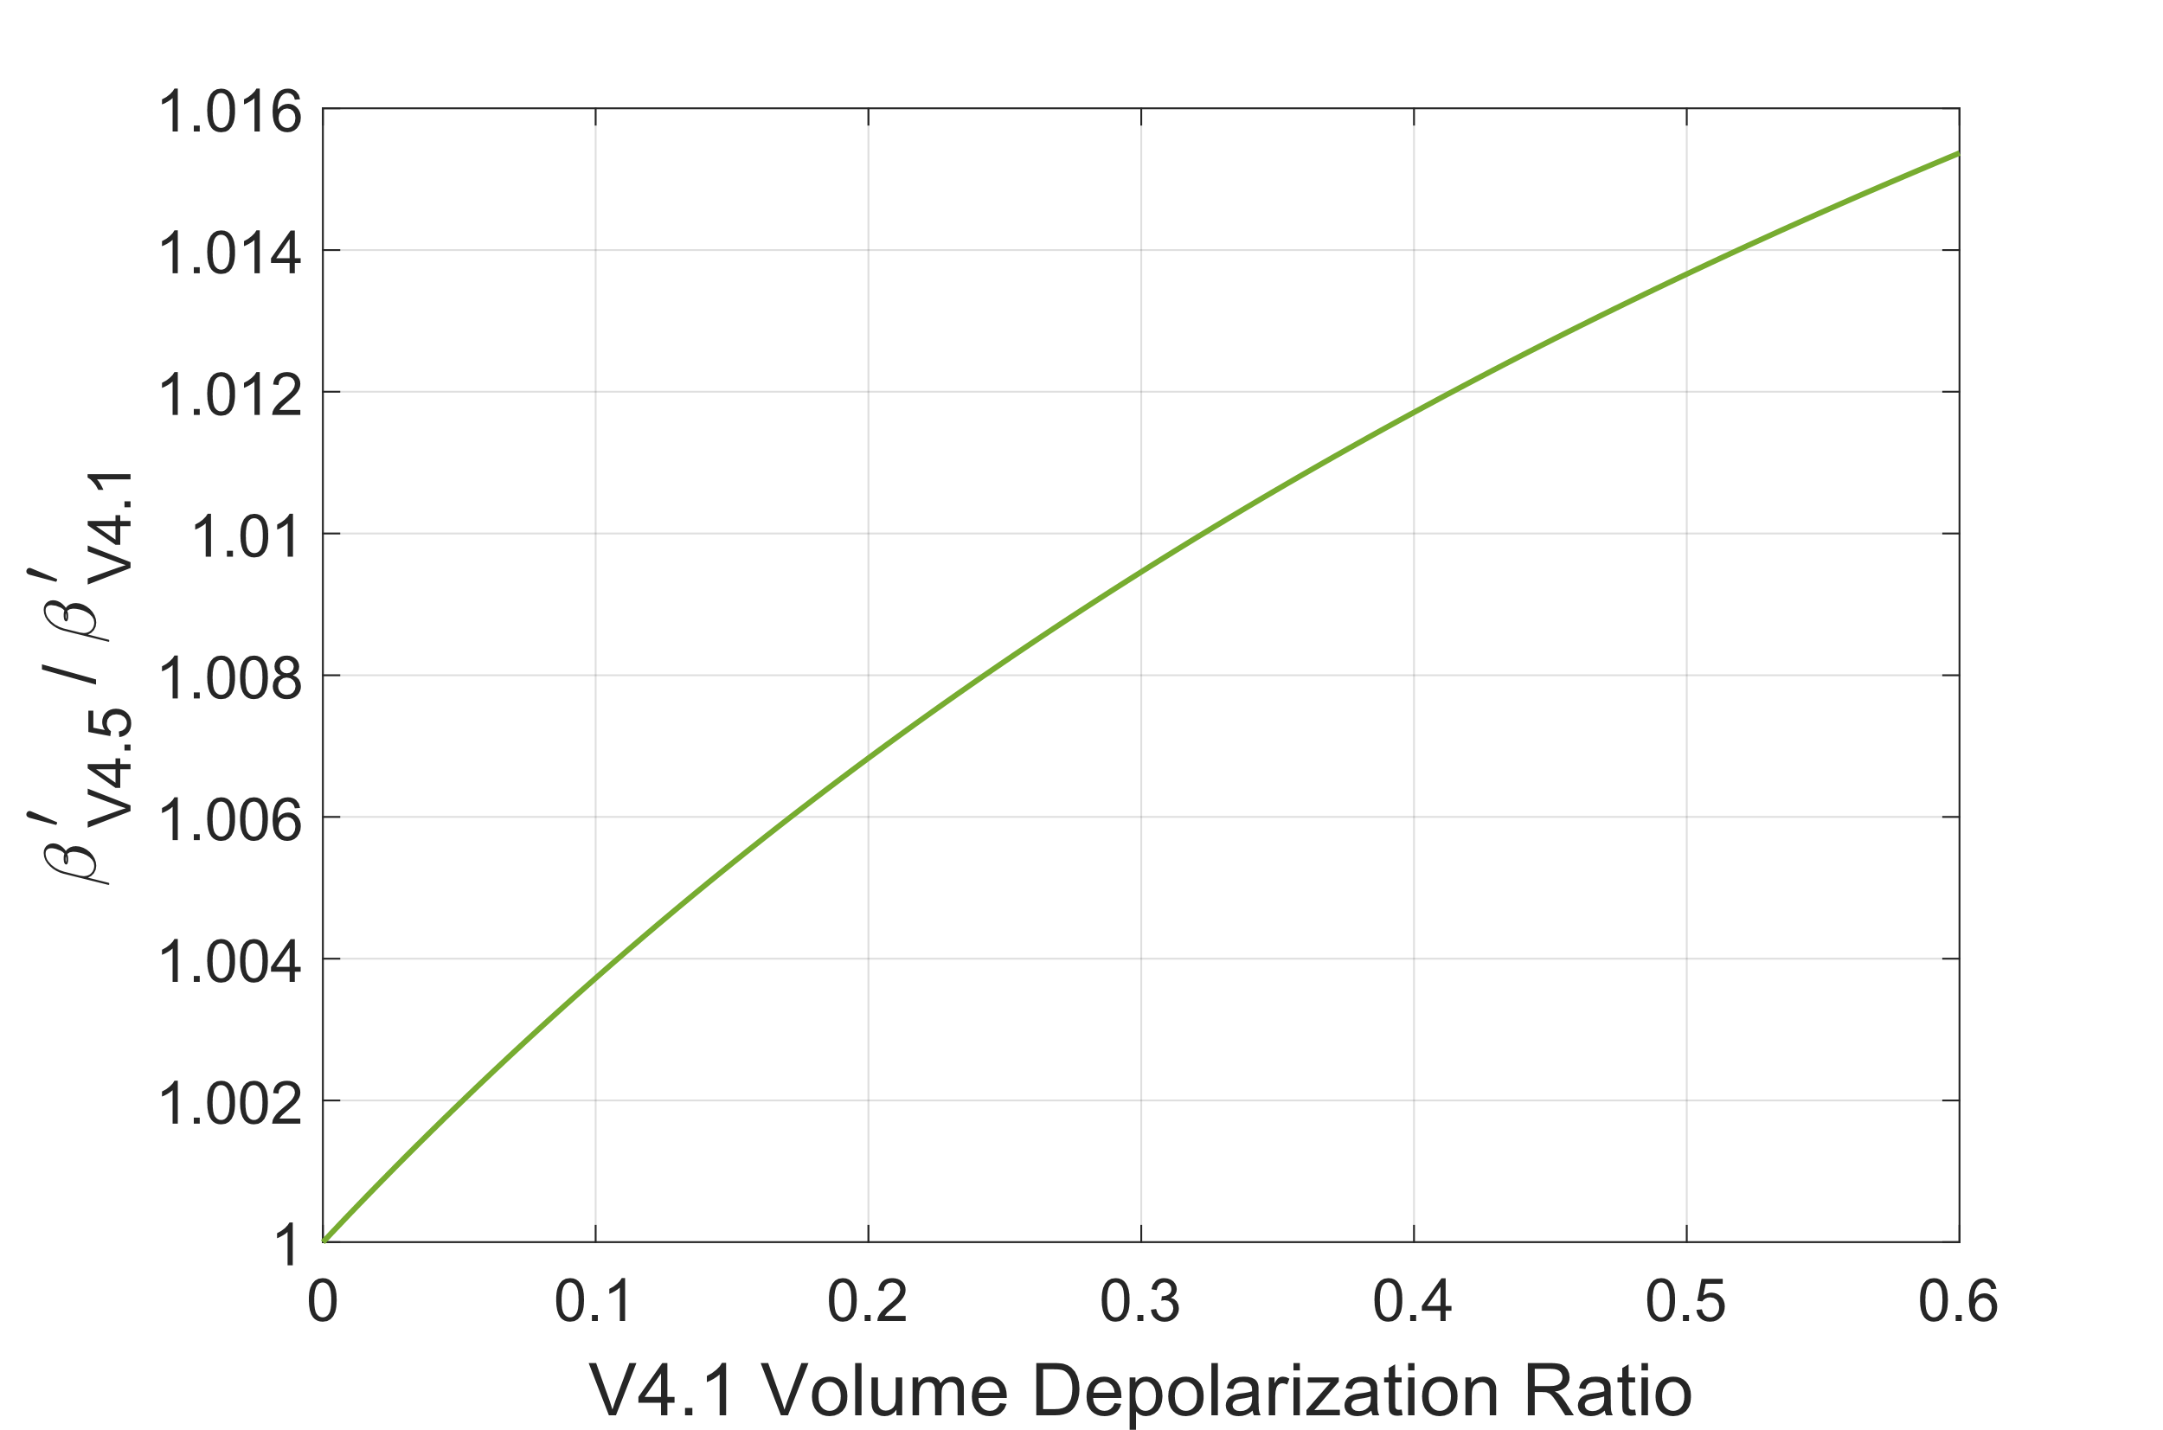
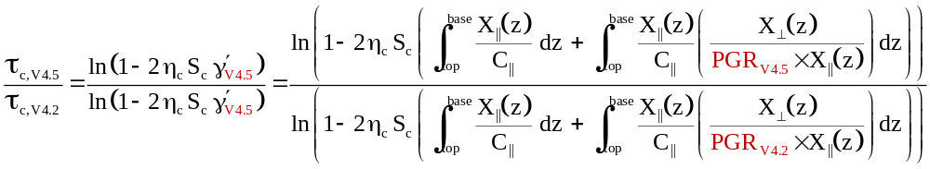
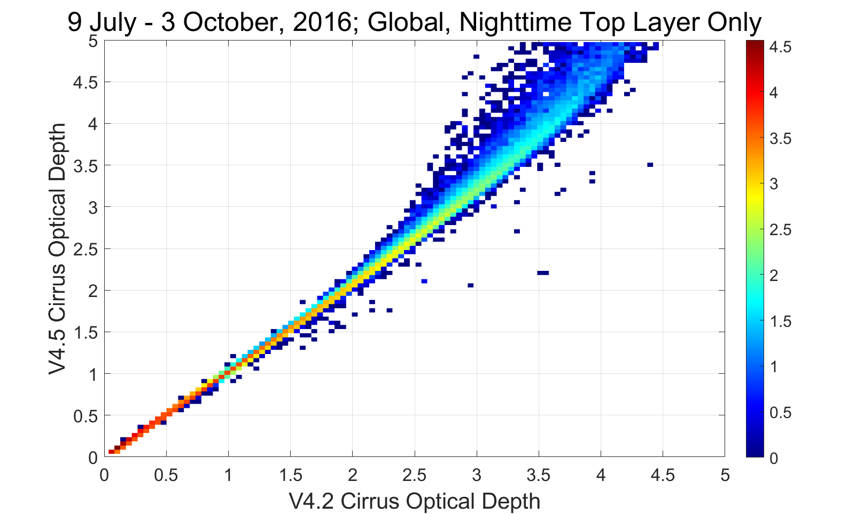
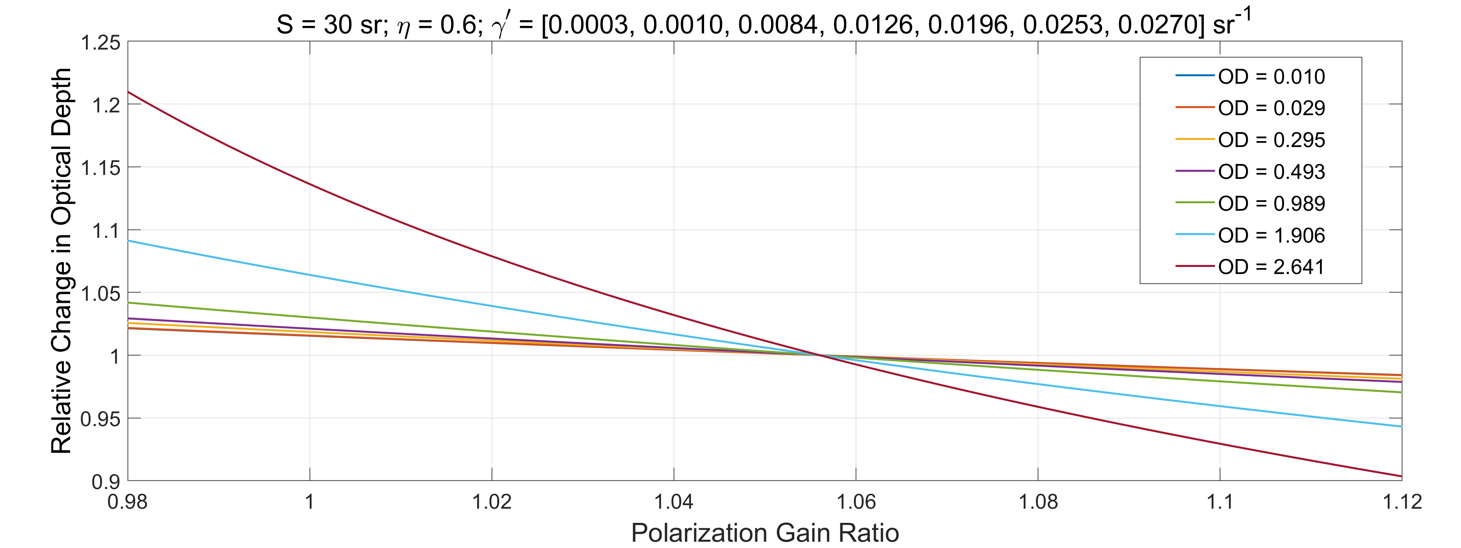
CALIOP PGR Corrections: Take Home Message for Data Users
By happenstance, the high biases in the PGR used in all CALIPSO data releases prior to version 4.5 are largely consistent with the revised daytime PGR estimates, hence daytime changes in 532 nm attenuated backscatter coefficients (β′₅₃₂) and volume depolarization ratios (δ_{v}) will generally be insignificant. At night, previous PGRs are biased high relative to the corrected values, leading underestimates (ranging from ~3% to ~6%) in nighttime δ_{v} and small underestimates (less than 1.5%) in nighttime β′₅₃₂, with relative differences varying as a function of δ_{v}.
Level 2 demo: relative change in optical depth (τ_{c}) as a function of PGR
Expected change in nighttime V4.5 β′₅₃₂ relative to V4.1 β′₅₃₂ as a function of δ_{v} in V4.1
For fixed values of X∥(z), X⊥(z), and C∥, β_{p}(z) and σ_{p}(z) are decreasing functions of PGR
V4.5 Night
PGR = 1.0245
V4.2 Day & Night
PGR = 1.0559
changes in layer optical depths will be larger for more highly depolarizing layers
V4.5 Day
PGR = ~1.07

