Slide 1

Effects of trigger delay on the lidar depolarization products
Livio Belegante⁽¹⁾, Doina Nicolae⁽¹⁾, Victor Nicolae⁽¹⁾, Cristian Radu⁽¹⁾, Razvan Pirloaga⁽¹⁾, Camelia Talianu⁽¹⁾
¹National Institute of Research and Development for Optoelectronics INOE2000, Magurele, Romania
02.Emerging lidar techniques, methodologies, and discoveries
30-Jun, 12:00
02_P34
The 30th International Laser Radar Conference (ILRC) virtual conference, June 26th – July 1st, 2022.

Slide 2
Motivation
1
The study is based on the Triggerdelay test introduced by Freudenthaler (2018).
The aim of the study is to understand how the typical vertical resolution of lidar instruments (3.75m, 7.5m, …) limits the Triggerdelay correction and how this limit is affecting the final lidar products.
The study also presents a method that can be used to correct the Triggerdelay with an accuracy better than the vertical resolution limit of the lidar instrument by using multiple fiber optics approach.
Freudenthaler, V., Linné, H., Chaikovski, A., Rabus, D., and Groß, S.: EARLINET lidar quality assurance tools, Atmos. Meas. Tech. Discuss. [preprint], https://doi.org/10.5194/amt-2017-395, in review, 2018.
The 30th International Laser Radar Conference (ILRC) virtual conference, June 26th – July 1st, 2022.

Slide 3
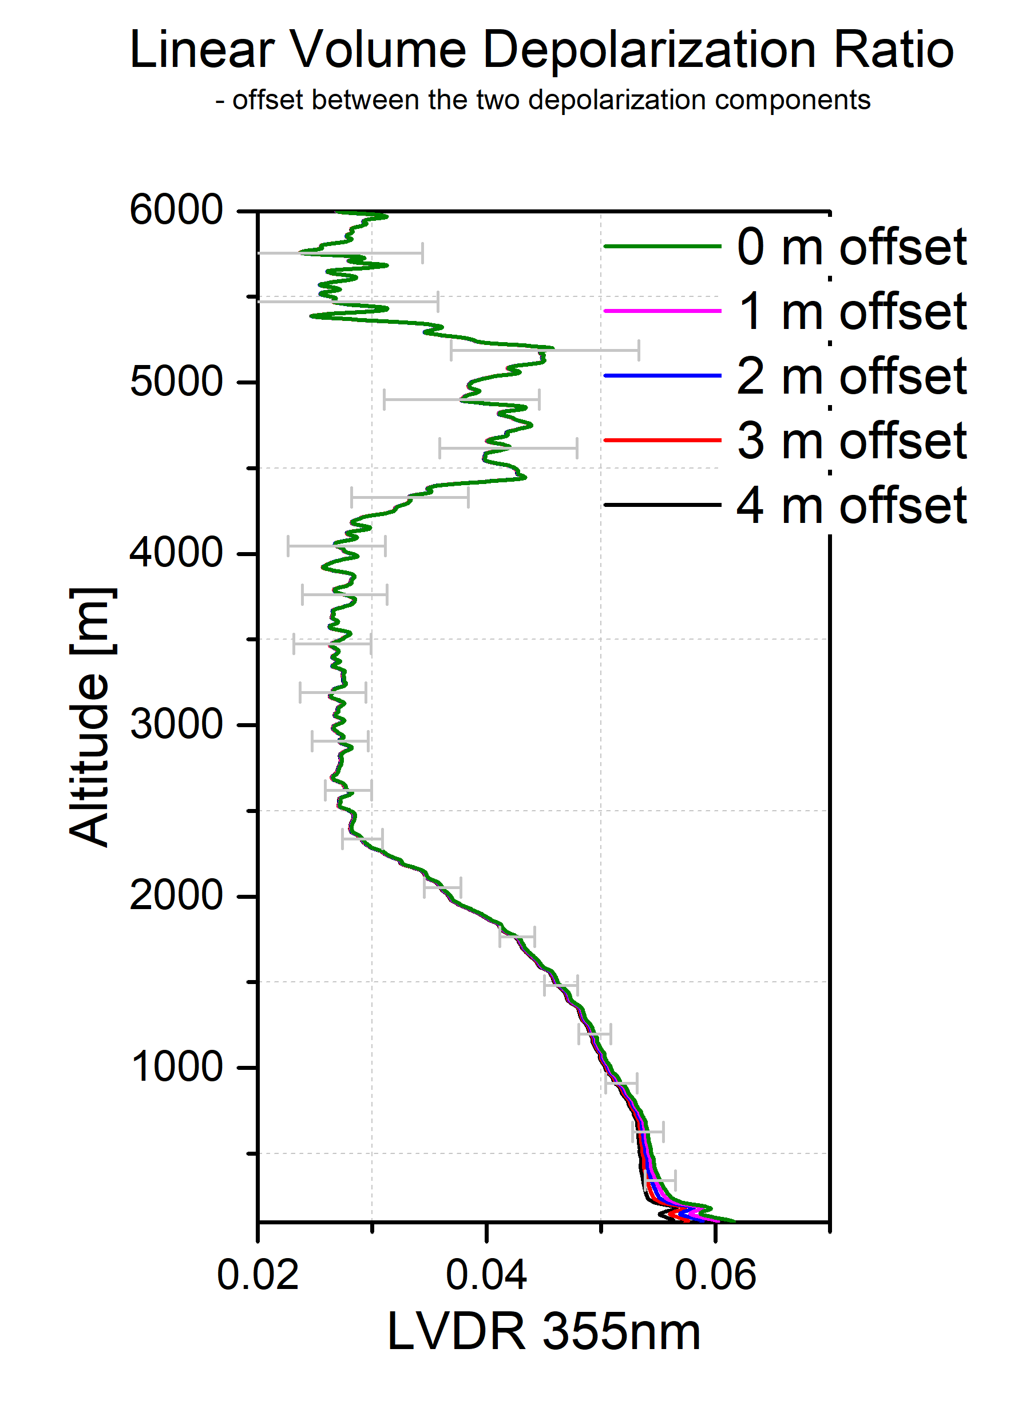
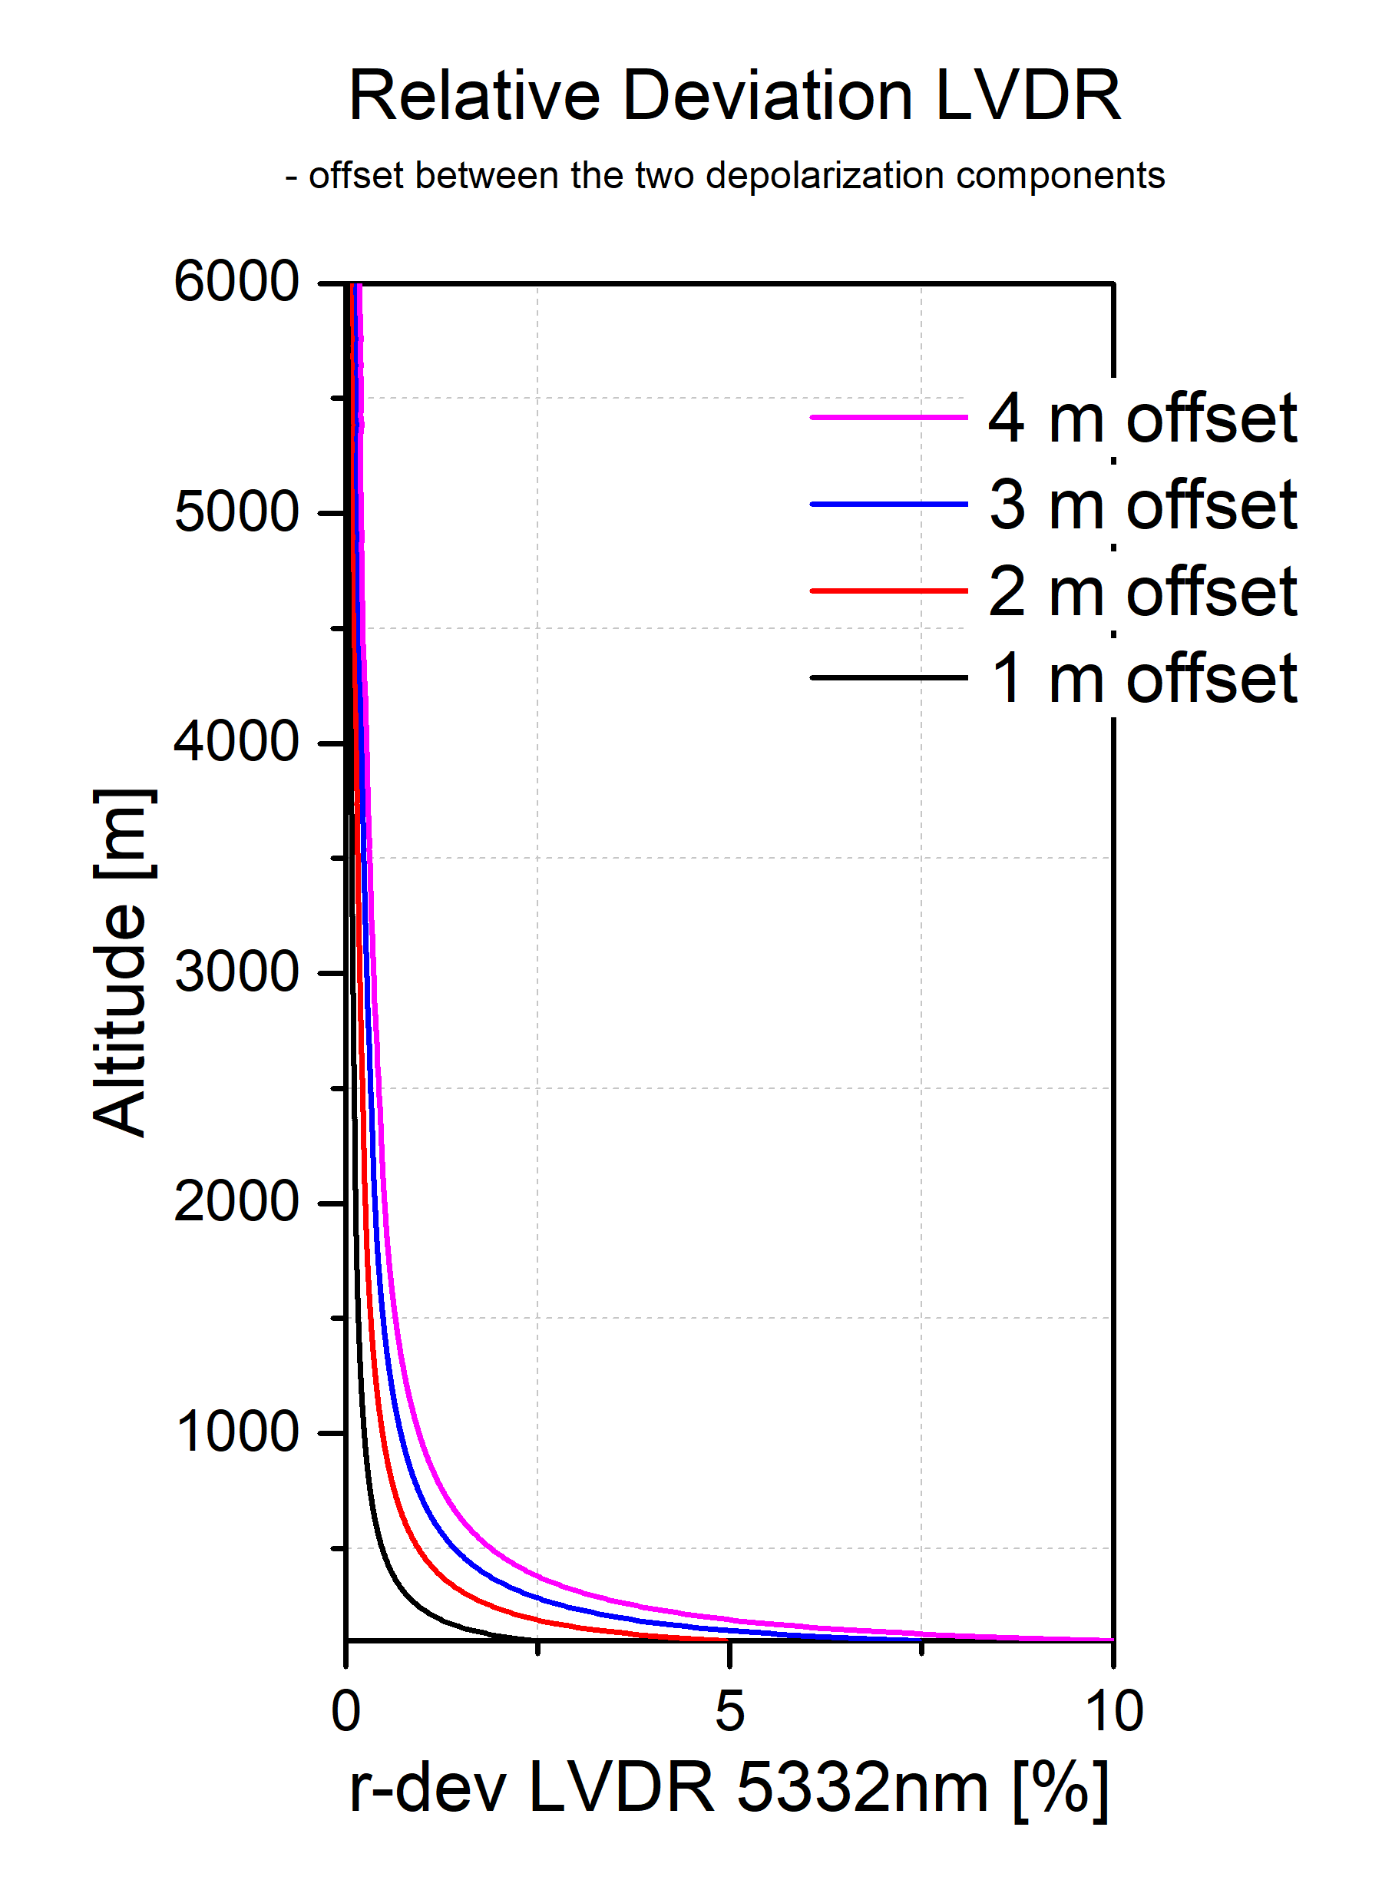
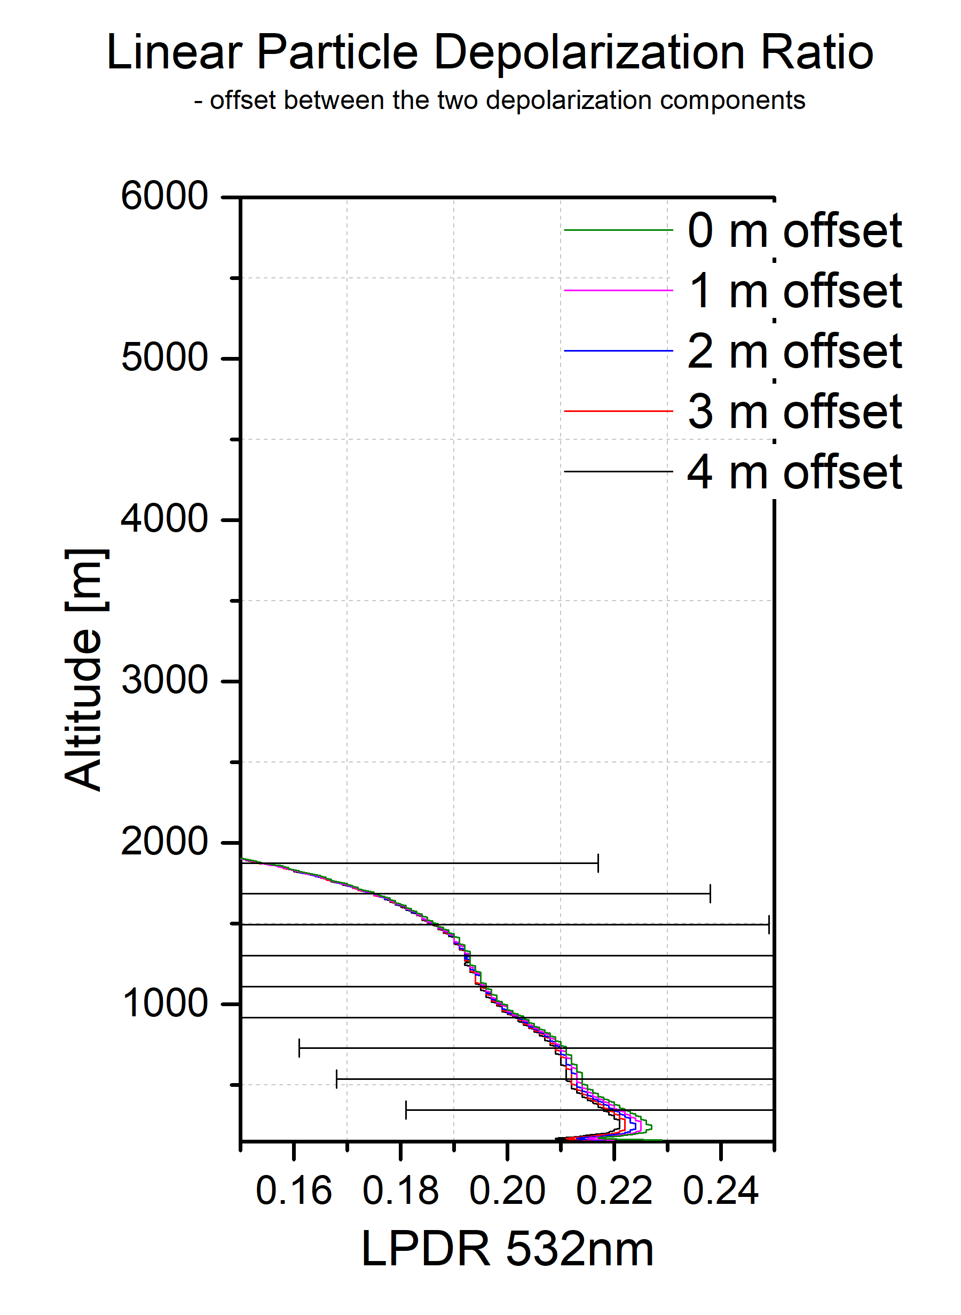
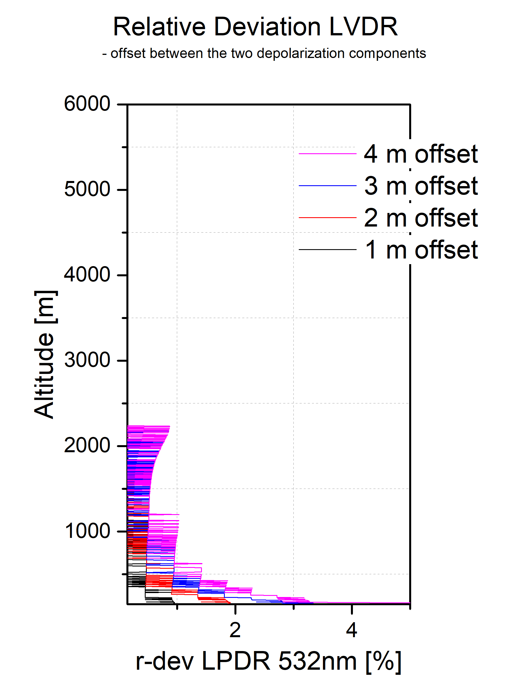
Methods
1
Concept:
The correction of the trigger is limited by the vertical resolution since each bin of the signal corresponds to a certain range window (3.75, 7.5, 15m).
When we correct for the Triggerdelay*, we are limited by the range window (the Triggerdelay correction can be performed only by a multiple of the range resolution: e.g. N x 3.75 m). In reality, the real Triggerdelay correction could have a value between 0 to 3.75 m.
Effects of trigger-delay:
* We usually correct for the Triggerdelay by assessing the number of bins that corresponds to the distance of a known target (or we use a fiber optics with known length and refractive index).
Lidar products in case of trigger induced altitude offset
(1-4 m) for LVDR, LPDR
Relative deviation in case of trigger induced altitude offset
(1-4 m) for LVDR and LPDR
The simulation shows the effects of trigger correction for the case when only one of the used raw profiles has an altitude offset in the range of the bin window (1-4 m for a bin window of 3.75 m)
The 30th International Laser Radar Conference (ILRC) virtual conference, June 26th – July 1st, 2022.

Slide 4
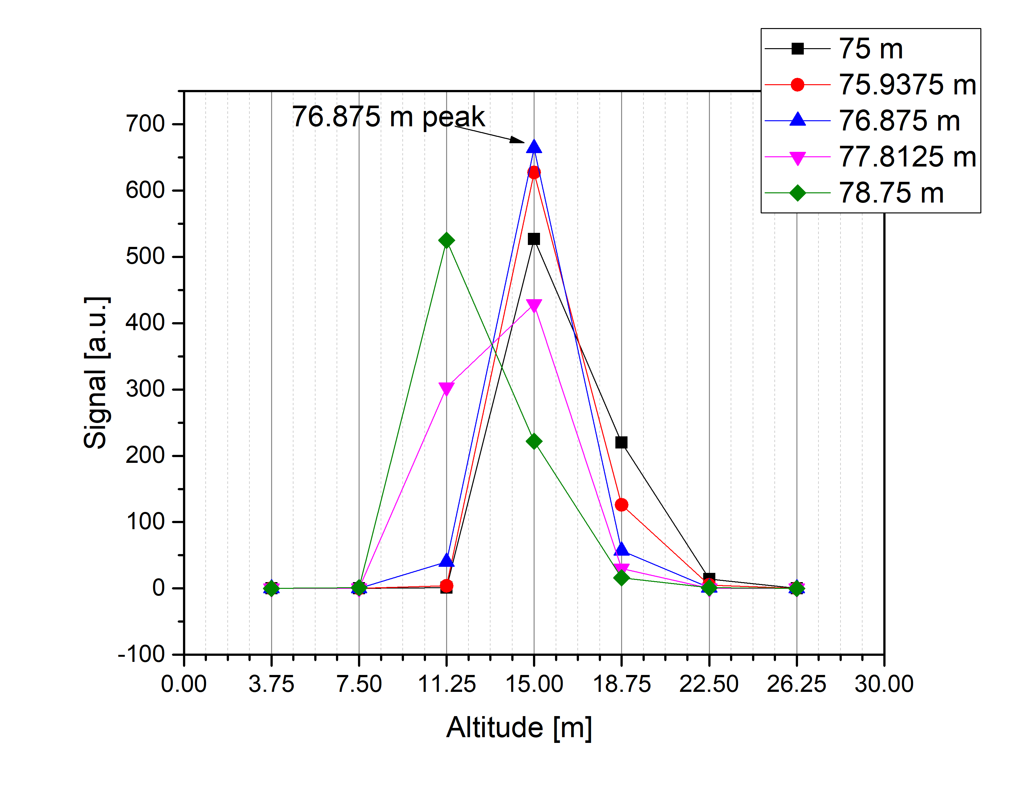
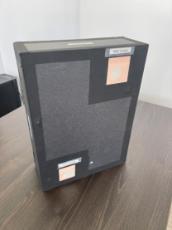
Triggerdelay correction below the range resolution
1
We use multiple fiber optics with lengths within one range bin and we analyse the output peak of the signal returned by using these fibers. The peak centred to the rangebin will have the highest intensity.
Results:
Experimental setup (for 3.75 m resolution):
Fiber lengths:
N x 3.75 m = 75 m
N x 3.75 m + 0.9375 m = 75.9375 m
N x 3.75 m + 1.875 m = 76.875 m
N x 3.75 m + 2.81 m = 77.8125 m
N x 3.75 m + 3.75 m = 78.75 m
Fiber I/O
Optical fiber module to assess the trigger delay
* We usually correct for the Triggerdelay by assessing the number of bins that corresponds to the distance of a known target (or we use a fibre optics with known length and refractive index).
The 30th International Laser Radar Conference (ILRC) virtual conference, June 26th – July 1st, 2022.

Slide 5
Results & Conclusions
1
Effects on the lidar products (simulation):
  LVDR
    up to 1000 m - the signal deviates 2.5% for 1 m offset up to 10% for 4 m offset
    at 1000 m - the relative deviation is 0.5% for 1 m offset and 2.5% for 4 m offset
  LPDR
    up to 1000 m - the signal deviates up to 3% for a 4 m offset and up to 1% for 1 m offset
    at 1000 m - the relative deviation is around 1% for all offset values
Triggerdelay correction:
  highest intensity peak was obtained at 15 m for a 76.875m fiber indicating that the altitude correction could be performed with an accuracy better than the vertical resolution of the lidar instrument (±0.9375 m instead of ±3.75 m).
  the range correction: 61.875 m
Multiple fibers could be used to correct the trigger delay with an accuracy better than the range resolution limit of the instrument.
The Triggerdelay correction method could be used by low overlap lidar instruments in PBL studies.
The range resolution effect can be considered a systematic uncertainty that should be added in the error assessment of the lidar products.
The 30th International Laser Radar Conference (ILRC) virtual conference, June 26th – July 1st, 2022.

