Slide 1

First Simultaneous High-Sensitivity Lidar Observations of Permanent and Sporadic D-Region Ca+, Ca and Na Layers at Yanqing (40.5ºN, 116.0ºE), Beijing
Yuchang Xun (1), Xinzhao Chu (2) （corresponding） , Xu Zou (3), Jing Jiao (4), Zhibin Yu (5)，Guotao Yang(6) （corresponding）
(1) Taiyuan University of Technology,Taiyuan , China E-mail:xunyuchang@tyut.edu.cn
(2) Cooperative Institute of Research in Environmental Sciences & Department of Aerospace Engineering Sciences, University of Colorado Boulder, Boulder, CO, USA, E-mail: xinzhao.chu@colorado.edu
(3) Department of physics and electronic engineering, Hainan Normal University, Haikou, China, Haikou, 571158, China, E-mail: christian5022@163.com
(4) National Space Science Center, Chinese Academy of Sciences, Beijing, China, E-mail: jjiao@swl.ac.cn
(5) Institute of Space Science and Applied Technology, Harbin Institute of Technology (Shenzhen), Shenzhen, China, E-mail: yuzb@hit.edu.cn
(6) National Space Science Center, Chinese Academy of Sciences, Beijing, China, E-mail: gtyang@swl.ac.cn
[12].[Measurements in the stratosphere, mesosphere and thermosphere]
[29-Jun], [12:00]
[Wednesday_ 12_P03]
The 30th International Laser Radar Conference (ILRC) virtual conference, June 26th – July 1st, 2022.

Slide 2
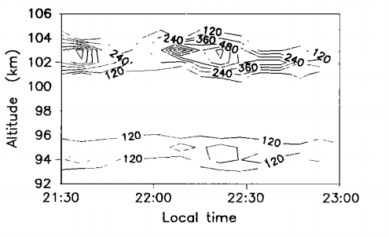
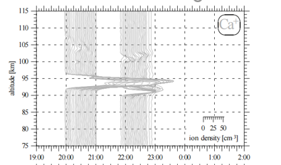
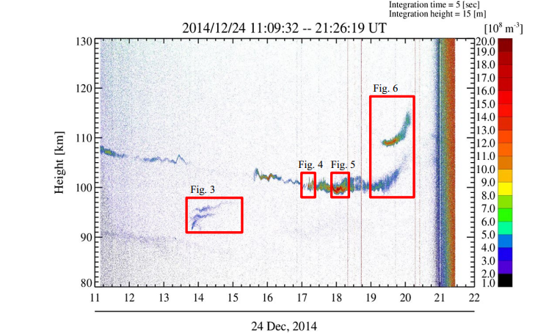
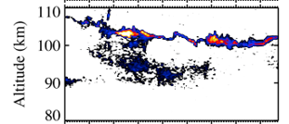
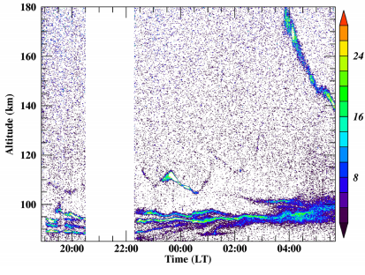
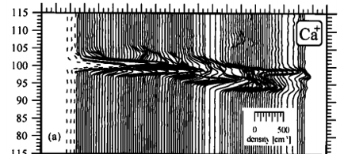
sporadic
above 90 km
2
History: Lidar measurements of Ca⁺
Observatoire de Haute Provence
(44°N, 6°E), October 27, 1983
Kühlungsborn
(54°N, 12°E), April 7, 1997
Tachikawa
(35.7°N, 139.4°E), December 24, 2014
(Granier et al., 1989)
(Gerding et al., 2001)
(Ejiri et al., 2019)
Juliusru
(54.5°N,13.4°E), August 21, 1995
Arecibo
(18.3°N,66.7°W) December 8, 2009
Arecibo
(18.3°N,66.7°W) November 29,2016
(Alpers et al., 1996)
(Raizada et al., 2011)
(Raizada et al., 2020)
The 30th International Laser Radar Conference (ILRC) virtual conference, June 26th – July 1st, 2022.

Slide 3
Observations of background (main) Ca+ layers
2
Yanqing Station (40.5°N, 116.0°E) near Beijing, China
201912-202108:131 nights
All of Ca⁺ background (main) layers reach below 90 km2
permanent weak Ca⁺ layer
density: a dozen Ca⁺ cm⁻³
altitude: 83 - 103 km
The 30th International Laser Radar Conference (ILRC) virtual conference, June 26th – July 1st, 2022.

Slide 4
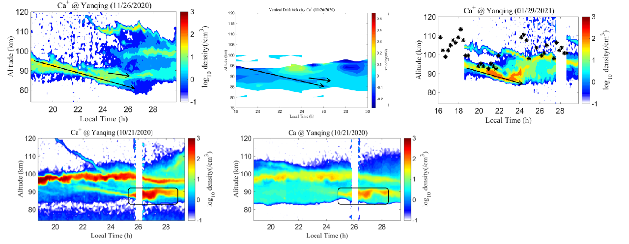
Observations of sporadic Ca+ layers
2
Yanqing Station (40.5°N, 116.0°E) near Beijing, China.
201912-202108:131 nights
64 sporadic Ca⁺ layers reach below 90 km2
Two major categories:
Transported downward from high altitude
The 30th International Laser Radar Conference (ILRC) virtual conference, June 26th – July 1st, 2022.

Slide 5
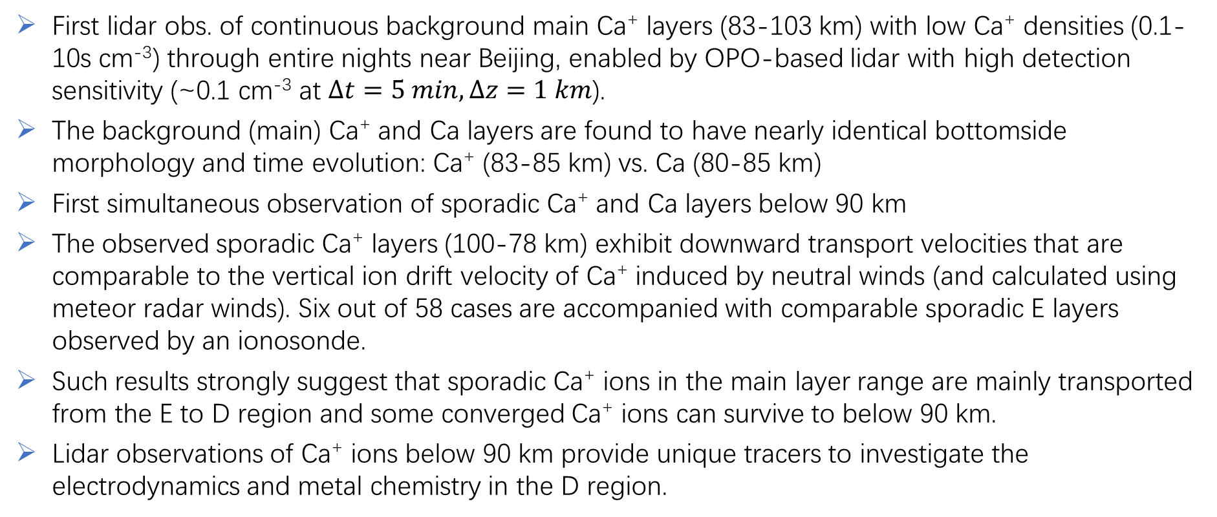
Conclusions and Significance
1
First lidar obs. of continuous background main Ca⁺ layers (83-103 km) with low Ca⁺ densities (0.1-10s cm⁻³) through entire nights near Beijing, enabled by OPO-based lidar with high detection sensitivity (~0.1 cm⁻³ at $∆t=5 min, ∆z=1 km$).
The background (main) Ca⁺ and Ca layers are found to have nearly identical bottomside morphology and time evolution: Ca⁺ (83-85 km) vs. Ca (80-85 km)
First simultaneous observation of sporadic Ca⁺ and Ca layers below 90 km
The observed sporadic Ca⁺ layers (100-78 km) exhibit downward transport velocities that are comparable to the vertical ion drift velocity of Ca⁺ induced by neutral winds (and calculated using meteor radar winds). Six out of 58 cases are accompanied with comparable sporadic E layers observed by an ionosonde.
Such results strongly suggest that sporadic Ca⁺ ions in the main layer range are mainly transported from the E to D region and some converged Ca⁺ ions can survive to below 90 km.
Lidar observations of Ca⁺ ions below 90 km provide unique tracers to investigate the electrodynamics and metal chemistry in the D region.
The 30th International Laser Radar Conference (ILRC) virtual conference, June 26th – July 1st, 2022.

