Slide 1

Tropospheric Ozone Differential Absorption Lidar (DIAL) Development at New York City
Dingdong Li¹ , Yonghua Wu^{1,2} , Thomas Legbandt^{1,2} , Mark Arend^{1,2} , Maggie Liang^{1,2} , Fred Moshary^{1,2}
¹ City College of New York, CUNY, New York
² NOAA Center for Earth System Sciences and Remote Sensing Technologies
(CESSRST), New York, NY
05. Greenhouse gases, tracers, and transport in the free troposphere and above
Jun. 27th, 14:15 (UTC)
P06
The 30th International Laser Radar Conference (ILRC) virtual conference, June 26th – July 1st, 2022.

Slide 2
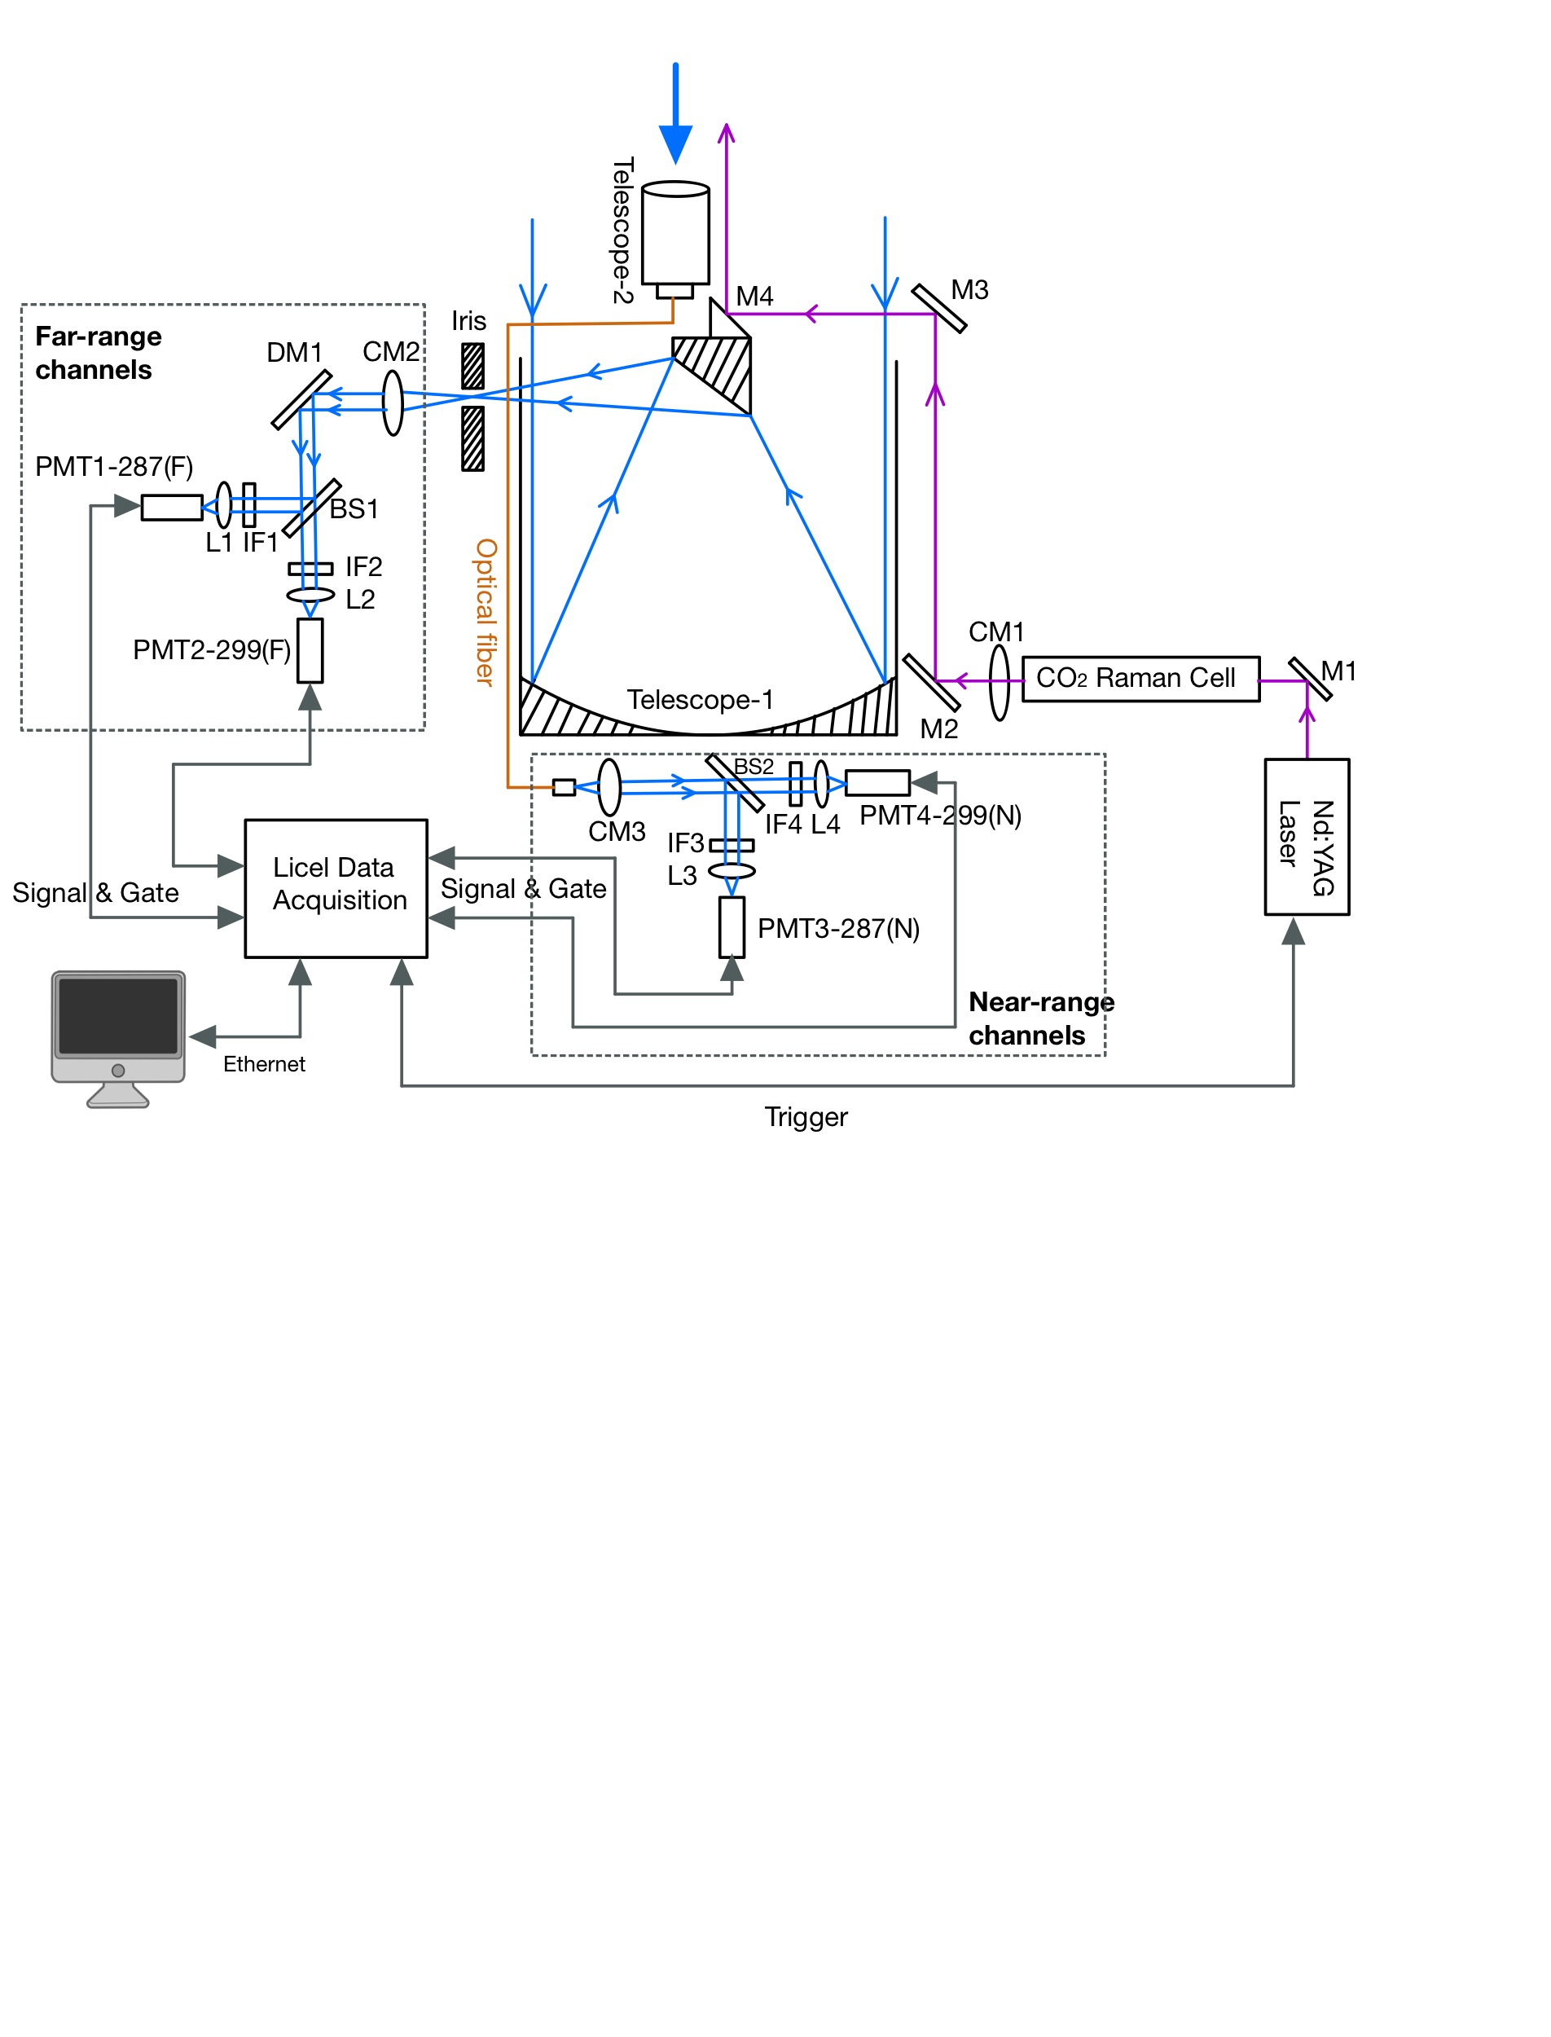
CCNY-Ozone-DIAL System
1
Transmitter:
Nd:YAG Laser (Quantel Q-Smart 450), 266 nm, 50 mJ, 20 Hz
1-m Raman Cell filled with CO₂ of 10.3 bar.
“On”-line: 287.2 nm, 10.6 mJ
“Off”-line: 299.1 nm, 6.3 mJ.
Receivers:
Far-range telescope: 50-cm diameter, 1.5-mrad FOV, 510-m full overlap (simulated).
Near-range telescope: 5-cm diameter, 4.3-mrad FOV, 120-m full overlap (simulated).
Beam splitter: Omega Optical, >90% T @ 299.1 nm, >95% R @ 287.2 nm.
Interference Filter: Alluxa, 287.2 nm and 299.1 nm (FWHM ~1nm, T ~ 35%, OD 5 blocking)
Detectors: gated PMTs, Hamamatsu R9880U-113
Data Acquisition:
Licel transient recorder (model TR40-16bit-3U, Ethernet), 40 MHz and 16 bits Analogy to Digital Converter, 800 MHz Max Photo-Counting rate, 25 ns time resolution.
Fig. 1. Schematic diagram of CCNY O3-DIAL system.
The 30th International Laser Radar Conference (ILRC) virtual conference, June 26th – July 1st, 2022.

Slide 3
Ozone Retrieval
2
1. Ozone DIAL Equation:
2. Retrieval Procedures:
Pre-processing
Cloud Screening
Signal Merge
Ozone Calculation
Aerosol Correction
1. Merge the near and far range analog signal for cloud screening.
2. Take derivative of Pz² of the merge signal.
3. Identify the cloud base height.
1. Calculate ozone number density.
2. Calculate the molecular extinction and air density using the model data or radio-sound data.
3. Calculate the ozone mixing ratio.
Calculate the aerosol correction terms with the ceilometer or aerosol lidar data.
1. Time average.
2. PC signal dead time correction.
3. Background subtraction.
Merge the PC and analog signal profile.
The 30th International Laser Radar Conference (ILRC) virtual conference, June 26th – July 1st, 2022.

Slide 4
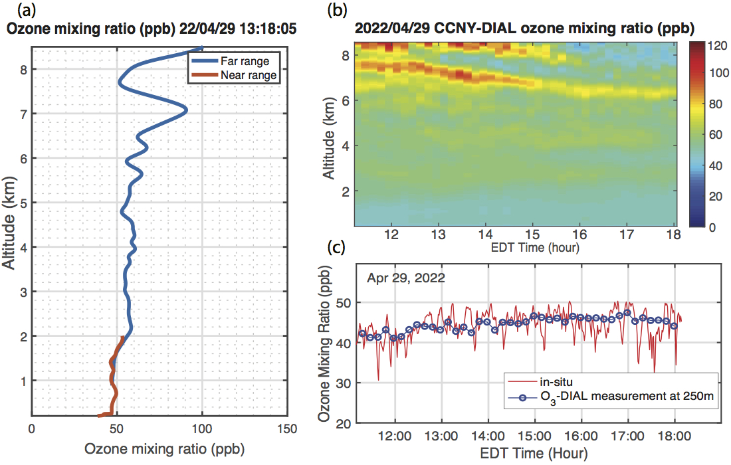
Result
3
04/29/2022 Ozone retrievals consistency from the near and far-range channels and comparison with ground obs.
elevated ozone concentration around 7.5 km and above 8. km, which may be associated with stratospheric ozone intrusion in spring.
Good consistency between the two channels at 0.9-1.8 km
Fig. 2. CCNY-DIAL ozone mixing ratio retrieval on April 29th 2022. (a) Ozone mixing ratio profiles from the far- and near-channel at 2022 April 29th 13:18:05 (EDT). (b)Time-altitude curtain plot of the near-far range merged ozone mixing ratio from 11:00-18:00 (EDT). (c)The comparison of DIAL-measured ozone mixing ratio at 250 m and ground ozone measurements.

Slide 5
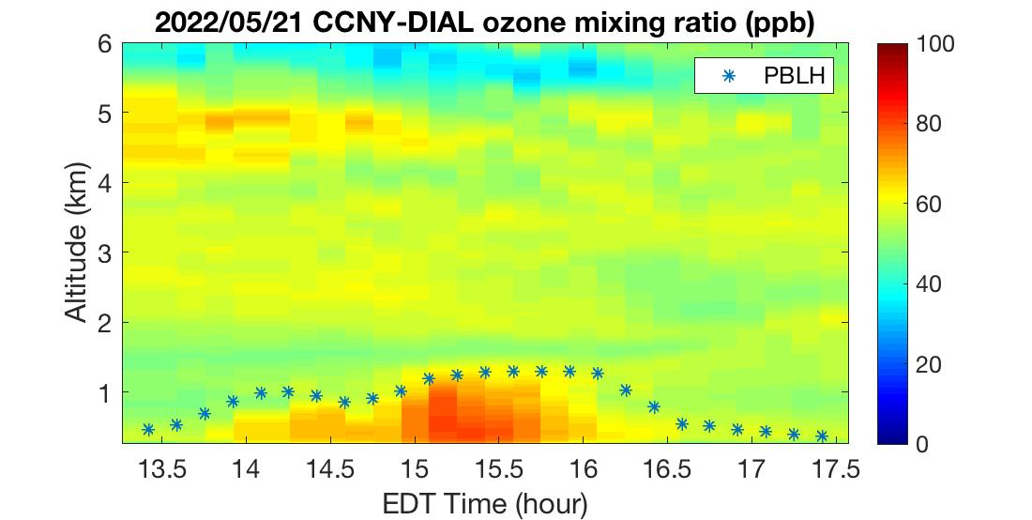
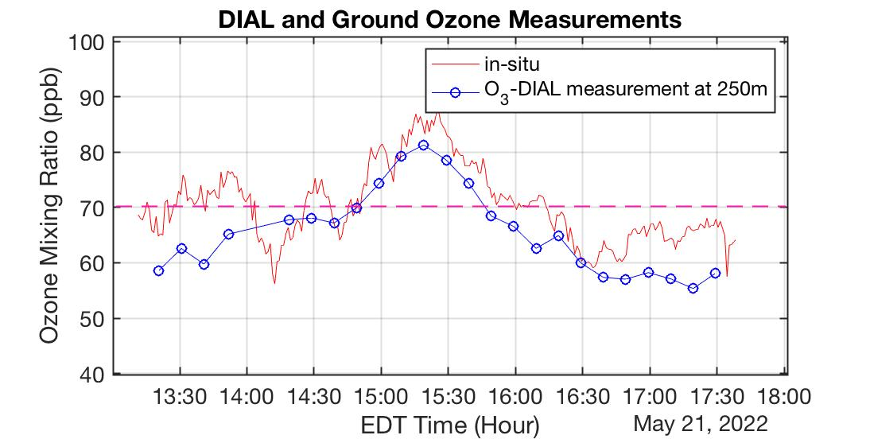
05/21/2022: An O3 pollution event on the hot day (air Tmax>90F) Good consistency and trend between the DIAL retrieval and ground in-situ obs.
Result
4
High ozone concentration (>70 ppb) within the PBL around 15:00 - 15:40 (EDT)
The ozone mixing ratio from DIAL at 250 m altitude showed consistent temporal variation with the ozone mixing ratio from the surface ozone monitor.

Slide 6
Conclusion
5
In this paper, we demonstrated a newly-built Ozone DIAL system at the City College of New York (CCNY).
The DIAL uses a Nd:YAG laser pumping a CO2 Raman cell to generate the desired wavelengths at 287.1 nm and 299.2 nm. The receiver utilizes two telescopes that cover the near-range and far-range ozone measurement from near-surface to upper troposphere.
We have made experimental observations and evaluated the O3 retrievals with the in-situ measurements. The results indicate consistent O3 retrievals in the upper PBL between the far-range and near-range channels.
The O3 results at near-surface (∼0.25 km) show good agreement with the ground in-situ measurements under favorable weather condition.
Our observations show aloft O3 layers in the free troposphere in NYC area, which might be associated with the regional transport from the wildfire smoke and/or the stratosphere-troposphere exchange, and high ozone concentration within the PBL during pollution events. These initial results show that the CCNY-Ozone DIAL is able to provide reliable ozone profiles in the troposphere.
Currently, we are continuing the system optimization and regular experiments. The DIAL system will be moved into a trailer which allows mobile observation for the field campaign and inter-comparison with other ozone vertical measurements.
Acknowledgements:
This research was in part funded by the New York State Energy Research Development Authority (NYSERDA, grants #: 137482), NESCAUM (grant# 2417) and the NOAA under the CESSRST agreement NA16SEC4810008.

