Slide 1


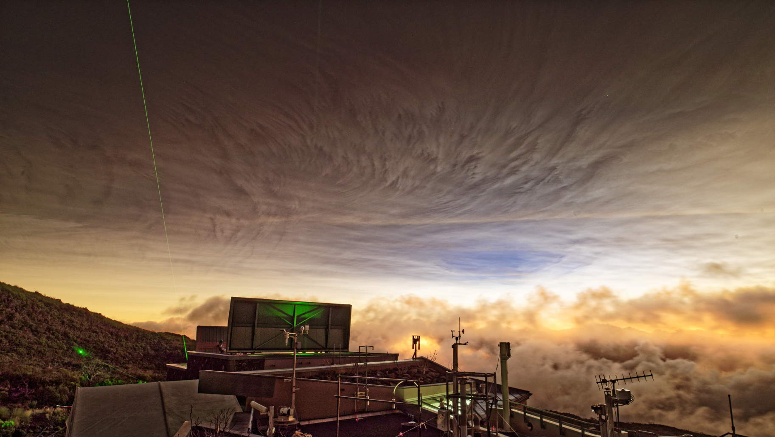





Hunga-Tonga Volcanic Plume Optical Properties Derived from Lidar Observations at Reunion Island (Indian Ocean, 21°S, 55°E)
Alexandre Baron¹, Guillaume Payen², Valentin Duflot^{1,2}, Patrick Chazette³, Yann Hello², Nicolas Marquestaut², Marion Ranaivombola¹, Nelson Bègue¹, Thierry Portafaix¹ & Jean-Pierre Cammas²
¹Laboratoire de l'Atmosphère et des Cyclones (LACy), UMR 8105, Université de La Réunion - CNRS - Météo-France, Saint-Denis de La Réunion, France
²Observatoire des Sciences de l'Univers de La Réunion (OSU-R), UMS 3365, Saint-Denis de La Réunion, France
³Laboratoire des Sciences du Climat et de l'Environnement, LSCE-IPSL, UMR 8212, Université Paris-Saclay - CEA - CNRS - UVSQ, Gif-sur-Yvette, France
03- Atmospheric aerosol and clouds properties
27 June, 14:15
Monday_ 03_P08
The 30th International Laser Radar Conference (ILRC) virtual conference, June 26th – July 1st, 2022.
Picture – Maïdo Observatory © University of La Réunion

Slide 2
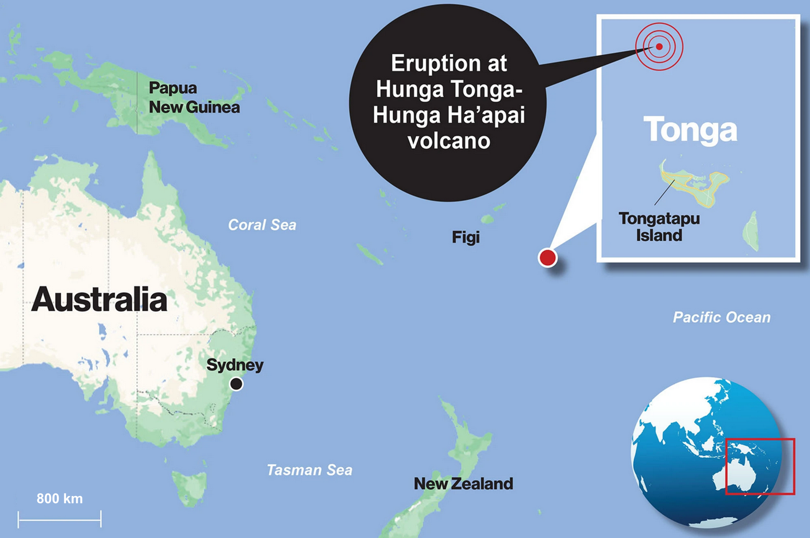
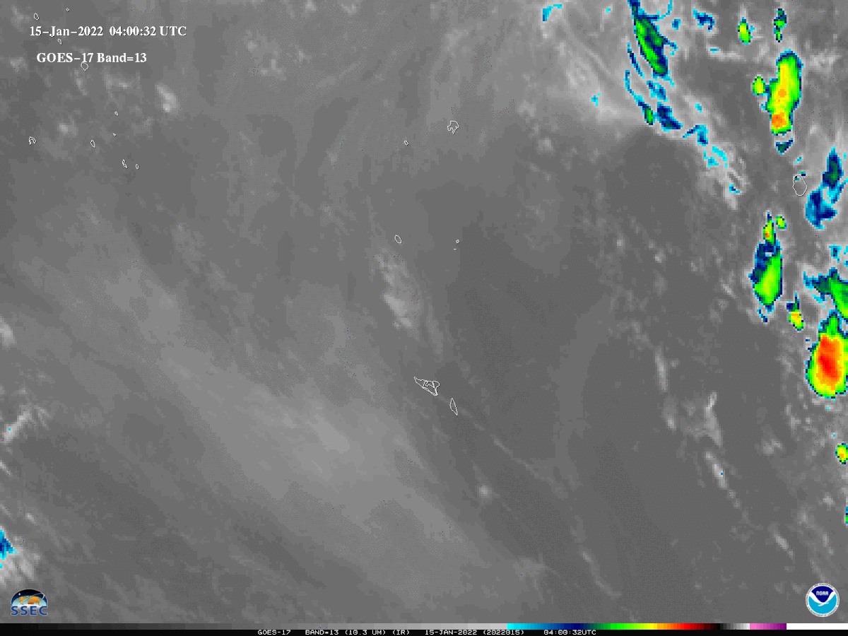







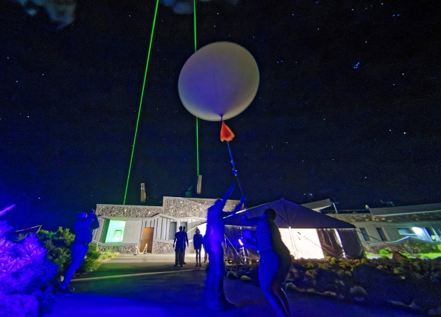
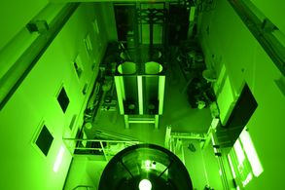
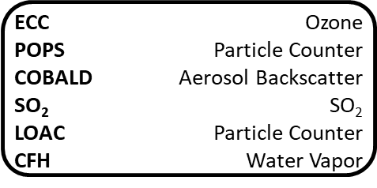
Hunga-Tonga eruption and campaign settlement in La Réunion
1
TR²Ex campaign
© New York Post
15th January → powerful Phreato-Plinian eruption
Blast ~100 Mt of TNT equivalent due to the volcano underwater caldera
High altitude perturbation → Up to 58 km, a record in the satellite era (Carr et al. 2022)
~0.4 Tg of SO₂ injected / ~150 Tg of Water injected into the stratosphere
Balloon-born in-situ measurements during the intensive campaign at Maïdo
Large size lidar systems at Maïdo © CNRS
>15 payloads launched
Scientific Challenges
Observations every nights between 19 Jan. and 28 Jan. using two lidars
Stratospheric chemistry perturbations
Radiative budget perturbation
Compare with historical volcanic activity
λ = 355 nm & λ = 532 nm
The 30th International Laser Radar Conference (ILRC) virtual conference, June 26th – July 1st, 2022.

Slide 3
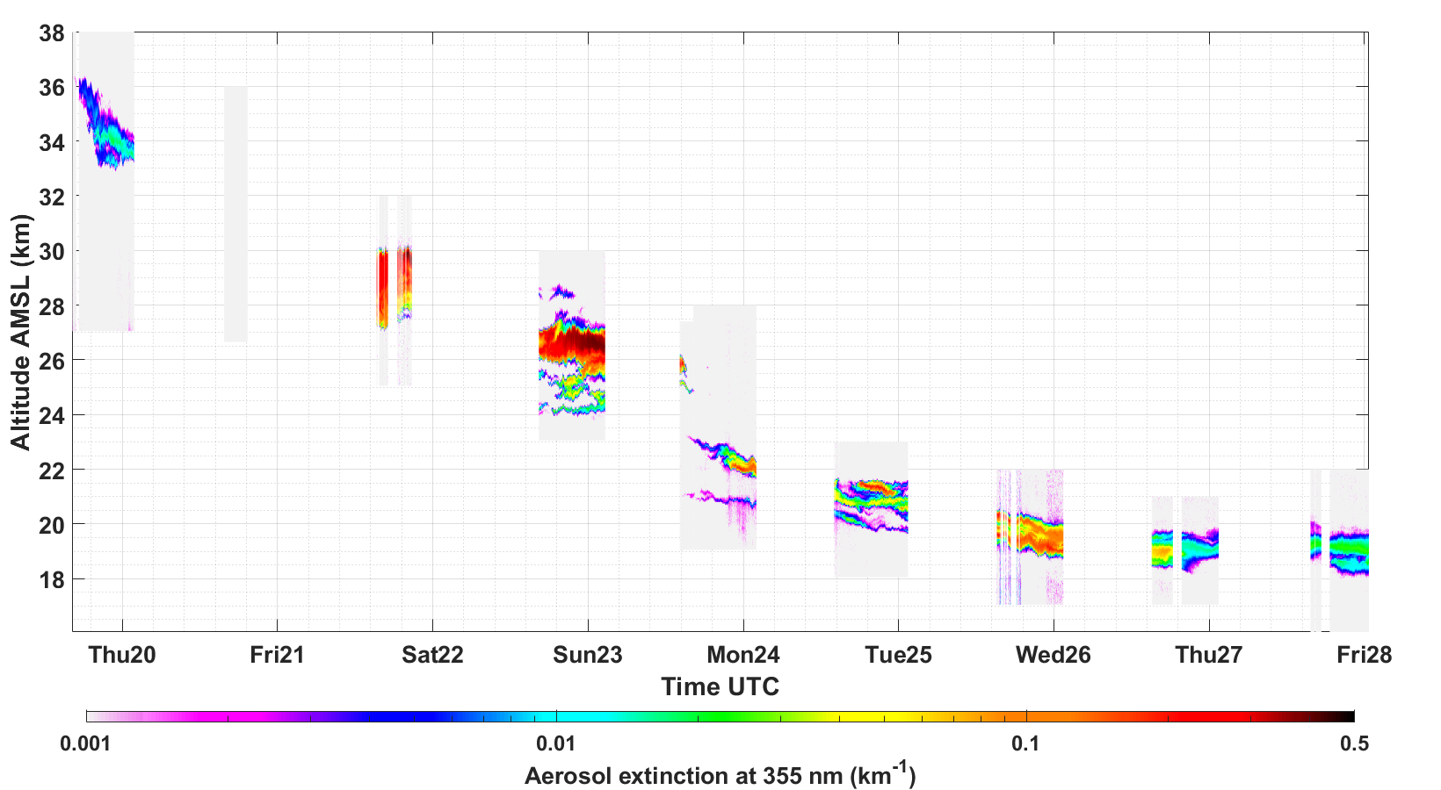
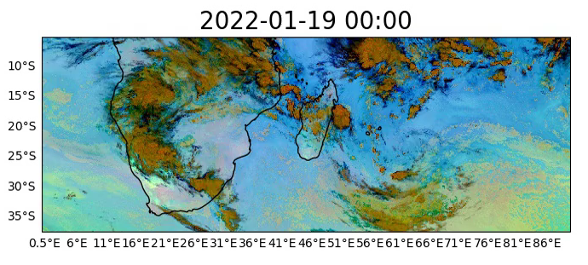
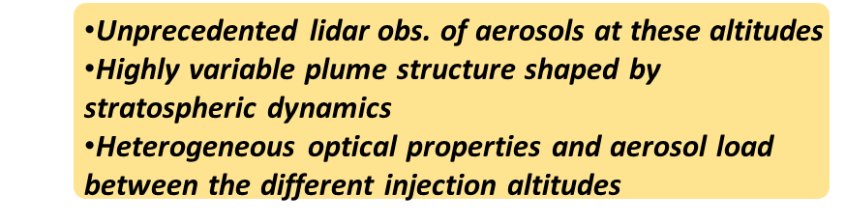
Hunga-Tonga volcanic plume observations above La Réunion – First overflight
2
L1
12000 km in 4 days
~ 30 m.s⁻¹
L2
~ 21 m.s⁻¹
L3
~ 18 m.s⁻¹
L4
~ 15 m.s⁻¹
Baron et al. 2022, To be submitted
The 30th International Laser Radar Conference (ILRC) virtual conference, June 26th – July 1st, 2022.

Slide 4
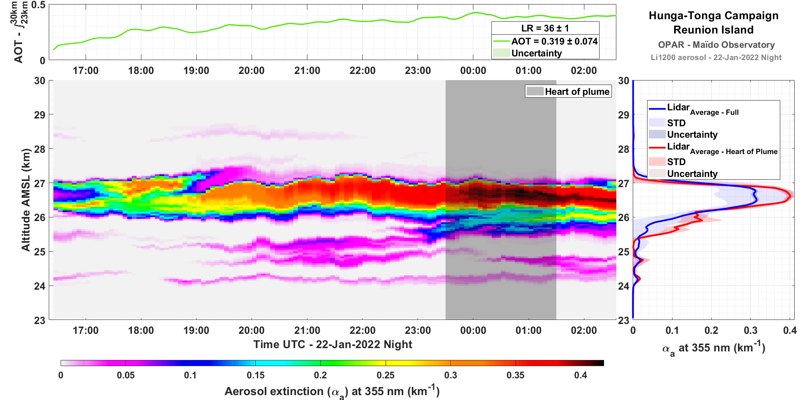
Hunga-Tonga volcanic plume – L3 layer
3
sr
ECC
POPS
SO₂
_{Balloon-born obs.}
ECC
CFH
COBALD
_{Balloon-born obs.}
Heart of
Plume
Baron et al. 2022, To be submitted
The 30th International Laser Radar Conference (ILRC) virtual conference, June 26th – July 1st, 2022.

Slide 5
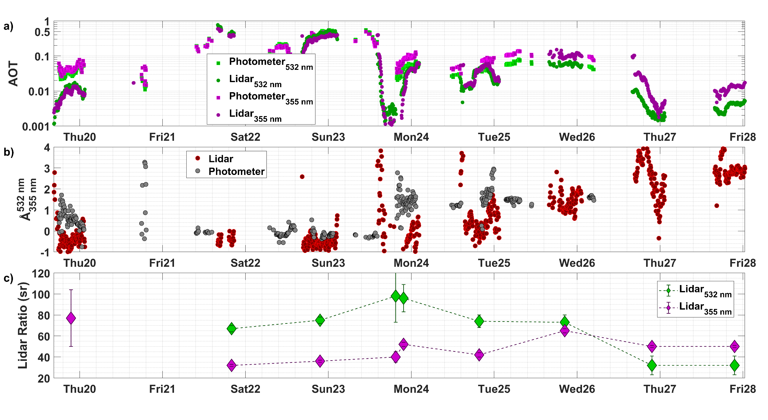
Hunga-Tonga volcanic plume optical properties – First overflight
4
Preliminary results
High AOT values
The higher is the coarser
Aerosol nature:
a complex mixing
x
x
Lower LR than expected, mixing with marine aerosols?
Aerosol optical properties are heterogeneous depending of the altitudes of injections
Baron et al. 2022, To be submitted
The 30th International Laser Radar Conference (ILRC) virtual conference, June 26th – July 1st, 2022.

Slide 6
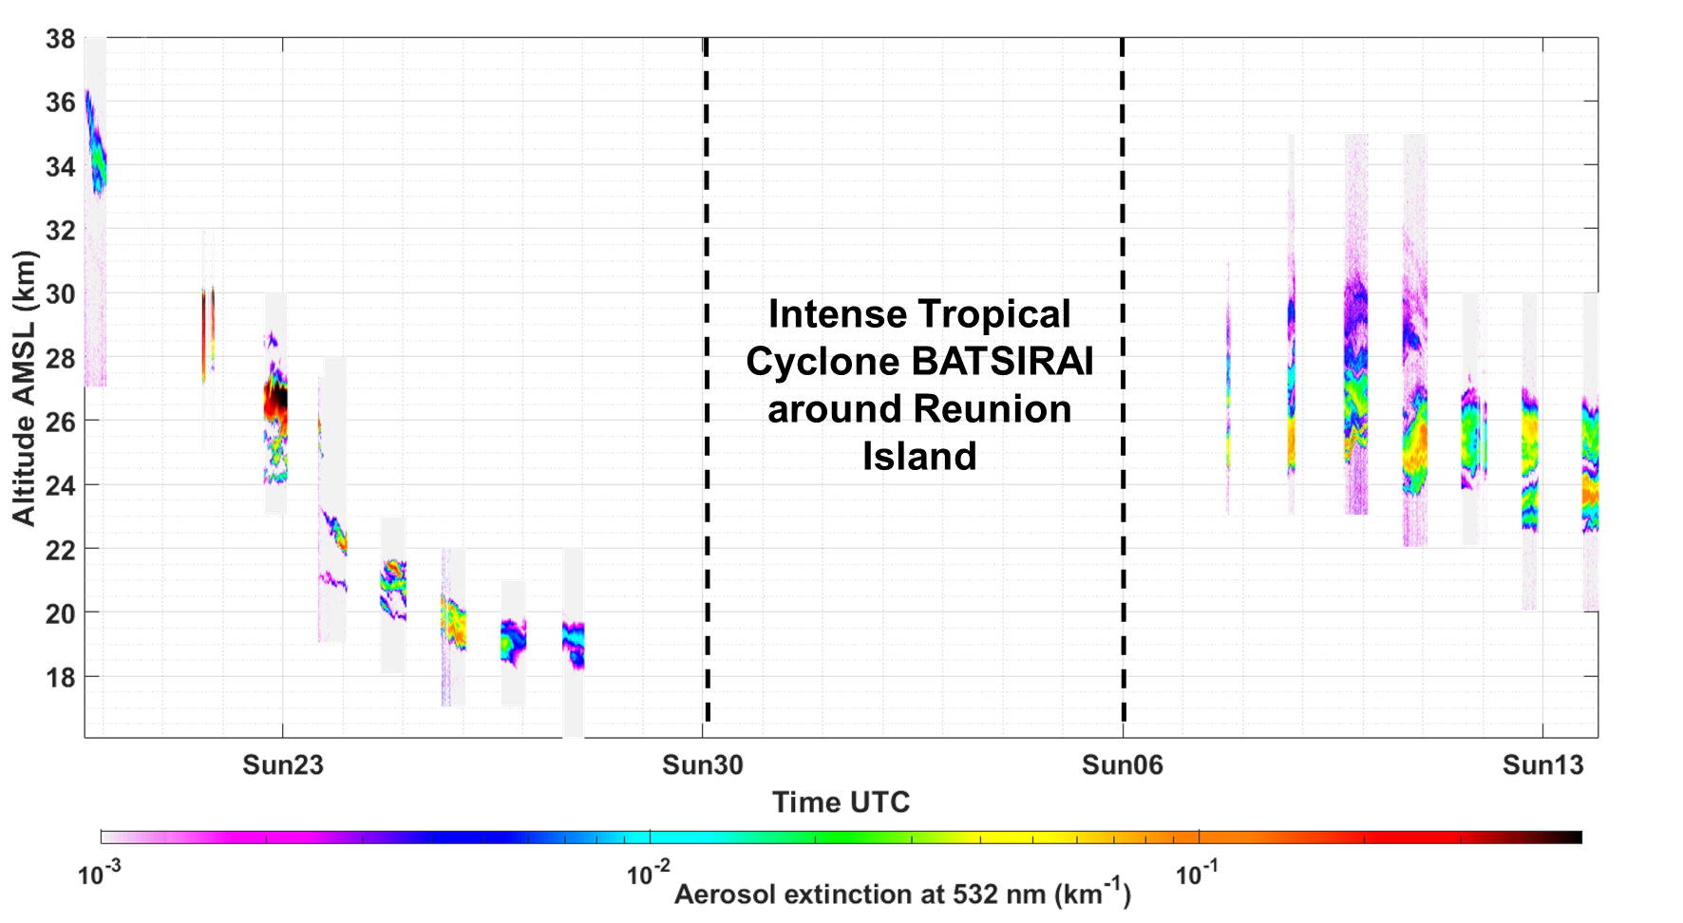
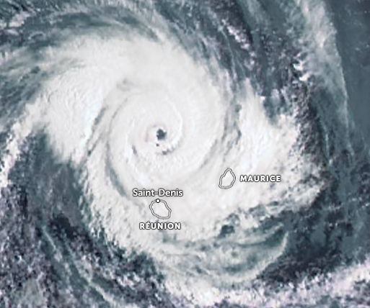
Hunga-Tonga volcanic plume – First & Second overflight
5
1st overflight
Intense tropical cyclone Batsirai around La Réunion
2nd overflight
L3
L3?
January
February
Aerosol optical properties are likely to evolve as the plume circle the Earth with time
The 30th International Laser Radar Conference (ILRC) virtual conference, June 26th – July 1st, 2022.

Slide 7
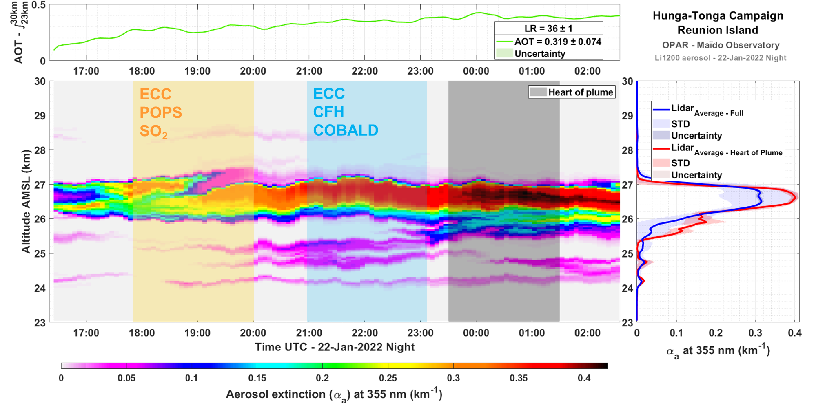
Conclusion & perspectives
6
OPAR RS measurements
  Unprecedented lidar observations of aerosol volcanic plume at these altitudes
  Highly variable plume structure shaped by stratospheric dynamics
  Heterogeneous optical properties and aerosol load between the different injection altitudes
  Follow up the plume descent an dispersion as it circled the Earth
In situ & Lidar synergies
  POPS x Lidar: aerosol extinction cross section → time height cross section of aerosol mass/surface concentration in the plume
  POPS + CFH x Lidar: aerosol hygroscopic properties, aerosol ageing and associated optical properties
The 30th International Laser Radar Conference (ILRC) virtual conference, June 26th – July 1st, 2022.

