Slide 1

Optical Properties and Radiative Forcing of the Hunga Tonga-Ha’apai Volcanic Eruption in 2022
Kokkalis Panagiotis¹, Christina-Anna Papanikolaou², Soupiona Ourania^{2,3}, Papayannis Alexandros^{2,4}
1 Department of Physics, Kuwait University, Safat, 13060, Kuwait, Email: panagio-tis.kokkalis@ku.edu.kw
2 Laser Remote Sensing Unit, Department of Physics, National and Technical University of Athens, Zografou, 15780, Greece
3 Raymetrics S.A. Spartis 32, 14452, Athens, Greece
4 Laboratory of Atmospheric Processes and their Impacts (LAPI), Ecole Polytechnique Fédérale de Lausanne (EPF), Lausanne, CH-1015, Switzerland
[02].[Emerging lidar techniques, methodologies, and discoveries]
[Thursday], [12:00 UTC]
[P40]
The 30th International Laser Radar Conference (ILRC) virtual conference, June 26th – July 1st, 2022.

Slide 2
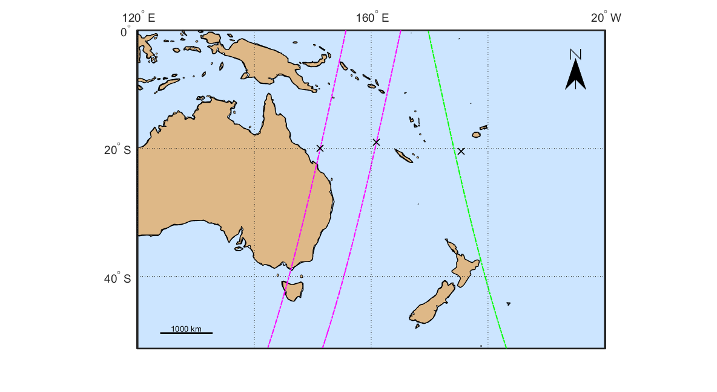
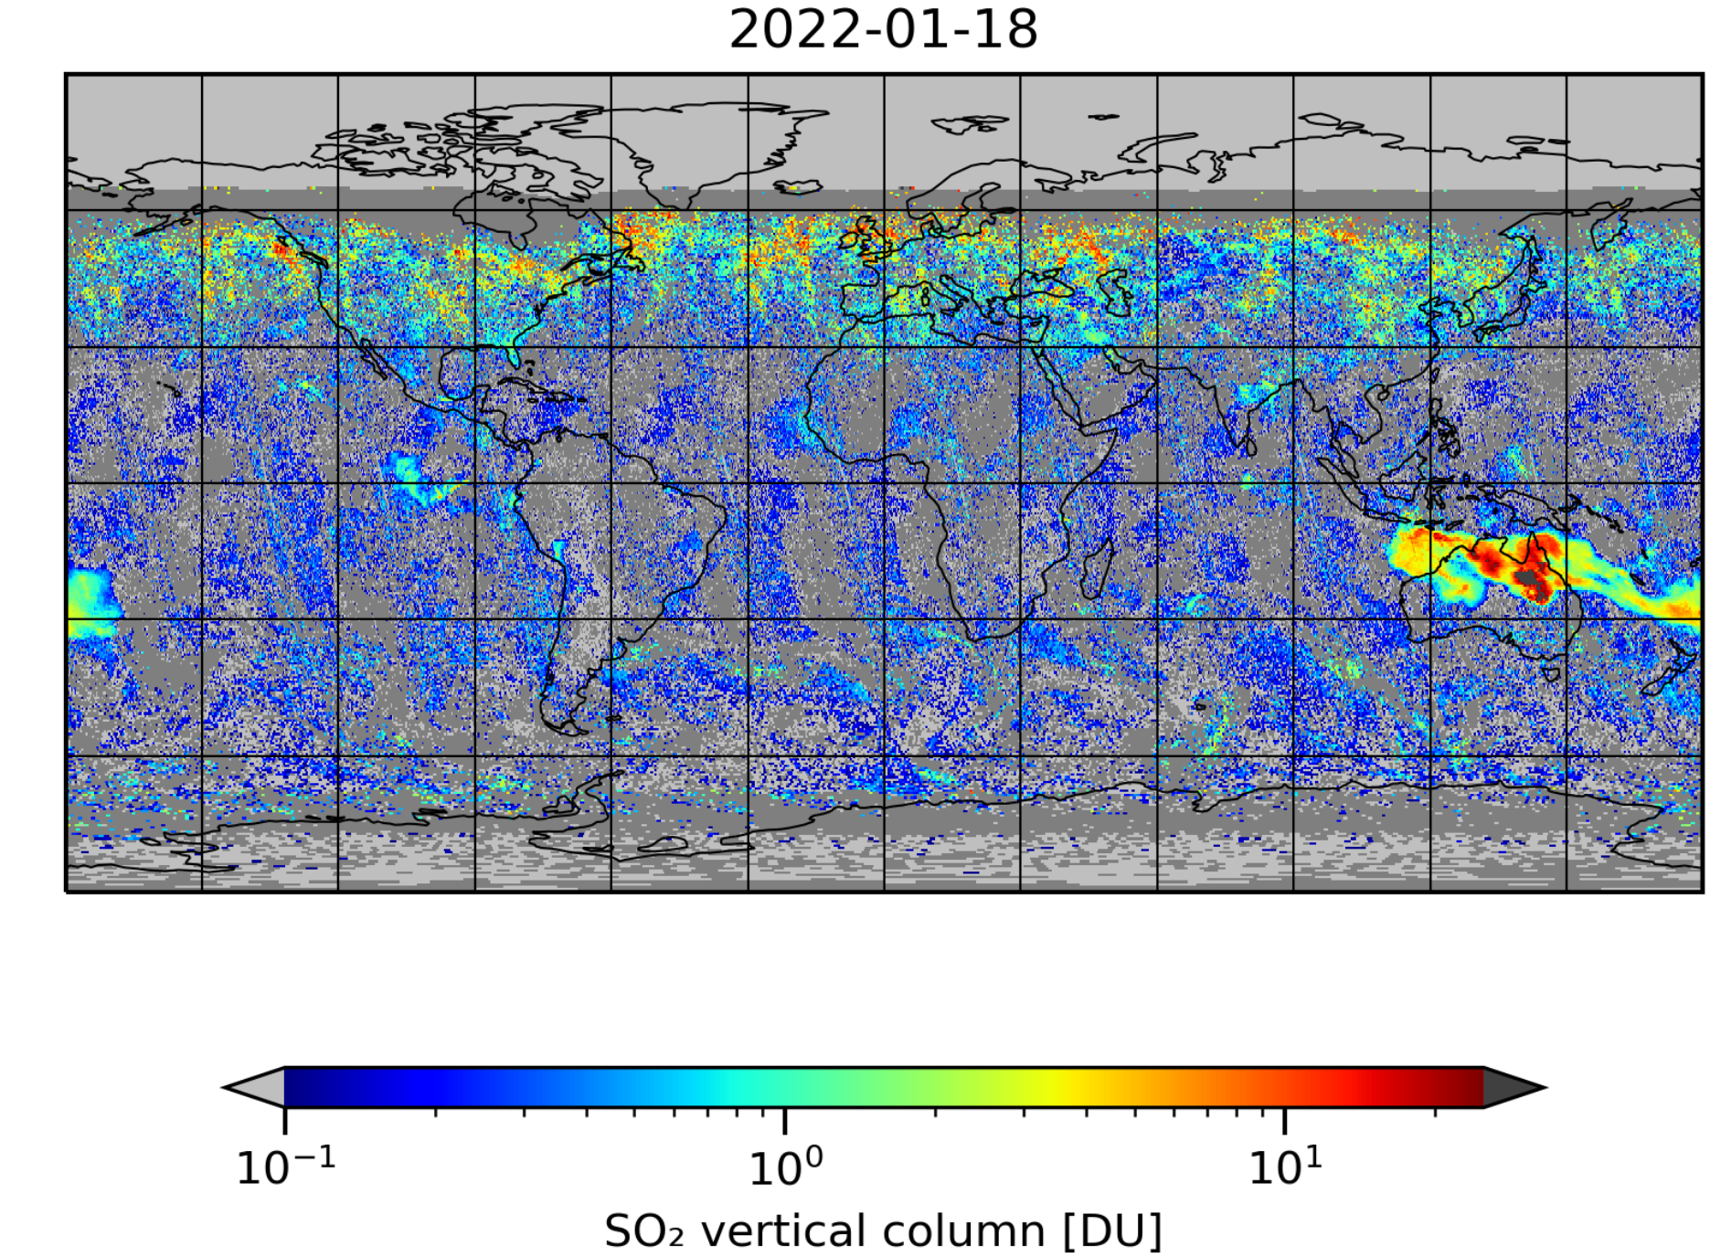
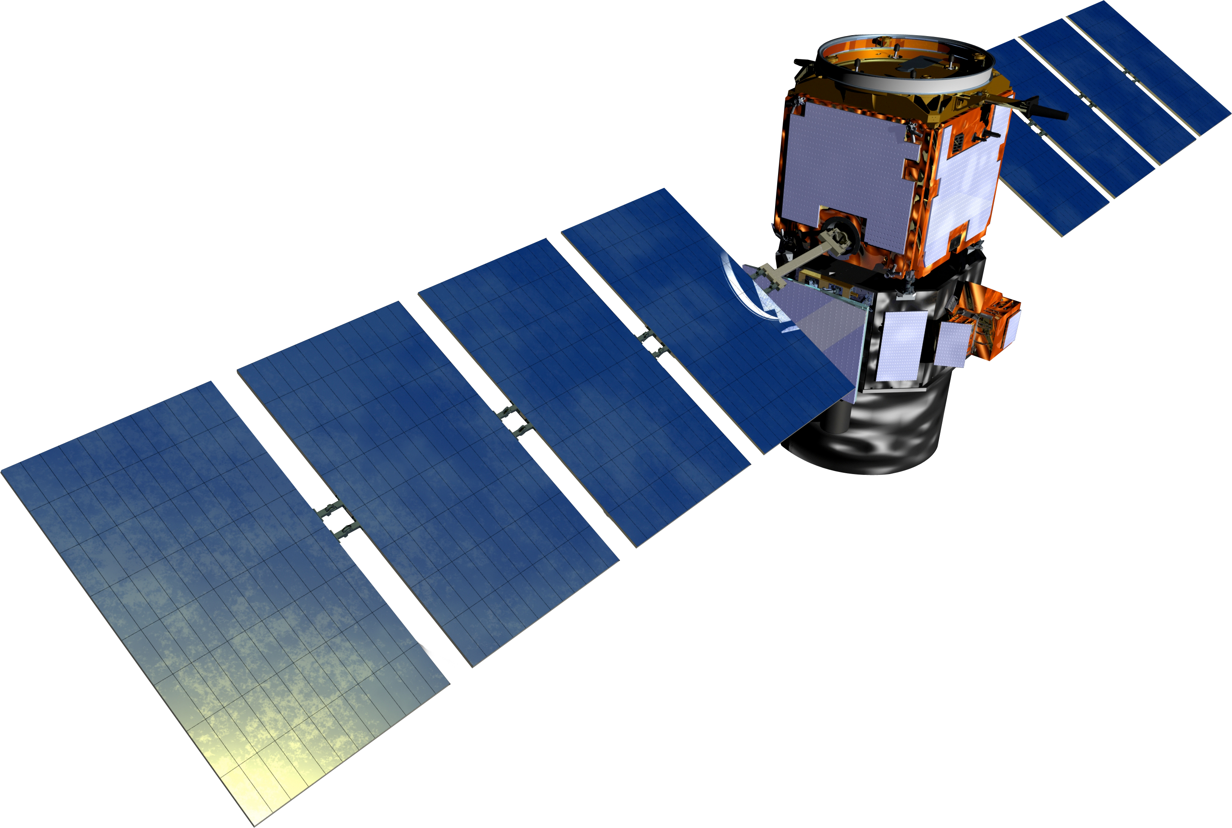

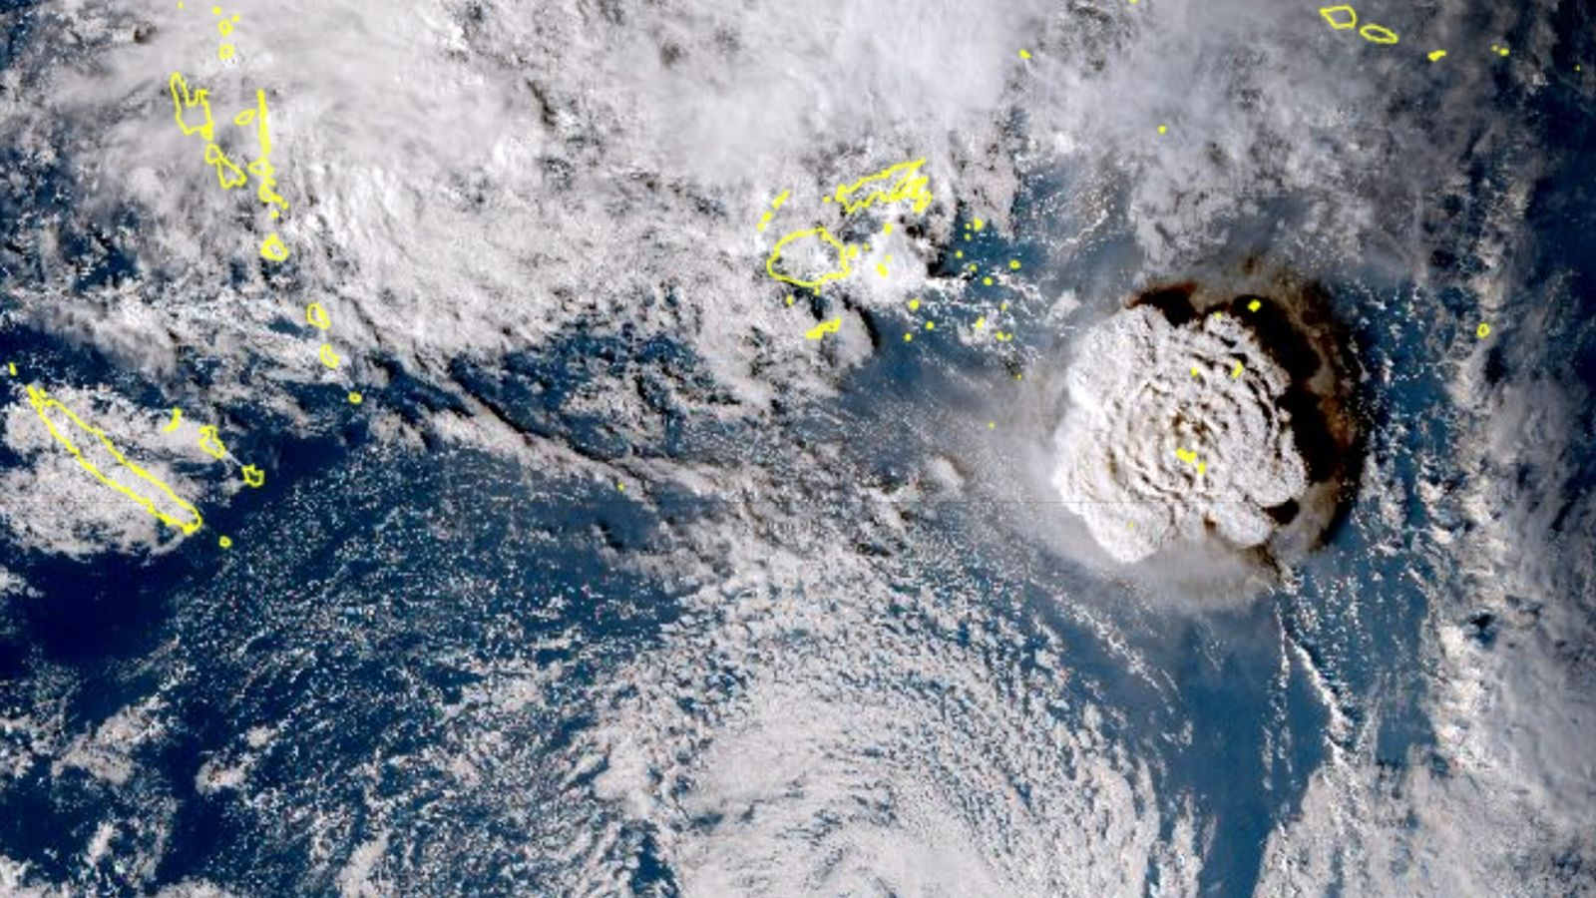
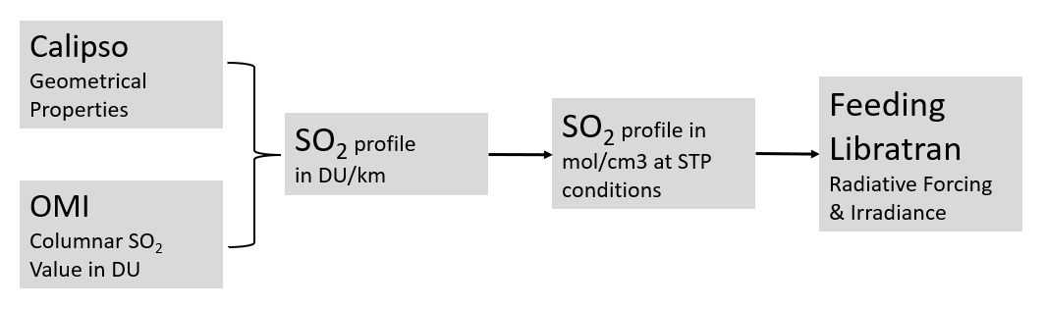
Undersea Volcanic Eruption: Hunga-Tonga
1
Tools Used:
CALIOP overpasses
Tropomi – Lev 2 QC
16 Jan 2022
17 Jan. 2022
Methodology Followed:
The 30th International Laser Radar Conference (ILRC) virtual conference, June 26th – July 1st, 2022.

Slide 3
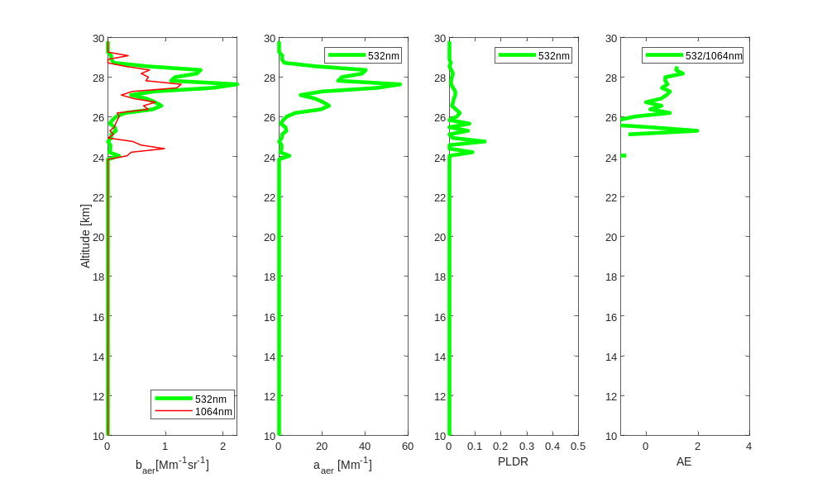
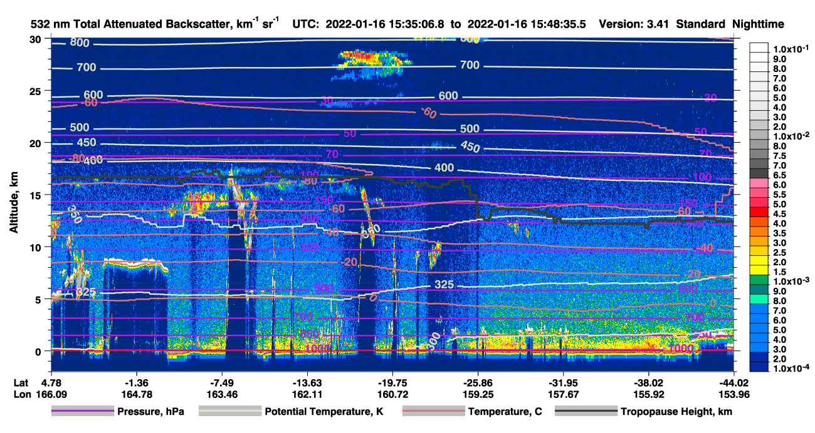
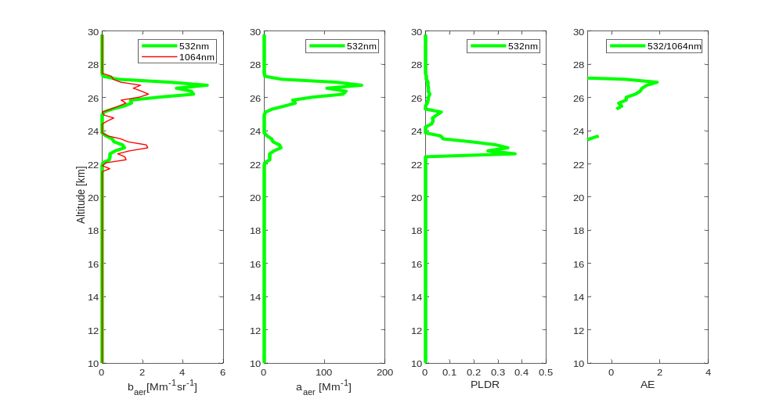
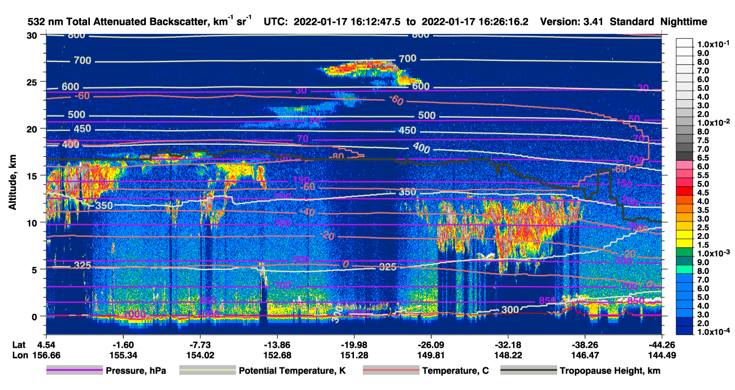
Undersea Volcanic Eruption: Hunga-Tonga
2
The 30th International Laser Radar Conference (ILRC) virtual conference, June 26th – July 1st, 2022.

Slide 4
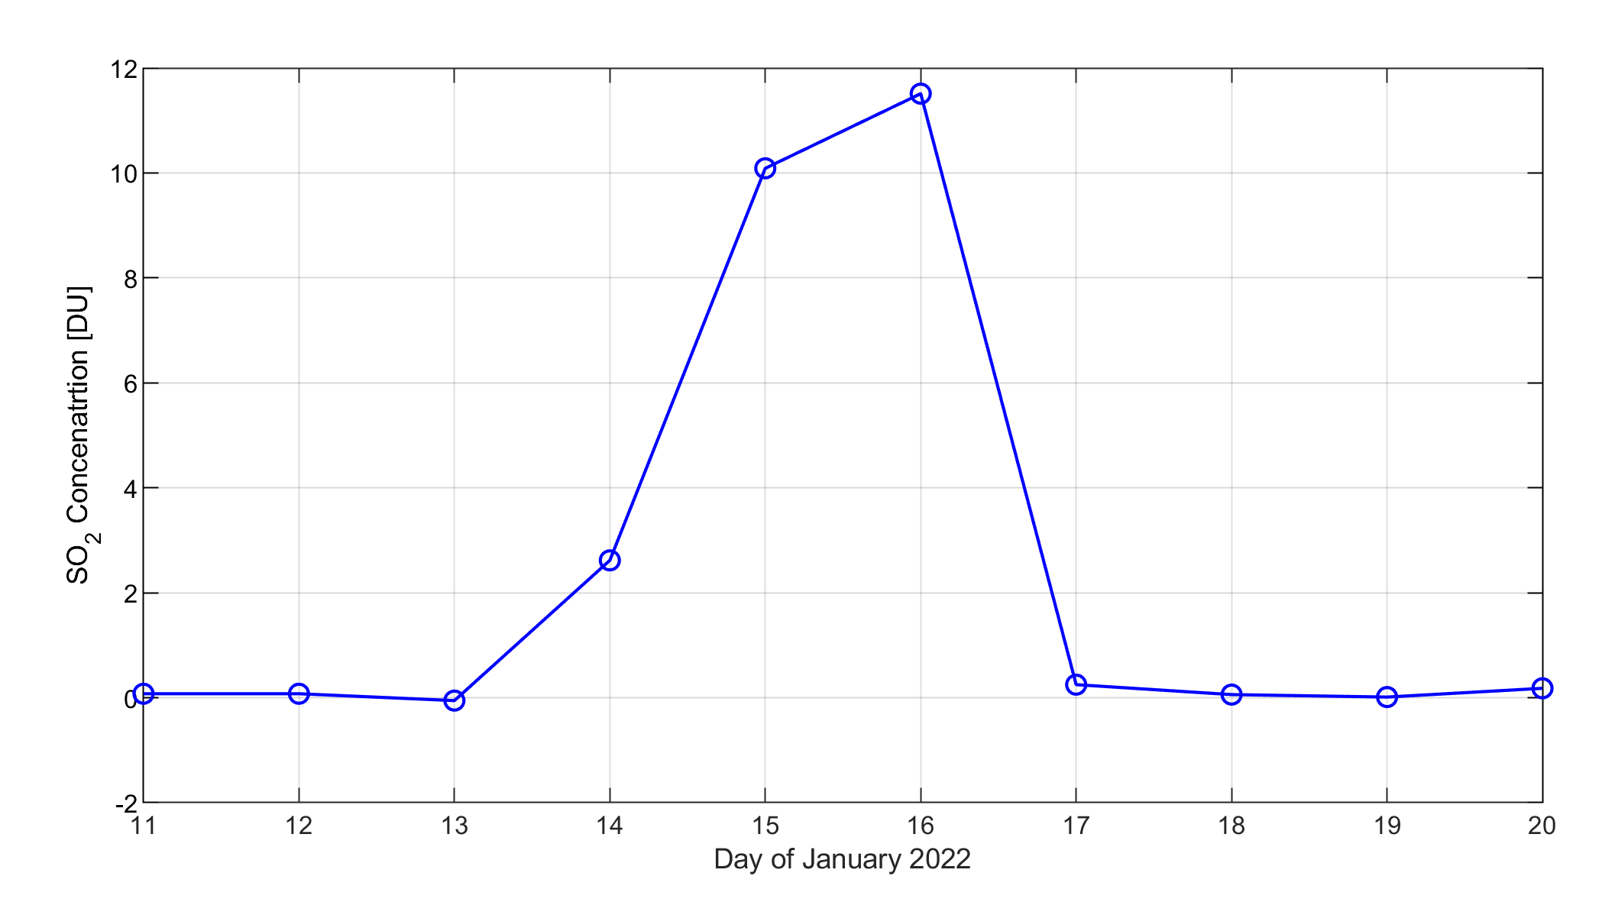
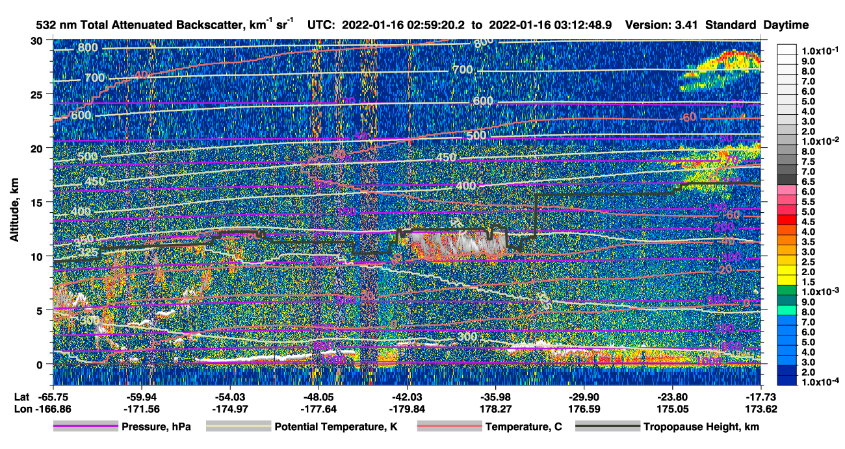
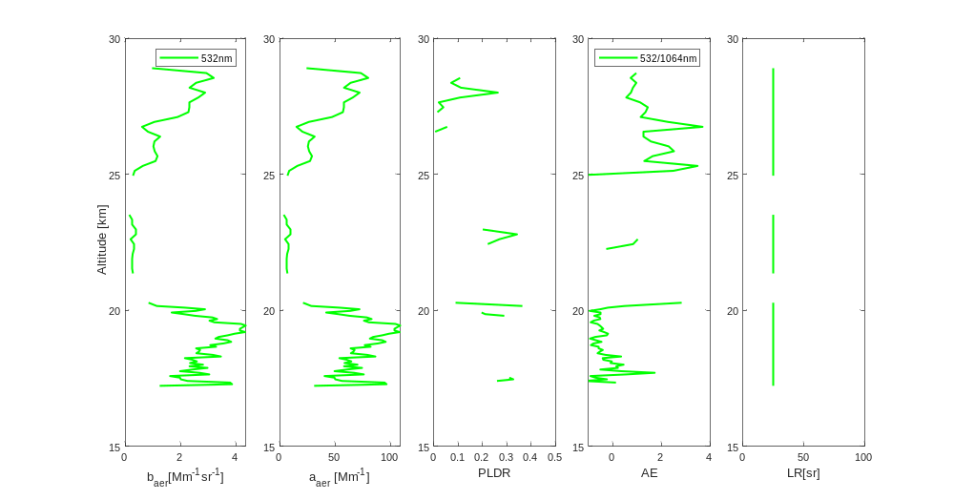
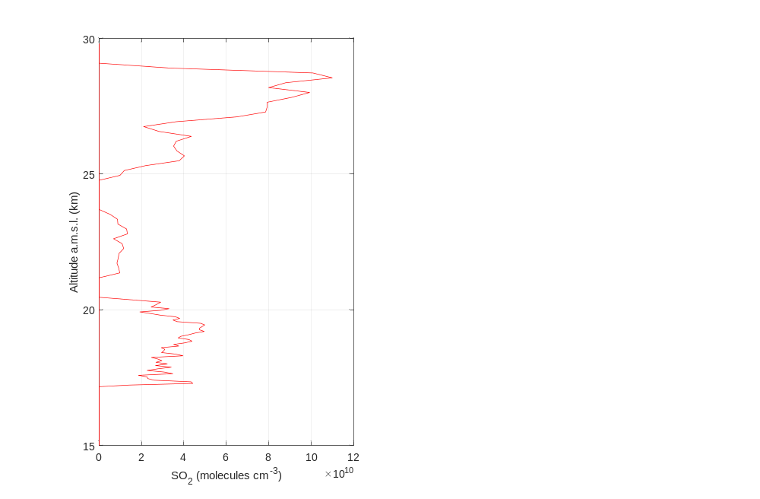
Undersea Volcanic Eruption: Hunga-Tonga
3
The 30th International Laser Radar Conference (ILRC) virtual conference, June 26th – July 1st, 2022.

Slide 5
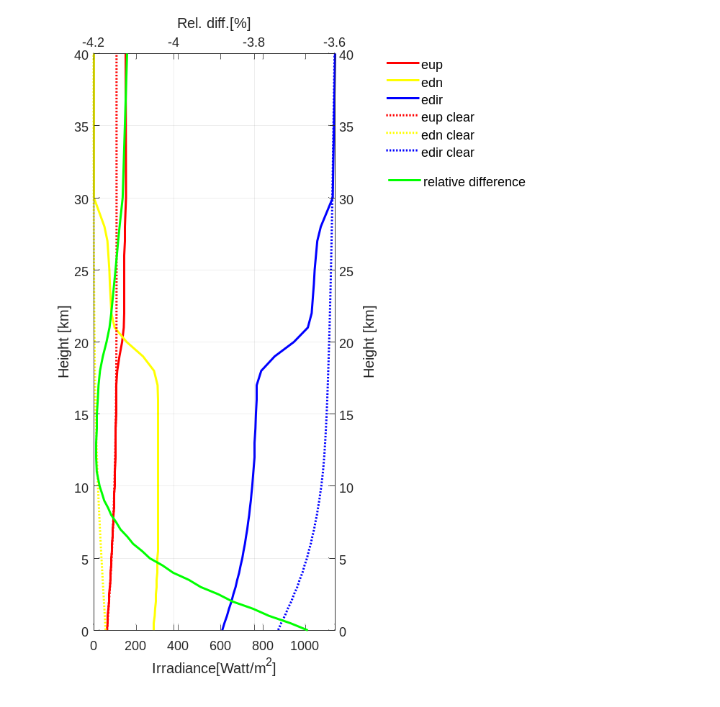
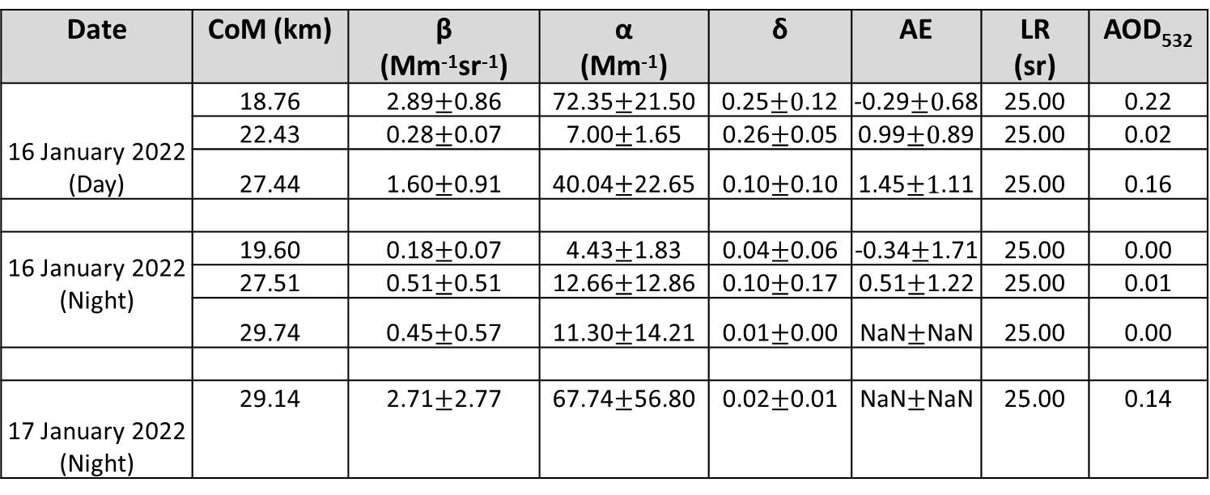
Take-home message: Accurate SO₂ profiles are required for further studying the case
4
Calipso Lev. 3 – Layer Properties
Date | CoM (km) | β (Mm⁻¹sr⁻¹) | α (Mm⁻¹) | δ | AE | LR (sr) | AOD₅₃₂
16 January 2022 (Day) | 18.76 | 2.89$±$0.86 | 72.35$±$21.50 | 0.25$±0$.12 | -0.29$±0$.68 | 25.00 | 0.22
 | 22.43 | 0.28$±$0.07 | 7.00$±$1.65 | 0.26$±$0.05 | 0.99$±0$.89 | 25.00 | 0.02
 | 27.44 | 1.60$±$0.91 | 40.04$±$22.65 | 0.10$±$0.10 | 1.45$±1$.11 | 25.00 | 0.16
16 January 2022 (Night) | 19.60 | 0.18$±$0.07 | 4.43$±$1.83 | 0.04$±$0.06 | -0.34$±$1.71 | 25.00 | 0.00
 | 27.51 | 0.51$±$0.51 | 12.66$±$12.86 | 0.10$±$0.17 | 0.51$±$1.22 | 25.00 | 0.01
 | 29.74 | 0.45$±$0.57 | 11.30$±$14.21 | 0.01$±$0.00 | NaN$±$NaN | 25.00 | 0.00
17 January 2022 (Night) | 29.14 | 2.71$±$2.77 | 67.74$±$56.80 | 0.02$±$0.01 | NaN$±$NaN | 25.00 | 0.14
The 30th International Laser Radar Conference (ILRC) virtual conference, June 26th – July 1st, 2022.

