Slide 1





Interpreting Lidar Backscattering Angstroem Exponents Beyond a Size Indicator : Dependence with Size, Shape and Complex Refractive Index
Danaël CHOLLETON, Patrick RAIROUX, Alain MIFFRE
Institute of Light and Matter (iLM), ATMOS Research group,
Lyon University, France.
02. Emerging lidar techniques, methodologies and discoveries
Thursday June 30th, 12:00 UTC
P36
The 30th International Laser Radar Conference (ILRC) virtual conference, June 26th – July 1st, 2022.

Slide 2
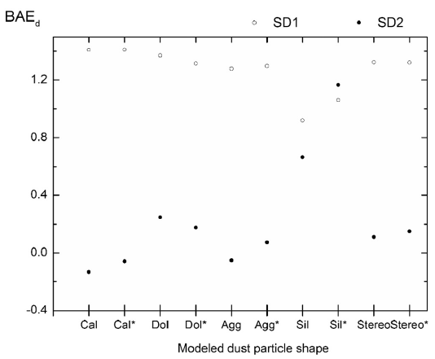
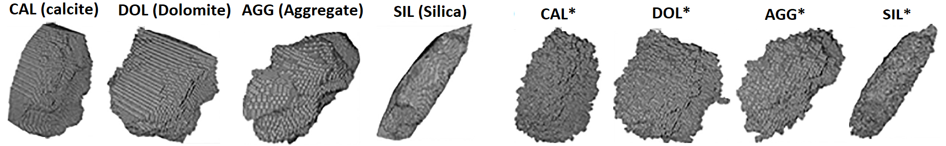




Backscattering Ångström Exponents
1
2$\text{β}$-lidars: vertical profiles of BAE interpreted as a particles size indicator
${BAE}_{p}= {− Ln(β}_{p,2}/β_{p,1})/Λ$
where $β_{p,1}=β_{p}(λ_{1})$, $β_{p,2}{=β}_{p}(λ_{2})$ and $Λ=Ln\left(λ_{2}/λ_{1}\right)>0$.
Ref: Burton et al., (2016); Veselovskii et al., (2016); Haarig et al., (2018), Miffre et al., (2019).
Original paper (Ångström, 1929): quantity 𝑎 describing the spectral behavior of optical scattering, noting that "the larger the particle size, the lower the value obtained for 𝑎".
Ångström, "On the Atmospheric Transmission of Sun Radiation and on Dust in the Air," Geogr. Ann. 11(2), 156–166 (1929).
Light scattering textbooks (Mishchenko, 2002) :
$${BAE}_{dust}$$
${BAE}_{p}$ depends on the particles size, shape and refractive index as $β_{p}$ :
$C_{back,p}$ : particles backscattering cross-section
$m_{p}$ : particles complex refractive index ($CRI$)
SD : size distribution, characterized by number density $n_{p}$at radius $r_{p}$.
Light scattering numerical simulations (> 2000):
${BAE}_{p}$ dependence on the CRI : Veselovskii et al. (2015, 2016).
${BAE}_{p}$ dependence on the particles shape : Miffre et al. (2018).
$∗$ : roughened version of these stereo-particles.

Slide 3
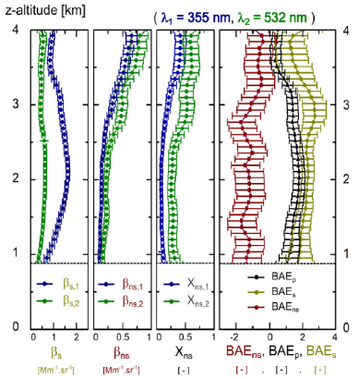
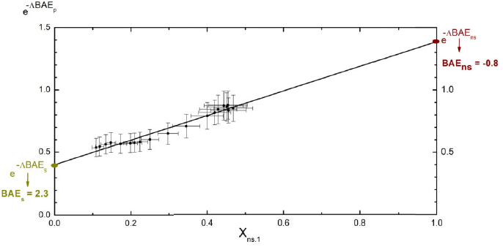

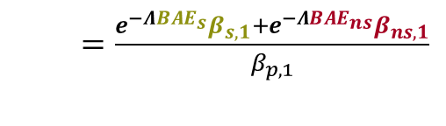
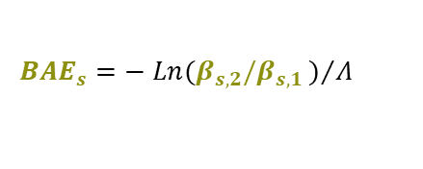

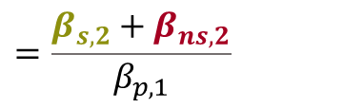
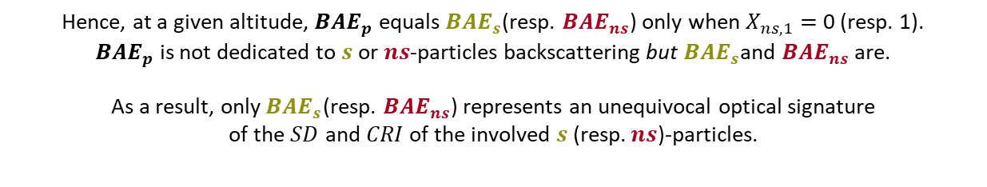

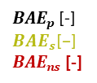


Our methodology (Miffre et al., Opt. Lett., 2020) : use of light polarization in addition
2
2β+2δ-lidars: vertical profiles of BAE for spherical $(s)$and nonspherical $\left(ns\right)$-particles
Particle mixtures ($p$) = {$s,ns\}$
${ BAE}_{p}= {− Ln(β}_{p,2}/β_{p,1})/Λ$
$SD$ : Size Distribution
$CRI$ : Complex Refractive Index.
$${BAE}_{s}=− Ln(β_{s,2}/β_{s,1})/Λ$$
$${BAE}_{ns}= {{− Ln(β}_{ns,2}}/{β_{ns,1}})/Λ$$
Polarimetry
Spectroscopy
$=\frac{e^{−{ΛBAE}_{s}}β_{s,1}+e^{−Λ{BAE}_{ns}}β_{ns,1}}{β_{p,1}}$
$$e^{−Λ{BAE}_{p}}$$
$$=β_{p,2}/β_{p,1}$$
$$=\frac{β_{s,2}{+ β}_{ns,2}}{β_{p,1}}$$
${BAE}_{p}$ [-]
$${BAE}_{s}\text{[−]}$$
${BAE}_{ns}$ [-]
$e^{−Λ{BAE}_{p}}=e^{−{ΛBAE}_{s}}+X_{ns,1}×\left(e^{−{ΛBAE}_{ns}}−e^{−{ΛBAE}_{s}}\right)$ with $X_{ns,1}$= $β_{ns,1}$/$β_{p}$.
Hence, at a given altitude, ${BAE}_{p}$ equals${ BAE}_{s}$(resp. ${BAE}_{ns}$) only when $X_{ns,1}=$ 0 (resp. 1).
${BAE}_{p}$ is not dedicated to $s$ or $ns$-particles backscattering but${ BAE}_{s}$and ${BAE}_{ns}$ are.
As a result, only${ BAE}_{s}$(resp. ${BAE}_{ns}$) represents an unequivocal optical signature
of the $SD$ and $CRI$ of the involved $s$ (resp.$ns$)-particles.

Slide 4
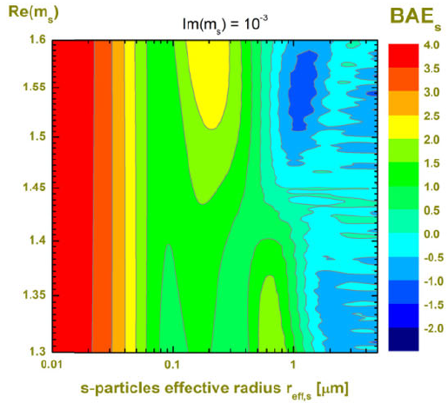
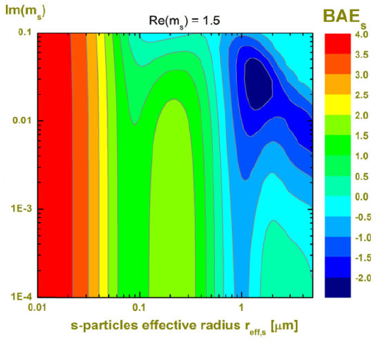
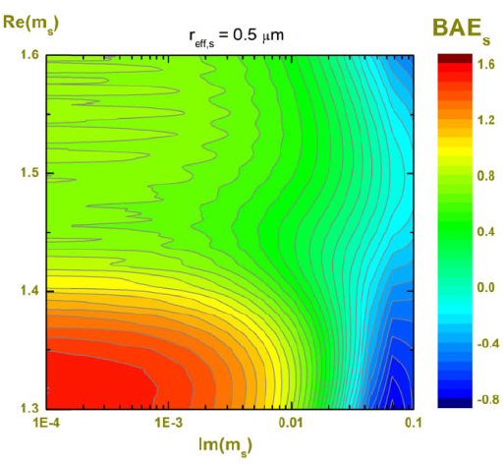
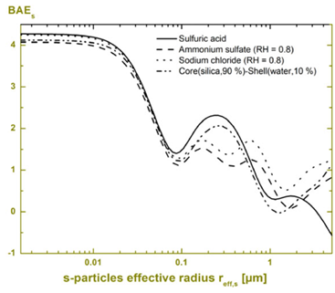
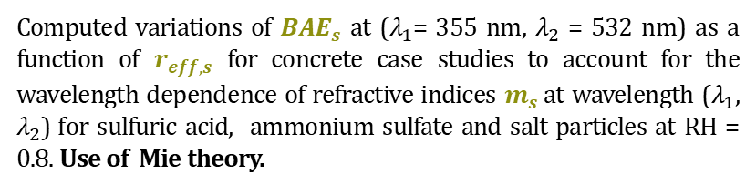
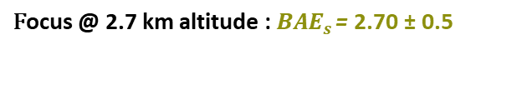
${BAE}_{s}$ : Backscattering Ångström exponents for $s$-particles
3
Computed variations of ${BAE}_{s}$ at ($λ_{1}$= 355 nm, $λ_{2}$ = 532 nm) as a function of $r_{eff,s}$ for concrete case studies to account for the wavelength dependence of refractive indices $m_{s}$at wavelength ($λ_{1}$, $λ_{2}$) for sulfuric acid, ammonium sulfate and salt particles at RH = 0.8. Use of Mie theory.
$$\text{F}\text{ocus}\text{ @ 2.7 }\text{km} \text{altitude}\text{ :} {BAE}_{s} \text{= }\text{2.70 ± 0.5}$$

Slide 5
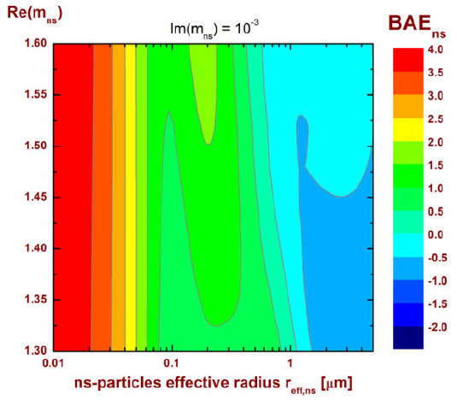
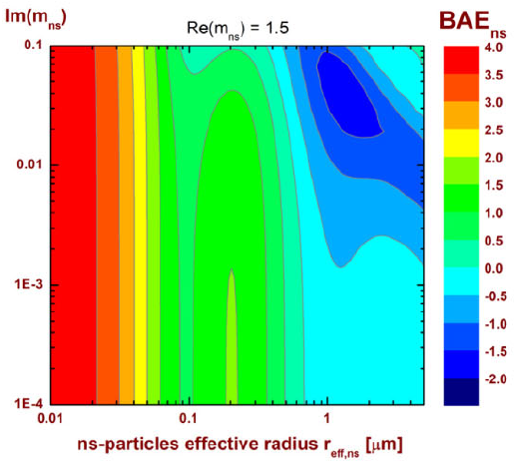
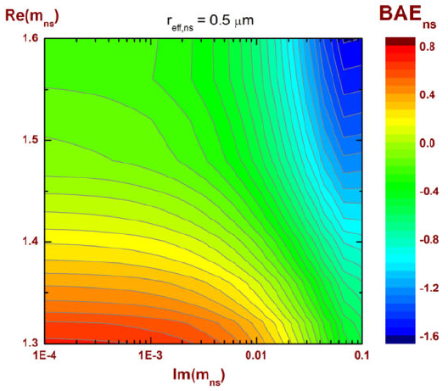
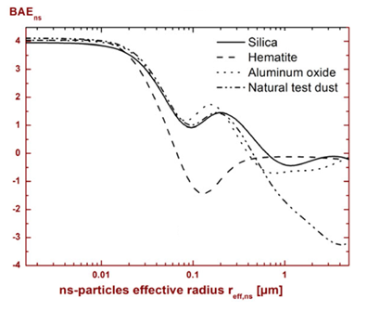
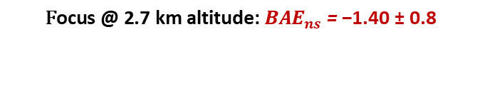
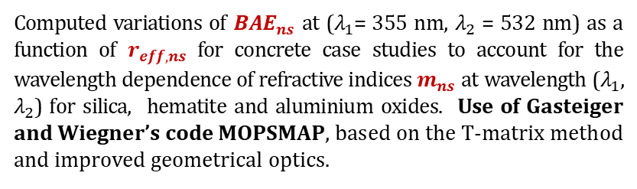
${BAE}_{ns}$ : Backscattering Ångström exponents for $ns$-particles
4
Computed variations of ${BAE}_{ns}$ at ($λ_{1}$= 355 nm, $λ_{2}$ = 532 nm) as a function of $r_{eff,ns}$ for concrete case studies to account for the wavelength dependence of refractive indices $m_{ns}$ at wavelength ($λ_{1}$, $λ_{2}$) for silica, hematite and aluminium oxides. Use of Gasteiger and Wiegner’s code MOPSMAP, based on the T-matrix method and improved geometrical optics.
$$\text{F}\text{ocus}\text{ @ 2.7 }\text{km} \text{altitude}\text{:} {BAE}_{ns}\text{ = }\text{−1.40 ± 0.8 }$$

Slide 6
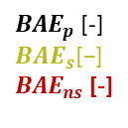
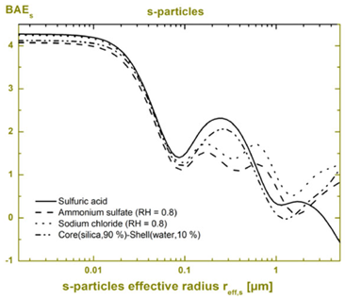
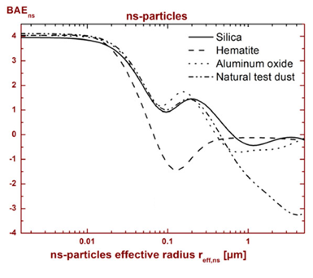

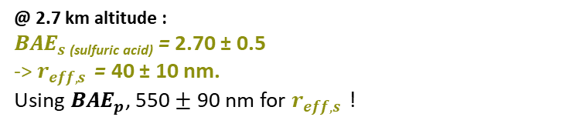





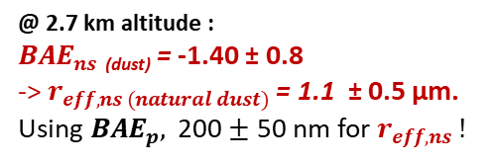

Output : range of involved effective radii / $CRI$ for spherical and nonspherical particles
5
Mie-code ($s$-particles) :
MOPSMAP-code ($ns$-particles):
${BAE}_{s \left(sulf. acid\right)}$ = 2.70 ± 0.5
$${BAE}_{ns (dust)}=−1.40 \text{±} 0.8$$
@ 2.7 km altitude :
${BAE}_{s}$ _{(sulfuric acid)} = 2.70 ± 0.5
-> $r_{eff,s }$ = 40 ± 10 nm.
Using ${BAE}_{p}$, 550 $±$ 90 nm for $r_{eff,s }$ !
@ 2.7 km altitude :
${BAE}_{ns}$ _{(dust)} = -1.40 ± 0.8
-> $r_{eff,ns (natural dust)}$ = 1.1 ± 0.5 µm.
Using ${BAE}_{p},$ 200 $±$ 50 nm for $r_{eff,ns} !$
$$β_{s}$$
$$β_{ns}$$
$$X_{ns}$$
${BAE}_{p}$ [-]
$${BAE}_{s}\text{[−]}$$
${BAE}_{ns}$ [-]
[Mm⁻¹.sr⁻¹]
[Mm⁻¹.sr⁻¹]
[-]
Size ranges in agreement with PNAS, (2012), highlighting this dust nucleation pathway.
-> Range of involved effective radii or / and $CRI$* to be considered for $s$ or $ns$-particles.
-> Can be applied to inversion algorithms to reduce the search space, for both $s$ and $ns$-particles.
Ref : Miffre et al., On the use of light polarization to investigate the size, shape and refractive index of $BAE$, Opt. Lett. 45, (2020).
Notes:
S3
Hence, using Mie-code for spherical particles and MOPSMAP- code for nonspherical ones, we could identify a range of involved effective radii and complex refractive indices for both spherical and nonspherical particles.
So, as a take-home message, use of light polarization allowed us to go beyond the size indicator interpretation by accounting for the dependence of such exponents with the particles shape (spherical or not) and complex refractive index.
Our new methodology, which has been published in Optics Letters, can be applied to improve the accuracy of inversion algorithms by reducing the search space : it indeed provides a range of involved effective radii and complex refractive indices, and this for both spherical and nonspherical particles.

