Slide 1
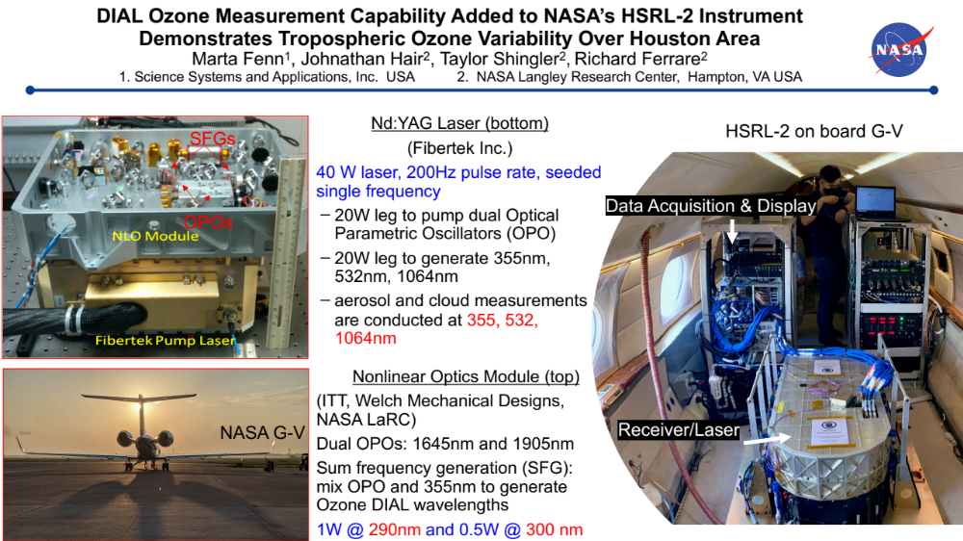

Slide 2
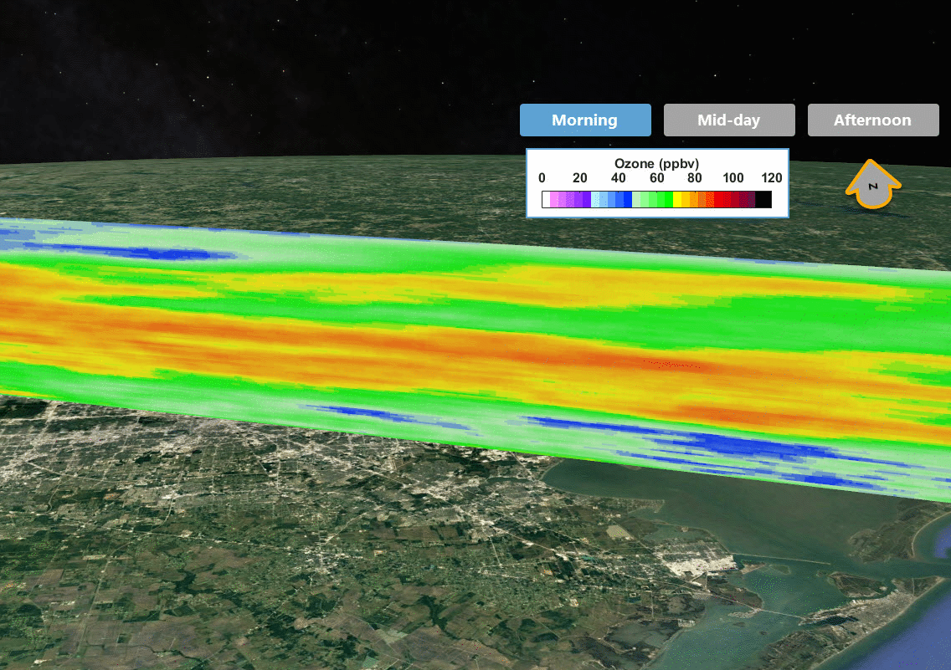
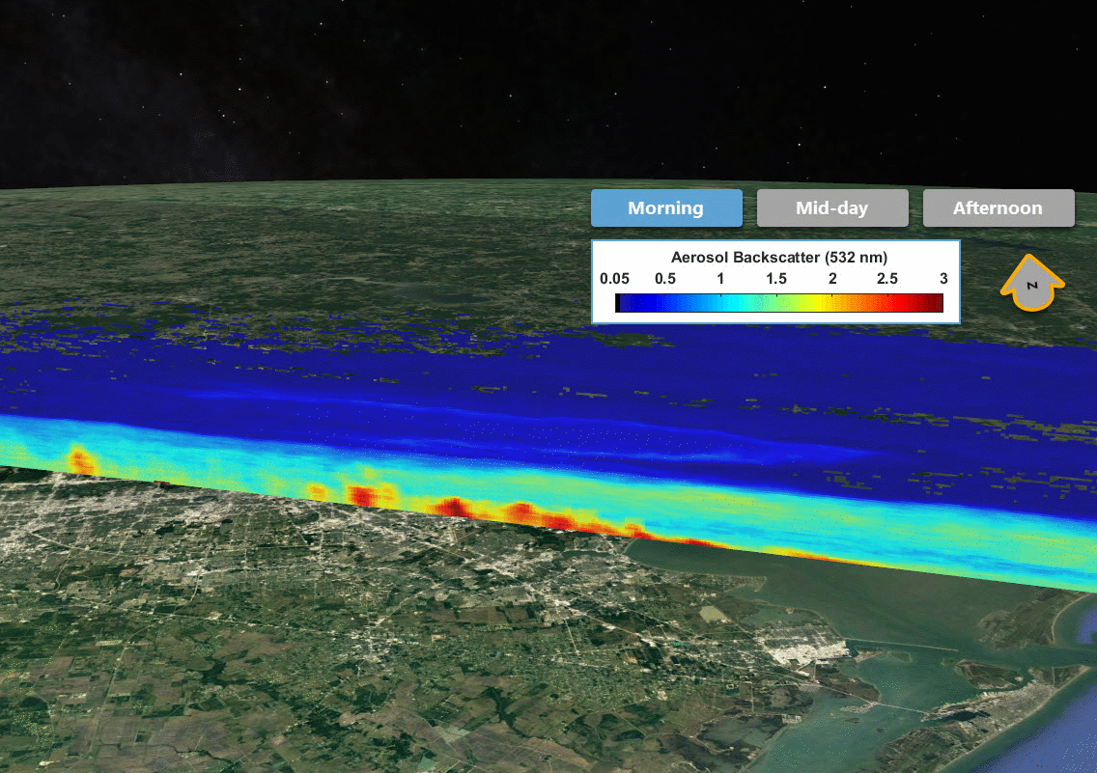
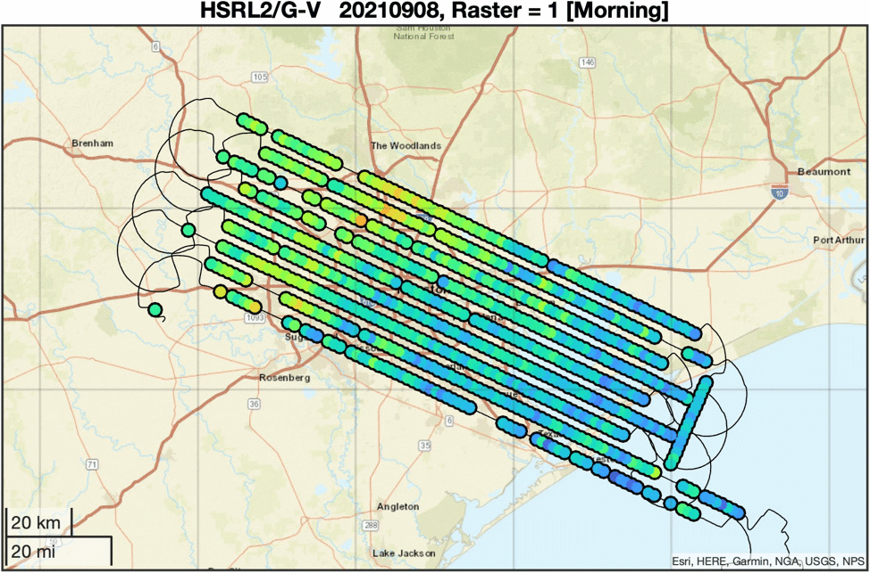
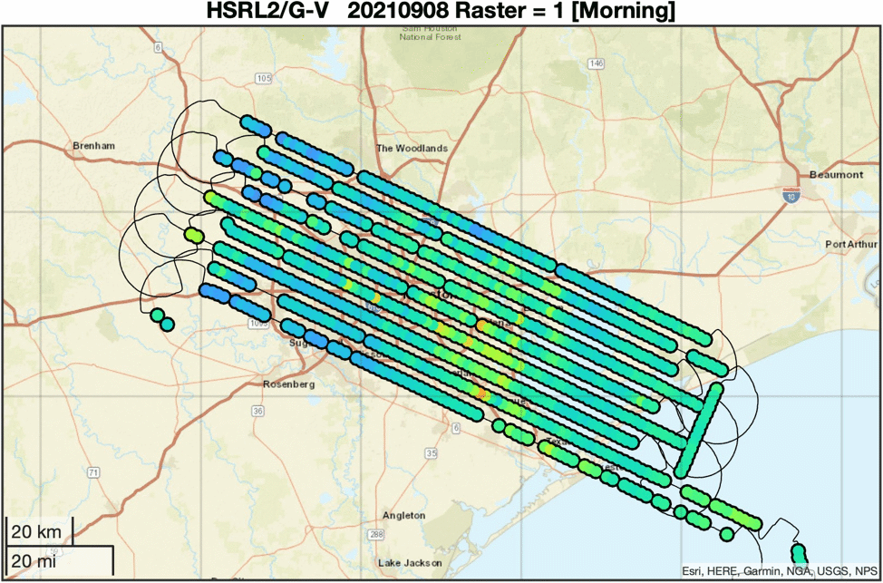
Vertical Profile Products: Connecting to the Surface
Diurnal Variations (RF03 – 20210908)
Ozone Vertical Profiles
Aerosol Backscatter Vertical Profiles
Single transect shown
Single transect shown
Near-surface (0-1km) Average Ozone
Near-surface (0-1km) Average Backscatter

Slide 3
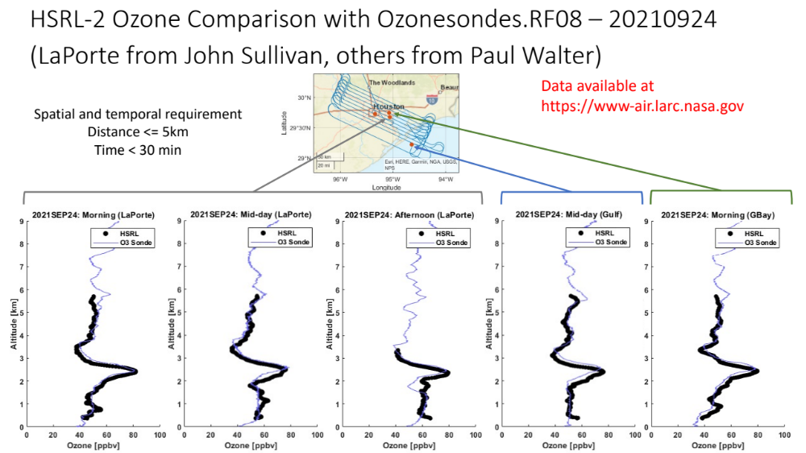
Notes:
Add responsible party names

Slide 4
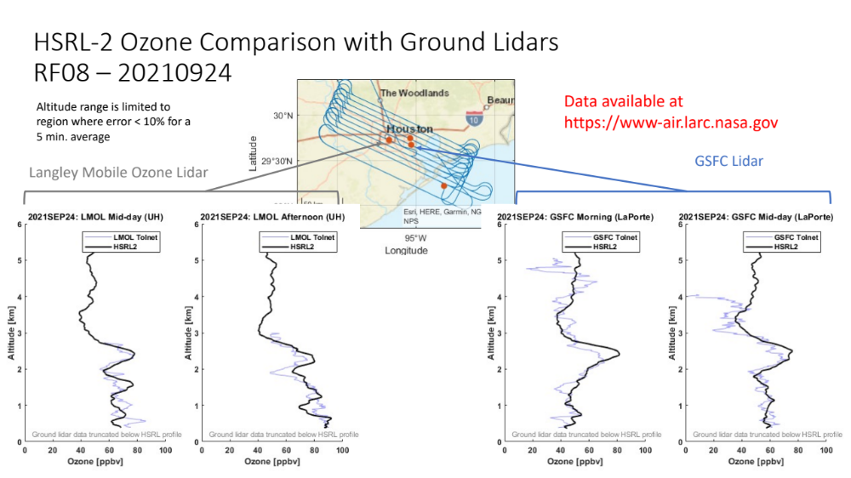

Slide 5
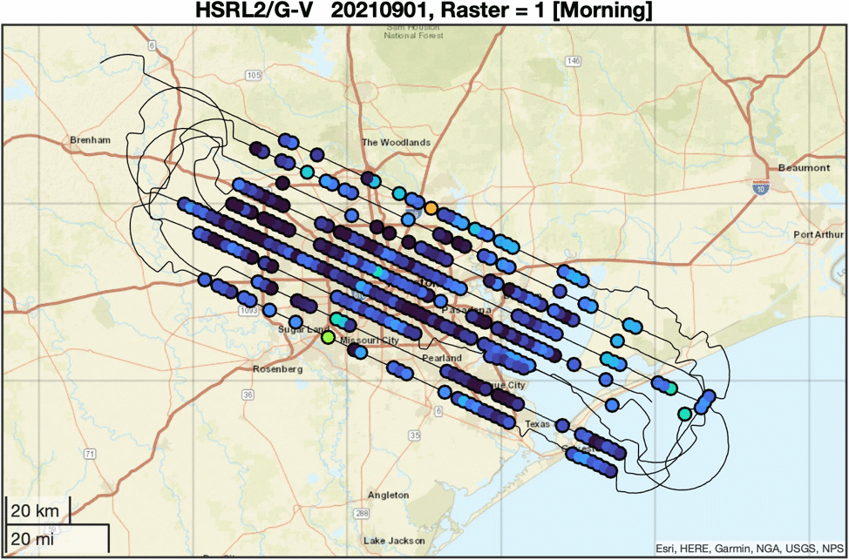
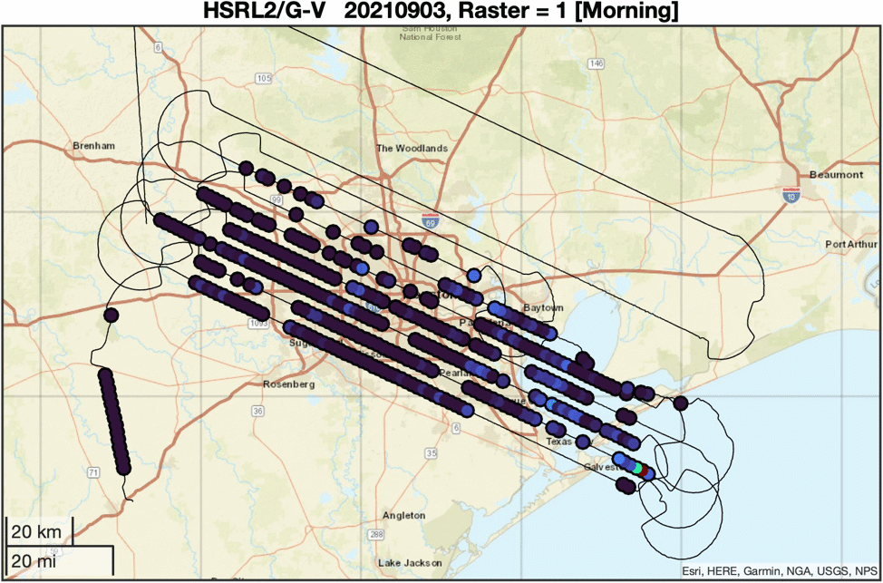
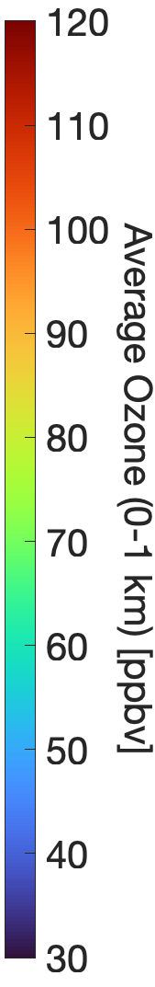
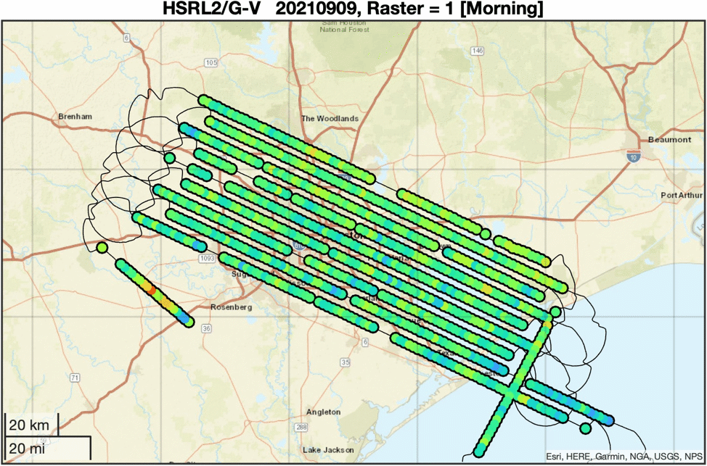
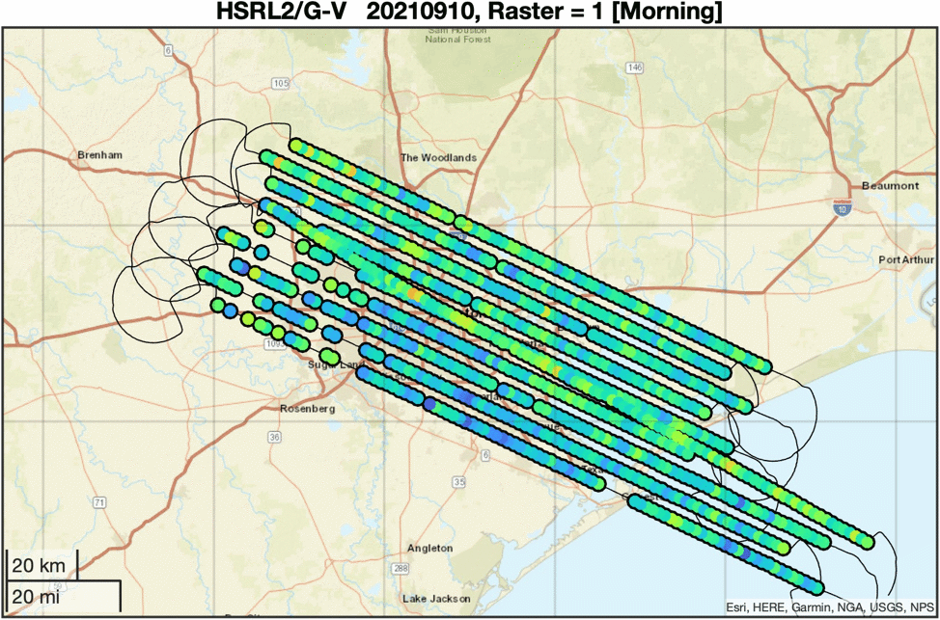
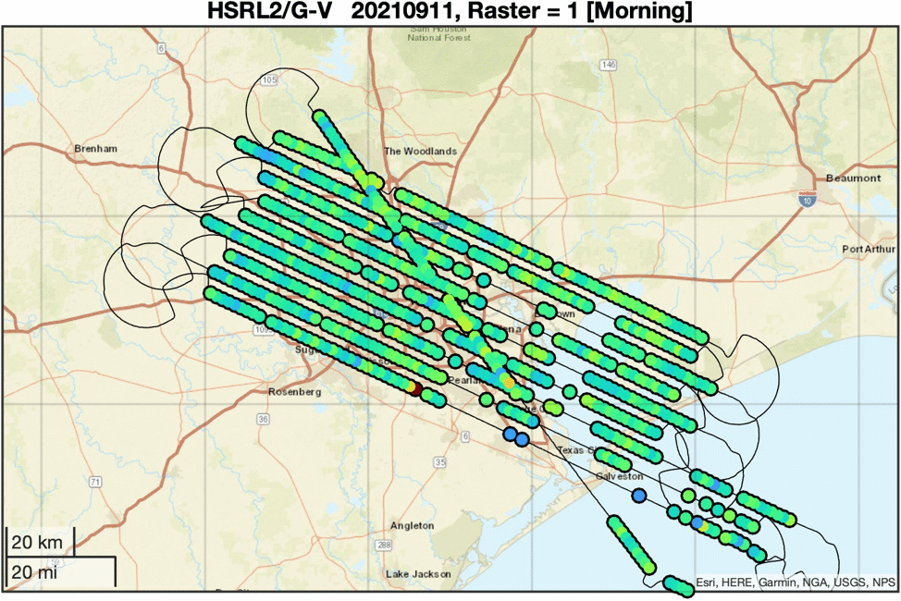
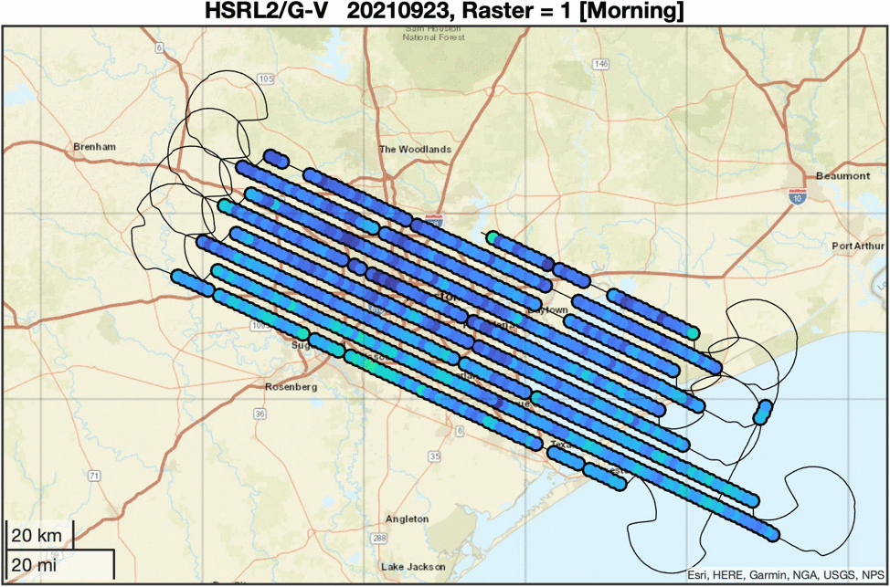
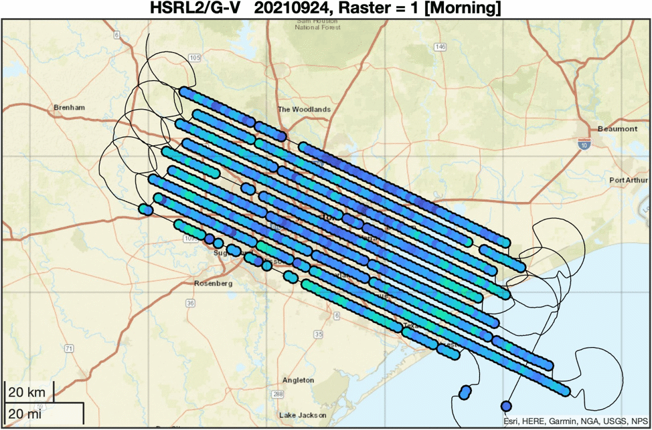
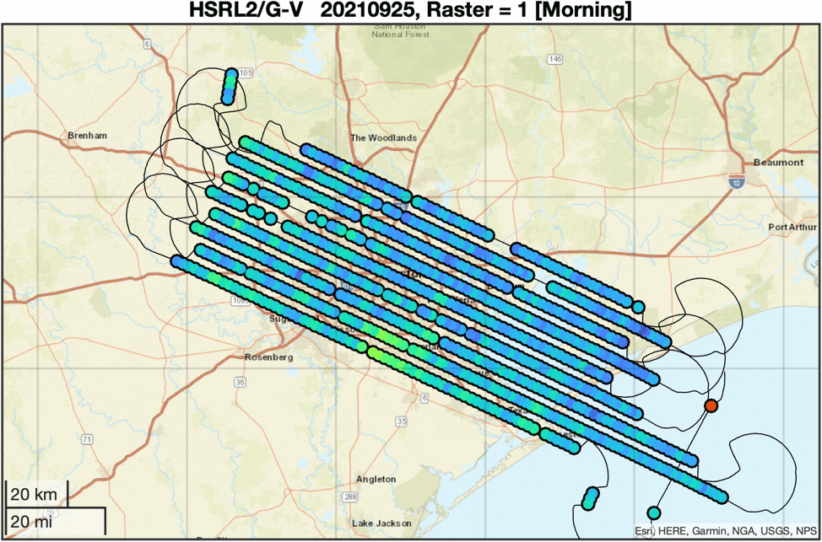
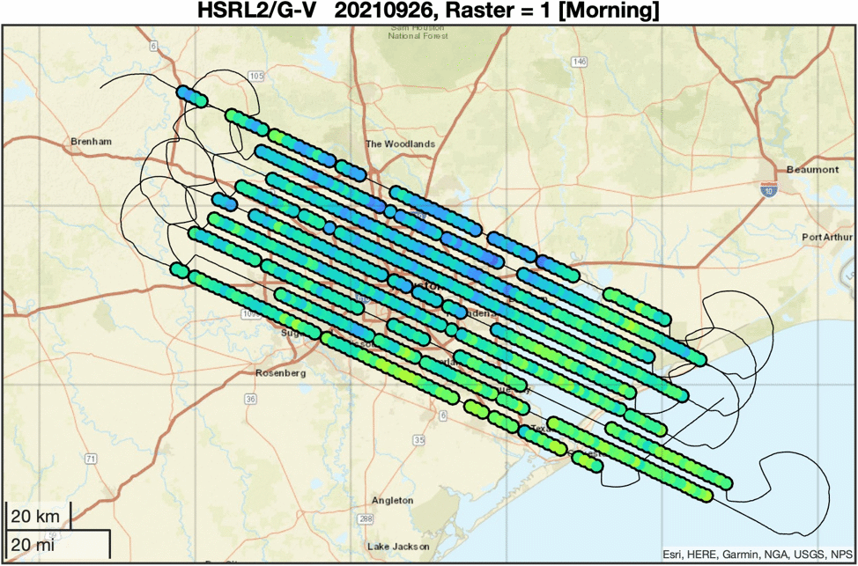
Distribution and evolution of near surface ozone
09/01
09/03
Cloud cleared
10 second (~2 km)
1 km above surface
Co-located to point on surface
09/08
09/09
09/10
09/11
09/23
09/24
09/25
09/26
Notes:
Note that these products are at 10sec (~2km) horizontal resolution and are a 1km vertical average. Individual points are independent.
Regions with no data are due to clouds (first two flights and 9/11 had increased cloud coverage and limited flights to morning and noon)
Changes from early in the campaign to later with low ozone the first week to increase regional background and enhancements over the city.
Cases with increase ozone over the Gulf and Bay in the afternoon (2 flights).

Slide 6
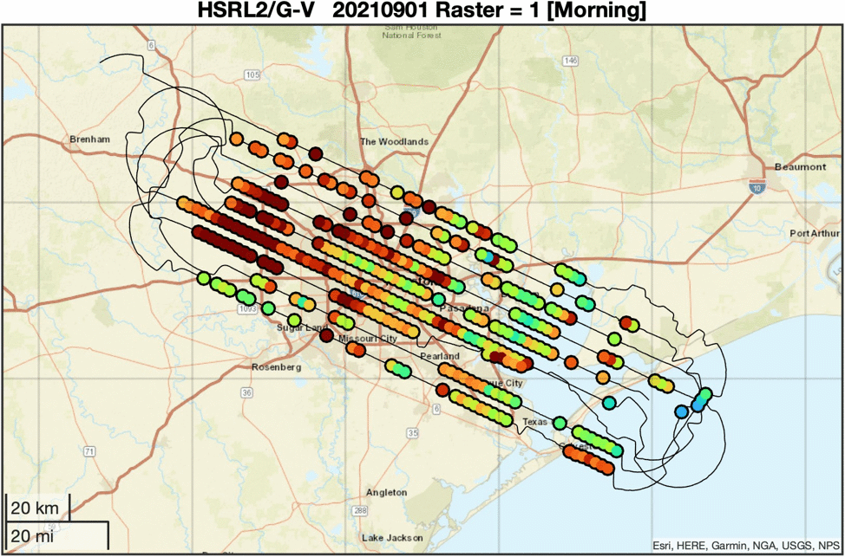
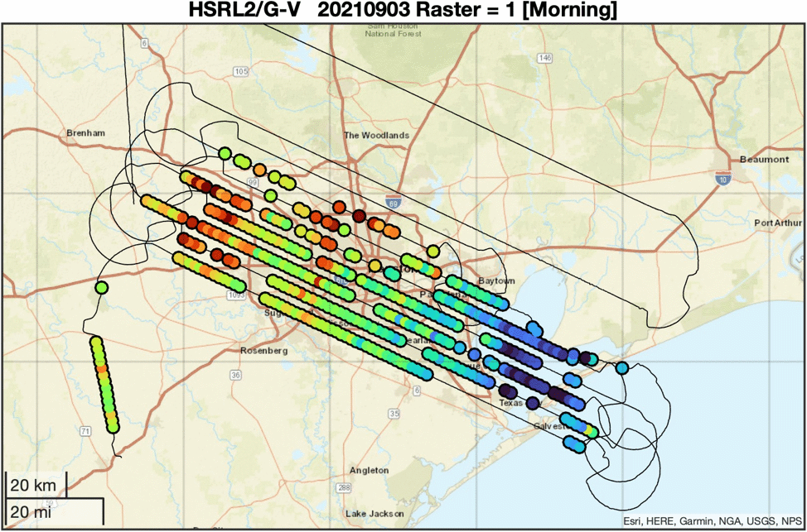
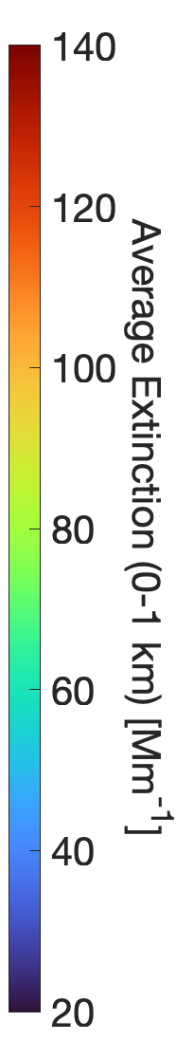
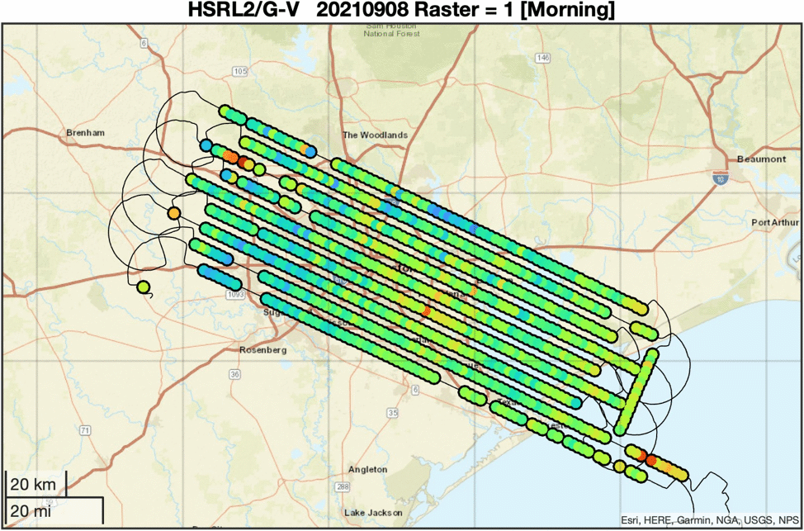
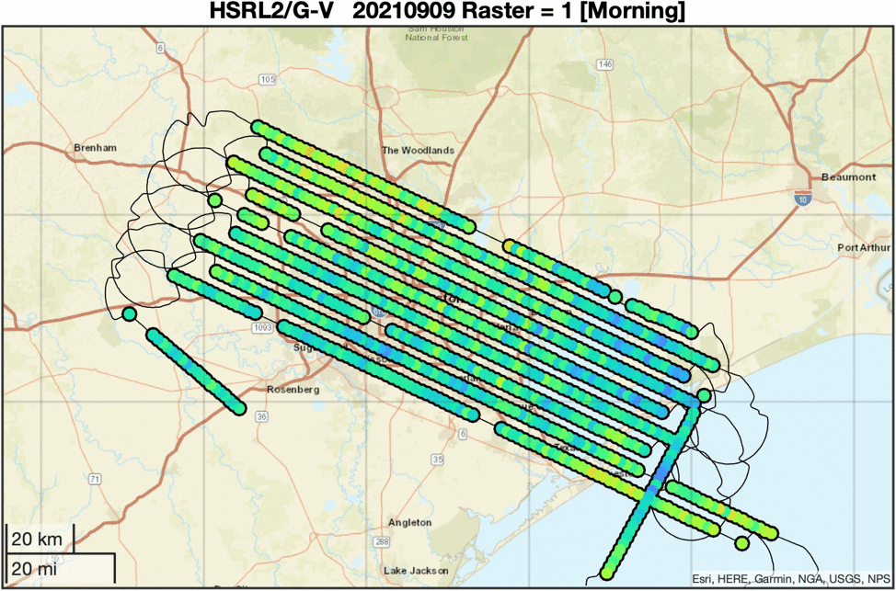
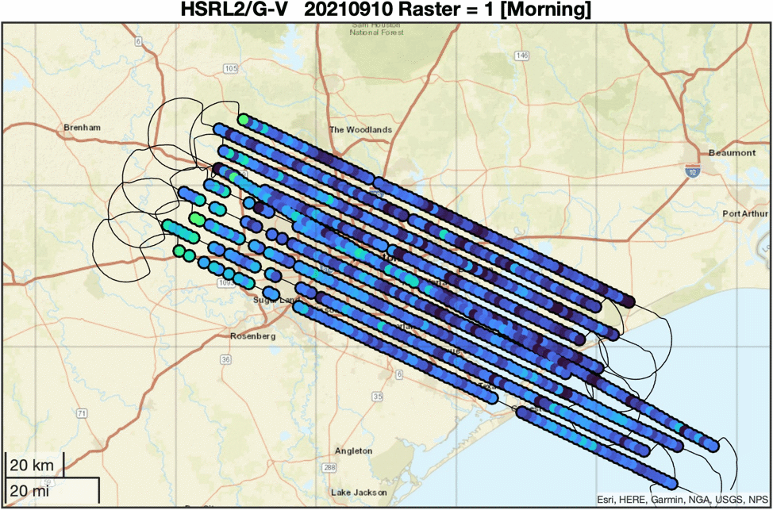
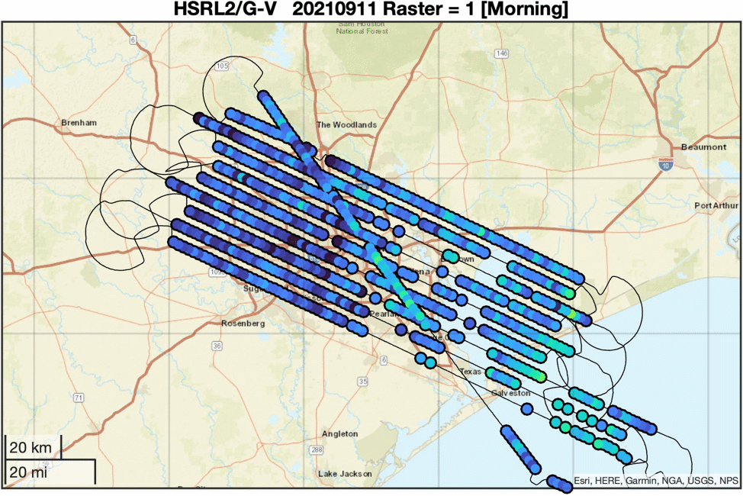
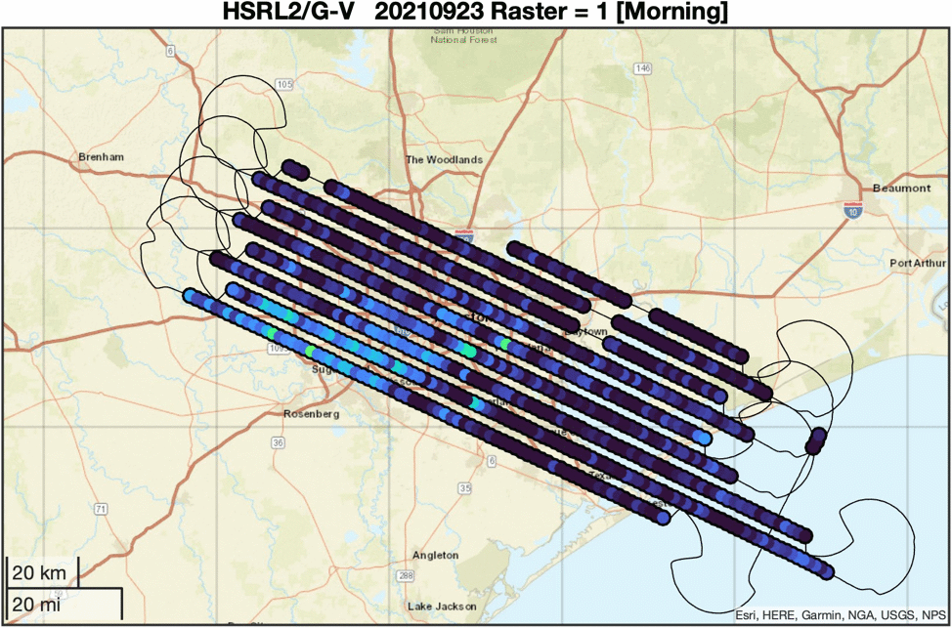
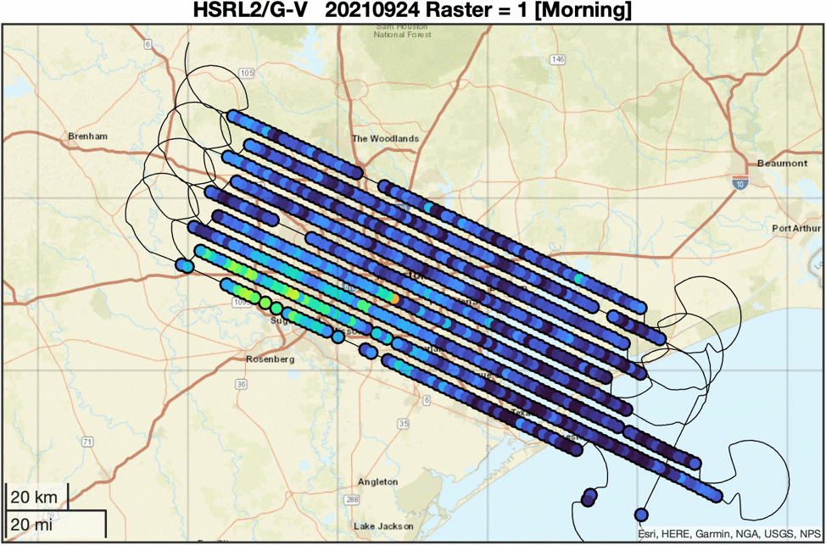
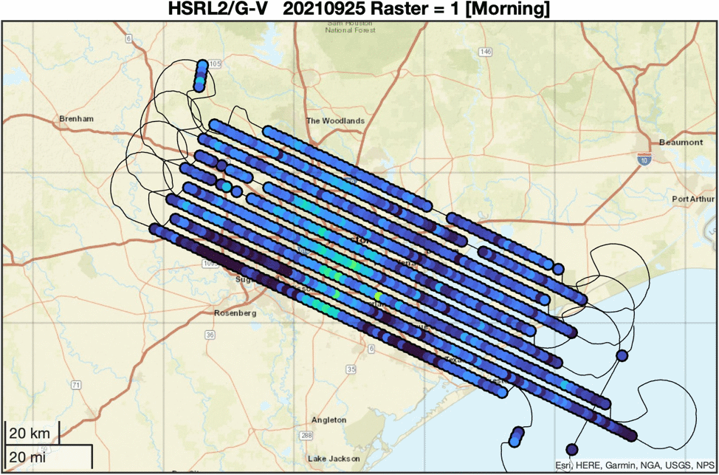
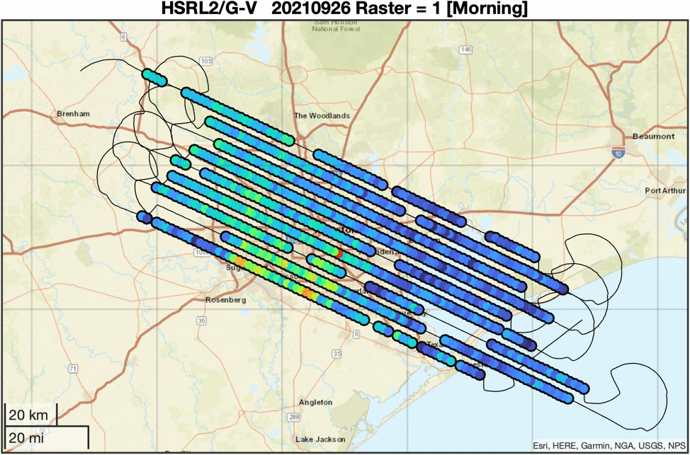
Distribution and evolution of near surface aerosol extinction
09/01
09/03
Cloud cleared
10 second (~2 km)
1 km above surface
Co-located to point on surface
Wavelength 532 nm
09/08
09/09
09/10
09/11
09/23
09/24
09/25
09/26

