Slide 1

ALL FIBER FREE-RUNNING DUAL-COMB RANGING SYSTEM
Fu Yang¹, Yanyu Lu¹, Guibin Liu²
¹Department of Applied Physics, Donghua University, No. 2999 North Renmin Road, Shanghai, 201620, P.R. China
[02].[Emerging lidar techniques, methodologies, and discoveries]
[29-JUN], [12:00]
[Wednesday_02_P25]
The 30th International Laser Radar Conference (ILRC) virtual conference, June 26th – July 1st, 2022.

Slide 2
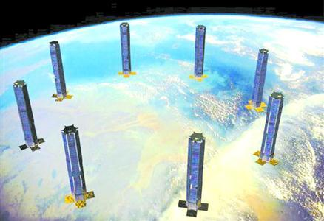

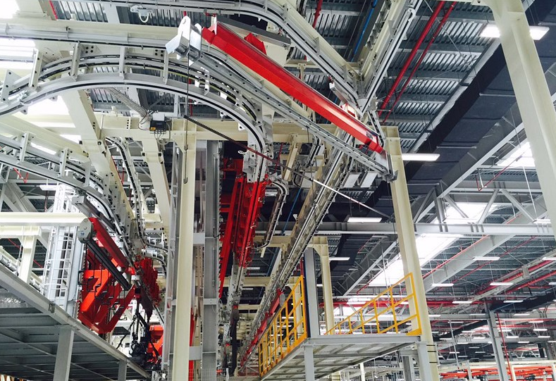
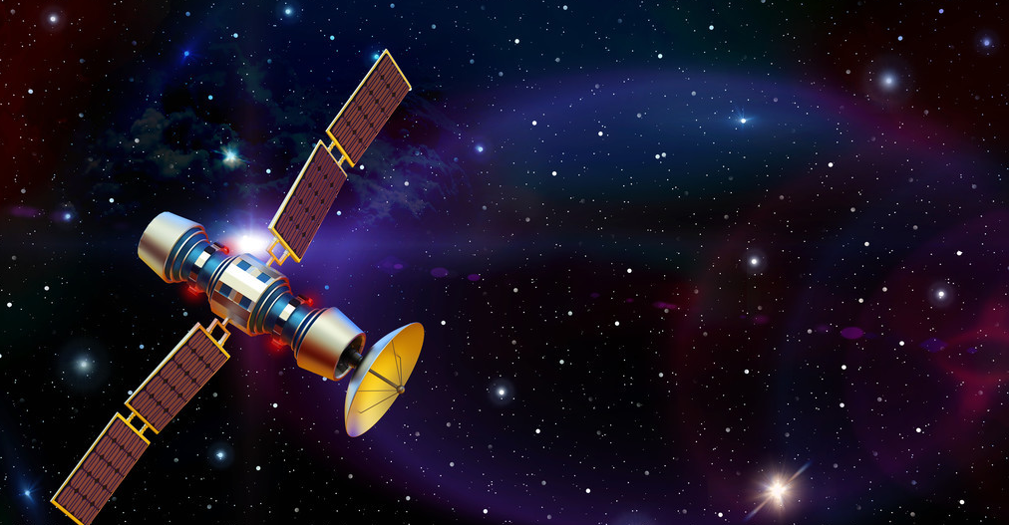
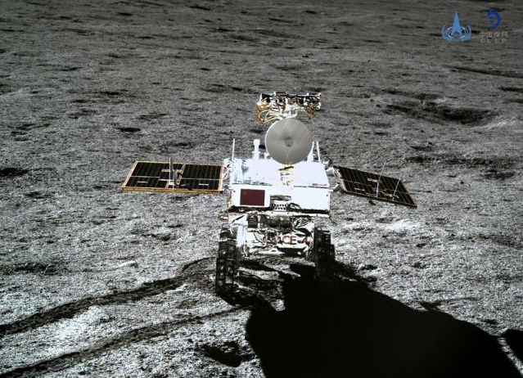

Background
2
Satellite formation flying
Large structure measurement
Precision equipment manufacturing
Satellite tracking
Space exploration imaging
Gravitational wave detection
The 30th International Laser Radar Conference (ILRC) virtual conference, June 26th – July 1st, 2022.

Slide 3
Advance Research
2
M. Cui Specifications：
Ambiguity range：50m
Resolution：2μm
Ki-Nam技术指标：
Ambiguity range ：1.46mm
Resolution ：7nm
THU Specifications：
Ambiguity range ：3.1mm
Resolution ：5μm
TJU Specifications ：
Ambiguity range ：0.6m
Resolution ：0.5μm
Dispersion
interferometry
Michelson
interferometer
NUDT Specifications：
Ambiguity range ：1m
Resolution ：61.9nm
Synthetic wavelength interferometry
Dual-comb
(Minoshima) Specifications ：
Ambiguity range ：：240m
Resolution ：50μm
NIST Specifications ：
Ambiguity range ：1.5m
Resolution ：5nm
THU Specifications：
Ambiguity range ：20m
Resolution ：10.4μm
Optical cross-correlation
J. Lee Specifications：
Ambiguity range ：0.7km
Resolution ：117nm
DCR system | Advantages
1.Simplified system | Simple structure
2.Simpler principle | Asynchronous optical sampling
TJU Specifications：
Ambiguity range ：52m
Resolution ：12nm
The 30th International Laser Radar Conference (ILRC) virtual conference, June 26th – July 1st, 2022.

Slide 4
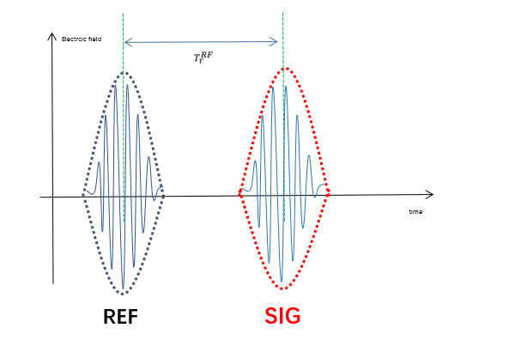

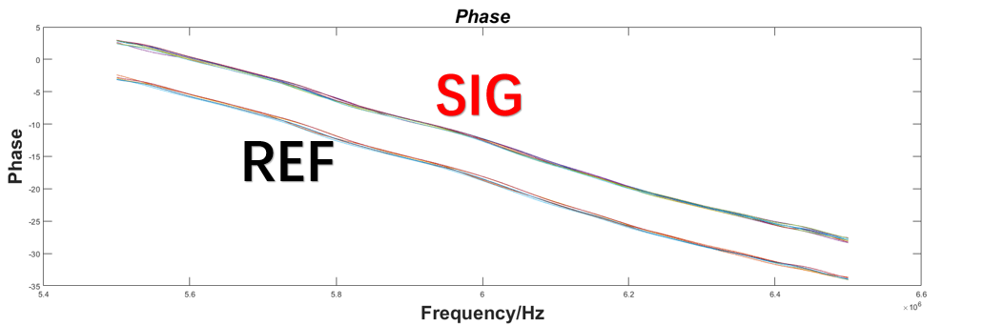


Principle
3
Peak extraction method
（a）Optical frequency domain
Electrcic field
LO
time
SIG
time
REF
$$τ_{r}^{RF}=t_{SIG}−t_{REF}$$
（b）Radio frequency domain
Phase method
Voltage
SIG
interferograms
time
Asynchronous optical sampling
The 30th International Laser Radar Conference (ILRC) virtual conference, June 26th – July 1st, 2022.

Slide 5
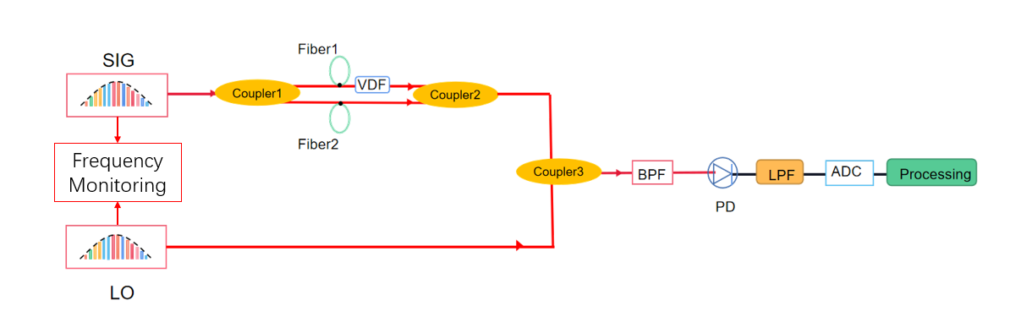
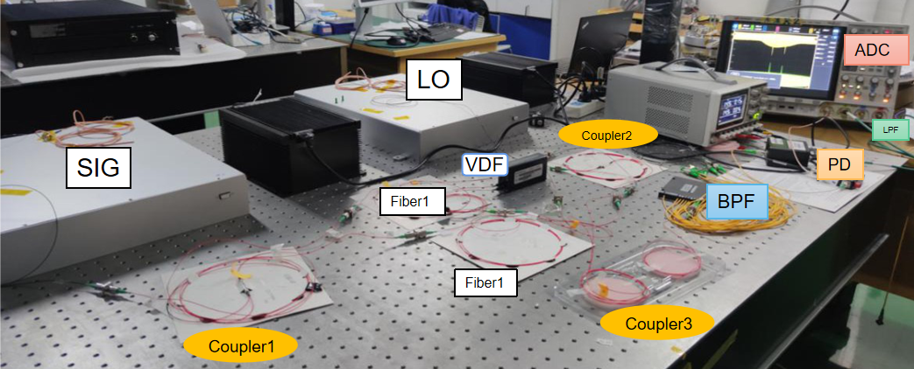
Experiment setup and parameters
4
Devices | Parameters
Comb1(SIG) | PRF:181.437MHz Output power:20mW 3dB width:51.7nm
Comb2(LO) | PRF:181.439MHz Output power:20mW 3dB width:107.6nm
VDL | Distance resolution:50μm
LPF | 3dB 80MHz
BPF(DWDM) | Bandwidth：2nm
Sampling rate | 2G~10G
Experiment setup
parameters
The 30th International Laser Radar Conference (ILRC) virtual conference, June 26th – July 1st, 2022.

Slide 6
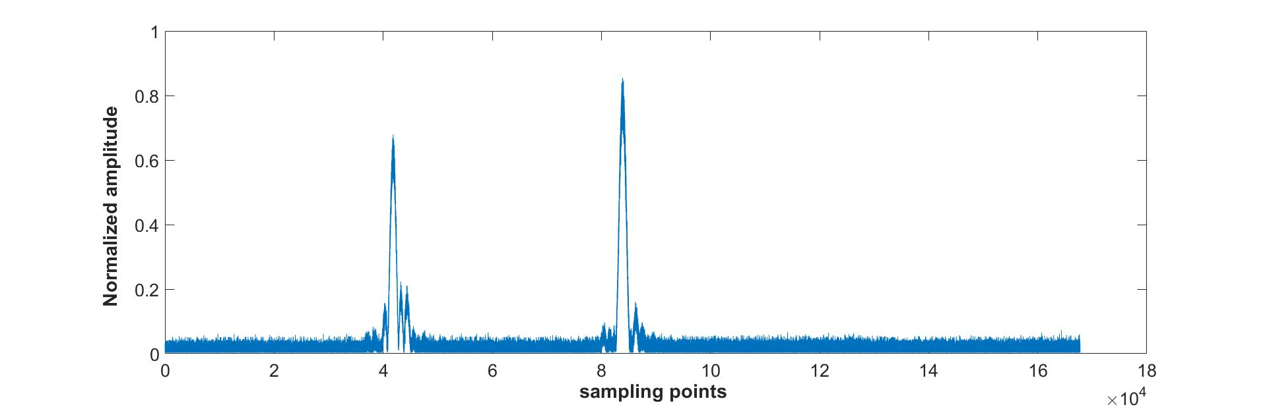
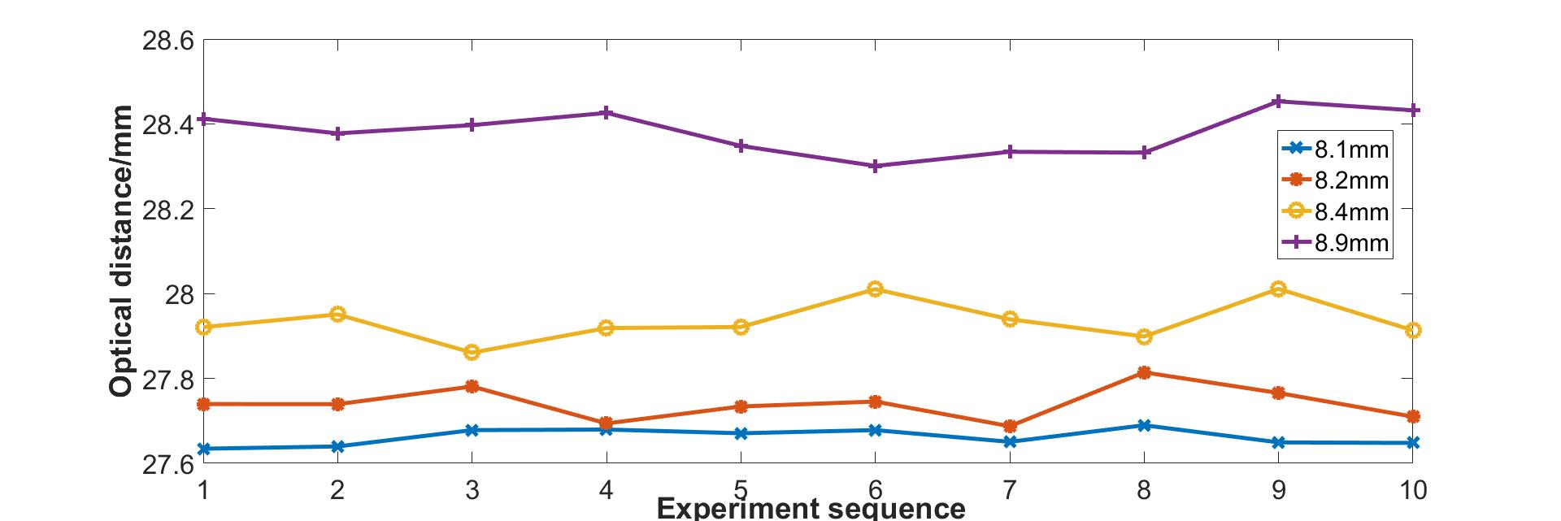
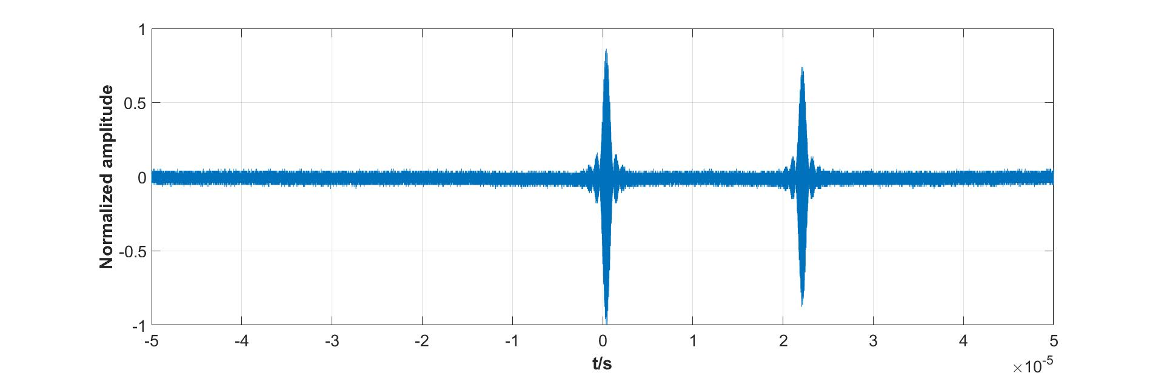
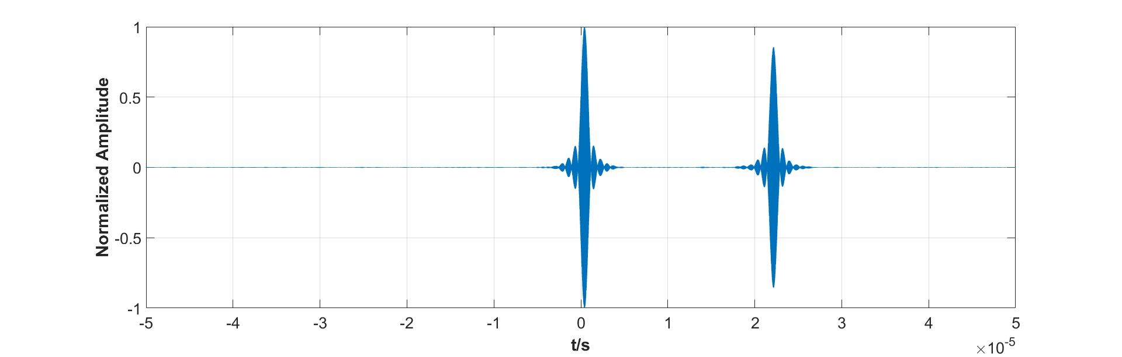
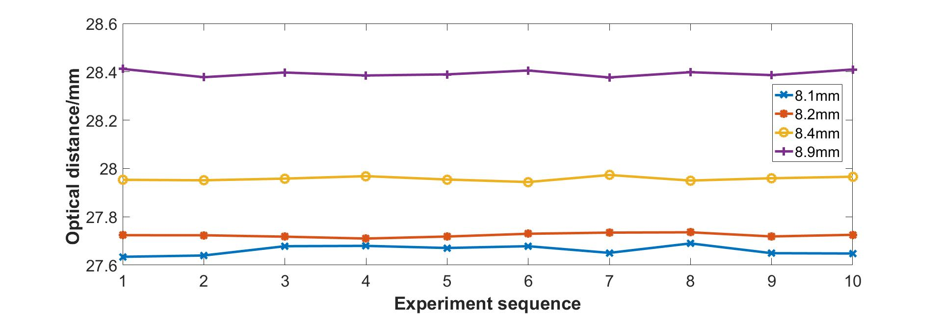
Process and measurement Results
5
(a)Fftfilt method
Filtering method | 8.1 mm | 8.2 mm | 8.4 mm | 8.9 mm
Adaptive(Ave mm / std um) | 27.65mm/30um | 27.72mm/8um | 27.95mm/11um | 28.40mm/14um
Fftfilt(Ave mm / std um) | 27.65mm/68um | 27.74mm/39um | 27.94mm/38um | 28.40mm/47um
(b) Adaptive filtering method
The 30th International Laser Radar Conference (ILRC) virtual conference, June 26th – July 1st, 2022.

Slide 7
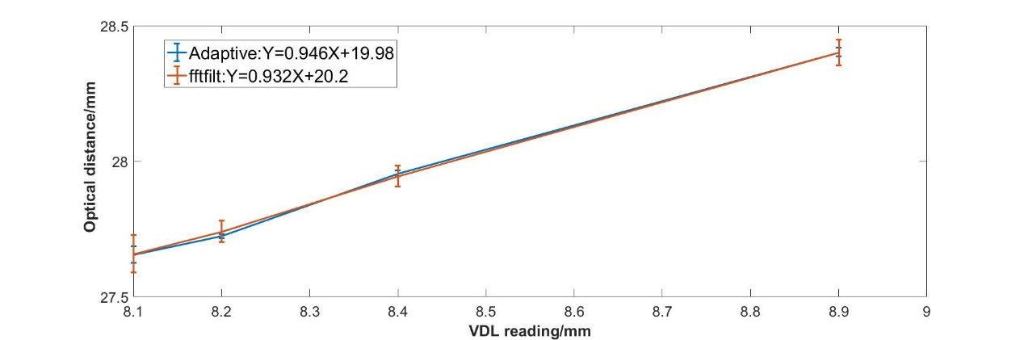
Conclusion
6
In conclusion, this paper demonstrates an all fiber free-running DCR system, which can realize a range precision about 16.2um. The system has the advantages of high precision, fast measurement rate, large ambiguity range, simple system structure, and eye safe.
Acknowledgment
The research is supported by No. 22ZR1402600 from the Shanghai Natural Science Foundation, Shanghai 2021 “Science and Technology Innovation Plan” Social Development Science and Technology Research Project(21DZ1205402). We also acknowledge the Key Laboratory of Space Laser Communication and Detection Technology of Shanghai Institute of Optics and Fine Mechanics, Chinese Academy of Science for offering the experiment platform.
Email:
Fu Yang: fuyang@dhu.edu.cn
Yanyu Lu: walyq129@163.com
The 30th International Laser Radar Conference (ILRC) virtual conference, June 26th – July 1st, 2022.

