Slide 1

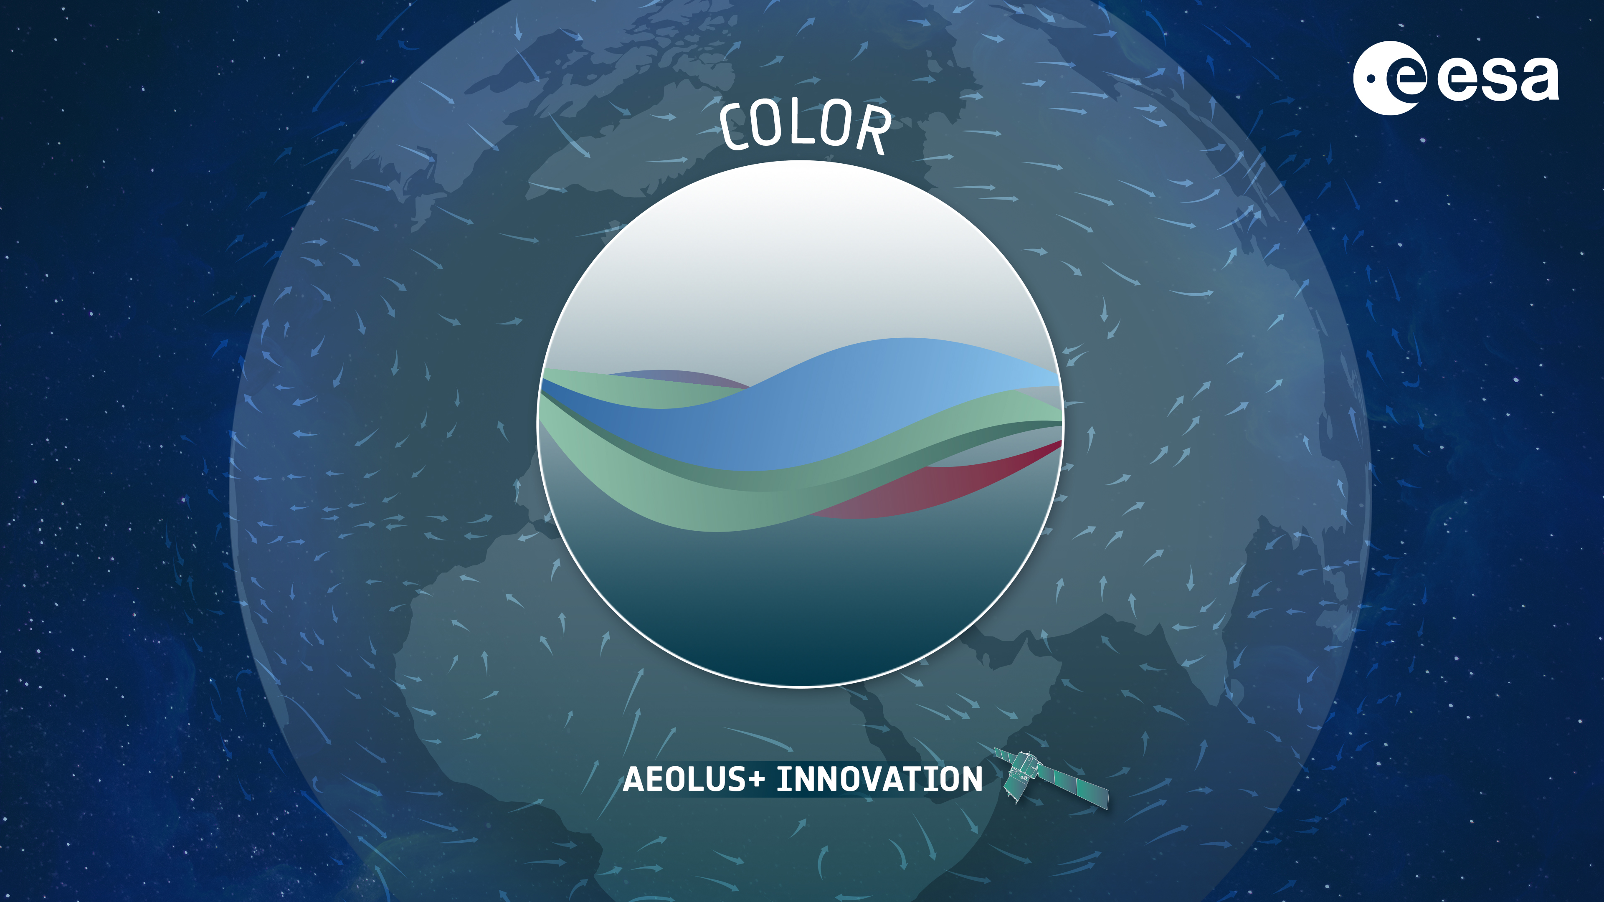





COLOR: CDOM-proxy retrieval from aeOLus ObseRvations
ESA AO/1-9544/20/I/NS
D. Dionisi¹, S. Bucci², C. Cesarini¹, S. Colella¹, D. D’Alimonte³, L. Di Ciolo², P. Di Girolamo⁴, M. Di Paolantonio^{1,4}, N. Franco⁴, T. Kajiyama³, G. L. Liberti¹, E. Organelli¹, R. Santoleri¹
¹Consiglio Nazionale delle Ricerche, Istituto di Scienze Marine, Rome, Italy
²Serco Italia S.p.A., Frascati, Italy
³AEQUORA, Lisbon, Portugal
⁴Università degli Studi della Basilicata, Potenza, Italy
[10].[Measurement techniques and observations of Ocean] properties]
[29-Jun], [12:15]
[Wednesday_ 10_P03]
The 30th International Laser Radar Conference (ILRC) virtual conference, June 26th – July 1st, 2022.

Slide 2
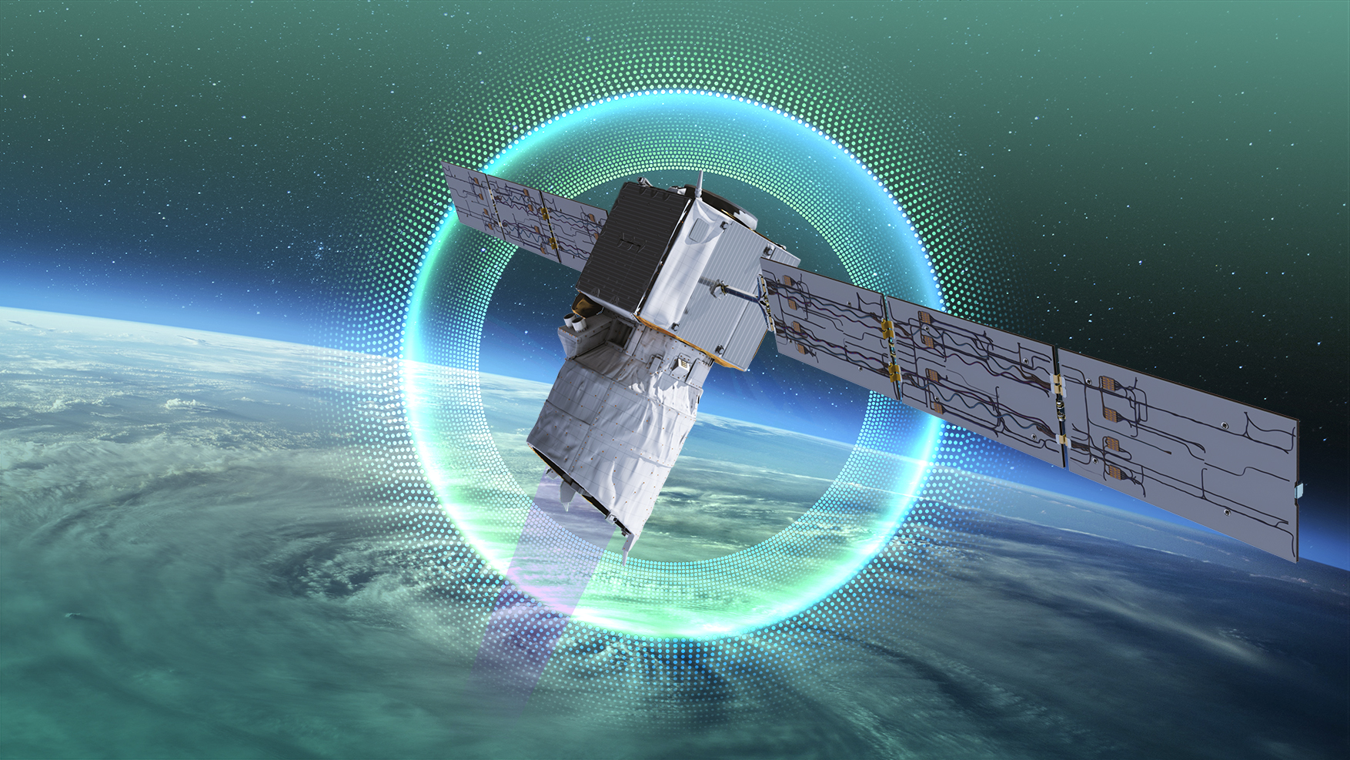
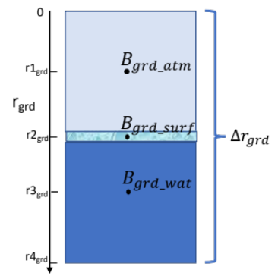
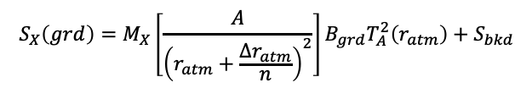
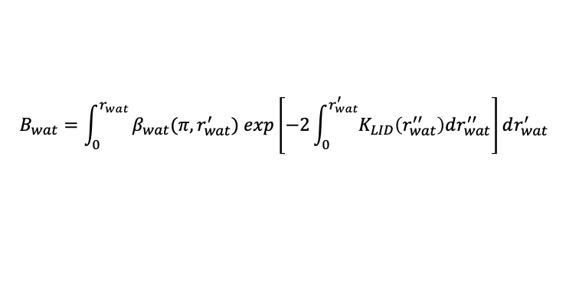
COLOR: context and method
1
Motivation and Context
COLOR (CDOM-proxy retrieval from aeOLus ObseRvations) is an on-going 18 month feasibility study approved by ESA within the Aeolus+ Innovation program (ESA AO/1-9544/20/I/NS). Kick-off: 10 march 2021.
Being AEOLUS the first orbiting HSRL lidar at 355 nm, COLOR proposes to evaluate and document the feasibility of deriving an in-water AEOLUS product at 355 nm (lidar attenuation coefficient K_{L}, in-water particle backscattering 𝛽_{wat}, ocean color parameters, e.g. Kd, Chl-a, CDOM)
COLOR approach
The core activity of the project is the characterization of the backscattered radiation signal (S_{grd}) from the AEOLUS ground bin (Δr_{grd}), where the potential information on ocean subsurface optical properties is contained.
$$S_{X}\left(grd\right)=M_{X}\left[\frac{A}{{\left(r_{atm}+\frac{∆r_{atm}}{n}\right)}^{2}}\right]B_{grd}T_{A}^{2}\left(r_{atm}\right)+S_{bkd}$$
(1)
(2)
X= Ray_{A,B}
X= Mie
$$B_{wat}=\int_{0}^{r_{wat}}{β_{wat}(π,r_{wat}^{′}) exp\left[−2\int_{0}^{r_{wat}^{′}}{K_{LID}\left(r_{wat}^{′′}\right)dr_{wat}^{′′}}\right]dr_{wat}^{′}}$$
(3)
This characterization is based on:
a) Radiative Transfer numerical Modelling (RTM): development and validation of a RTM to simulate AEOLUS signal propagation in ocean
b) AEOLUS data analysis: verification of the AEOLUS L1B data, statistical characterization of relevant variables
Development, assessment and validation of a potential AEOLUS Ocean Color retrieval algorithm.
The 30th International Laser Radar Conference (ILRC) virtual conference, June 26th – July 1st, 2022.

Slide 3
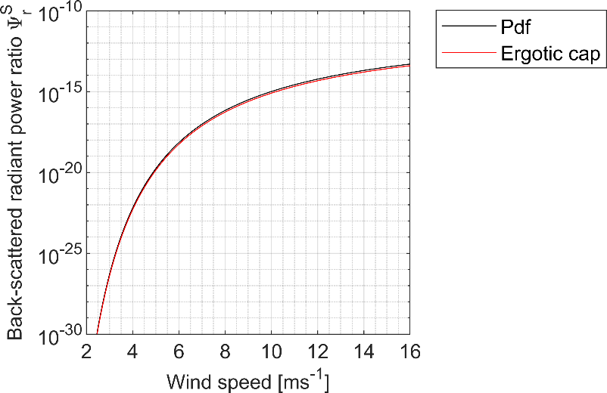
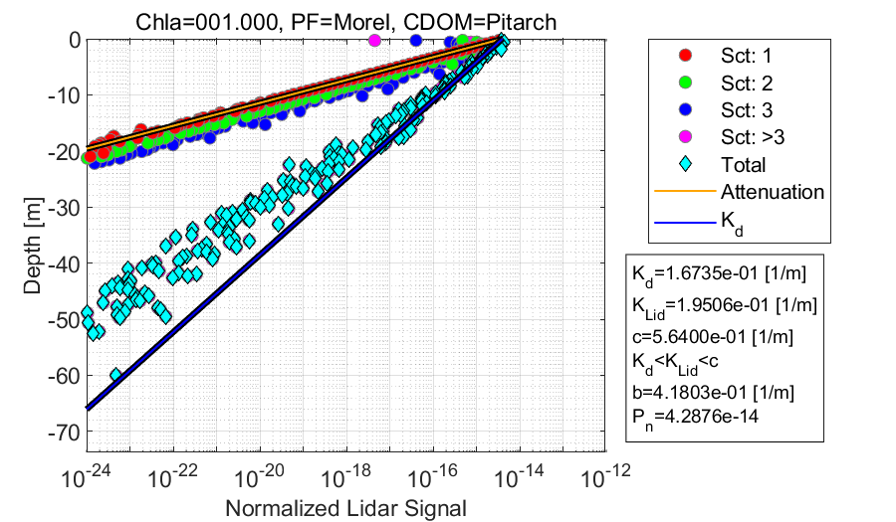
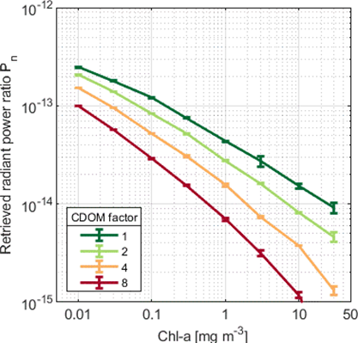
COLOR: CDOM-proxy retrieval from aeOLus ObseRvations)
2
Radiative transfer numerical
Aim: Development and validation of a RTM to simulate AEOLUS signal propagation in ocean.
Sea-surface back-scattering contribution
Simulation profile
Contribution of the water bin to the retrieved signal
Simulation identified “expected” conditions where the echoed lidar signal can be informative of optically active sea-water constituents (e.g., v_{w}<8 ms⁻¹, Chl-a > 0.1 mg m⁻³ if $z_{b}≈100$ m).
The 30th International Laser Radar Conference (ILRC) virtual conference, June 26th – July 1st, 2022.

Slide 4
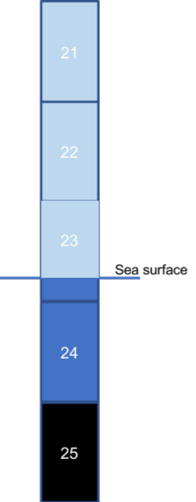
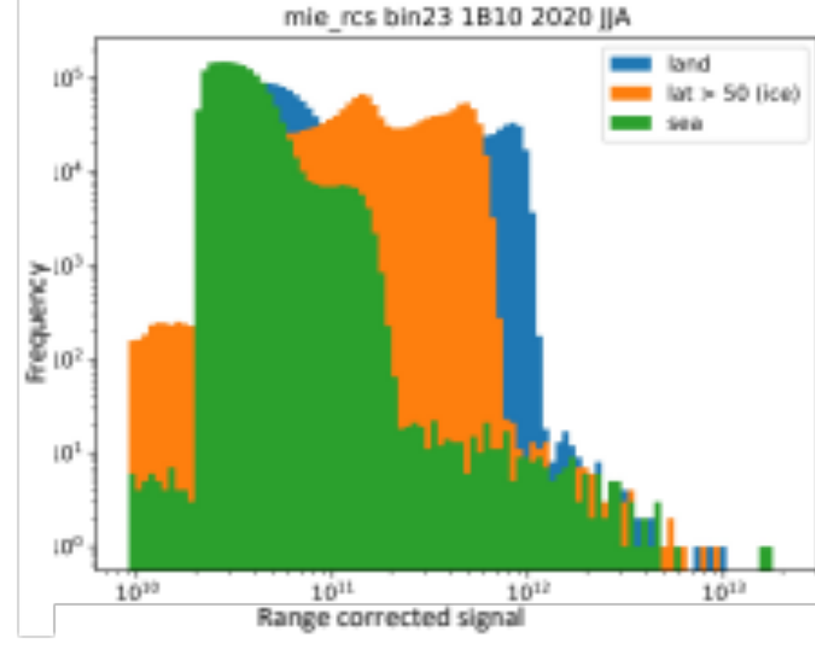
COLOR: CDOM-proxy retrieval from aeOLus ObseRvations)
2
Data analysis
Aim: Verification and characterization of the information content of AEOLUS L1B data for the development of a potential AEOLUS Ocean Color retrieval algorithm.
BIN #23
Bin #23 contains the atmosphere-ocean interface (more than 95% of the cases). Water portion is around 20% of the bin.
Analysis of the different contributions of the ground bin (#23) signal
500 m
Flagging procedure
1) Bathymetry*: sea depth ≥ 100 m; lower edge of BIN #23 < -70 m
2) Wind at the surface**: < 8 m/s
3) Cloud/aerosols contamination (BIN #23, #22 and #21 of Mie channel)
  SNR ≥ 5 and SNR ≤ SNR_{FWHMb}
  SIG ≤ SIG_{FWHMb}
Data filtering procedure on AEOLUS Mie channel removes the majority of cloud contaminated bins but filters out around 70% of the original data sample. Residual contaminated bins are present.
The 30th International Laser Radar Conference (ILRC) virtual conference, June 26th – July 1st, 2022.

Slide 5
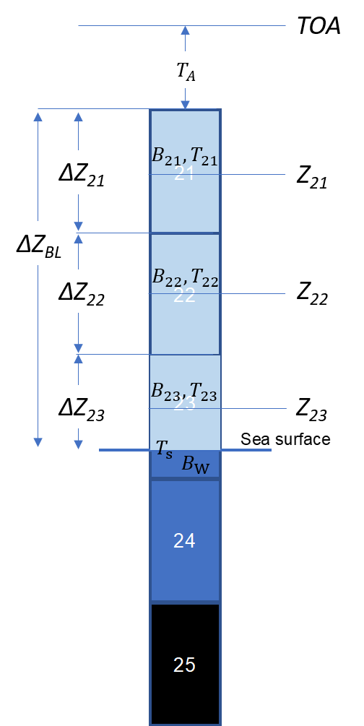
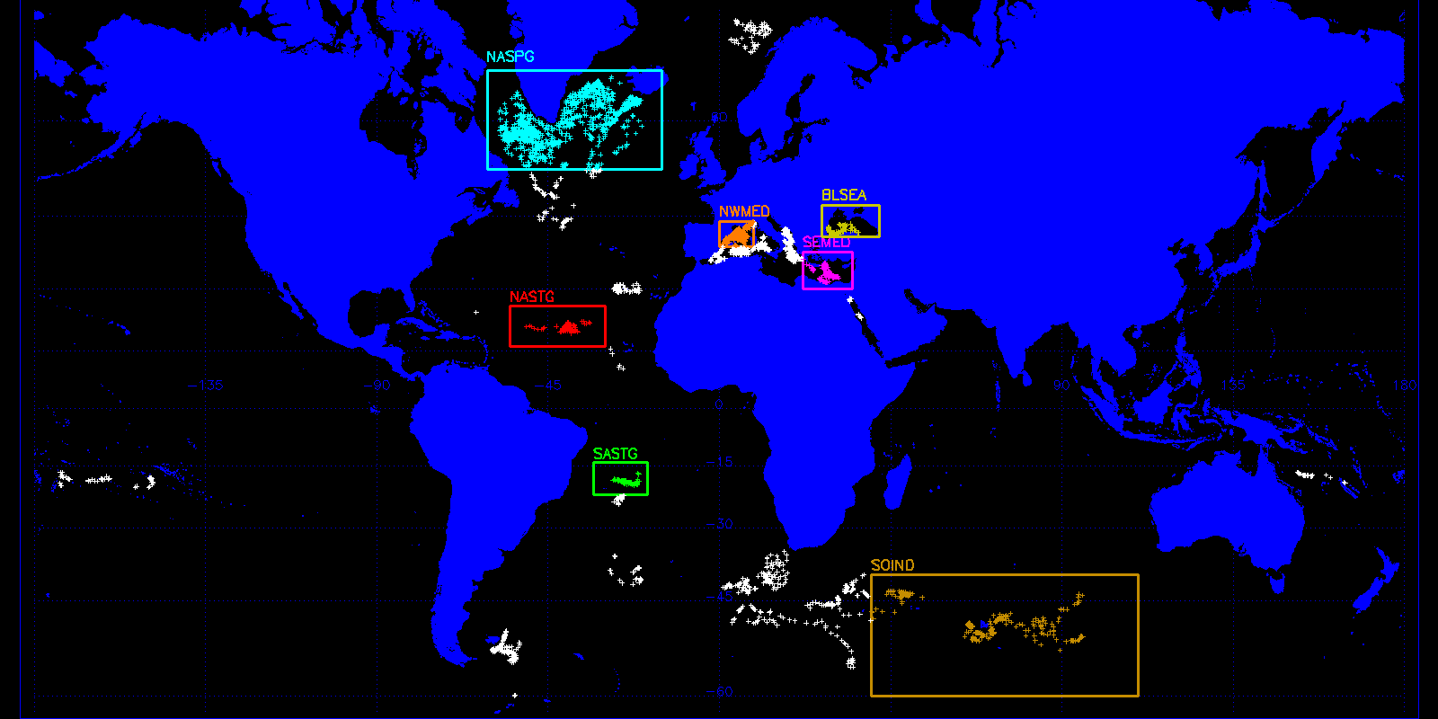
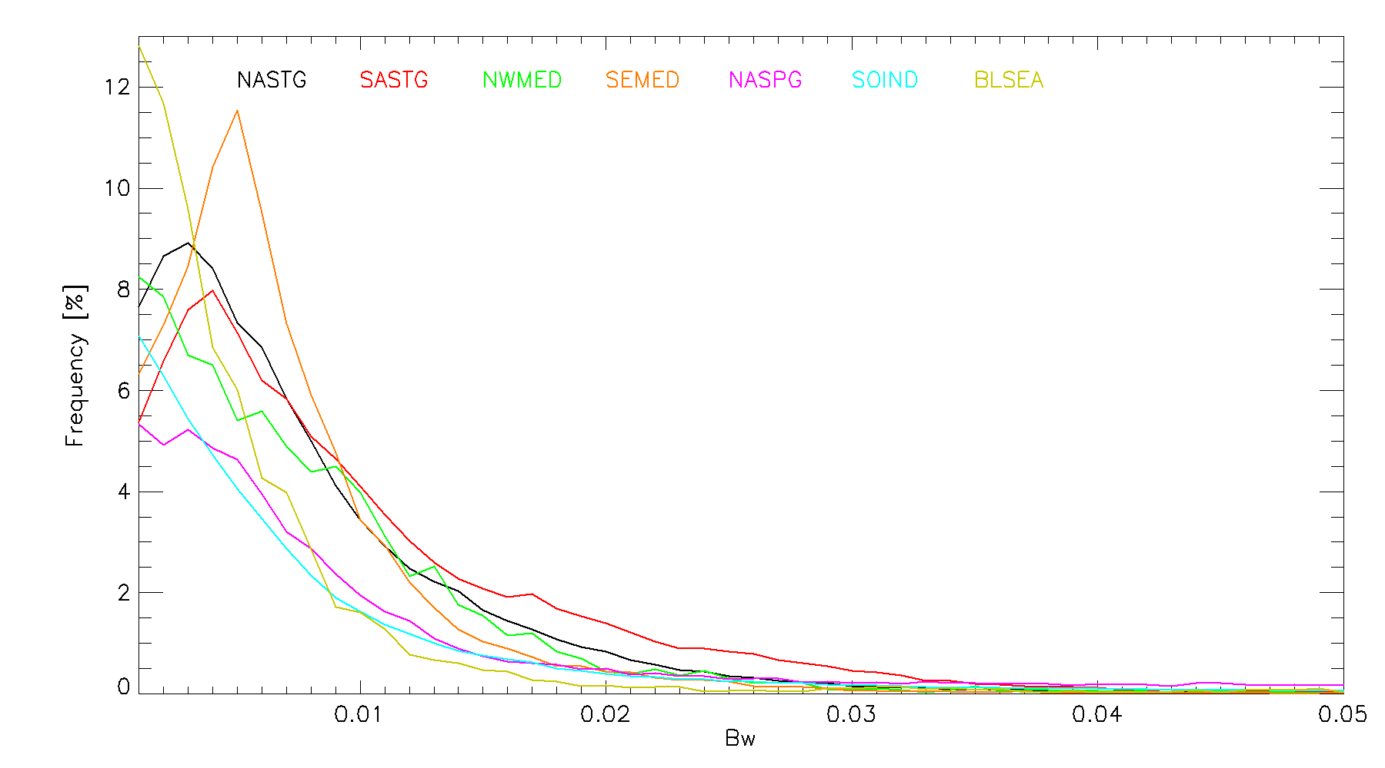
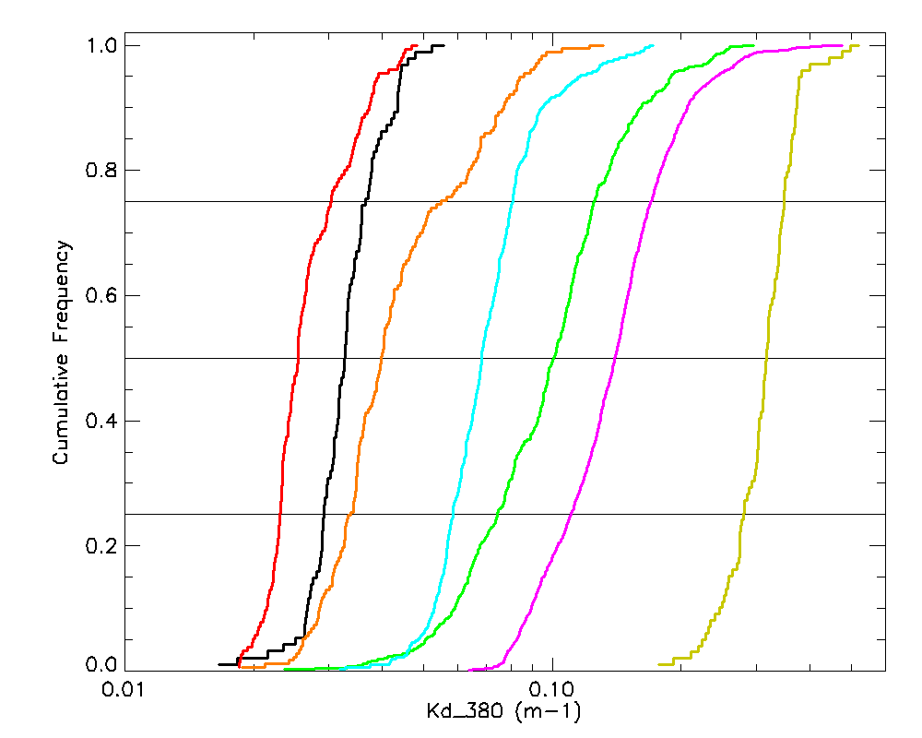
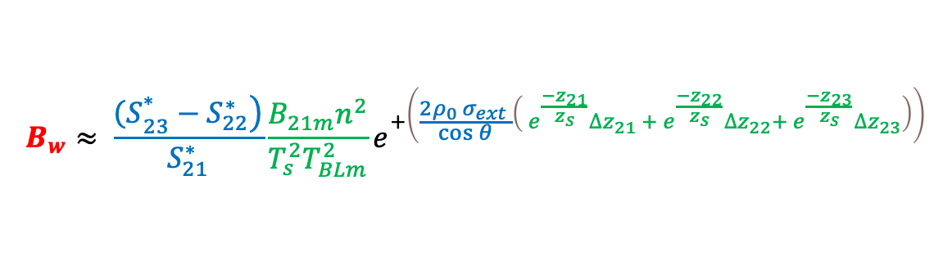
COLOR: CDOM-proxy retrieval from aeOLus ObseRvations)
2
Algorithm implementation
$$B_{w}≈ \frac{\left.{\left(S\right.}_{23}^{∗}−S_{22}^{∗}\right)}{S_{21}^{∗}}\frac{{B_{21m}n}^{2}}{T_{s}^{2}T_{BLm}^{2}}e^{+\left(\frac{{2ρ}_{0 }σ_{ext} }{\cos{θ}}\left( e^{\frac{{−z}_{21}}{z_{s}}}∆z_{21} {+ e}^{\frac{{−z}_{22}}{z_{s}}}∆z_{22}+{ e}^{\frac{{−z}_{23}}{z_{s}}}∆z_{23}\right)\right)}$$
Testing the capability to reproduce expected behaviours
Areas of interest:
1) North Atlantic subpolar gyre;
2) North Atlantic subtropical gyre;
3) South Atlantic subtropical gyre;
4) Black Sea;
5) North Western Mediterranean Sea;
6) Levantine Sea (Mediterranean Sea);
7) Southern Ocean – Indian sector.
  Statistical comparison between K_{d} derived by BGC-Argo and AEOLUS B_{w} seems to confirm RTM results

Slide 6
COLOR: CDOM-proxy retrieval from aeOLus ObseRvations)
2
Summary
COLOR (CDOM-proxy retrieval from aeOLus ObseRvations) has the objective to evaluate the feasibility of deriving an in-water AEOLUS prototype.
COLOR core approach is the characterization of the AEOLUS ground bin signal coupling RTM and data analysis
RTM results identify conditions where the AEOLUS signal can be used to derive information about ocean optical properties
Preliminary analysis on AEOLUS signal confirms RTM results
Next COLOR phase is devoted to develop, consolidate, assess and validate the Ocean AEOLUS algorithm
On going activities
Closure assessment between ocean simulated signal and measured signal of the ground bin
Estimation of the atmospheric contribution
Estimation of the Brillouin contribution on the Rayleigh channels
Implementation of specific Q/C tests (e.g. cloud detection)
Design and development HSRL retrieval inversion
The 30th International Laser Radar Conference (ILRC) virtual conference, June 26th – July 1st, 2022.

