Slide 1
Polarimetric Multiple Scattering LiDAR Model Based on Poisson Distribution
Grégoire Tremblay and Gilles Roy
The 30th International Laser Radar Conference (ILRC) virtual conference, June 26th – July 1st, 2022

Slide 2
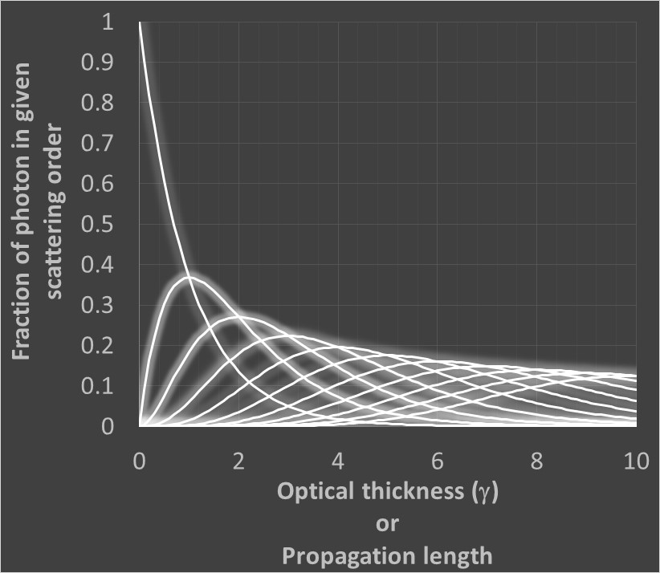


Introduction: the Poisson distribution
The transmission through a cloud depends on its optical thickness (γ) as
Photons not transmitted are scattered. In an infinite cloud, the population of scattering events of order k are predicted exactly by a Poisson distribution
$$Transmission\left(γ\right)=exp\left(−γ\right)$$
$$Poisson\left(γ,k\right)=\frac{γ^{k}}{k!}exp\left(−γ\right)$$
The Poisson distribution can be used to predict the population of photons after a given propagation length.

Slide 3

Equivalent-Medium theorem
The Equivalent-Medium theorem states that for any given chain of forward scattering events, an equivalent backscattering chain of events exists.
Forward scattering multiple scattering is easier to model. Combining the Poisson distribution and the Equivalent-Medium theorem yields the maximum amount of photons available for capture on the LiDAR receiver
3
1
2
$$LiPoisson\left(γ,k\right)=\frac{γ^{k}}{k!}exp\left(−2γ\right)$$
1
3
2

Slide 4
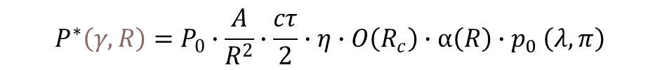
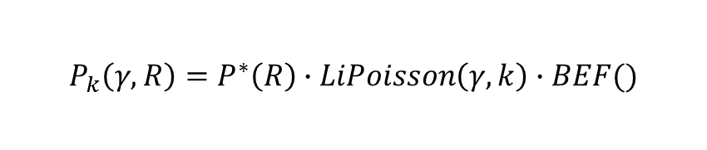
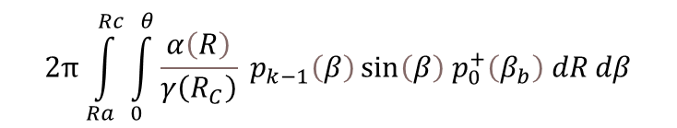
Getting the correct amount of captured photons
$$P_{k}\left(γ,R\right)=P^{∗}\left(R\right)∙LiPoisson\left(γ,k\right)∙BEF()$$
Convoluted forward
scattering phase function
Weighted scattering phase
function to account for EMT
Total power on receiver for
scattering order k, optical
thickness γ and range R
$$2π\int_{Ra}^{Rc}{\int_{0}^{θ}{\frac{α\left(R\right)}{γ\left(R_{C}\right)} p_{k−1}\left(β\right)\sin\left(β\right) p_{0}^{+}\left(β_{b}\right) dRdβ}}$$
Backscattered Energy Fraction
$$P^{∗}\left(γ,R\right)=P_{0}∙\frac{A}{R^{2}}∙\frac{cτ}{2}∙η∙O\left(R_{c}\right)∙α\left(R\right){∙p}_{0}\left(λ,π\right)$$
Detailled description can be found in
Roy, G. Tremblay, G.: A Polarimetric multiple
scattering LiDAR model based on Poisson
Distribution. Applied Optics (2022) DOI
10.1364/AO.458566
Initial power
Extinction
Probed length
Receiver solid angle
System efficiency
Backscattering phase
function

Slide 5

Getting the depolarization
Knowing the aerosol phase function, we know the depolarization parameter D provided by the ratio of the secondary polarization signal over the total signal
Knowing the total signal and D gives us the secondary polarization.
This is applied to the Backscattering Energy Fraction to get the secondary signal (BEFS) from the total signal (BEF).
$$D=\frac{S\left(θ,R_{C}\right)}{P\left(θ,R_{C}\right)} .$$

Slide 6
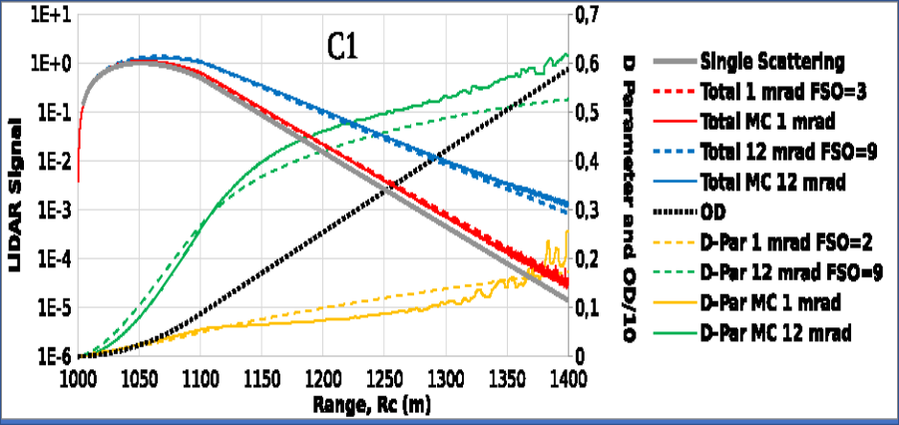
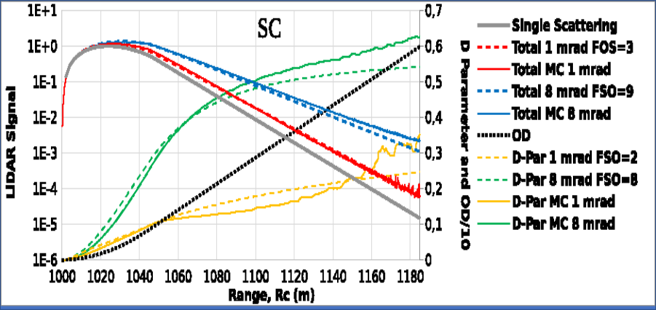
Some results
The model is used on four types of water clouds and compared to Monte Carlo simulations.
We look at a Cumulus (C1), a stratocumulus (SC), a nimbostratus (NS) and a moderate water cloud (MWC).
The Monte Carlo results are in full lines. The model results are in dashed lines.

Slide 7
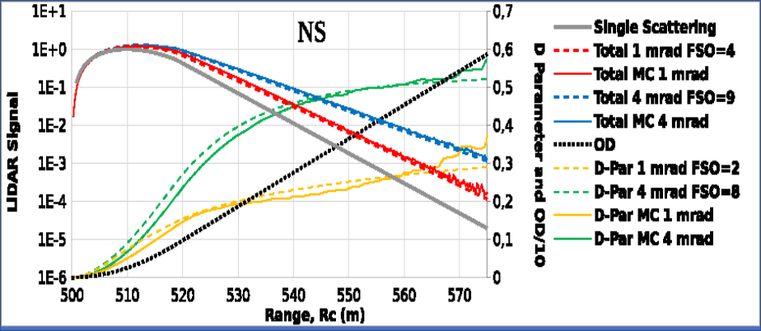
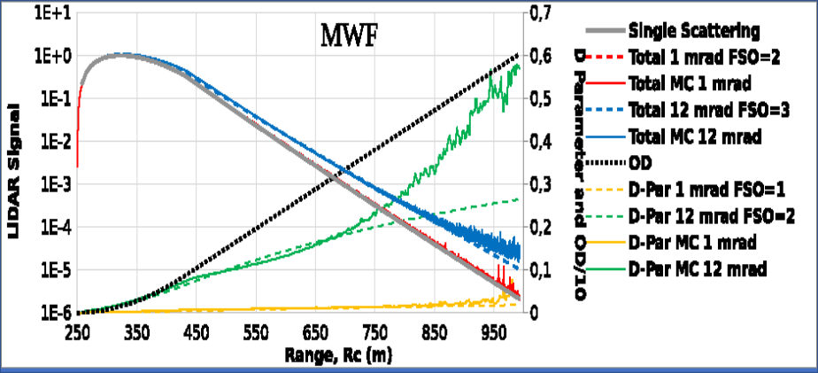
Conclusion
The agreement of our polarimetric multiple scattering model with the Monte Carlo is good in most cases, particularly for the larger aerosols and the smaller FoV.
We would like to thank Luc R. Bissonnette for reviewing the model.
This work was supported by the Defence Research and Development Canada Program.

