Slide 1


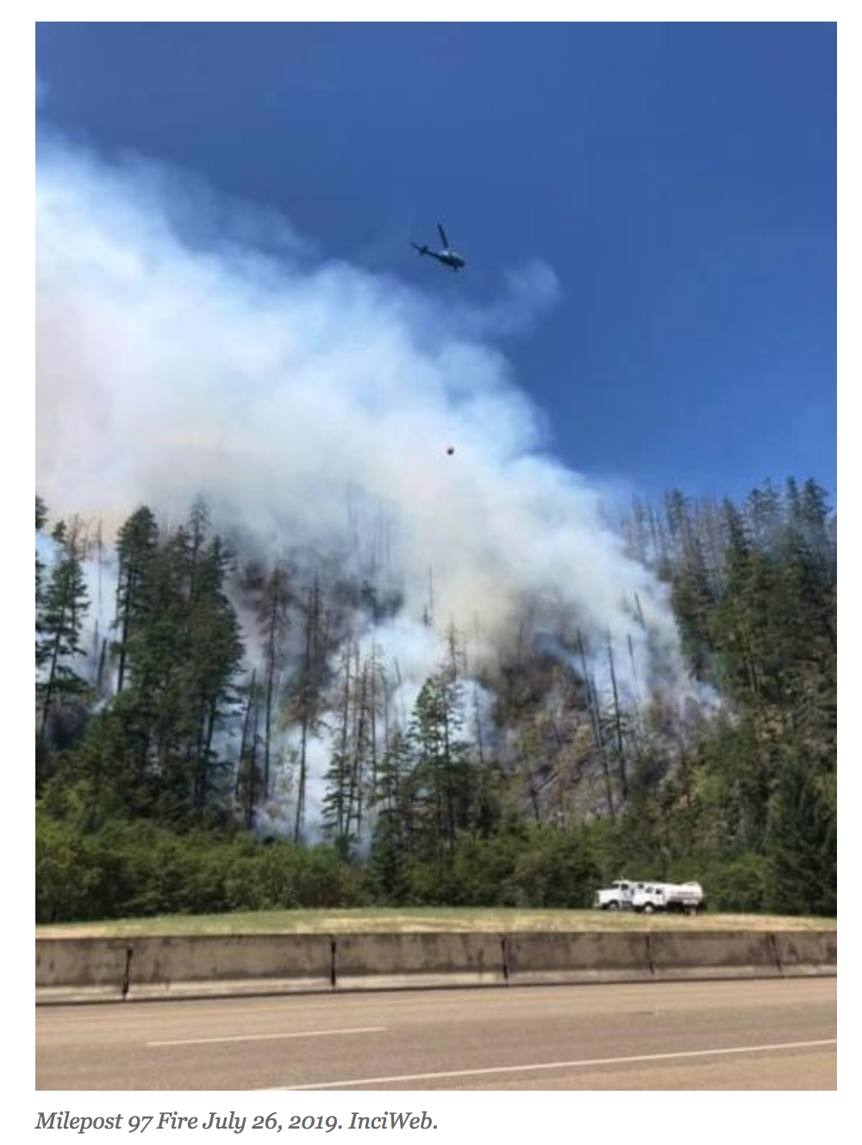
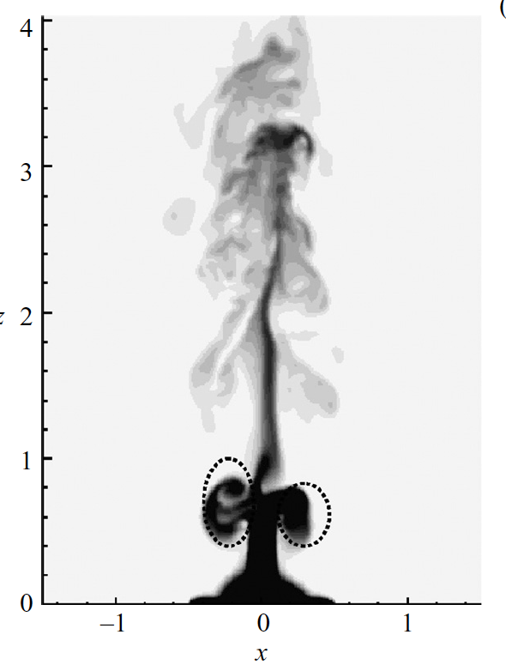
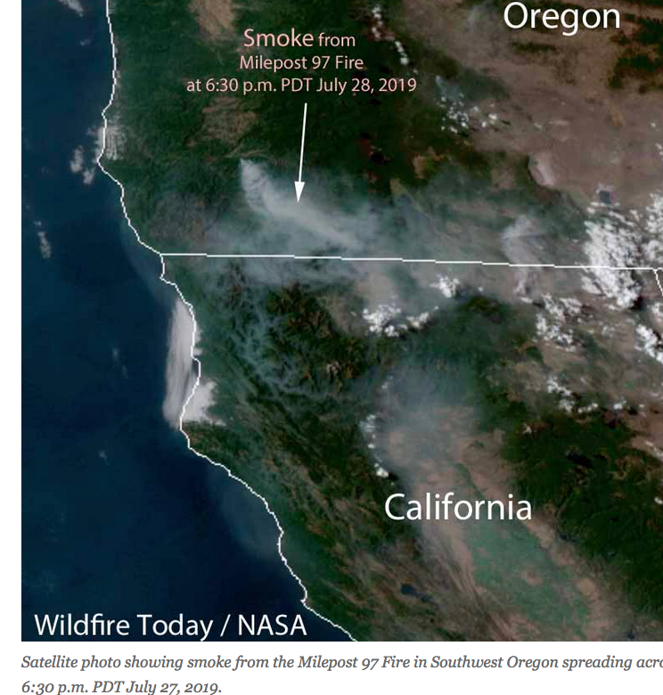
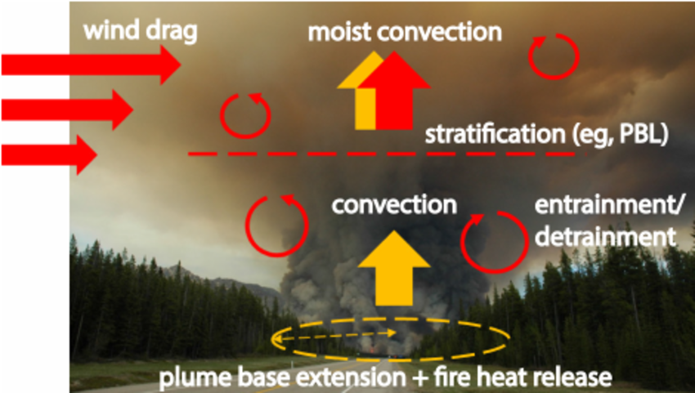




Isolating and Disseminating Core Updraft Structures for the 2019 FIREX-AQ Campaign using Observations from an Airborne Doppler Lidar
Paugam et. al. (2016)
Plourde et. al. (2008)
$$z_{plume}?$$
Edward Strobach^{1,2}, Alan Brewer², Brandi McCarty^{1,2}, Amanda Makowiecki^{1,2}
¹CIRES/University of Colorado, Boulder
²NOAA Chemical Sciences Laboratory
08-Atmospheric Boundary Layer Processes
June 30th, 2022, 12:00 UTC
08 P19
The 30th International Laser Radar Conference (ILRC) virtual conference, June 26th – July 1st, 2022.

Slide 2
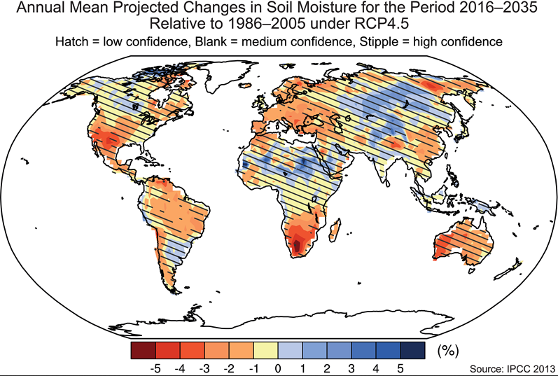
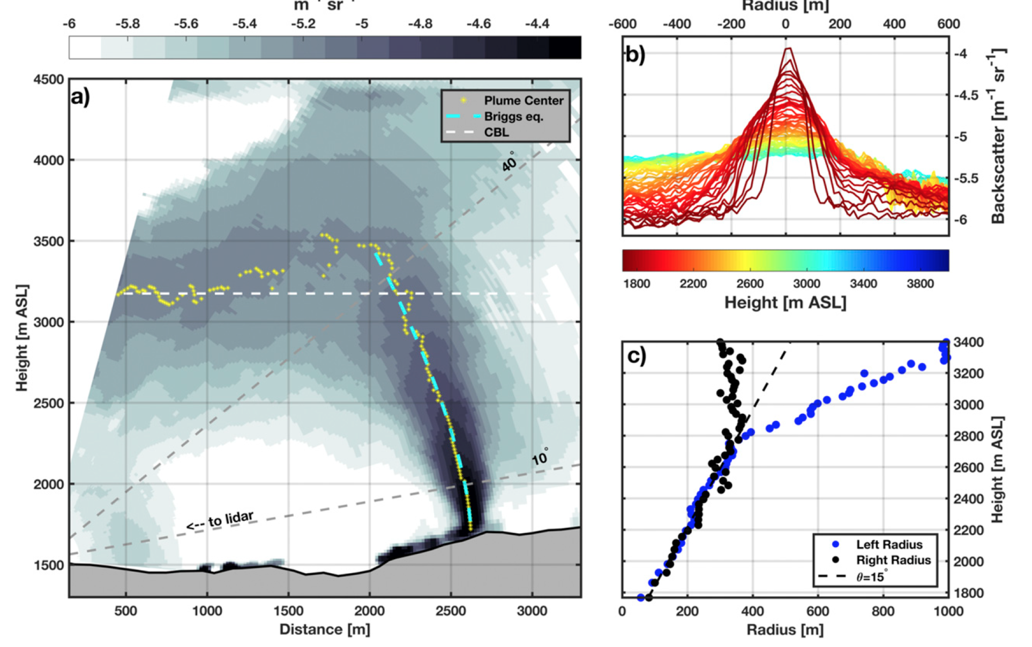
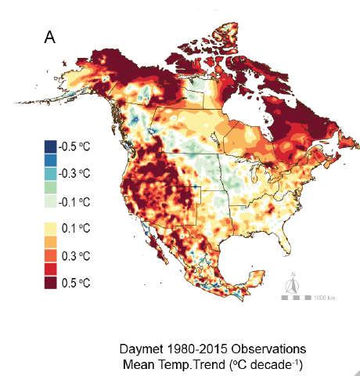
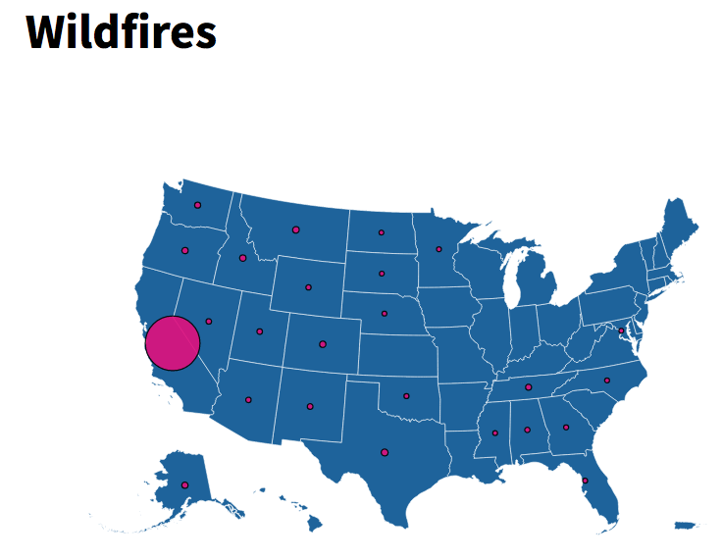
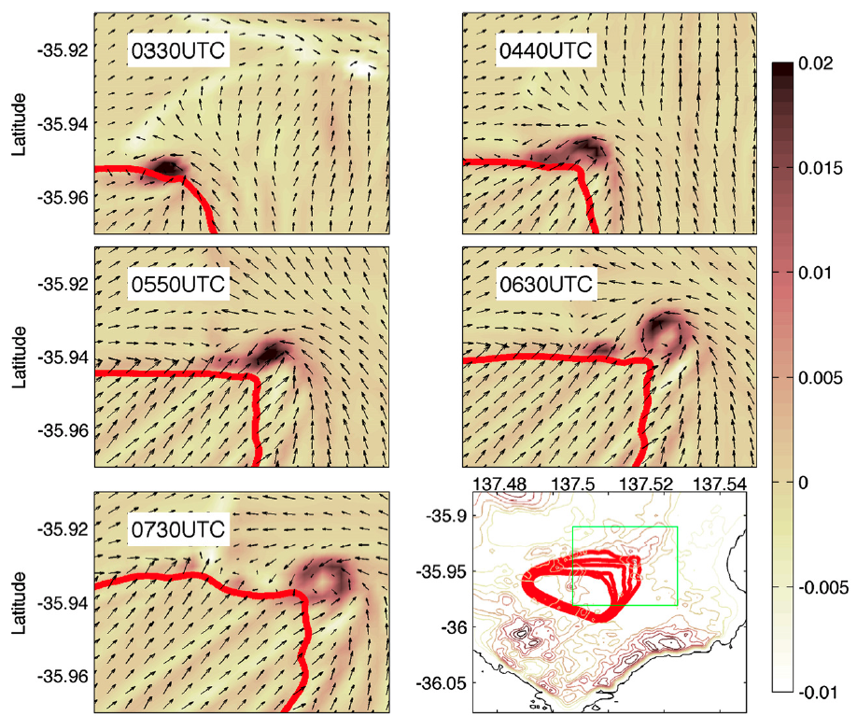
Motivation
1
IPCC (2022)
Lareau and Clements (2017)
Surface conditions are expected to become drier (already evident)
Regions west of the Rockies have experienced enhanced warming over the last 3 decades
California leads the way in fire damage but other states are catching up
Changes in conditions leads to increases in wildfires which leads to more pollution which changes background conditions further
Vertical velocity structure will depend on fire-induced surface buoyancy, radiative effects from smoke, background stability/wind, topography, and entrainment
Vortex structures can develop and assist in modifying burn area and with winds along wildfire front
Peace et. al. (2015)
USA Facts
The 30th International Laser Radar Conference (ILRC) virtual conference, June 26th – July 1st, 2022.

Slide 3
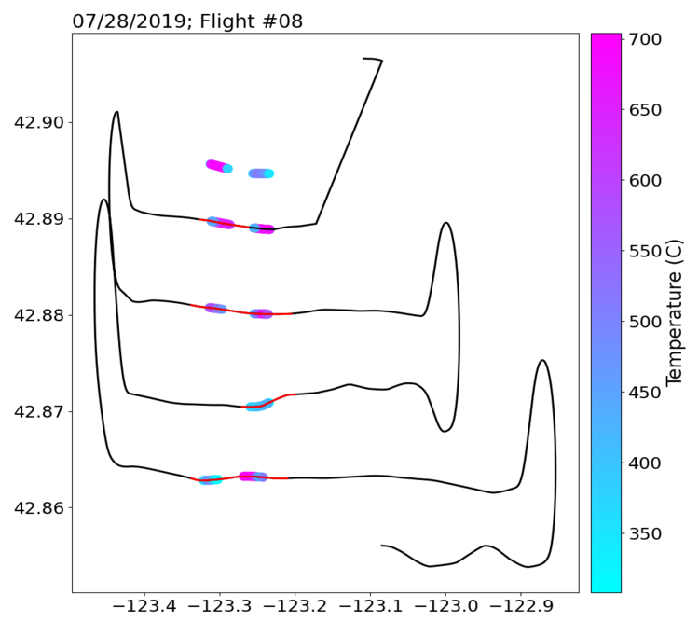
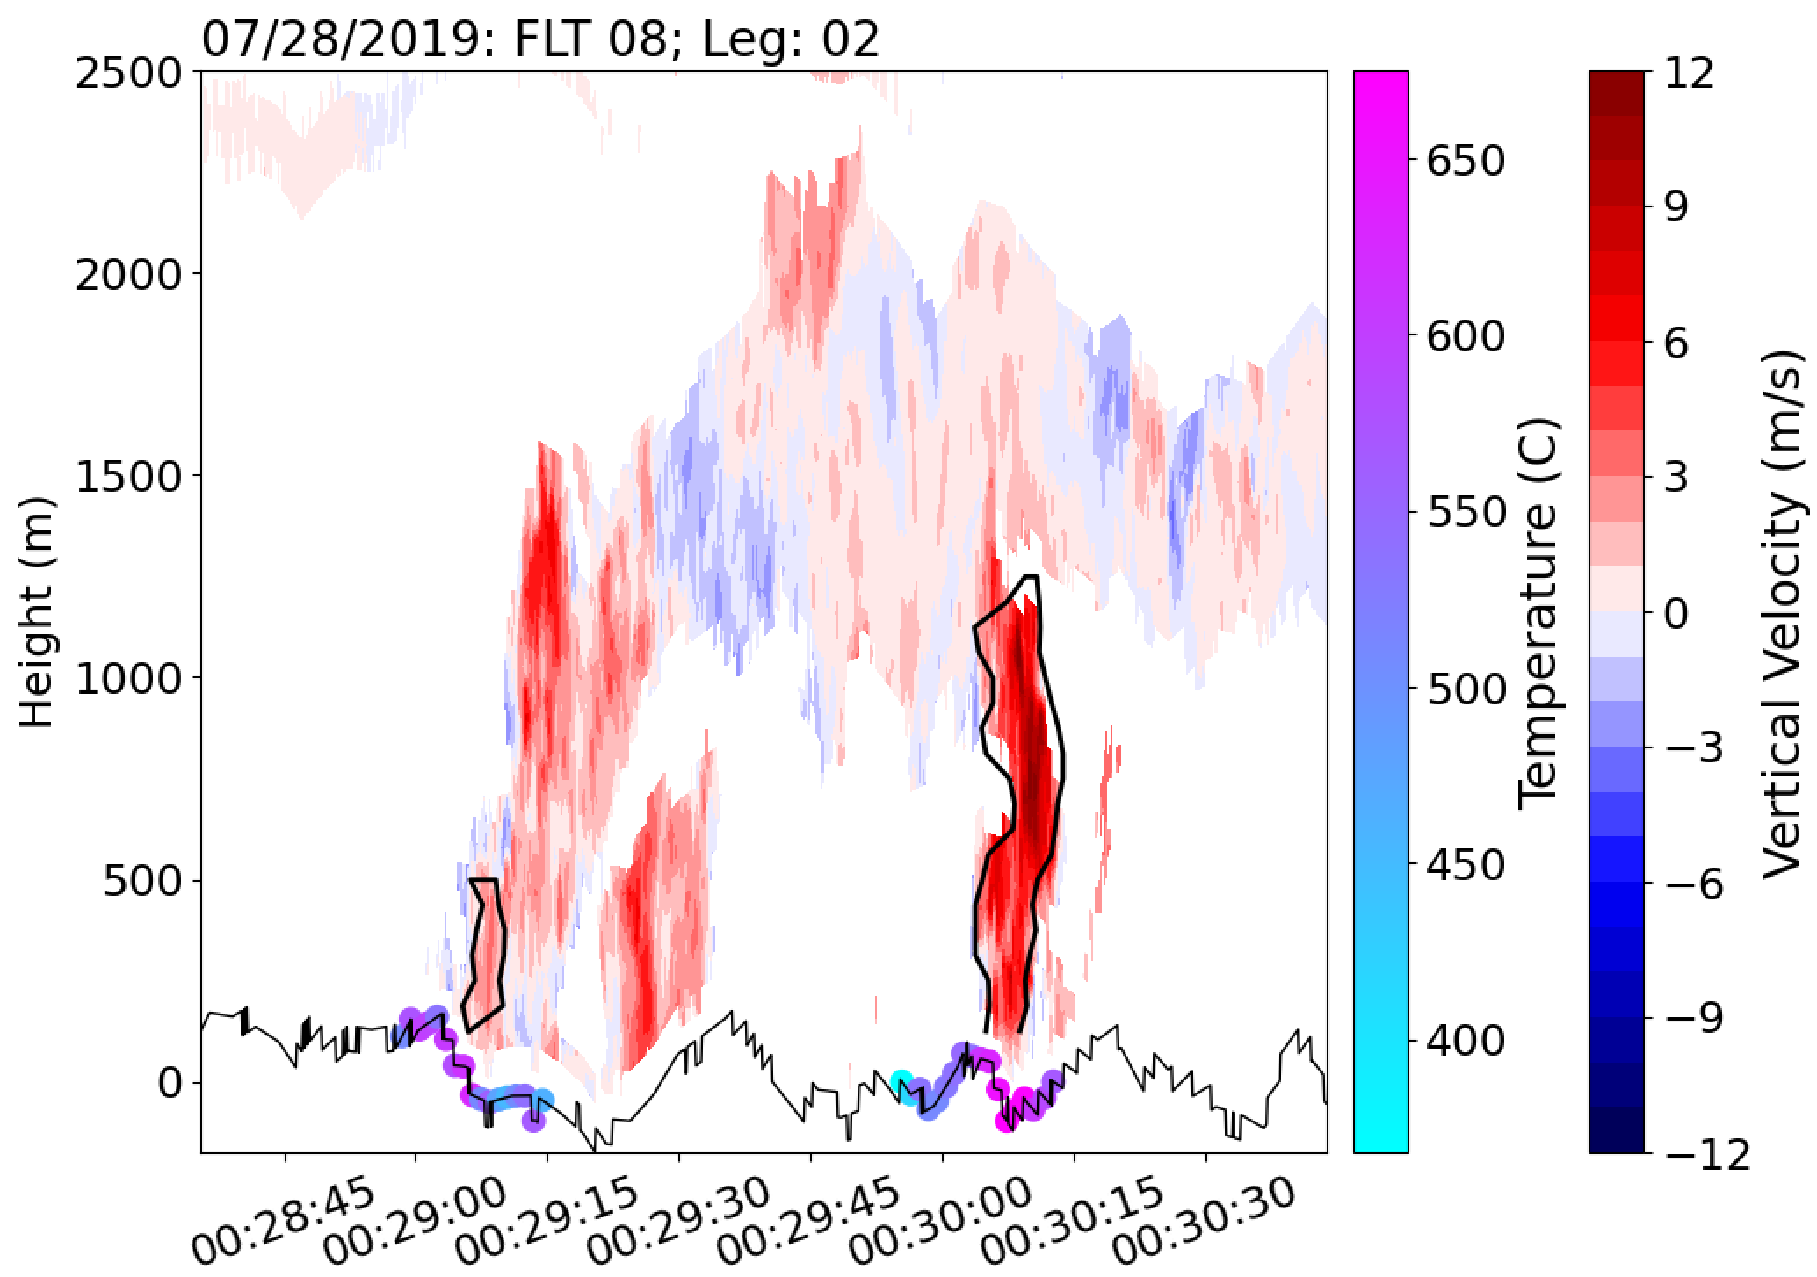
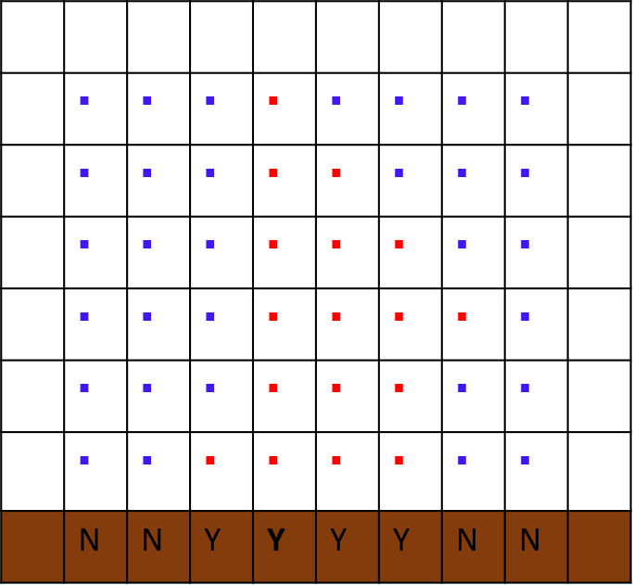
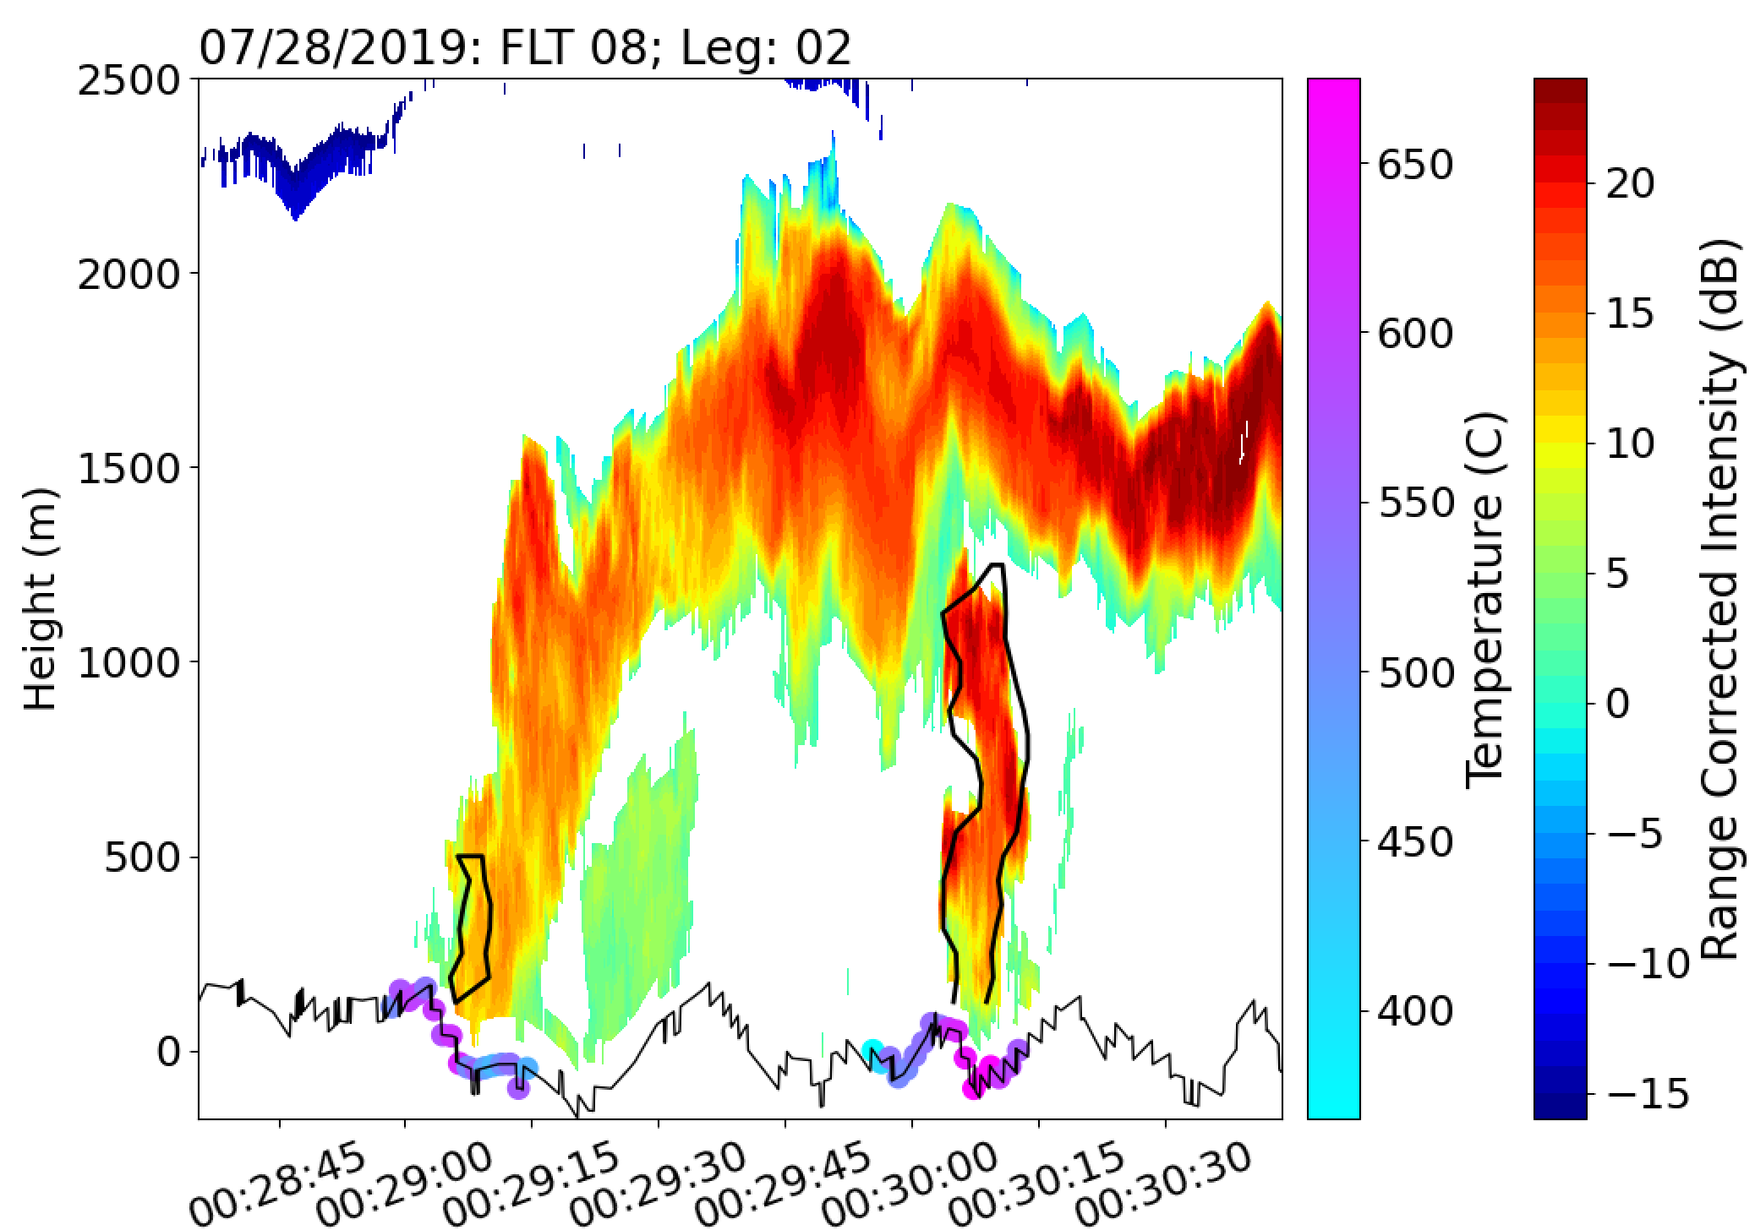
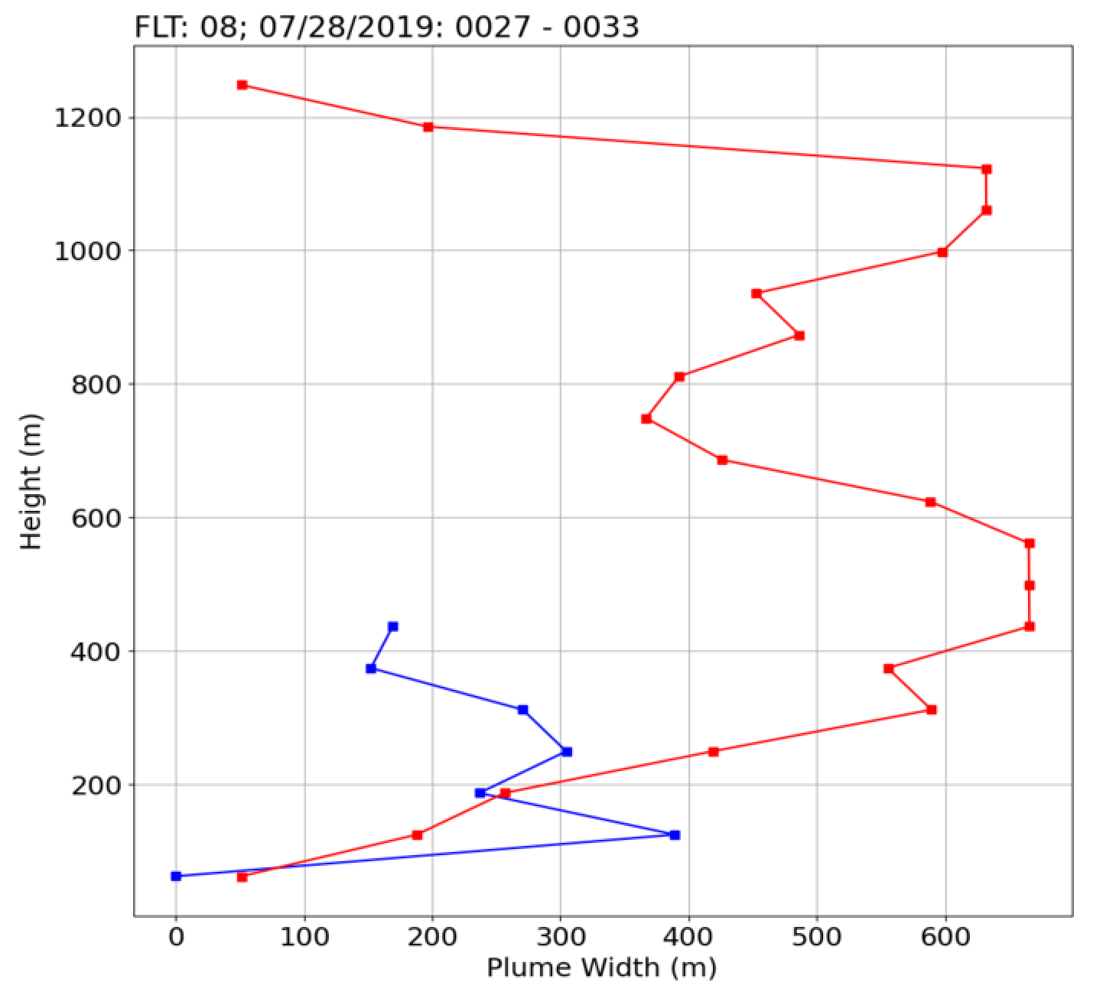
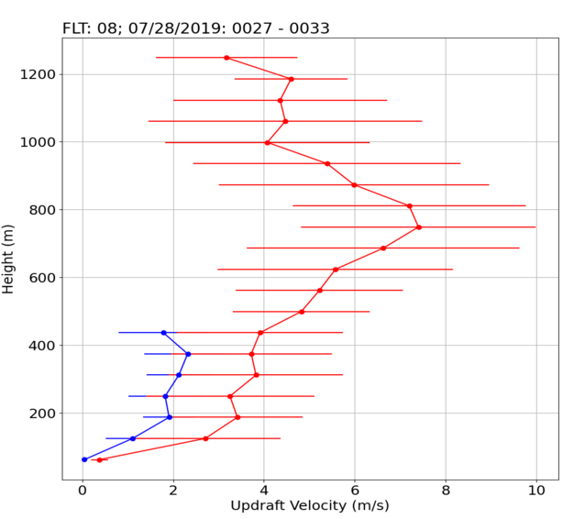




Isolating Updrafts Over Wildfires
2
We identify closest time stamp of Doppler wind lidar data to fire temperature records that have been flagged as hotspots in order to define initial starting points (above figure and center figures—black outlines)
Along points where a fire record has been determined, we identify all consecutive positive vertical velocities near the surface
The maximum vertical velocity at the bottom level is used as a starting point for identifying positive vertical velocities at the next level
Process continues until a suspected updraft is fully captured
We identify closest time stamp of Doppler wind lidar data to fire temperature records that have been flagged as hotspots in order to define initial starting points (above figure and center figures—black outlines)
$\max{width}$~400-m
Red and blue boxes in top center plots correspond to red and blue profiles
The stronger profile appears deeper and wider with more variability about its width
$\max{width}$~650-m
${\overline{w}}_{max}$~2m/s
${\overline{w}}_{max}$~8m/s
The 30th International Laser Radar Conference (ILRC) virtual conference, June 26th – July 1st, 2022.

Slide 4
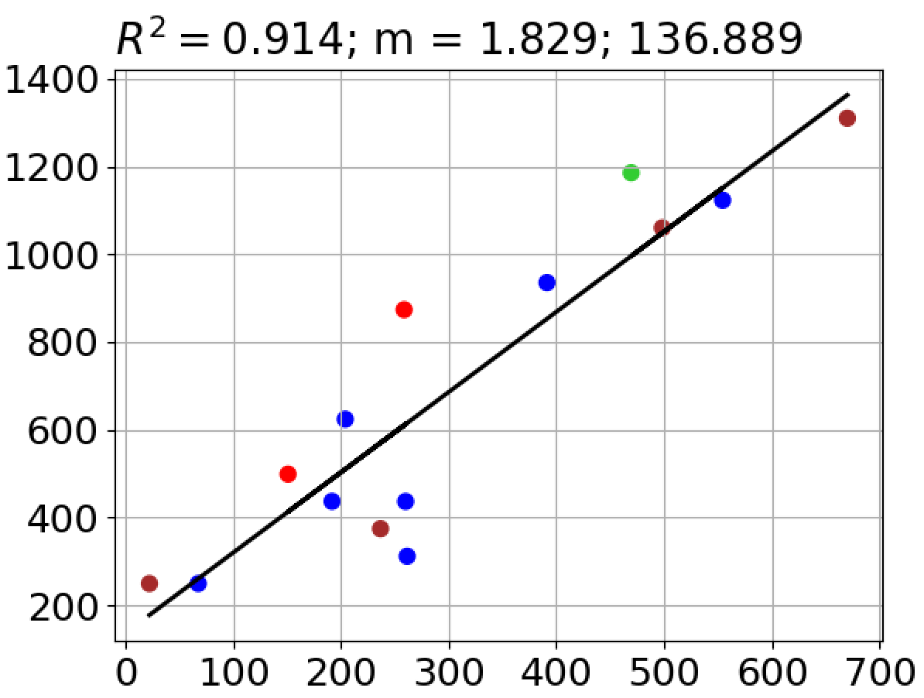
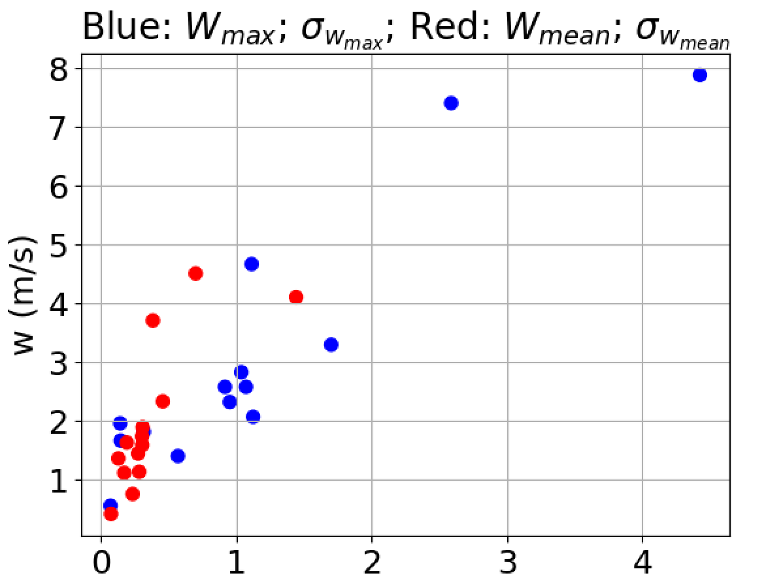
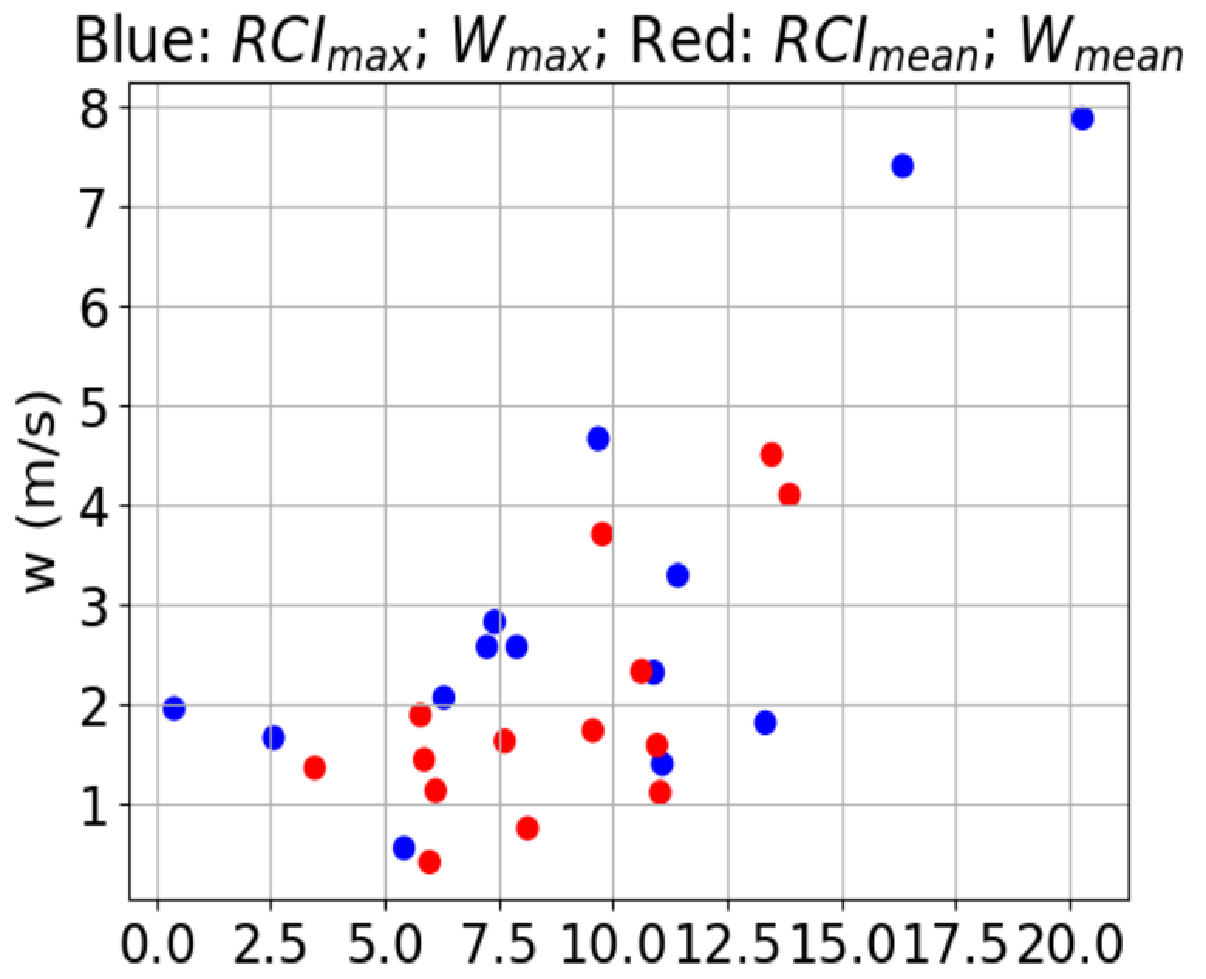
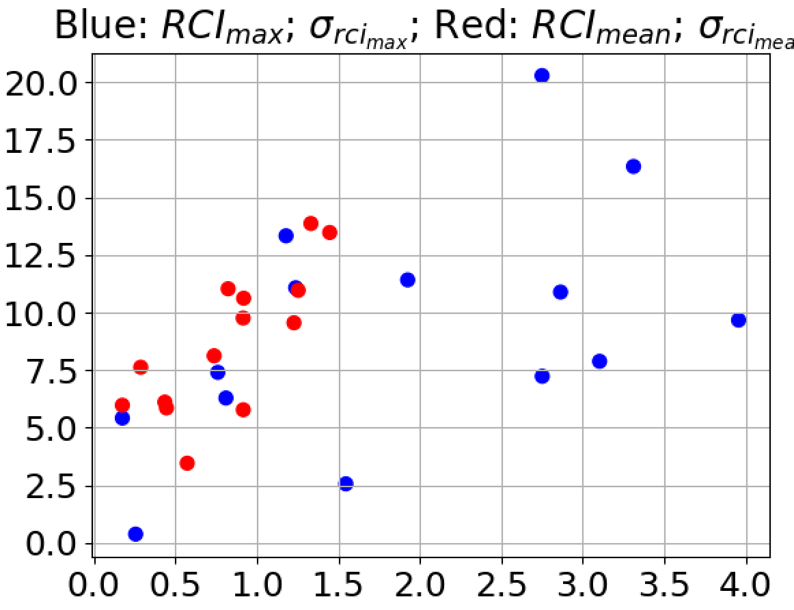
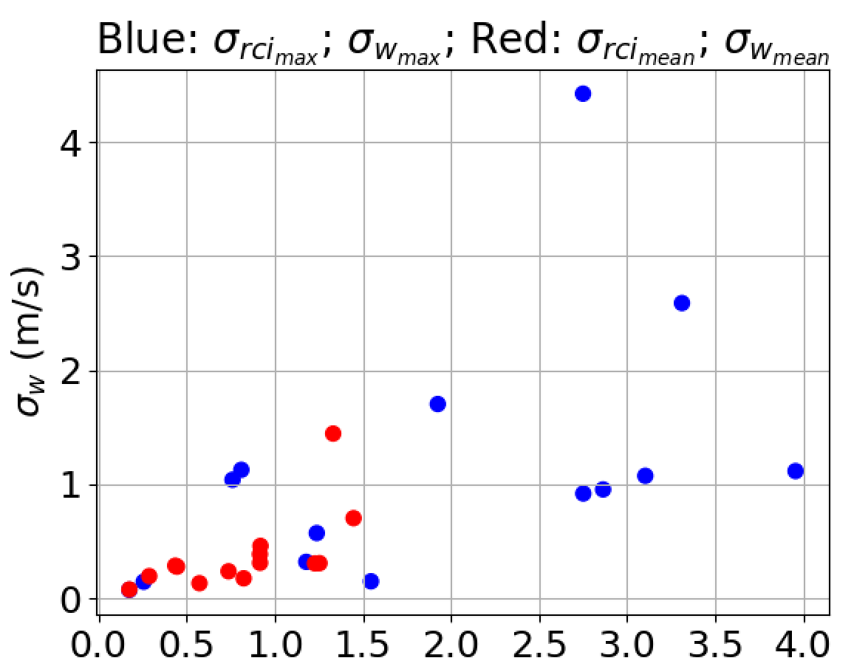


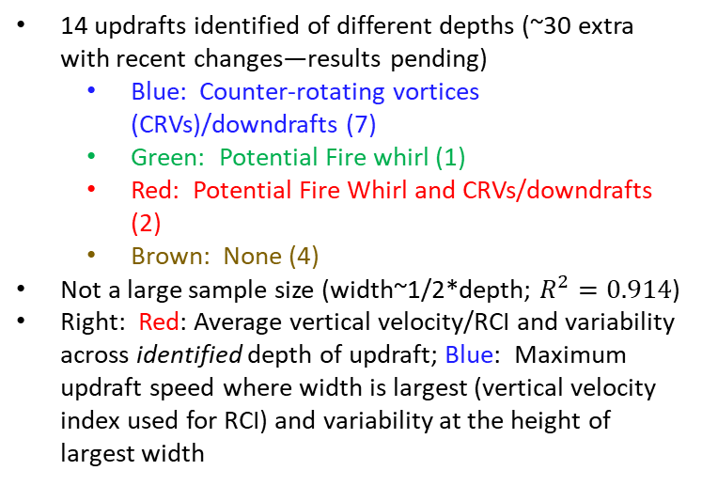



Updraft Characteristics
3
Updraft strength and smoke content positively correlated
Depth (m)
Horizontal variability increases with updraft strength and smoke content
Width (m)
$σ$ (m/s)
$RCI$(dB)
14 updrafts identified of different depths (~30 extra with recent changes—results pending)
  Blue: Counter-rotating vortices (CRVs)/downdrafts (7)
  Green: Potential Fire whirl (1)
  Red: Potential Fire Whirl and CRVs/downdrafts (2)
  Brown: None (4)
Not a large sample size (width~1/2*depth; $R^{2}=0.914$)
Right: Red: Average vertical velocity/RCI and variability across identified depth of updraft; Blue: Maximum updraft speed where width is largest (vertical velocity index used for RCI) and variability at the height of largest width
Increase in updraft and smoke variability positively correlated
$RCI$(dB)
$σ$ (dB)
$σ$ (dB)
The 30th International Laser Radar Conference (ILRC) virtual conference, June 26th – July 1st, 2022.

Slide 5
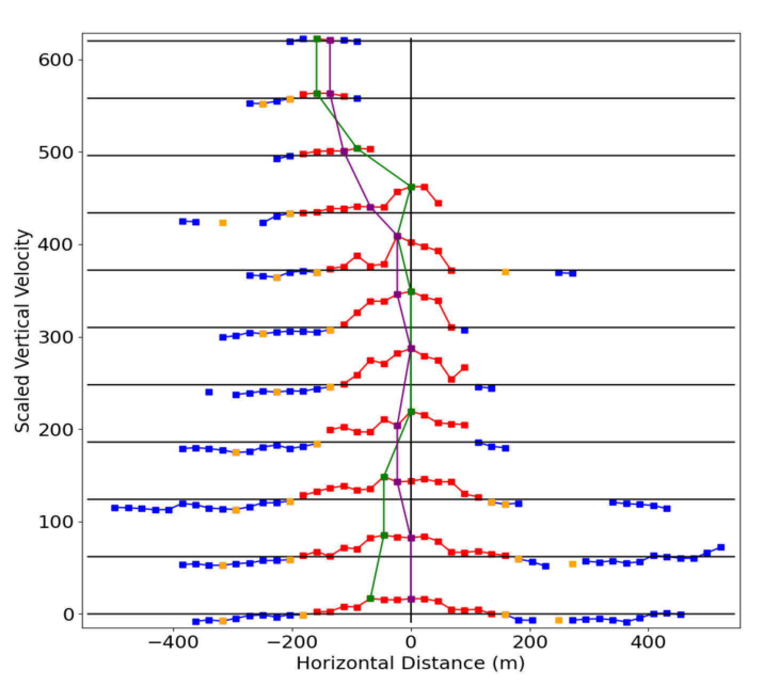
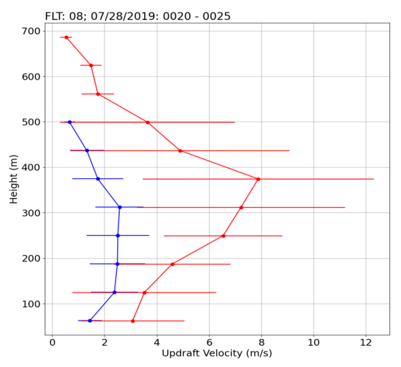
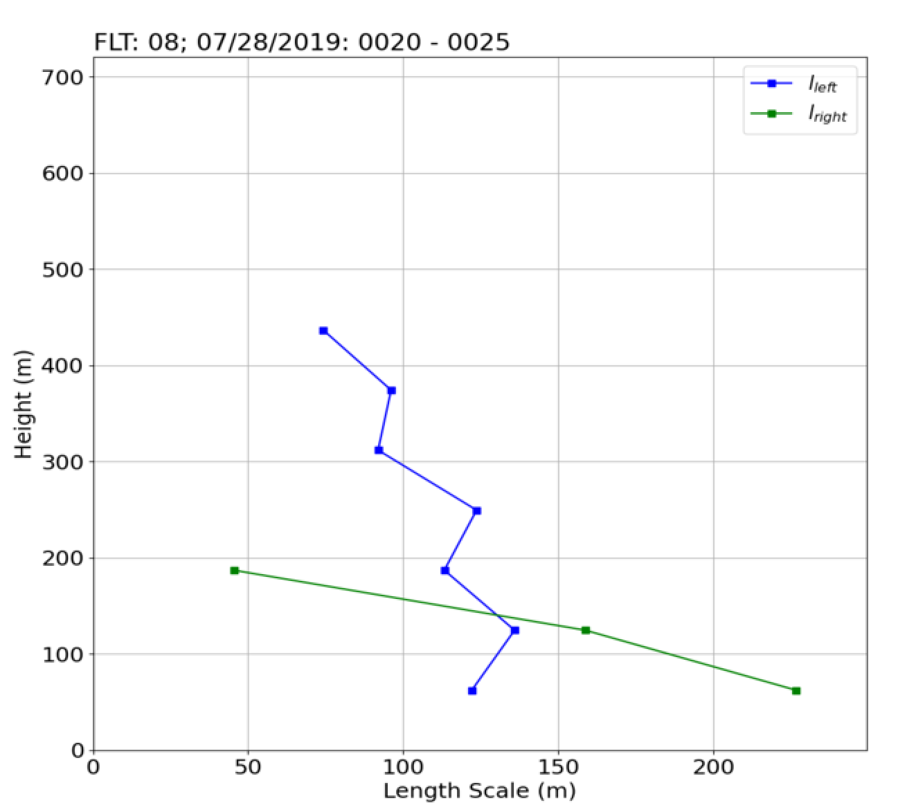
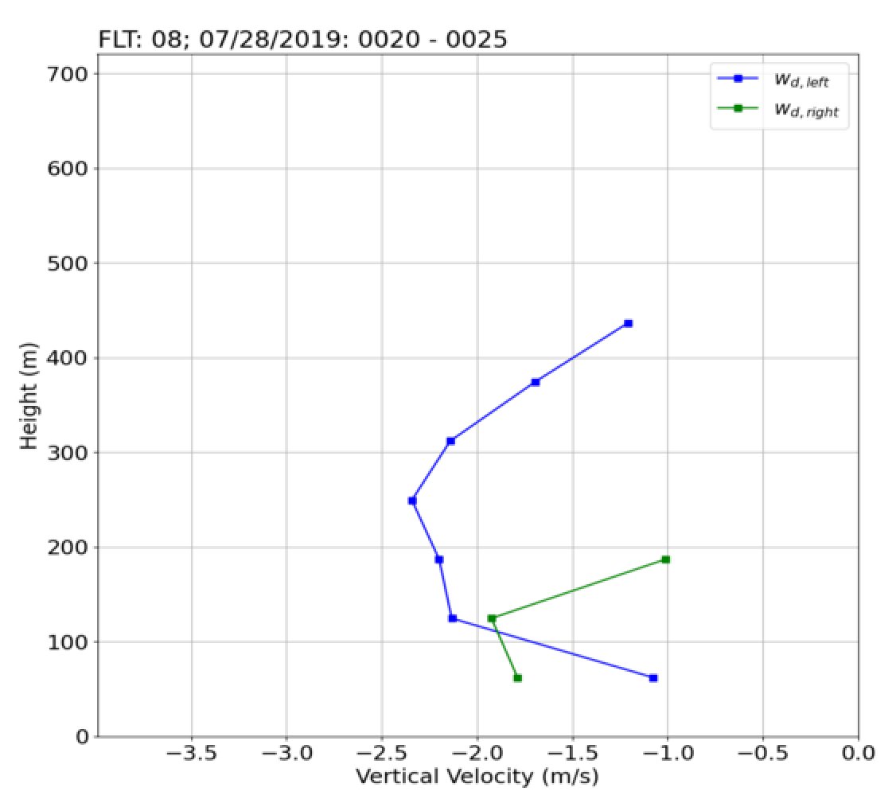

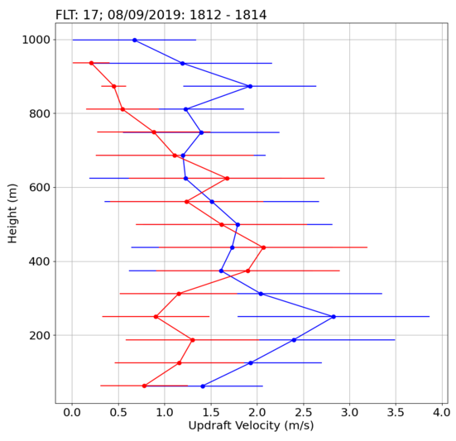
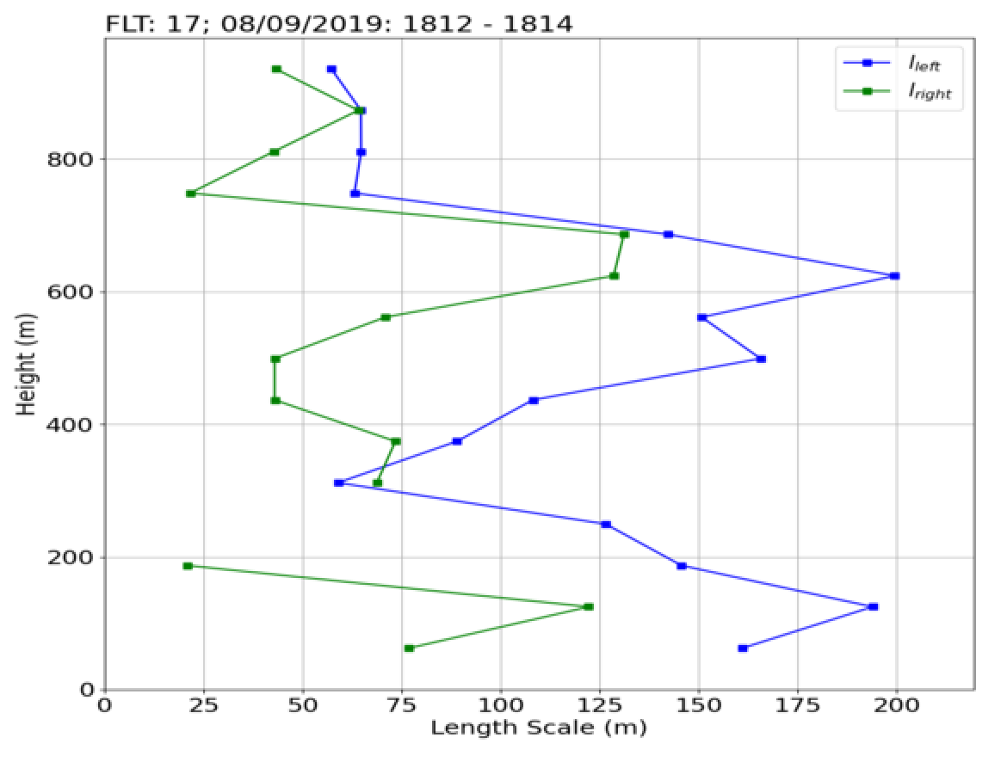
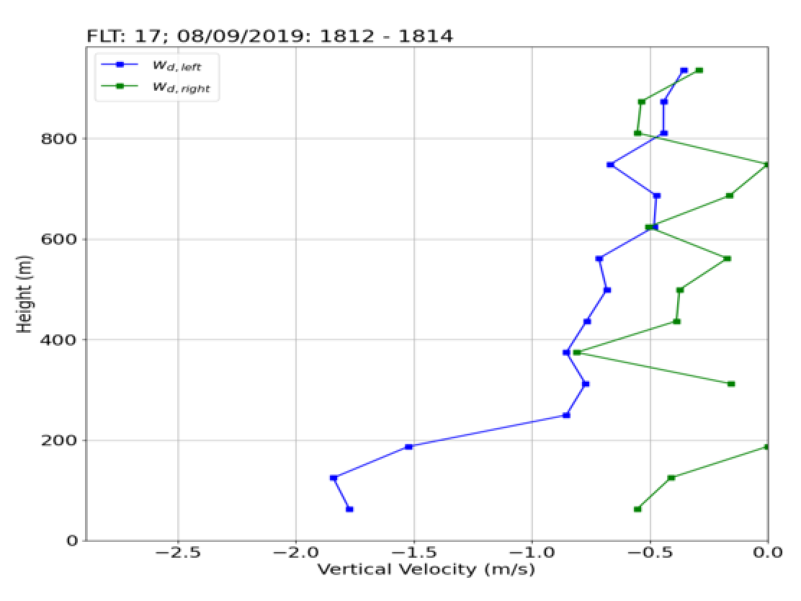






Toward Examining Entrainment
4
Depth: 700-m
Width: 350-m
$$τ_{turnover}=\frac{l_{max}}{max⁡(\left\langle w_{d}\left(z\right)\right\rangle )}$$
${\overline{w}}_{max}$~8m/s
$τ_{turnover}\sim 1 min$
-Focus is on red profiles for both top and bottom case.
Scaled vertical velocity of updraft (top left) (zoom-in from inset) is used to examine horizontal variability closely; note the peak core updraft structure
-Negative vertical velocities common outside updraft (blue squares). Minima are used to derive CRV properties (plots to the right)—confident in calculations for left side (no data gaps).
-Some symmetry and double CRV structures evident for bottom case.
-Bottom updraft clearly modified by CRVs
Depth: 950-m
Width: 500-m
${\overline{w}}_{max}$~2.2m/s
$$τ_{turnover}\sim 4.5 min$$
$$τ_{turnover}\sim 1.5 min$$
The 30th International Laser Radar Conference (ILRC) virtual conference, June 26th – July 1st, 2022.

Slide 6
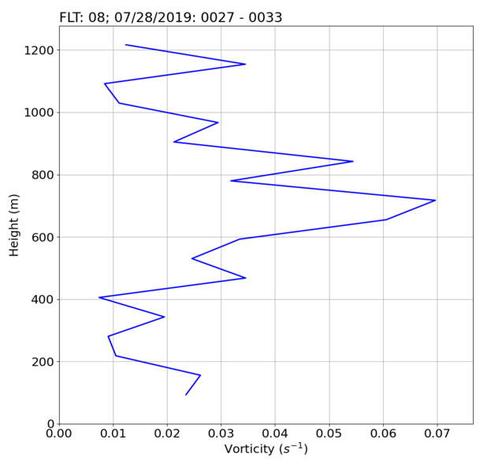
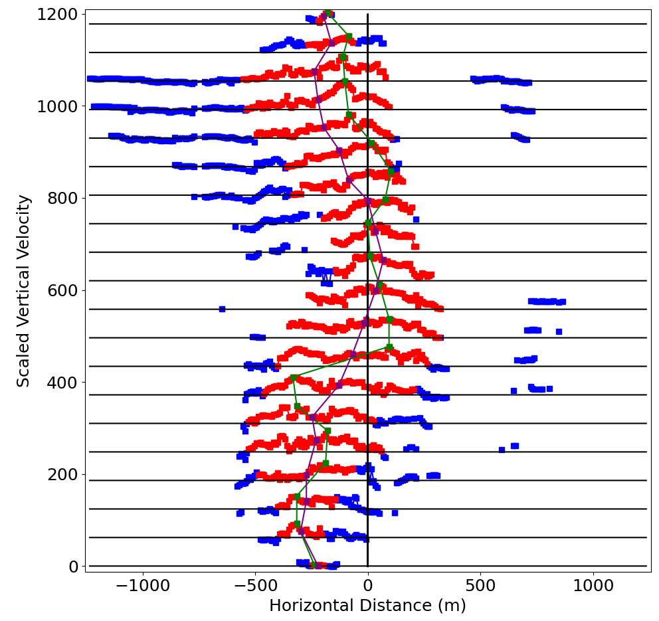
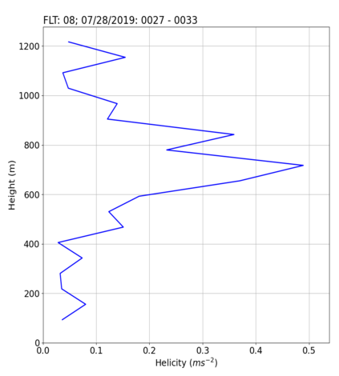
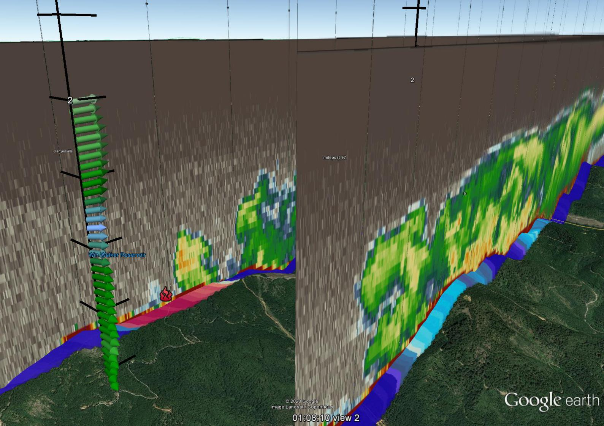

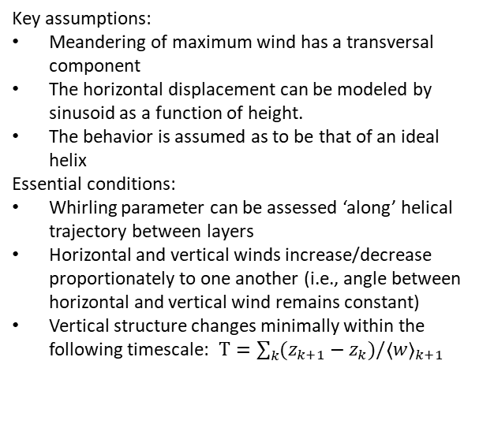
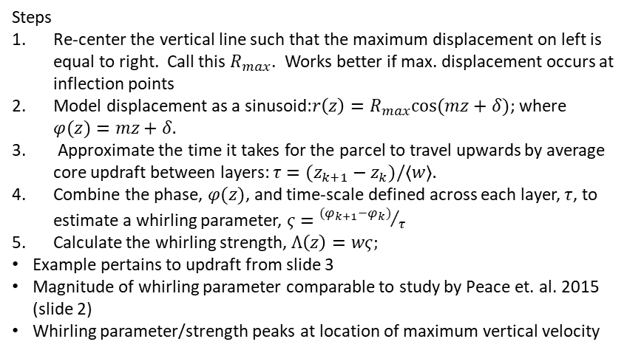
Rotationality and Future Work
5
Key assumptions:
Meandering of maximum wind has a transversal component
The horizontal displacement can be modeled by sinusoid as a function of height.
The behavior is assumed as to be that of an ideal helix
Essential conditions:
Whirling parameter can be assessed ‘along’ helical trajectory between layers
Horizontal and vertical winds increase/decrease proportionately to one another (i.e., angle between horizontal and vertical wind remains constant)
Vertical structure changes minimally within the following timescale: $Τ=\sum_{k}{(z_{k+1}−z_{k})\text{/}{\left\langle w\right\rangle }_{k+1}}$
Steps
Re-center the vertical line such that the maximum displacement on left is equal to right. Call this $R_{max}$. Works better if max. displacement occurs at inflection points
Model displacement as a sinusoid:$r\left(z\right)=R_{max}cos⁡(mz+δ)$; where $φ(z)=mz+δ.$
Approximate the time it takes for the parcel to travel upwards by average core updraft between layers: $τ=(z_{k+1}−z_{k})\text{/}\left\langle w\right\rangle .$
Combine the phase, $φ(z)$, and time-scale defined across each layer, $τ$, to estimate a whirling parameter, $ς={{(φ}_{k+1}−φ_{k})}/τ$
Calculate the whirling strength, $Λ\left(z\right)=wς;$
Example pertains to updraft from slide 3
Magnitude of whirling parameter comparable to study by Peace et. al. 2015 (slide 2)
Whirling parameter/strength peaks at location of maximum vertical velocity
$$Whirling Parameter (s^{−1})$$
Process remaining updrafts to examine entrainment for more cases
Examine instances where plumes are projected into the next flight leg (e.g., plot to left)
Use results to inform scanning/measurement strategies for CaLFiDE
Whirling Strength ($m s^{−2})$
The 30th International Laser Radar Conference (ILRC) virtual conference, June 26th – July 1st, 2022.

