Slide 1

Properties of Polar Stratospheric Clouds over the European Arctic from ground-based lidar
Christine Böckmann^{1,2}, Christoph Ritter²
¹Institut für Mathematik, Universität Potsdam, Am neuen Palais 10, 14469 Potsdam, Germany
²Alfred Wegener Institut, Telegrafenberg A45, 14473 Potsdam, Germany
[03].[Atmospheric aerosol and cloud properties]
[Wednesday], [12:00 UTC]
[03-P27]
The 30th International Laser Radar Conference (ILRC) virtual conference, June 26th – July 1st, 2022.

Slide 2

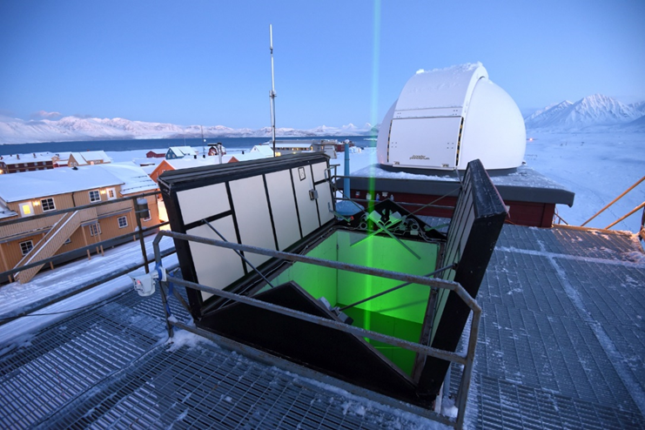
Polar Stratospheric Clouds #03-27 The Lidar and PSCs
1
Ny-Ålesund (78.9 N, 11.9E) Spitsbergen
„3+2+2“ Raman Lidar (KARL)
70cm mirror
Spectra 290 / 50 with 10J per color
Licel electronics
System for tropo- and stratosphere
Edvard Munch‘s „the scream“ may refer to prominent PSCs ~ 8 yrs after 1883 Krakatau eruption
The 30th International Laser Radar Conference (ILRC) virtual conference, June 26th – July 1st, 2022.

Slide 3
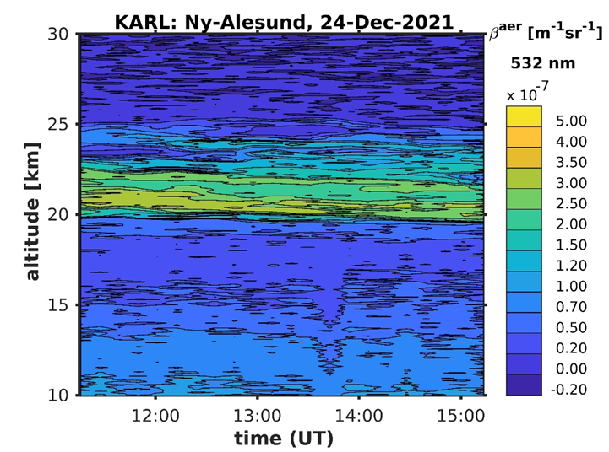
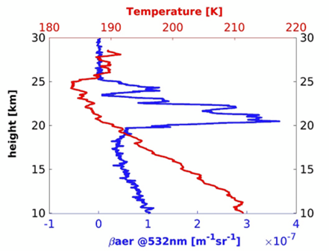
Polar Stratospheric Clouds #03-27 Observations
2
Frequent PSCs in Dec 2021 and Jan 2022
PSC: O₃ reduction, relevant
(generally PSCs in about 70% of winters, but Arctic more variable than Antarctic)
PSCs cannot exist at T > 195K. Over the European Arctic they appear typically in 15km – 27km altitude.
For this day a Vaisala RS-41 sonde captured 39% (78%) rel. Humidity over water (ice) in 24km height.
The 30th International Laser Radar Conference (ILRC) virtual conference, June 26th – July 1st, 2022.

Slide 4
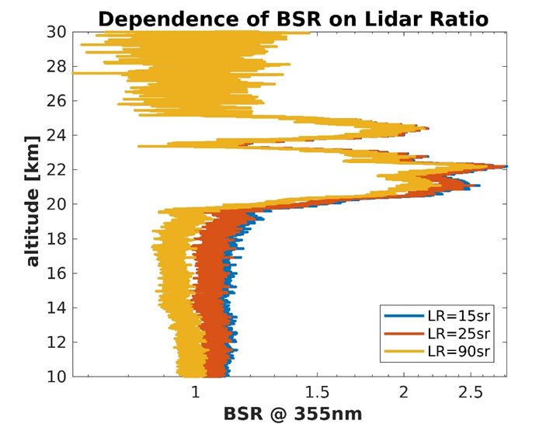
Polar Stratospheric Clouds #03-27: Derivation of extinction
3
Generally, a higher (lower) LR leads to a lower (higher) backscatter below the cloud.
For 3 cases mid to end Dec. 2021 we found:
LR355: 15sr < LR355 < 25sr
LR532: 55sr < LR532 < 70sr
Extinction at 1064nm too low to constrain the LR
(„all solutions with different LR very similar“)
Low depolarization, so spherical particles, Mie theory valid
Assume clear sky above and below PSC
Estimate LR @355nm and 532nm
ΔLR < 10sr
LR532 >> LR355:
Hence 3 backscatter, 2 extinction values
The 30th International Laser Radar Conference (ILRC) virtual conference, June 26th – July 1st, 2022.

Slide 5
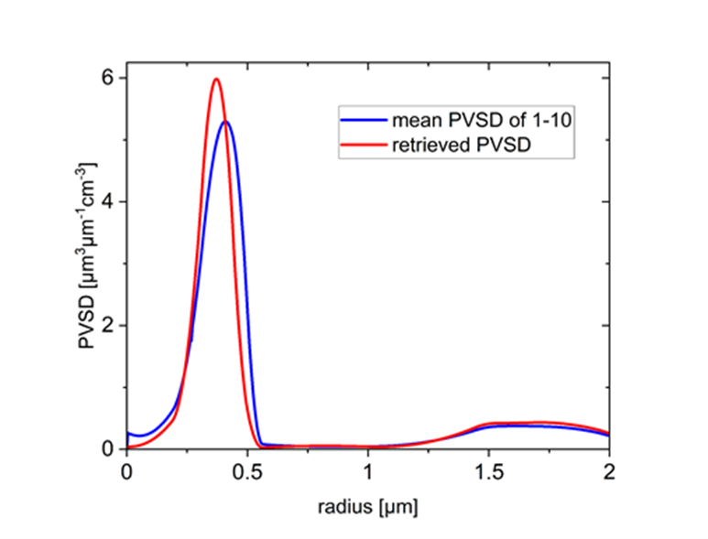
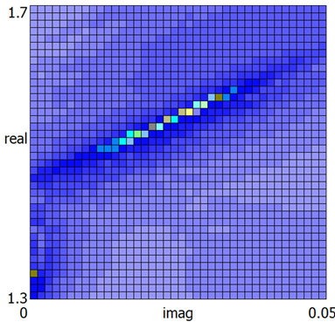
Polar Stratospheric Clouds #03-27 inversion optics to microphysics
4
Using Mie theory we derive a refractice index and a particle volume distribution function (PSDV) from the lidar data (3 backscatter, 2 extinction coefficients)
A surprisingly well-defind „stripe-like“ distribution for the complex refractive index has been found.
Inversion: volume distribution function: dominance of small particles
10 times repeated for impact of uncertainties, next slide…
The 30th International Laser Radar Conference (ILRC) virtual conference, June 26th – July 1st, 2022.

Slide 6
Polar Stratospheric Clouds #03-27: uncertainties optics to microphysics
5
To understand how uncertainties in the lidar input data changes the retrived volume distribution function, 10 additional inversions with arbitrarily under- or overestimated lidar input were
calculated.
Experi- ment | Description | real(RI) | imag(RI) | r_eff | v_t | s_t | SSA355 | SSA532
 | retrieved solution | 1.549 | 2.46E-02 | 3.901E-01 | 1.35 | 1.043E+01 | 7.603E-01 | 8,645E-01
1 | α355: too high α532: too high | 1.536 | 2.20E-02 | 3.222E-01 | 1.39 | 1.311E+01 | 8.061E-01 | 8,832E-01
2 | α355: too low α532: too low | 1.548 | 2.20E-02 | 4.261E-01 | 1.24 | 8.734E+00 | 7.620E-01 | 8.754E-01
3 | α355: too low α532: too high | 1.461 | 6.84E-03 | 3.759E-01 | 1.78 | 1.618E+01 | 8.917E-01 | 9.467E-01
4 | α355: too high α532: too low | 1.574 | 2.05E-02 | 2.850E-01 | 1.13 | 1.196E+01 | 8.473E-01 | 8.913E-01
5 | all β too low | 1.540 | 2.28E-02 | 3.780E-01 | 1.31 | 1.062E+01 | 7.766E-01 | 8.759E-01
6 | all β too high | 1.541 | 2.12E-02 | 3.665E-01 | 1.32 | 1.090E+01 | 7.882E-01 | 8.825E-01
7 | all β too low α355: too low α532: too high | 1.457 | 7.42E-03 | 2.787E-01 | 1.80 | 2.383E+01 | 8.798E-01 | 9.470E-01
8 | all β too low α355: too high α532: too low | 1.583 | 2.32E-02 | 2.807E-01 | 1.12 | 1.204E+01 | 8.320E-01 | 8.810E-01
9 | all β too high α355: too low α532: too high | 1.498 | 1.59E-02 | 4.690E-01 | 1.76 | 1.127E+01 | 7.900E-01 | 8.990E-01
10 | all β too high α355: too high α532: too low | 1.549 | 1.42E-02 | 3.021E-01 | 1.12 | 1.121E+01 | 8.892E-01 | 9.231E-01
 | mean | 1.531 | 1.83E-02 | 3.522E-01 | 1.39 | 1.275E+01 | 8.203E-01 | 8.972E-01
 | standard deviation | 0.04 | 6.30E-03 | 6.350E-02 | 0.265 | 4.120E+00 | 5.030E-02 | 2.883E-02
Results:
the volume distributions are surprisingly stable!
LR355 < LR532 results in SSA355 < SSA532
If alpha355 is decreased (red bar) the real part of refractive index goes down and the particle volume increases
(unlikely as LR355 is small)
If alpha532 is decreased (green bar): real(RI) increases, v_t decreases
Backscatter coefficients are less important for microphysics (#5 and #6)
The 30th International Laser Radar Conference (ILRC) virtual conference, June 26th – July 1st, 2022.

Slide 7
Polar Stratospheric Clouds #03-27
2
The 30th International Laser Radar Conference (ILRC) virtual conference, June 26th – July 1st, 2022.

Slide 8
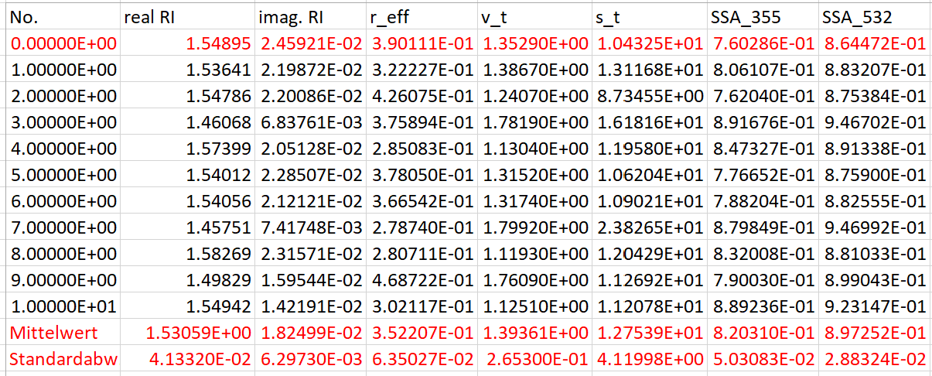
Polar Stratospheric Clouds #03-27
2
The 30th International Laser Radar Conference (ILRC) virtual conference, June 26th – July 1st, 2022.

