Slide 1

Locations for the best lidar view of
mid-level, high, and Polar Stratospheric Clouds
Matthias Tesche¹, Peggy Achtert¹, Michael Pitts², and Vincent Noel³
¹Leipzig Institute for Meteorology, Leipzig University, Leipzig, Germany | matthias.tesche@uni-leipzig.de
²NASA Langley Research Center, Hampton, Virginia, USA
³Laboratoire d’Aérologie, CNRS/UPS, Observatoire Midi-Pyrénées, Toulouse, France
03.Atmospheric aerosol and clouds properties
29 June 2022, 12:00 UTC
Wednesday_03_P25
The 30th International Laser Radar Conference (ILRC) virtual conference, June 26th – July 1st, 2022.

Slide 2
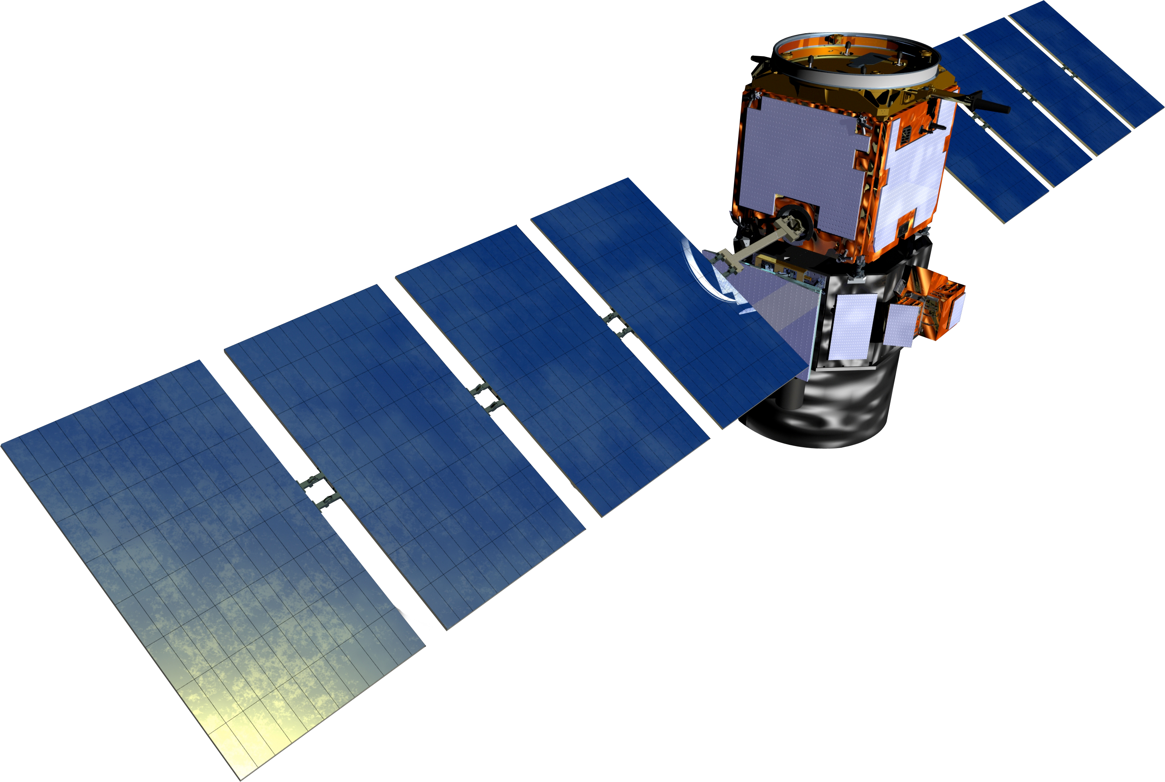
Motivation, data sets, and method
1
How often do opaque clouds interfere with ground-based lidar measurements?
CALIPSO L2 v4.20/4.21 Cloud Profile product (05kmCPro.v4.20/4.21) for 01/07 - 12/21 (clouds) and 12/06 - 02/18 (PSCs); Vertical Feature Mask
Cloud types: low overcast, transparent; low overcast, opaque; transition stratocumulus; low, broken cumulus; altocumulus (transparent); altostratus (opaque); cirrus (transparent); and deep convective (opaque)
CALIPSO polar stratospheric cloud mask v2
STS, NAT mixture, ice, NAT enhanced, and wave ice.
CATS L2O Profile (05kmPro.v3.01) and L2O Layer (05kmLay.v3.01) products for 02/15 - 10/17 to compile a customized mask for altocumulus and cirrus analogous to CALIPSO‘s VFM
Filter profiles for scenarios that enable or inhibit ground-based lidar measurements (spaceborne vs. ground-based view)
The 30th International Laser Radar Conference (ILRC) virtual conference, June 26th – July 1st, 2022.

Slide 3
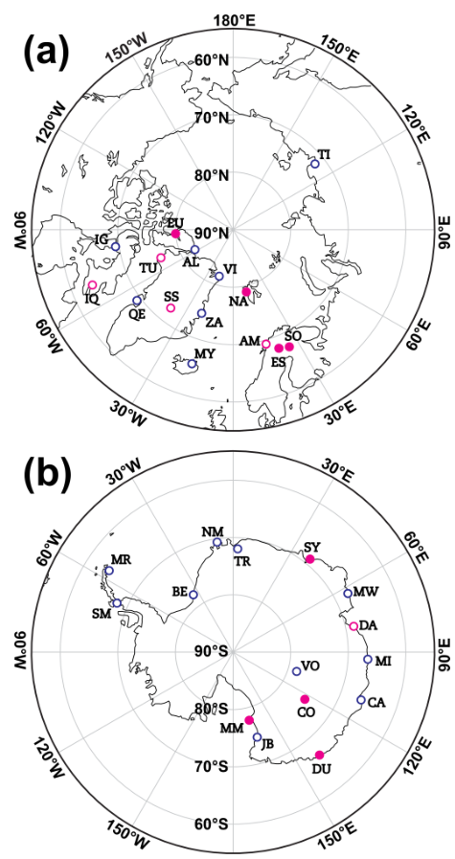
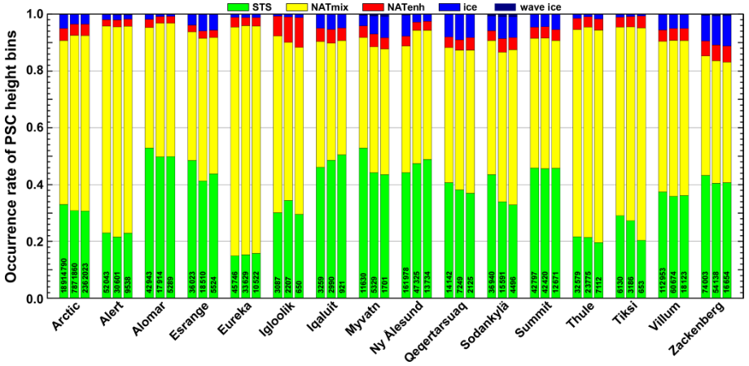
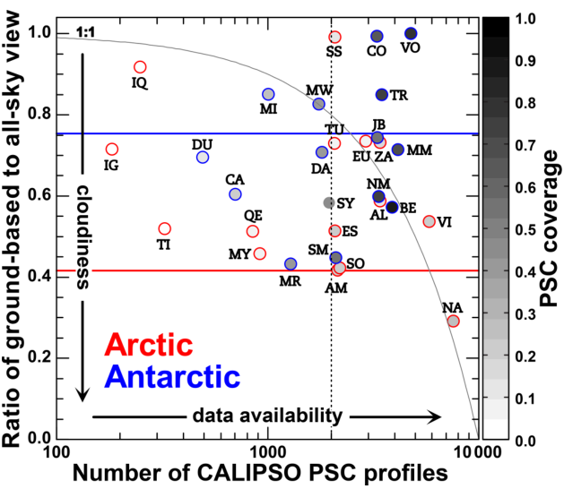
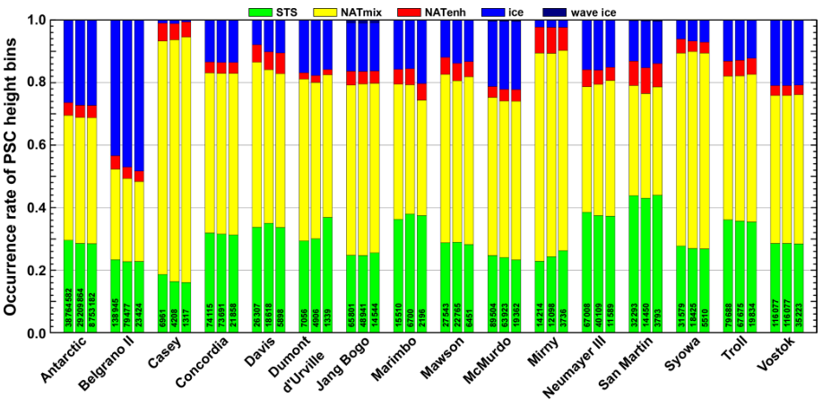
Results: Polar Stratospheric Clouds
2
12/06-02/18
1. column: spaceborne view
2. column: ground-based view
3. column: random sample of
1/3 of ground-based view
2012 & 2015

Slide 4
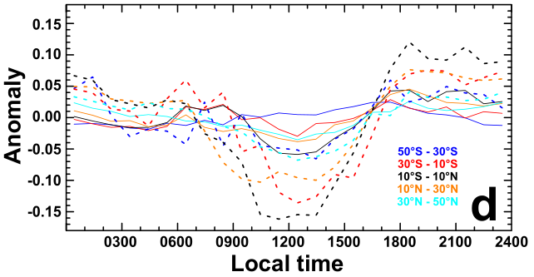
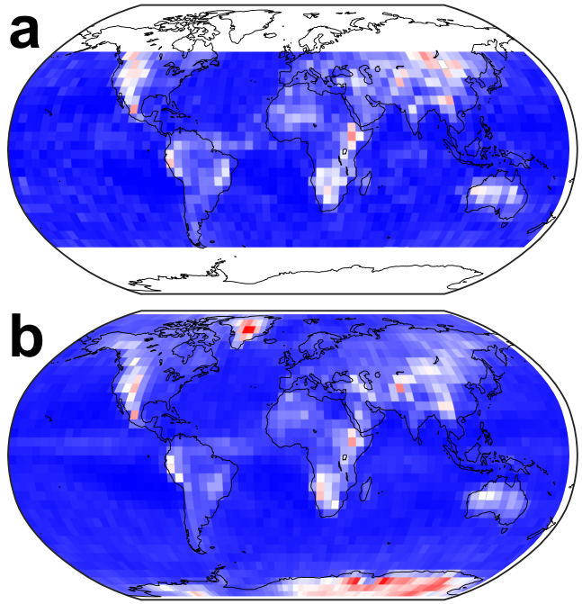
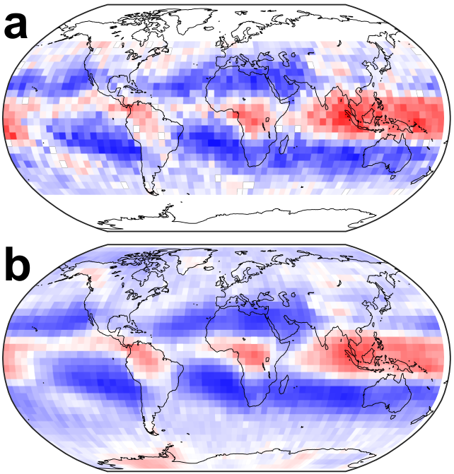
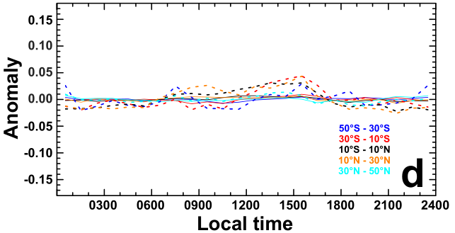
Diurnal variation in Ac and Ci occurrence from CATS observations
3
2007-2021
Difference in occurrence rate derived as
hourly values minus daily mean
Cirrus
CATS
CALIPSO
CATS
CALIPSO
Altocumulus
Difference in occurrence rate derived as
hourly values minus daily mean

Slide 5
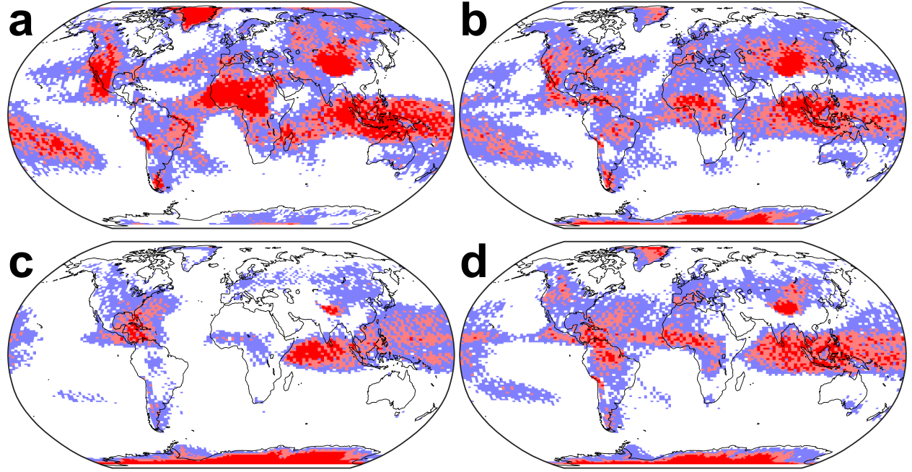
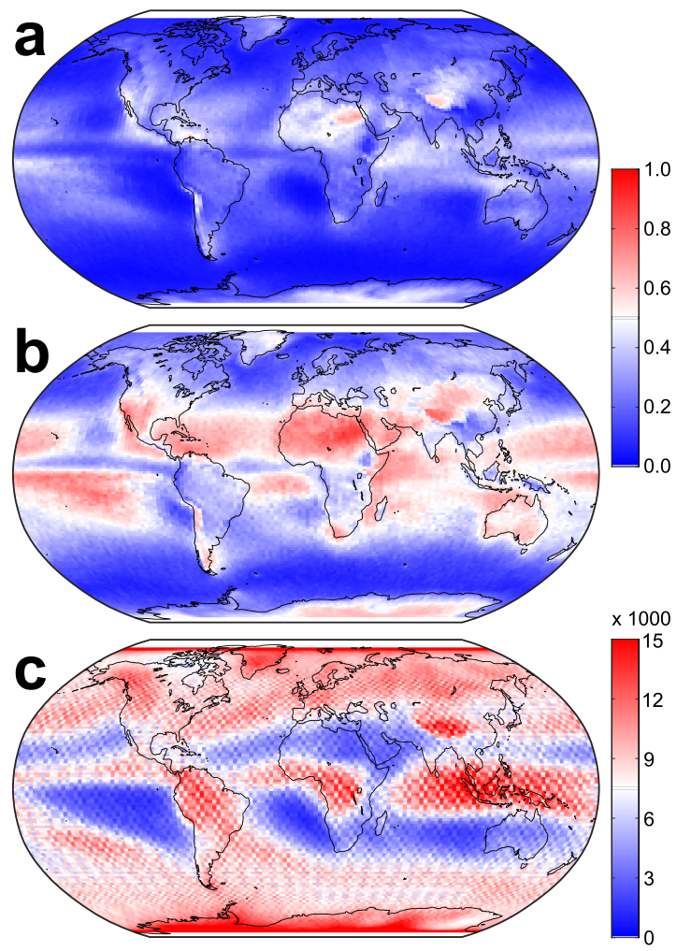
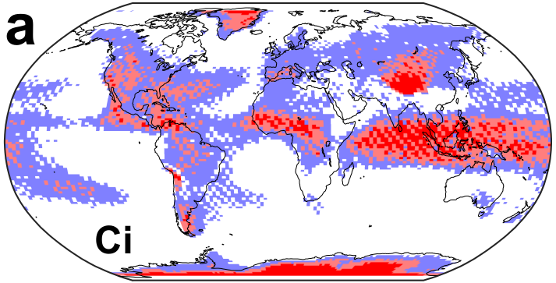
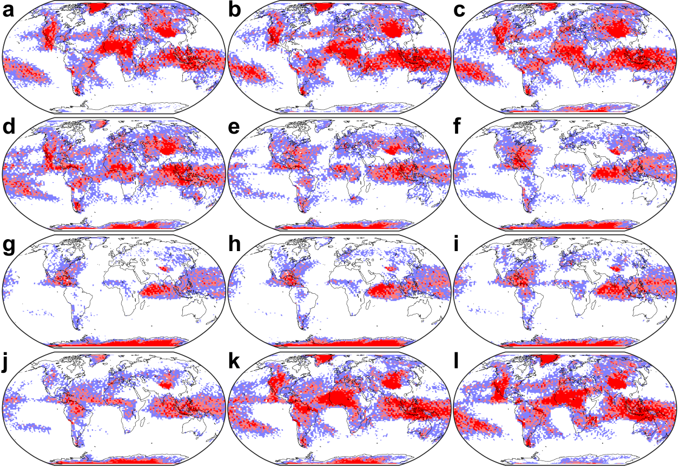
Results: Cirrus
4
2007-2021
cirrus clouds in the absence of opaque low- and mid-level
clouds versus all cloudy profiles
seasonal
cirrus clouds in the absence of opaque low- and mid-level
clouds versus all cloudy profiles with cirrus
annual
number of cirrus-containing cloudy profiles per grid box
monthly

Slide 6
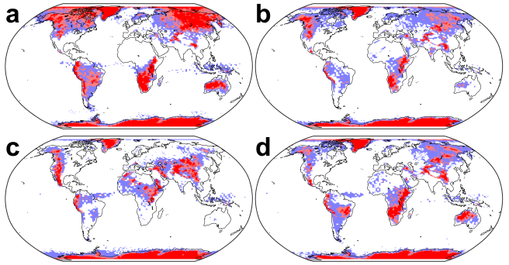
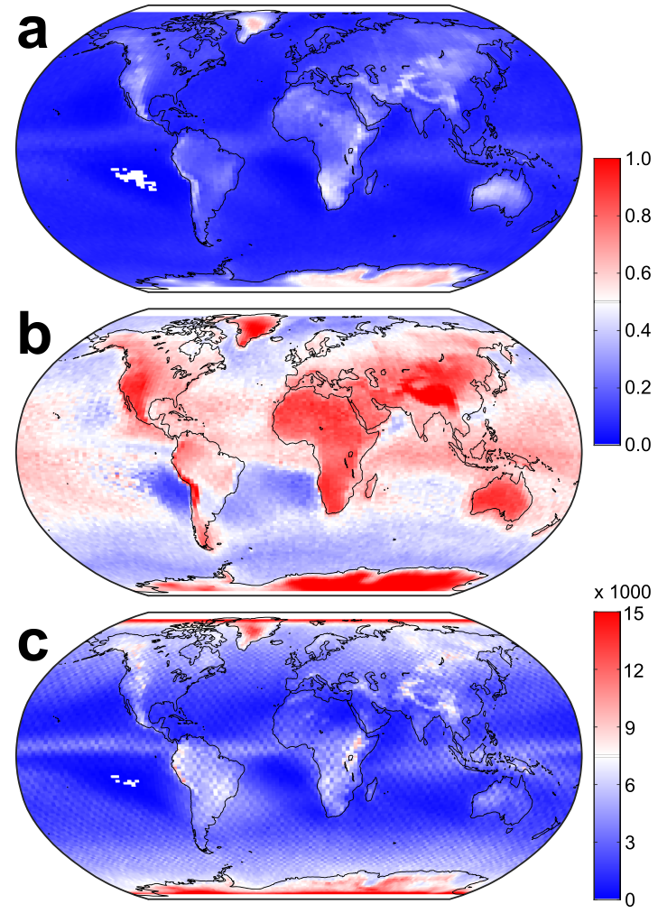
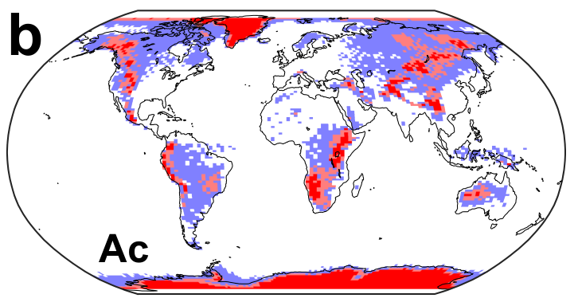
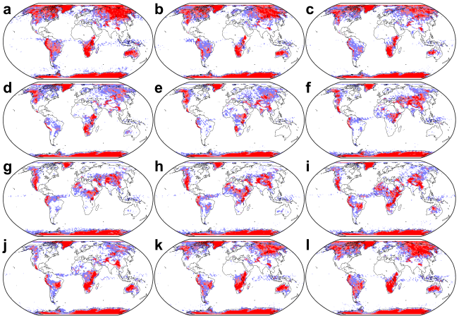
Results: Altocumulus
5
2007-2021
cirrus clouds in the absence of opaque low- and mid-level
clouds versus all cloudy profiles
seasonal
cirrus clouds in the absence of opaque low- and mid-level
clouds versus all cloudy profiles with cirrus
annual
number of cirrus-containing cloudy profiles per grid box
monthly

Slide 7
Summary
6
Information on tropospheric and stratospheric clouds from the CALIPSO Cloud Profile product (05kmCPro version 4.10/4.20/4.21) and the CALIPSO polar stratospheric cloud mask version 2, respectively, is combined on a profile-by-profile basis to identify conditions under which a ground-based lidar is likely to perform useful measurements for the analysis of the occurrence of PSCs, altocumulus clouds, and cirrus.
CATS observations are used to assess the representativeness of CALIPSO observations for the whole day.
Consistent occurrence rates of Ac and Ci in observations from CATS (32 months) and CALIPSO (15 years).
Recommendations on where to expect the best ratio of the occurrence of a targeted cloud type and the occurrence of tropospheric conditions that would enable the measurement of that cloud type, i.e. absence of opaque clouds below.
Yearly, seasonal, and monthly maps of favourable conditions for measurements with ground-based lidar.
Findings are useful to guide the planning of short-term instrument deployment during measurement campaign and to put published findings of lidar observations of Ac, Ci, and PSCs into perspective.
More details can be found in:
Tesche, Achtert, & Pitts (2021), On the best locations for ground-based polar stratospheric cloud (PSC) observations, ACP, 21, https://doi.org/10.5194/acp-21-505-2021.
Tesche & Noel (2022), Locations for the best lidar view of mid-level and high clouds, AMT, https://doi.org/10.5194/amt-2022-34.
Or get in touch with matthias.tesche@uni-leipzig.de
The 30th International Laser Radar Conference (ILRC) virtual conference, June 26th – July 1st, 2022.

