Slide 1







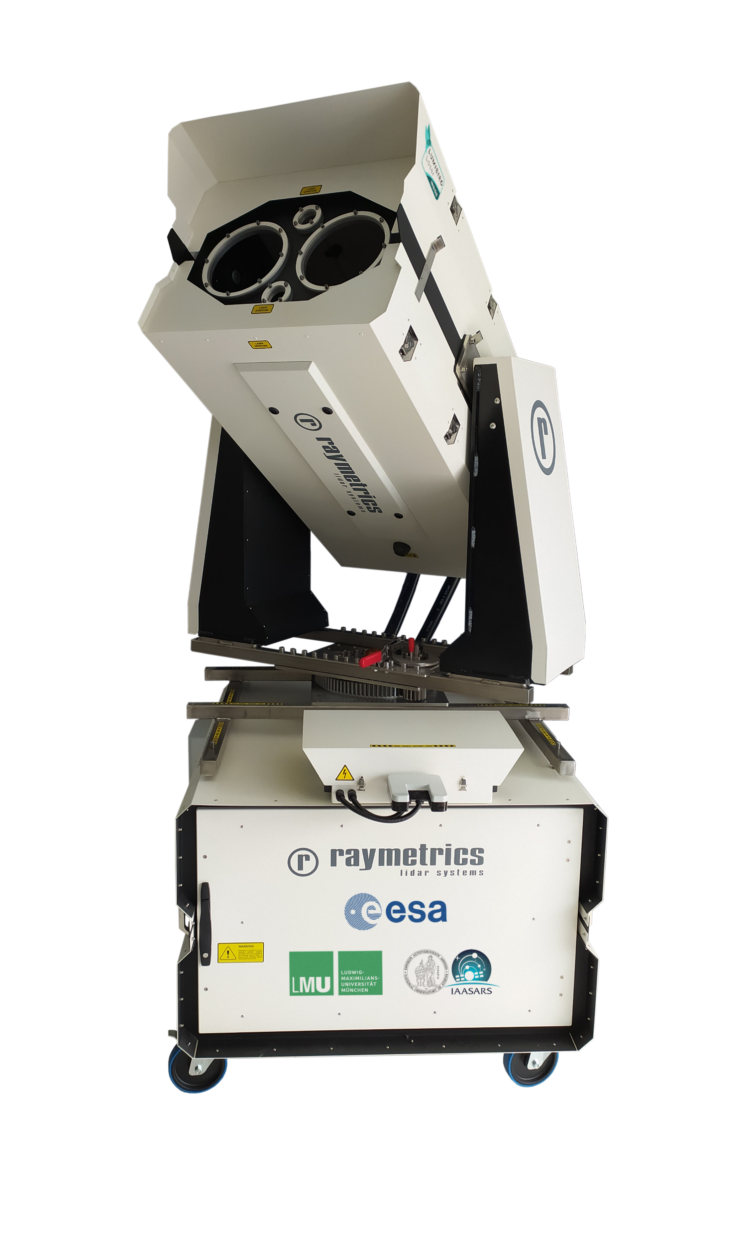
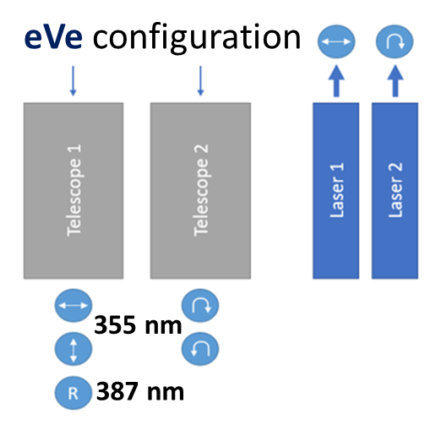
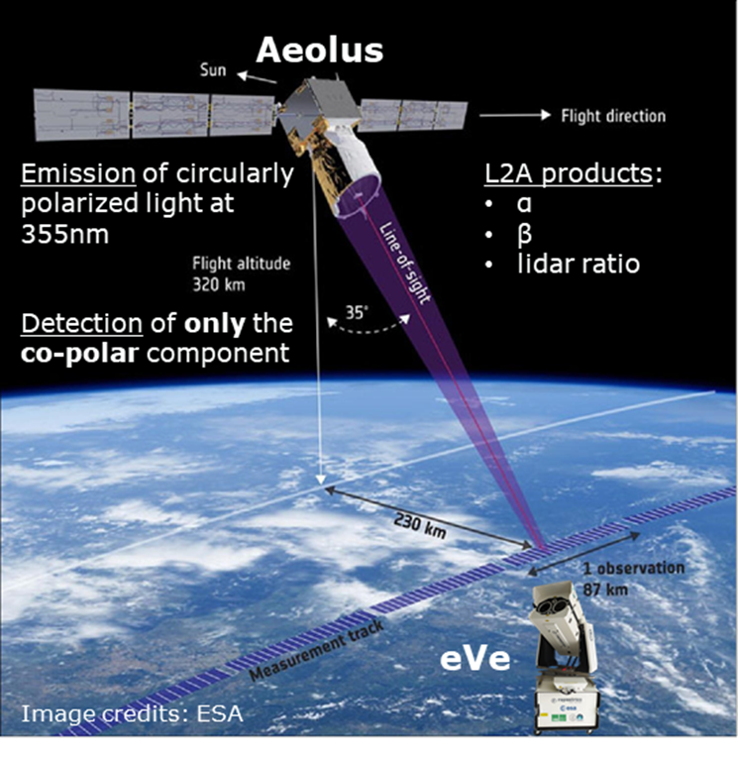
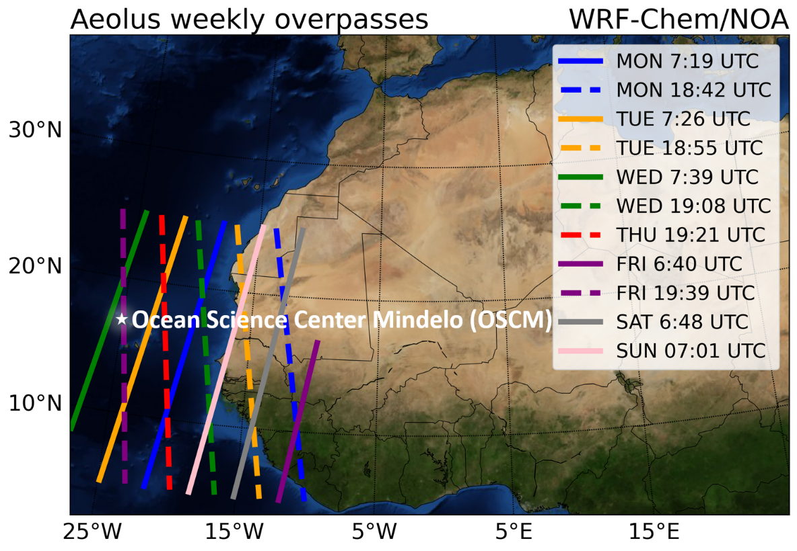
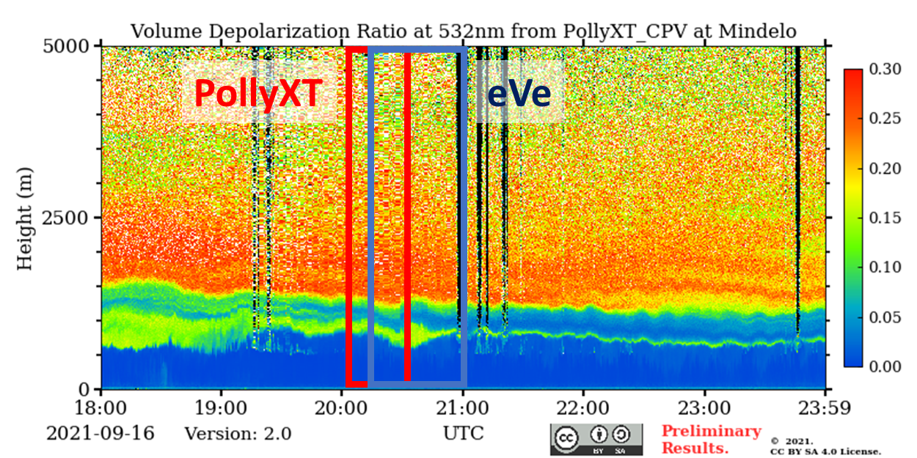
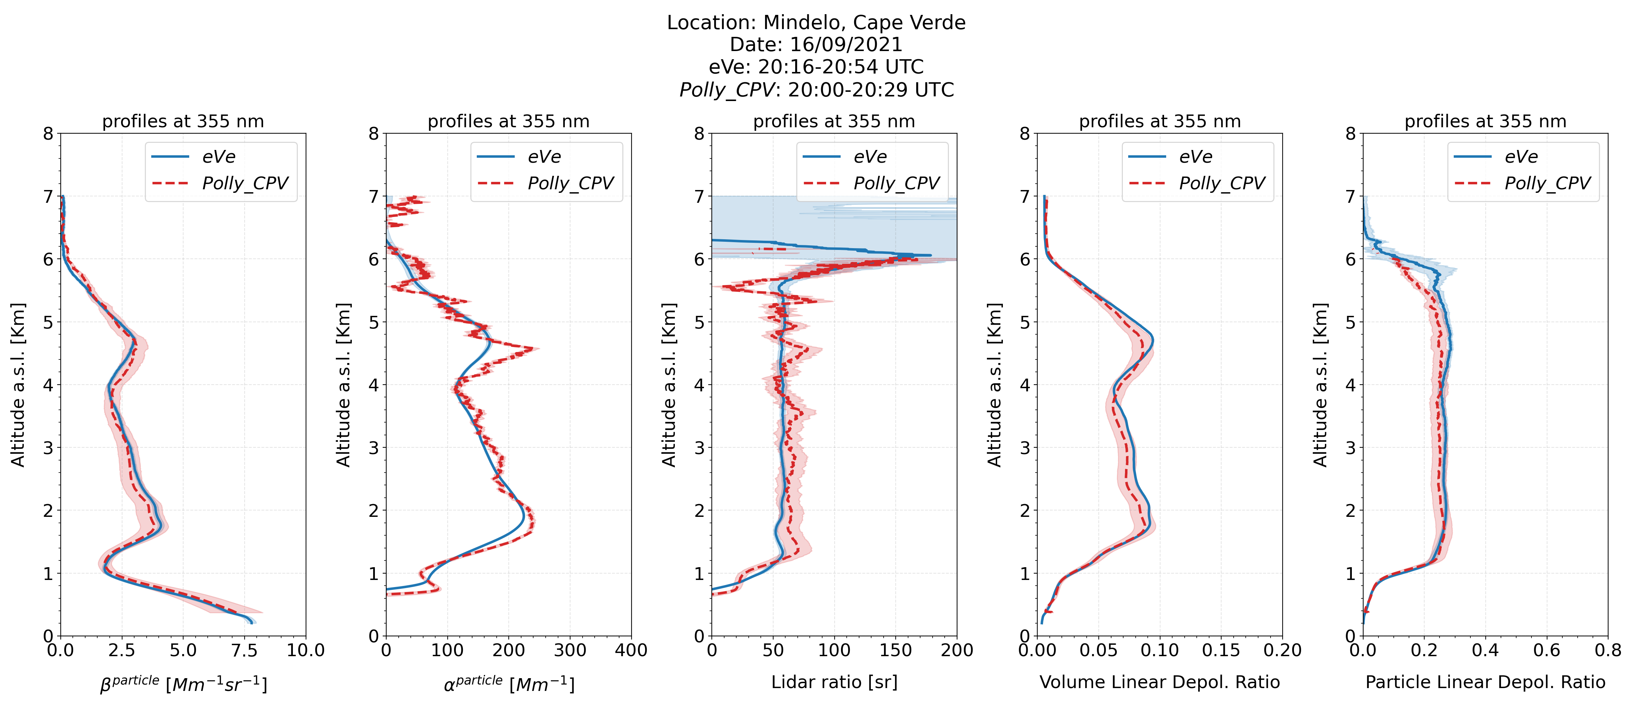
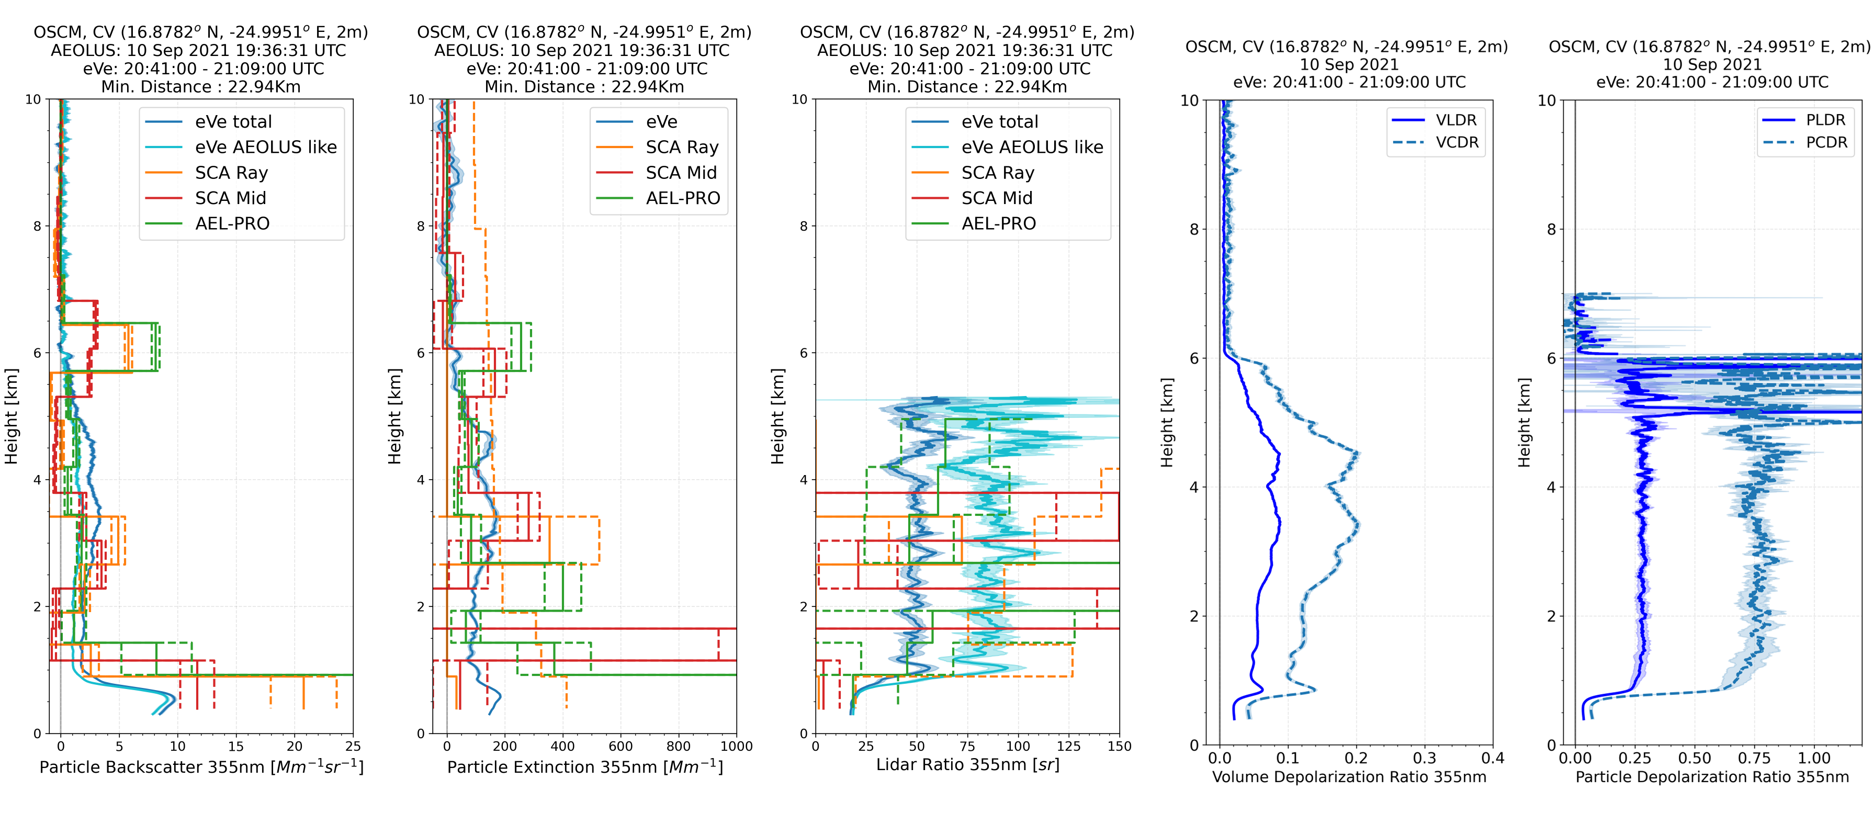
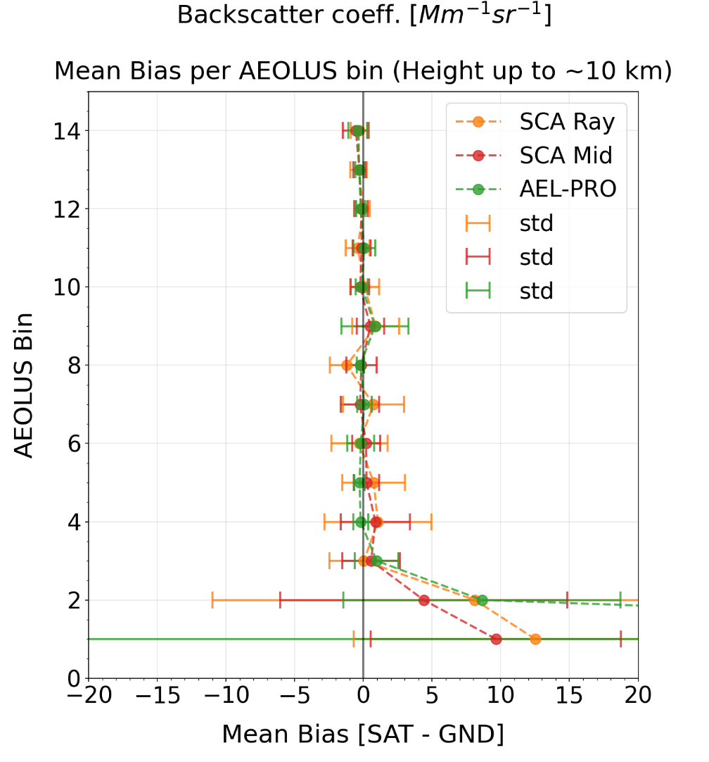
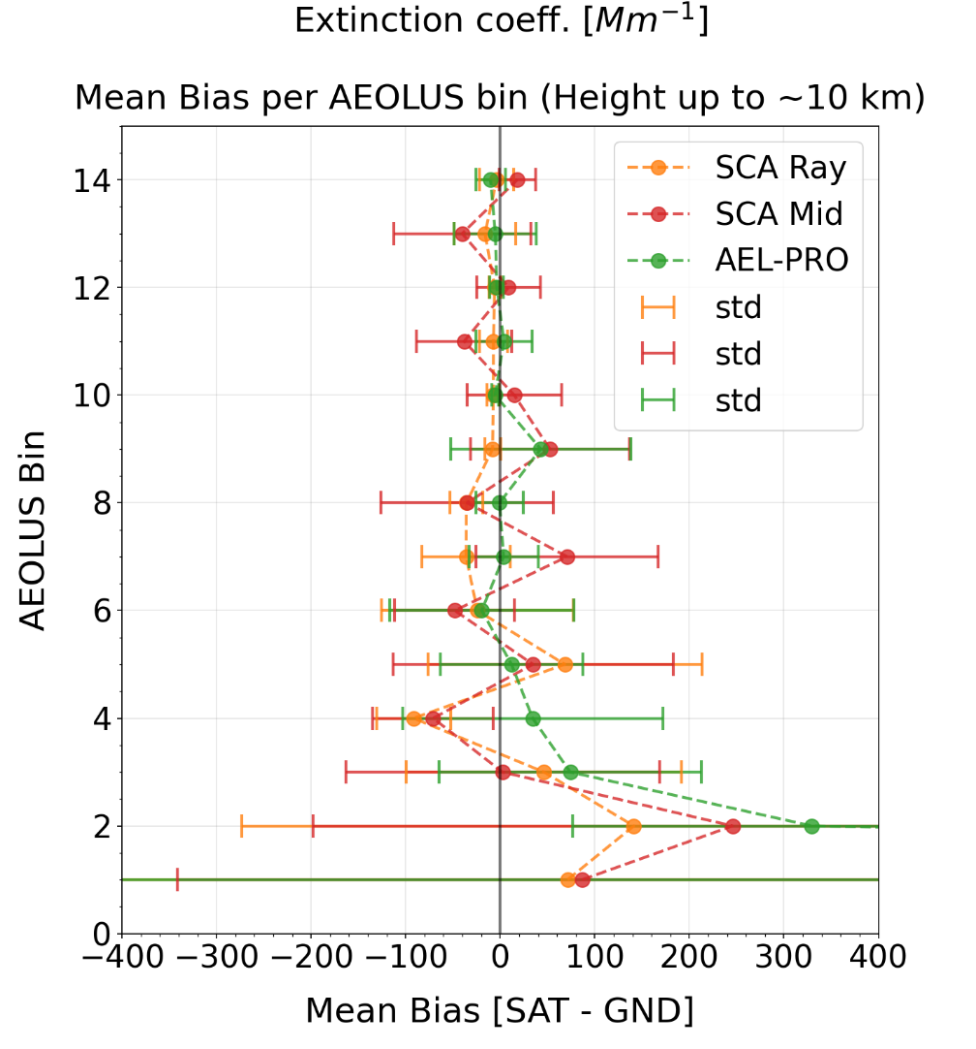
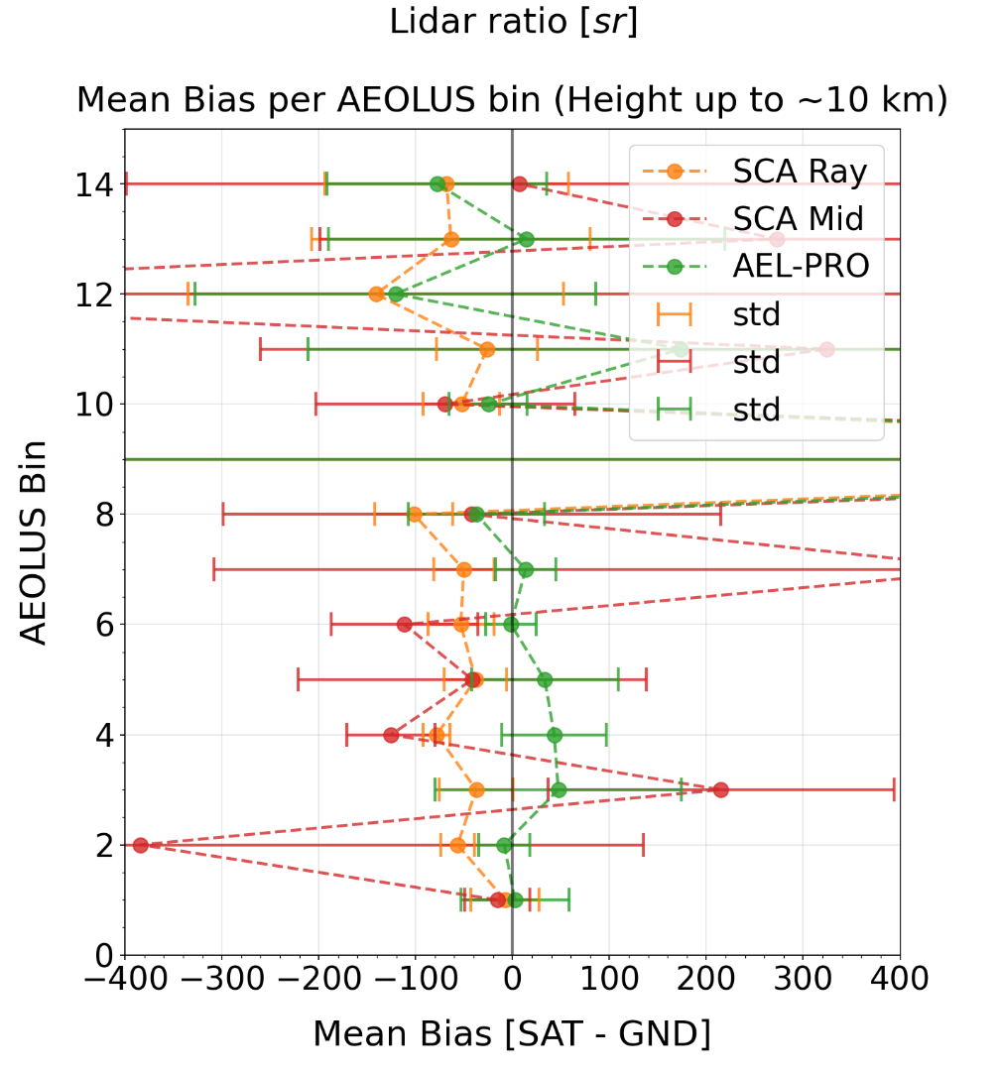
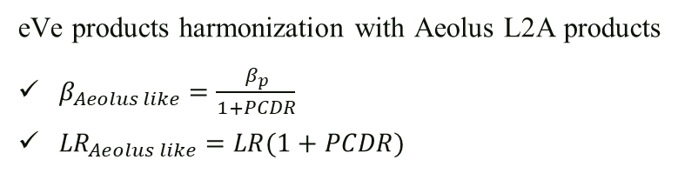
First Results from the Aeolus reference lidar eVe during the tropical campaign JATAC at Cabo Verde
P. Paschou^{1,2}, N. Siomos ^{3,2,1}, E. Marinou¹, H. Baars⁴, A. Gkikas¹, G. Georgoussis⁵, D. Althausen⁴, R. Engelmann⁴, J. von Bismarck⁶, T. Fehr⁷, and V. Amiridis¹
¹National Observatory of Athens, Athens, Greece, ²Aristotle University of Thessaloniki, Thessaloniki, Greece, ³Ludwig-Maximilians-Universität, Munich, Germany, ⁴Leibniz Institute for Tropospheric Research (TROPOS), Leipzig, Germany, ⁵Raymetrics S.A., Athens, Greece, ⁶European Space Agency (ESA/ESRIN), Frascati, Italy, ⁷European Space Agency (ESA/ESTEC), Noordwijk, the Netherlands
30th International Laser Radar Conference,
virtual conference, June 26th – July 1st, 2022.
Towards the Aeolus L2A validation with eVe lidar during JATAC
Lidar intercomparison during JATAC (eVe vs PollyXT)
PollyXT lidar:
linear emission at 355, 532, 1064 nm
lidar products:
  β; α (nighttime); lidar ratio (nighttime); linear depolarization ratios (355, 532, 1064 nm)
  Angstrom exponent (355/532, 532/1064 nm)
  water vapor mixing ratio
Optical products retrieval | eVe | PollyXT
Pointing angle | 5º off zenith | 5º off zenith
Signal smoothing window: | 750 m | 750 m
Time averaging (UTC): | 20:16 - 20:54 | 20:00 - 20:30
JATAC
Emission: linearly and circularly polarized light at 355 nm
Detection: a linear analyzer (EARLINET lidar) with Raman channel and a circular analyzer (similar to Aeolus)
Pointing geometry: off-zenith and azimuth rotation
Products (355 nm):
  β (from linear and circular emission)
  α (nighttime; from linear and circular emission)
  lidar ratio (nighttime; from linear and circular emission)
  linear depolarization ratios
  circular depolarization ratios
Aeolus L2A retrievals (version Baseline 12):
1. Standard Correct Algorithm (SCA) [L2A processors I; Meteo France]
  Two vertical resolution scales (Rayleigh bin / Mid bin)
2. AEL – PRO [L2A processors II; KNMI]
  Algorithm from EarthCARE developments
  JATAC Aeolus profiles reprocessed on February 2022
Campaign: Joint Aeolus Tropical Atlantic Campaign (JATAC) for the validation of Aeolus products.
When: July and September 2021
Where: Ocean Science Centre Mindelo (OSCM), Mindelo, Cabo Verde
eVe Dataset:
  8 collocated measurements with Aeolus (Friday 19:39 UTC)
  13 collocated measurements with airborne/in-situ instrumentation
β
α
LR
VLDR
PLDR
Aeolus L2A (B12) vs eVe
Outcomes and next steps
Aerosol load:
Marine PBL < 1 km: LR ~ 25 sr, PLDR ~ 0.02 (355 nm)
Dust layer 1 – 6 km: LR ~ 53 sr, PLDR ~ 0.28 (355 nm)
eVe products harmonization with Aeolus L2A products
$β_{Aeolus like}=\frac{β_{p}}{1+PCDR}$
${LR}_{Aeolus like}=LR(1+PCDR)$
Mean Bias and standard deviation over Aeolus Bin (July and September overpasses; 8 in total)
4th Aeolus Bin → ~2 km
14th Aeolus Bin → ~ 10 km
Summary:
Better agreement above 2 km for backscatter and extinction profiles
Aeolus extinction profiles are nosier than the backscatter profiles
Aeolus lidar ratio profiles are quite noisy for validation
Next step: enrich the dataset from the ongoing ASKOS 2022 operations
~10 km
~10 km
~10 km
β
α
LR
VDR
PDR
MB < 1.2
MB < 0.9
MB < 0.8
MB < 92
MB < 71
MB < 42
MB < 100
MB < 220
MB < 40
~2 km
MB < 12.5
MB < 9.7
MB < 89.1
~2 km
MB < 141
MB < 246
MB too high
~2 km
Acknowledgments
eVe lidar was developed under an ESA project (No. 4000127438/19/I-BG) by Raymetrics S.A. in collaboration with the National Observatory of Athens and the Ludwig-Maximilians University. The work is supported by the European Space Agency project ASKOS (4000131861/20/NL/IA), by the European Research Council (ERC) D-TECT project, under the European Community’s Horizon 2020 research and innovation framework programme (grant agreement no. 725698), and the Stavros Niarchos Foundation.

