Slide 1

Validation and uncertainty characterization of the water vapor mixing ratio measured by the MeteoSwiss Raman lidar and advanced experiments towards operational assimilation.
Giovanni martucci¹, Bas Crezee¹, Daniel Leuenberger¹ , Alexander Haefele¹
¹Federal Office of Meteorology and Climatology, MeteoSwiss, Switzerland

Slide 2
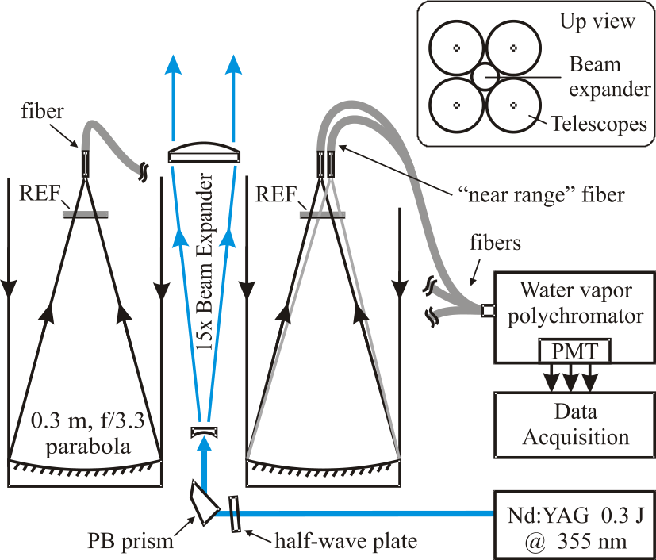
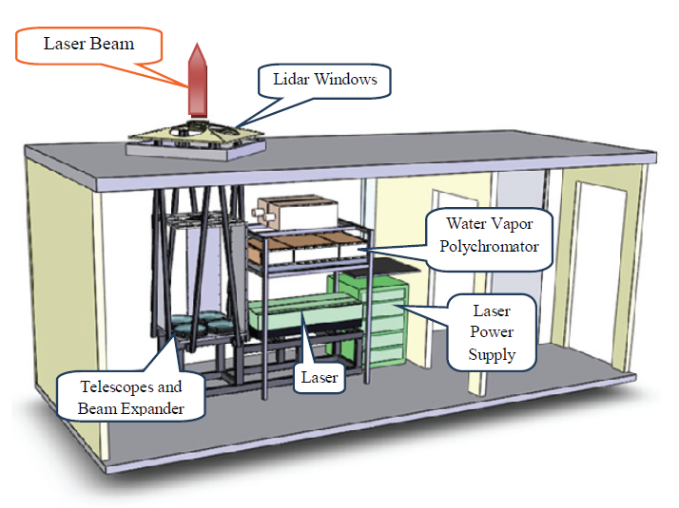
Instrument overview
The RAman Lidar for Meteorological Observations - RALMO
Operated in Payerne, Switzerland
Since 2008
Fully automatic Raman lidar
Day and nighttime operation
Narrow FOV and bandwidth
High laser-pulse energy

Slide 3
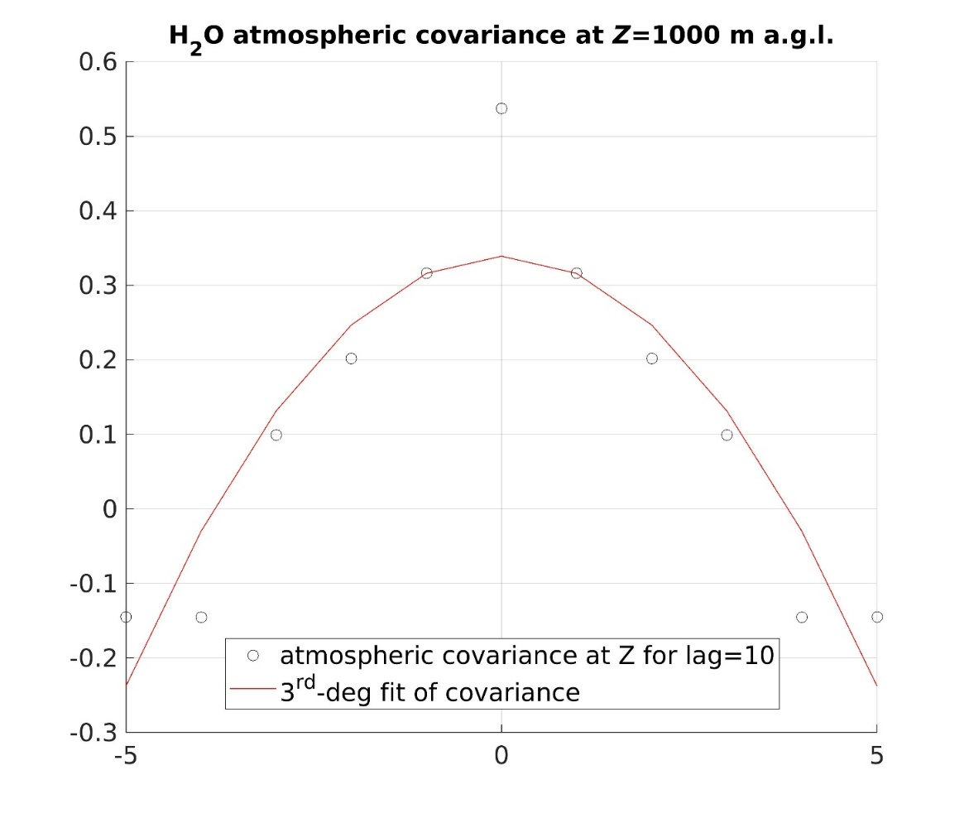
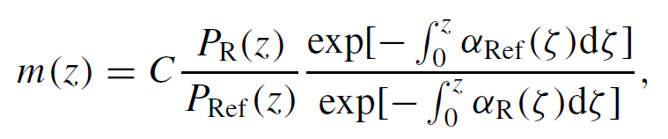





Water vapor mixing ratio: definition and uncertainty calculation
An automatic solar-background calibration module provides the calibration coefficient C for the WV mixing ratio every day.
$$var\left(X_{0−lag}\right)$$
$$σ_{X}$$
A development into Taylor’s series of the equation of m(z) with (assumed independent) errors on P_{R}(z), P_{Ref}(z) and C is performed.
$$cov(X_{0−lag})$$
$$σ_{tot}={C\left(\frac{σ_{H2O}^{2}}{P_{N2}^{2}}+\frac{P_{H2O}^{2}σ_{N2}^{2}}{P_{N2}^{4}}+σ_{C}^{2}\frac{P_{H2O}^{2}}{{C^{2}P}_{N2}^{2}}\right)}^{1/2}∙∆α^{m}$$
σ_{H2O} and σ_{N2} are the combination of two error contributions: the signal variance at time i (0-lag) and the atmospheric covariance of P_{N2} and P_{H2O} signals over a time-lag of 10 minutes (i-5 to i+5) at every altitude. The atmospheric component is subtracted from the 0-lag variance.
$$σ_{X}=var\left(X_{0−lag}\right)−cov(X_{0−lag})$$

Slide 4
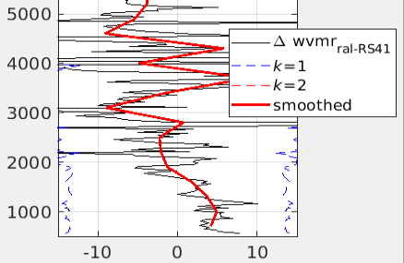
Water vapor mixing ratio: calibration and uncertainty validation
Comparison of WVMR between Ralmo and the RS41. The shaded area rapresents k=2, i.e. 95% of the Gaussian-distributed differences RAL-RS41should be embedded within the green area and the dashed red curve.
The WV RAL-RS41are of the order of |10%| in the 0-5km region.

Slide 5
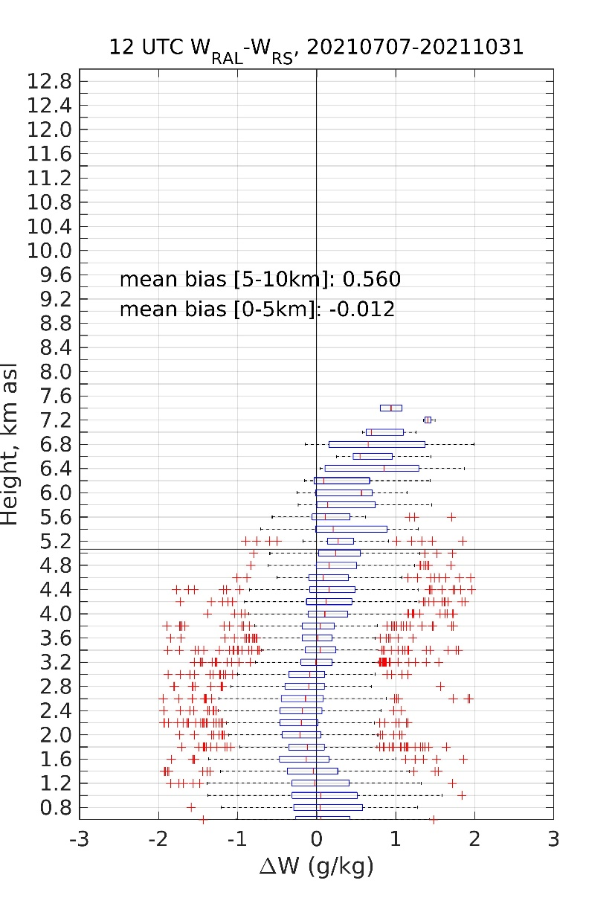
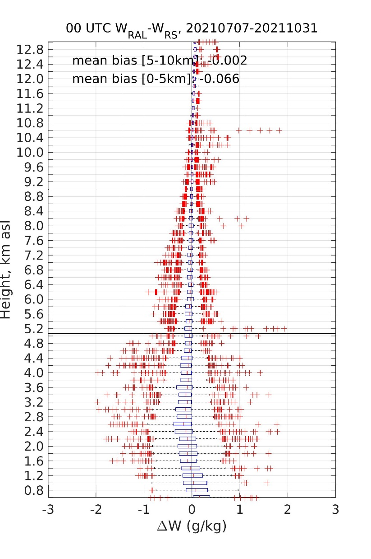
Water vapor mixing ratio: validation against radiosounding RS41
From 7.7.2021 to 31.10.2021, profiles of WVMR have been compared to the profiles obtained by the operational sonde Vaisala RS41 at Payerne and assessed separately for daytime and nighttime (76 and 72, respectively) based on the bias and standard deviation
Both nighttime and daytime statistics show biases compatible with zero within k=1.
The Standard deviation is about 0.5 g/kg in the first 5 km for daytime and 0.3 g/kg for nighttime.

Slide 6
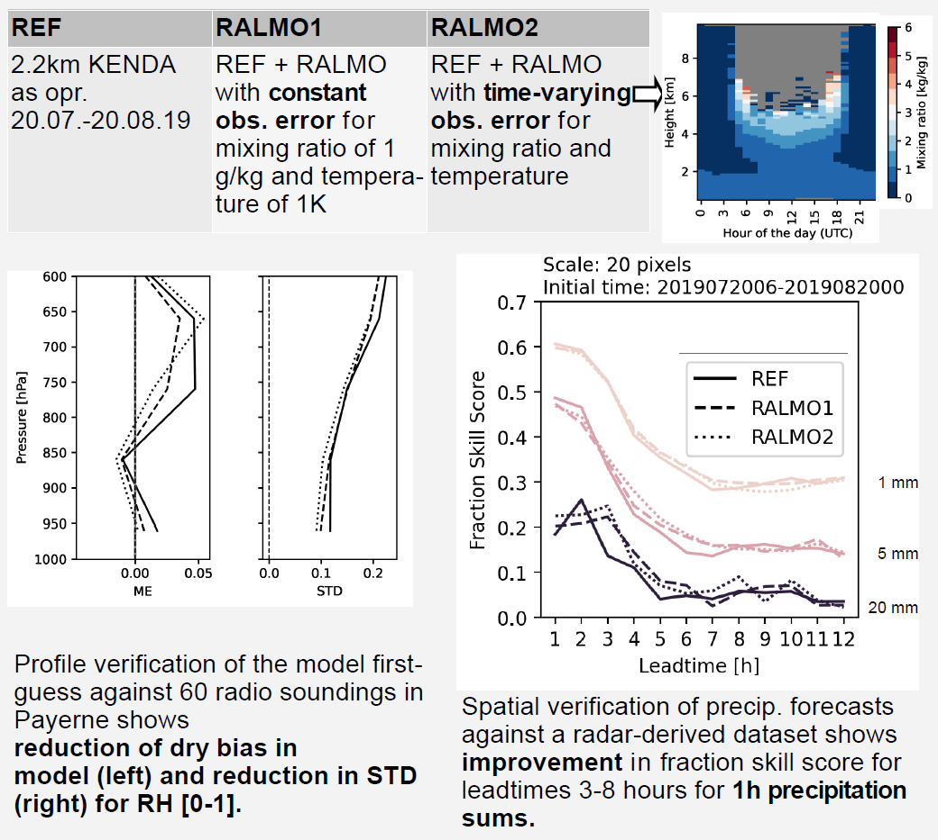
WV and Temperature: assimilation experiment
RALMO validated WV and temperatrure data are stored in the MeteoSwiss Data Ware House (DWH). And made available for assimilation into KENDA-1.
Since a few months the NWP team at MeteoSwiss is testing the impact of assimilating humidity and temperature data along with the time varying observation error on the weather forecasts. The impact is positive and MeteoSwiss moves towards the operational assimilation in 2022.

