Slide 1
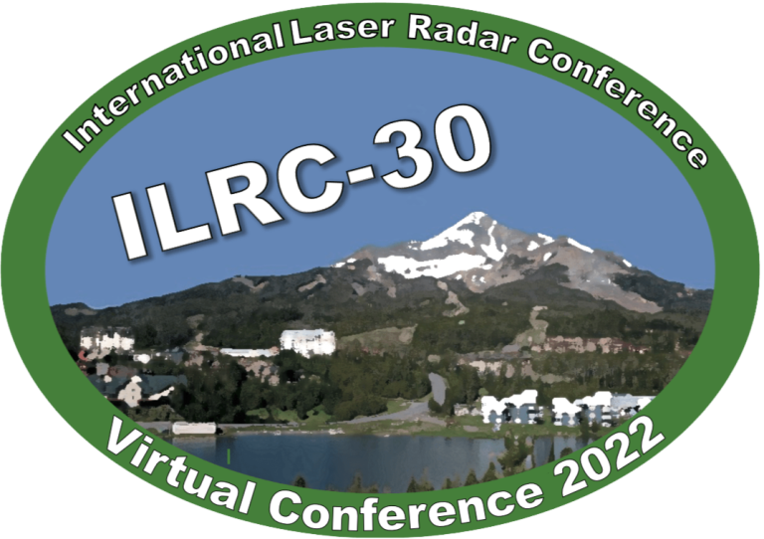



ID: Monday_03_P02
Natural seeder-feeder process originating from mixed-phase clouds observed with polarization lidar
Motivation:
Cloud seeding is one reason for the occurrence of ice virgae below warmer mixed-phase cloud (>-15℃).
Cloud seeding may result in the enhancement of extreme precipitation and flooding.
Natural cloud seeding originating from mixed-phase cloud to low-lying liquid cloud is poorly studied.
He et al., JGR: Atmos., 127, e2021JD036094, 2022.
Yun He
Wuhan University， China
2022.06.27

Slide 2
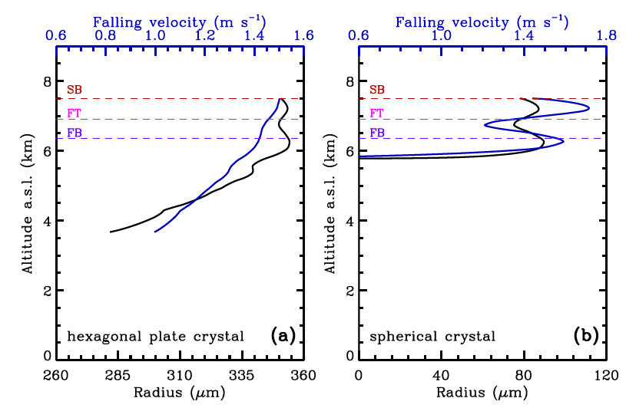
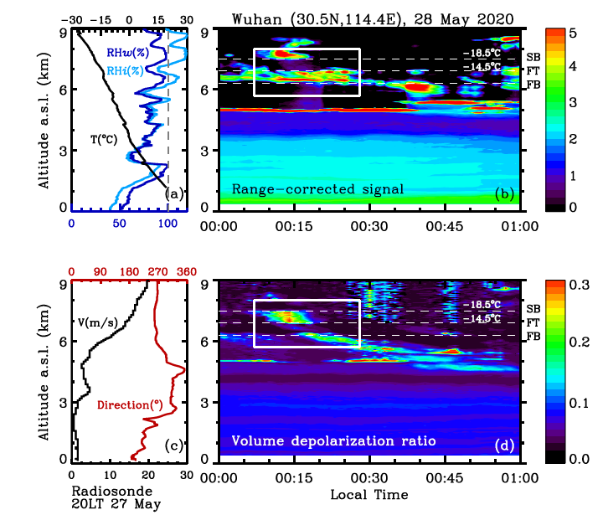
The first case on 28 May 2020
slight shrinkage
Feeding: small
enhancement
intense
sublimation
Sublimation calculations during sedimentation.
Estimated initial velocity of 1.5 m s⁻¹.
Super/near-supersaturation in between results in weak sublimation of crystals.
Evident enhancement of crystal radius appeared near feeder cloud base.
Feeder cloud promoted the growth of ice crystals and further prolonged the survival time/distance of falling ice crystals.

Slide 3
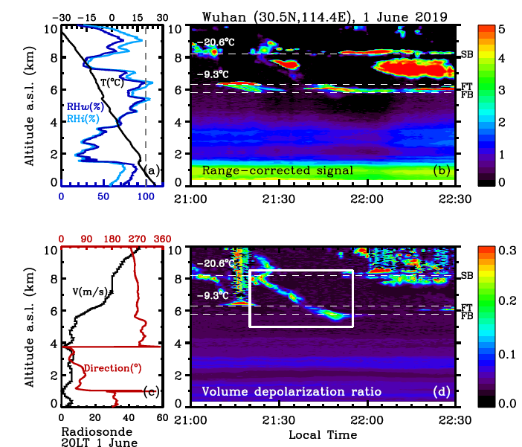
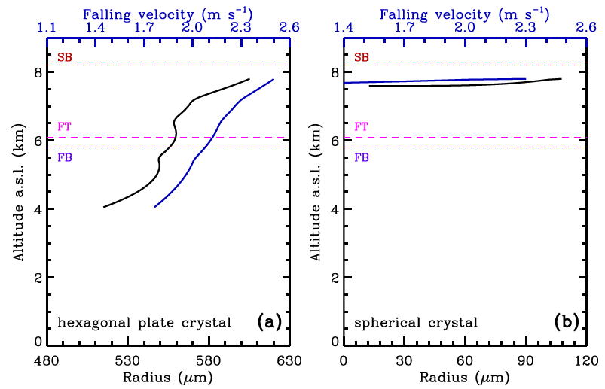
The second case on 1 June 2019
strong shrinkage
Feeding: small
enhancement
intense
sublimation
prolonged
survival time
Sublimation calculations during sedimentation.
Estimated initial velocity: 1.5 m s⁻¹.
Dry air layer in between results in intense sublimation of crystals (strong shrinkage).
Seeder-feeder mechanism delayed the complete sublimation of ice crystals.

Slide 4
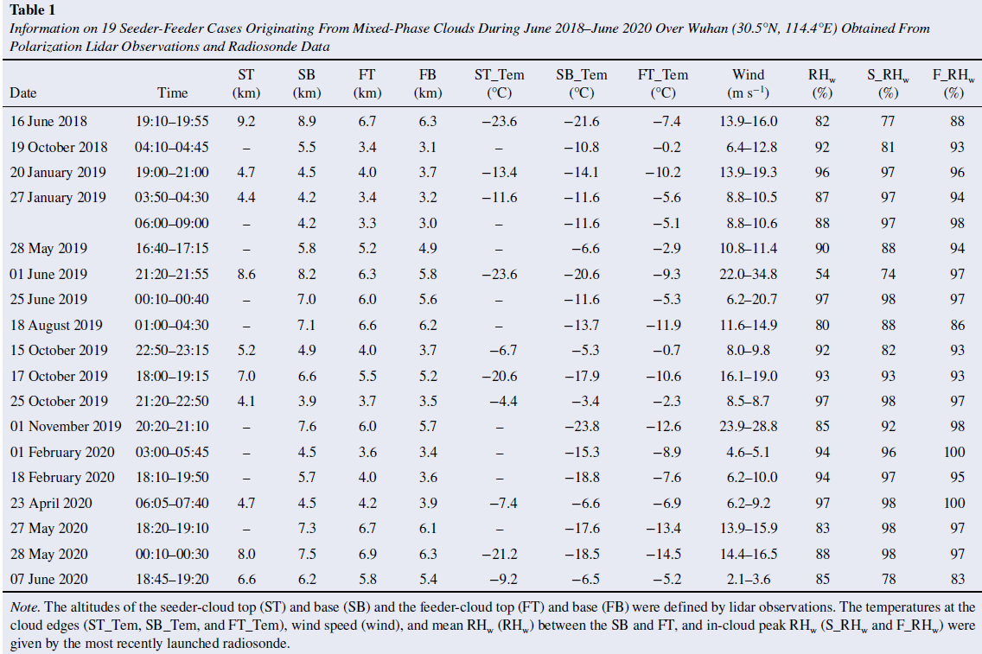
Two-year statistical characteristics （2018 –2020）
Distance / RH between seeder cloud base (SB) and feeder cloud top (FT) ： 0.2-2.2 km / >80%
Temperatures at SB：-3.4 to -23.8 ℃
Temperatures at FT：
-0.2 to -14.5 ℃ (this study)
-5 to -20 ℃ in Verde Cape (Ansmann et al., 2009)
-12 to -15 ℃ in Morocco (Ansmann et al., 2008)
-0.9℃– -4.1℃ (Fleishauer et al., 2002)

Slide 5
Summary
With polarization lidar and radiosonde, natural seeder-feeder processes from mixed-phase clouds to lower-lying liquid clouds were observed at a mid-latitude plain site.
Ice crystals from seeder clouds fell into feeder clouds located 0.2-2.2 km below.
During sedimentation, ice crystals partly underwent sublimation when passing through the in-between dry air layers.
Feeder clouds inhibited ice crystals from complete sublimation and grew them larger by supplying favorable liquid water.
Owing to cloud seeding, feeder clouds with top temperatures (CTT) as warm as −0.2 to −14.5°C produced ice virgae, although these CTTs are generally considered somewhat insufficient to initiate primary heterogeneous ice nucleation.

