Slide 1

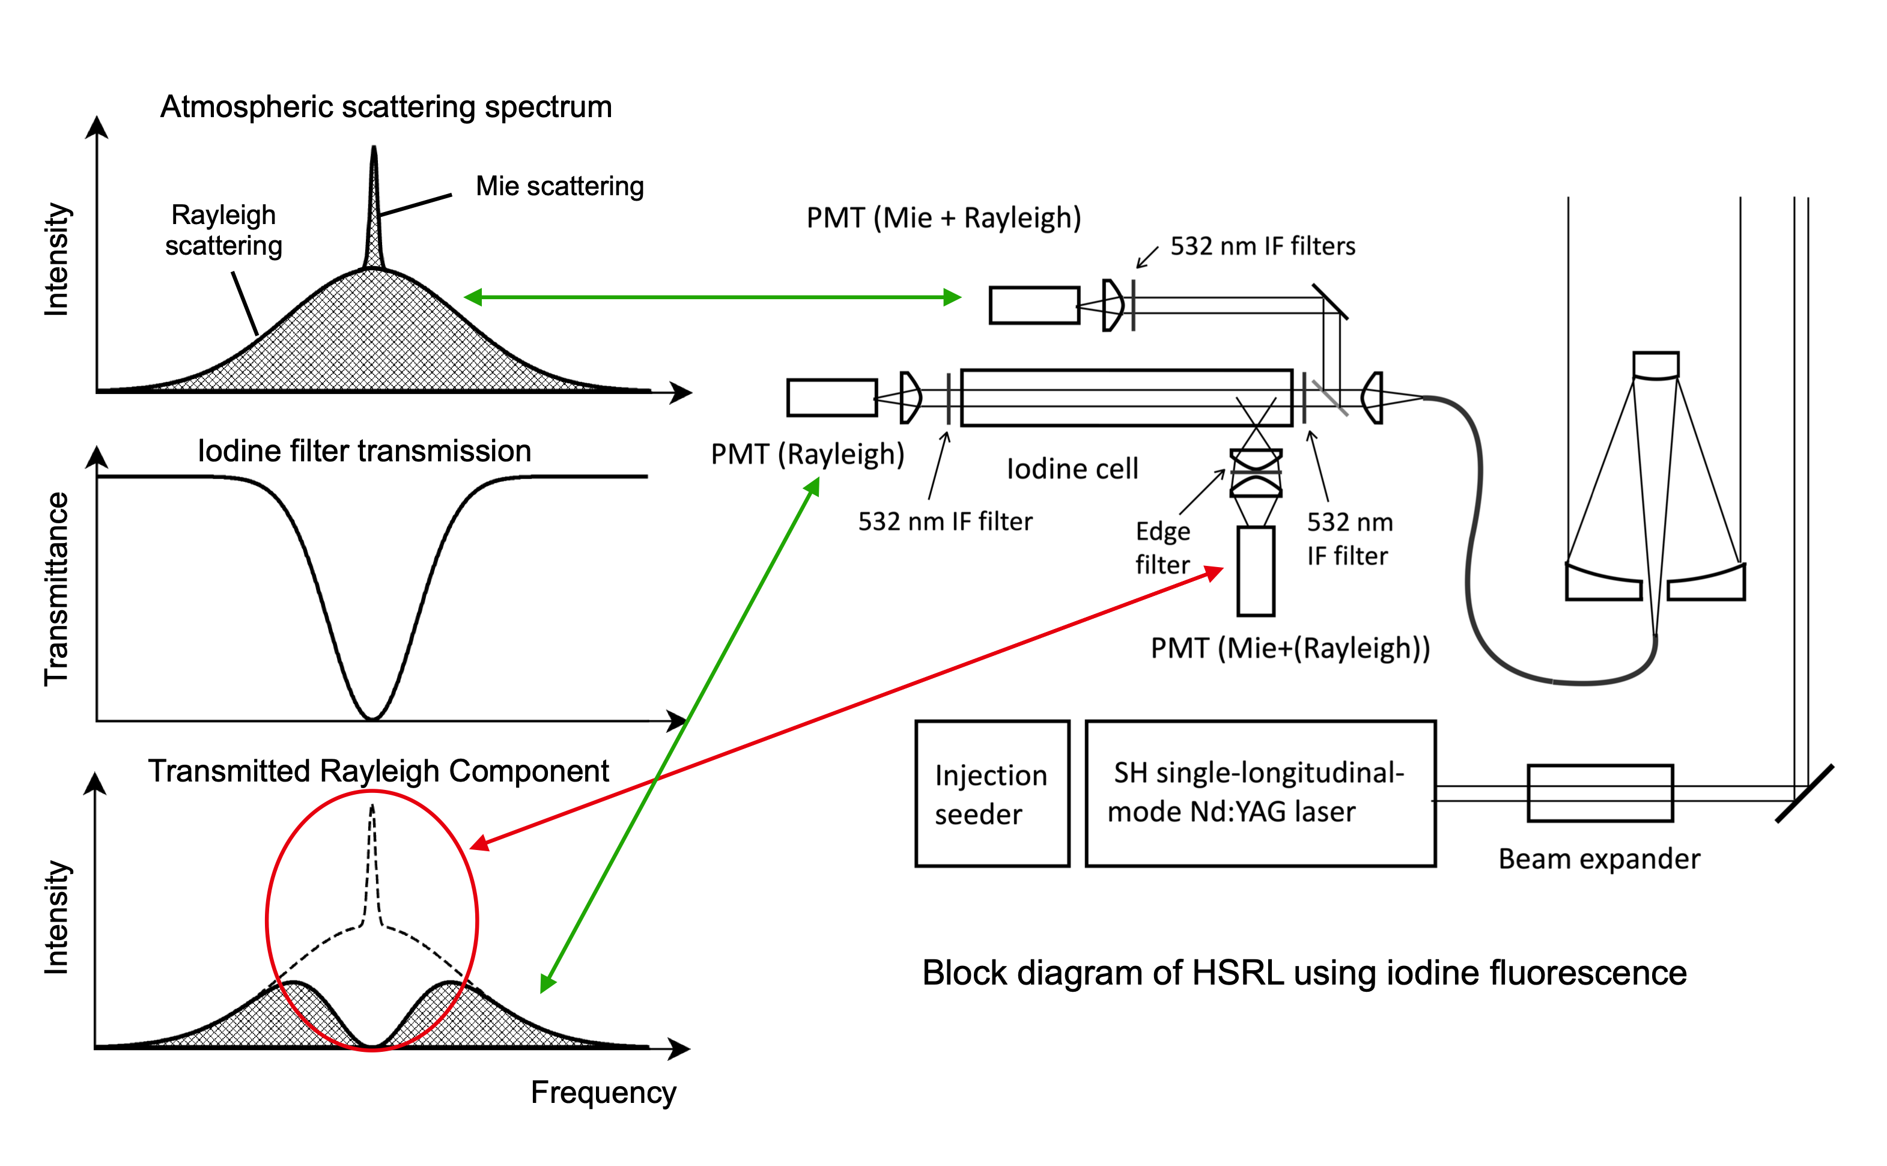
1
[Monday_ 02_P02] (Poster Slide 1)
2
Possible Use of Iodine Absorption/Fluorescence Cell in High-Spectral-Resolution Lidar
Nobuo Sugimoto¹, Yoshitaka Jin¹, Tomoaki Nishizawa1
1National Institute for Environmental Studies, Japan
Iodine cell is often used in 532-nm high-spectral-resolution lidars as a blocking filter to remove the Mie scattering component in the Rayleigh scattering receiver. The light absorbed in the iodine cell is usually not used, but a part of the absorbed light is emitted as fluorescence. We tried to used the fluorescence to detect the Mie scattering component by adding a fluorescence detection channel to our HSRL system.
(The initial motivation was to demonstrate crosstalk in the Rayleigh channel.)
Fig. 1. Concept of HSRL using the fluorescence from the iodine blocking filter.
The 30th International Laser Radar Conference (ILRC) virtual conference, June 26th – July 1st, 2022.

Slide 2
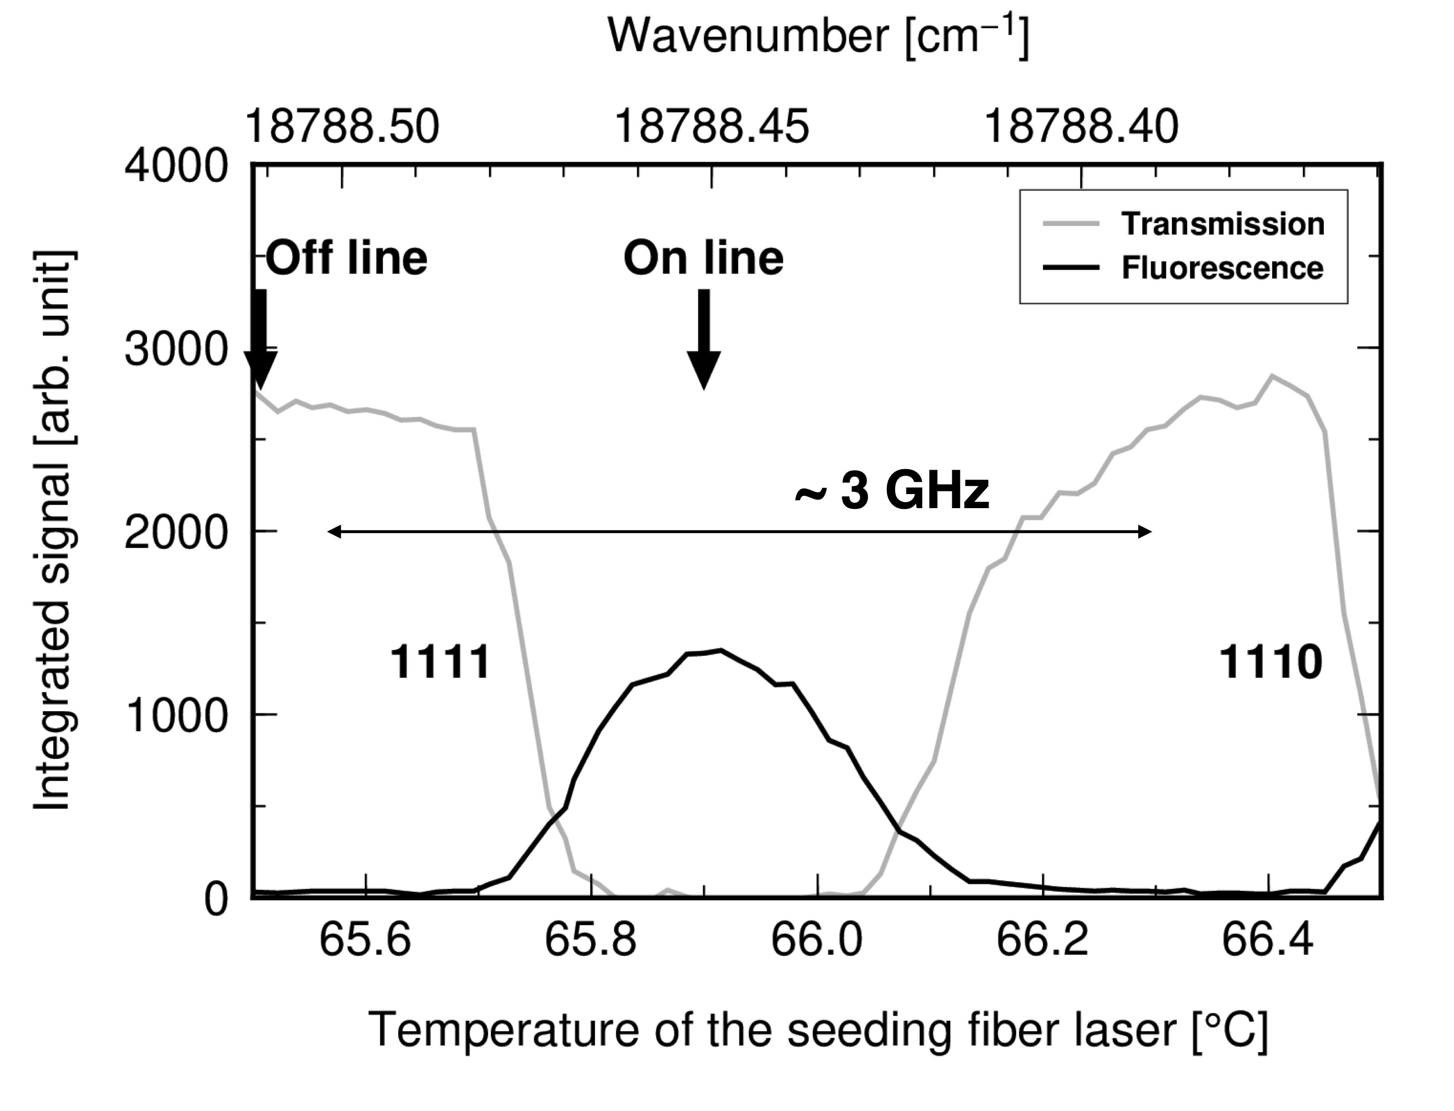
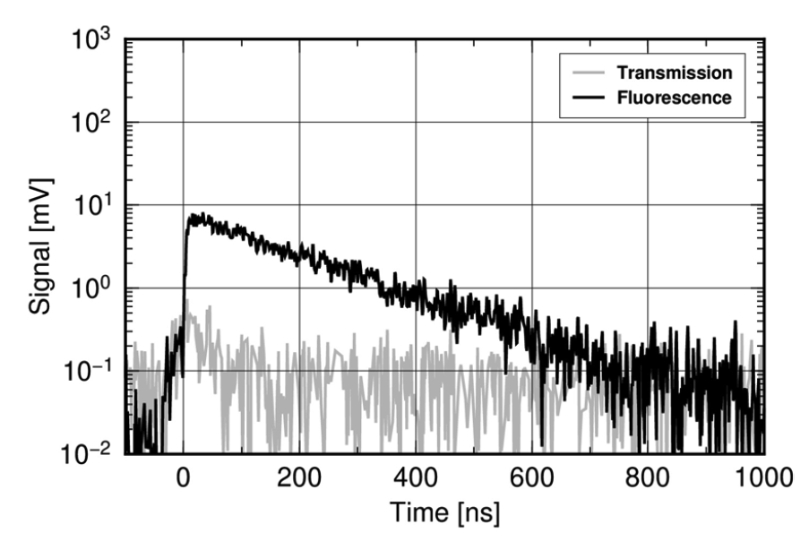
2
[Monday_ 02_P02] Possible Use of Iodine Absorption/Fluorescence Cell in HSRL (Poster Slide 2)
2
Fig. 2 shows the transmission and fluorescence excitation spectra of the iodine cell measured by directing the laser beam directly to the receiver and scanning the laser wavelength around the absorption line 1111 (18788.4510 cm⁻¹) of iodine molecule (I2). In the excitation spectrum measurement, the fluorescence decay signal (an example is shown in Fig. 3) was recorded and integrated to obtain fluorescence intensity.
Fig. 2. Transmission and excitation spectra of the iodine cell (Sugimoto et al., 2021).
Fig. 3. Waveform of transmission and fluorescence signals at absorption line 1111 (Sugimoto et al., 2021).
The 30th International Laser Radar Conference (ILRC) virtual conference, June 26th – July 1st, 2022.

Slide 3
2
[Monday_ 02_P02] Possible Use of Iodine Absorption/Fluorescence Cell in HSRL (Poster Slide 3)
3
The temperature of the iodine cell was 22°C, the iodine vapor pressure was 31.8 Pa, and the fluorescence lifetime (decay time) was ~0.18 μs. The fluorescence quantum efficiency is expressed as τobs/τrad, where τobs is the observed decay time, and τrad is the radiative lifetime, which is ~2.3 μs (Sugimoto et al., 2021). The resulting fluorescence quantum efficiency for the experimental condition was ~0.08.
There is non-radiative relaxation process in the excited state (B³Π⁺0u) of I2 due to unimolecular predissociation (Sakurai et al., 1971), and the fluorescence lifetime extrapolated to zero pressure is ~1.1 μs (Paisner and Wallenstein, 1974). As a result, the maximum quantum efficiency at zero pressure is ~0.48.
In the pressure range useful for absorption/fluorescence cell, the quantum efficiency is about 0.2 or smaller.
The overall efficiency as a detector is represented as the product of the fluorescence quantum efficiency and the efficiency of collecting fluorescence from the iodine cell. In the experimental system, fluorescence of iodine was measured only near the input window, and the optical efficiency was low (~0.008). The fluorescence collecting efficiency, however, can be improved by using an integrating sphere or using arrays of detectors surrounding the iodine cell. In addition, the fluorescence decay time (~1.1 μs at maximum) limits the temporal response as a detector, but the decay is a simple exponential function, and deconvolution methods may be applied.
The 30th International Laser Radar Conference (ILRC) virtual conference, June 26th – July 1st, 2022.

Slide 4
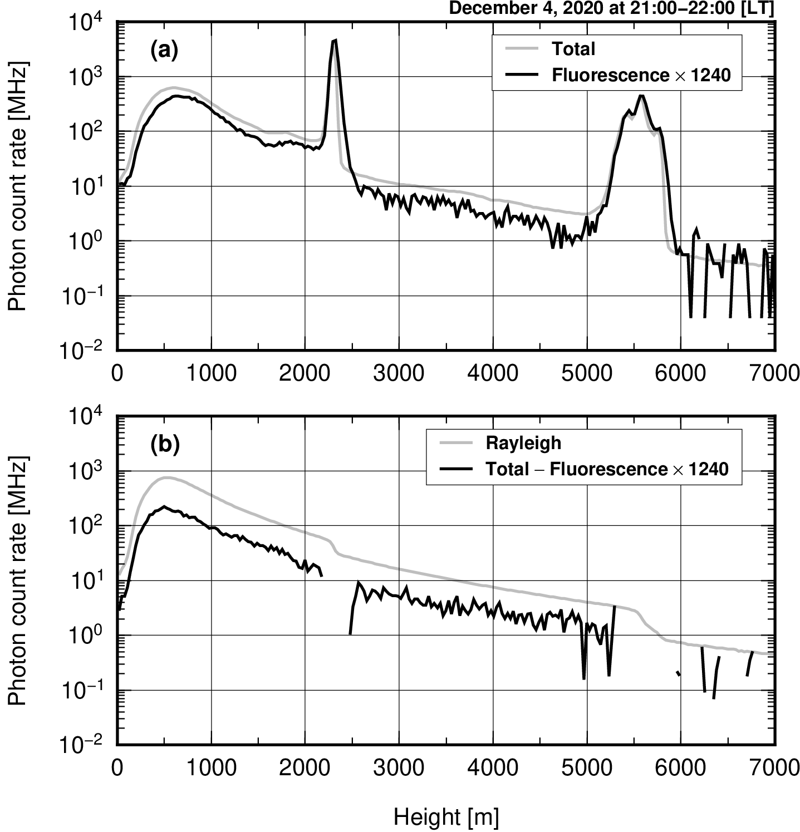
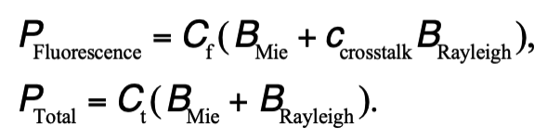
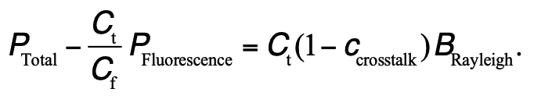
[Monday_ 02_P02] Possible Use of Iodine Absorption/Fluorescence Cell in HSRL (Poster Slide 4)
4
We succeeded in measuring atmospheric backscattering signals and confirmed the fluorescence channel actually detected Mie scattering.
We also showed that about half of the Rayleigh Cabaness line was absorbed in the iodine cell at the same time with the Mie scattering component.
Fig. 5 Atmospheric scattering signals measured with the HSRL having a receiver channel using fluorescence of the iodine absorption cell. (Sugimoto et al., 2021).
The 30th International Laser Radar Conference (ILRC) virtual conference, June 26th – July 1st, 2022.

Slide 5
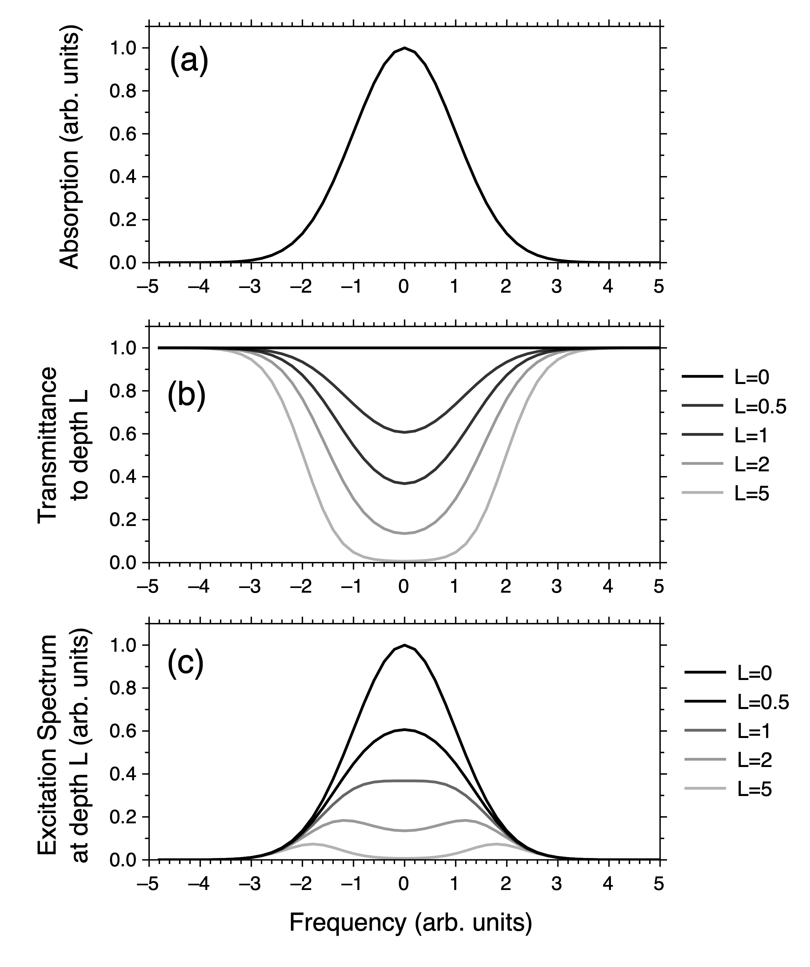
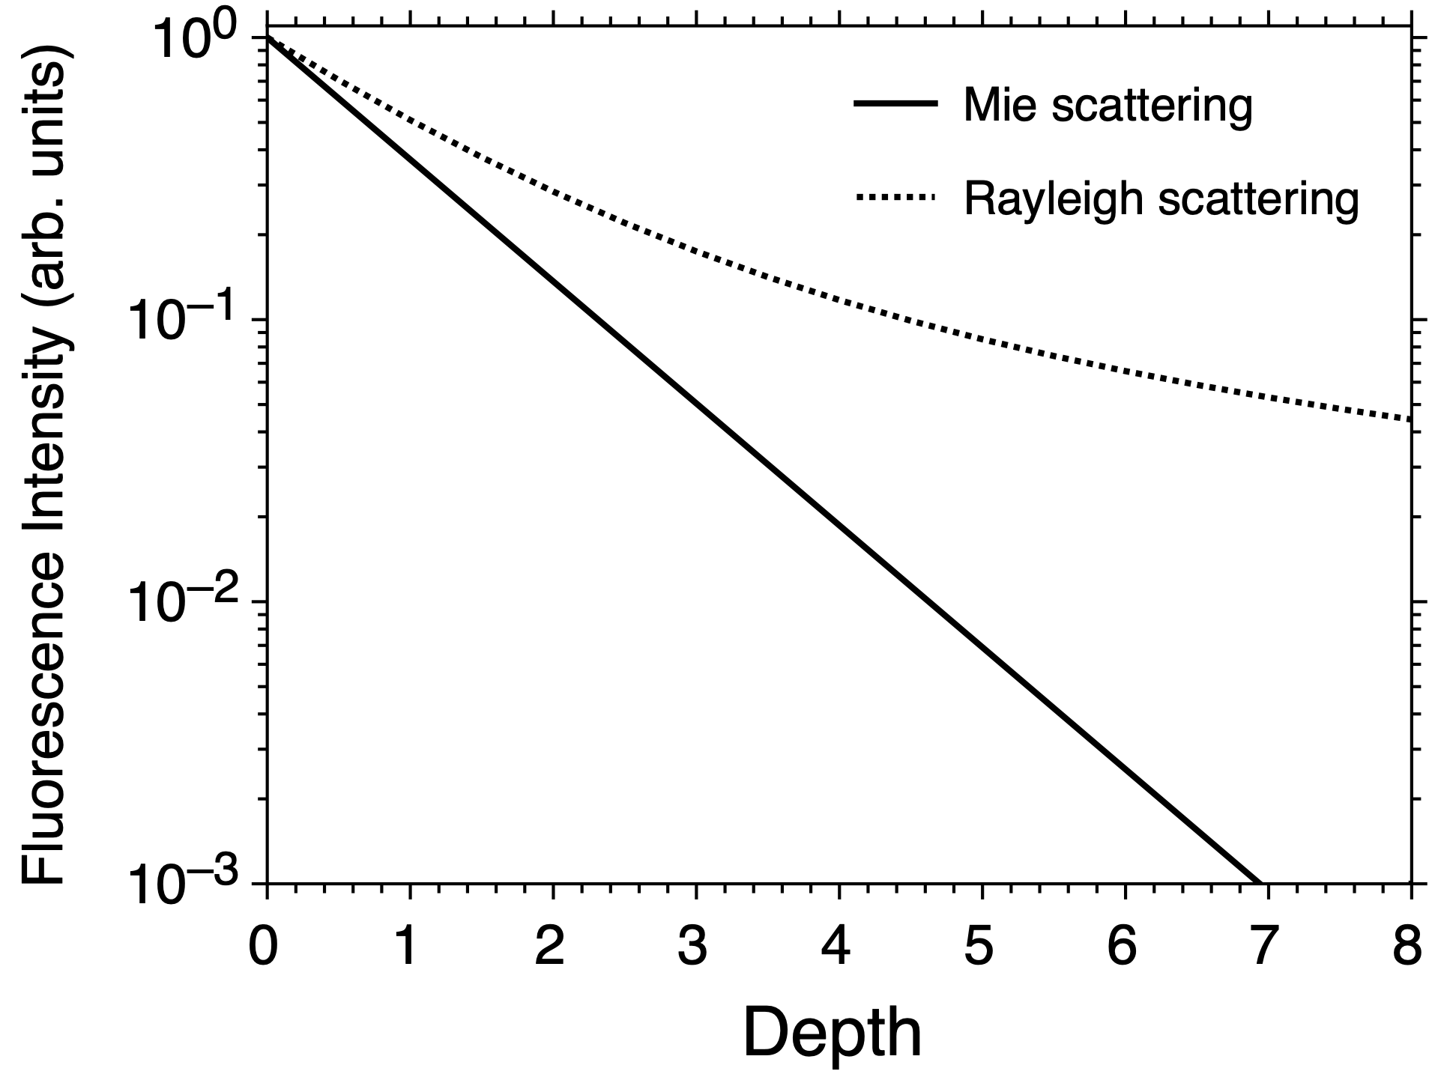
[Monday_ 02_P02] Possible Use of Iodine Absorption/Fluorescence Cell in HSRL (Poster Slide 5)
5
Fluorescence excitation spectrum is dependent on the light penetration depth. Figure 6 (a), (b) and (c) shows absorption spectrum, transmission spectrum to depth L, and excitation spectrum at depth L for a Gaussian absorption line. The depth L is defined so that the optical depth at the center of the absorption line is L.
Figure 7 shows the depth dependence of the fluorescence intensity integrated with frequency for the Mie and Rayleigh backscattering signals. We may use the difference to separate the Mie and Rayleigh components absorbed in the iodine cell.
Fig. 6. (a) absorption spectrum, (b) transmission spectrum to depth L, and (c) excitation spectrum at depth L for a Gaussian absorption line.
Fig. 7. Depth dependence of the fluorescence intensity integrated with frequency for the Mie and Rayleigh backscattering signals.
The 30th International Laser Radar Conference (ILRC) virtual conference, June 26th – July 1st, 2022.

Slide 6
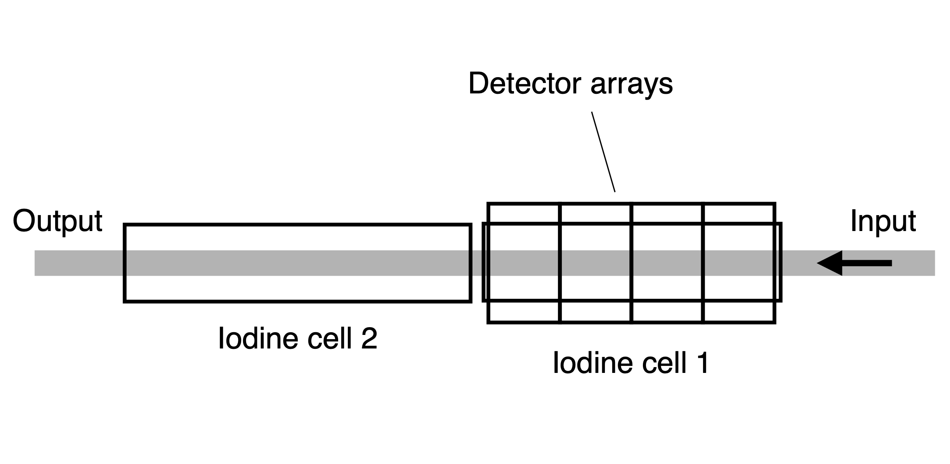
[Monday_ 02_P02] Possible Use of Iodine Absorption/Fluorescence Cell in HSRL (Poster Slide 6)
6
Figure 8 illustrates a method using detector arrays surrounding the fluorescence cell to improve the optical efficiency of collecting fluorescence and to measure the dependence of the fluorescence intensity on the beam penetration depth. Iodine cell 1 is for detecting fluorescence and cell 2 is for optimizing the transmission characteristics as a blocking filter. Cell 1 is surrounded by detector arrays. In this figure, the detector arrays consist of 4 segments.
The method using fluorescence from the iodine cell may be useful for detecting very low density aerosols having very low Mie to Rayleigh scattering ratio, because the contrast between the Mie and Rayleigh signals is higher in the fluorescence detection channel compared with the total scattering channel. Also, the effect of solar background radiation can be reduced by a factor of ~1/7, because the fluorescence channel is sensitive only to the wavelengths of iodine absorption lines.
References
Sugimoto, N., Y. Jin, and T. Nishizawa: Possible use of fluorescence from iodine blocking filter in high-spectral-resolution lidar to detect Mie scattering signals. Appl. Opt. 60(13), 3617-2622 (2021).
Sakurai, K., G. Capelle, and H. P. Broida: Measurements of lifetimes and quenching cross sections of the B³Π⁺0u state of iodine using a tunable dye laser. Chem. Phys. 54, 1220–1223 (1971).
Paisner, J. A. and R. Wallenstein: Rotational lifetimes and self-quenching cross sections in the B³Π⁺0u state of 12712. J. Chem. Phys. 61, 4317–4320 (1974).
Fig. 8. Concept of the method using detector arrays.
The 30th International Laser Radar Conference (ILRC) virtual conference, June 26th – July 1st, 2022.

