Slide 1

Applications with ceilometer with depolarization ratio measurement
Minttu Tuononen
Raisa Lehtinen, Reijo Roininen
Notes:
Hello everyone, my name is Minttu Tuononen, I am coming from Vaisala and I will give a talk about the application potential with our newest ceilometer instrument with depolarization measurement capability.

Slide 2
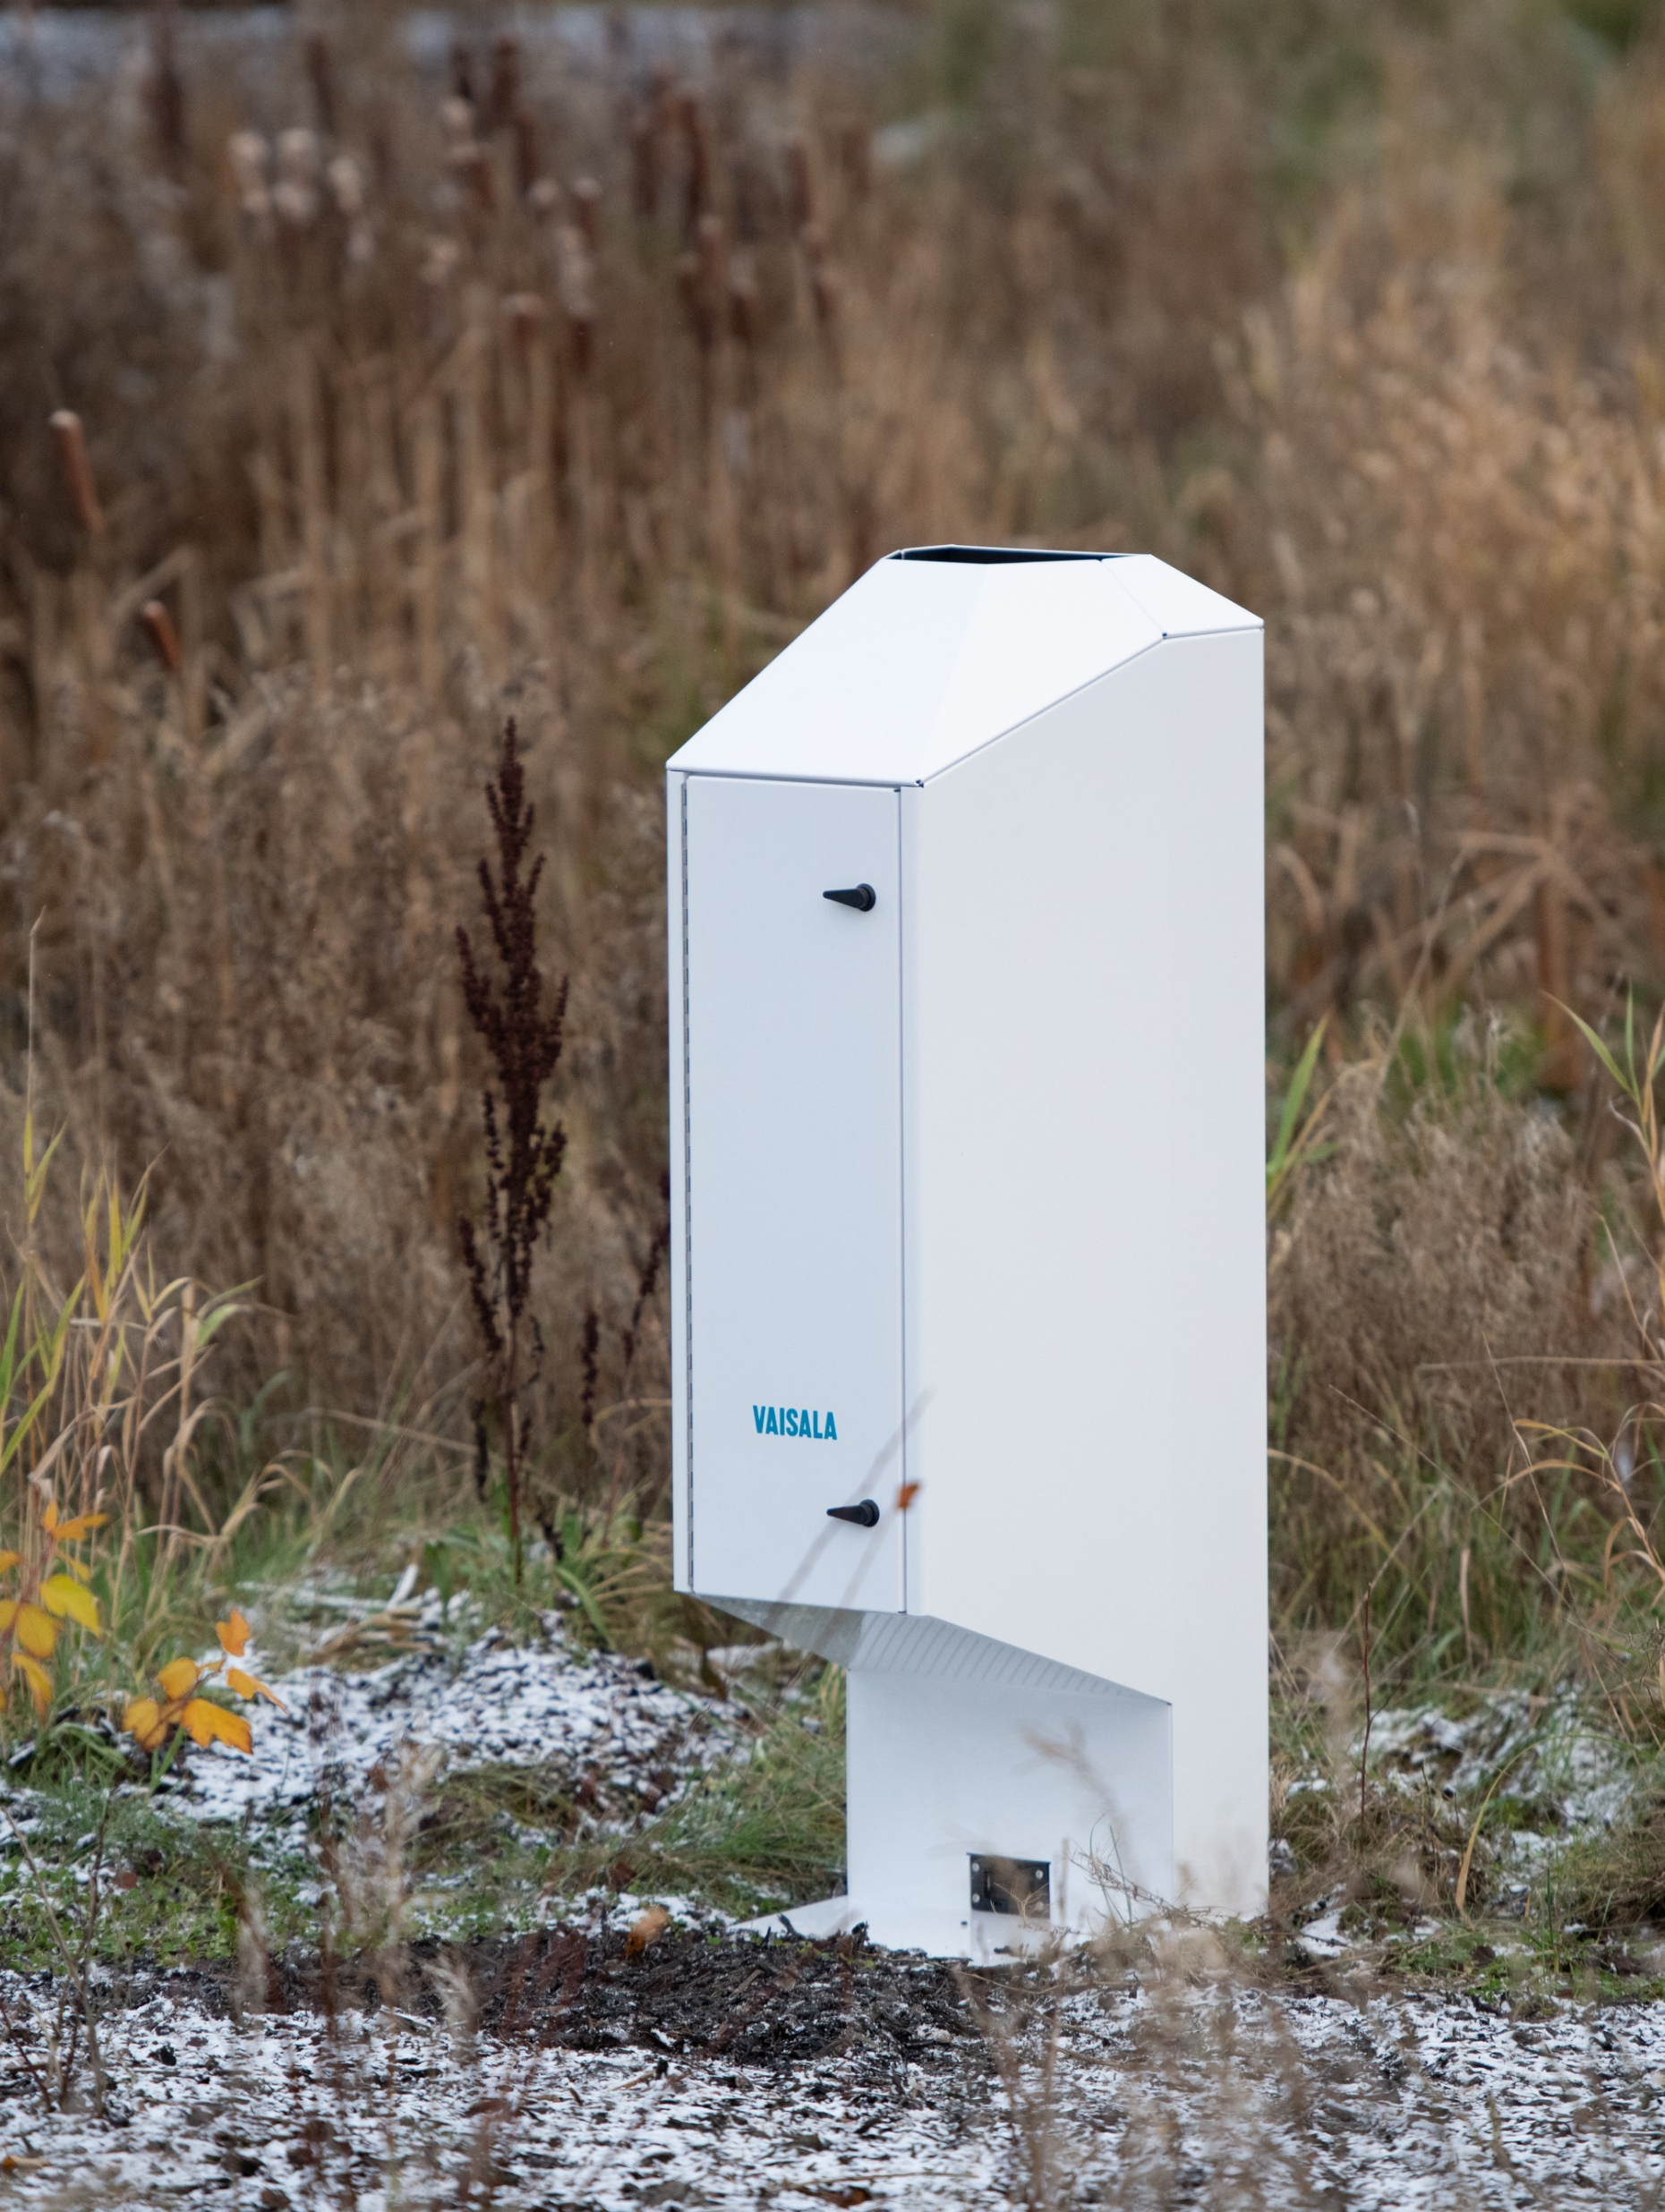
More than a ceilometer
New and enhanced measurements
High resolution attenuated backscatter profiles
Depolarization measurement for liquid solid differentiation
High performance
Unique single lens technology for low altitude detection
Minimized water vapour absorption, 910.55 nm
Traceable factory calibration
Designed for operational use in networks
Measures reliably in any weather condition
No consumable parts
Professional software security
Attractive pricing
Notes:
Roughly a year ago we launched a completely new ceilometer product, CL61. It is a lidar-based instrument and measures backscattered light from the cloud droplets, precipitation and aerosol particles. In addition, compared to our previous ceilometer models, it has completely new measurement capability, depolarization ratio measurement, which gives information on the characteristics of the scatterers enabling liquid and solid differentiation.
We have unique single-lens technology, enabling good performance at low altitudes, minimized water vapor absorption with 910.55 nm wavelength and traceable factory calibration for time-of-flight measurement.
Our ceilometer are suitable for 24/7 operation with attractive pricing.

Slide 3
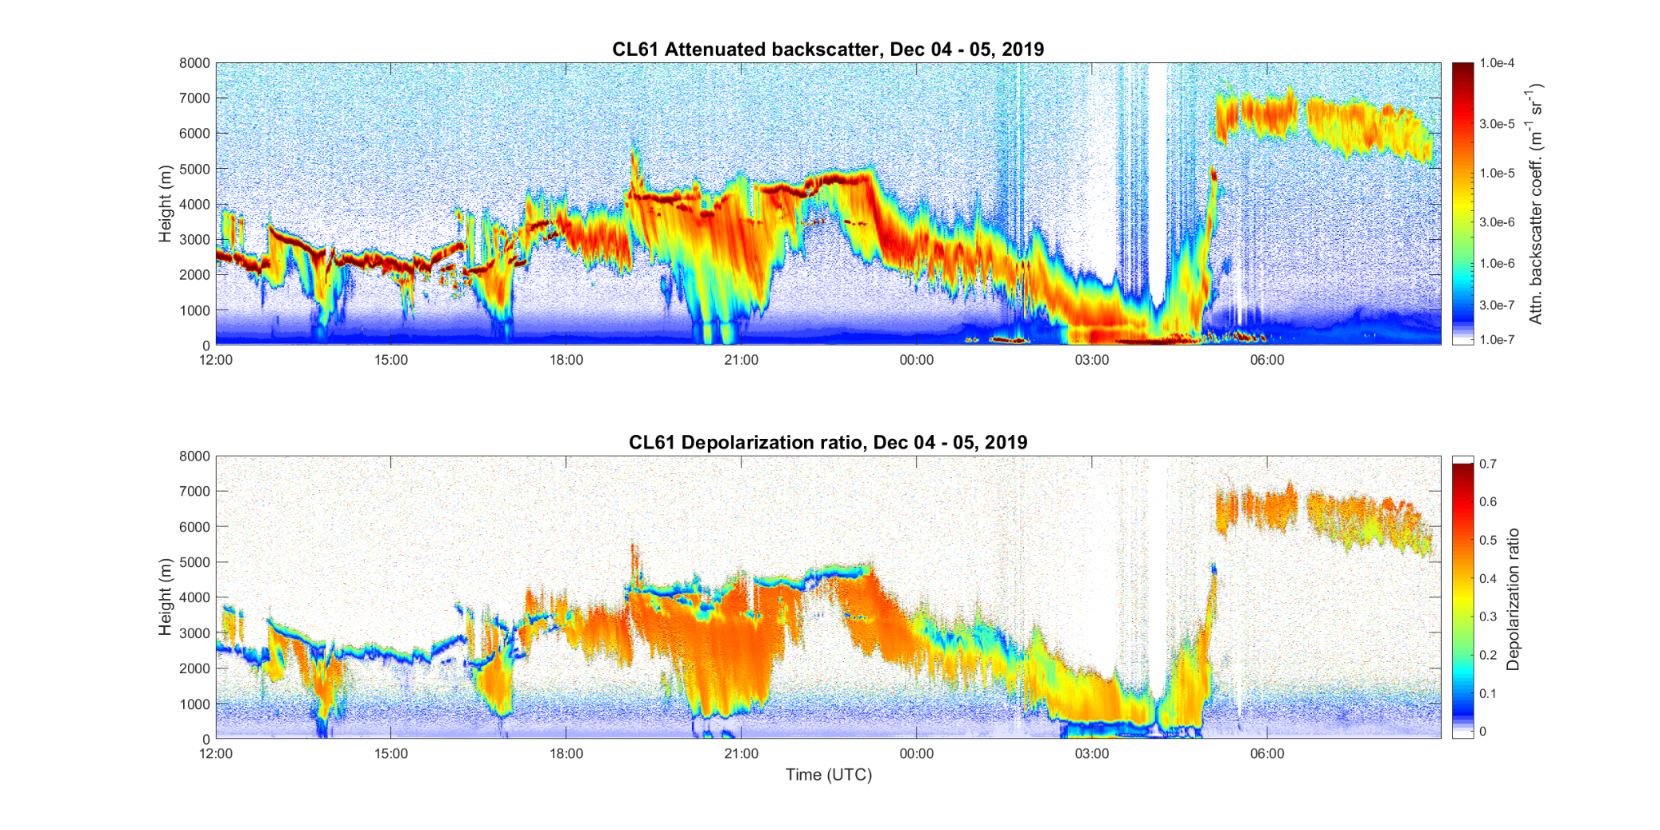
More information with depolarization measurement
Ice crystals
Supercooled
liquid cloud
Rain
Melting layer
Solid precipitation
Notes:
With this data example I want to give you an overview of the capabilities of the instrument. On the top panel, you see 21 hours of attenuated backscatter data from our ceilometer and on lower panel you see linear depolarization ratio during the same time period. The height range in these images are up to 8km but the device can measure up to 15km. From these images it is easy to verify different phenomena in the atmosphere, such as supercooled liquid layers, solid precipitation, rain, melting layer inside the precipitation and ice crystals.
Further conclusions can be done for example about the freezing conditions. During next slides I will show a few case examples demonstrating the CL61 capabilities.

Slide 4
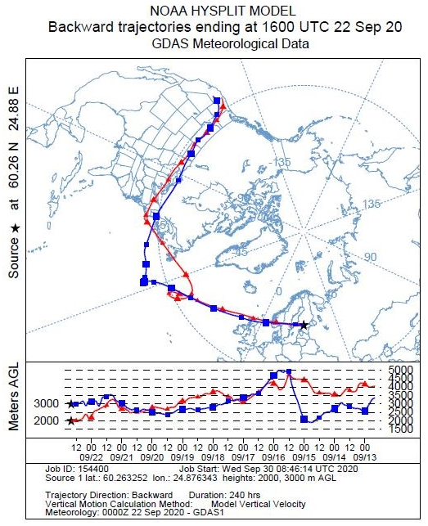

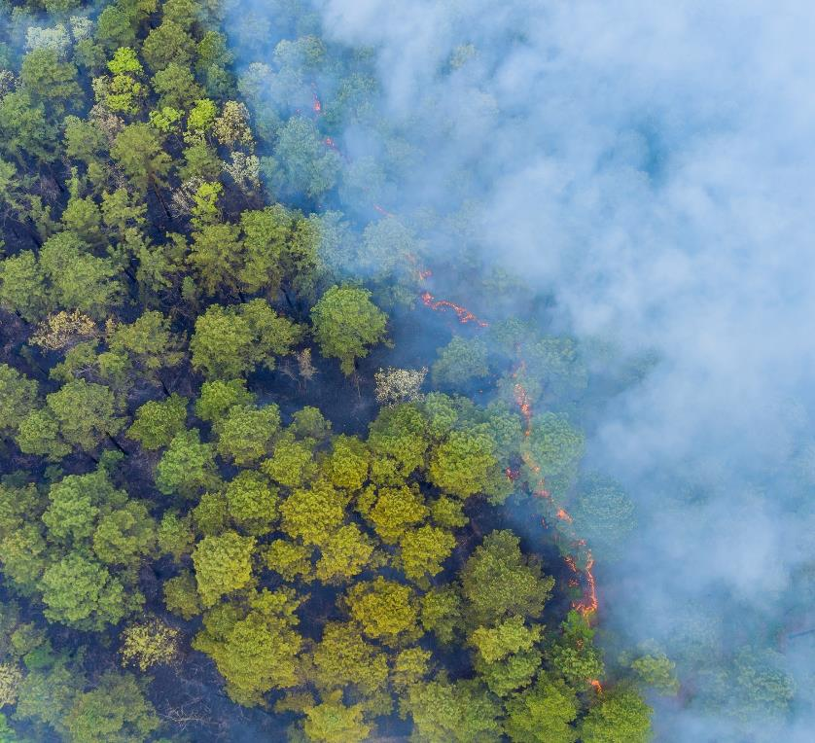
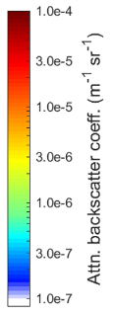
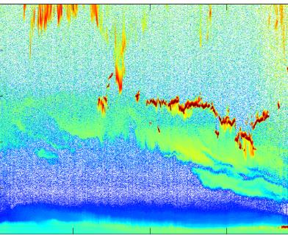
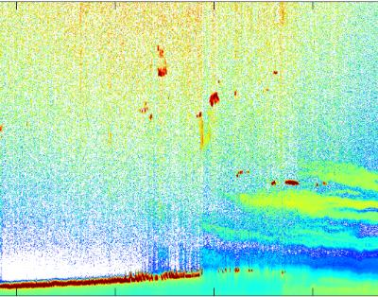

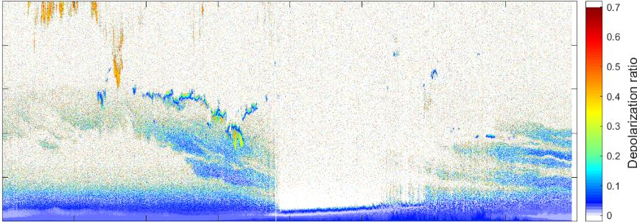
Smoke layers from California, US
CL61 attenuated backscatter
Smoke
CL61 depol ratio
Notes:
In this slide I will show an data example of the wildfire smoke transported to Finland. During this day elevated aerosol layers were detected between 1000 and 6000 meters and can be distinguished both at attenuated backscatter and depolarization ratio plots. By further analysis, it was seen aerosols were originated from California forest fires and traveled across the Atlantic Ocean all the way to Finland. In addition, these measured values compare well with the depolarization ratio values from forest fire smoke reported in literature.

Slide 5
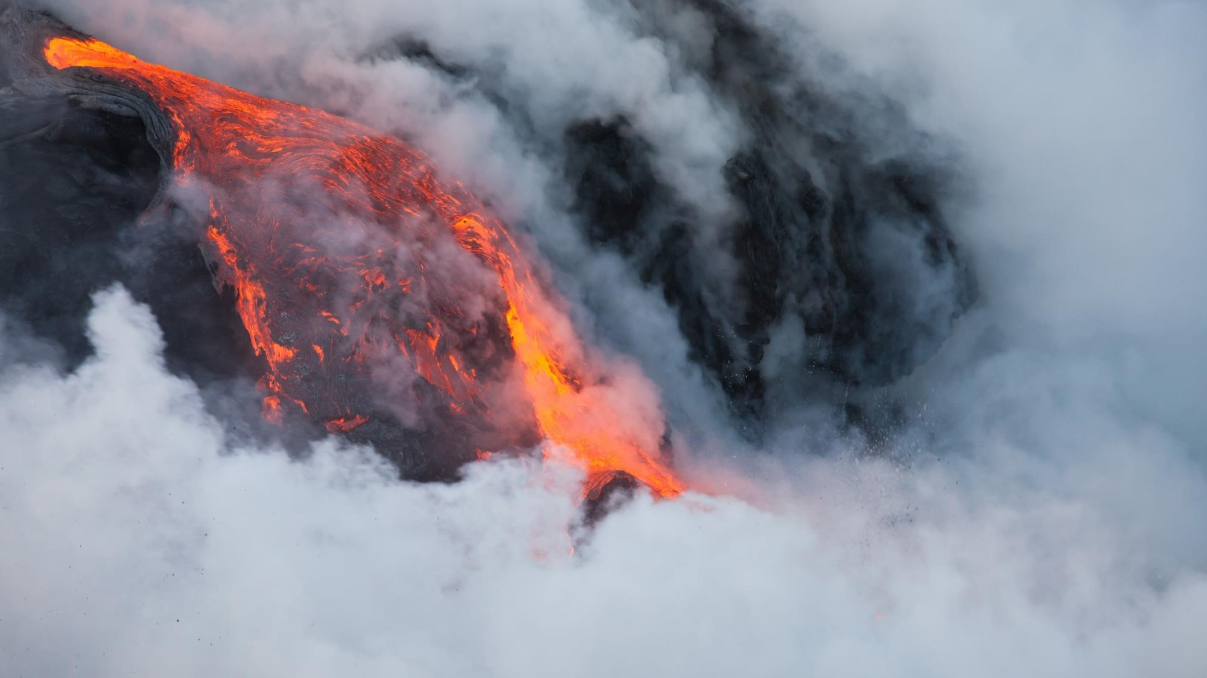
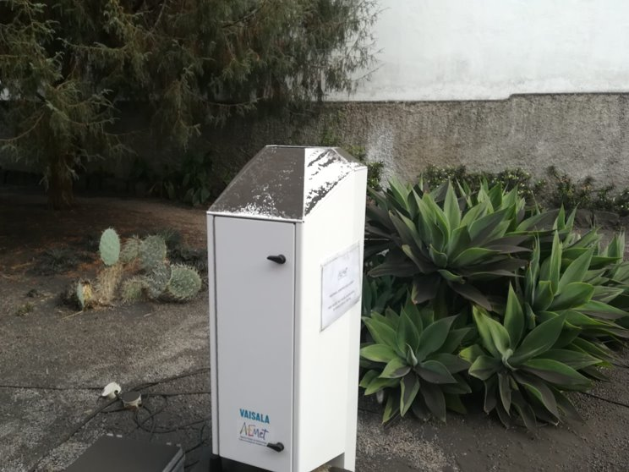
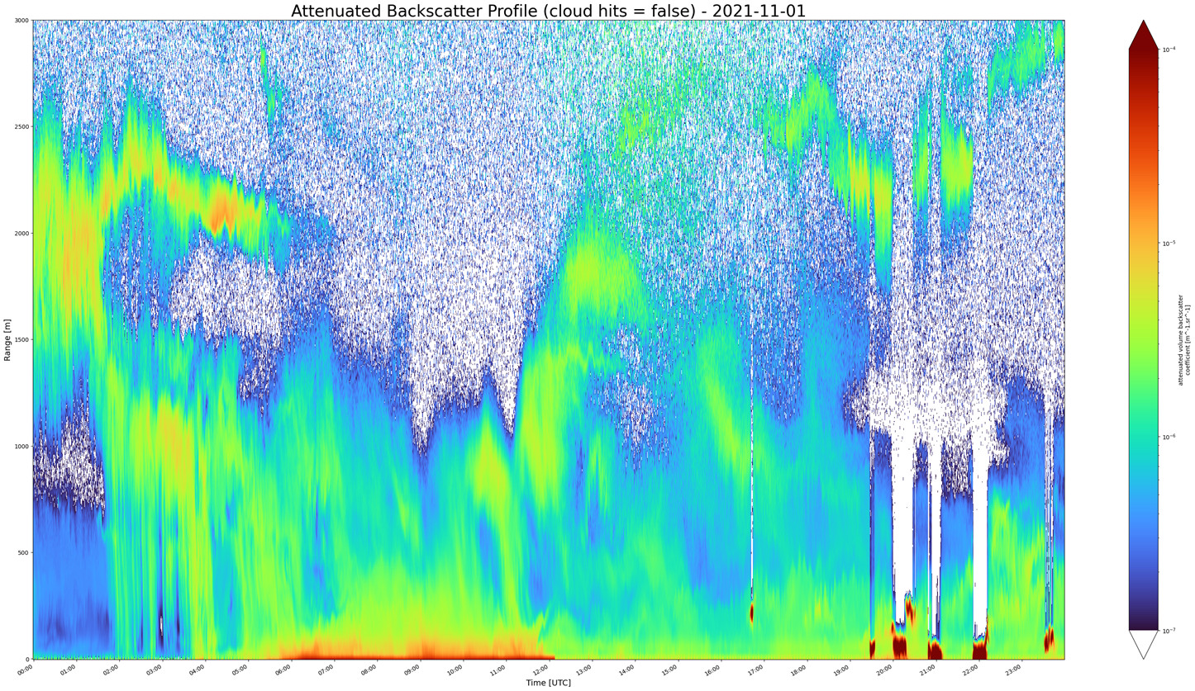
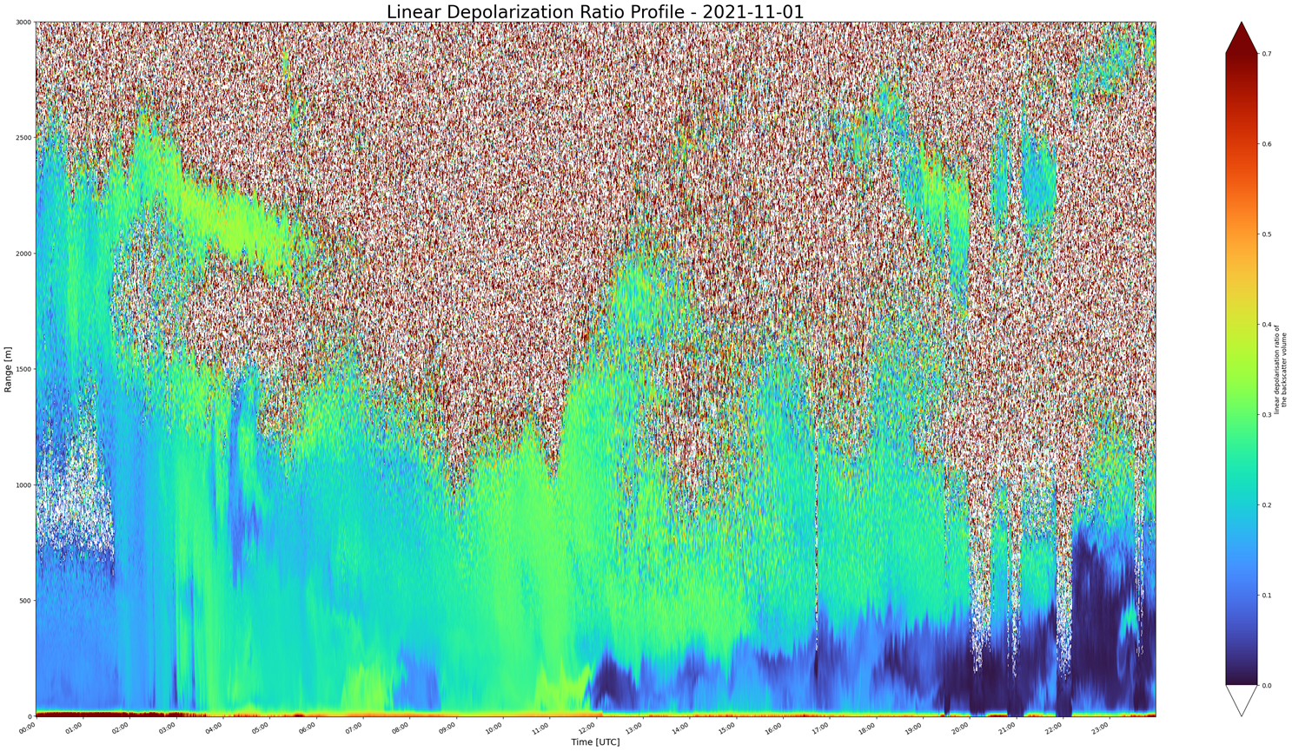

Example – Volcanic Ash from
Cumbre Vieja, La Palma
Ash rain
Range (m)
Attenuated backscatter profile 2021-10-31
Range (m)
Depolarization profile 2021-10-31
3000
3000
0.7
2500
2500
0.6
2000
2000
0.5
0.4
1500
1500
0.3
1000
1000
0.2
500
500
0.1
0
0
0
00:00 06:00 12:00 18:00 24:00
Time - UTC
00:00 06:00 12:00 18:00 24:00
Time - UTC
Notes:
Volcanic eruption was measured in La Palma, Spain in the end of 2021. In this slide, I have CL61 data over one day measured north from volcano Cumbre Vieja. On the left hand side, the attenuated backscatter could be interpreted as precipitation and at the same time linear depolarization ratio show values between 0.3 to 0.4. It is evident from these measurements that something is coming down from the sky – and considering the situation, and the levels of attenuated backscatter and linear depolarization – the most probable option is falling ash.
It was also evident from the photographs of the instrument itself that ash had been falling, as the CL61 unit was covered with ash.

Slide 6
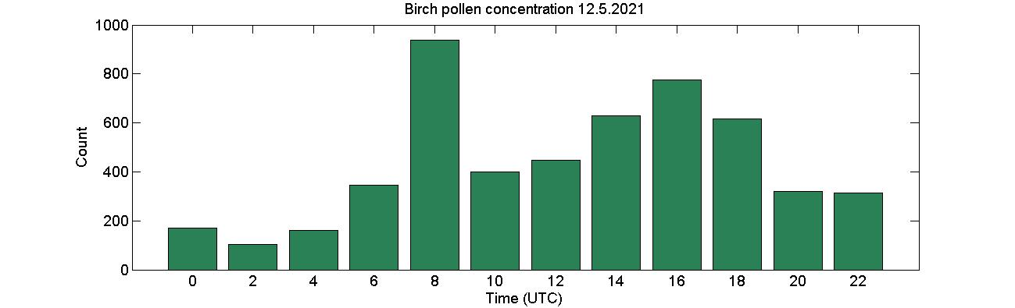
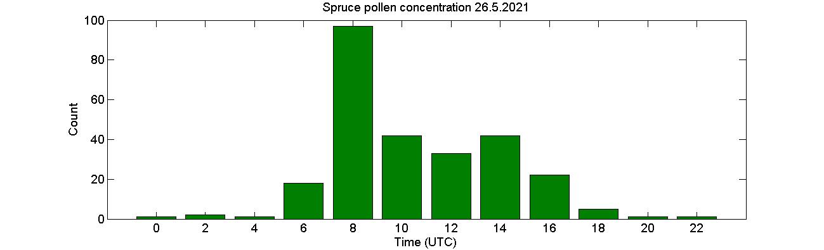
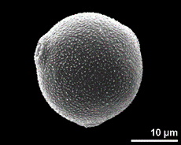
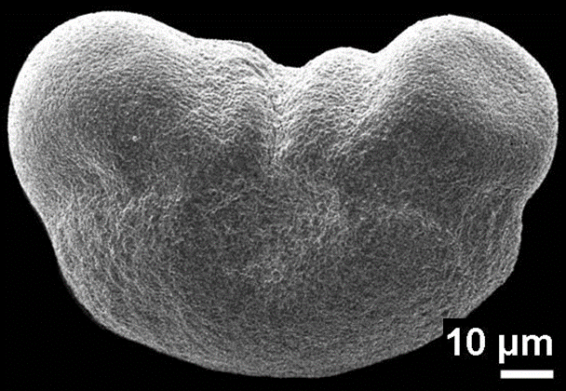
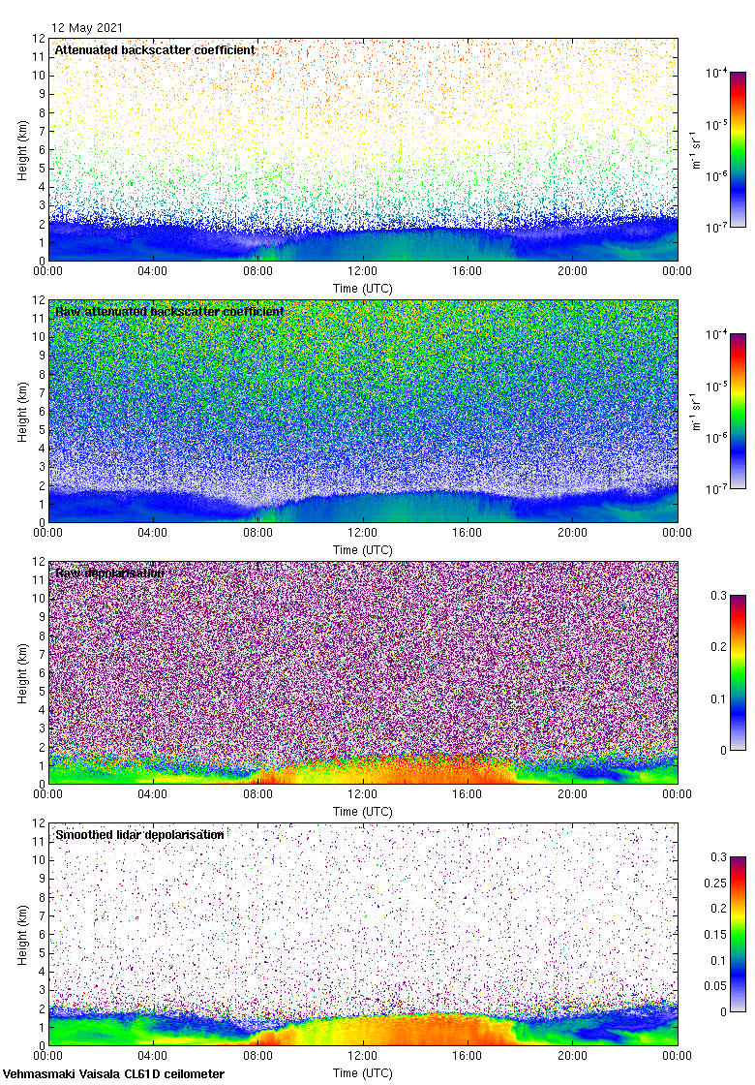
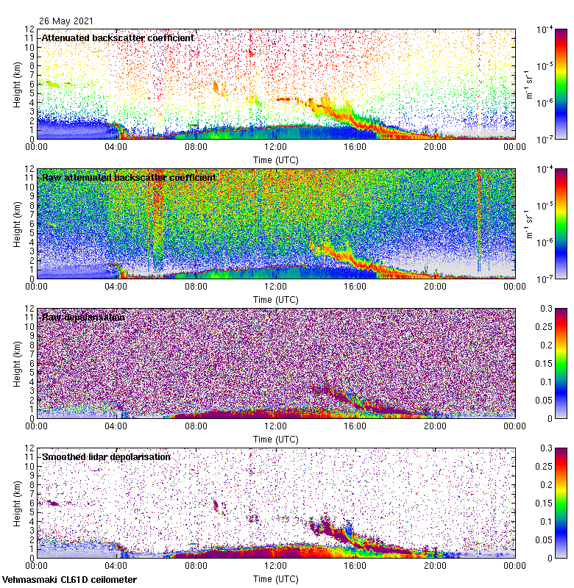

Pollen detection (birch and spruce) in Vehmasmäki, Kuopio
Different depol levels
Notes:
One more nice example from our other scientific collaborator and customer, Finnish Meteorological institute, is the potential of using CL61 in studying different pollen types. In this slide you can see on top panel birch pollen concentration measured in Eastern-Finnish site and below CL61 attenuated backscatter in the middle and linear depolarization on the bottom.
ON the right hand side, you can see another day, with spruce pollen concentration data on top and CL61 data below. These initial results are promising as different prevailing pollen types seem to result different depolarization ratio levels measured with CL61 due to the different microscopical shape of those particles.

Slide 7
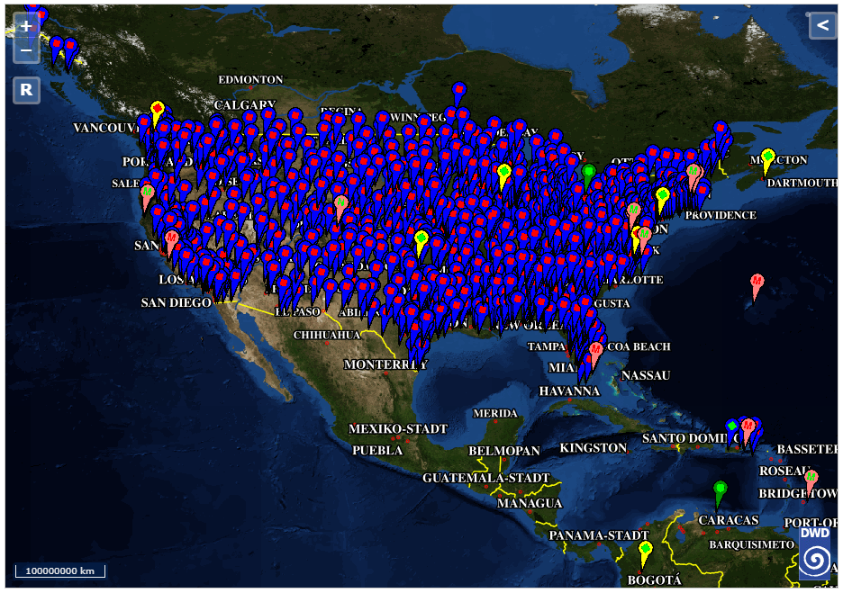
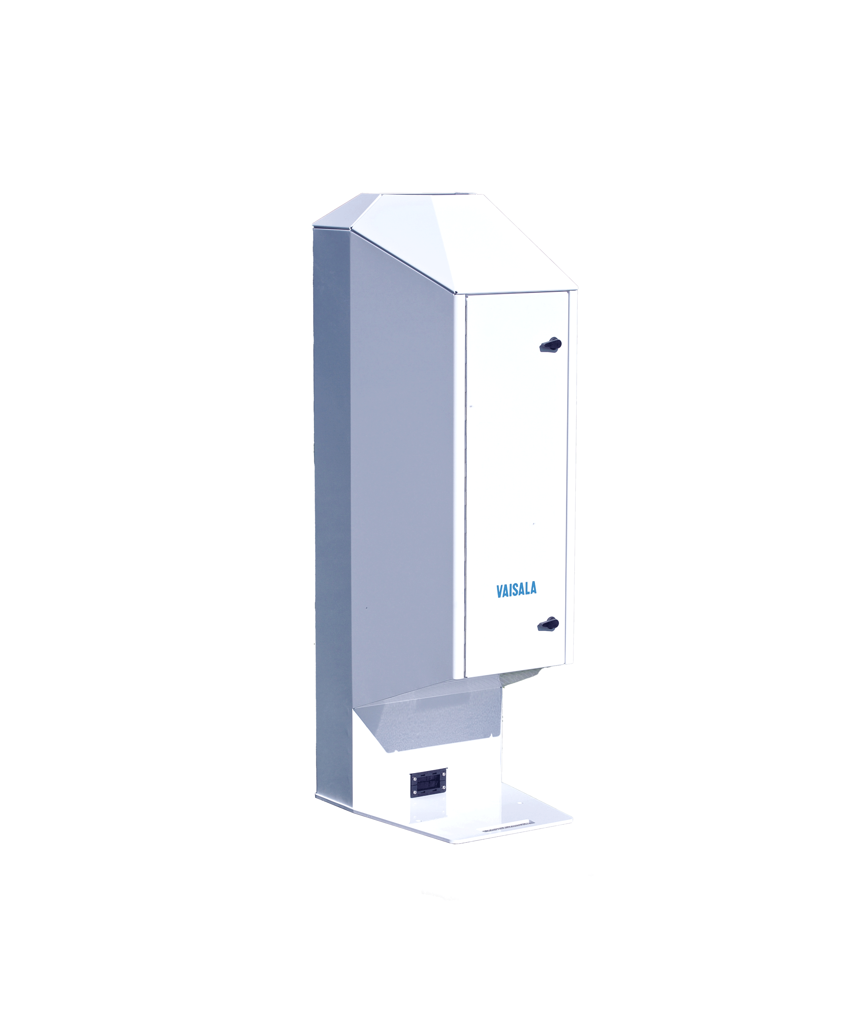
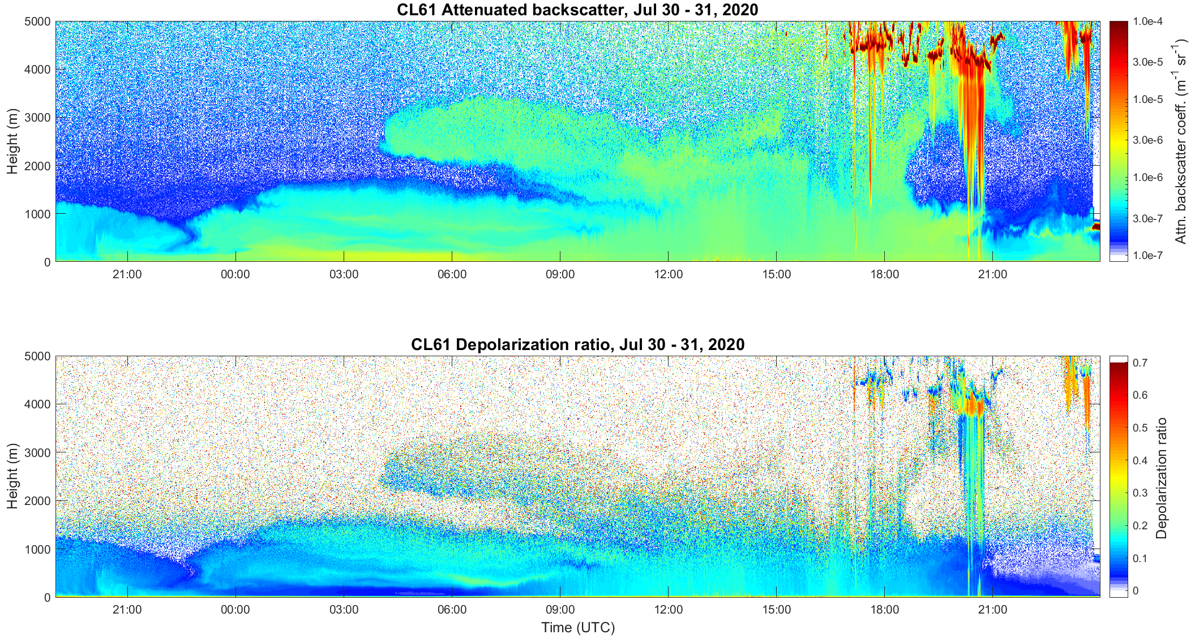
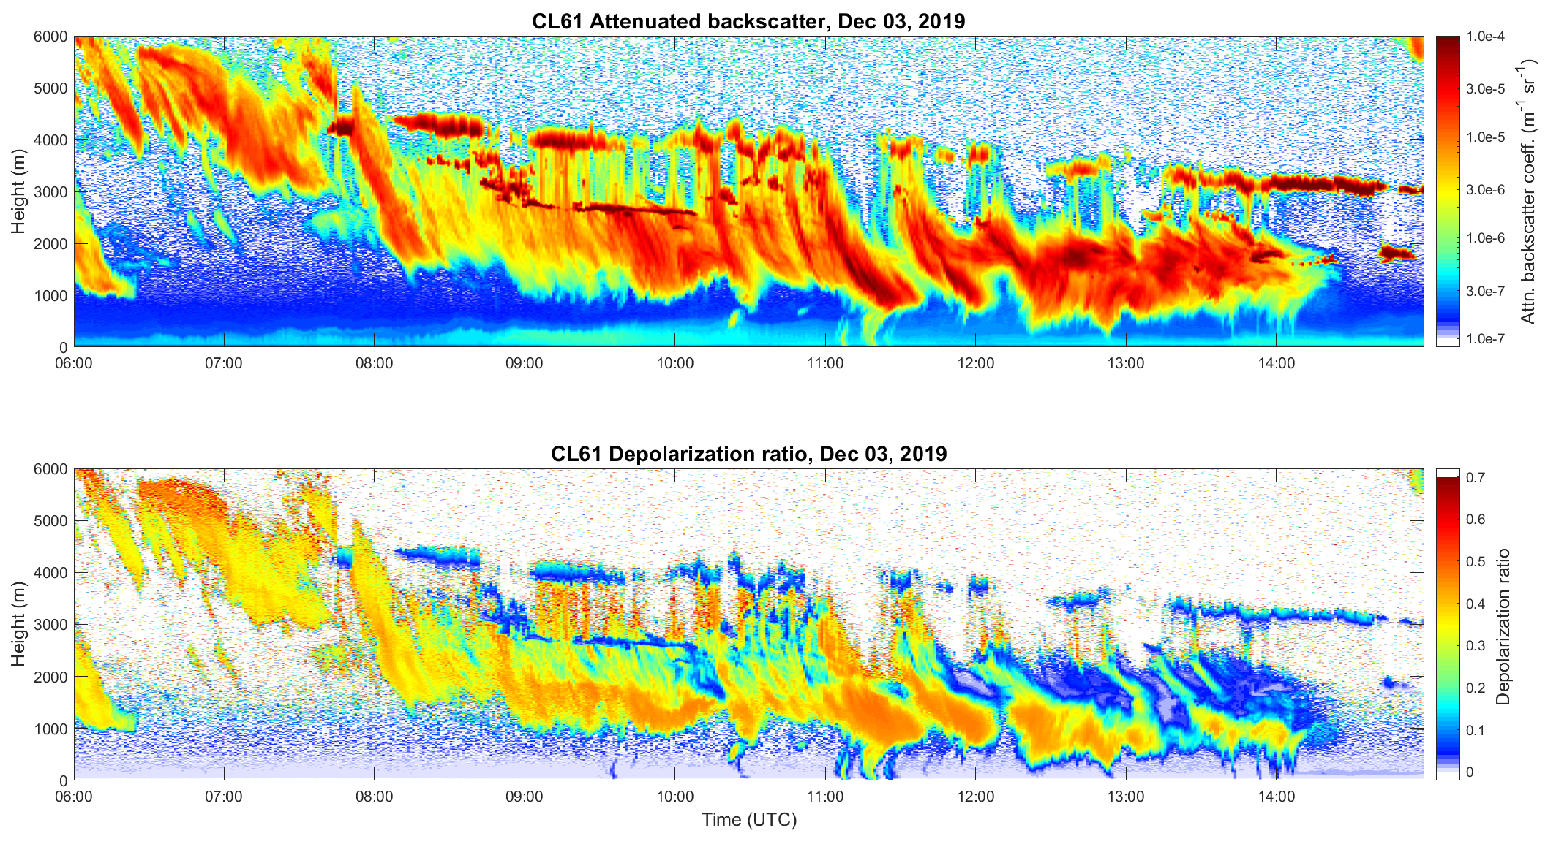
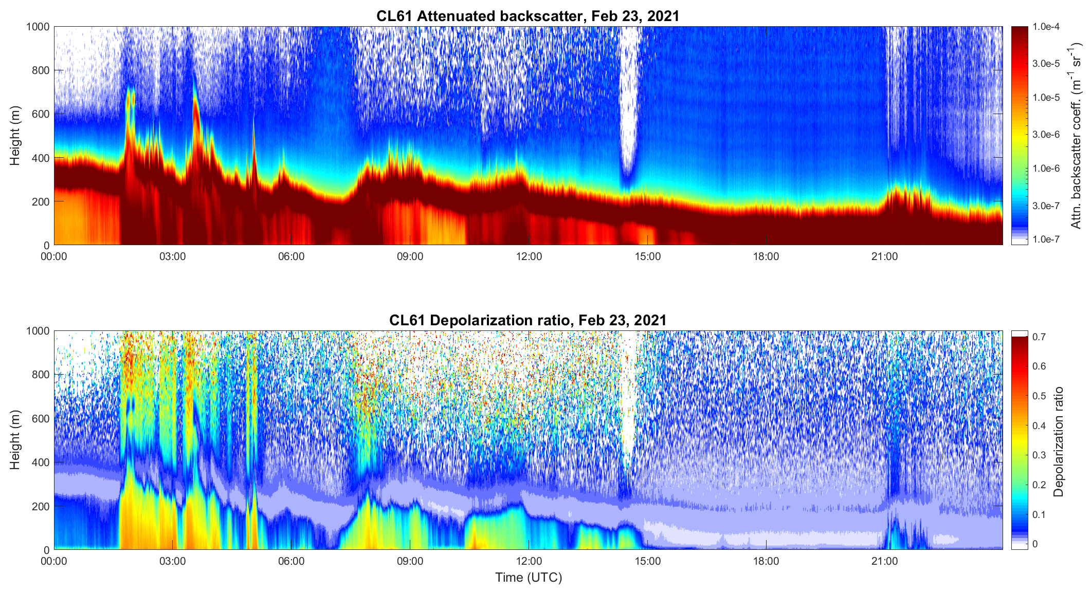
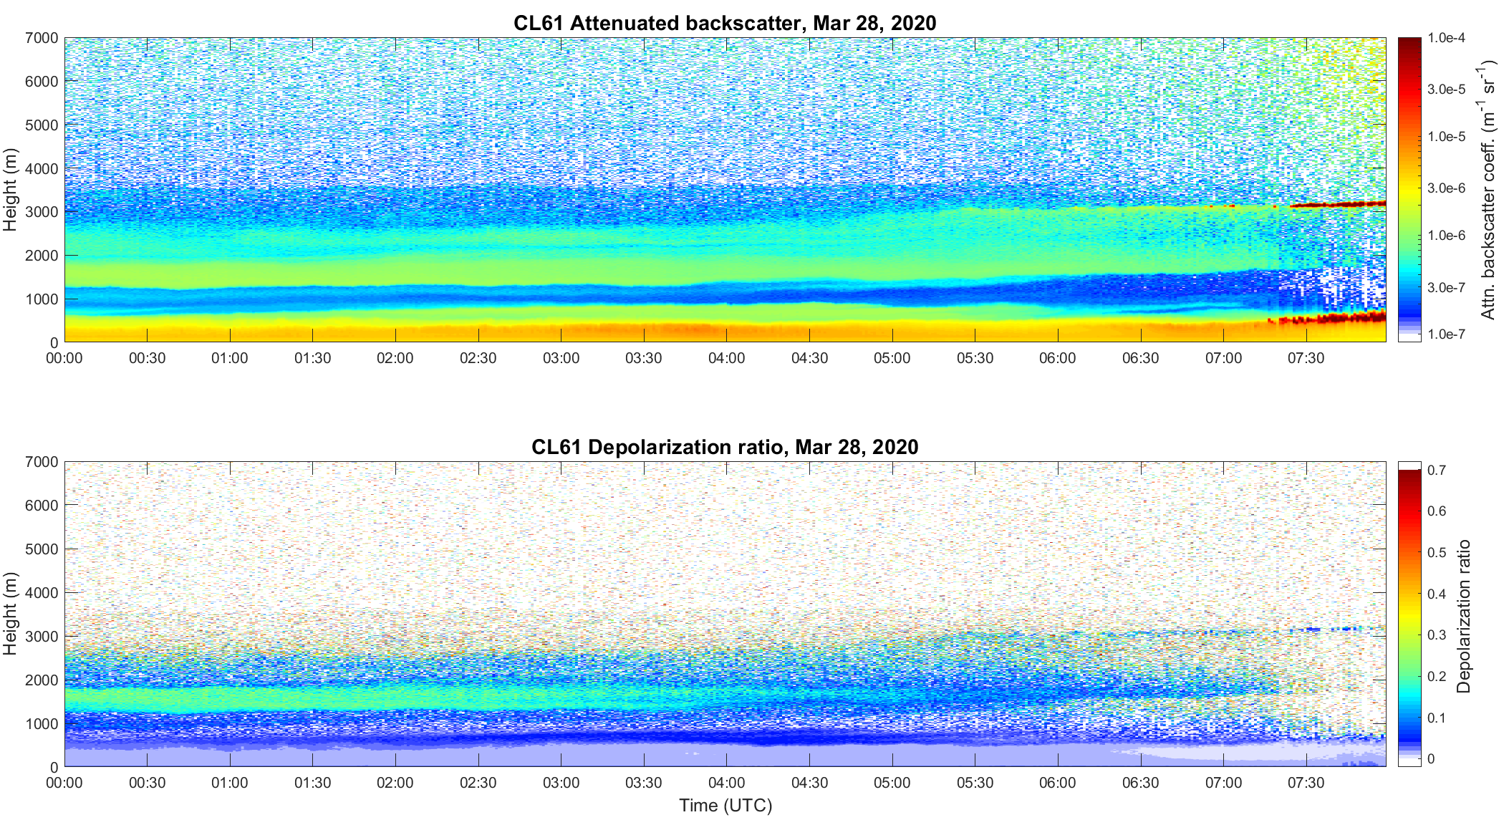

Conclusions
Ceilomap (dwd.de)
Thank you for your attention!
Questions? Contact:
minttu.tuononen@vaisala.com
MinttuTuononen
This Photo by Unknown Author is licensed under CC BY
Notes:
To conclude, we have developed new ceilometer instrument with a depolarization measurement capability. It can be used in various applications from boundary layer and aerosol studies, identifying the characteristics of clouds and precipitation, identifying potential freezing condition and monitoring elevated aerosol layers, such as Saharan dust in this example. Finally, I’d like to highlight the extended potential through installing ceilometers in networks, as highlighted with this installation base of ceilometers in Europe.
We believe that this exciting new instrument will enhance the existing Ceilometer networks and lead to improved global observation networks for weather, climate and air quality.

