Slide 1

Observation of Polar Stratospheric Clouds at Dome C, Antarctica (Poster Slide 1)
Observation of Polar Stratospheric Clouds at Dome C, Antarctica
Marcel Snels¹, Luca Di Liberto¹, Ilir Shuli¹, Francesco Colao², Andrea Scoccione³, Federico Serva⁴
¹CNR-Institute of Atmospheric Sciences and Climate, Via Fosso del Cavaliere 100, 00133 Roma (Italy)
²ENEA, Via Enrico Fermi 45, 00044 Frascati (Italy)
³Aeronautica Militare, Pratica di Mare (Italy)
⁴Agenzia Spaziale Italiana (ASI); European Space Agency (ESA) $\Phi$-lab , Roma(Italy)
03-Atmospheric Aerosol and cloud properties
June 29, 2022, 12:00
03-P26
The 30th International Laser Radar Conference (ILRC) virtual conference, June 26th – July 1st, 2022.

Slide 2
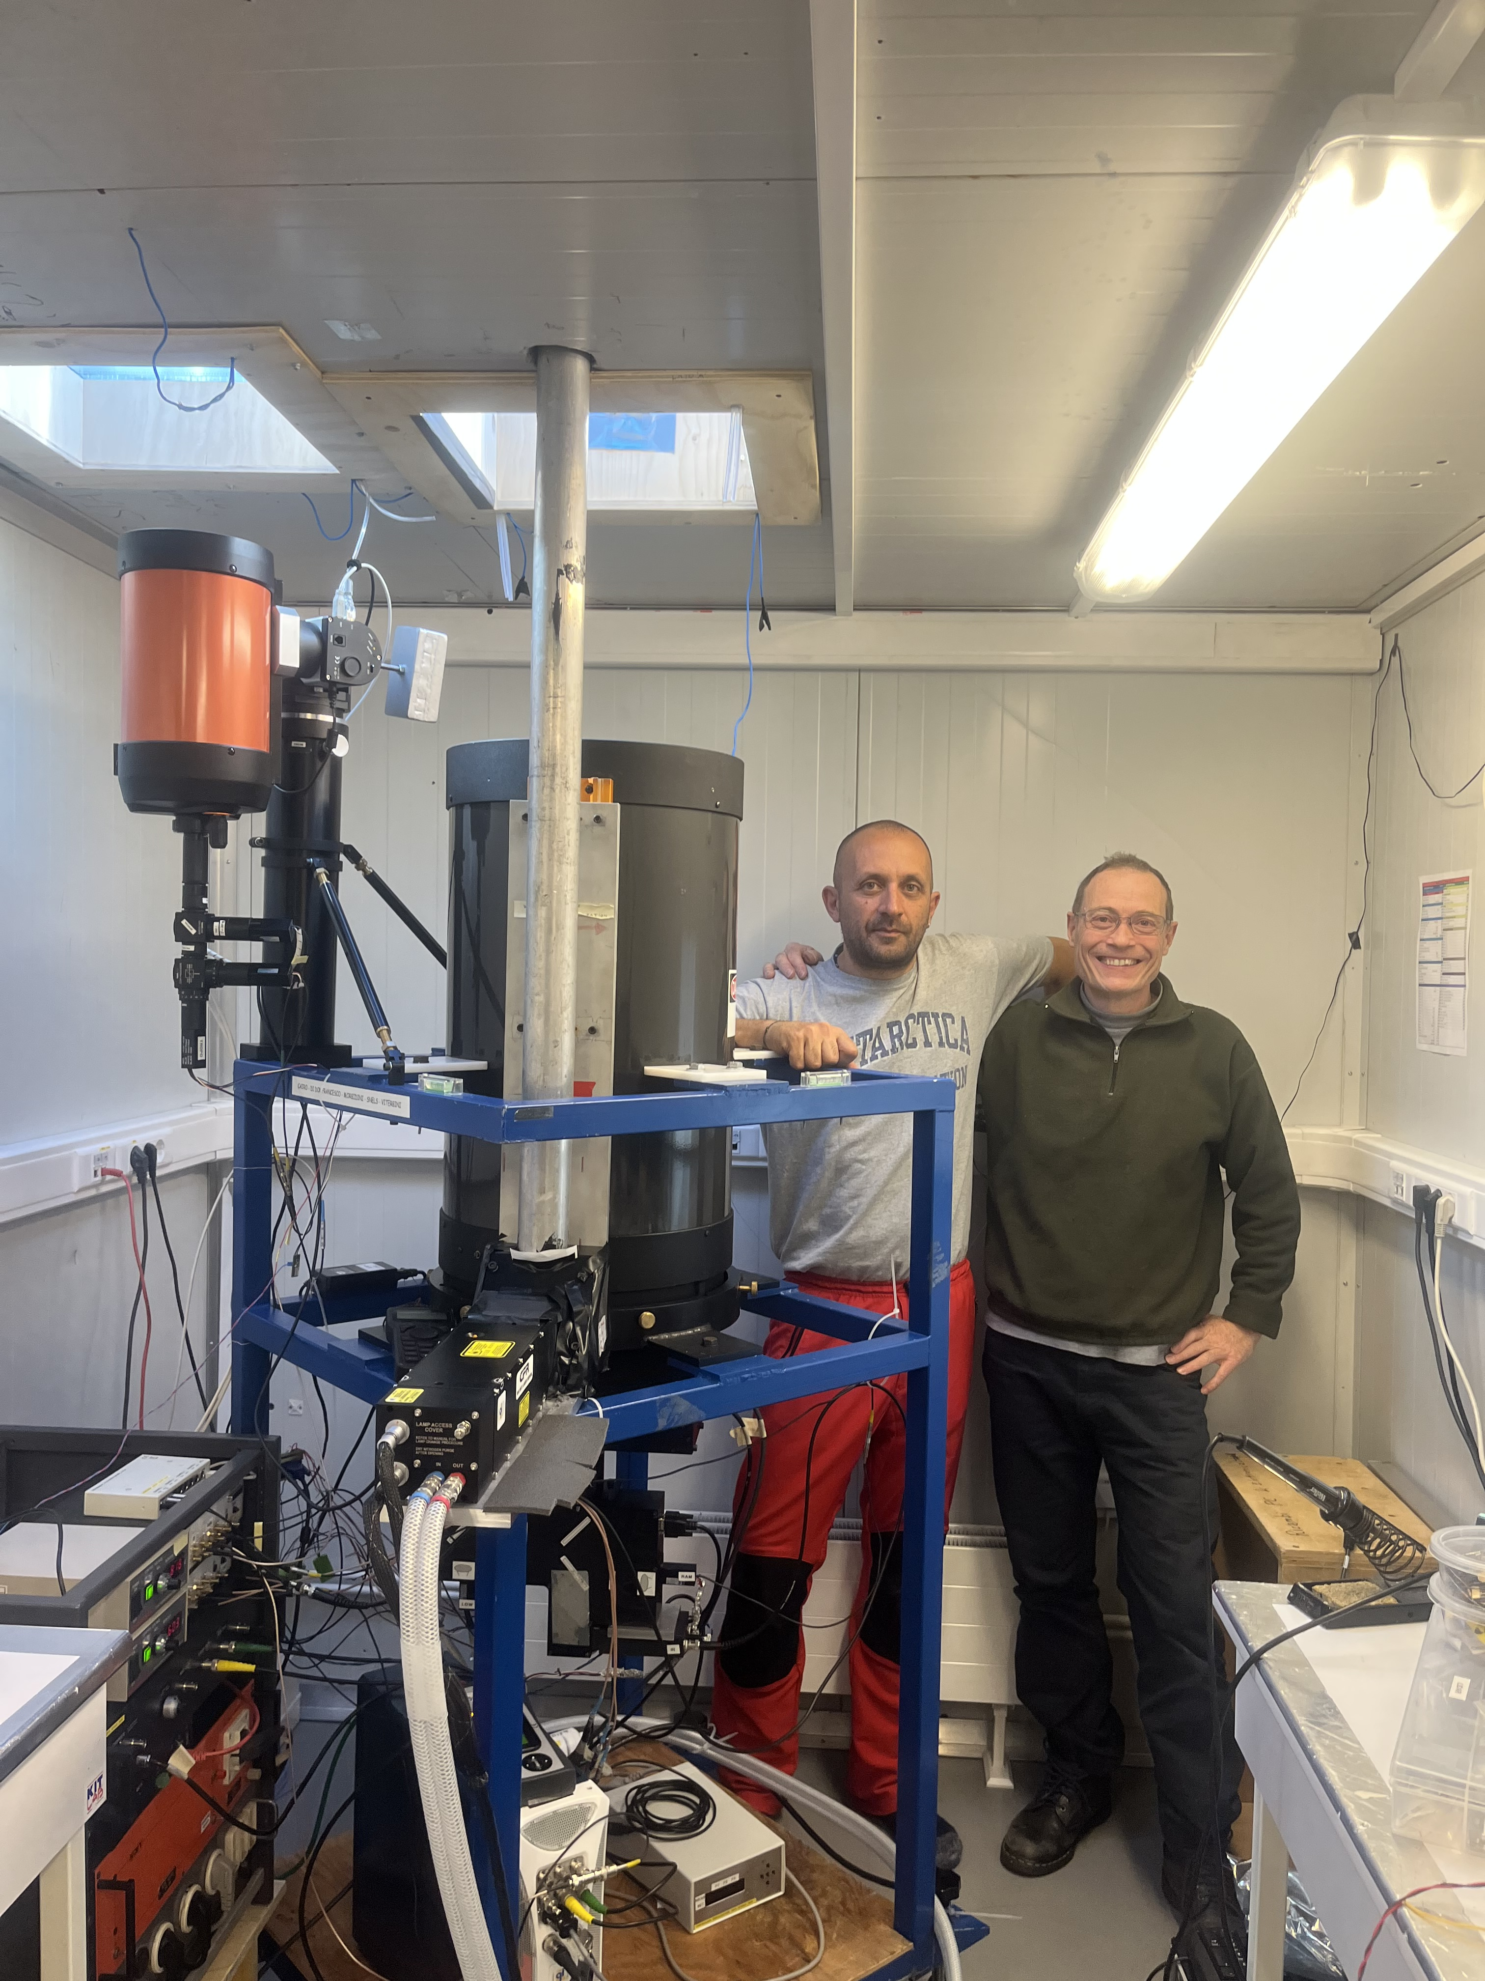
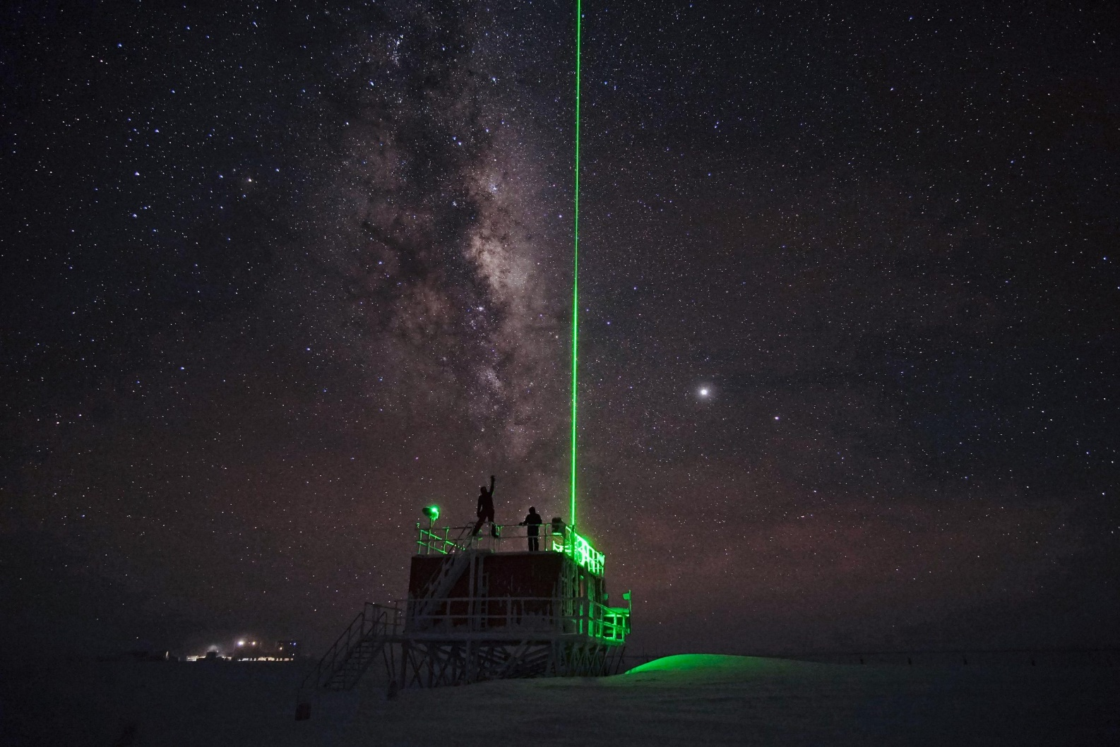
Observation of Polar Stratospheric Clouds at Dome C, Antarctica (Poster Slide 2)
2
The lidar observatory
Dome C by night
The physics
shelter
The observatory has now a tropospheric and stratospheric channel. It is fully remotely controlled, allowing to
perform alignment, tests and routine measurements from a computer console connected to Internet.
The 30th International Laser Radar Conference (ILRC) virtual conference, June 26th – July 1st, 2022.

Slide 3
Observation of Polar Stratospheric Clouds at Dome C, Antarctica (Poster Slide 3)
1
The lidar observatory at Dome C (Concordia station) is the only italian stratospheric lidar in Antarctica. It is also a primary NDACC station since 2014. Polar stratospheric clouds (PSCs) can be observed from June through September. Usually observations are made in coincidence with nearby CALIPSO overpasses. Recently Dome C has been indicated as the best available station for the observations of PSCs.
Scientific motivation:
The availability and further consolidation of multi-annual records of PSC occurrence and characteristics will be beneficial for climate studies related with long term changes in surface and stratospheric climate
tests of microphysical and chemical models by using case studies
comparison with global chemistry-climate models (CCMs)
Detailed knowledge of stratospheric cloud processes will be beneficial to further guide the development of microphysical parameterizations currently adopted in current chemistry-climate models
Continuous monitoring of upper tropospheric and stratospheric cloud occurrences helps understanding how emissions from middle and lower latitudes (such volcanoes or wildfires during austral summer) can feed back and delay the ozone layer recovery in Antarctica
In the southern hemisphere, surface circulation variability is strongly related with upper atmospheric dynamics
Comparison with satellite borne lidars (CALIOP) contributes to calibration and integration of PSC dta obtained from ground-based and satellite-borne lidars
The 30th International Laser Radar Conference (ILRC) virtual conference, June 26th – July 1st, 2022.

Slide 4
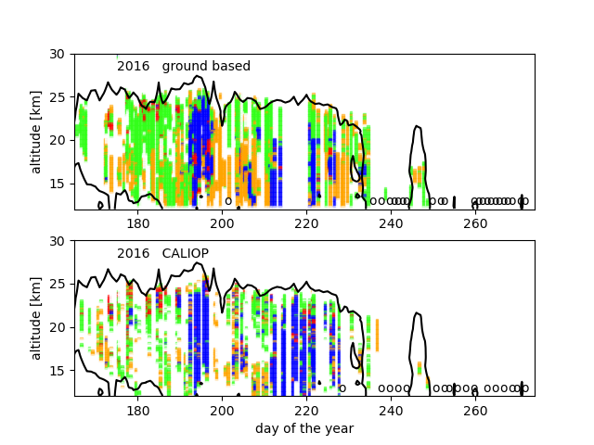
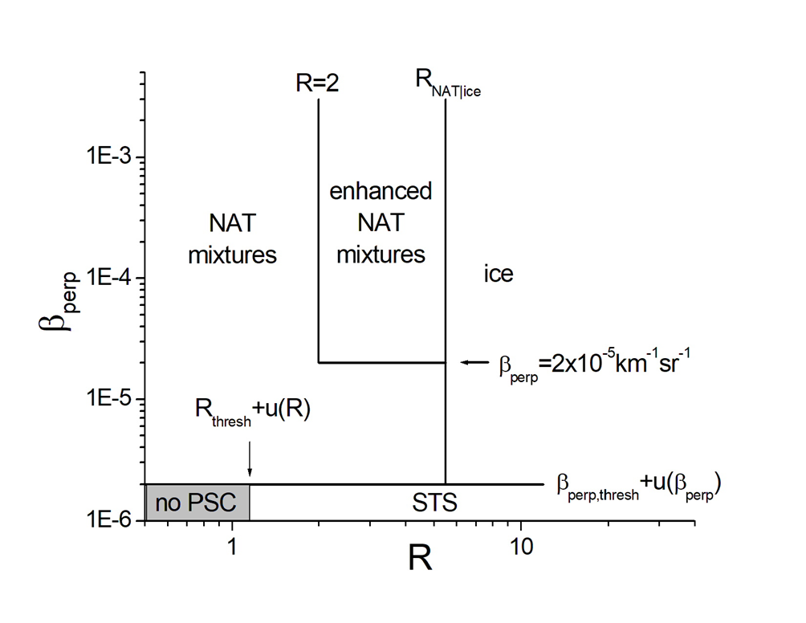
Observation of Polar Stratospheric Clouds at Dome C, Antarctica (Poster Slide 4)
2
2016
Classification of PSCs
PSCs observed above Concordia station
Blue = ice
Orange= STS (liquid PSCs)
Green = NAT
Red= enhanced NAT
Black contour= formation temperature of NAT
PSCs are classified from the observed optical parameters:
Total back scatter ratio and perpendicular backscatter coefficient,
by using an algorithm similar to that used for CALIOP data
The 30th International Laser Radar Conference (ILRC) virtual conference, June 26th – July 1st, 2022.

Slide 5
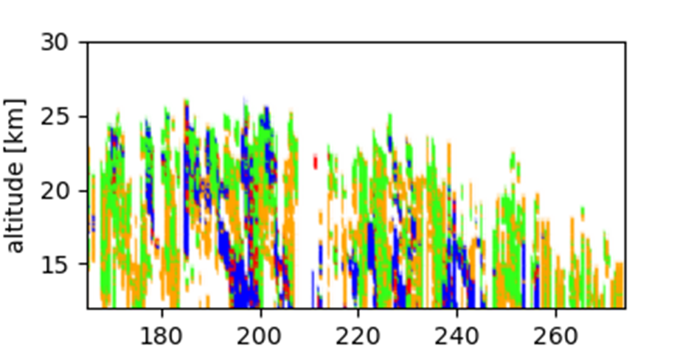
Observation of Polar Stratospheric Clouds at Dome C, Antarctica (Poster Slide 5)
2
Recent results
2021
The polar vortex in 2021 was very cold and PSCs have
been observed until the end of September
The 30th International Laser Radar Conference (ILRC) virtual conference, June 26th – July 1st, 2022.

Slide 6
Observation of Polar Stratospheric Clouds at Dome C, Antarctica (Poster Slide 6)
2
Outlook
We are currently elaborating the CALIOP data of the last few years, both for climate studies and comparison with ground based data.
Since may 2022 we are operating the tropospheric channel routinely, and contribute
to the YOPP-SH observational campaign, with the goal to get a better understanding
of precipitation in Antarctica
The 30th International Laser Radar Conference (ILRC) virtual conference, June 26th – July 1st, 2022.

