Slide 1
Impact of Meteorological Uncertainties in the Methane Retrieval Ground Segment of the Merlin Lidar Mission
Vincent Cassé¹, Olivier Chomette¹, Cyril Crevoisier¹, Fabien Gibert¹, Frédéric Nahan²
1 Laboratoire de Météorologie Dynamique (LMD/IPSL), École polytechnique, Institut polytechnique de Paris, Sorbonne Université, École normale supérieure, PSL Research University, CNRS, École des Ponts, 91128 Palaiseau, France
2 Magellium Paris, 92400 Courbevoie, France
Merlin (MEthane Remote sensing LIdar missioN)
  a Franco-German space mission
  designed to to provide weighted columns of atmospheric methane by IPDA lidar signal processing
  using in the ground segment a priori information on the state of the atmosphere
Errors and uncertainties in the meteorological parameters contribute to the error budget of the retrieved methane column.
We evaluate them with the Lidsim lidar simulator and Prolid inversion processor developed for Merlin
  errors and uncertainties of the data produced by the weather forecasting models, estimated from ECMWF (European Centre for Medium-Range Weather Forecasts) ensemble forecast data
    →a bias of 0.4 ppb and a standard deviation of 0.6 ppb
      linked with the uncertainties in the surface pressure and in the total amount of water
    improvement over previous studies due to advances in numerical weather prediction
  errors and uncertainties due to space-time interpolations under the satellite track
    vertical interpolation errors, estimated by using state-of-the-art methods for vertical extrapolation under topography
    → an additional random error of 0.1 ppb
    time interpolation error: 3-hour temporal interpolation of tidal waves
    → bias up to 2 ppb (which is a major problem for models trying to identify methane sinks and sources)

Slide 2
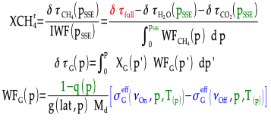
Integrated Path Differential Absorption (IPDA) lidar
A IPDA lidar emits and receives two frequencies, one absorbed by methane (νOn) and the other not (νOff)
In Merlin's ground segment, the optical thickness difference between the two frequencies (δτfull) is determined from signal intensity measurements and the distance from the satellite to the target is converted to altitude and then to pressure (PSSE) from the propagation time record.
The meteorological data are then used to estimate the differences in optical thickness due to methane (δτCH4) and other gases (δτH2O, δτCO2).
XG(p) the mole fraction profile with respect to dry air
g(lat,p) the gravity at the target location (determined by its latitude and pressure)
Md the molar mass of dry air
T(p) the temperature profile
q(p) the specific humidity profile
σG^{eff}(ν0,p,T) an average (over the spectral distribution of the laser emission around wavenumber ν0)of the absorption cross sections

Slide 3
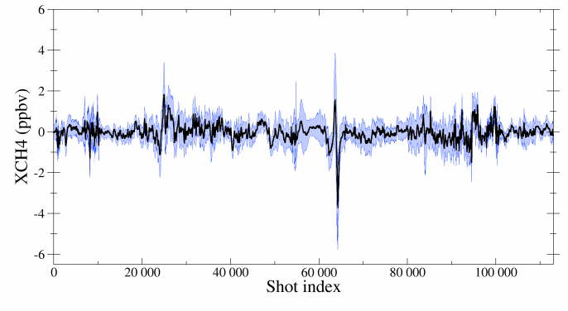
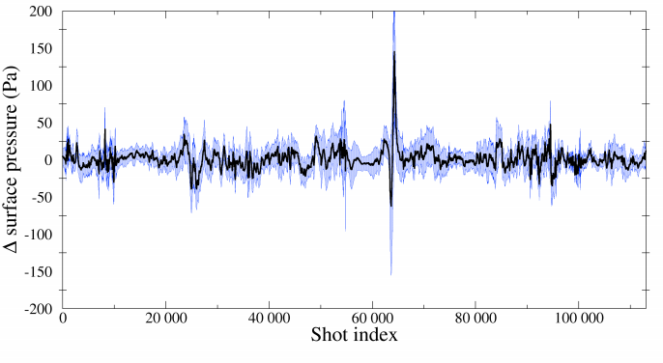
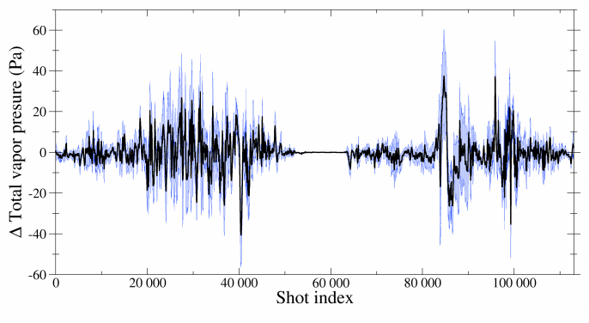
Meteorological errors from numerical weather prediction models
We simulate Merlin data with a reference atmospheric state provided by the ECMWF and then inverted these data using fifty different atmospheric states representative of the estimated dispersion between the true and reference states.
On one orbit, we observe a bias (-0.03±0.39 ppb) and a standard deviation (0.58±0.27 ppb) for the retrieved methane.
A correlation computation shows that 50% of the dispersion on methane is explained by that on surface pressure and 25% by that on integrated humidity.
(a) Methane retrieval results for a simulated orbit without instrumental noise, to be compared with the deviations (b) on the surface pressure and (c) on the total amount of water vapour. The shot index corresponds to the position in the orbit. Mean curve in black and area between \pm one standard deviation in blue.

Slide 4
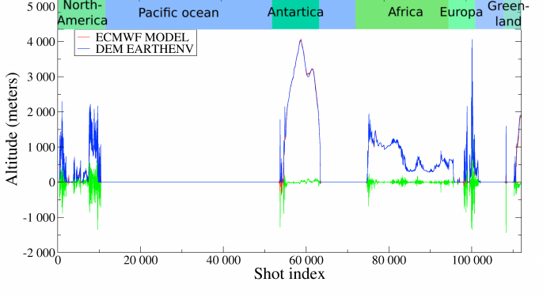
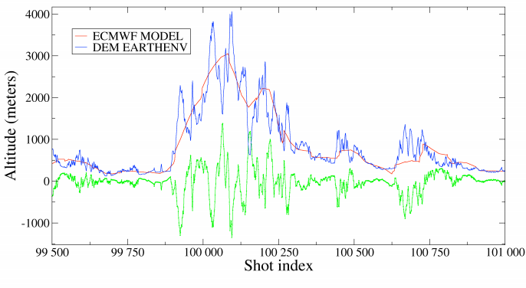
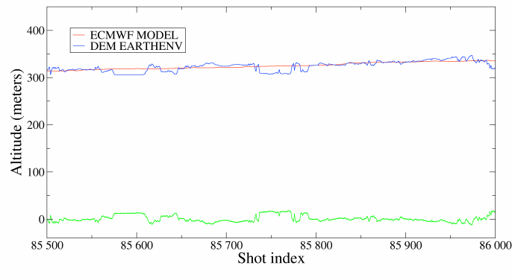
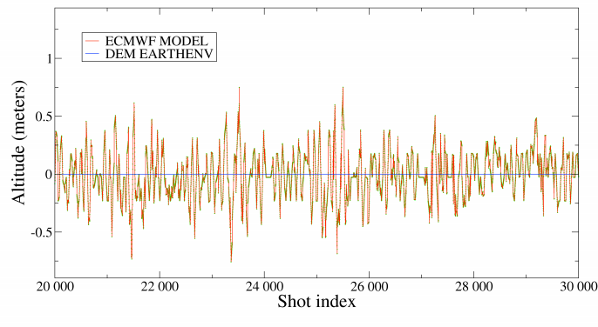
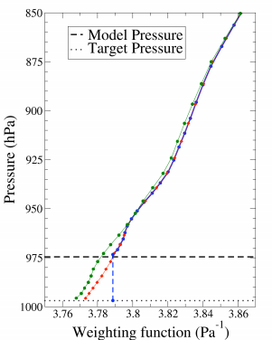
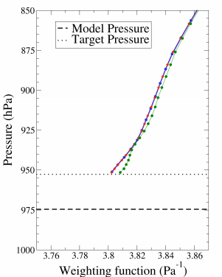
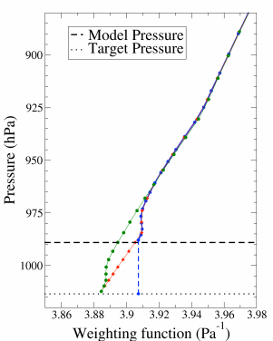
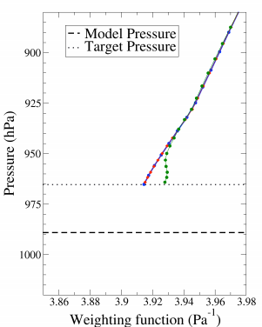
Differences between the meteorological model topography and the Digital Elevation Mode
The Alps region
A flat area
Over the sea
Complete orbit
More than 1km
Less than 20m
Meteorological model topography in red and the numerical elevation model used in blue. The difference are in green.
The differences are not zero because of the Gibbs phenomenon affecting the model topography, but they are less than 1m.
These differences being an estimation of the differences with the actual relief;
vertical interpolations are therefore important and frequently over several hundred metres.
Three methods of extrapolation under relief which differ in the assumptions made about the gradient of temperature and specific humidity, and, an unpublished approach developed at Météo-France named Apache which preserve a boundary layer close to the ground, both when the target topography is lower than the initial topography and in the opposite case. The figure shows for four cases the different methane weighting functions corresponding to the four vertical interpolations used.
Methane weighting functions obtained according to different extrapolations: with zero gradient in blue, standard gradient in red and Apache method in green. Two examples: the first one over Africa the second over the Alps. (a, c) with a target below the model topography, (b, d) with a target above it.

Slide 5
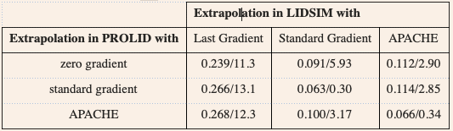
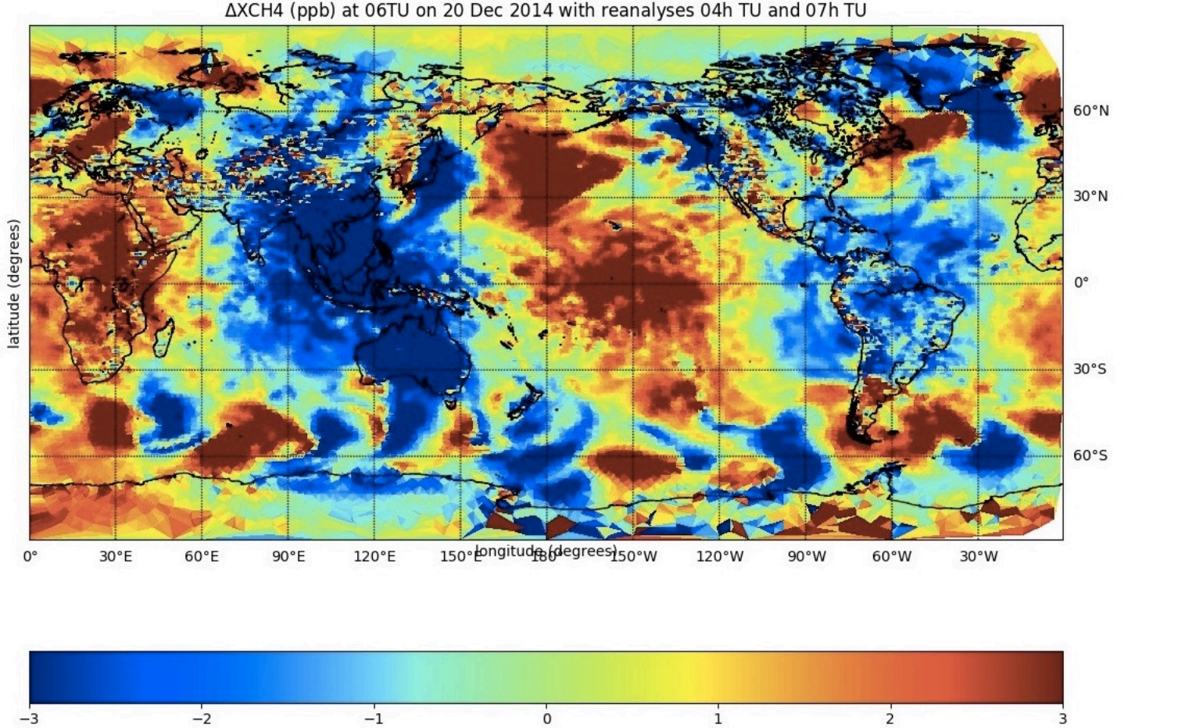
Vertical and time interpolation errors
To estimate the impact of the vertical interpolations we simulate the data using one in Lidsim and retrieve the methane in Prolid using the others. The results indicate that for the operational treatments it is appropriate to choose the method with standard gradients or Apache and that the errors to be expected are less than 3 ppb with a standard deviation of 0.1.
The standard deviation and the absolute maximum of the difference on the mole fraction of methane to dry air averaged over the atmospheric column in ppb according to the extrapolation methods used by Lidsim and by Prolid.
The mean is in all cases the same and its value of 0.08 ppb can be attributed to factors other than the meteorological data.
The simulation is for a complete orbit. It is based on meteorological data from 6 May 2019 between 3:30 UT and 5:08 UT and on realistic reflectivity data.
The 20 December 2014 at 06H UT the difference between the amount of methane obtained with the meteorological fields reanalysed at that time and that obtained with an interpolation between the meteorological fields reanalysed at 04H UT and 07H UT.
Figure, made by Edouard Martins and Jordi Chinaud and reproduced with their kind permission

Slide 6
Conclusion, acknowledgements and references
Conclusion
Improved meteorological forecasting and analysis reduces errors in obtaining the integrated methane column from the Merlin data (currently 0.4 ± 0.6 ppb)
Vertical interpolations, mainly extrapolations under the model topography, add a standard deviation contribution of the order of 0.1 ppb outside the flat areas.
But the main remaining problem is the signature of atmospheric tidal waves on the ground pressure which is insufficiently described by a linear interpolation over three hours.
References
Bousquet, P.; Pierangelo, C.; Bacour, C.; Marshall, J.; Peylin, P.; Ayar, P.V.; Ehret, G.; Bréon, F.M.; Chevallier, F.; Crevoisier, C.; et al.: Error Budget of the MEthane Remote LIdar missioN and Its Impact on the Uncertainties of the Global Methane Budget. JGR Atmos. 123, 766–785 (2018) https://doi.org/10.1029/2018JD028907
Cassé, V.; Chomette, O.; Crevoisier, C.; Gibert, F.; Brožková, R.; El Khatib, R.; Nahan, F.: Impact of Meteorological Uncertainties in the Methane Retrieval Ground Segment of the MERLIN Lidar Mission. Atmosphere 13, 431 (2022)
https://doi.org/10.3390/atmos13030431
Nikolov, S.; Wührer, C.; Kühl, C.; Bode, M.; Hupfer, W.; Lucarelli, S.: MERLIN: Design of an IPDA LIDAR instrument. CEAS Space J. 11, 437--457 (2019)
https://doi.org/10.1007/s12567-019-00267-7
Cassé, V.; Armante, R.; Bousquet, P.; Chomette, O.; Crevoisier, C.; Delahaye, T.; Edouart, D.; Gibert, F.; Millet, B.; Nahan, F.; Pierangelo, C.: Development and Validation of an End-to-End Simulator and Gas Concentration Retrieval Processor Applied to the MERLIN Lidar Mission. Remote Sens. 13, 2679 (2021)
https://doi.org/10.3390/rs13142679
Li, Z.; Chen, W.; Jiang, W.; Deng, L.; Yang, R.: The Magnitude of Diurnal/Semidiurnal Atmospheric Tides (S1/S2) and Their Impacts on the Continuous GPS Coordinate Time Series. Remote Sens. 10, 1125. (2018) https://doi.org/10.3390/rs10071125
Acknowledgements
The authors acknowledge the financial, moral and technical support of Cnes.
They thank Radmila Brožková and Ryad El Khatib for developing and providing the Apache interpolation.
They are grateful to Edouard Martins and Jordi Chinaux for allowing them to reproduce the figure showing the impact of the atmospheric tides.
The authors also wish to thank the entire Merlin bilateral project team at Cnes, DLR, Airbus DS and the various laboratories involved in the project.

