Slide 1

Aerosol profiling by ground-based, airborne and spaceborne lidar systems: working principles, highlights, and perspectives
Dr. Lucia Mona
CNR-IMAA
Italy

Slide 2
OUTLINE
Aerosols: what is and why is relevant
Profiling needs
Aerosol lidar techniques
Example of aerosol lidar measurements
Products
Current lidar observations
What next?

Slide 3
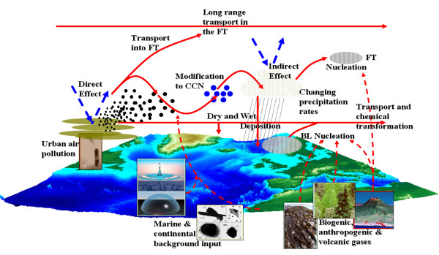
Aerosol and its impacts
Aerosol: is a suspension of fine solid particles or liquid droplets in air (Wikipedia)
Highly variable in space time and composition
Health
Some types related to small particles and certain compositions have larger impacts
Air quality
PM10 and PM2.5 are air quality indicators.

Slide 4
Aerosol and its impacts
Climate change
Absorbing aerosols have a positive impact, while reflecting ones reduce the effects of greenhouse gases. Indirect effect still uncertain.
Precipitations
Depending on size and shape, aerosol can be more effective for occurrences of strong events

Slide 5


Measurements at the surface
Particle size distribution
Brown/black carbon
Organic matter
OC/EC
Chloride
Nitrate
Sulfate
PM_{2,5}
PM₁₀
PM₁
Ammonium
VOC

Slide 6
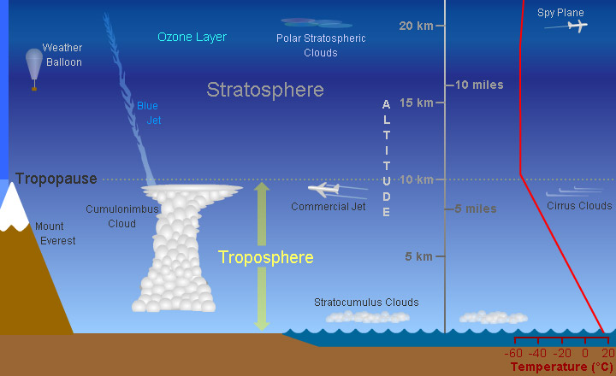
Profiling: why important?
From surface to UTLS different interactions, effects and impacts
Buondary Layer

Slide 7
Profiling: why important?
Aerosol
Strong impact on radiation budget for UTLS layers
Impact on aviation
Long range transport in the Free troposphere
Impact on radiation budget for lofted layers
Formation of clouds and precipitations in the Free troposphere
air quality & health in the PBL
impacts on agriculture and environment at the surface

Slide 8
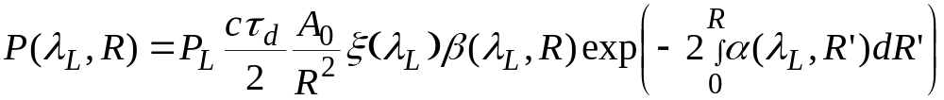
Aerosol lidar: basic equations
Elastic Lidar
Signal collected at the laser wavelength
2 unknows to be solved assumption needed about α/β
which means assumption on type of particle
Example of only-elastic lidars: ceilometers, CALIOP
PRO:
less expansive
same capability day and night
CONS:
Strong assumption needed
Highly sensitive to calibration procedure

Slide 9
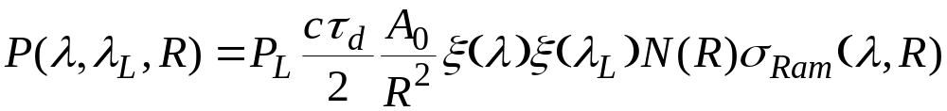
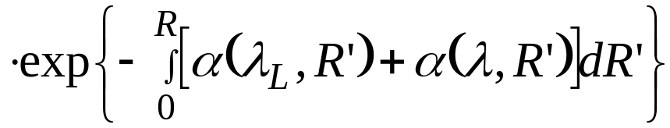
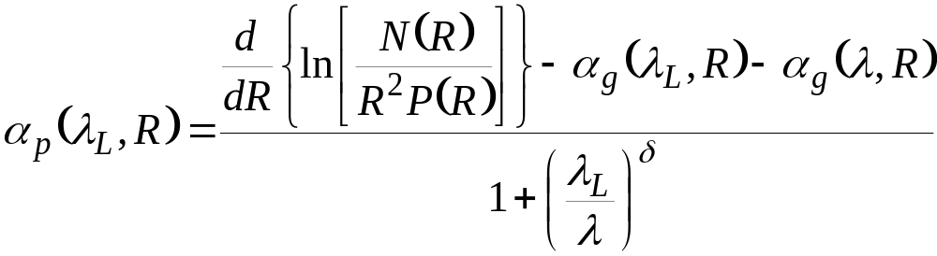
Aerosol lidar: basic equations
Raman lidar
Signal collected at a wavelength shifted respect to laser wavelength
Shift depending on the target molecules in the atmosphere
p=particles
g=gases
α=coeff λ^{−δ}
δ = Angstrom coefficient

Slide 10
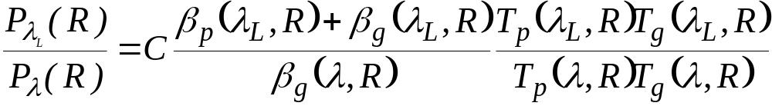
Aerosol lidar: basic equations
Raman signal
Elastic signal
Known through the extinction
Backscatter retrievable with no significant assumptions
PRO:
More accurate
Provides info about aerosol type
CONS:
Low signal-to-noise ratio
Extinction efficiently determined only in night-time

Slide 11
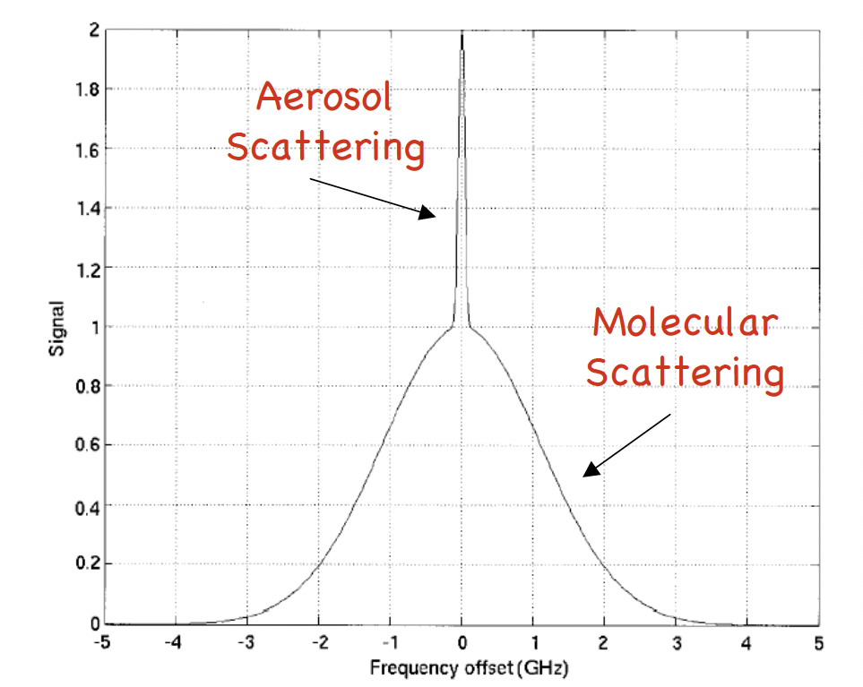
High Spectral Resolution Lidar
HSRL utilizes high-spectral-resolution optical filters to resolve the Doppler-broadened molecular scattering spectrum and the aerosol signal
Two main set up possiiblities
Fabry-Perot etalon (less stable)
robust and stable atomic/molecular absorption filter (available only at some wavelengths)
PRO:
Good signal to noise ratio
CONS:
instrumental complexity

Slide 12

Particle depolarization ratio
The way in which particles in atmosphere modify the polarization status of the emitted laser beam (and its return) is related to asphericity of the particles:
the more they depolarize, the more aspherical they are
The particle depolarization ratio δ can be measured using depolarizing cube separating the perpendicular depolarized component of the backscattered radiation
NOTES
Easy to be implemented
Accurate calibration methods required (Freudenthaler, et al. Tellus B,2009)

Slide 13
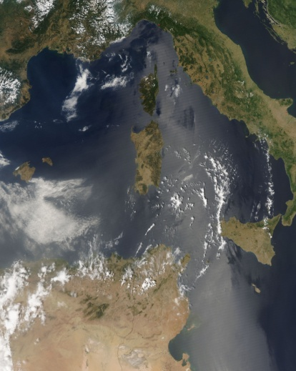
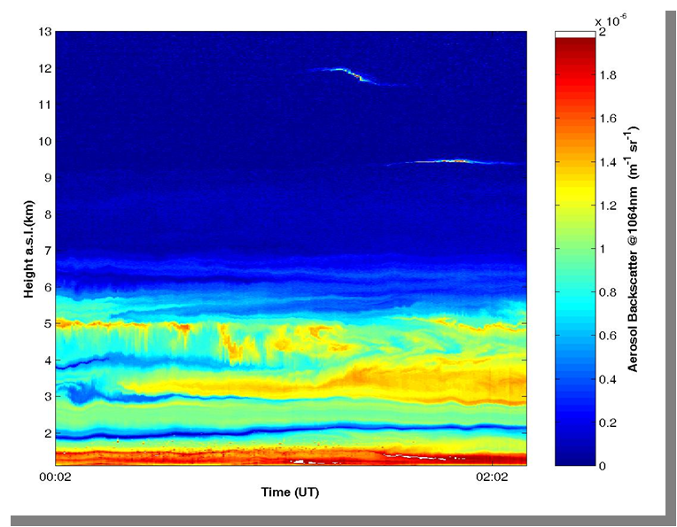
Example of aerosol lidar observations
Thin cirrus
Feeble aerosol layer
Intense layer of desert dust
Interface PBL- free troposphere
Aerosol lidar measurements @ 1064 nm CNR-Potenza-IT

Slide 14
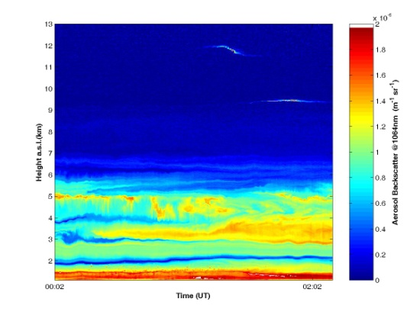
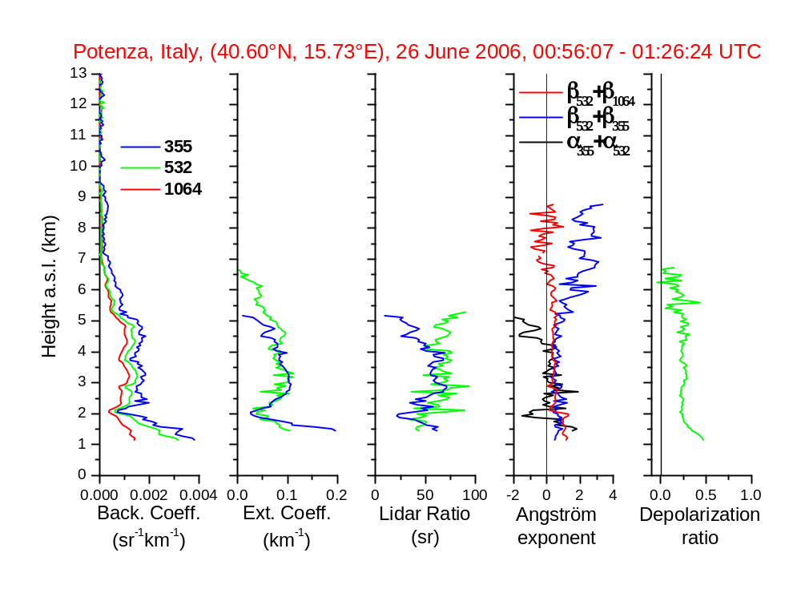
Example of aerosol lidar observations
Columnar integrated quantities (like AOD)
Mean values in the layers
Layer integrated quantities (like AOD)
Layer typing
Dust back and ext
Potenza, Lidar
AOD@532 nm = 0.30 (in the dust layer = 0.25)
AOD@355 nm = 0.33 (in the dust layer = 0.25)
Dust concentration
Fine and mode concentration

Slide 15
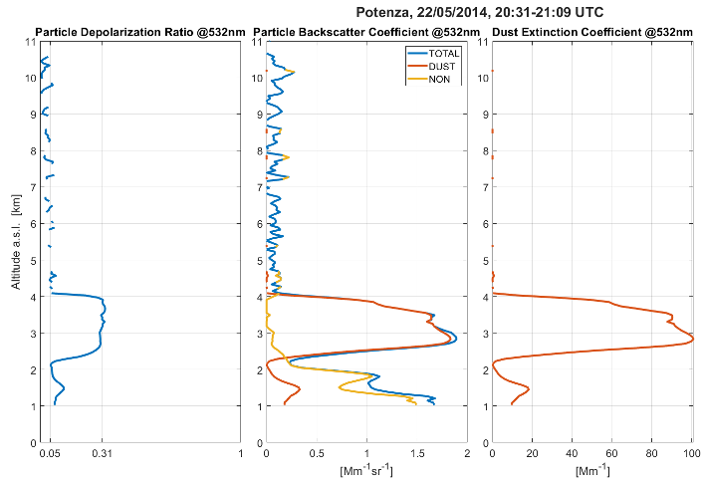
Dust extinction profiles
EARLINET profile measured at Potenza lidar station on 22nd May 2014
δ
β
β_{dust}
α_{dust}
Freudenthaler et al., 2009
Tesche et al., 2009
Papagiannopolus et al., 2009

Slide 16
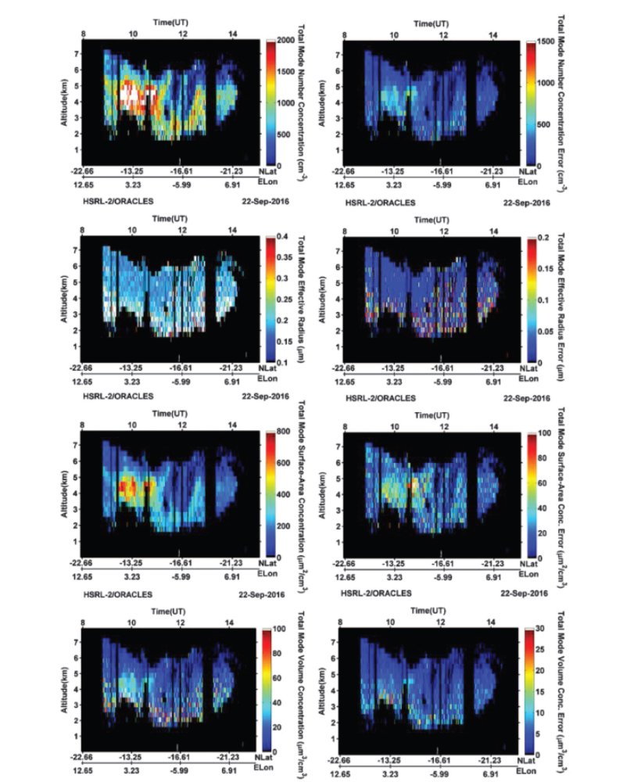
Microphysical retrieveals
Multiwavelength measurements including extinction, backscatter and depolarization can allow, through specific advanced inversion algorithms, the retrieval of micrphysical properties like:
Number concentration
Effective radius
Volume concentration
Refractive index
Muller, et al. Applied Optics,2019

Slide 17
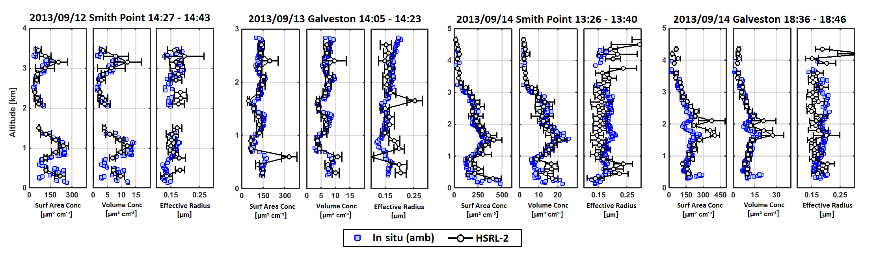
Microphysical retrieveals
In order to make an assessment of this comparison with in situ measurement is needed.
This is an example with HSRL on aircraft vs colocated in situ measurements
Muller, et al. Applied Optics,2019

Slide 18
Microphysical retrieveals
More methods and algorithms have been developed.
Some papers about
Böckmann, C.: Appl. Optics, 2001.
Böckmann, C., et al., J. Opt. Soc. Am. A, 2005.
Müller, D., et al., Appl. Optics, 1998.
Müller, D., et al., Appl. Optics, 1999.
Müller, D., et al., Atmos. Meas. Tech2014.
Müller, D., et al., Atmos. Meas. Tech., 2016.
Veselovskii, et al., Appl. Optics, 2002.
Veselovskii, I., et al.,, Atmos. Meas. Tech., 2013.
Veselovskii, I., Atmos. Chem. Phys., 2016.

Slide 19
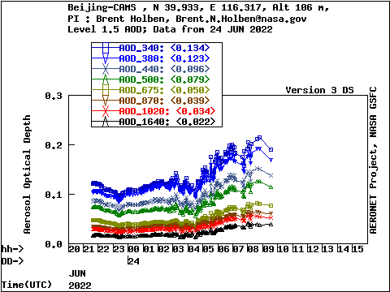
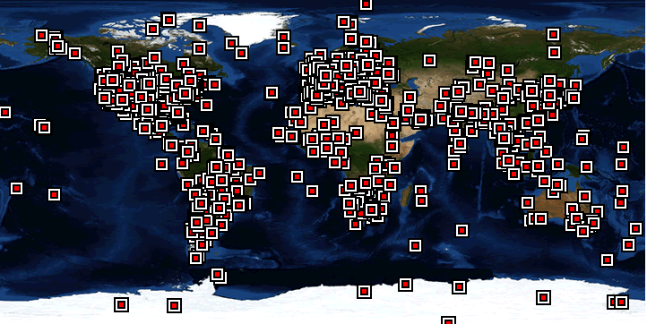
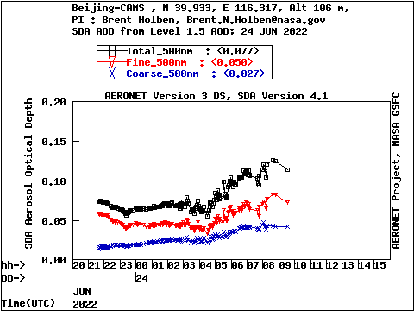
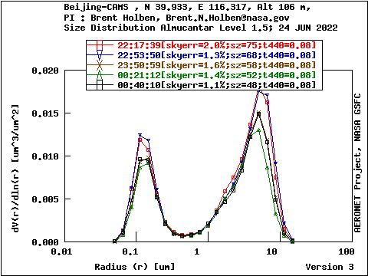
Combined lidar and photometer products
Photometer provides columnar Aerosol Optical Depth at different wavelengths and, through retrievals, size distribution , single scattering albedo , fine/coarse fraction.
AERONET
An example for 24 June 2022, Bejing

Slide 20
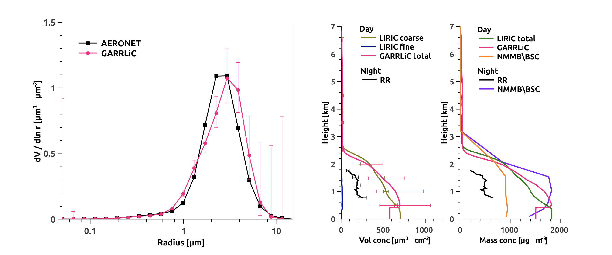
Combined lidar and photometer products
Synergy of profiling and columnar info allows for more robust retrievals and determination of constrained concentration profiles in fast and automatic way.
LIRIC (LIdar-Radiometer Inversion Code)
GARRLiC (Generalized Aerosol Retrieval from Radiometer and Lidar Combined data)
Bovchaliuk, et al. Atm. Meas. Tech.,2016
RR= lidar only inversion
NNMB/BSC dust forecast

Slide 21
Aerosol typing: why important?
Knowing the type of the aerosol can help to:
understand sources, transformations, effects, and feedback mechanisms
improve accuracy of satellite retrievals and aerosol models
quantify assessments of aerosol radiative impacts on climate
investigate the impact of the different aerosol sources on climate, precipitation and air quality.
improve the aerosol emissions policies
define actions for local authorities and hazards management

Slide 22
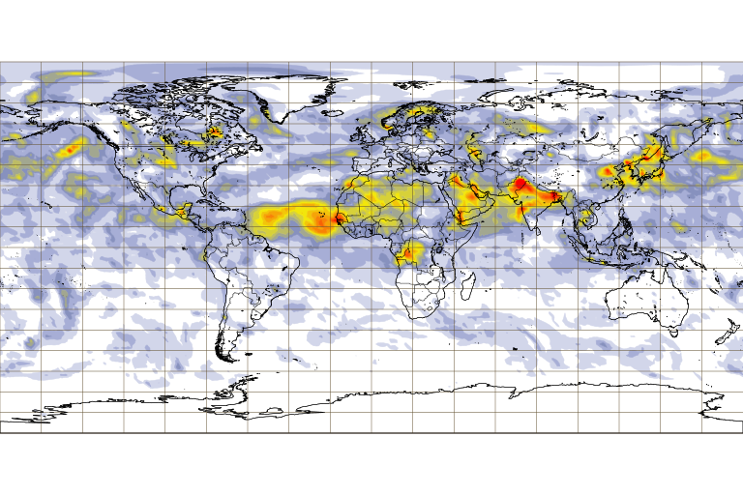
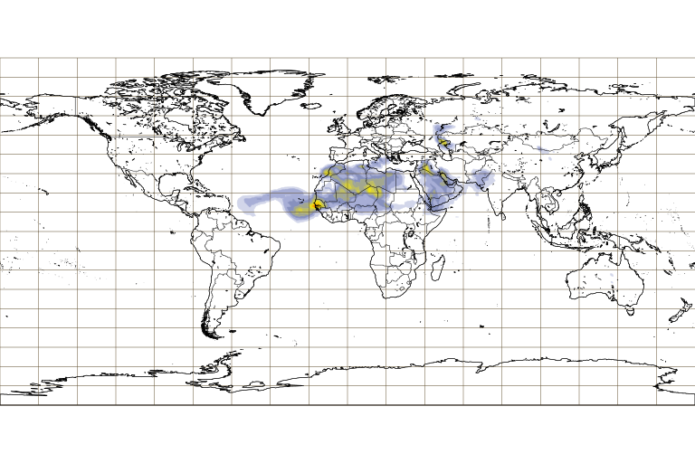
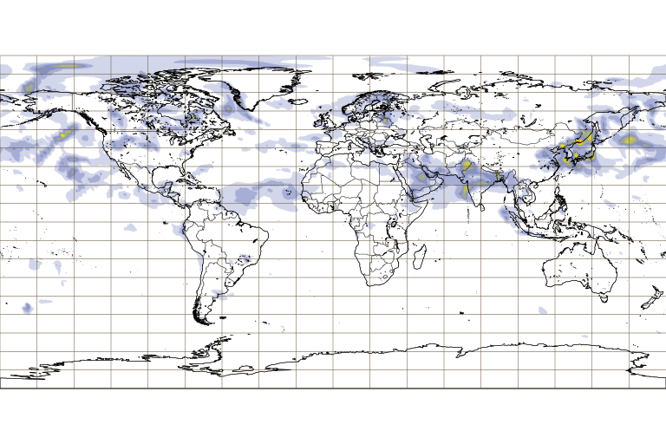
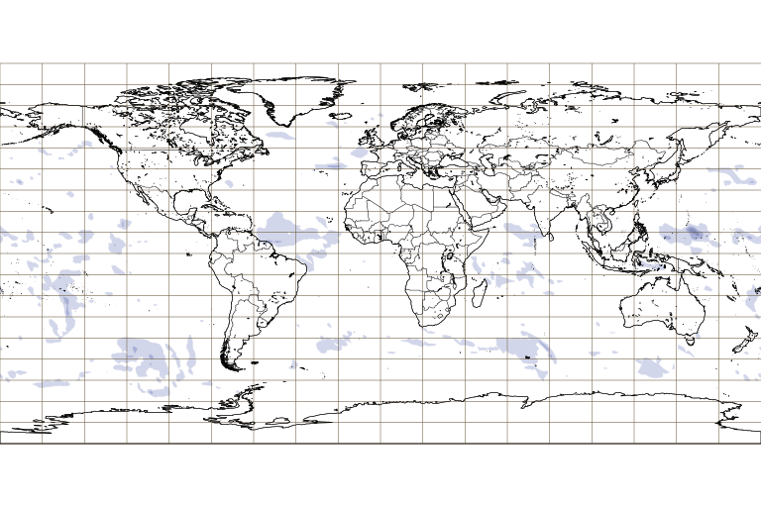
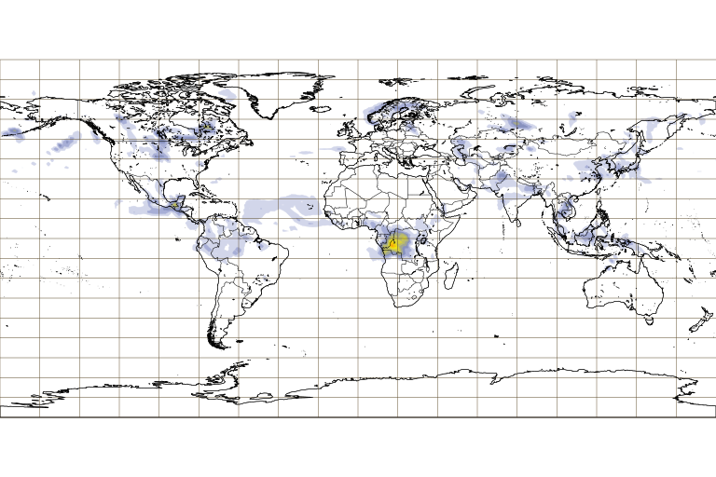
Aerosol typing: CAMS example
Copernicus Atmospheric Monitoring System
Forecast 15 May 2021 03 UTC
http://atmopsphere. copernicus.eu
Total AOD
Sulphate
Dust
Sea salt
Biomass Burning

Slide 23
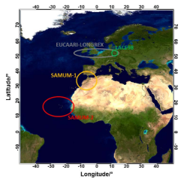
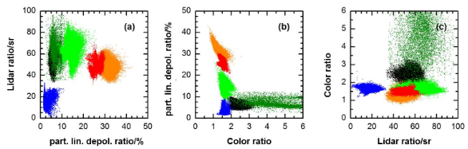
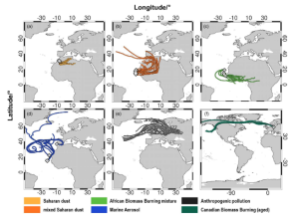
How to know about aerosol types
The general approach
Investigate characteristics for understanding the source
Identify the source for defining the aerosol characteristics
More common in Ground Based observations
More common in satellite observations
Inputs for defining automatic procedures for typing
Sources
Measurements
Procedures

Slide 24
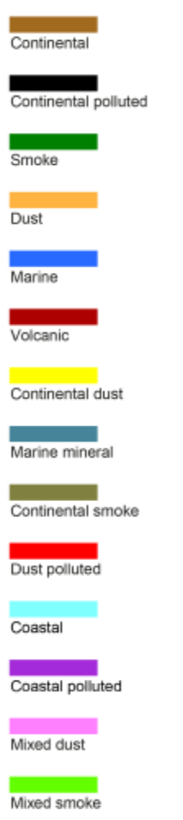
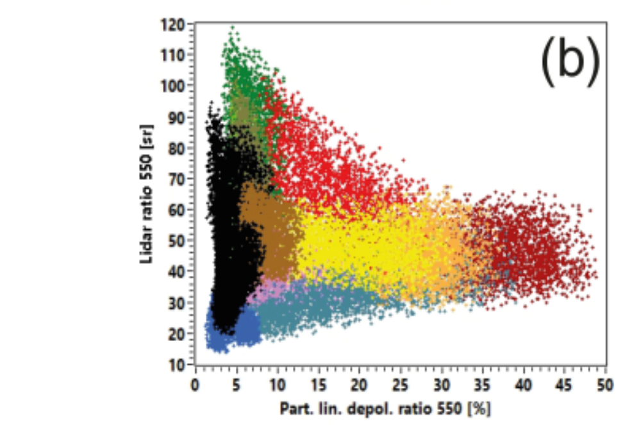
Aerosol typing: MW Raman – HSRL feature
NATALI
Neural network Aerosol Typing Algorithm based on aerosol LIdar data
+
OPAC + RH,
GDAC microphysics
Mischenko spheroidal model
Linear mixing of different components
Nicolae et al., ACP 2018

Slide 25
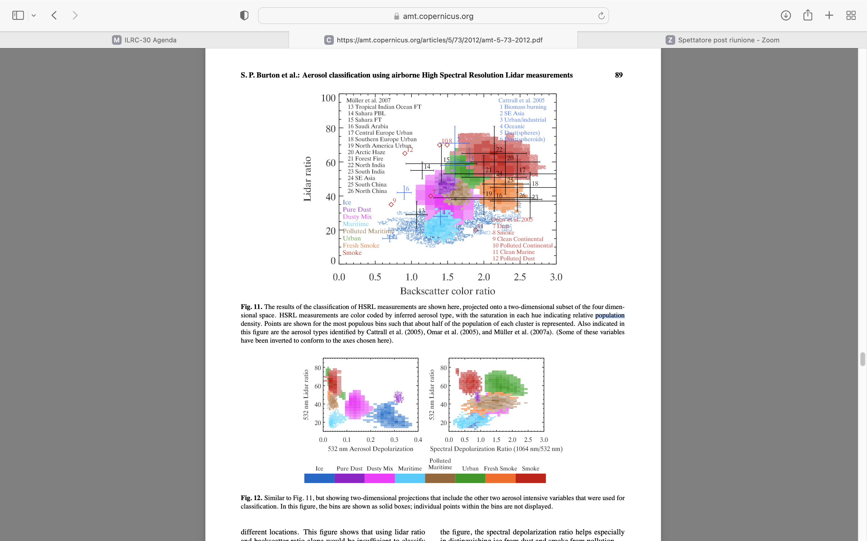
Aerosol typing : HSRL airborne
Mahanalobis distance typing method based on NASA Langley Research Center (LaRC) airborne HSRL obs
Burton et al., AMT 2012

Slide 26
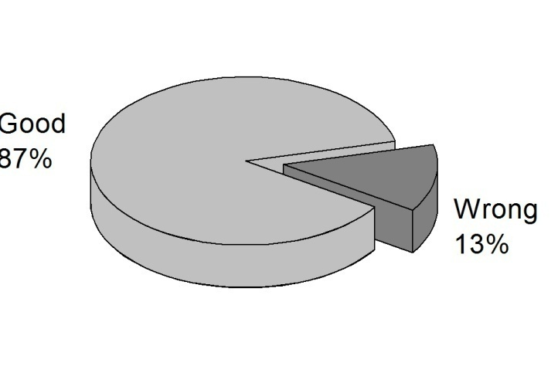
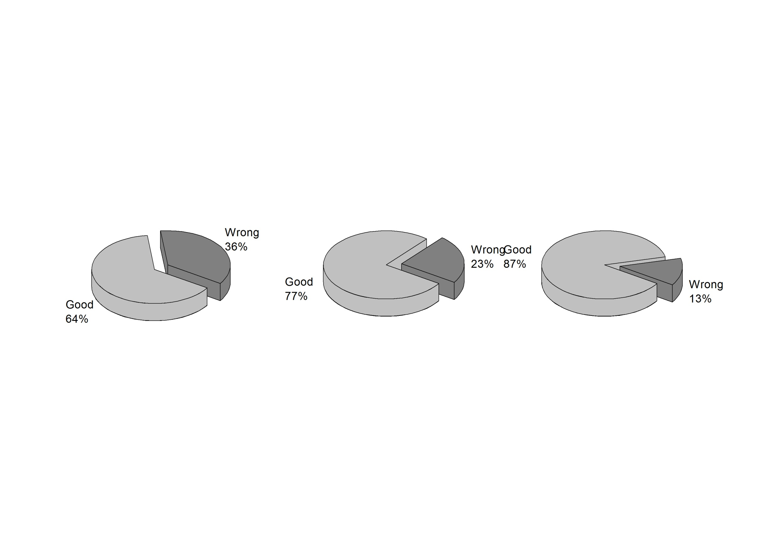
More tiny the classification higher its reliability
Backscatter Angstrom 355/1064 nm + Lidar Ratio at 355nm
+ Ratio of lidar ratio 355/532 nm
4 classes
Clean continental
Mixed marine
Absorbing particles
Dust & dusty mixture
Dust
Polluted dust
Mixed dust
6 classes
Clean continental
Mixed marine
Absorbing particles
Improving typing reliability
Improving insight
Polluted continental
Smoke
Dust
Polluted dust
Mixed dust
7 classes
Clean continental
Mixed marine
Papagiannopoulus et al., ACP 2018

Slide 27
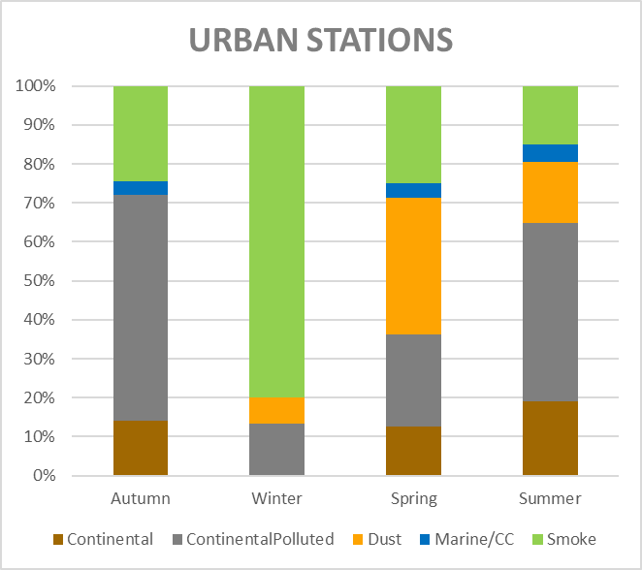
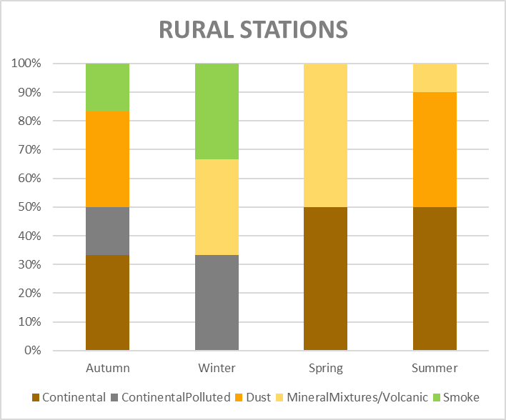
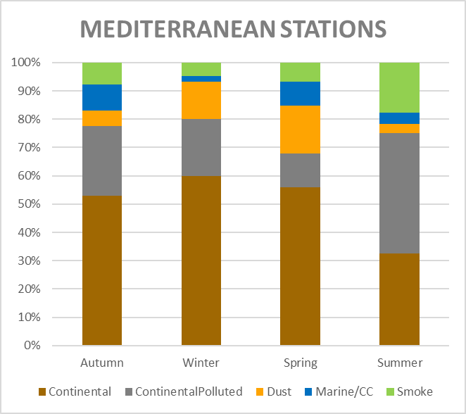
Example on long term observations
Method observation-only based (Nicolae et al., 2018)
Results for low troposphere , nighttime obs, 2015-2020
Continental ContinentalPolluted Dust Mineral mixture Marine/CC Smoke
Courtesy of Doina Nicolae – EARLINET/ACTRIS

Slide 28
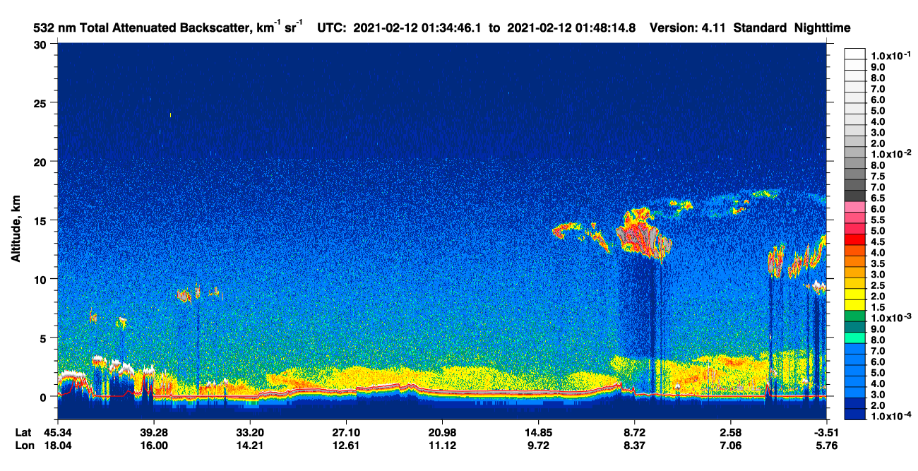
Aerosol typing: CALIPSO example

Slide 29
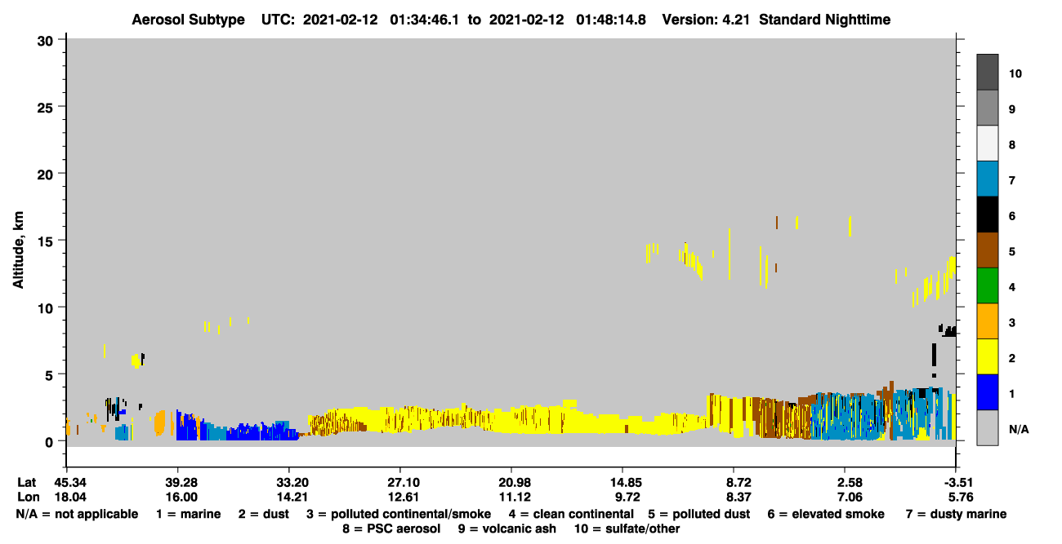
Aerosol typing: CALIPSO example
Different types provided… but how it works?

Slide 30
Aerosol typing: CALIPSO example
CALIPSO is a backscatter lidar
Basic equation has 2 unknowns: aerosol extinction and aerosol backscatter
CALIPSO to solve it assumes the extinction/backscatter ratio time by time altitude by altitude
HOW?
Look up table on the base of aerosol typing
So the products (extinction and backscatter) are the result of the typing scheme
CALIPSO typing based on assumptions and needed for retrievals

Slide 31
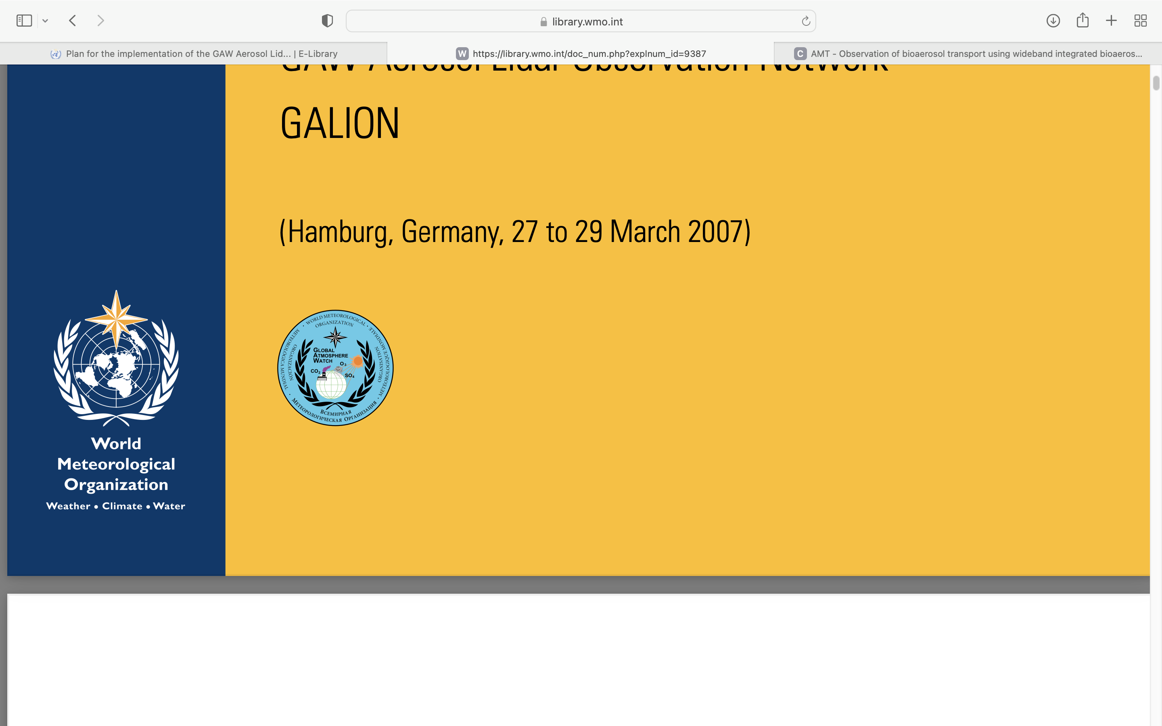
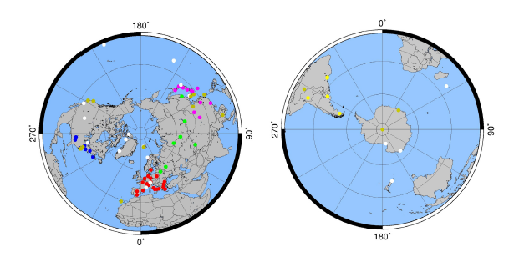
Profiling networks: aerosol lidar
GALION
(GAW Aerosol LIdar Observational Network)
Network of regional networks
Cooperation and harmonization are fostered
AD-NET
ALINE
CISLINET EARLINET MPLNET
NDACC
REALM
https://community.wmo.int/activity-areas/gaw

Slide 32
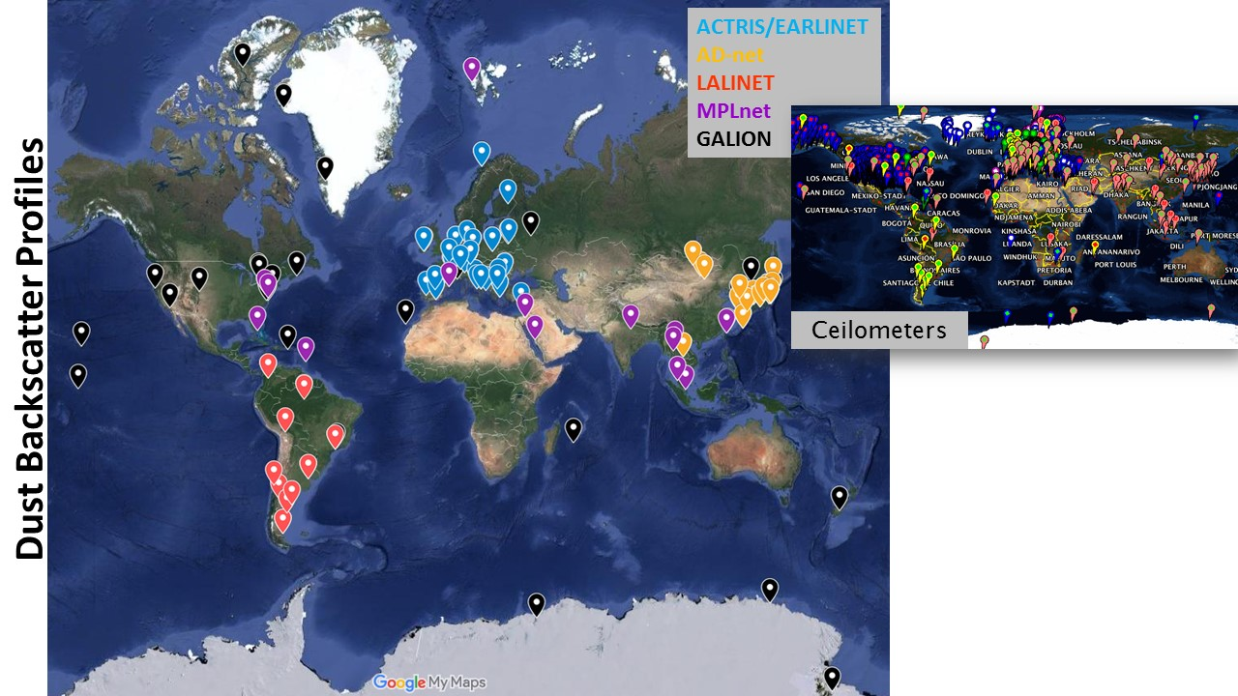
Profiling networks: aerosol lidar

Slide 33
Profiling networks: aerosol lidar
MPLnet:
US+Asia- elastic lidar + photometer Operational h24/7d
LALINET:
South America, few sites, in connection with EARLINET and Adnet for developments, Raman and elastic lidars
EARLINET:
Europe - multiwavelength Raman with depolarization Pre-Operational, typically colocated photometer Long Term funds
AD-net:
Asia, 3β+2α+2δ lidars, operational 24h /7d
Eprofile:
low power elastic lidar, high dense distribution, fully operational h24/7d

Slide 34
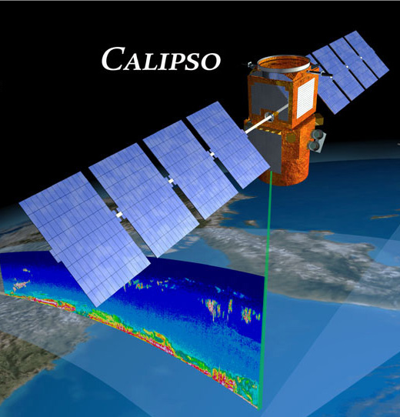

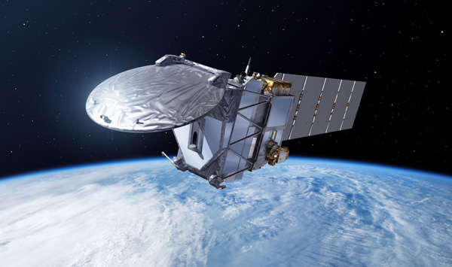

Satellite aerosol lidars
Currently flying aerosol lidars
CALIOP on CALIPSO since 2006
ADM Aeolus since2018
Providing data in NRT for wind but even about aerosol within identified aerosol layers
ATLID on EarthCARE 2023
EarthCARE
ESA Earth Cloud, Aerosol and Radiation Explorer mission
HSRL + depol at 355 nm
First ever spaceborne lidar providing independent extinction and backscartetr coefficients

Slide 35
What next?
Hot topics:
Aerosol and clouds investigations
Aerosol and RH
Aerosol and wind
Profiling and in situ combined for better insight
Bioaerosol
New technical challenges
Mobile systems measuring while moving
Cheep lidar for remote poor areas investigation

Slide 36
THANK YOU
lucia.mona@imaa.cnr.it

